Slide 1
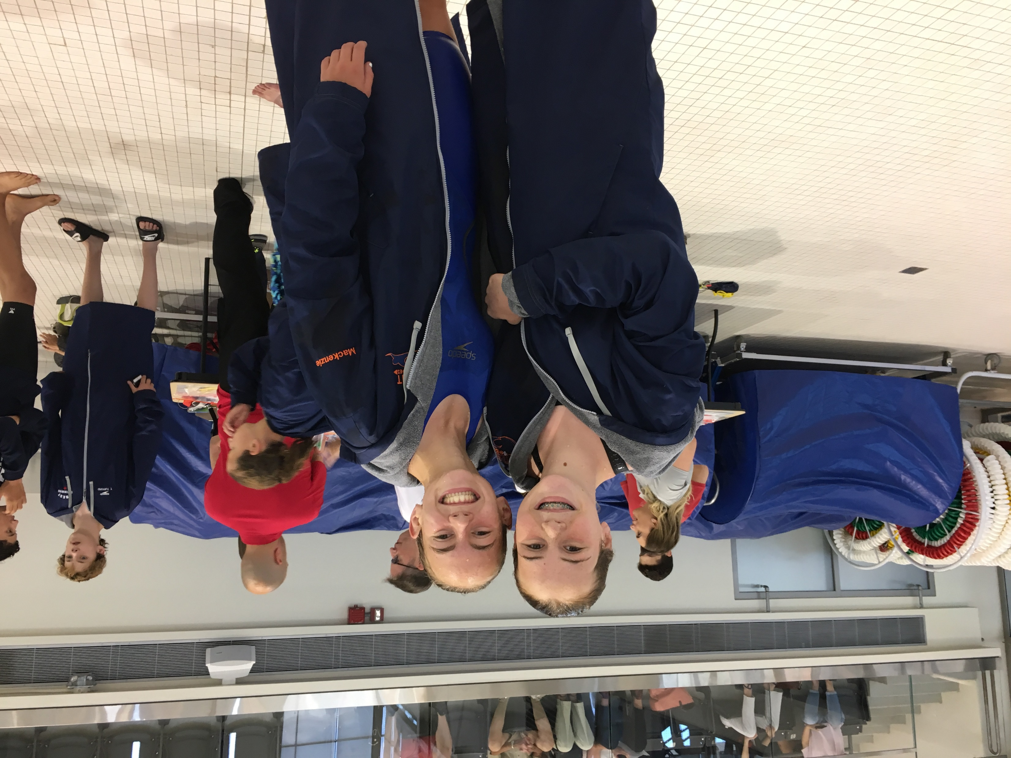
Trent swim club Our brand Communication
Club motto ‘Excellence by choice’
Twitter: @clubtrent
Facebook: Trent swim club – excellence by choice.
Instagram: @clubtrent
www.trentswimming.com
Bulletin board: south Rankings and notices.
Bulletin board: north swimmer of the month.

Slide 2
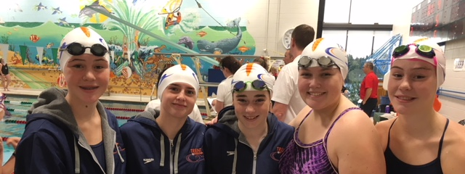
Trent swim club Goal Setting 4.0
Junior/Senior October 2018

Slide 3
Checklist from AG program
Learn to train checklist/ behaviors/ habits
Activation
Posture
Underwater fly kick
Kick Rate
Stroke count
Stroke rate/rhythm
Pace control
Fast transitions
Explosive starts
Race to win finishes

Slide 4
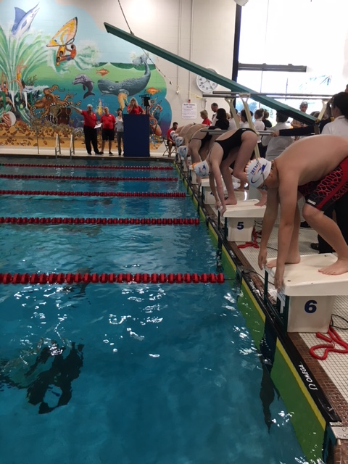
Underwater fly kick 5th Stroke
Utilization in all four strokes
Distance
Speed
Starts
Turns
Consistency over multiple distances and levels of fatigue.
Katie Ledecky 400 freestyle at Rio Olympics.
Reinforces fundamental skills (i.e. Streamlining, Breath control, stroke efficiency).

Slide 5
Stroke Count (Smart swimming) Integration into Racing
3 R’s (Range, Rhythm, Relaxation)
Controlled speed
IM ideals (8/14/8/14)
Requires breath control
Requires UWDK each turn plus start
30% of 100 time is start and turns (across all strokes)
Jason Morawski, my mentor and my model (provincially)
Jeno Tihanyi, my mentor and my model (nationally)

Slide 6
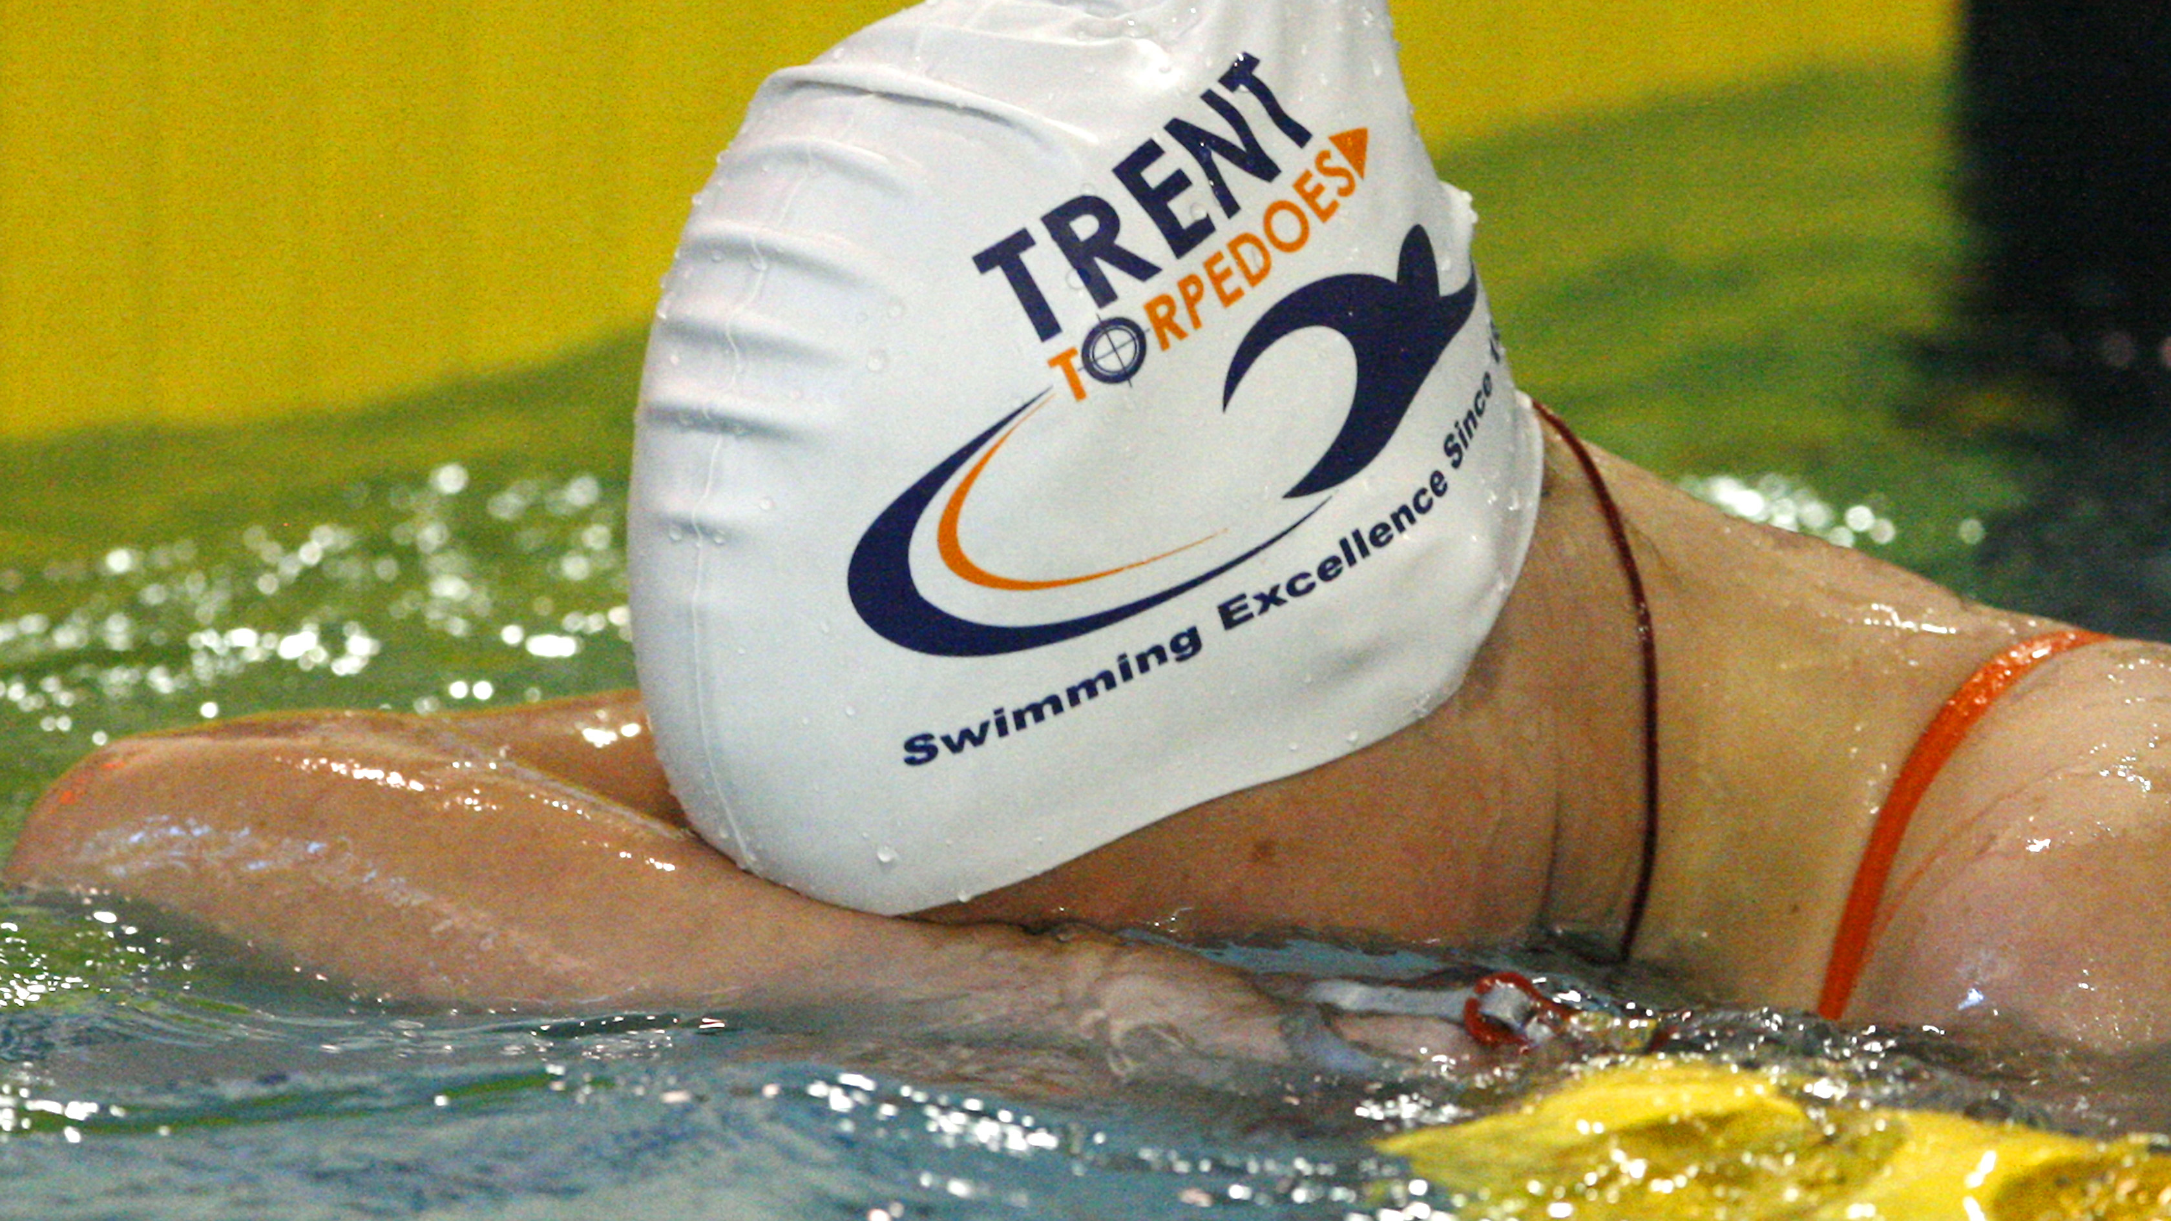
Hidden Training
Lifestyle choices
Time Management
Proper rest
Proper nutrition
Screen time, screen time, screen time.
Metrics; for head coach, single score… attendance.

Slide 7
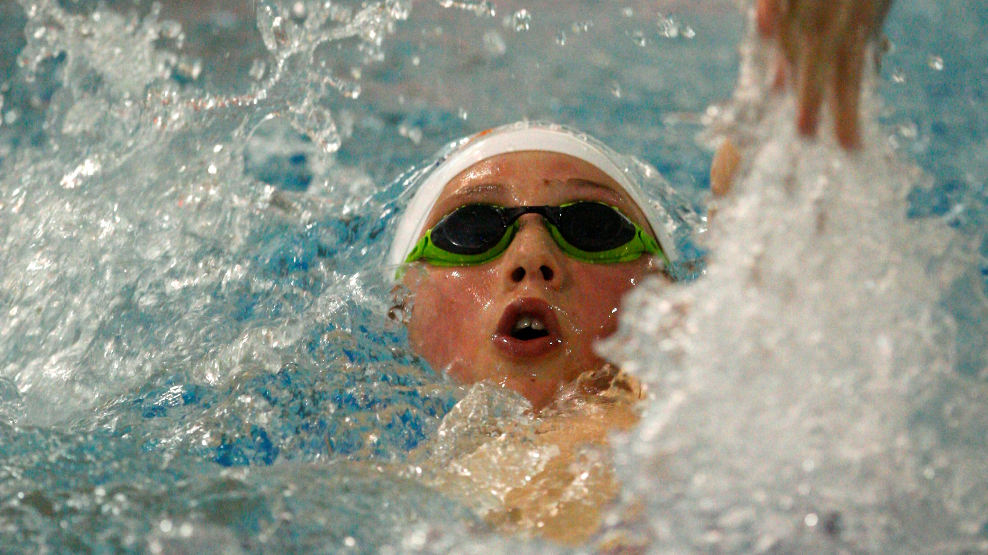
Attendance scores Junior Senior
Use team unify to track
November to June 2019
Rewarded at Short course awards
NOT punitive, WITH exceptions (SNC)
Beat the trends/history
Rewards?
Return?
Risk?
Pattern: 2017 69.28 Senior; 64.77 Junior Range 43-83% (senior) 48-80% (junior)
Pattern: 2016 69.3 Senior; 70.8 Junior (March to Junior)

Slide 8
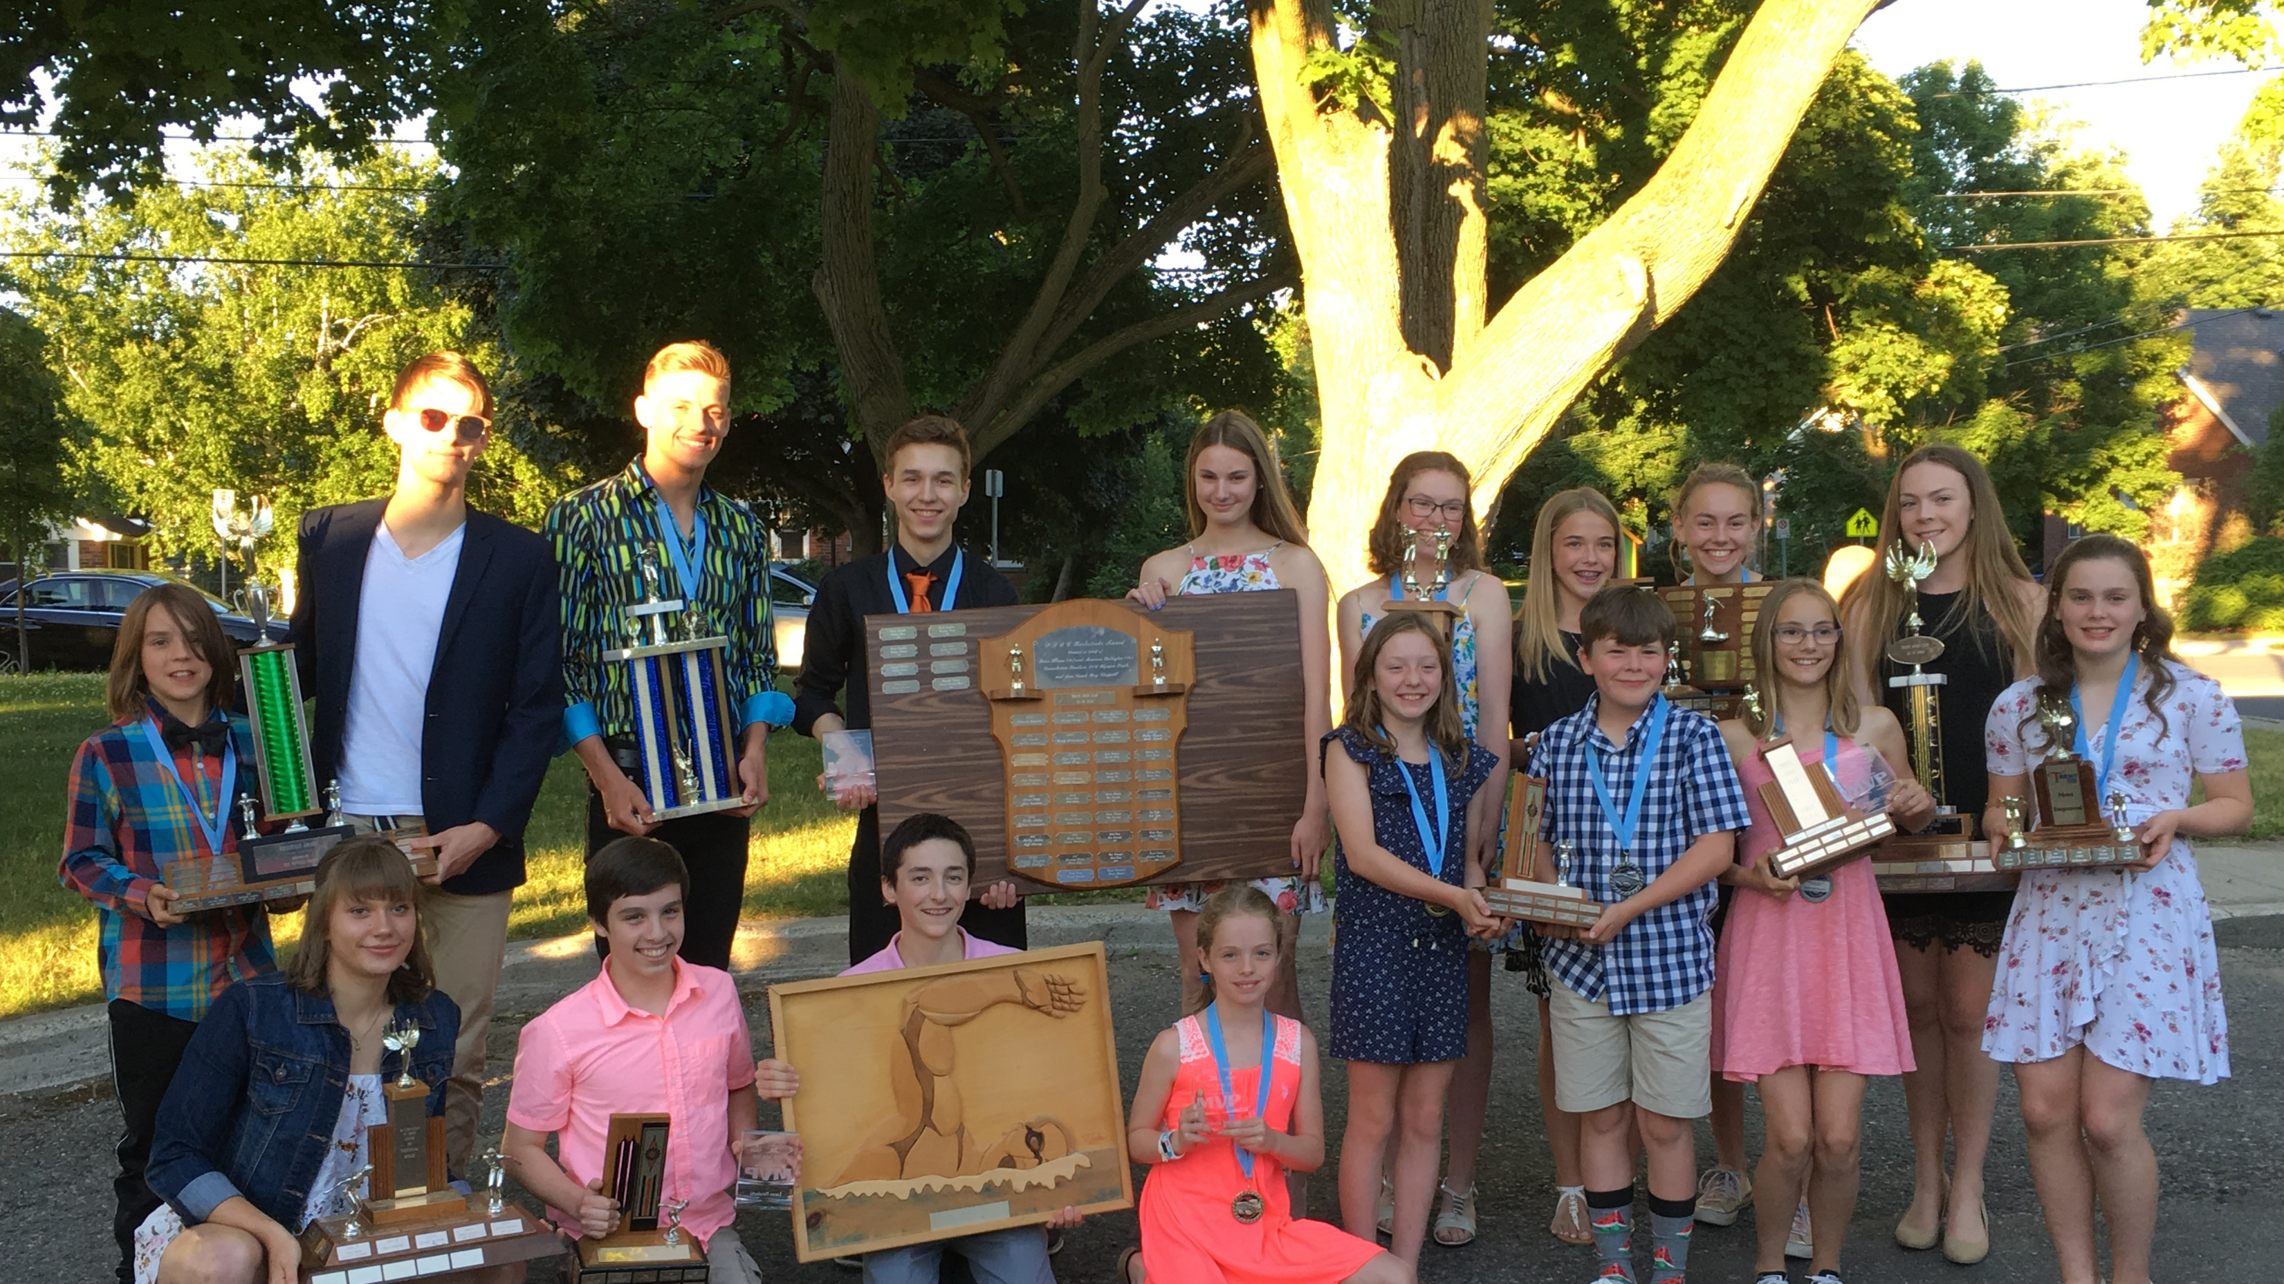
Goal Setting
Performance benchmarks.
Regional, Provincial and National standards.
Stroke Mastery (move from technique, to fitness, to execution).
Build a better individual (balanced, positive, and confident).
Build a better team (ranking, brand, and proud to be affiliated).
Be role models, ambassadors, and citizens in the community.
Be a better culture (environment that reflects engagement and maturity).

Slide 9
Swimmer Improvement rates (derived from CANADIAN DATA)
AGE | FEMALE | MALE
12 | 7.0 | 10.0
13 | 6.0 | 9.0
14 | 5.0 | 7.0
15 | 4.0 | 6.0
16 | 3.0 | 5.0
17 | 2.5 | 4.0
18 | 2.0 | 3.5

Slide 10
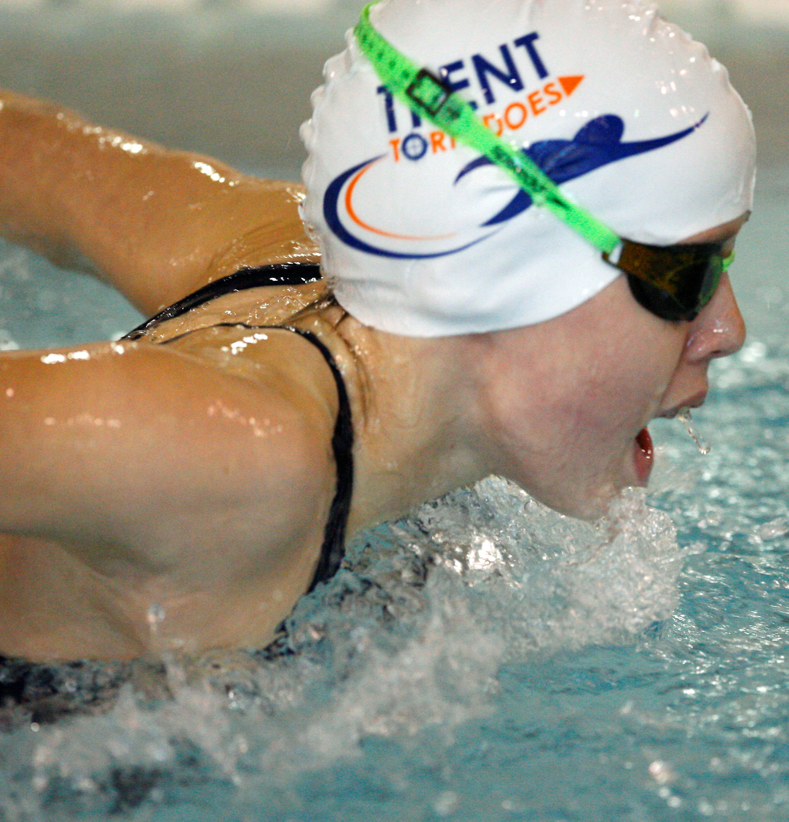
Swimmer coach conferences
Consider top 3 Performance goals (meet to qualify for, results, etc.)
Then three to five improvements in these areas to support the Performance Goals
Technical (strokes, turns, finishes)
Tactical (race plans to be practiced, areas of weakness to be addressed)
Training (how to and what to aim for to produce daily improvement. Habits to break, etc.
Mental performance (performance anxiety, focus, resiliency, etc.)
Lifestyle management (time management, nutrition, commitment)

Slide 11
Have the courage to fail
“A person who never made a mistake never tried anything new”
Albert Einstein

