Slide 1
Goal setting January 2021
Finding your Why, your purpose, your passion

Slide 2
A Brief Coaching history
Part time coaching in final year of university, ROW (Western Region)
Full time coaching residency after graduation, NCI (Swim BC)
Full time coaching position after residency, Ontario AG program in Western Region.
Part time coaching position at Western University, included a daily commute and a new baby.
One year hiatus from professional coaching, full time in Clinical Kinesiologist field.
Part time coaching position with Masters swimming, local school board.
Decision to act as a personal coach to Paralympic swimmer, unattached.
Decision to create a Masters/AG integrated program, self employed.
Placed a swimmer on the 2000 Paralympic Games team in Sydney, Australia
Decision to pursue full time coaching in concert with Masters/AG program, self employed
Decision to pursue full time coaching in concert with established programs in western Ontario region
Decision to pursue full time coaching in concert with established program in northeastern Ontario region
Decision to pursue full time coaching in concert with established program in Huronia region

Slide 3
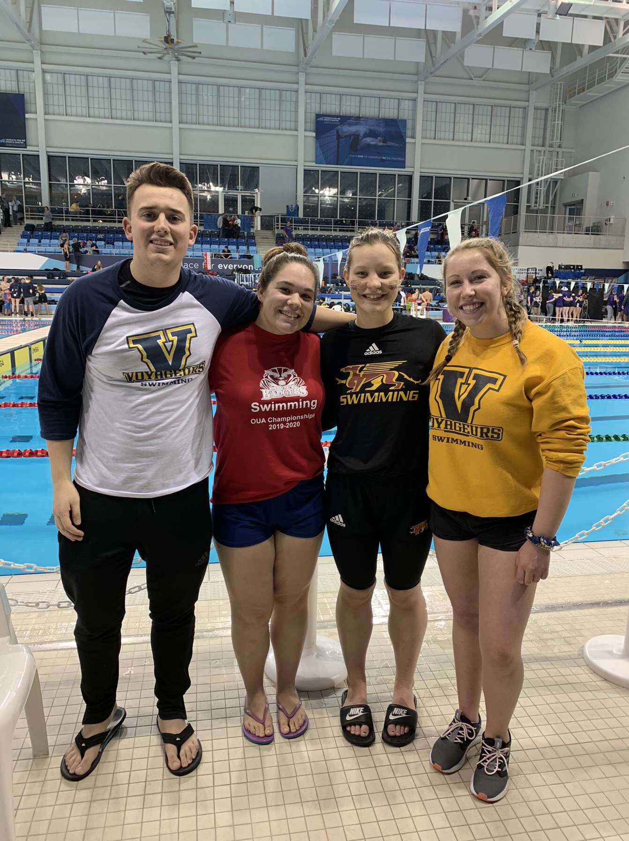
Finding your why
Difficult to articulate to family.
Provided new and challenging atmosphere, provincial AG swimming, national AG and Senior swimming.
Allowed me to observe and participate in youth development and Olympic movement.
Matches my personal strengths with the requirements of being a coach.
Connects me to my youth, instructional swimming and lifeguarding.
Allows me to revisit and recreate my experience.
To be determined, legacy of excellence and relationships.

Slide 4
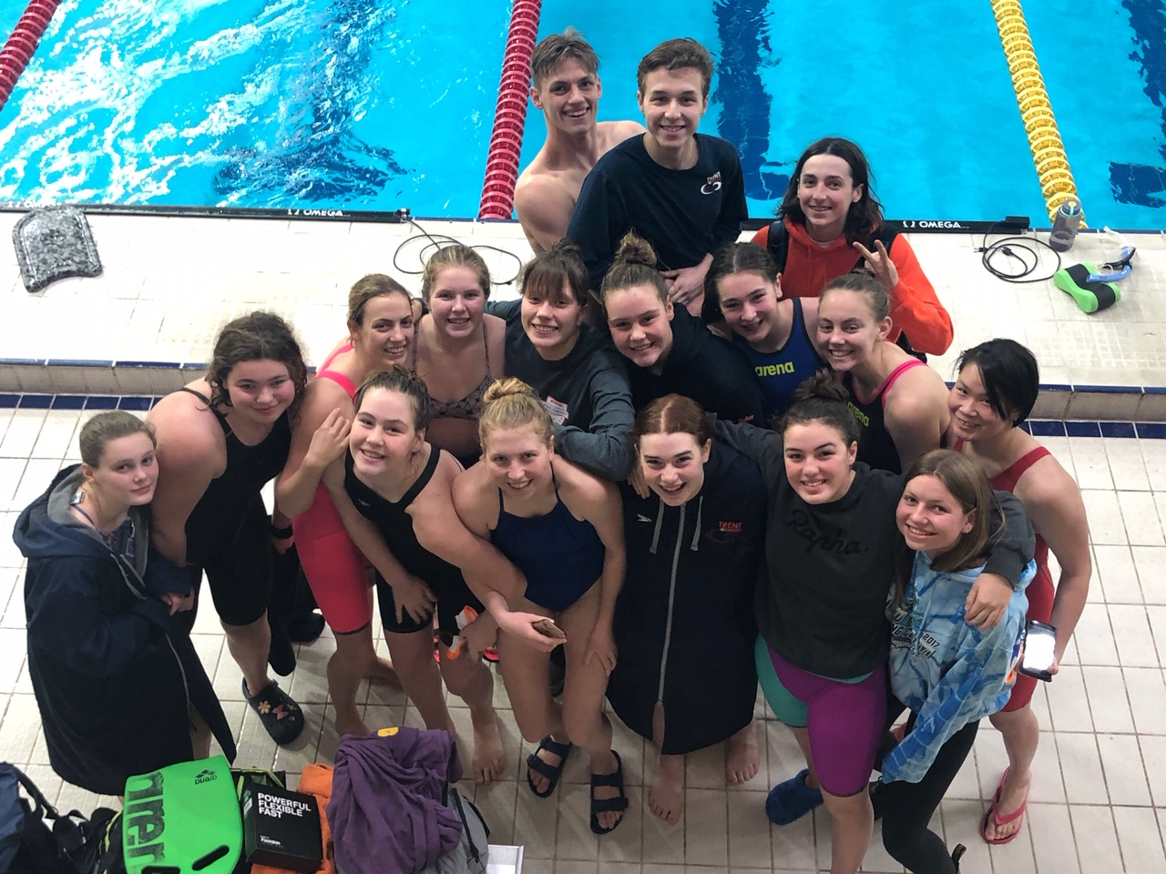
Your Passion and your purpose - informs your decisions
Provides context to your goals and expectations.
Ensures that decisions are consistent with Passion and Purpose.
Allows you to endure the challenges and obstacles along the way.
financial commitment
time commitment
impact on relationships
Risk versus return
Will be embedded deep in your heart.
May be perceived by others differently.
Allows you to surround yourself with those who possess a similar outlook.
May require compromise to other expectations or goals that are incongruent.

Slide 5
Goals for Trent Swim Club – January 2021
Stay connected – despite the challenges 2.0.
Plan for a return – Swim Ontario, venues, coaching staff and volunteers.
Grow back better – reintroduce AG, swim school and masters programming.
Expand venues – Trent, Lindsay, TPASC, YMCA, Peterborough sport and wellness centre.
Improve communications – overall plan for each component of AG programming and integration of Junior/ Senior in athlete development matrix.
Plan, evaluate and assess more frequently.
Survey membership in a more comprehensive fashion.
Maintain our standards of care, and expand our understanding.

Slide 6
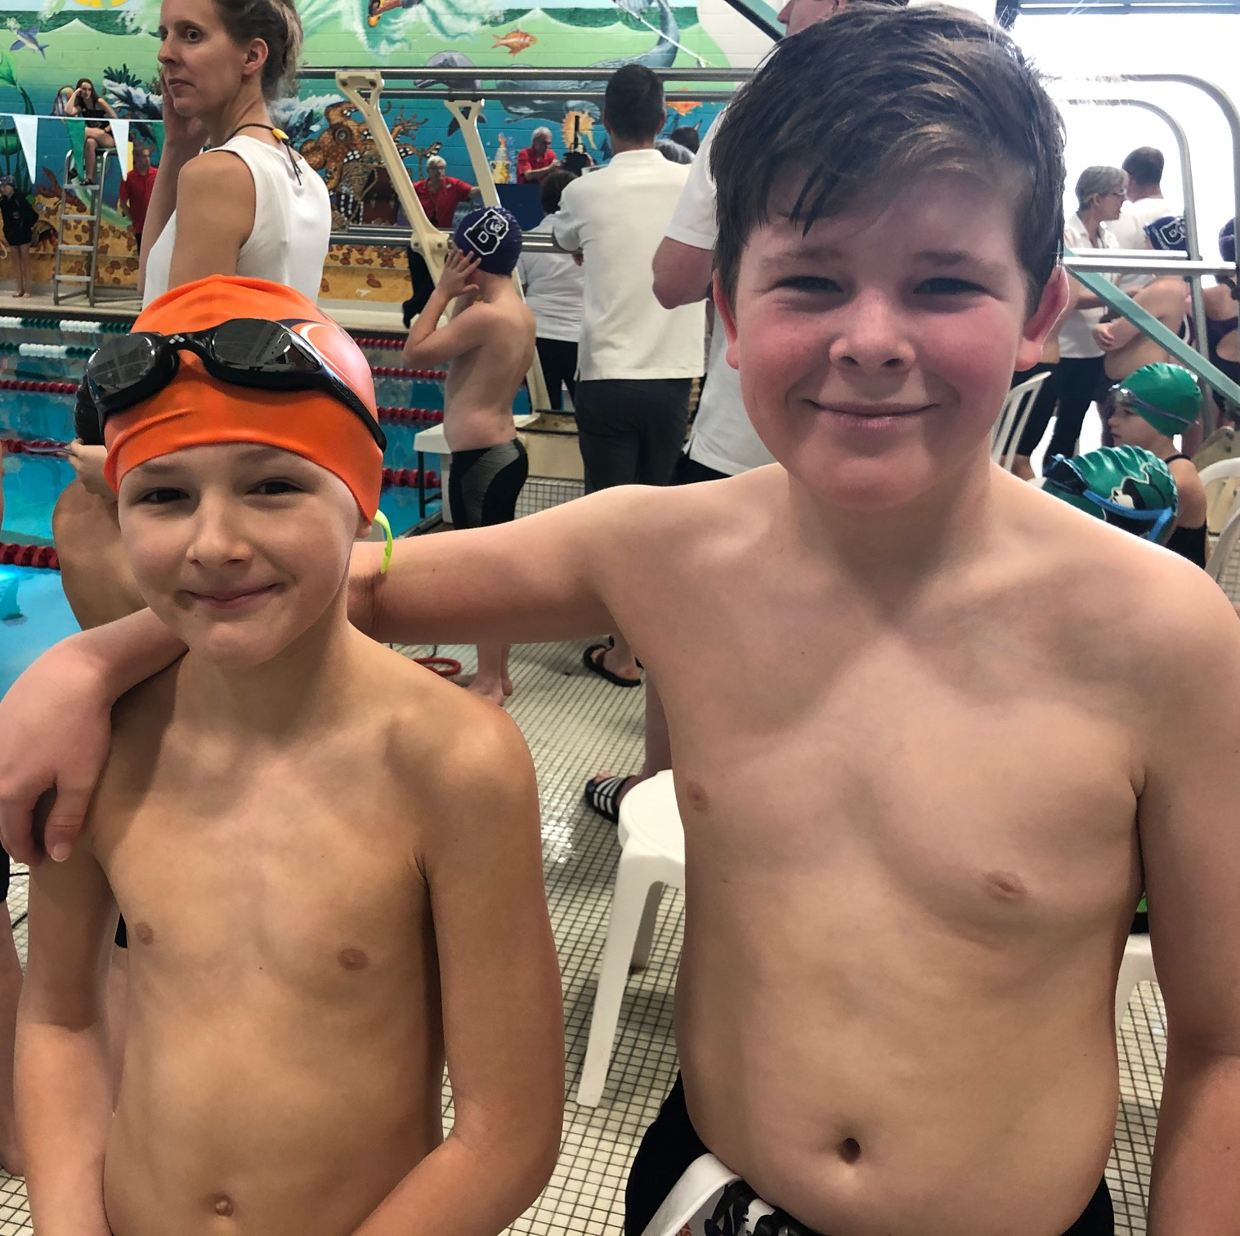
What are your goals
Personal
Brush your teeth.
Read more novels.
Less time on twitter.
Improve academic performance.
Less procrastination.
Get more sleep.
Stay connected with others.
Expand connection with others.
Use time more effectively.
Eat better or more informed.
Make healthier choices.

Slide 7
What are your goals – swimming
Skills: improve underwater dolphin kicks.
Training aspiration: advance to the next level of training group.
Training behaviour: improve my attendance.
Training focus: beat this teammate in each main set.
Training approach: be strong in all multi stroke and multi distance.
Training aspect: improve my kicking on test sets.
Make my practice more deliberate: never miss a meter.
Self regulate learning better: context of failure.

Slide 8
Swimming performance – expectations (derived from National AG Championships 2006-2016)
AGE | FEMALE | MALE
12 | 7.0 | 10.0
13 | 6.0 | 9.0
14 | 5.0 | 7.0
15 | 4.0 | 6.0
16 | 3.0 | 5.0
17 | 2.5 | 4.0
18 | 2.0 | 3.5

Slide 9
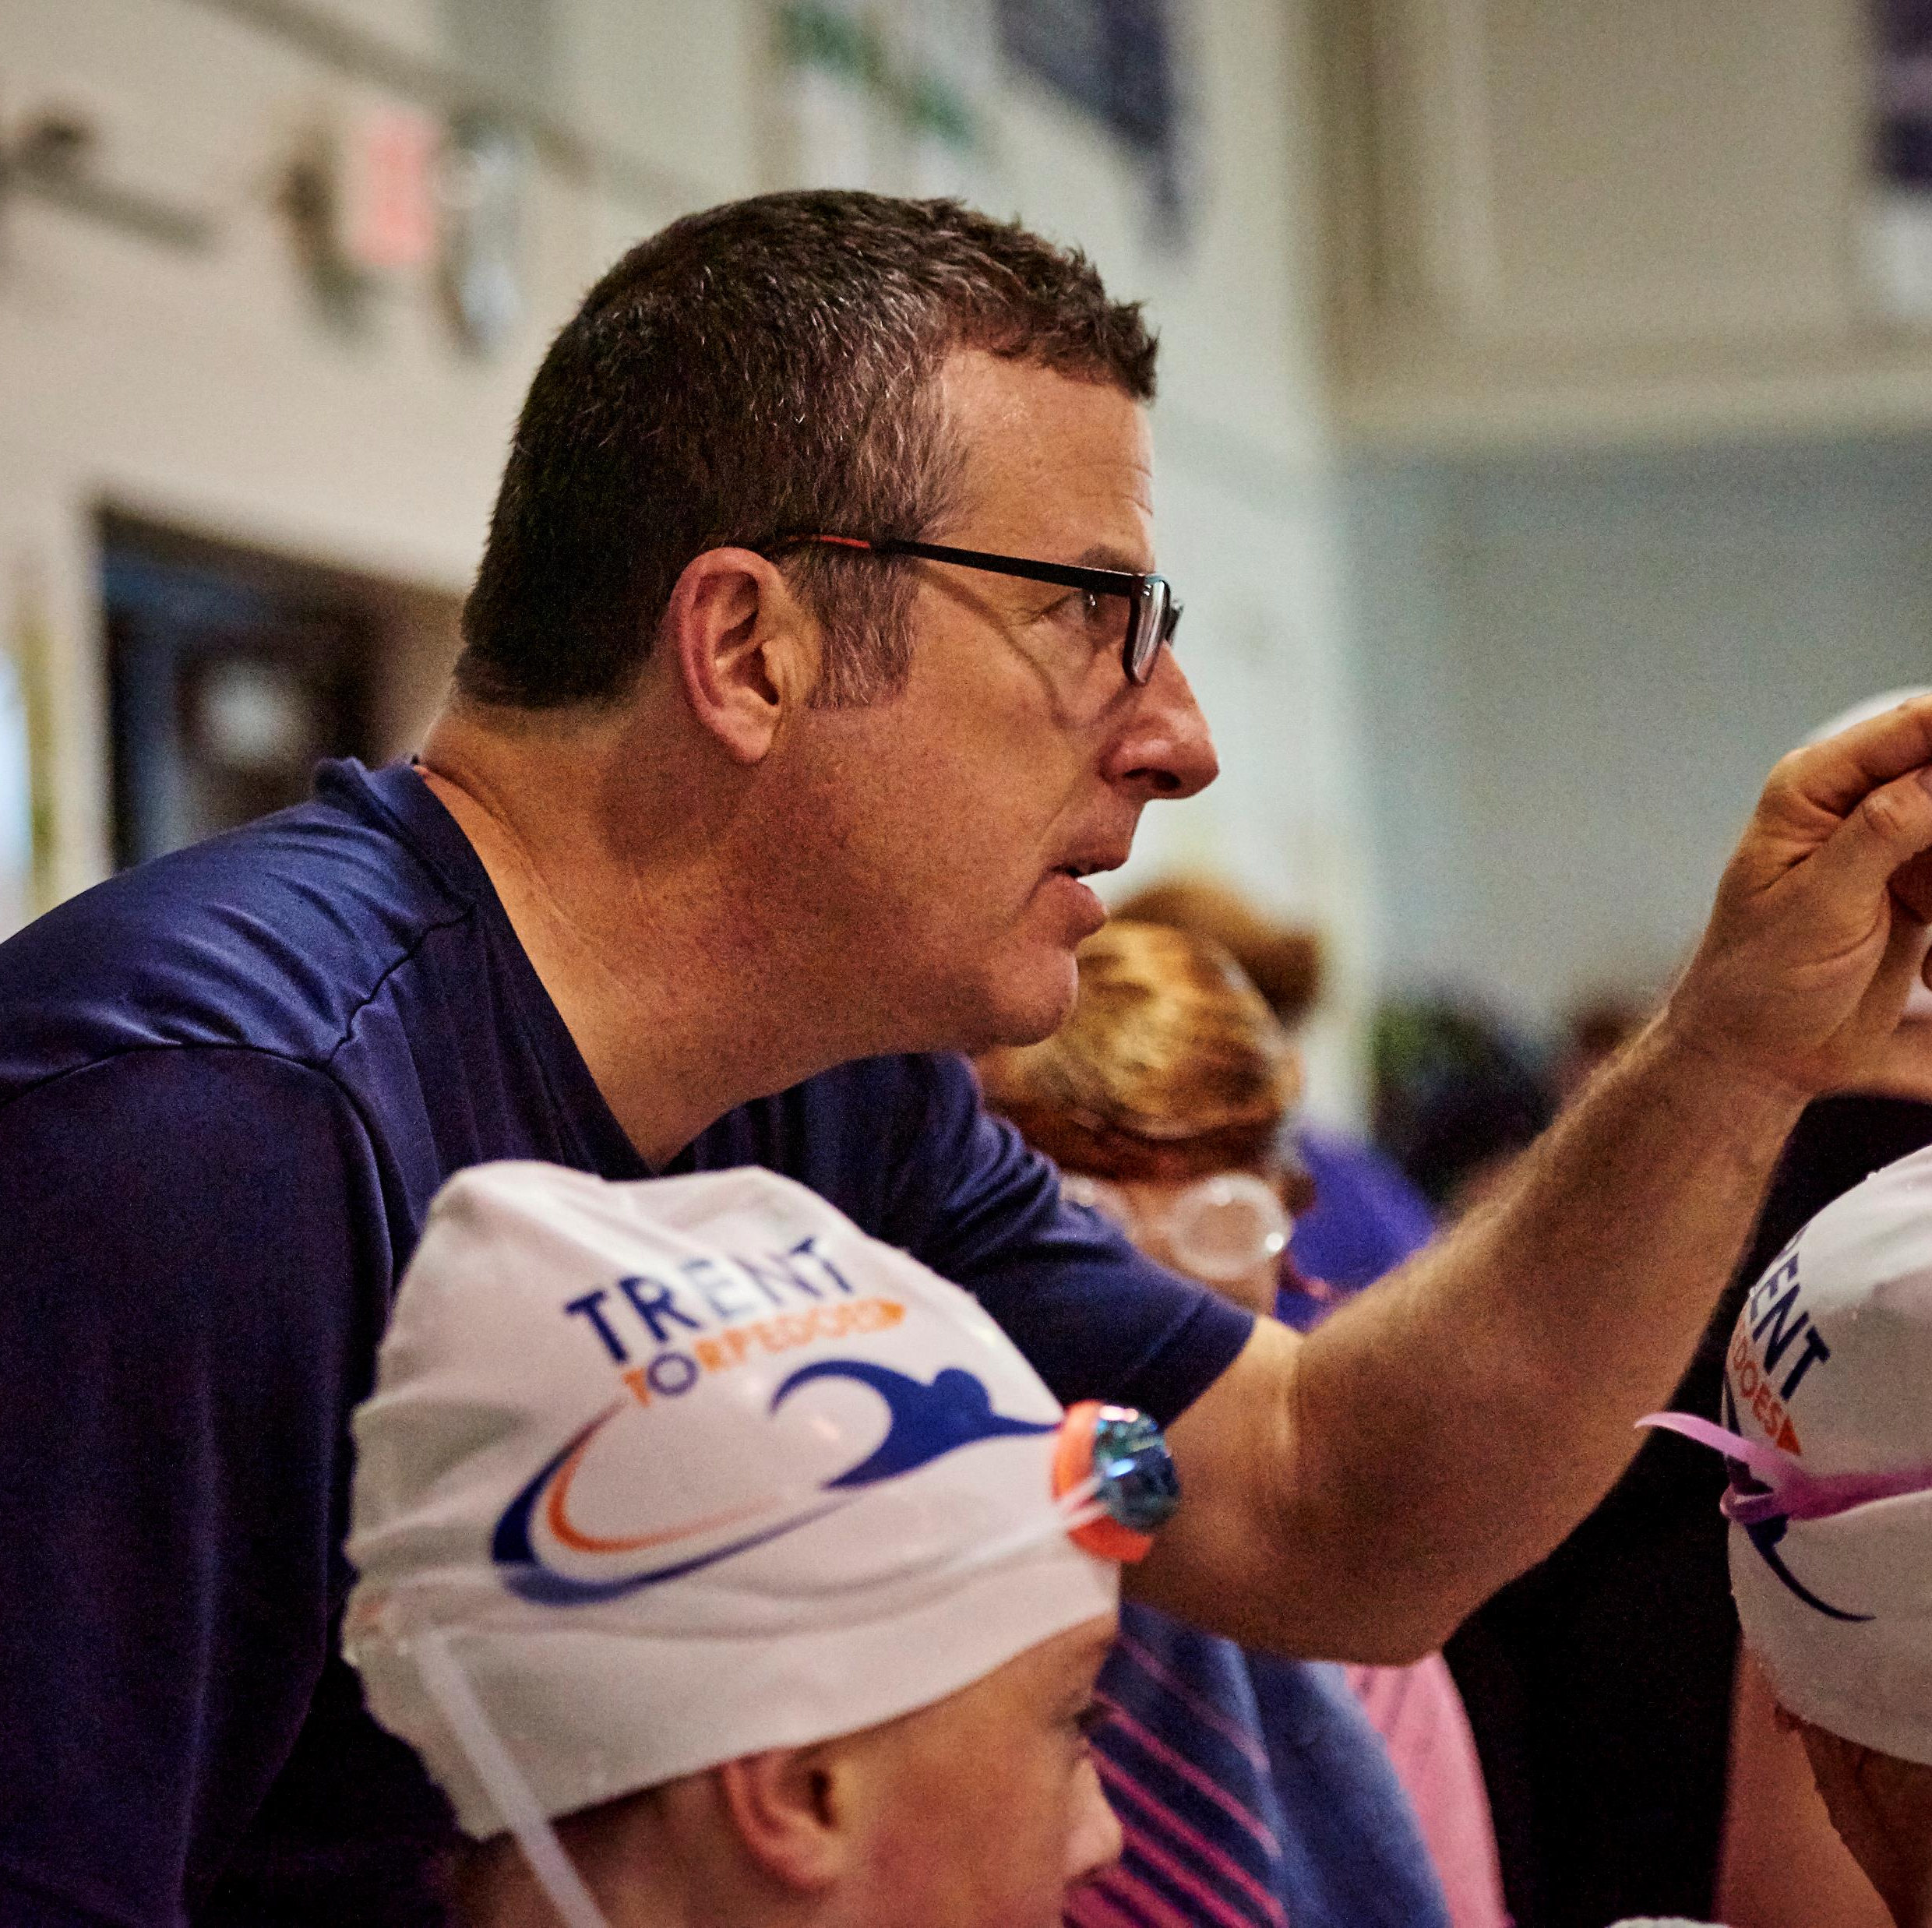
Finding your why – your passion and your purpose.
Who are your heroes – NOT marvel.
Ron McSpadgen – paid professional coach, lacrosse
Dean Boles – ROW, Provincial mentor, Denmark HP, and CEO Swim Ontario
Jeno Tihanyi – SLSC, Laurentian Voyeurers, Swim Ontario Learn Facilitator
Paul Bergen – Etobicoke Pepsi SC, Montreal HP centre, Cincinati Marlins
Murray Drudge – ROD, GO, NYAC, Ontario HP centre
Kevin Thorburn – ROD, Dolphins SC, Manta, ETOB
John Vadeika – WAC, Edmonton Olympians, Swim Ontario Executive director
Kelly Steeves – Edmonton Olympians, Swim Ontario and LAC

