Slide 1
Trent Swim club Winter 2021
Skills inventory or skills checklist

Slide 2
SWIMMER / ATHLETE DEVELOPMENT OVERVIEW
pg. 16
Notes:
Slide 34 – 1 pointer click
LF NOTES
Swimmer/Athlete Development – 4 Pillars – Physical; Technical; Mental; Life Skills
Changes will continue to evolve over time
Discuss what this shows:
- Progression of stages
- Sensitive periods and maintenance
- Recommended hours in the sport
- Gender differences
- Change in training focus into and after PHV
Needs to be discussed – what does it correlate to?
This course focuses on the athletes in the FUNdamental stage of development, generally between the ages of 6-10.
Briefly explore with the participants the meaning of the curves and Peak Height Velocity.
Definitions of “Ages”
Chronological Age - The number of years and days elapsed since birth
Developmental Age - the child’s stage of physical, mental, emotional and intellectual maturity
Two children of the same chronological age can be several years apart in developmental age
Training Age - the number of years an athlete has been training in a variety of sports, beginning with the early sampling years prior to the growth spurt
Sport Training Age - the number of years an athlete has trained in one specific sport
Peak Height Velocity
One of the key elements in applying LTAD principles to physical activities and sports programs is the recognition that an athletes’ chronological or ‘calendar’ age does not necessarily reflect their actual developmental age – physical or mental.
We all know kids ‘mature’ at different rates with their bodies, and their developmental age will determine how they should train and practice their activity or sport.
Draw the candidates’ attention to speed and what this correlates to.
Spend enough time with males at this level to maximize skill development.
Illustrate that you may have kids in your group that are going to be at slightly different stages of development.
As much as possible, address the needs of the kids in this program. (Where you bring in training age)
How to ensure that athletes are early or late maturers. How to measure and what to do.
Refer to slide 30 for early and late maturers and boys’ point

Slide 3
SWIMMER / ATHLETE DEVELOPMENT OVERVIEW
pg. 16
Notes:
Slide 35 – 1 pointer click
LF NOTES
-This slide focuses on the technical pillar – the sensitive periods of accelerated adaptation to training
- Optimal trainability at optimal times
- Through this slide, we want the coach candidates to get a better understanding of where the primary training emphasis should lie for the type of athlete that they are coaching

Slide 4
ACTIVITY
STROKES – TEACHING PARTS AND METAPHORS
SEGMENTS | Key teaching PARTS | METAPHORS
Streamline
Head and Body Position
Legs
Arms
Rhythm
pg. 34 - 41
Notes:
Slide 89 – 1 pointer click
LF NOTES
Activity Time: 30 minutes
Instructions: In groups coaches come up with Teaching Parts and metaphors for other strokes

Slide 5
BREAKING STROKES INTO TEACHABLE PARTS (SKILLS) CONT’D
KEY PERFORMANCE FACTORS: STARTS
Both starts and turns will be broken down into five (5) skills / key segments:
P.R.A.F.E. is an acronym used to identify the important parts of a competitive swimming start.
Preparation* = the “Zero” position on the block prior to “Take your mark.”
Reaction = the swimmer’s reaction at the starting signal (Less than 1 s)
Acceleration = the movement that gets the swimmer off the block / wall
Flight = the position of the swimmer’s body in the air
Entry = the position of the swimmer’s body as he/she enters the water
Notes:
Slide 90 – 8 pointer clicks
LF NOTES:
PRAFE
Preparation is the key to an effective start. Many later issues are a result in setting up incorrectly on the block.

Slide 6
BREAKING STROKES INTO TEACHABLE PARTS (SKILLS)
KEY PERFORMANCE FACTORS: TURNS
Turns are broken into 5 Key Performance Factors: A.T.P.G.T
Approach = coming into the wall (speed, angle, body position)
Turn = turning motion (flip, swivel)
Push off = pushing motion off the wall (feet position, leg set up, depth)
Glide = initial underwater (fastest part before deceleration)
Transition = Underwater kicks or pull out after the glide until body breaks surface.
Notes:
Slide 91 – 7 pointer clicks
LF NOTES:
ATPGT
Note transition could be the underwater kicking as well as the break out, this could easily be broken into 2 parts.
In breaststroke, the pull out may be the transition.

Slide 7
SCIENCE OF SWIMMING - PROPULSION
It’s the Law! : Acceleration
pg. 31
Force of hand accelerates the brick
Twice as much force produces twice as much acceleration
Twice the force on twice the mass gives the same acceleration
Notes:
Slide 81 – 7 pointer clicks
LF NOTES
The speed of a body depends on how much force is applied to it and the direction the force comes from.
Faster arm or leg speed in water creates more force = more speed
To advance the slide, select the advance button at the bottom of the screen.

Slide 8
FORCE
Any push or pull on an object
Force causes acceleration (Newton’s Second Law)
Can be broken down into the primary directions of motion
pg. 31
Notes:
Slide 84 – 4 pointer clicks
LF NOTES

Slide 9
Practice World Class Starts

Slide 10
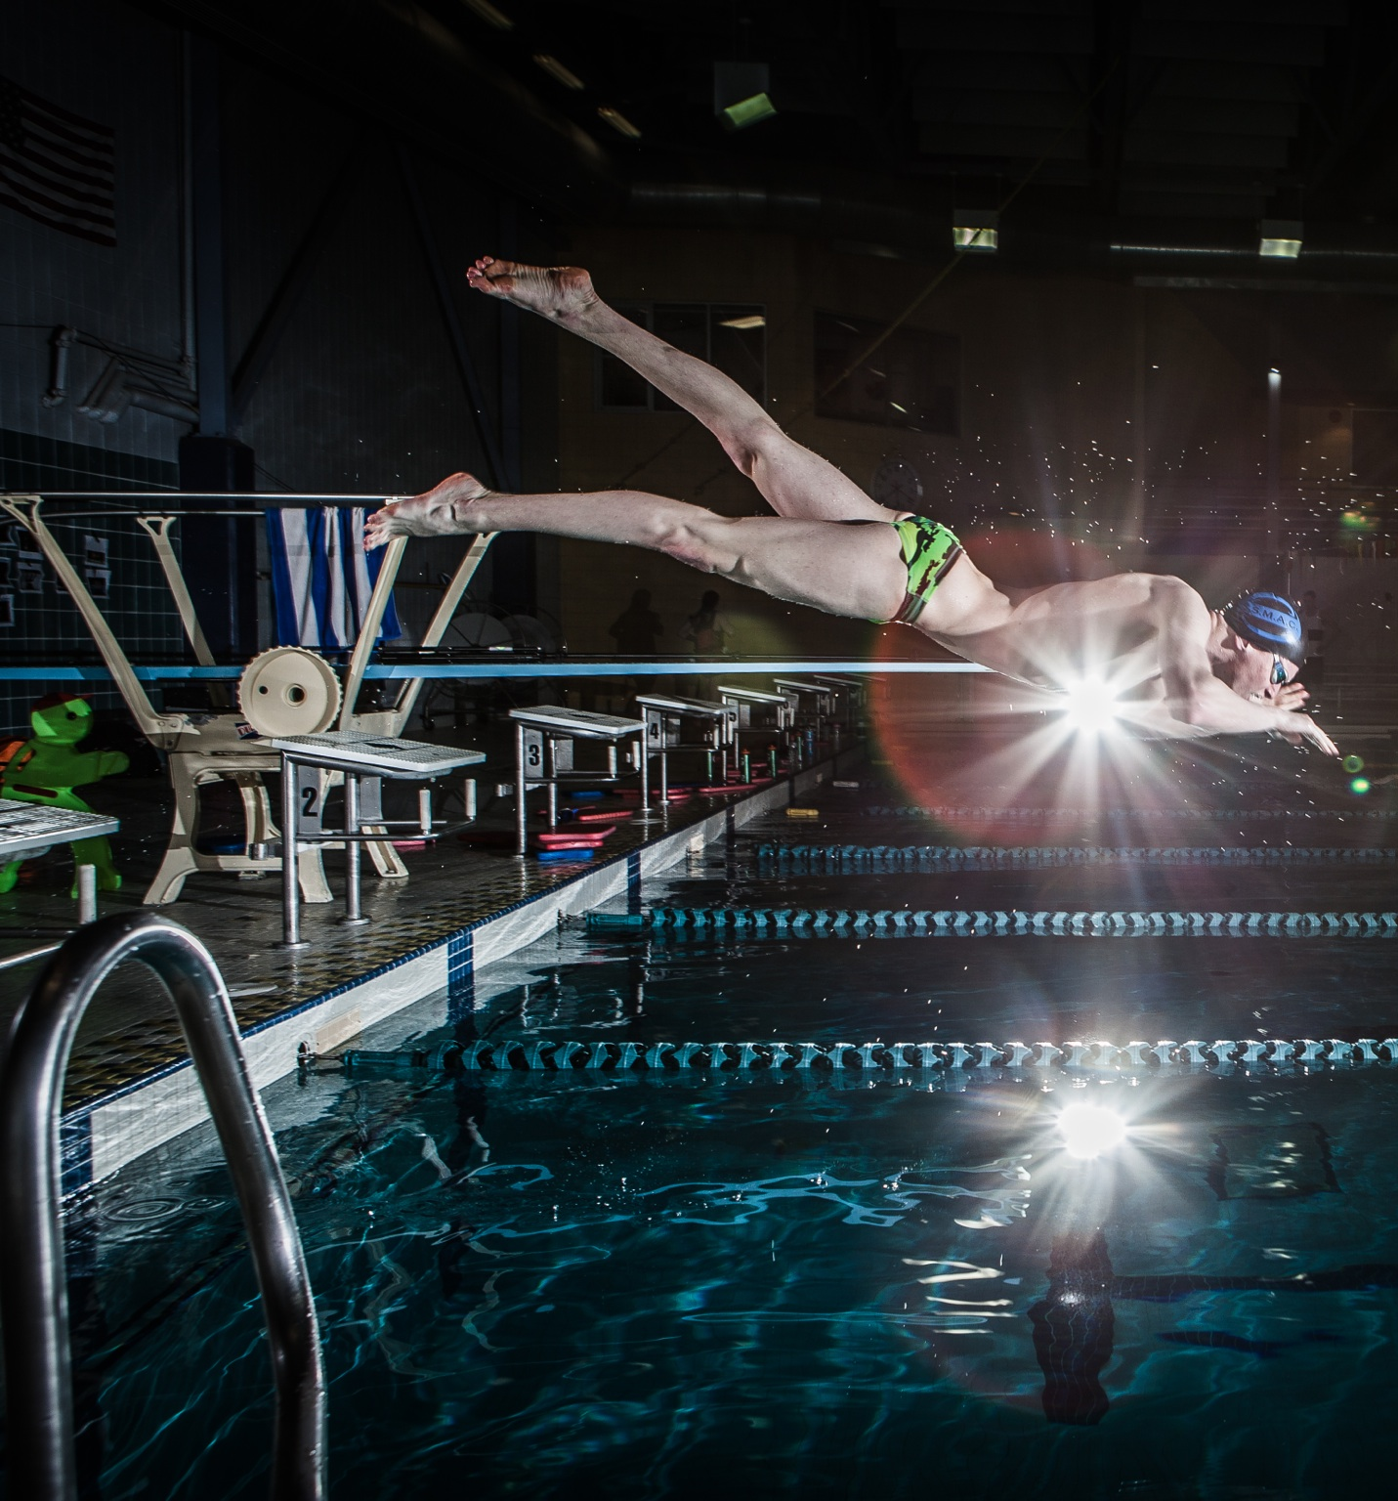
Junior and Senior (developing performance)
Skills for Swimming performance
Competent in four competitive stroke (i.e. SHLAR)
Starts for each competitive stroke (i.e. PRAFE).
Turns for each competitive stroke (i.e. APTGT).
Training skills (i.e. Stroke count, Pacing, HR, velocities).
Recovery skills (i.e. Sleep, Hydration, Nutrition).
Mental skills (i.e. Goal setting, stress management, imagery, distraction management, self talk, self image).

Slide 11
Mental Skills Checklist
Introduction
Training and performance are 50% mental
Identify 3 mental skills/abilities that you are doing well
Identify 3 mental skills/abilities that you would like to improve
Compare your current performance state (CPS) to your ideal performance state (IPS).
Why? What difference will it make.
Homework
Complete your worksheet and keep it for future reference.
Determine one mental skill you are good at and one your working to improve.

Slide 12
Goal Setting for optimal performance
Choose a goal that you would like to accomplish.
What is your deadline to accomplish it by.
Determine the steps (sub goals) that you need to accomplish.
Determine how important it is to you to be able to accomplish this goal.
One thing you can do today to bring you closer to the accomplishing your goal.
Signature line.
Dated and witnessed.
Homework
Journal for 10 minutes every day for 7 days in a row.

Slide 13
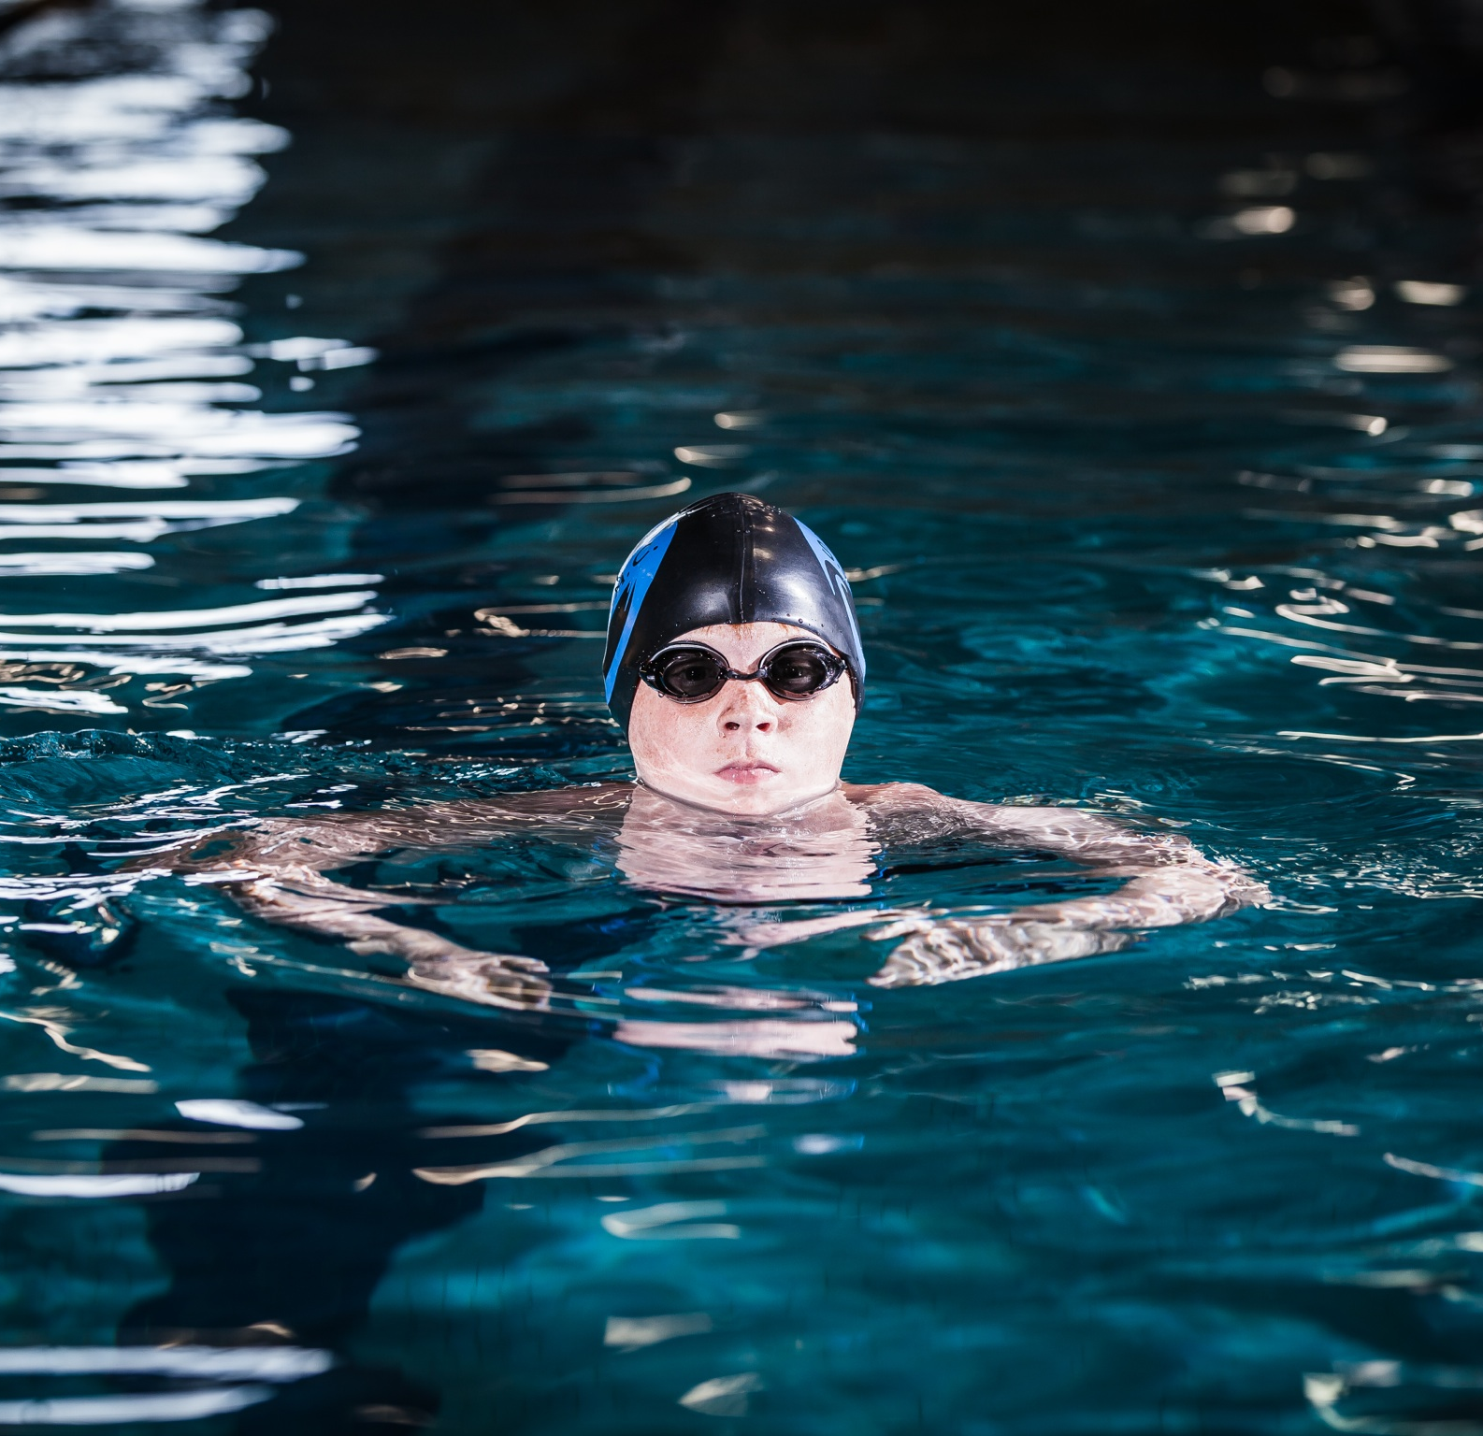
Stress Management
Be able to identify stressful situations.
What type of response does this elicit; physical, mental or both.
What is your preferred reaction and what strategy can you employ.
What level of emotional arousal (activation) are you as it relates to performance. (Sue, Sally, or Jane).
Mental Strategy: self talk (when you performed at your best)
Mental Strategy: thought, challenge, and replace
Physical (Somatic) Strategy: deep breathing
Physical (somatic) Strategy: Progressive Muscle Relaxation (PMR), headspace.
Homework
Try at least one strategy and practice it 3x this week.
Purposely expose yourself to at least 2 stressful situations.

Slide 14
Imagery
Find three scenarios or skills that you could work on using imagery.
Choose one of those three scenarios or skills and fill in the details.
Vividness; what so you see, smell, hear, feel.
Perspective; which do you prefer
Time; how long does this take in real life.
Sport imagery log; including date, imagery quality, areas worked on, things to work on next session.
Homework;
Should be done 3-4 times per week and should take approx. 10-15 mins start to finish – MAKE time.

Slide 15
One more thing
Sleep diary
Nutritional decisions.
Proper hydration routine.
Time management and academics.
Recreational time.
Strength and conditioning.
Stretching and activation.
Injury prevention and management.

Slide 16
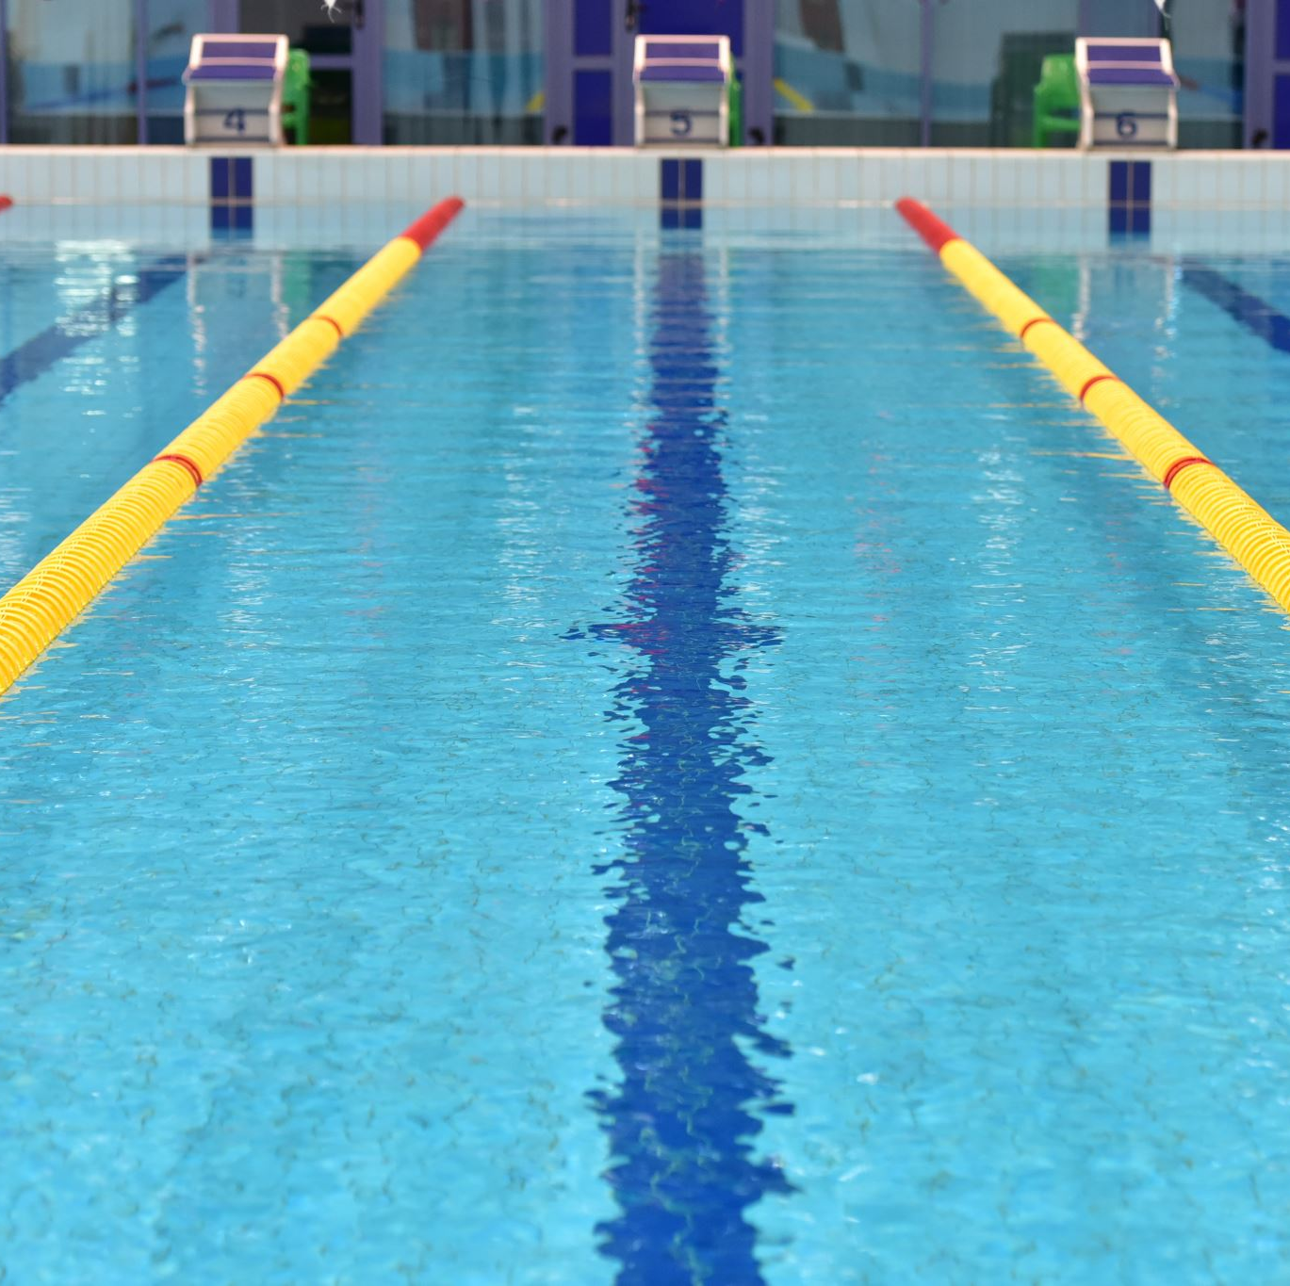
Celebrate your passion for sport
Live your dream.
Be a student of your pursuit.
Recognize how unique you are.
Appreciate the challenges you have overcome.
Be grateful for the supporters you have behind you.
Understand yourself.
Put your performance in perspective.
Use your experience to inform your life outside of sport.

