Slide 1
West Meets Jobs Sign Up www.westmeets.ca
Instructions on how to sign up for volunteer positions for swim meets or for officials clinics.

Slide 2
Click on Events/Meets Tab

Slide 3
Click on Job Sign Up button

Slide 4
1) Click on empty space 2) Click on Signup button

Slide 5
Enter in optional contact info only if you are signing up a friend or family member. If it just for you, leave it blank or if you have a special request.

Slide 6
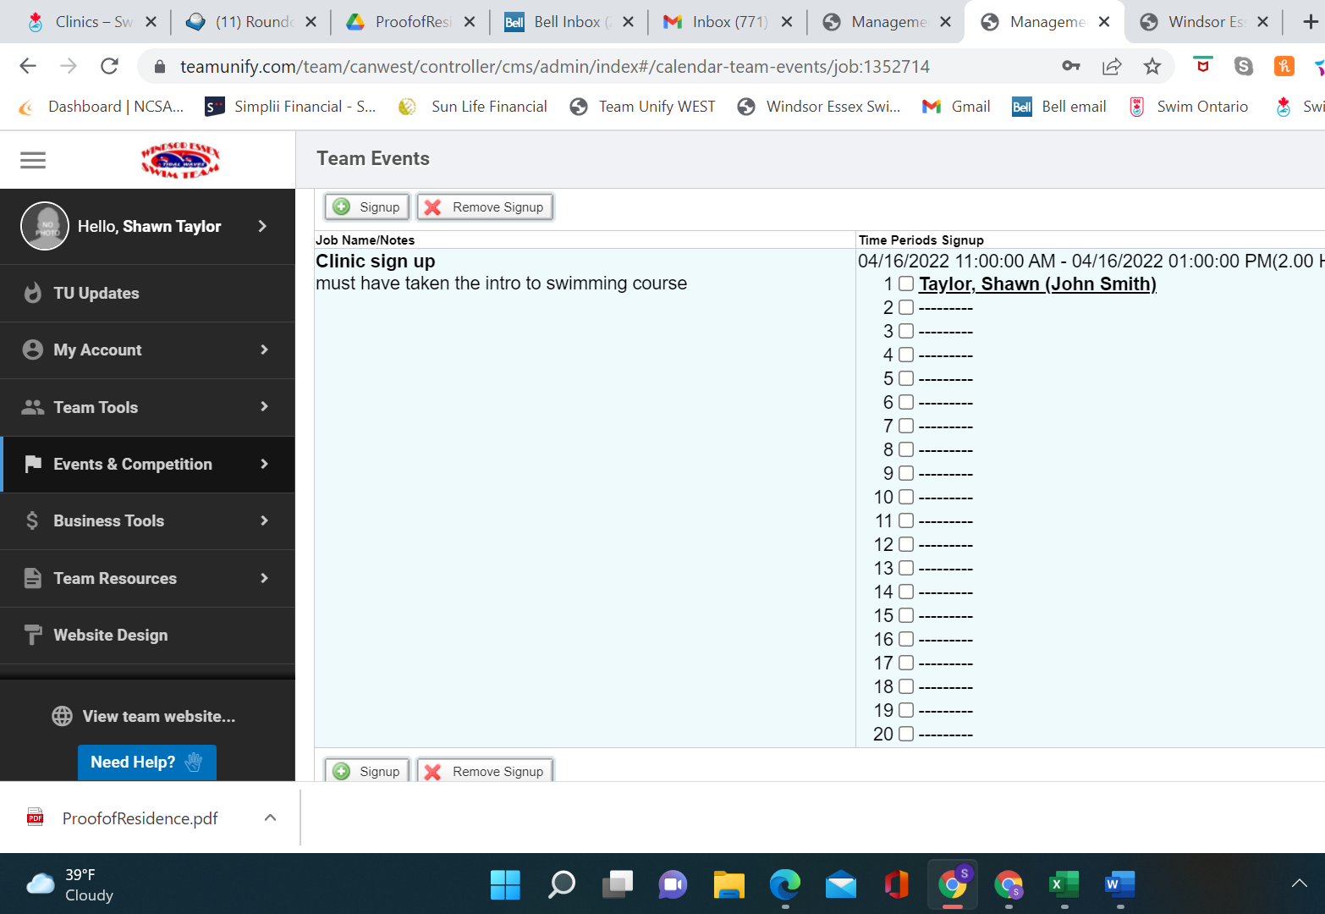
Verify of all information is correct. And you are all done. Congratulations!

