Slide 1
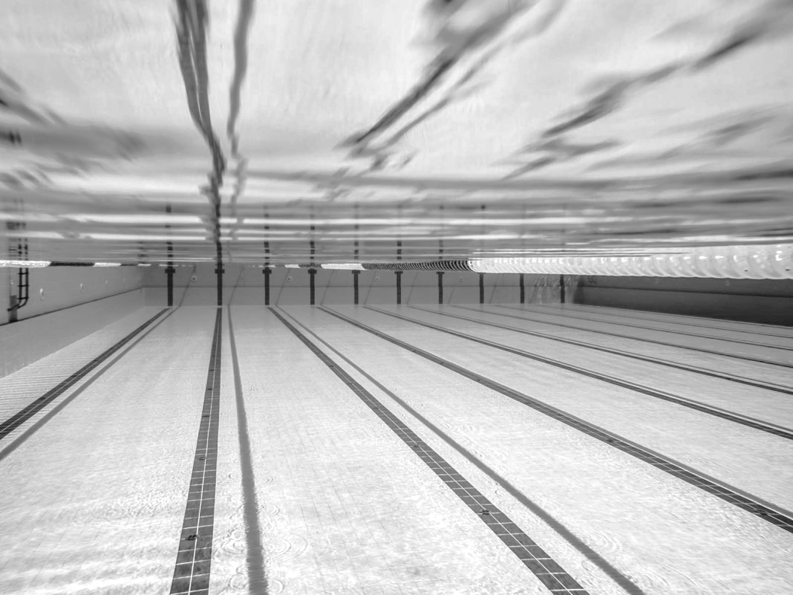

SWIM MEETS
The “How-To” Guide for Swim Parents

Slide 2
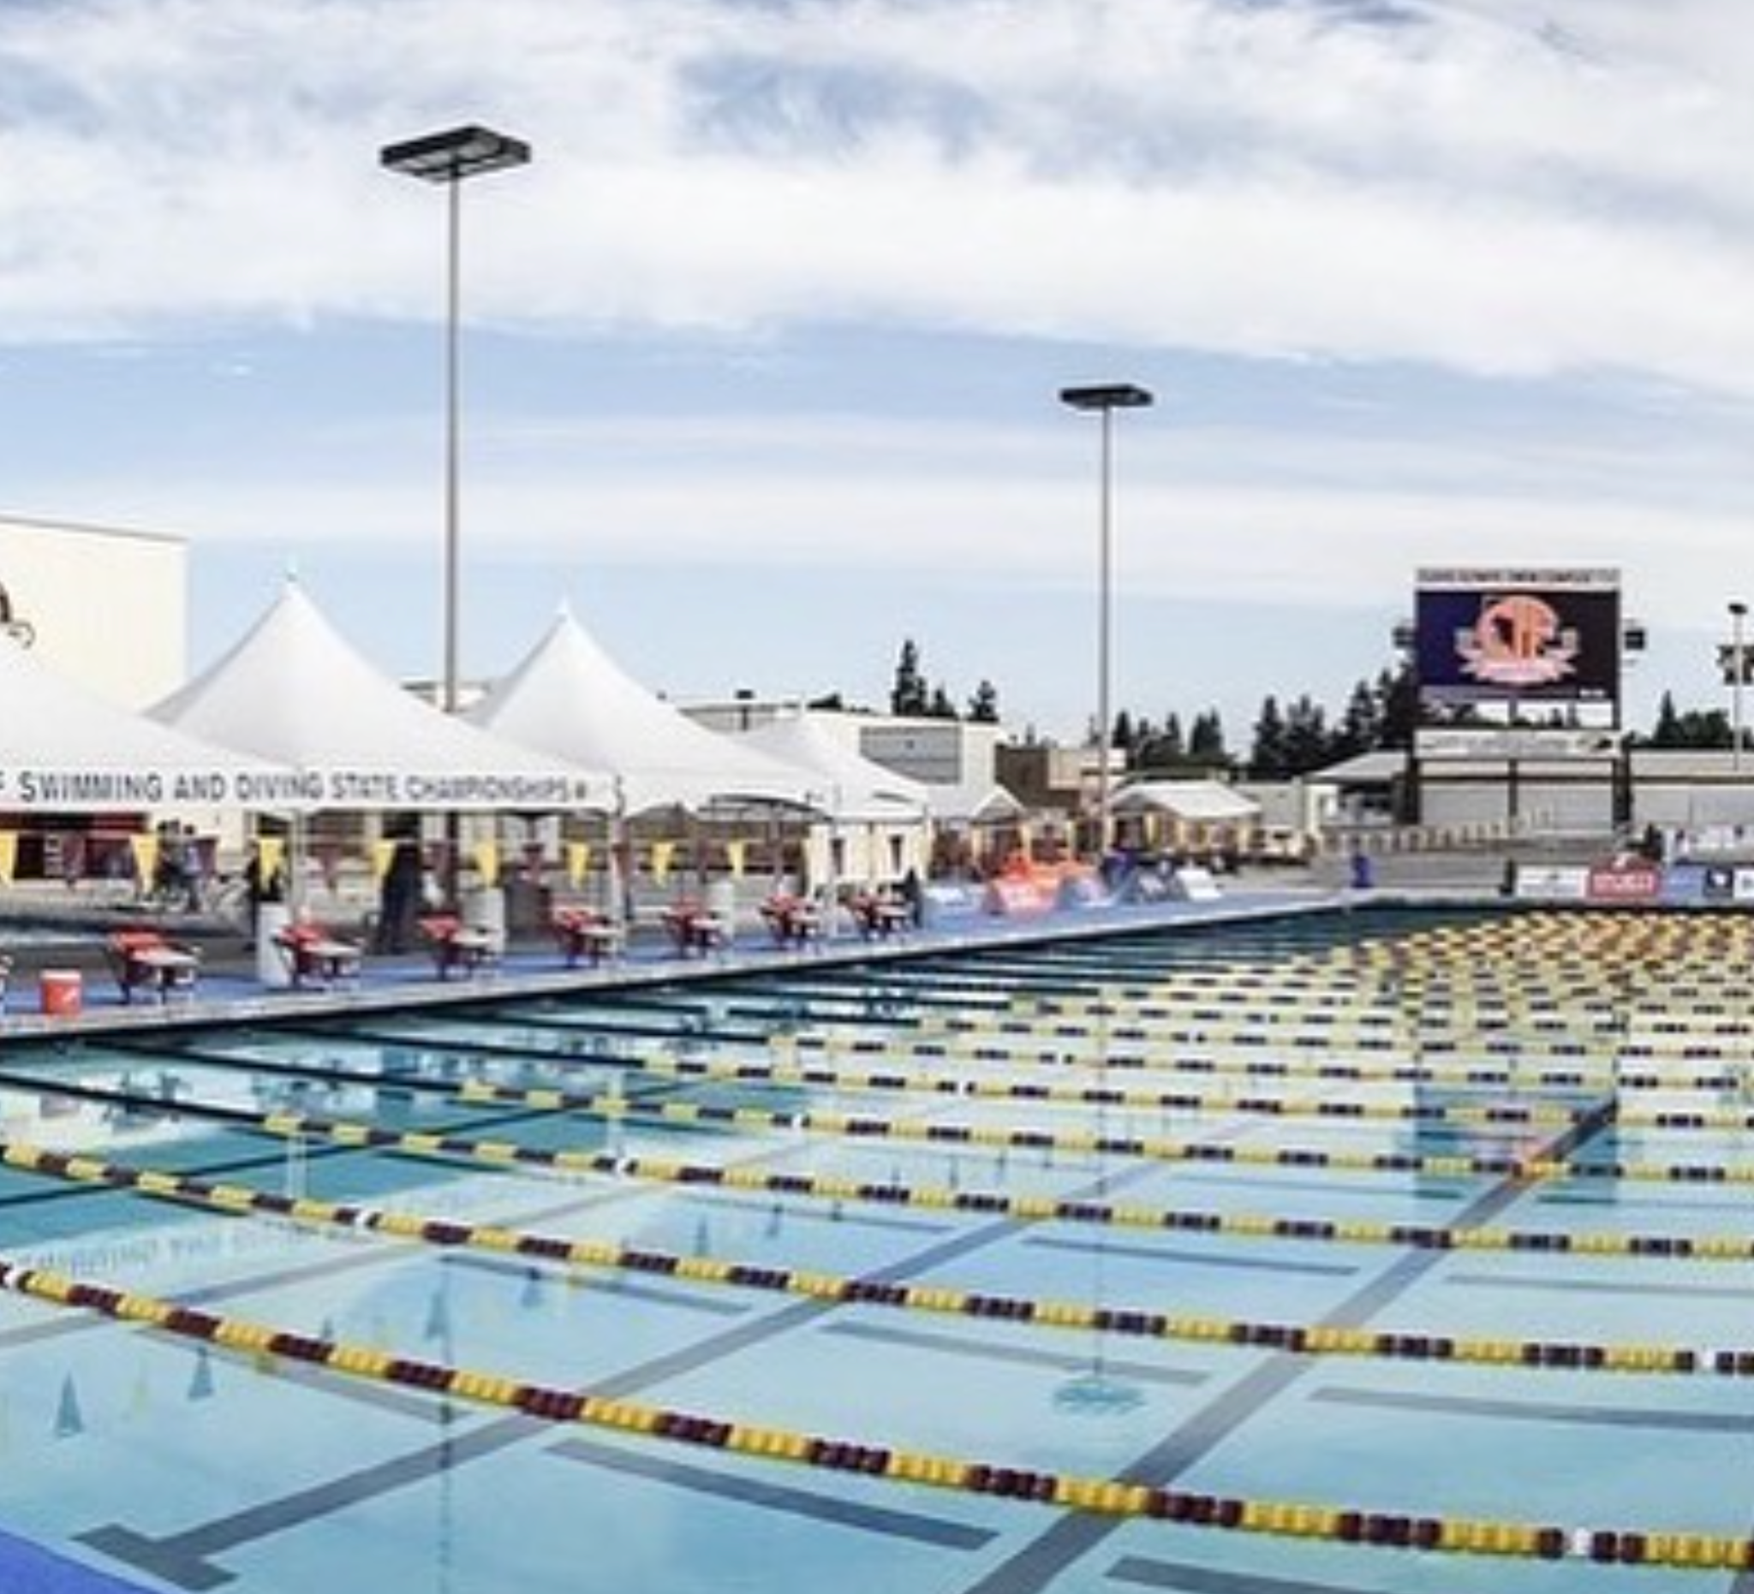
THE BASIC SWIM MEET
The first step is to Commit Attendance online
Coaches will notify you of meet arrival times at practice and through team emails
Getting there is just the beginning…
Unpack the car, walk in, find Coach, etc.
Kids will stretch and have a dryland warm up
It is IMPORTANT for your swimmer to Check-In
They will then have a warmup set in the pool
Then it’s off to the races!

Slide 3
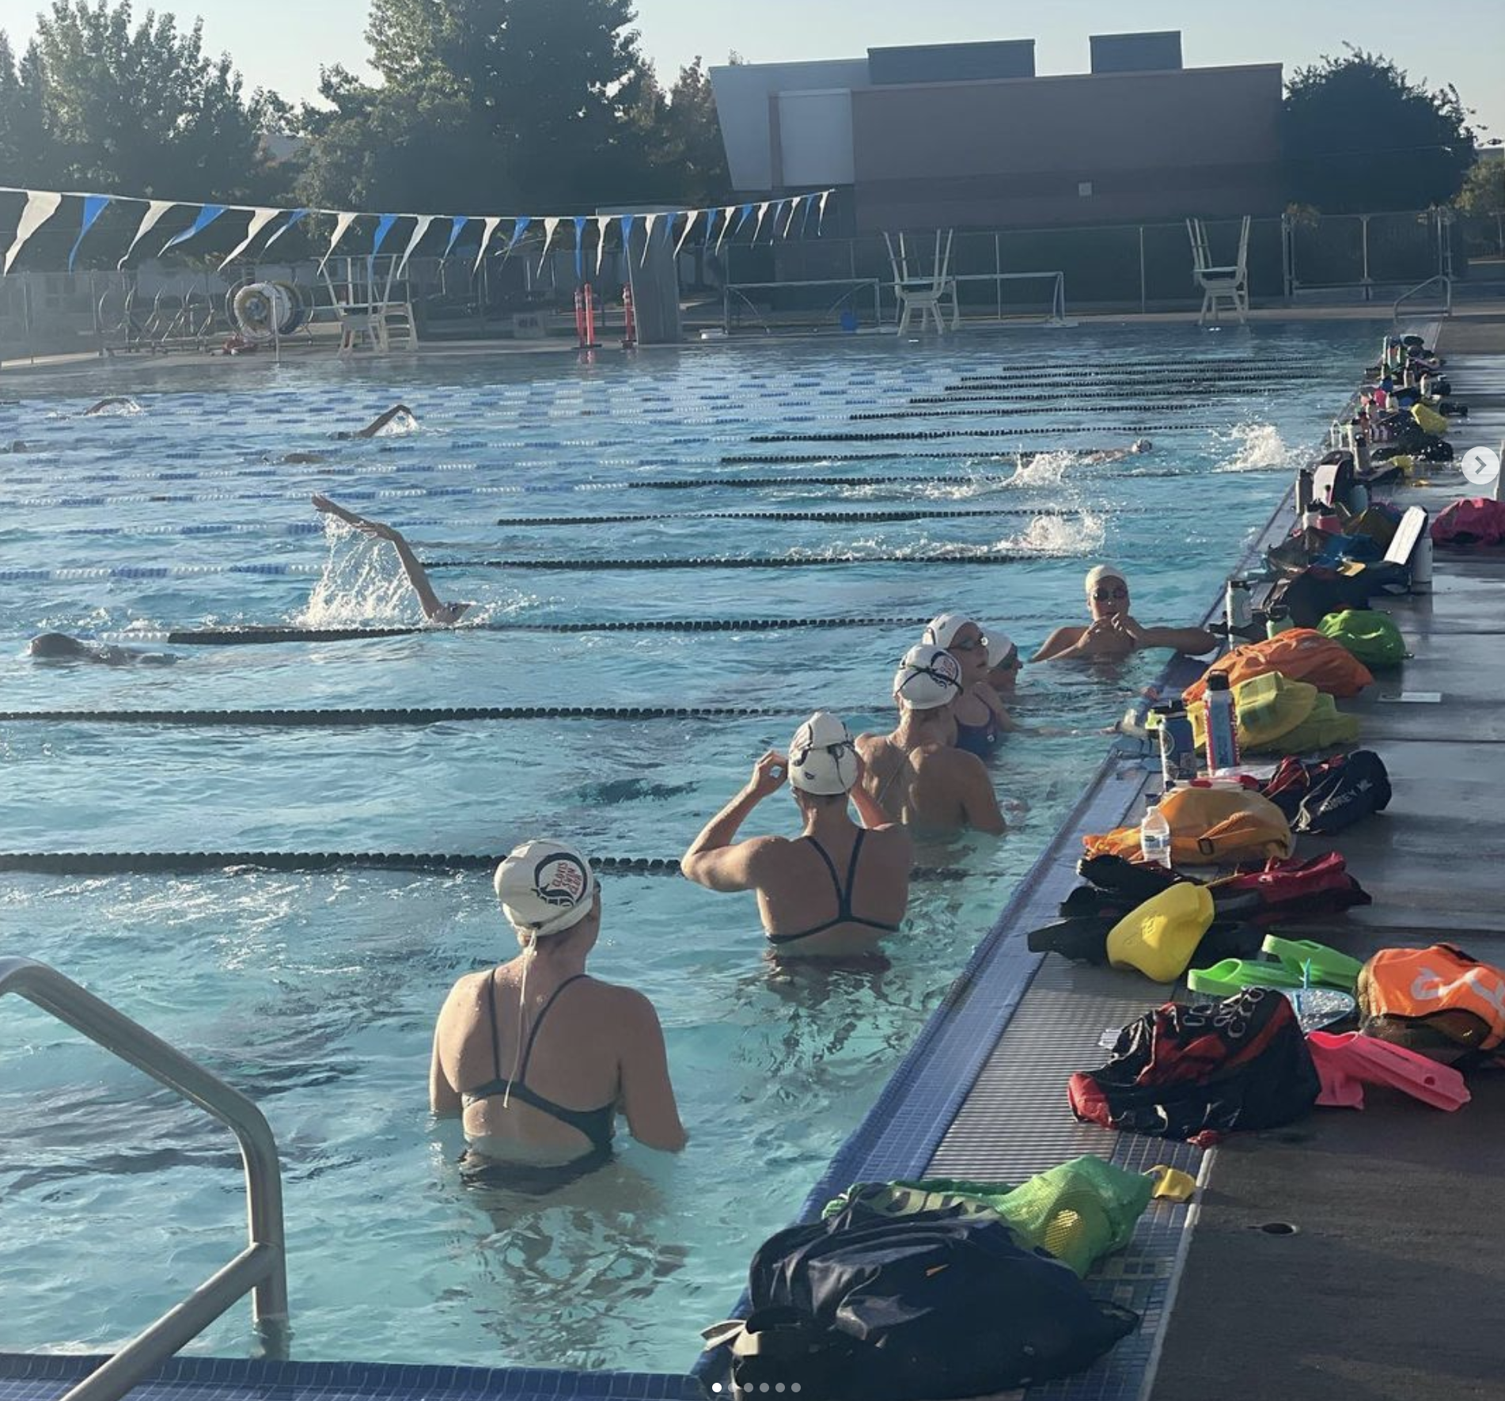
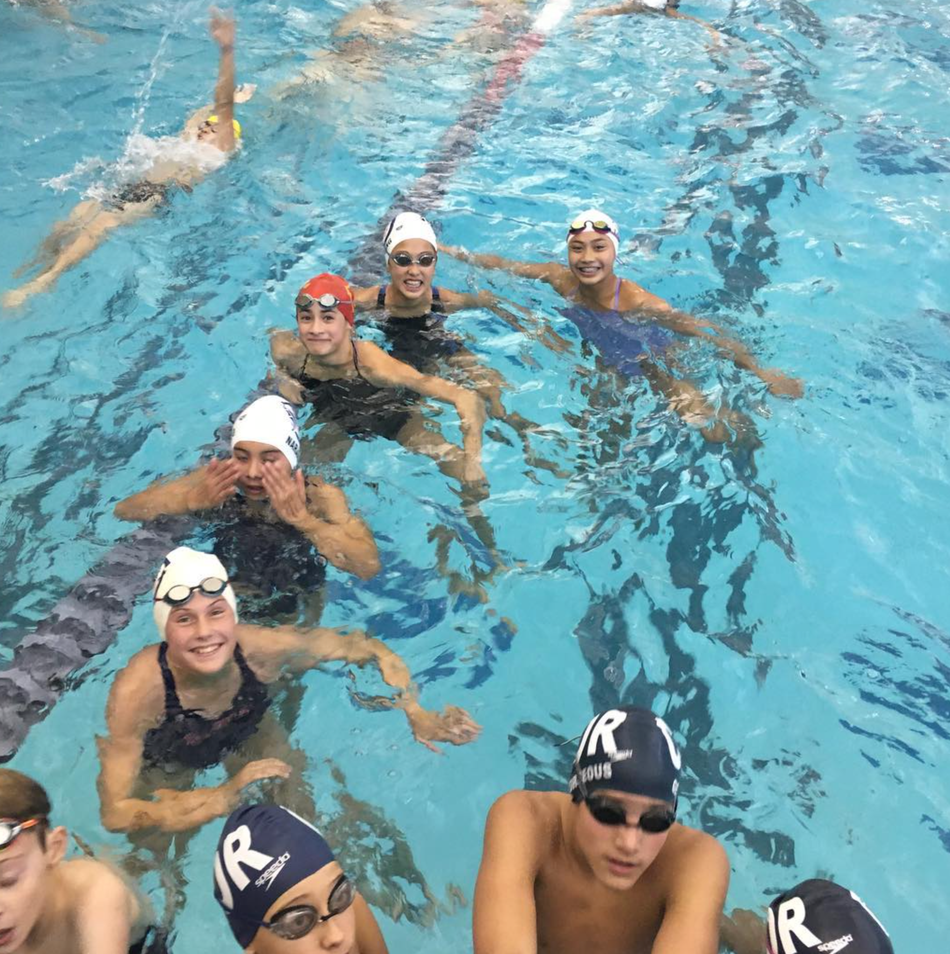
WHEN YOU ARRIVE + WARM UP
Please get to the pool on time. Allow extra time for parking and unloading
Have your child find their Coach to check in
Check In must be done by the swimmer
Their events will be confirmed by the host of the team
Meet warmup is standard before each meet, swimmer will get in the water when instructed by coach (often 1-2 hour/s before meet start

Slide 4
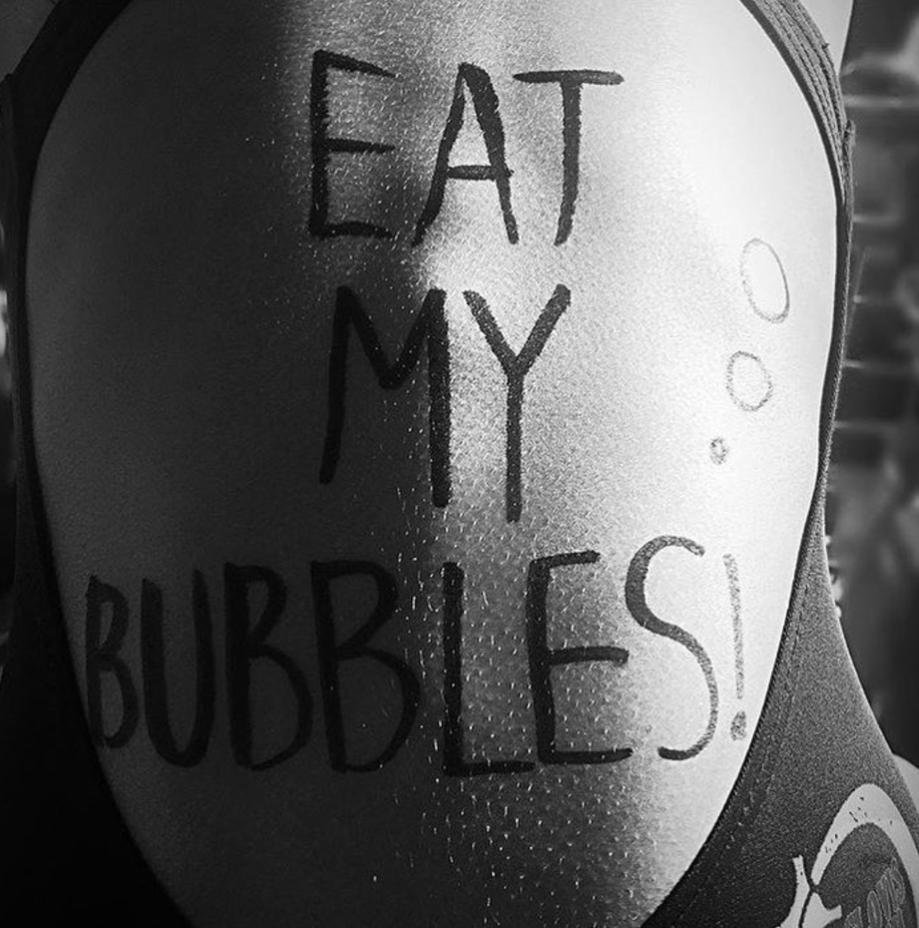
THE TEAM TENT | SET UP
“EZ-Up” canopies will be set up if you would like to sit with other CSC swimmers
CSC owns their own, bring your own if you wish to be covered
Most families bring folding chairs to sit in during meet
Most families bring ice chests with healthy snacks and lunch
CLOSED DECK
Some meets are Closed Deck which means no parents
allowed on deck. You will have a dedicated area to
watch and cheer.

Slide 5
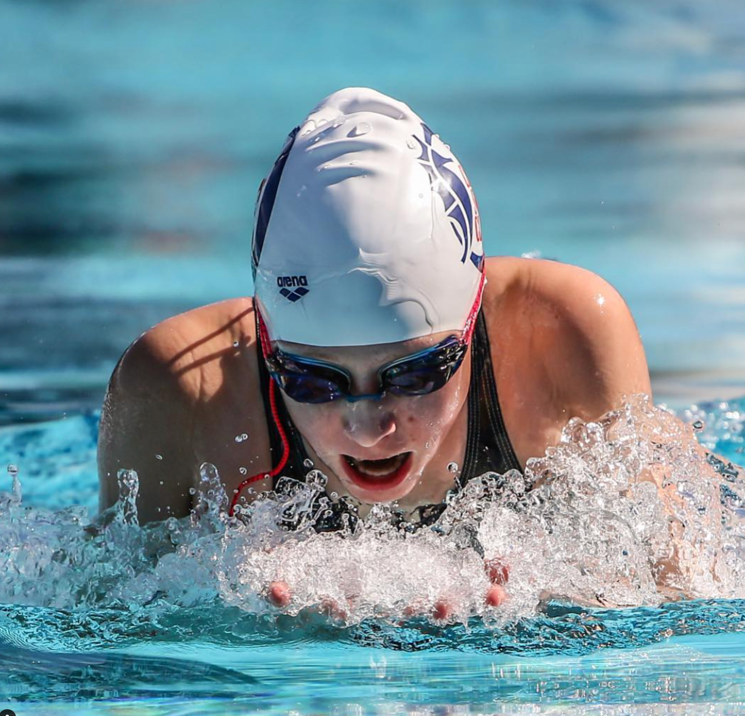
THE SCHEDULE FOR THE DAY
Some meets are broken into sessions. Morning and Afternoon
Younger swimmers tend to be in the morning sessions
Arrival time can vary but is usually between 7:00 - 7:30 AM
An average-sized meet tends to last until about 12:00 PM

Slide 6
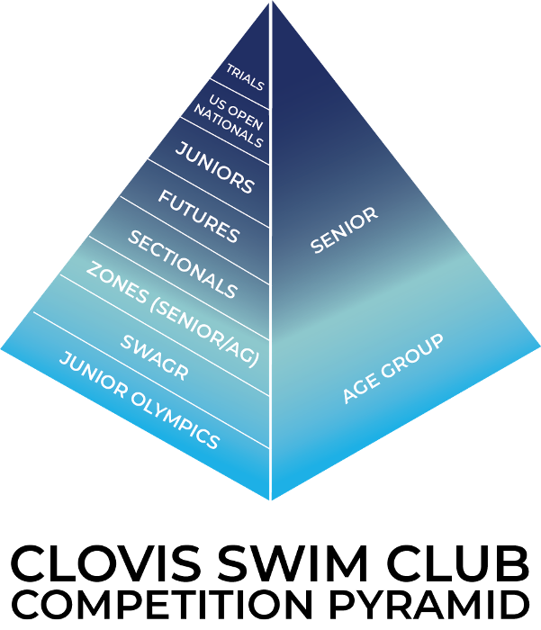
TIME STANDARDS
Age Group Motivational Time Standards
Age Group Zones
South Western Age Group Regionals
CCS Age Group Championships

Slide 7
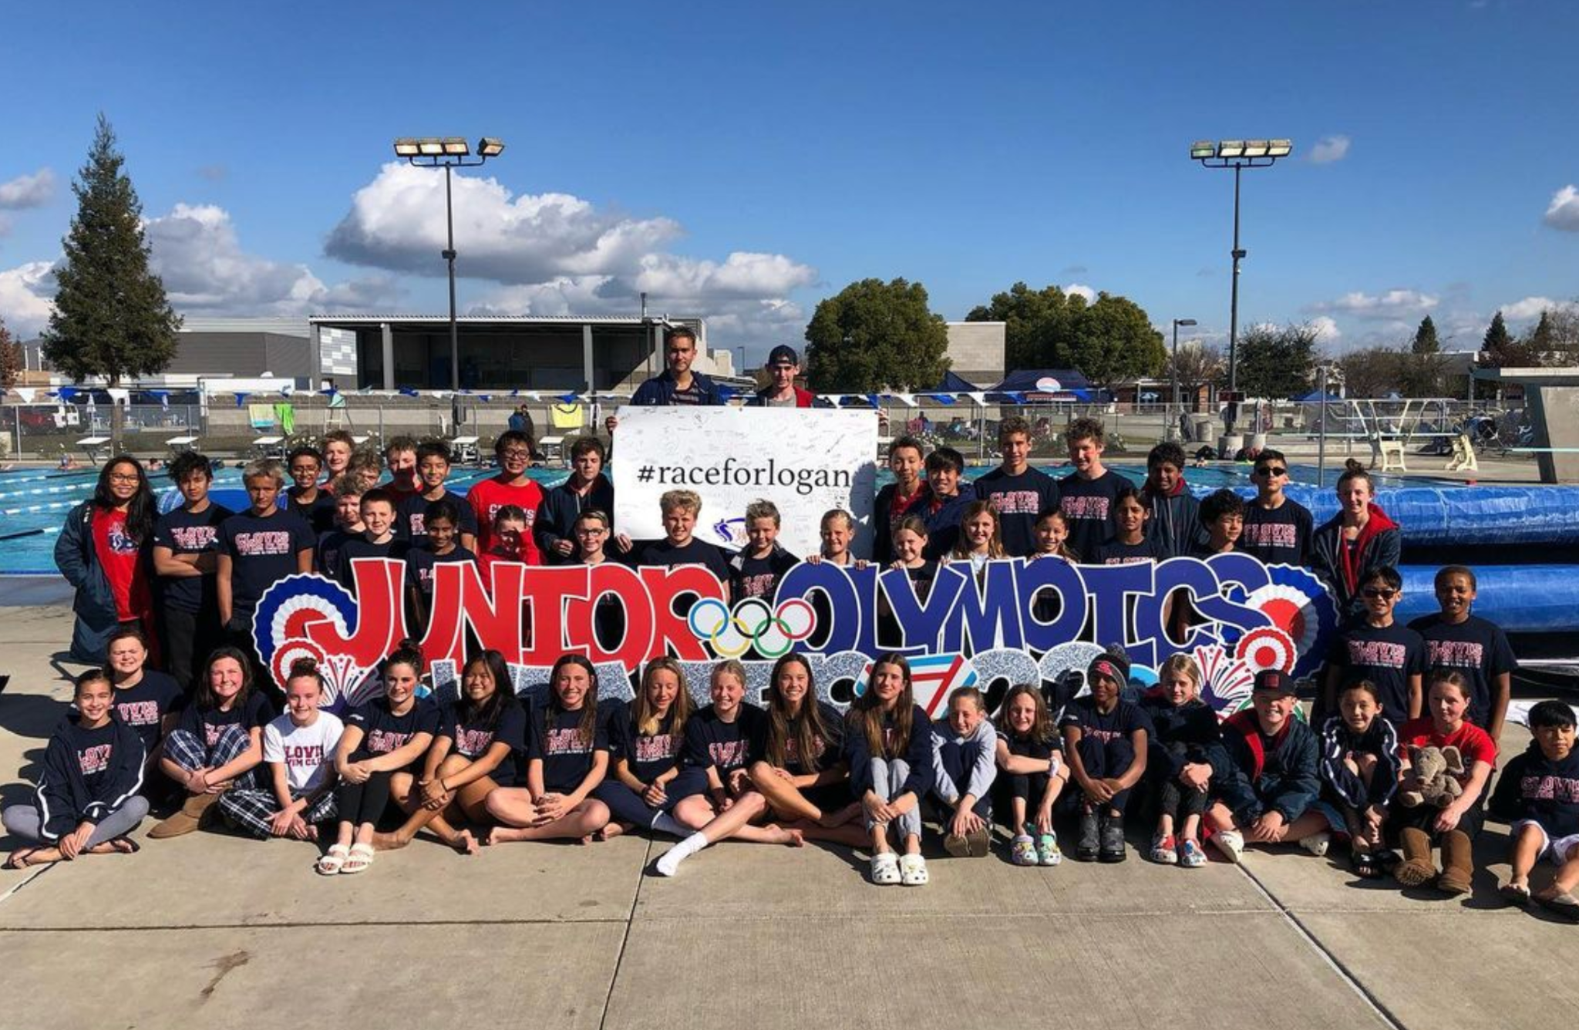
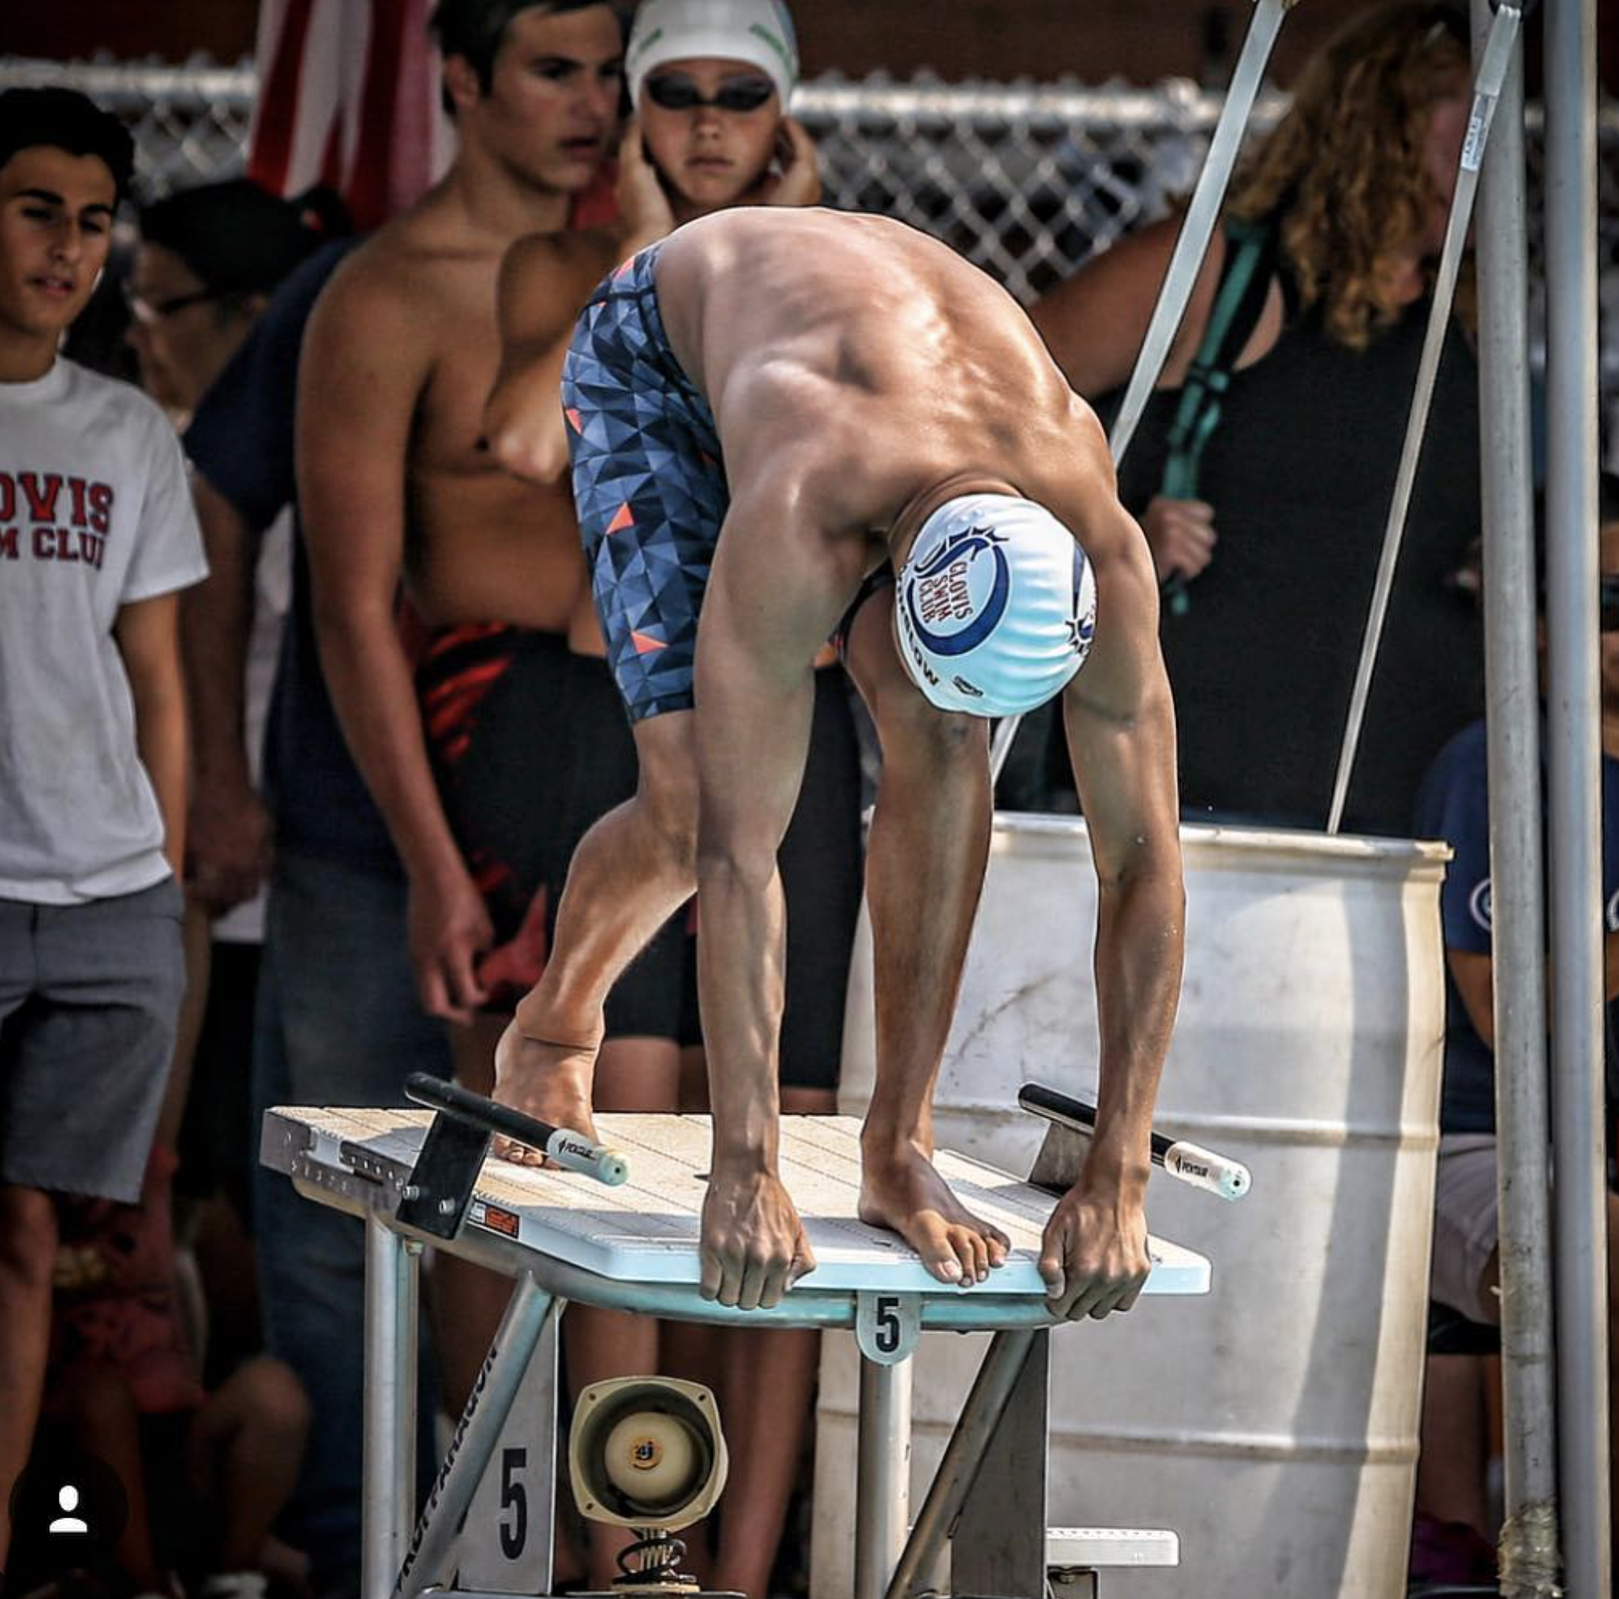
CHAMPIONSHIP MEETS
Swimmer must pre-qualify in each event
There are prelims in the morning and finals that run late afternoon into evening
Some may only swim once, between the two sessions based on their age
These are longer days at the pool for the family
Hotel stays are often associated with out non-local meets

Slide 8
GETTING INTO THE DETAILS | HEAT SHEETS + INSTRUCTION
Heat sheets will be posted for Boys and Girls
The first sheet posted in a “Psych Sheet”
Your child should appear in their events and you will see where they are “seeded”
The second sheet is the Heat and Lane assignments
These will be posted throughout the meet
Monitor as your child’s event approaches and they are behind the appropriate lane
Swimmer should report to coach before and after each event
Swimmers should plan on “warm up” and “warm down” before and after events

Slide 9
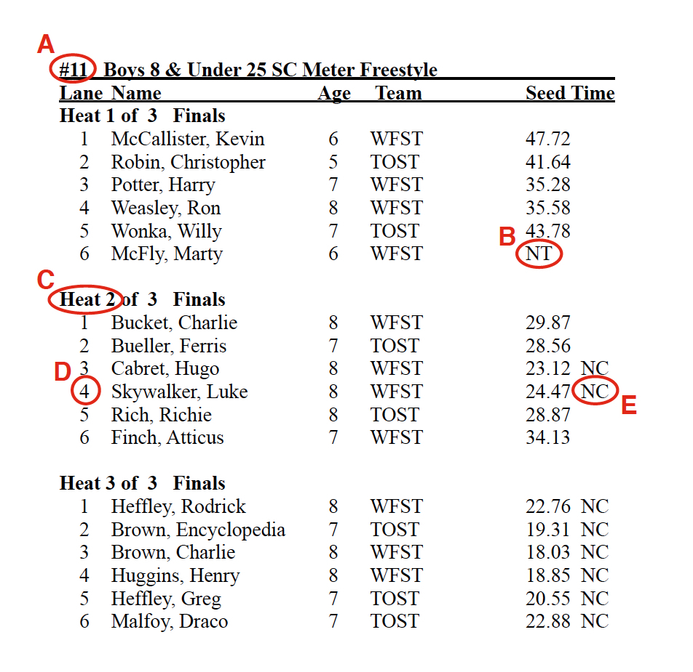
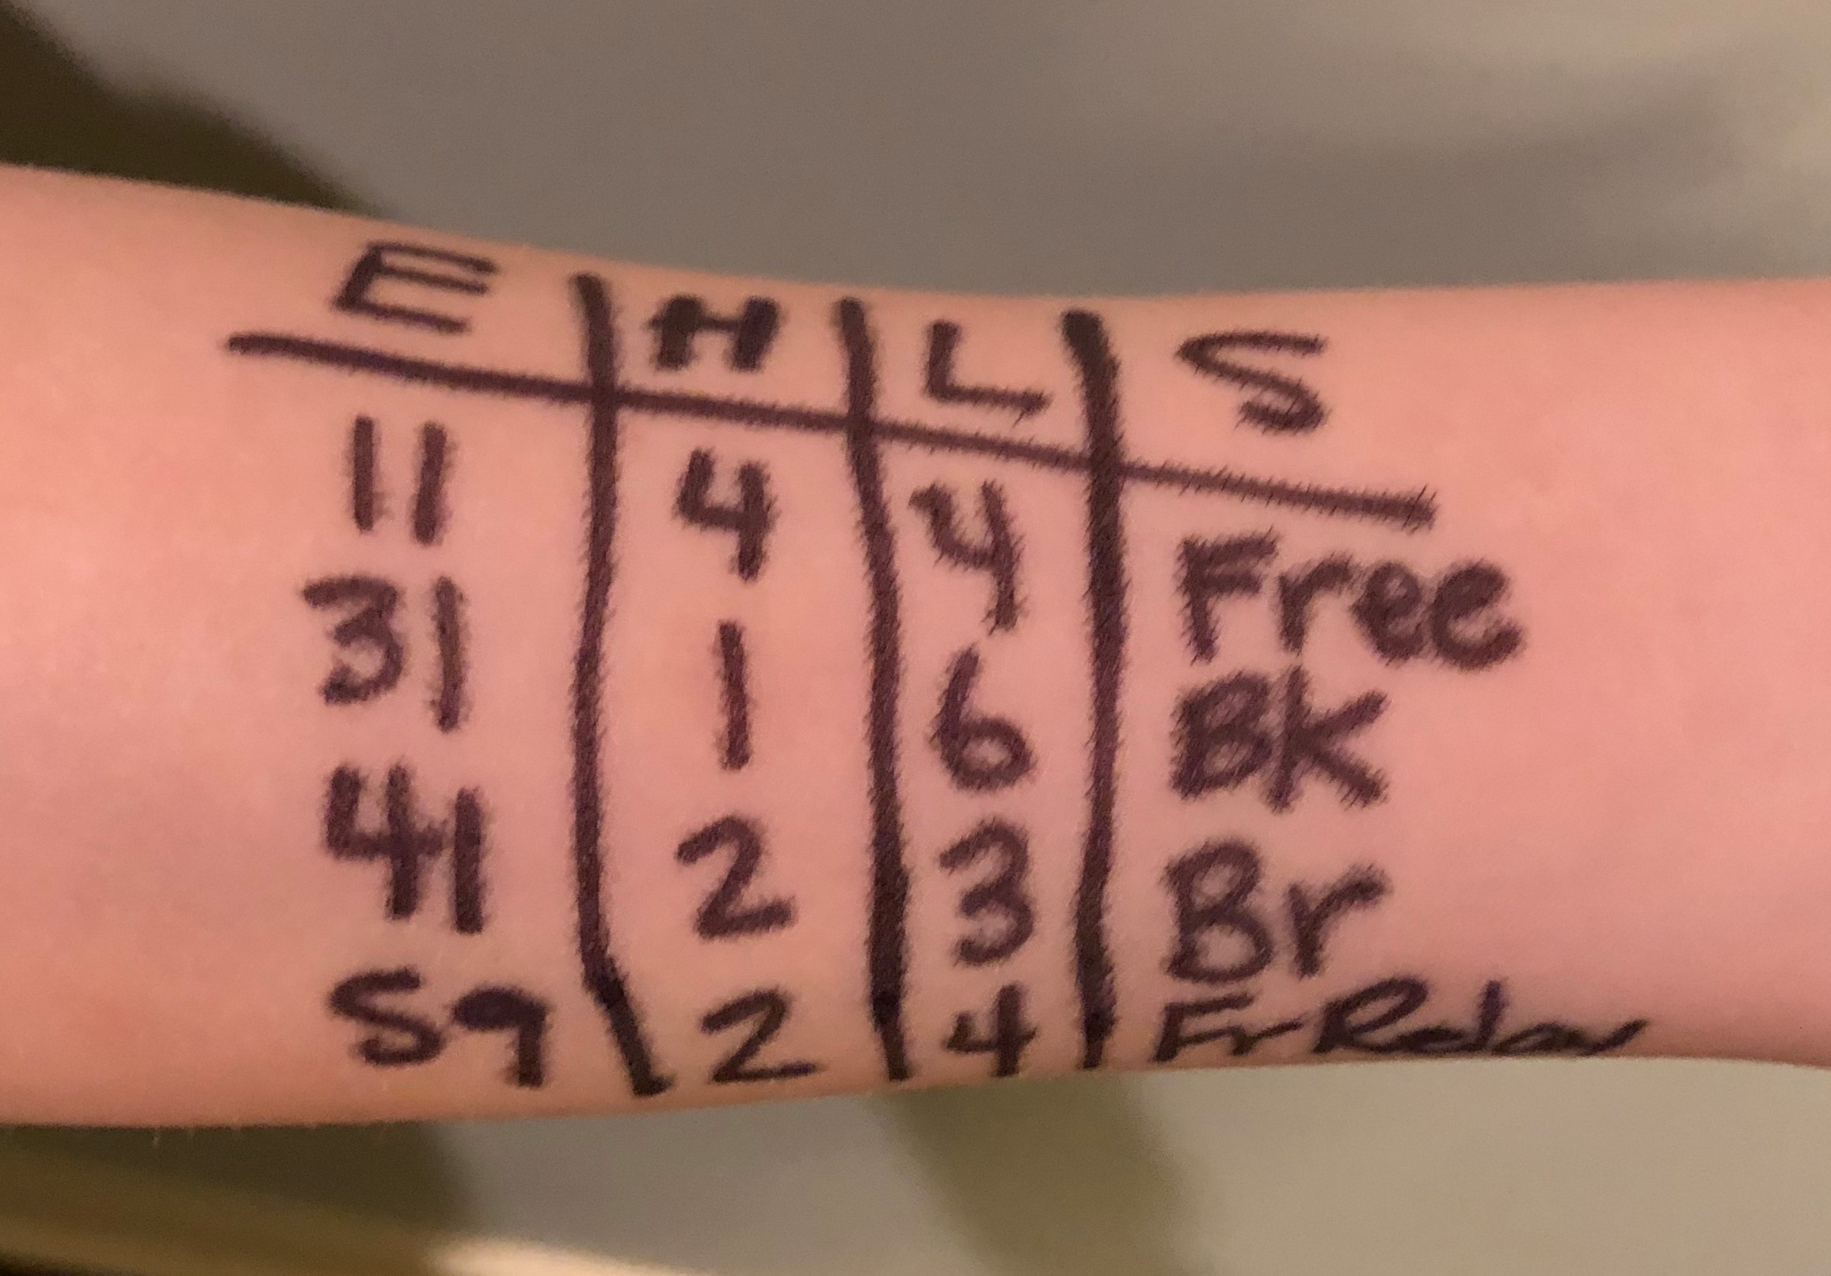
HEAT SHEET SAMPLE
A - Event Number
B - Means “No Time” (never swam before)
C - What heat or race # they are in
D - What Lane they are in
F - Some swimmers write events on their arm
F

Slide 10
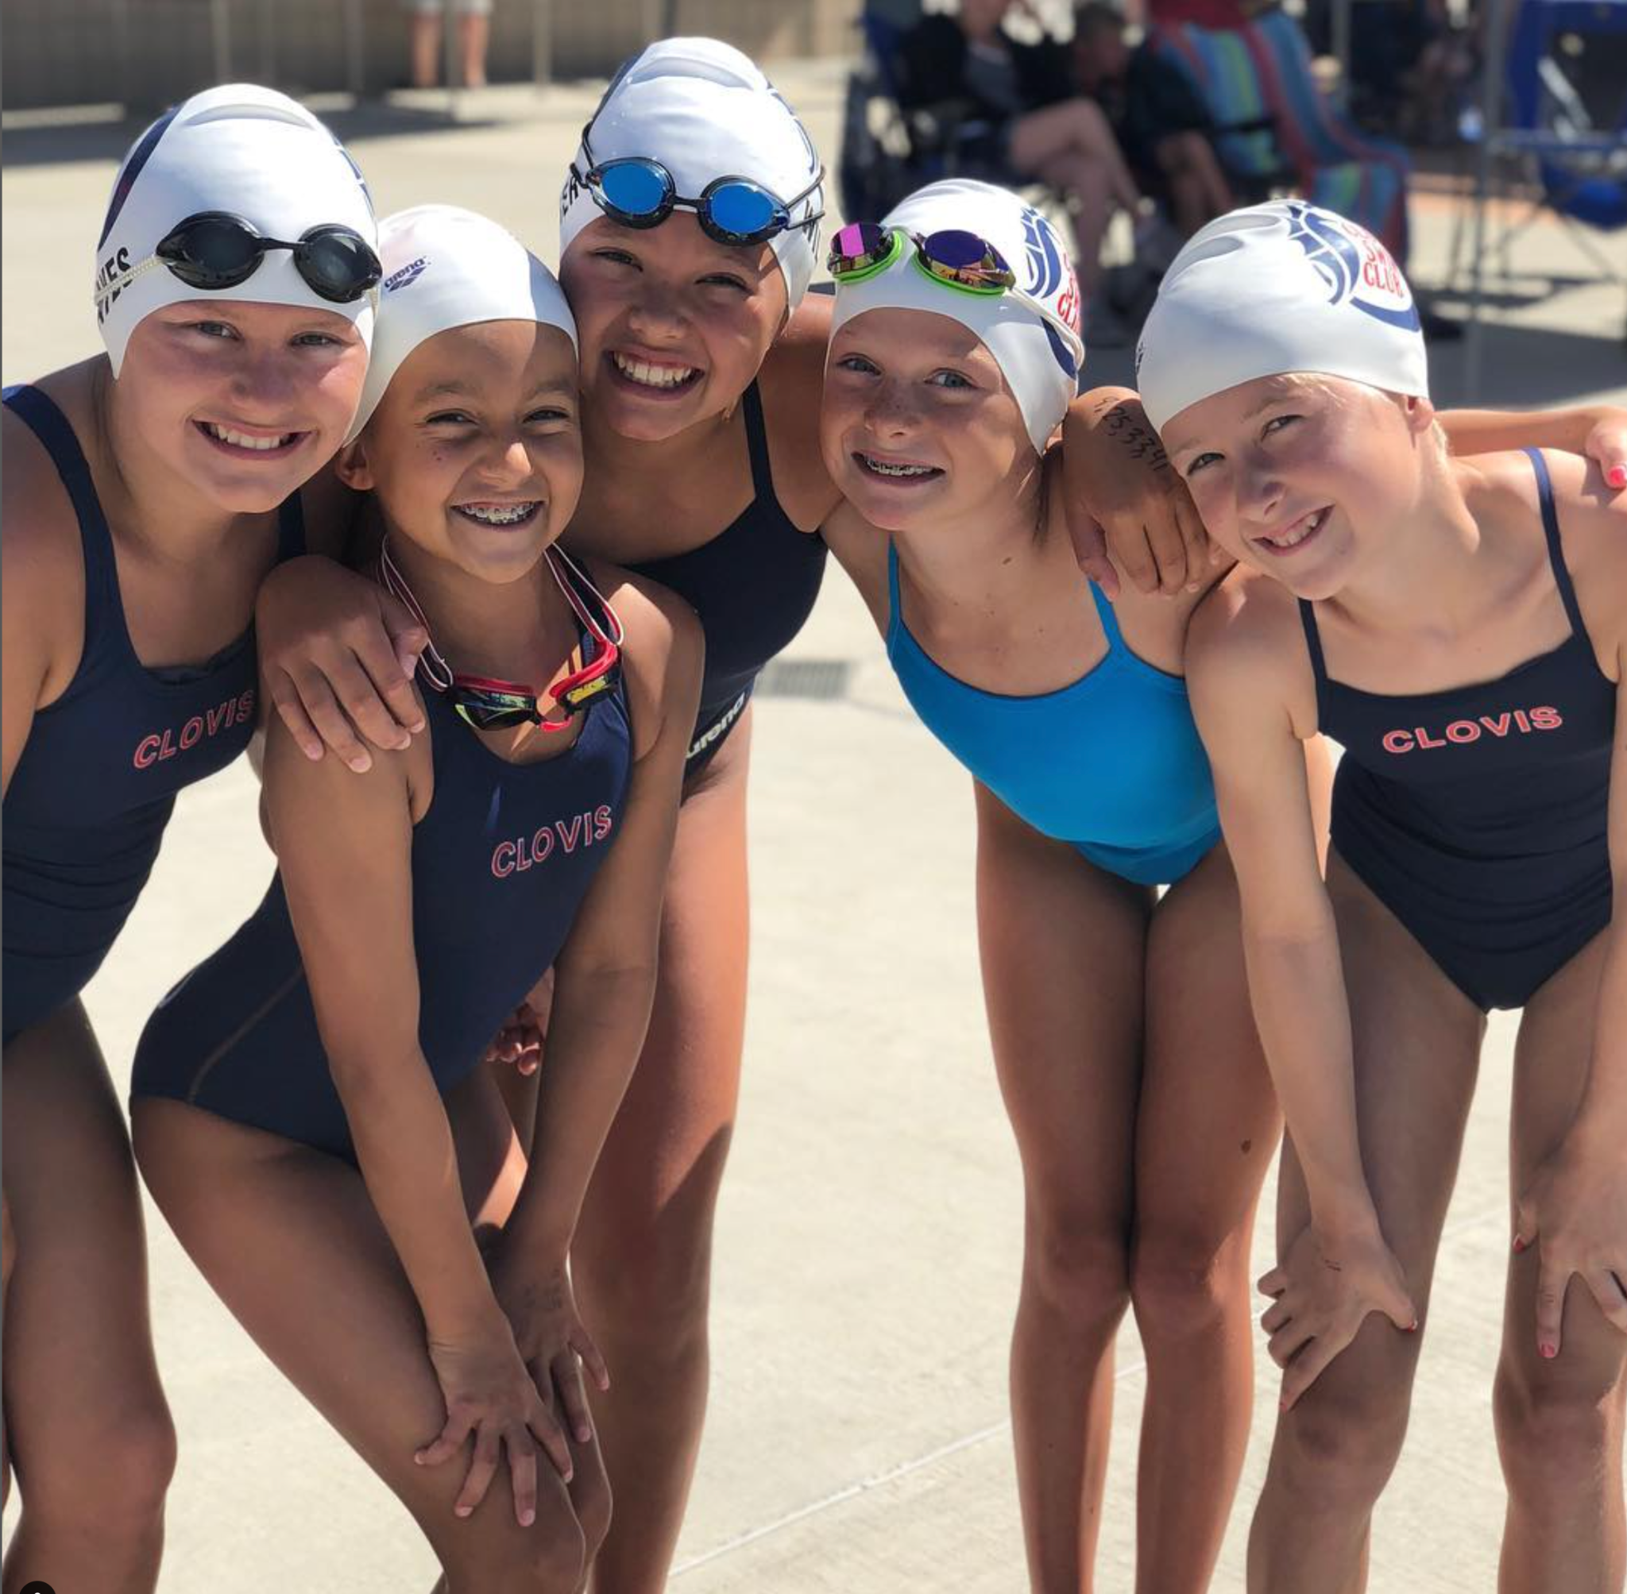
GETTING INTO THE DETAILS | HEAT SHEETS
The third sheet posted will the the Results Sheet
This sheet will show your swimmers official time after the event is complete
The time varies from meets to meet when these are posted
As your swimmer gains experience, it is beneficial for them to learn how to check their own Heat and Lane assignments

Slide 11

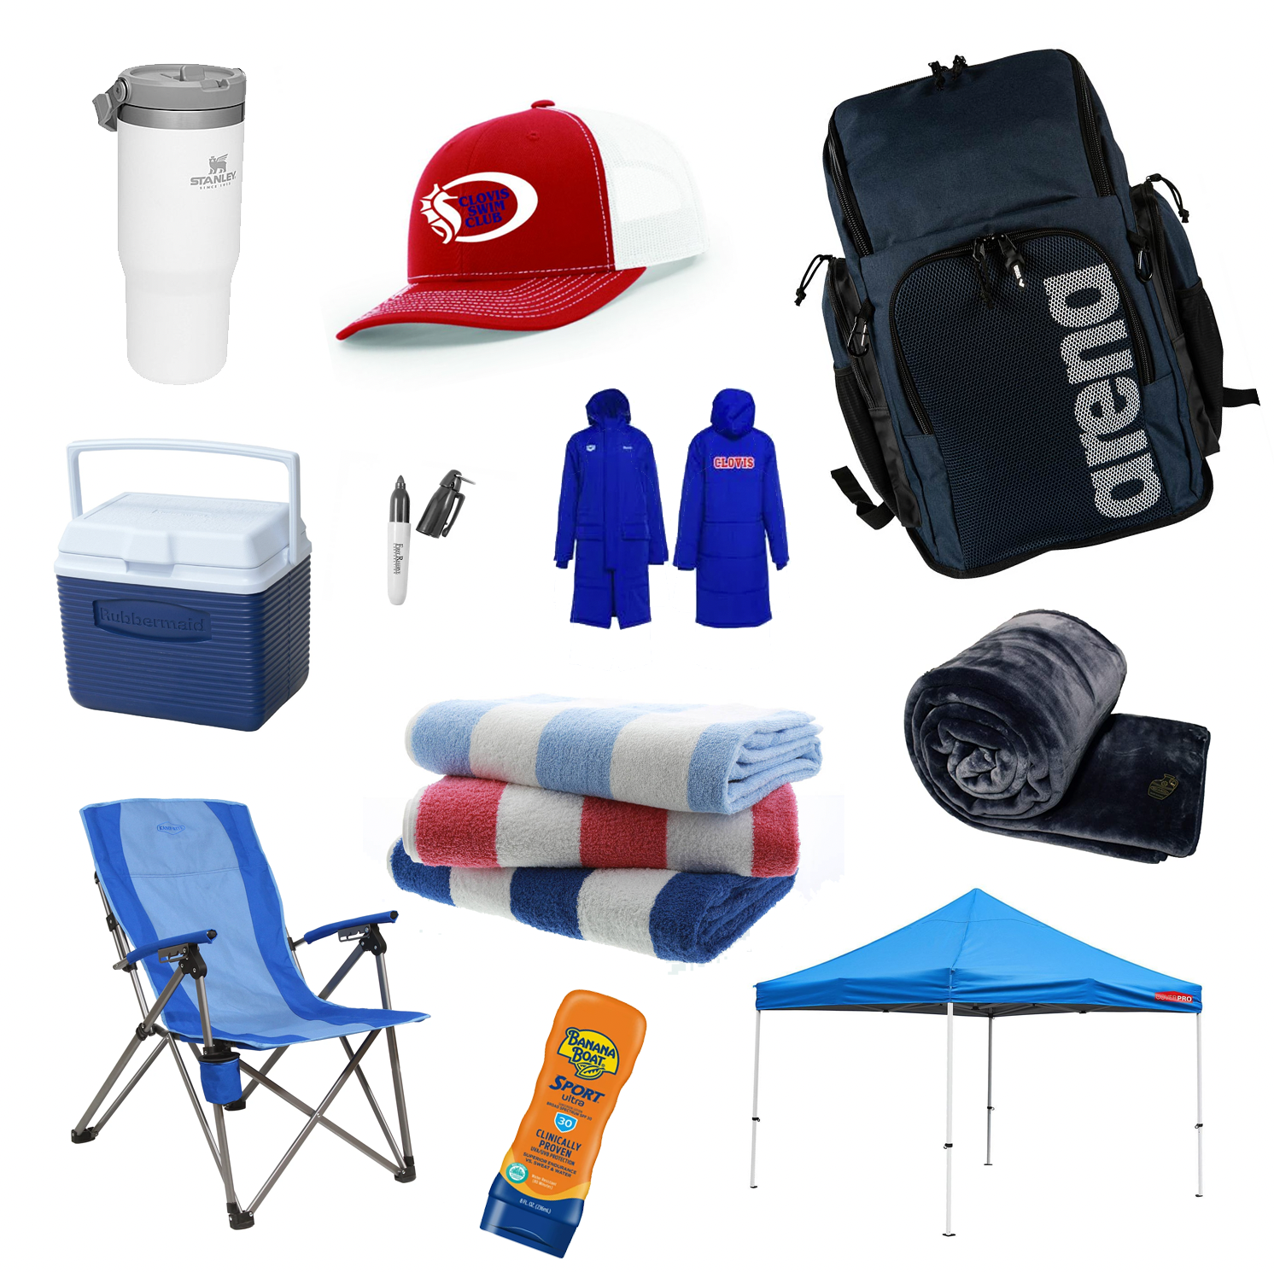
WHAT DO I BRING
Swim Bag!
You will not need the “Gear Bag”
Folding Chairs, optional Canopy
Towels, at least one a race + extra.
Jacket, Parka, Blankets, Hat + sunblock
Small ice chest with healthy snacks & drinks
Water Bottle!
Permanent Pen
TEAM ITEMS CAN BE FOUND AT Elsmore Swim

Slide 12
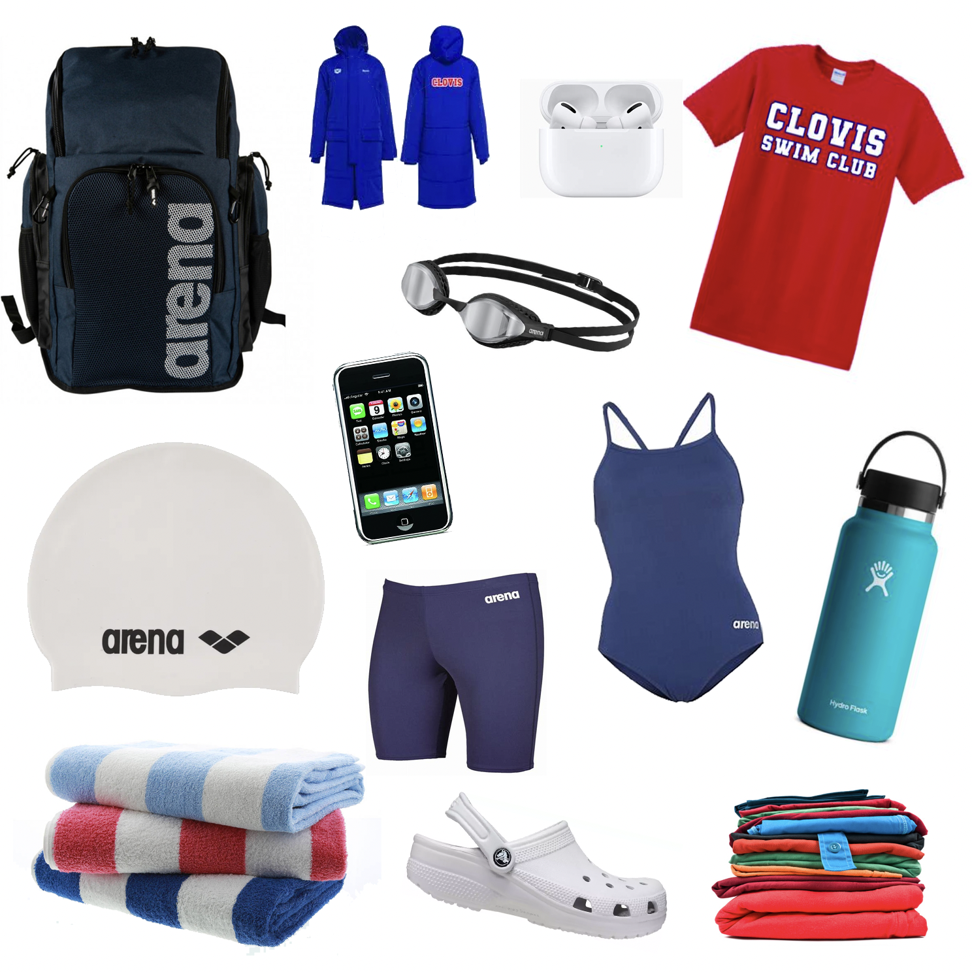
WHAT’S IN THE SWIM BAG?
Towels
Goggles + backup
Backup Swimsuit and/or Team Suit
Swim Cap + backup
airpods, iphone, books, games
Dry set of clothes to wear after
Water bottle
Team Attire
TEAM ITEMS CAN BE FOUND AT Elsmore Swim

Slide 13
HOW TIMING WORKS | GENERAL INFO
You may sign up on the TIMING SIGN UP CLIPBOARD, located near coaches
At every “away” meet, parents are responsible to assist with timing
Timing does count towards your CSC Volunteer hours at away meets
You may hear “How many chairs” we need to fill. We need to fill a certain amount chairs at meets
Timing is usually split into 1-2 hour time slots, and we have multiple chairs
At meets the team is assigned with a certain Lane(s)
Lane Assignments will differ between sessions
Most Announcers will announce what the lane assignments are if not they are in the meet information or posted on deck

Slide 14
HOW TIMING WORKS | INSTRUCTION
You will need to report to Lane about 10 minutes before the meet starts
You will have 1-3 chairs per lane
The officials will often give instruction to timers about 5 minutes before start
Each lane has a clipboard, pencil and 1-2 stopwatches + 1-2 pickles
One person will be in charge of writing/recording the times onto the clipboard paperwork, while the other holds stopwatch
1 or 2 timers will be responsible to stop pickle as well
The paperwork will be picked up by the “meet runner” several times throughout the session

Slide 15
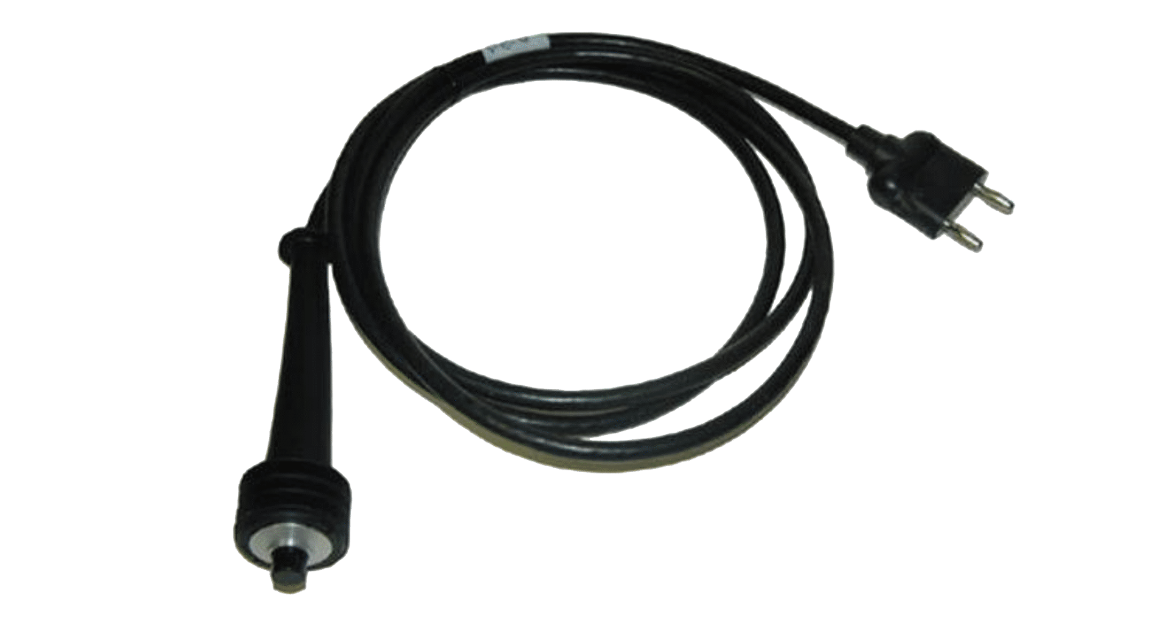
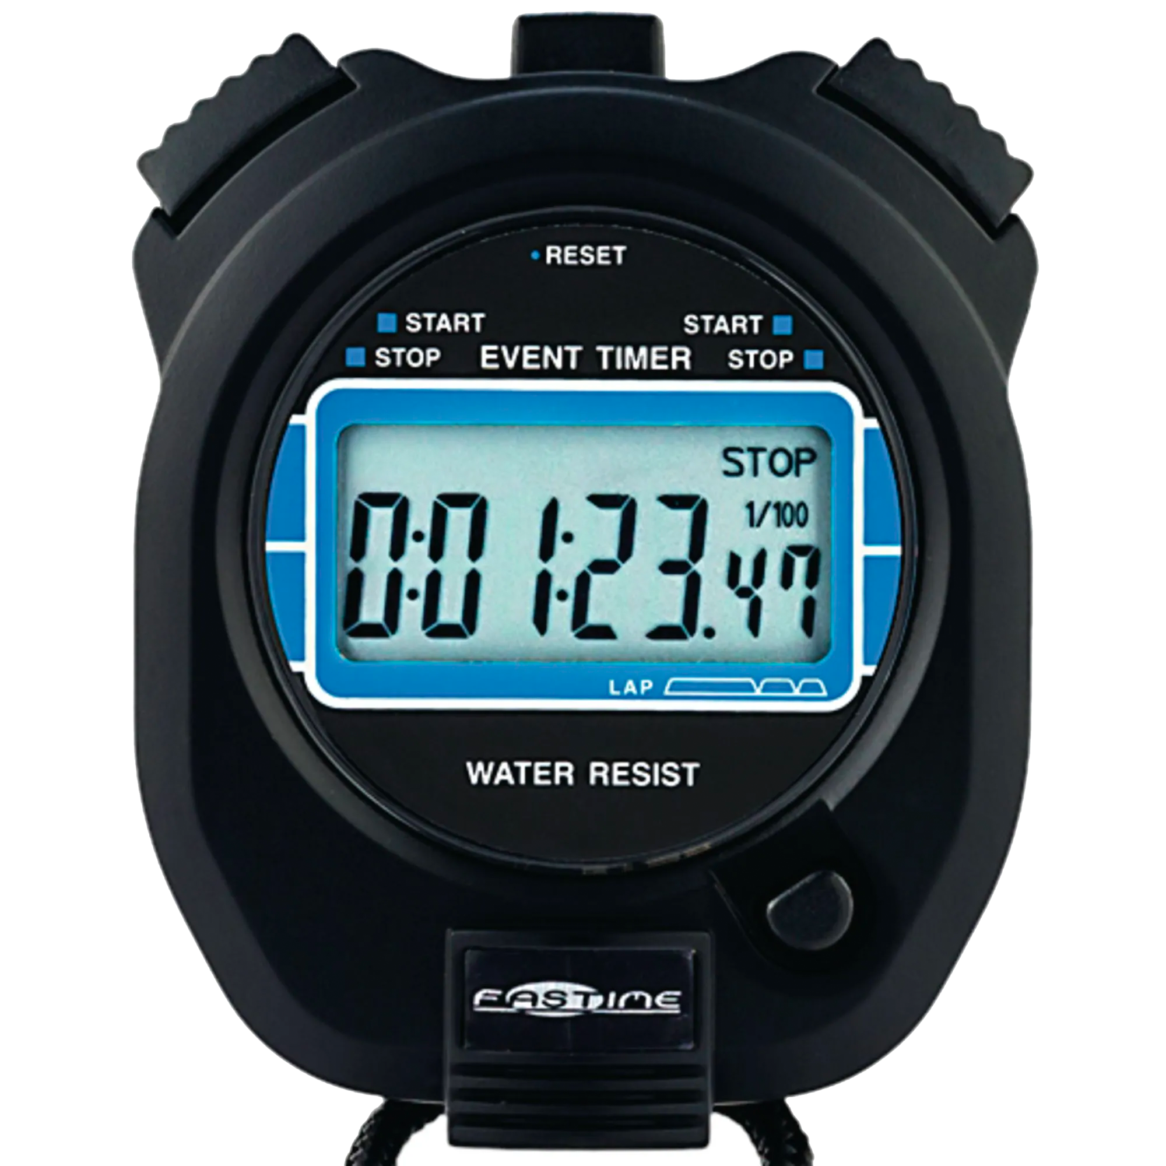
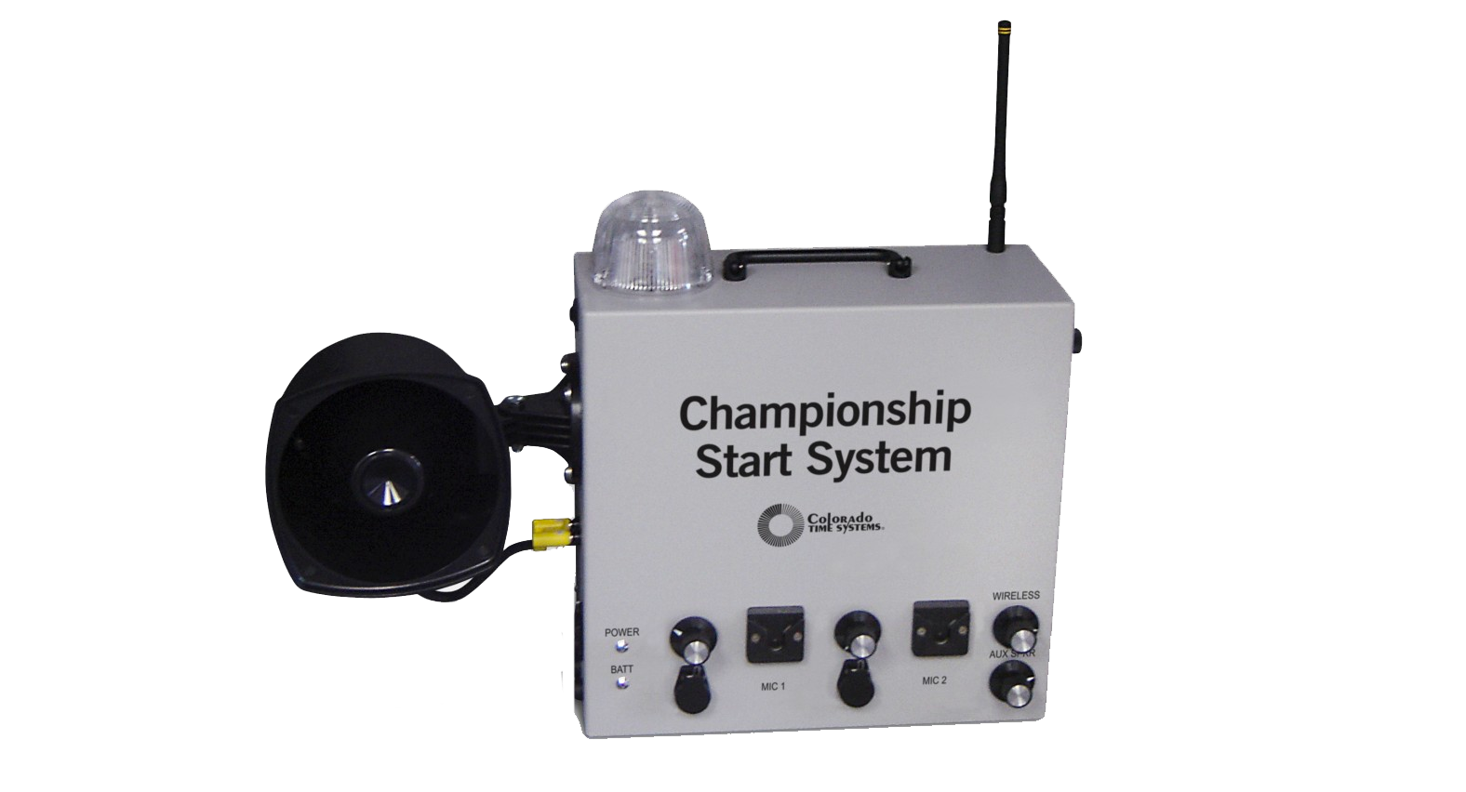
HOW TIMING WORKS | STOPWATCH, PICKLE + STROBE
You will be given 1-2 stop ( A ) watches per lane
You must look towards the strobe light ( C ) (located near officials) when swimmers are on blocks, when strobe flashes and you hear the beep you will press Start.
The other device you will hear about it “the pickle” ( B ) its attached to the starting block, timers will be responsible for hitting the pickle and the stopwatch at the same time at the end of each race.
When swimmer is on the last lap please stand and come to the end of the pool, lean over and press stop on both pickle and stopwatch when swimmers touches the wall
The pads on the wall of the lane is the “official time” the the pickle and the stopwatches are backup times
B
A
C

Slide 16
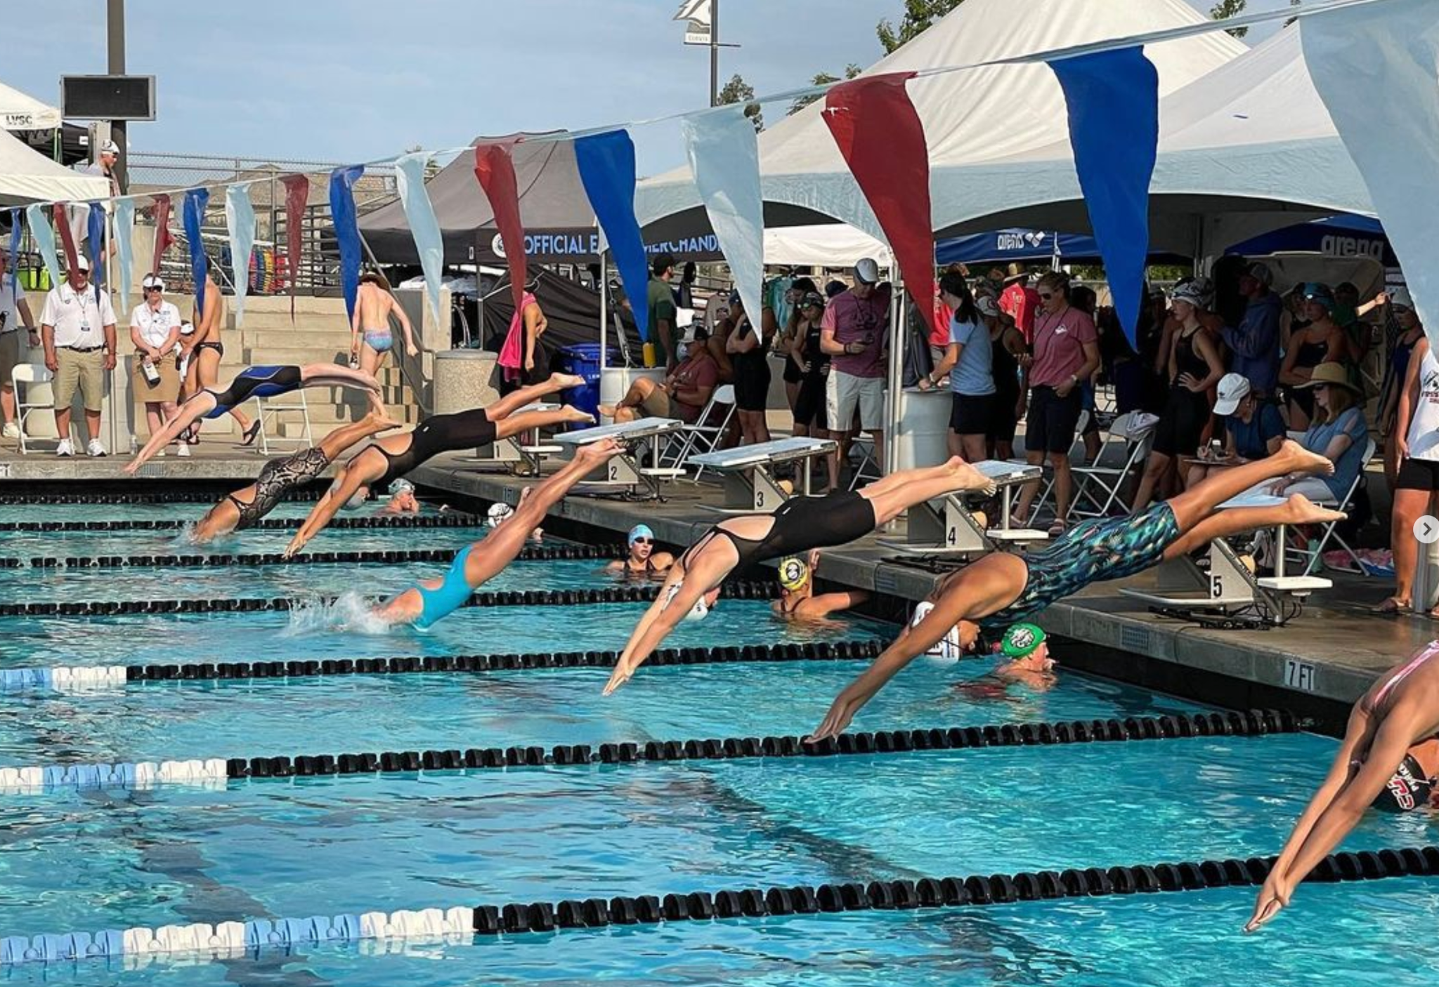
AN AVERAGE ROUTINE | RACE TIME!
As race approaches the swimmer should :
Check in with Coach
Determine Heat & Lane
Warm up in water
Report to Lane in plenty of time
Determine the Heat & Lane
After event swimmer should warm down (at least twice the distance of the race)
Check in with Coach after warm down

Slide 17
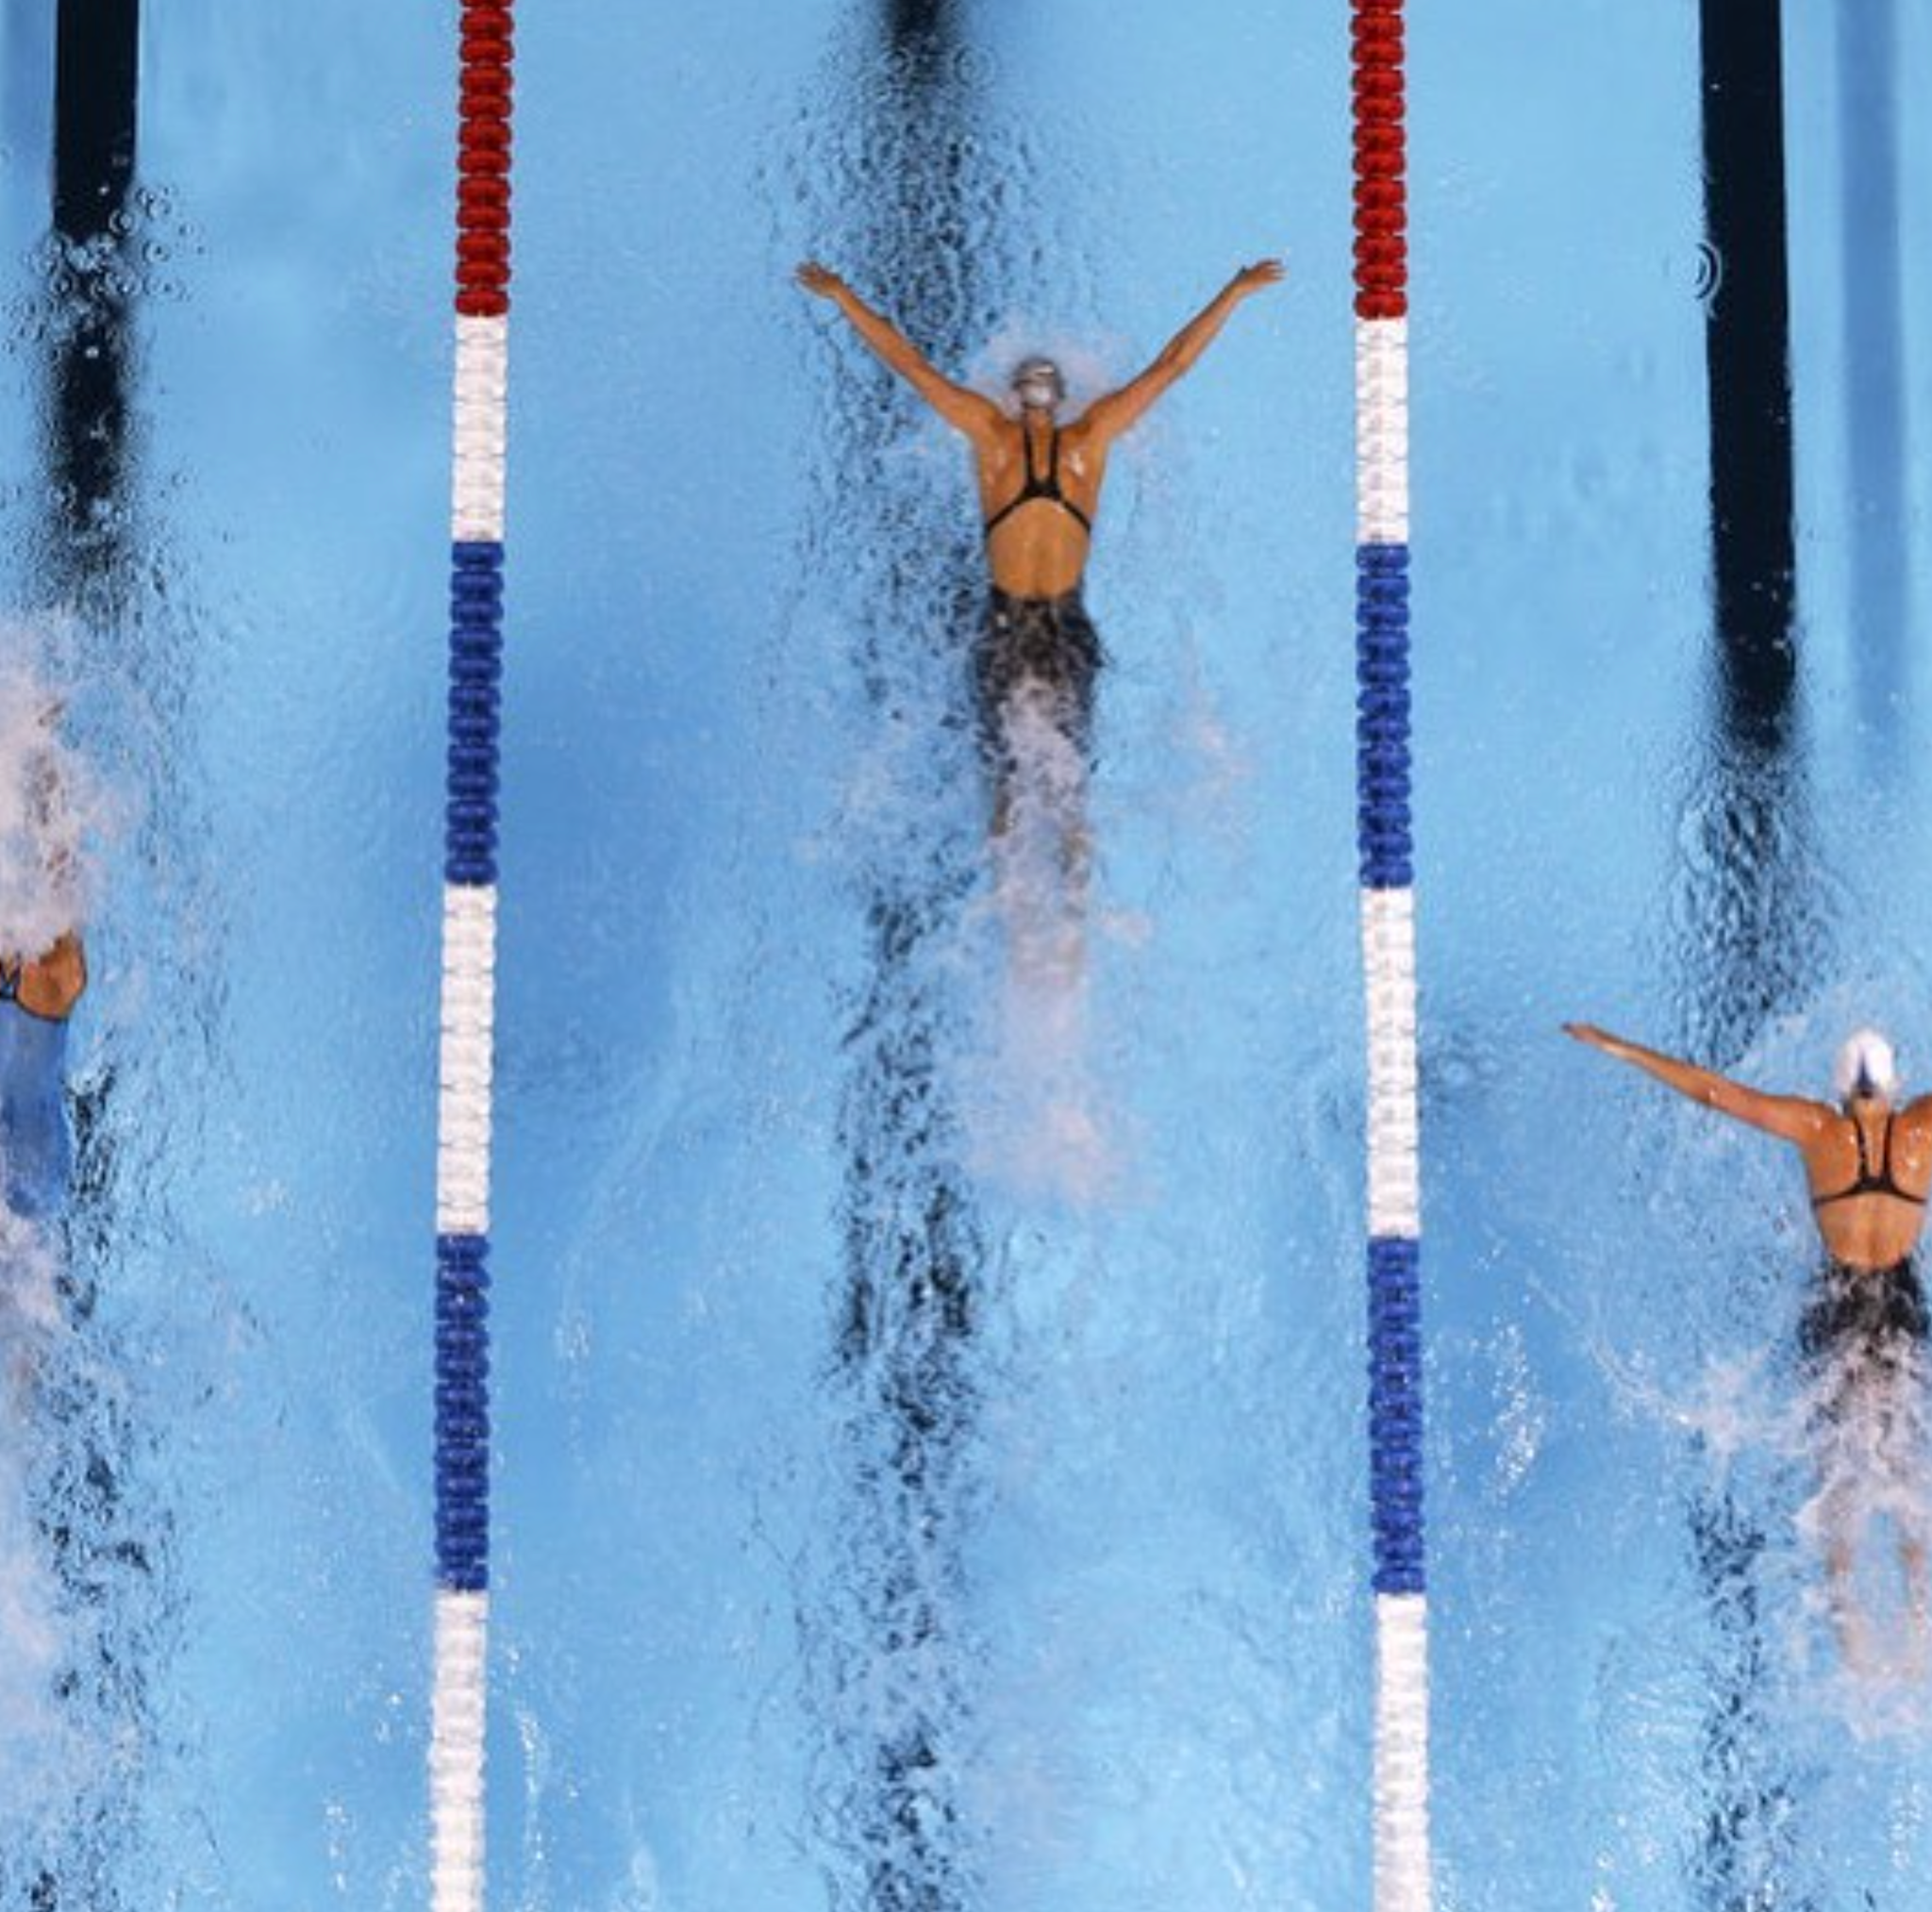
AN AVERAGE ROUTINE | BETWEEN RACES
WINTER MEET
Stay WARM!
Keep feet covered
Wear Parka!
SUMMER MEET
Stay HYDRATED!
Wear Sunscreen
Stay in Shade

Slide 18
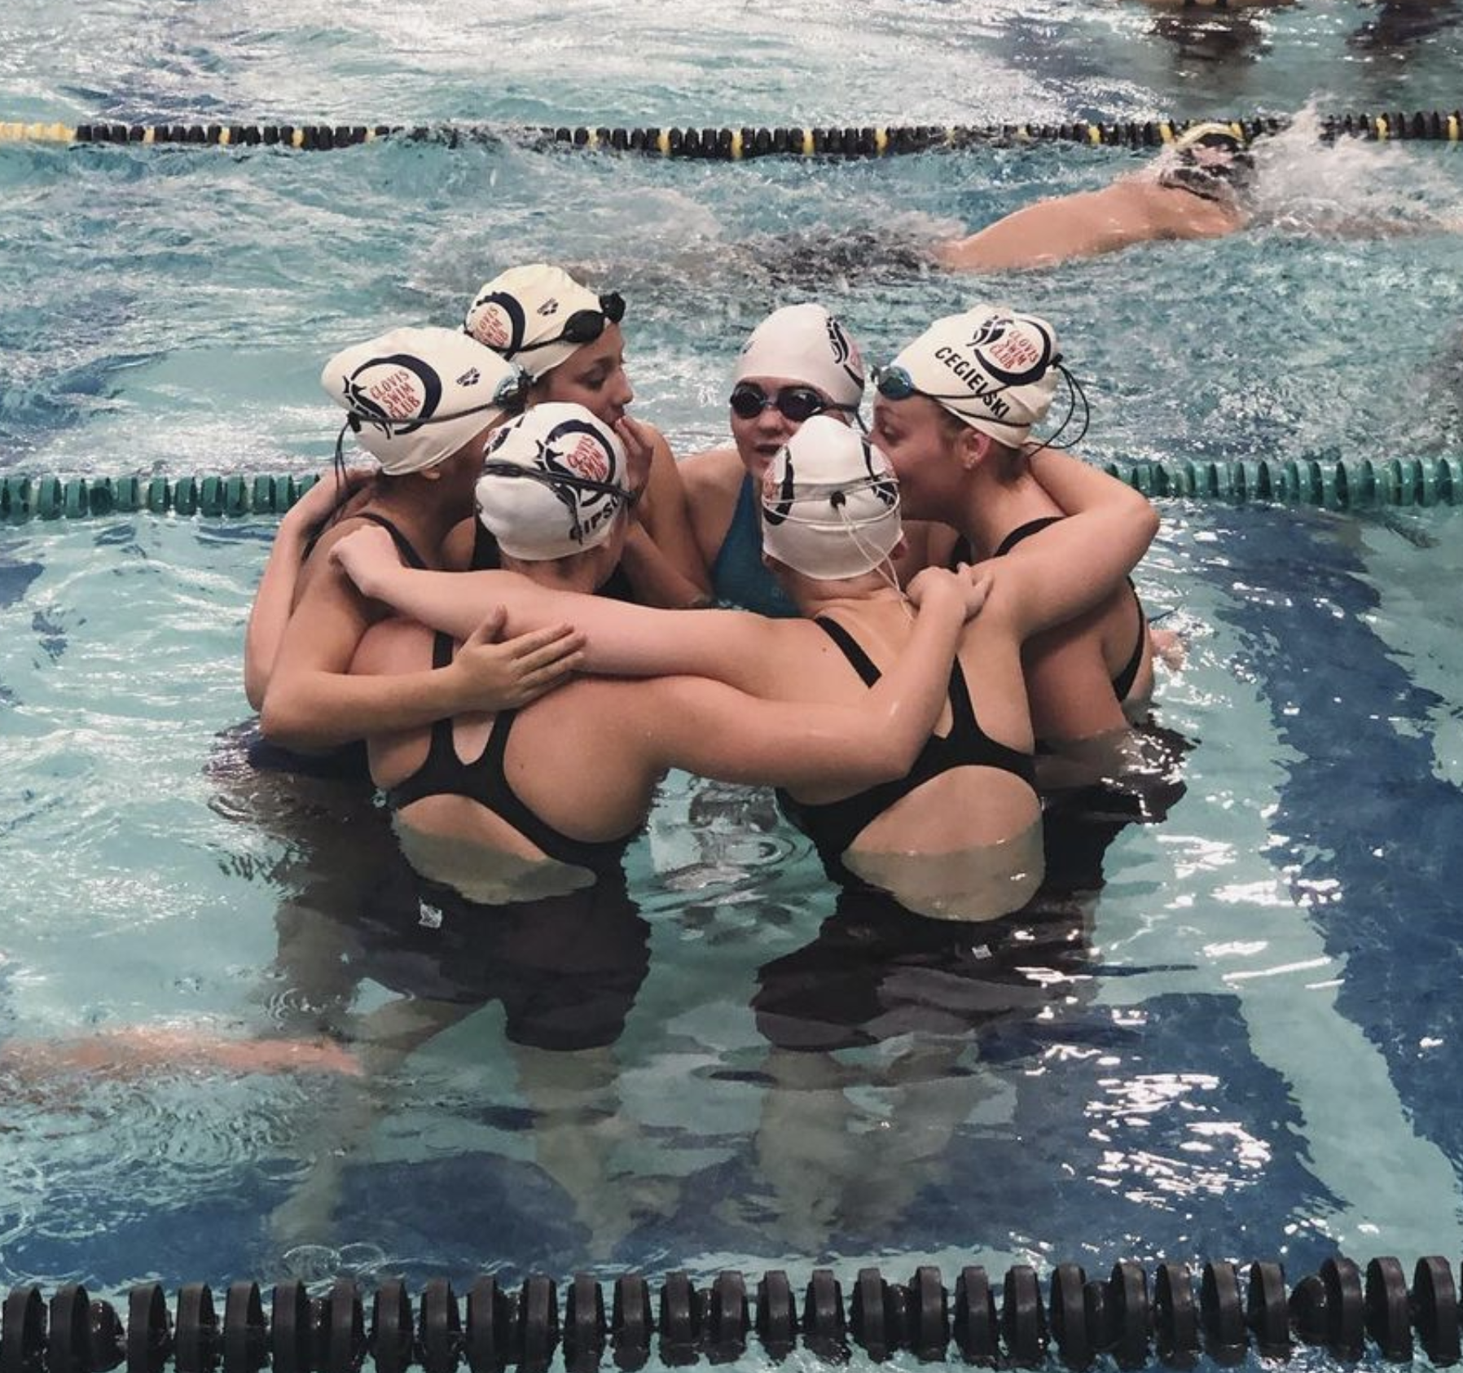
AN AVERAGE ROUTINE | BETWEEN RACES
Swimmer should rest and stay hydrated
Eat Healthy small snacks throughout meet
Cheer for other teammates
Keep team area clean

Slide 19



TECHNOLOGY | USEFUL APPS
Our Team homepage is CLOVIS SWIM CLUB
There are MANY aps for Free and Paid that are a great help
Meet Mobile (A) (VIP! Swim Meet Events and Times ) Meet Mobile
Swim Counts (B) ( swimmers swim times ) SwimCounts
OnDeck (C) ( times and information ) OnDeck
A
B
C

Slide 20
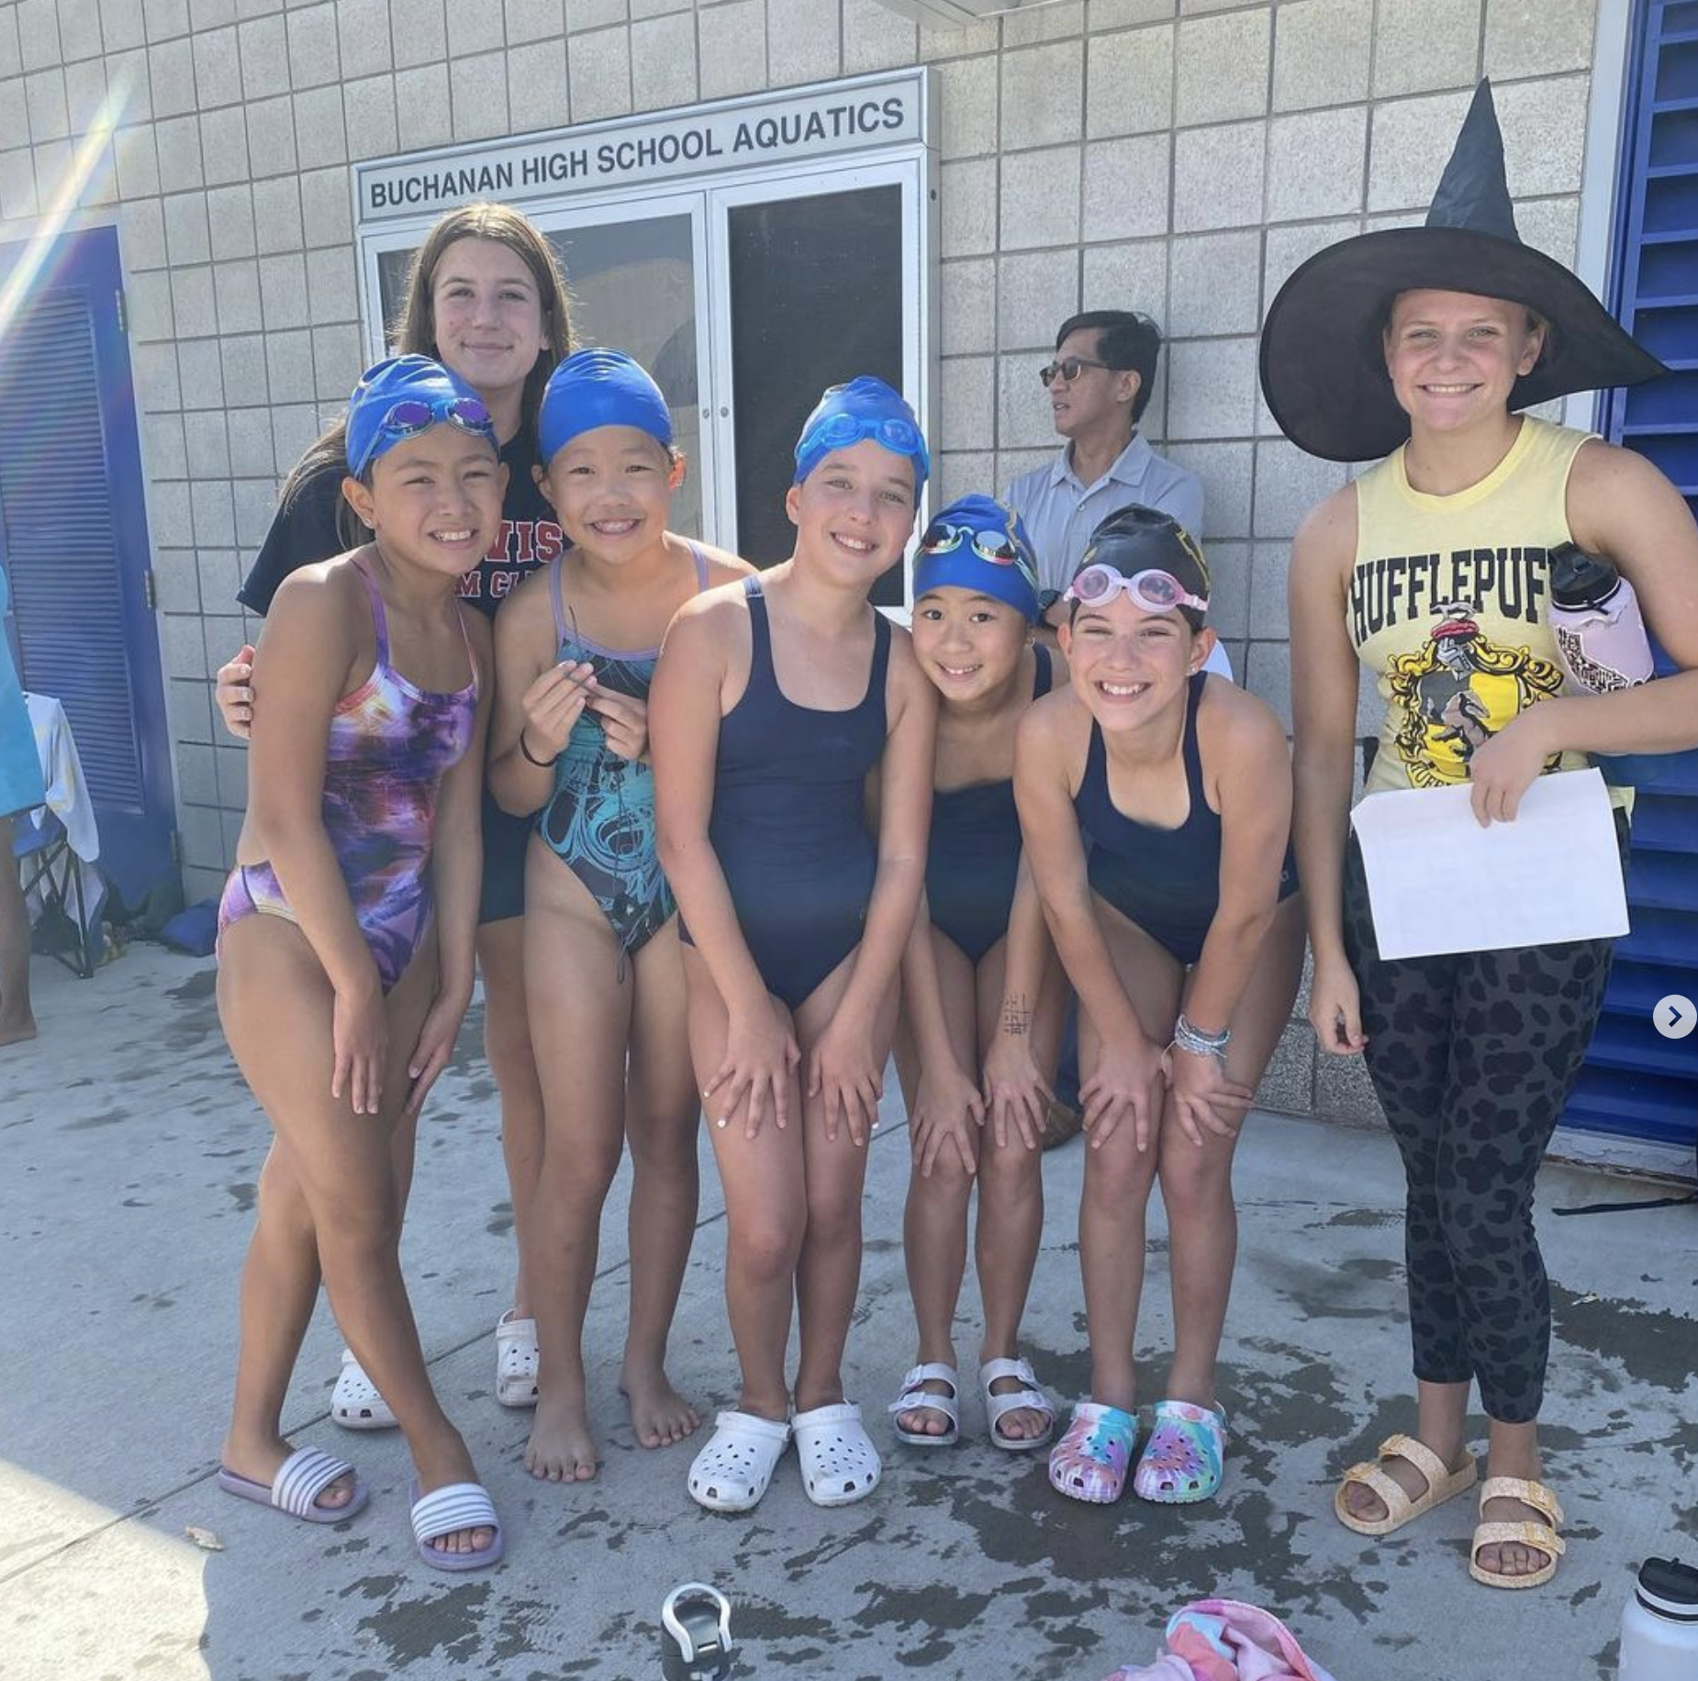
MOST IMPORTANTLY
Have fun! Enjoy the ride!
Please ASK if you need help at a meet there are several on deck parents and coaches willing to help you learn!
Thank you for your support to our club

