Slide 1
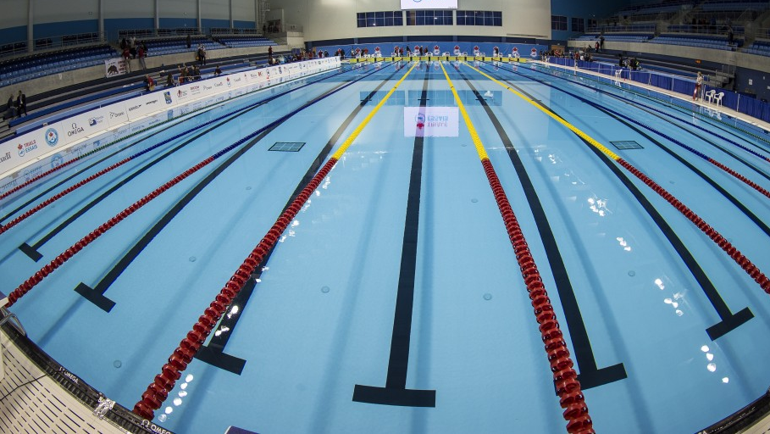
ASTS FALL INFORMATIONAL MEETING
08/13/2025

Slide 2
WELCOME TO ASTS : “ABOUT US”
Accokeek Stroke Technique Swim Team was established in 2013 as a technique-based program created to assist swimmers in stroke refinement and provide a competitive edge. Currently ASTS has become a competitive USA Swim Team and transformed into the present-day nonprofit organization in Southern Area Prince Georges and Northern Charles Counties centered around not only technique and goal-oriented swimming but to provide an opportunity for the community to learn to swim. ASTS participates in community food drives, mentorship program opportunities, and scholarships for families that are enduring financial hardships. As the team continues to grow, the core mission will remain the same, “preparing swimmers in the life sport of swimming.”
TOP TEAM COMPETITIVE ACCOMPLISHMENTS
ASTS Swim Team has produced Division II and III College Swimmers
Produced College, USA swim team, Prince-Mont, and High School head coaches
Appearances in Championship and National Meets

Slide 3

WELCOME TO USA SWIMMING
About USA Swimming
USA Swimming is the National Governing Body for the sport of swimming in the United States. We are a 400,000-member service organization that promotes the culture of swimming by creating opportunities for swimmers and coaches of all backgrounds to participate and advance in the sport through teams, events and education.
Our membership is comprised of swimmers from the age group level to the Olympic Team, as well as coaches and volunteers. Members can get involved through our more than 2,800 teams across the nation.
USA Swimming is also responsible for selecting and training teams for international competition including the Olympic Games, and strives to serve the sport through its core objectives including:
  • Build the base
  • Promote the sport
  • Achieve competitive success

Slide 4

ASTS SWIM TEAM GOVERNING BODY
POTOMAC VALLEY SWIMMING (PVS)
USA Swimming is the National Governing Body (NGB) for competitive swimming in this country. It is sub-divided into 59 local swimming committees (LSCs) which maintain jurisdiction over local swimming competition. Potomac Valley Swimming (PVS), the smallest in geographic area of the 59 LSCs, includes the District of Columbia, Montgomery and Prince George's counties in Maryland, and the counties of Fairfax and Arlington and the cities of Alexandria and Falls Church in Virginia. While small in area, PVS, with approximately 12,000 swimmers, is one of the largest in total number of swimmers in all of USA Swimming.
The approximately 45 member swim clubs in PVS offer competitive swim programs for the youth of this area from the novice to the Olympic competition level. Several World Record holders, past and present, have come out of PVS. Most of the PVS member clubs offer a variety of training levels, frequently at several locations and times and varying costs.
http://www.pvswim.org/

Slide 5
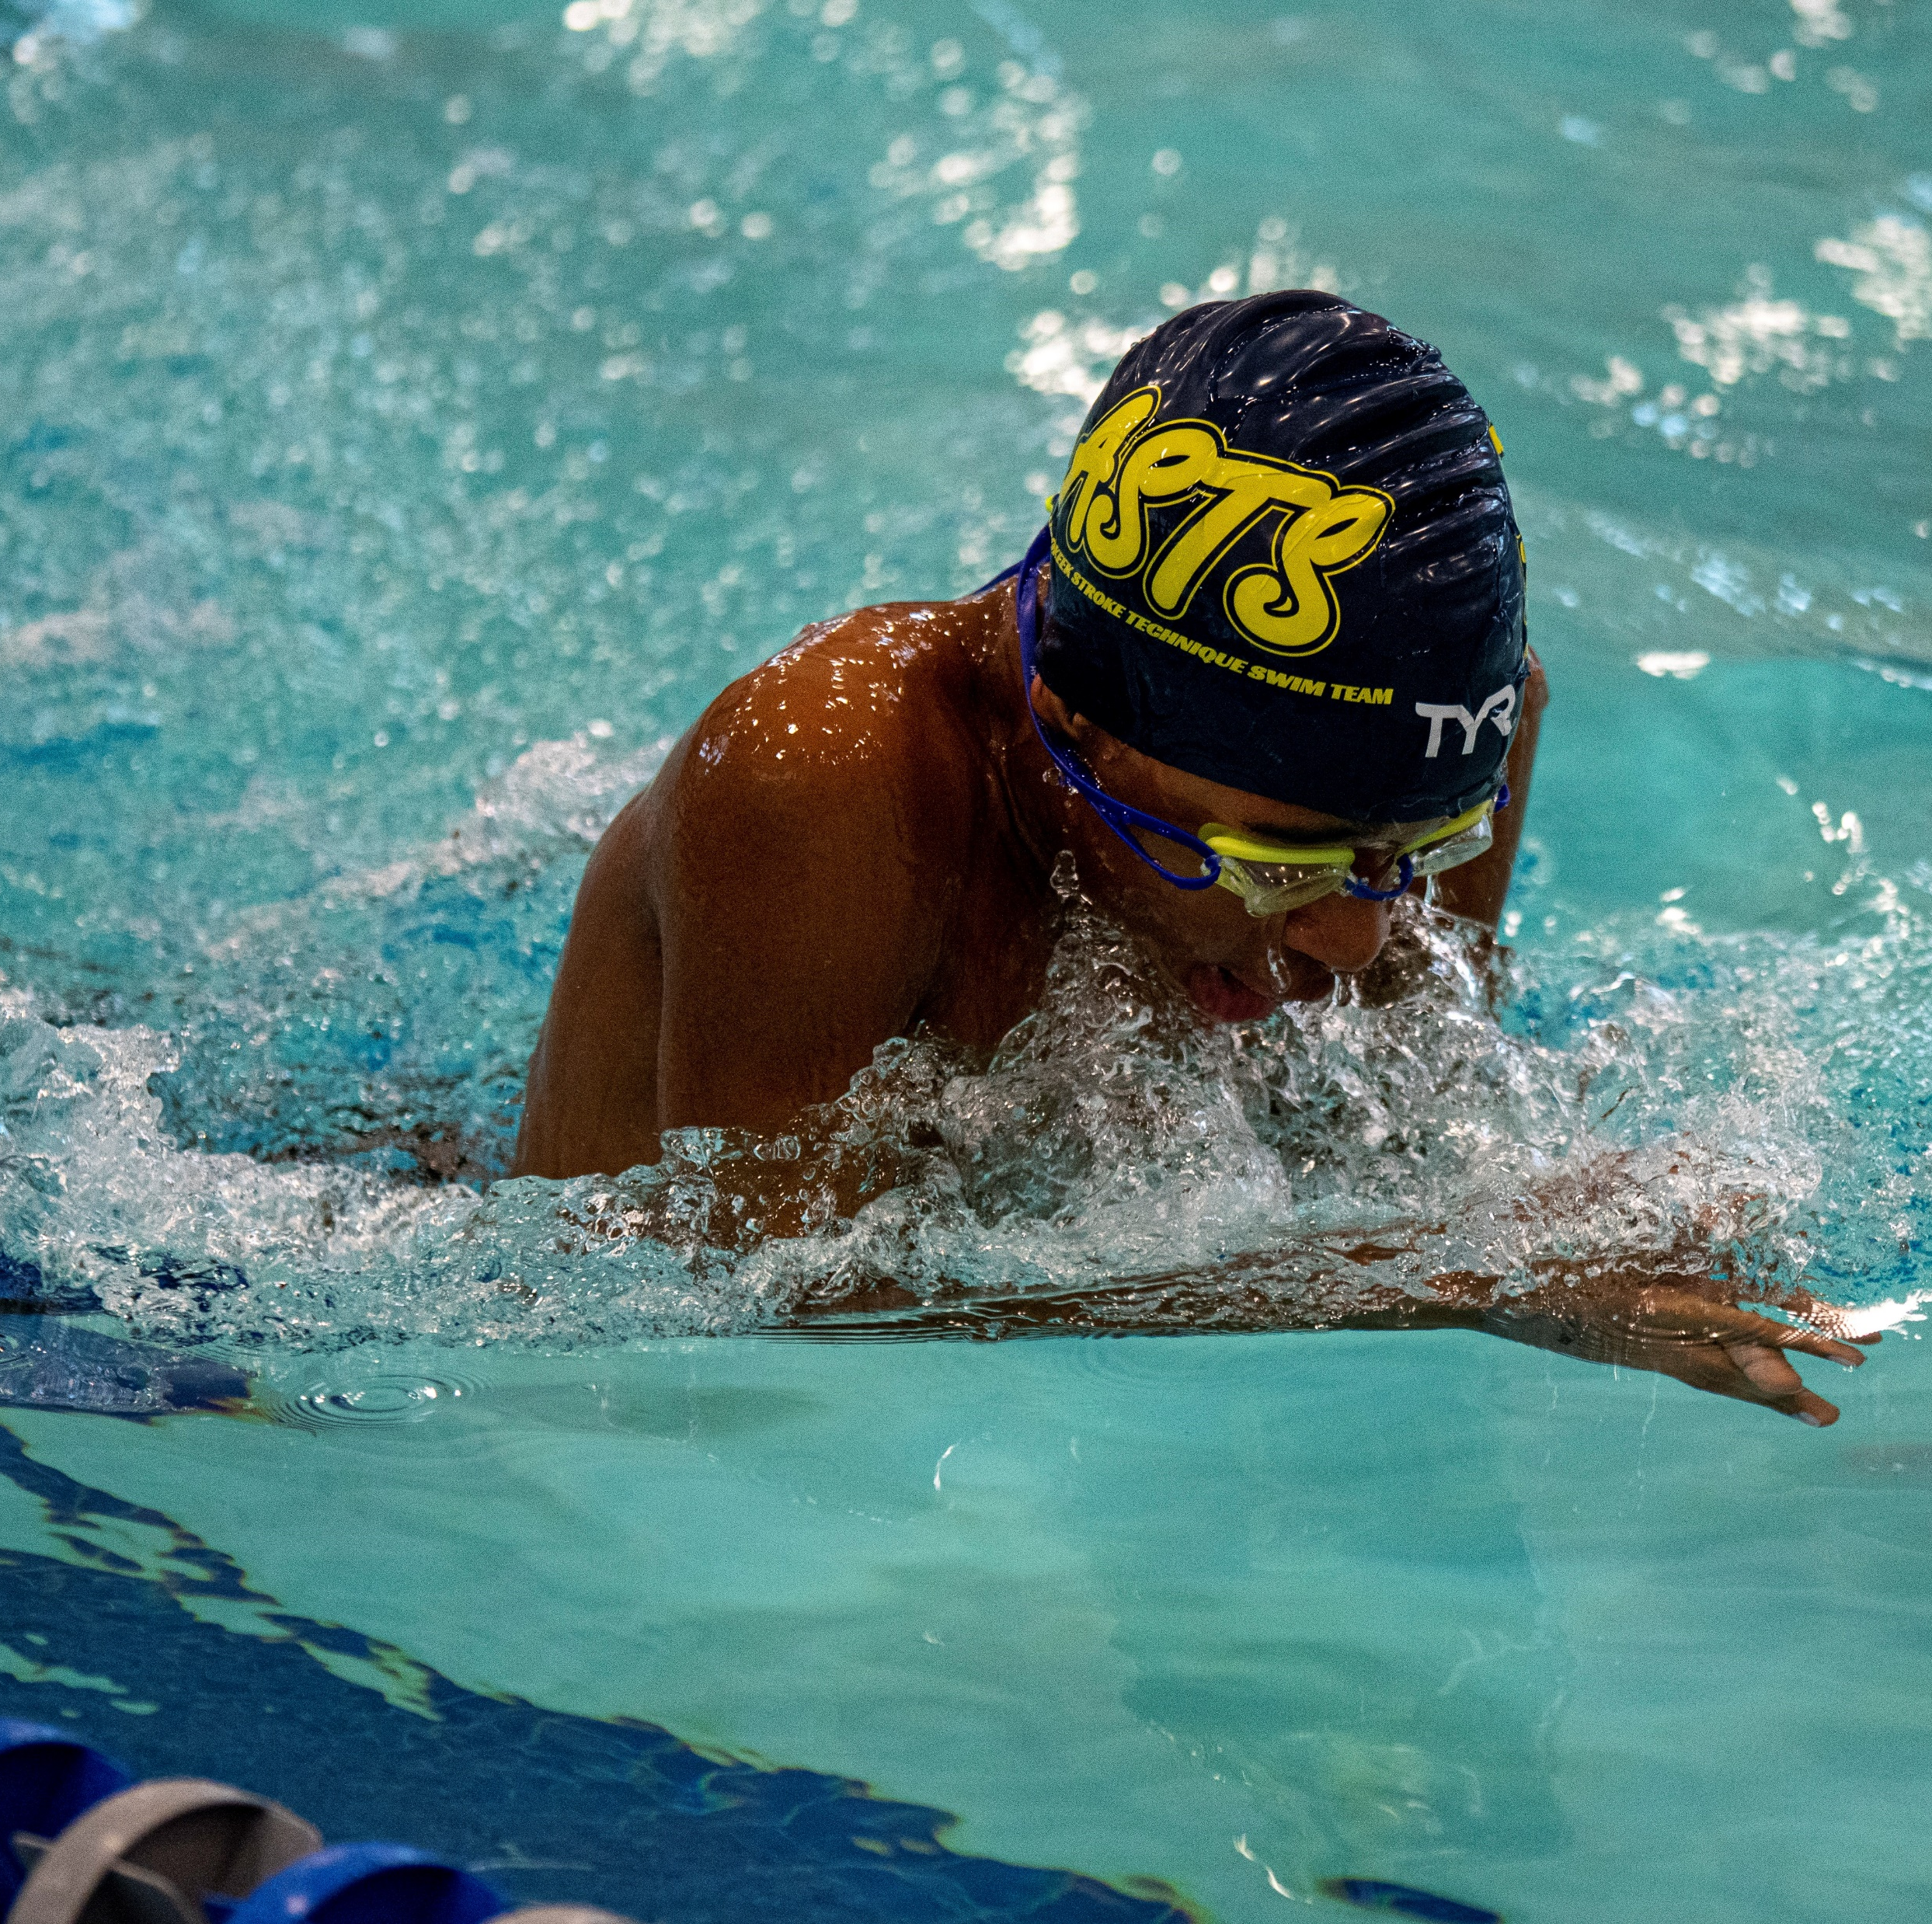
SWIMMING IS A SPORT
Professional Coaches
Competition
Injuries
Training
Practices
Seasons
Team-Mates
Team Requirements

Slide 6
ASTS SWIM TEAM
-VS-
SWIM LESSONS
SWIM LESSONS
  Frequent sign ups
  Classes fill up quickly
  Teach tactical / mechanics of swimming
  No endurance and speed training
  Only teach set skills within designated class
  Students must meet skills to move on to next level
  No competition
LEARN TO COMPETE
  1 sign up
  Group fills up quickly
  Learn 50 yrds freestyle, backstroke, simple dives by December (most within 2mths)
  Accelerated Program
  Endurance training along with mechanics

Slide 7
ASTS SWIM TEAM
-vs-
Prince-Mont Summer Swim
Winter Competition – USA Swimming
  Professional League
  Team Fall Season September-May
  Year around
    Short Course: September – March
    Long Course: April - August
  Open and LSC sponsored Championship Meets are pre-arranged through LSC a year in advanced
  Invitational Meets are set as placeholders a year in advanced
  Teams are ranked based on performance through USA Swimming
  Teams Schedules are determined by team and there are no set requirements on meet cadence and/participation
  Swim events and/or pool locations are sanctioned by USA swimming
  Times documented and used for college competition
  Times used for Olympic and/or FINA events
Summer Competition – Prince-Mont Swim League (PMSL)
  Recreational and used to introduce swim sport to Prince Georges, DC, Montgomery, Charles, and Anne Arundel Counties
  2 months practice and competition time
  Meets are pre-arranged 1 Year in advanced
  Teams are ranked according to points and swimmer performance
  Teams are placed in Divisions from A-F
  Regular season competitions are between two teams until Divisional and All-Star meets
  Swim events and/or pool locations are sanctioned by PMSL
  Times are tracked by www.reachforthewall.org and PMSL

Slide 8

LOCATIONS AND HEAD COACHING STAFF
North Point
“Southern Site”
TUES, THURS., FRI 6:15-8:30 PM
SAT. 9:30 -11:30 PM
SAARC
“Central Site”
MON, WED., FRI 5:30-8:30 PM
- “Central Site” is a midpoint location for ALL participants to attend if other pools are not available and if weekend practices are canceled. Swim team members assigned to Northern and Southern locations are welcome.
PGCC
“Northern Site”
MON – THURS. 6:30 – 8:00 PM
SITE COACH: ORLANDO PRACTICE TIMES (MON. – THURS.)
- If a practice is missed at northern and southern sites or if practice is canceled on the weekend, swimmers will attend the central site practices.
SITE COACH: JANISE “NEICY” HYSON PRACTICE TIMES (MON., WED., & FRI.)
Northern site practices will be at PG College.
SITE COACH: MARIA RAY PRACTICE TIMES (TUES., THURS., FRI. & Saturday )
- “Southern Site” offers practices on Saturday and Sunday for ALL swim team members regardless of site location and swim group. Practice schedule –Weekend Cancelations - When there are meets/events that include the full team or over 60 members, practices on the weekend will be canceled. Southern Site participants are expected to attend Central Site to makeup for the planned weekend cancelations.
The St. James
SUN. 9:30 – 11:30 AM
LONG COURSE PRACTICES SUNDAYS (SILVER, GOLD, AND PLATINUM ONLY!!!)

Slide 9
SWIM GROUPS LEARN TO COMPETE
This group will ONLY be held at SAARC and North Point (Starting September 2025).
ASTS Learn to Compete Program is designed for swimmers who are learning the mechanics of freestyle and backstroke. This group will allow swimmers the time and opportunity to build skills that will allow them to advance in the sport.
If your swimmer meets at least one of the following criteria below, they will need to swim sign up for this group.
  Do not meet the criteria of the Bronze group
  Learning to swim assisted by a coach
  Swimming experiences are swim lessons
  Have never competed either in a USA swim meet or summer recreational team ​
Criteria for Graduation:
  Legal in both freestyle and backstroke
  Must have a time in both the 50 freestyle and 50 backstroke in a USA Swimming Meet
  Ability to properly flip turn in both freestyle and backstroke
  Must compete in 3 or more meets during the season between (September - May)

Slide 10
SWIM GROUPS BRONZE
This group has been broken into three levels. Each level will have its degree of difficulty; however, the description of the category remains the same.
* Registration will remain the blanket group of Bronze. Swimmers will be grouped after try-outs by roster when the Fall Season begins
This group meets at ALL sites.
Designed for swimmers who are learning the mechanics of the four competitive strokes: freestyle, backstroke, breaststroke, and butterfly. Athletes in this group focus mainly on learning and becoming effective in all four legal competitive strokes, having fun, and competition. The practices will increasingly become harder overtime. At the time of registration, all swimmers that do not have the time standards for Silver are placed in Bronze 3.
Bronze 1
Must be able to swim a 50-yard freestyle and 50-yard backstroke unassisted and have met this criteria successfully in a USA Swim Meet.
Bronze 2
Must be able to swim a 50-yard freestyle, 50-yard backstroke, and 50-year breaststroke successfully in a USA Swim Meet.
Bronze 3
Must be able to swim a 50-yard freestyle, 50-yard backstroke, 50-year breaststroke, 50 butterfly, and 100 Individual Medley successfully in a USA Swim Meet.
Minimum Meet, Time, & Practice Requirements - Coach reserves the right to move swimmer back down to lower group for the entire season if swimmer does not stay competitive within level and/or meet below criteria:
Swimmer must attend 2 practices or more per week
Swimmer must attend 3 or more meets during the Fall Season (September - May)

Slide 11
SWIM GROUPS SILVER
Athletes in this group are usually between 11-12 years old. This group has been deemed effective in all four strokes and has competed previously in USA Swimming for at least one year and for a summer recreational league. All swimmers in this group must have four provable times. This group will use training methods conducive to building speed, endurance, and stroke proficiency while continuing to address technique.
11–12-year-old standard criteria:
Must have achieved four provable USA Swimming times at the 11-12 level
Two of the four events must be near the “B” standard
10 years old standard criteria:
Must have achieved four provable USA Swimming times
Two of four must be at the “B” standard and
The two remaining events must be near the “B” standard
This group meets at ALL sites.

Slide 12
SWIM GROUPS GOLD I - HIGH SCHOOL PREP
GOLD I – HIGH SCHOOL PREP GROUP - MEETS AT ALL SITES
*TRY-OUTS REQUIRED - INVITATION ONLY
This group meets at ALL sites
Athletes in this group are usually at 13 years old but with the times designated below could be accepted younger. This group has been deemed proficient in all four strokes and have competed in USA swimming for at least two years. All swimmers in this group must have six provable times. Swimmers must meet criteria in yards at the time of registration. *Summer swimmers will have try-outs and must meet a minimum qualifying time designated by Head Coach.
13 and older minimum criteria:
All swimmers that do not quite meet the platinum standard and are High School Swimmers
Must have achieved six provable USA Swimming and High School times
Swimmers must be proficient in all strokes

Slide 13
SWIM GROUPS – PLATINUM & GOLD II
*INVITATIONAL ONLY – MEETS ONLY AT SAARC
PLATINUM GROUP
This group meets exclusively at SAARC and will not be held at any other site from 6:30pm – 8:00pm
Athletes in this group are 13 and older. Must have achieved provable USA motivational time standards of at least the following in the 13 and older categories in yards at the time of registration. Summer swim times are “not” transferable.
GOLD II
11–12-year-old standard criteria:
  Must have achieved six provable USA Swimming times at the 11-12 level
  Three of six events must at the “B” standard
10 years old standard criteria:
  Must have achieved six provable USA Swimming times
  Three must be at the “BB” standard and
  The three remaining events must be at the “B” standard

Slide 14
Swim Group Overall Requirements
Platinum/Gold II
Swimmer must maintain "BB" times throughout the season to remain in this group.
Swimmer must attend 3 practices or more per week
Swimmer must attend 6 or more meets during the Fall Season (September - May)
Silver/ Gold I (High School Prep)
Swimmer must maintain the standard times described throughout the season to remain in this group
Swimmer must attend 3 practices or more per week
Swimmer must attend 5 or more meets during the Fall Season (September - May)
Bronze
Swimmer must attend 2 practices or more per week
Swimmer must attend 3 or more meets during the Fall Season (September - May)
MINIMUM MEET, TIME , & PRACTICE REQUIREMENTS
Coach reserves the right to move swimmer back down to lower group for the entire season if swimmer does not stay competitive within level and/or meet below criteria:

Slide 15
PRACTICE EQUIPMENT REQUIREMENTS
Kickboards
Pull-Buoys
Paddles (Silver/Gold/ Platinum ONLY)
Fins/training fins
Goggles
Caps
Snorkels (silver/gold/Platinum)

Slide 16
TEAM COMPETITION REQUIREMENTS
Fall Practice Schedule
All Team Members must be USA Swimming Registered
Team Members starting in LTC will become Bronze by end of season
Team Members from Bronze – Platinum will be required to attend meets during the season and the amount will differ according to group
ASTS Hosted Meets are REQUIRED – Swimmers will automatically be signed up

Slide 17
Deck Procedures
Practice
Parents are not allowed on deck while practice is commencing
Communication with coaches are either before practice or after practice
Meets
Parents are not allowed on deck unless volunteering at the meet
Swimmers must stay with their team until their last race is swum
Communication with coaches can be through text message (emergency purposes only)

Slide 18
ADMINISTRATIVE ITEMS
Payment is due 1st of each month
Late charges are automatically assessed by the 15th of every month
Meet fees assessed one week prior to the meet commencing
Parents sign swimmers up for meets except ASTS hosted meets
Swimmers can not be withdrawn one week prior to meet
If swimmers do not attend and are not withdrawn fees will still be assessed
Membership Cancellation or Pause
Fees previously paid are non-refundable
Notification must be received in writing to the club one month to the date of cancelation.
If invoice due date is past then amount for that month is due
Cancelation Penalty Charge is one month
There will be no monthly prorate
Questions
Please email ASTS.Teambox@gmail.com, or
Site Coaches

