Slide 1
GTS Handbook
2022-2023

Slide 2
Welcome
Welcome to the Greenwood Tiger Sharks and USA Swimming! This booklet will give you the structure and information about the GTS program. It includes parent expectations, swimmer expectations, what to expect from the coaching staff and other GTS information that must be signed annually to be part of the GTS team. We ask that you read this material carefully as we seek your cooperation and support in helping make your child’s membership with GTS a rewarding and worthwhile experience.

Slide 3
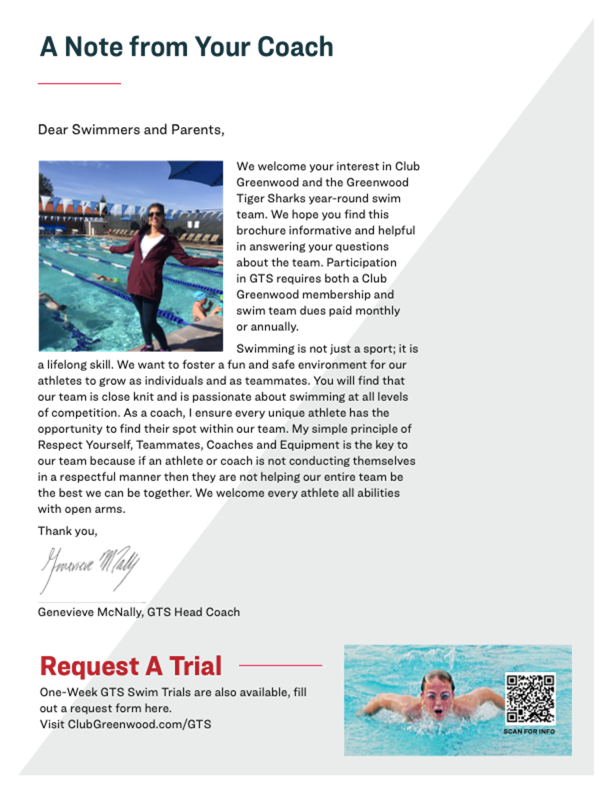

Slide 4
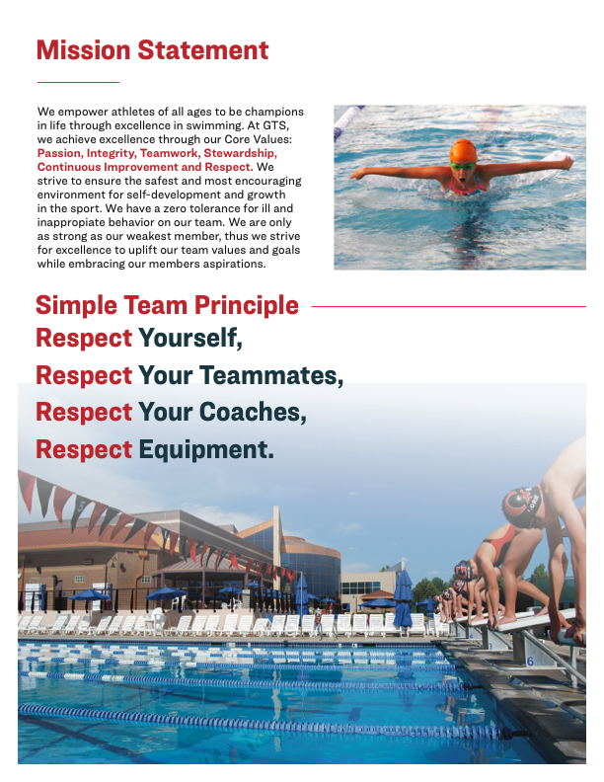

Slide 5
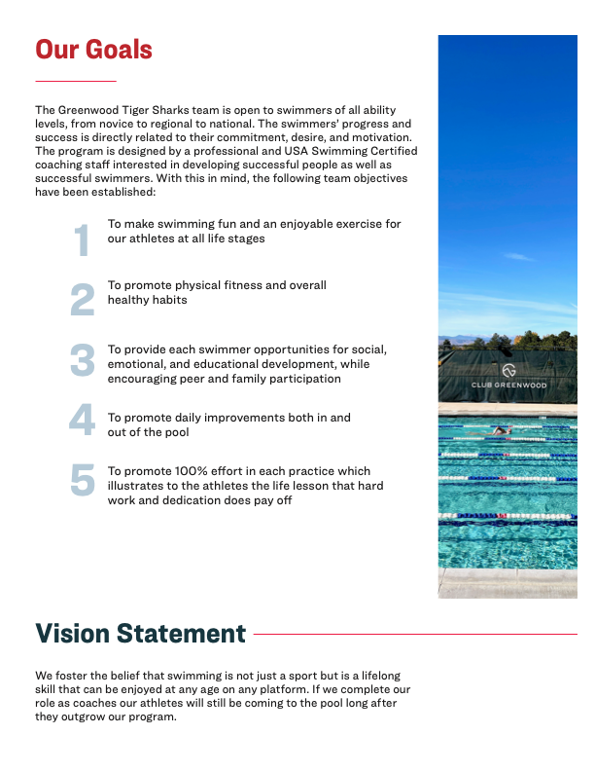

Slide 6
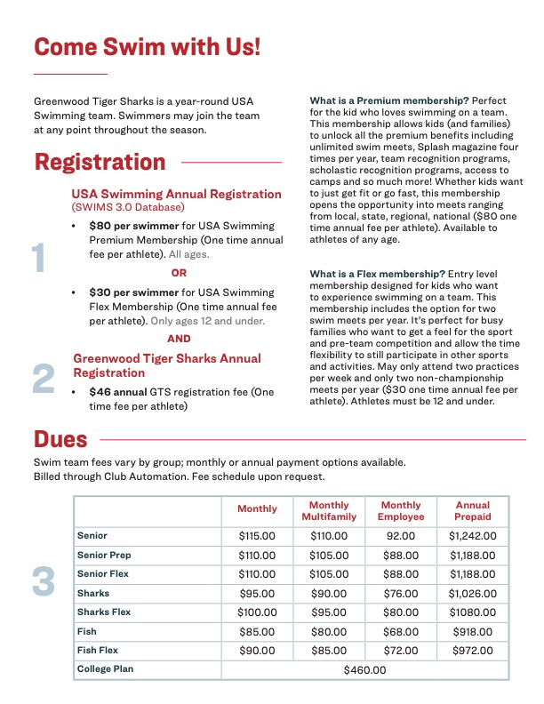

Slide 7

SAFE SPORT CLUB COORDINATOR
Crystal Garland (Interim)
Safe Sport Club Coordinator
crystalg@greenwoodatc.com

Slide 8
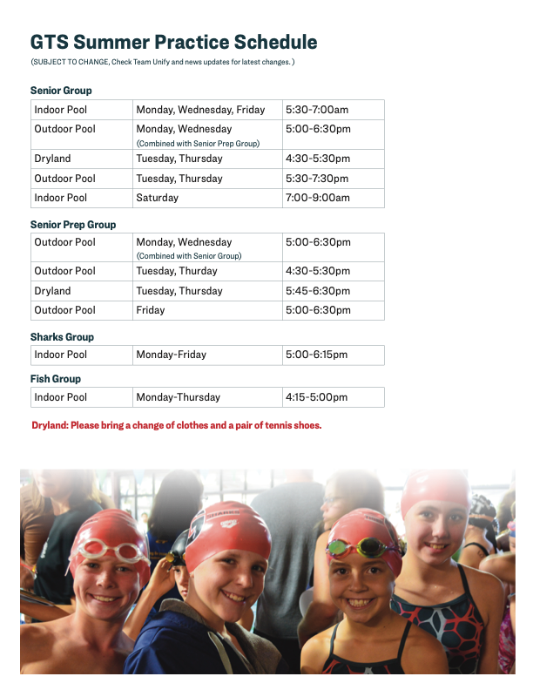

Slide 10
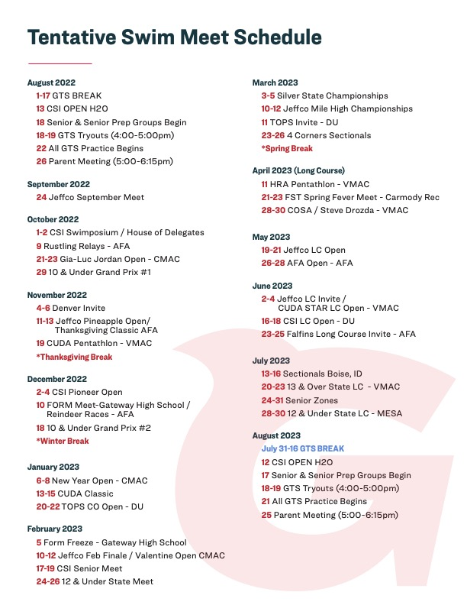

Slide 11
Groups
FISH
Four practices offered per week
Workouts are 45 minutes
Begin to use the pace clock, learning how to work on intervals
Expectations:
  Swim a length of the pool freestyle, butterfly, backstroke, and breaststroke
  Understand the difference between fly and breast
  Strokes must be swam legally
  Ability to focus and listen to instruction for an hour
SHARKS
Five practices offered per week
Workouts one hour and 15 minutes
Expectations:
  Be able to do freestyle flip-turns
  Be able to do backstroke flip-turns
  Be able to streamline to the flags
  200 IM legally
Work on refining all four strokes, turns, start work.
Proficient using pace clock, start to learn more complex intervals
Introduction to land training through teaching different body movements to improve ability in the water, such as push-ups, sit-ups, streamline jumps, body weight only etc.
Senior Prep
Five practices offered per week
Workouts range from one hour to one hour and 30 minutes with an additional 45 minutes of land training two days a week
Regular and consistent attendance required to travel, final decisions on all travel up to coach’s discretion
Focus on building endurance, while maintaining proper technique in order to limit injuries
Expectations:
  Know how to read the pace clock
  Complete all turns legally
  Finish a 400 IM legally
  Complete a 500 Free
  5X100@1:35
SENIOR
Six to seven practices offered per week, with two dryland practices
Practices range from one hour and thirty minutes to 2 hours
Expectations:
  Proficient in all four strokes, with only minor adjustments needed
  Clear idea of personal goals (long term and short term)
Focus on building endurance while maintaining proper technique in order to limit injuries
Regular and consistent attendance required to travel, final decisions on all travel up to coach’s discretion
Expectations:
  10x100 @1:25
NOTE:
All group moves will be discussed and ultimately decided by the coaching staff.
Group assignments are subject to change by the coaching staff at any time throughout the swim season.

Slide 12
Communications/Resources
Email is the primary communication from the team to parents/swimmers. When you receive your first informational email, please add the contact to your contact list in order to avoid emails being sent to your spam folder, and please let us know if you encounter any issues sending or receiving emails.
Text will be used sparingly and only in the case of a short notice situation (i.e. getting scratched into finals at meets). Both coaches will be included in on all communication. Further information can be found in the Electronic Communication Policy document.
Weekly newsletters will be sent via email every Sunday
  Information on schedule changes
  Meet information and entry reminders
  Other timely information
  Articles from coaches and other sources
Please refer to the following for additional information
www.clubgreenwood.com
www.greenwoodtigersharks.com
www.coloradoswimming.org
www.usaswimming.org

Slide 13
Meet Entries
Swimmers shall only attend “team designated” meets
Swimmers will have the ability to pick their events, however ALL ATHLETES are required to discuss their entries with their primary coach prior to the entry deadline
Coaches will make all final entry decisions
Entries must be submitted by the entry deadline; no late entries will be accepted – nor will deck entries be accepted at ANY team designated meet. Extraneous situations will be discussed on a case-by-case basis.
Any relevant notes to the entry regarding which days your child cannot attend etc. must be received by the entry deadline.
It is each swimmer’s responsibility to double check your entry and notify the head coach of any corrections
A meet entry report will be emailed out following entry deadlines
Entries will always be charged to your credit card on file, which must be kept up to date. Checks will not be accepted
  Regarding all billing questions contact Coach Genevieve, genevievem@clubgreenwood.com

Slide 14
Relay Entries
Coaches are always in charge of relays
If you cannot attend a meet with relays that you had entered, please inform the coaches ASAP
Always check with the coaches before leaving a meet to see if you are in any relays
Championship meet relays
Always the four fastest swimmers/best possible relay
It is the coach’s decision to enter ‘B’ relays and the coach’s responsibility to make sure ‘relay-only’ swimmers are available to attend the meet for a relay

Slide 15
Youth Certification
Youth certification is available to all members 14+ years and allows youth 14-17 years to utilize ALL areas of the club as an adult. The certification is one hour and involves a short quiz. Registration for the youth certification is complimentary and may be scheduled at the Service desk.
  This process is recommended for all Tiger Sharks 14+ years

Slide 16
Locker Rooms
If you are 14 and over and have obtained your youth certification, you may use the adult locker room without supervision. Swimmers 13 and under may use the adult locker room with adult supervision or use the family locker room
All towels and trash must be disposed of properly
Whirlpool (Hot tub), steam room and sauna are available to ONLY Youth Certified GTS

Slide 17
Deck Behavior / Equipment Storage
Pull buoys and kick boards must be placed back in the metal bins after practice
No equipment will be thrown
Towels must be placed in dirty towel bins
Water bottles must be taken with you when you are done with your workout
Pick up bobby pins, hair ties, band aids, etc. that you may have taken out or off prior to getting in the pool
All mesh bags must be placed properly in bins (Senior/Senior Prep) or taken home (Sharks/Fish)
Stretch cords are to be placed on the hooks in the GTS office
Equipment storage bin is to be locked by the Senior/Senior Prep swimmers. The code is “BULK.”

Slide 18
Club Parking Policy
We would like to make sure that all GTS families are aware of the parking policies at Club Greenwood. No cars, under any circumstances, may be parked along the red curbs in the front circle, even with a driver present. There are three drop-off spots, marked in white, for dropping off swimmers. This policy is very important for the safety of everyone and is not meant to inconvenience you. In the event of an emergency, emergency vehicles would need immediate and unimpeded access to the club. Please abide by these regulations and let us know if you have any questions.

Slide 19

Snow Day Cancellation
The Club is within the boundaries of the Cherry Creek school district; we consider the school district's decisions regarding school closures as best practice when producing perimeters for cancelling GTS practice and ultimately follow the precedence the district sets.
We always take the health and safety of our members into consideration when making any decisions.

Slide 20
GTS TEAM CODE OF CONDUCT: PARENTS
The purpose of a code of conduct for parents is to establish consistent expectations for behavior by parents. As a parent/guardian, I understand the important growth and developmental support that my child’s participation fosters. I also understand that it is essential to provide the coaching staff with respect and the authority to coach the team. I agree with the following statements:
I will set the right example for our children by demonstrating sportsmanship and always showing respect and common courtesy to the team members, coaches, competitors, officials, parents, and all facilities.
I will get involved by volunteering, observing practices, cheering at meets, and talking with my child and their coach about their progress.
I will refrain from coaching my child from during practices or meets
I understand that criticizing, name-calling, use of abusive language or gestures directed toward coaches, officials, volunteers, and/or any participating swimmer will not be tolerated.
I will respect the integrity of the officials.
I will direct my concerns to first to the head coach; then, if not satisfied, to the appropriate supervisor.
I will not drop off your swimmers with enough time to gather their equipment, change, fill water bottles and put on their cap and goggles, prior to practice start
I will not talk to coaches while they are coaching
I will arrive to meets 15 minutes prior to the start of warm up for team stretch; time will be designated in an email prior to the meet
I understand that the team will sit together on deck without parents and that parents are not allowed on deck with the coaches unless there is an emergency.
I will have my swimmer speak with their coach if they are disqualified.
I will encourage my swimmers to speak to the coaches before and after their races
I will volunteer at team designated meets by timing
I will email the coaches with any questions or concerns, keeping in mind that the coaches have a plan; contact information can be found on page four of the 2019-2020 Team Handbook
I understand that if my swimmers violate the Athlete Code of Conduct then there will be consequences that may include meetings with coaches, suspension from meets, practices and team activities, and/or removal from the team.
Note:
Please cc: both coaches on all GTS related emails
Office hours are posted on the GTS office window and should be used for meetings with the coaches
I understand the above expectations and that my failure to adhere to them may result in disciplinary action.
________________________________________
Print Family Name
___________________________________ _____________________
Parent Signature Date

Slide 21
GTS TEAM CODE OF CONDUCT: ATHLETES
The purpose of a code of conduct for athletes is to establish a consistent expectation for athletes’ behavior. By signing this code of conduct, I agree to the following statements:
I will always respect and show courtesy to my teammates and coaches.
I will demonstrate good sportsmanship at all practices and meets.
I will set a good example of behavior and work ethic for my younger teammates.
I will be respectful of my teammates’ feelings and personal space. Swimmers who exhibit sexist, racist, homophobic, or otherwise inappropriate behavior will be faced with consequences.
I will attend and be on time to all team meetings and training sessions, unless I am excused by my coach.
I will show respect for all facilities and other property (including locker rooms) used during practices, competitions, and team activities.
I will refrain from foul language, violence, behavior deemed dishonest, offensive, or illegal.
If I disagree with an official’s call, I will talk with my coach and not approach the official directly.
I will obey all of USA Swimming’s rules and codes of conduct.
I will bring all equipment to every practice and appropriate gear/apparel to meets.
I will know my schedule.
If I must get out early, I will inform the coach on deck prior to getting in for warm-up
If I am going to miss practice, I will let my coaches know 24 hours in advance.
I will make sure I am ready for warm-up prior to coming on deck for team stretching.
I will arrive at meets 15 minutes prior to warm-up start; time designated in team emails.
I understand that the team will sit together on deck at meets.
I will speak to my coaches before and after my races.
I will warm-up before and cool-down after every race.
I will keep open communication with my coach regarding individual and team goals.
I understand that office hours are posted on the office door and should be used for meetings with the coaches
I will have Fun!
I understand that if I violate this code of conduct, I will be subject to disciplinary action determined by my coaches that may include suspension from meets, practices and team activities, and/or removal from the team.
_____________________________________
Print Name
_________________________________ _____________________
Swimmer’s Signature Date
_________________________________ _____________________
Parent’s Signature Date

Slide 22
GTS Team Code of Conduct: Coach
The purpose of this code of conduct for coaches is to establish common expectations for all members of the coaching staff of the club. It is to be used as a guide to promote a positive team environment and good sportsmanship.
I will always, adhere to USA Swimming’s rules and code of conduct.
I will set a good example of respect and sportsmanship for participants and fans to follow.
I will instruct participants in sportsmanship and demand that they display good sportsmanship.
I will act and dress with professionalism and dignity in a manner suitable to his/her profession.
I will respect officials and their judgment and abide by the rules of the event.
I will treat opposing coaches, participants, and spectators with respect.
I will coach in a positive manner and do not use derogatory comments or abusive language.
I will win with humility and lose with dignity.
I will treat every athlete fairly, justly, impartially, intelligently, and with sensitivity.
I will always place the well-being, health, and safety of swimmers above all other considerations, including developing performance.
I will continue to seek and maintain their own professional development in all areas in relation to coaching and teaching children.
I will always maintain a professional separation between coach and athlete.
I will be USA Swimming registered and current on all required certifications.
I will come prepared to coach every day.
I will keep the team unified during all team functions and designated meets.
I will support and encourage the swimmers and the other coaches, while guiding the swimmers love for the sport.
I will work in strategic and fair partnership with the other coaches, ensuring the team comes first.
I will check and respond to emails and voicemails daily, except when traveling for a meet.
I will be on time to office hours.
I will be willing to set up meetings with swimmers and parents, outside of office hours by appointment only.
I will make it Fun!
Any complaints of a coach violating this code of conduct will be brought to the attention of his/her supervisor and/or the club’s management.
_____________________________________________________
Print Name
_____________________________________________________ _______________
Coaches Signature Date

Slide 23
Electronic Communication
PURPOSE The Greenwood Tiger Sharks Swim Team (the “Club”) recognizes the prevalence of electronic communication and social media in today’s world. Many of our swimmers use these means as their primary method of communication. While the Club acknowledges the value of these methods of communication, the Club also realizes that there are associated risks that must be considered when adults use these methods to communicate with minors.
GENERAL CONTENT All communications between a coach or other adult and an athlete must be professional in nature and for the purpose of communicating information about team activities. The content and intent of all electronic communications must adhere to the USA Swimming Code of Conduct regarding Athlete Protection.
For example, as with any communication with an athlete, electronic communication should not contain or relate to any of the following:
• drugs or alcohol use;
• sexually oriented conversation; sexually explicit language; sexual activity
• the adult’s personal life, social activities, relationship or family issues, or personal problems
• inappropriate or sexually explicit pictures
• Note: Any communication concerning an athlete's personal life, social activities, relationship or family issues or personal problems must be transparent, accessible and professional.
Whether one is an athlete, coach, board member or parent, the guiding principle to always use in communication is to ask: “Is this communication something that someone else would find appropriate or acceptable in a face-to-face meeting?” or “Is this something you would be comfortable saying out loud to the intended recipient of your communication in front of the intended recipient’s parents, the coaching staff, the board, or other athletes?”
With respect to electronic communications, a simple test that can be used in most cases is whether the electronic communication with swimmers is Transparent, Accessible and Professional.
Transparent: All electronic communication between coaches and athletes should be transparent. Your communication should not only be clear and direct, but also free of hidden meanings, innuendo and expectations.
Accessible: All electronic communication between coaches and athletes should be considered a matter of record and part of the Club’s records. Whenever possible, include another coach or parent in the communication so that there is no question regarding accessibility.
Professional: All electronic communication between a coach and an athlete should be conducted professionally as a representative of the Club. This includes word choices, tone, grammar, and subject matter that model the standards and integrity of a staff member.
If your communication meets all three of the T.A.P. criteria, then it is likely your method of communication with athletes will be appropriate.
FACEBOOK, MYSPACE, BLOGS, AND SIMILAR SITES Coaches may have personal Facebook (or other social media site) pages, but they are not permitted to have any athlete member of the Club join their personal page as a “friend.” A coach should not accept any “friend” request from an athlete. In addition, the coach should remind the athlete that this is not permitted. Coaches and athletes are not permitted to “private message” each other through Facebook. Coaches and athletes are not permitted to “instant message” each other through Facebook chat or other IM method.
The Club has an official Facebook page that athletes and their parents can “friend” for information and updates on team-related matters.
Coaches are encouraged to set their pages to “private” to prevent athletes from accessing the coach’s personal information.
TEXTING Subject to the general guidelines mentioned above, texting is allowed between coaches, parents and athletes during the hours from 7am until 9pm. Texting only shall be used for the purpose of communicating information directly related to team activities.
EMAIL Athletes, parents and coaches may use email to communicate between the hours of 7am and 9pm. When communicating with an athlete through email, a parent, another coach, or a board member must also be copied.
REQUEST TO DISCONTINUE ALL ELECTRONIC COMMUNICATIONS The parents or guardians of an athlete may request in writing that their child not be contacted by coaches through any form of electronic communication.

Slide 24
Photography Policies
PURPOSE
There has been much talk about whether it is safe to have images taken of children participating in sports. While the great majority of images are appropriate and are taken in good faith, it is a fact that images can be misused, and children can be put at risk if common- sense procedures are not observed.
1. The publishing of a minor athlete’s photograph (under 18) either on a notice board or in a published article or video recording (including video streaming) of swimming competitions (“publication”) should only be done with parents’ consent per the attached form.
2. A parent or guardian has the right of refusal to have their children photographed. The exercise of this right of refusal cannot be used as grounds for refusing entry into a swimming competition. Therefore, a publisher of any photo of a minor that may go to press or on a notice board, be it through a member of the club or official photographer, must receive parental consent before publishing/displaying the photo, preferably in writing.
In the case of open meets and other competitions where the host club has an official photographer present, all parents attending should be made aware of this in the meet information. If photos are to be published anywhere, the individual parent should be given the opportunity to withhold their consent. Their right to do so should be specifically drawn to their attention.
All photographs must observe generally accepted standards of decency, in particular:
1. Action shots should be a celebration of the sporting activity and not a sexualized image in a sporting context.
2. Action shots should not be taken or retained where the photograph reveals a torn or displaced swim suit.
3. Photographs should not be taken from behind swimming blocks at the start of a race or exhibit a child climbing out of the swimming pool.
4. Photography of any kind is strictly prohibited in locker-rooms or bathrooms.

Slide 25
Photography Consent Form
The Greenwood Tiger Sharks Swim Team may wish to take photographs (individual and in groups) of swimmers under the age of 18 that may include your child during their membership in the club. All photos will be taken and published in line with club policy (found below). The club requires parental consent to take and use photographs.
Parents have a right to refuse agreement to their child being photographed.
As the parent/caregiver of __________________ I allow the following:
Take photographs to use on the club’s secure website
Consent given Consent refused
Take photographs to include with newspaper articles
Consent given Consent refused
Take photographs to use on athletic club notice boards / FYI
Consent given Consent refused
Video for training purposes only
Consent given Consent refused
Signed: ______________________________________________________________
Dated: ______________________________________________________________
Please return this form to: __WWPBA Safe Sport Coordinator_
I hereby grant permission to Greenwood Tiger Sharks Swim Team to use my likeness (or my child's likeness) in a photograph on its website or in other official club printed publications without payment or any other consideration.
I acknowledge the Club’s rights to crop and treat the photograph at its discretion. I understand that the club may choose not to use my photo at this time but may do so at its own discretion at a later date. I also understand and agree that these materials will become property of Greenwood Tiger Sharks Swim Team and will not be returned.
I hereby hold harmless and release and forever discharge Greenwood Tiger Sharks Swim Team from all claims, demands, and causes of action, which I, my heirs, representatives, executors, administrators, or any other persons acting on my behalf or on my estate’s behalf have or may have by reason of this authorization.
I understand that once my image is posted on Greenwood Tiger Sharks website, the image can be downloaded by any computer user. Therefore, I agree to indemnify and hold harmless from any claims the following:
• Club Greenwood Employees
• Greenwood Tiger Shark Employees
I am 21 years of age and am competent to contract in my own name or am doing so on behalf of my child(ren) under the age of 21 years. I have read this release and I fully understand the contents, meaning, and impact of this release.

Slide 26
Locker Room Monitoring Policy
PURPOSE
The following guidelines are designed to maintain personal privacy as well as to reduce the risk of misconduct in locker rooms and changing areas.
FACILITIES
The following is a description of our practice facilities to allow athletes and their families to plan their use: We practice at: Club Greenwood. This location has a changing area that is shared with the general public. As such, there are likely to be people who are not associated with Greenwood Tiger Sharks in the changing area around the time of practice.
MONITORING
General Policy Considerations Coaches and staff make every effort to recognize when an athlete goes to the locker room or changing area during practice and competition and, if they do not return in a timely fashion, we will check on the athlete’s whereabouts.
We discourage parents from entering locker rooms and changing areas unless it is truly necessary. In those instances, it should only be a same-sex parent. If this is necessary, parents should let the coach or administrator know about this in advance.
If an athlete needs assistance with his or her uniform or gear (for example, a child under the age of eight), or an athlete’s disability warrants assistance, then we ask that parents let the coach or an administrator know beforehand that he or she will be helping the athlete.
The Greenwood Tiger Sharks have staggered practices, with different groups arriving and departing throughout the day. It is therefore not practical to constantly monitor locker rooms and changing areas over this extended course of time. While we do not post staff, coach, parent, other adults inside or at the doors of the locker rooms and changing areas, we do make occasional sweeps of these areas. Staff, coach, parent, and other adults conduct these sweeps, with women checking on female locker rooms, and men checking on male locker rooms.

Slide 27
USE OF CELL PHONES AND OTHER MOBILE RECORDING DEVICES
Cell phones and other mobile devices with recording capabilities, including voice recording, still cameras and video cameras increase the risk for different forms of misconduct in locker rooms and changing areas. The USA Swimming Athlete Protection Policies prohibit the use of such devices in the locker room or other changing area:
305.3 Use of audio or visual recording devices, including a cell phone camera, is not allowed in changing areas, rest rooms or locker rooms.

Slide 28
Team Travel Policy
Purpose: Athletes are most vulnerable to misconduct during travel, particularly overnight stays. This includes a high risk of athlete‐to‐athlete misconduct. During travel, athletes are often away from their families and support networks, and the setting – new changing areas, locker rooms, workout facilities, automobiles, and hotel rooms – is less structured and less familiar.
Team Travel is defined as overnight travel to a swim meet or other team activity that is planned and supervised by the club or LSC.
Section 1 ‐USA Swimming Required Policies
Club travel policies must be signed and agreed to by all athletes, parents, coaches and other adults traveling with the club. (305.5.D)
Team managers and chaperones must be members of USA Swimming and have successfully passed a USA Swimming‐administered criminal background check. (305.5.B)
Regardless of gender, a coach shall not share a hotel room or other sleeping arrangement with an athlete (unless the coach is the parent, guardian, sibling, or spouse of that particular athlete). (305.5.A)
When only one athlete and one coach travel to a competition, the athlete must have his/her parents’ (or legal guardian’s) written permission in advance to travel alone with the coach. (305.5C)
Athletes must attend 90% of the offered practices the month prior to the meet.
Section 2 ‐ Team Travel Policies
During team travel, when doing room checks, attending team meetings and/or other activities, two‐deep leadership and open and observable environments should be maintained.
Athletes should not ride in a coach’s vehicle without another adult present who is the same gender as the athlete unless prior parental permission is obtained.
During overnight team travel, if athletes are paired with other athletes they shall be of the same gender and should be a similar age. Where athletes are age 13 & over, chaperones and/or team managers would ideally stay in nearby rooms. When athletes are age 12 & under, chaperones and/or team managers may stay with athletes. Where chaperones/team managers are staying in a room with athletes, they should be the same gender as the athlete and written consent should be given by athlete’s parents (or legal guardian).
When only one athlete and one coach travel to a competition, at the competition the coach and athlete should attempt to establish a “buddy” club to associate with during the competition and when away from the venue.
To ensure the propriety of the athletes and to protect the staff, there will be no male athletes in female athlete’s rooms and no female athletes in male athlete’s rooms (unless the other athlete is a sibling or spouse of that athlete).
A copy of the Club Code of Conduct must be signed by the athlete and his/her parent or legal guardian.
Team or LSC officials should obtain a signed Liability Release and/or Indemnification Form for each athlete.
Team or LSC officials should carry a signed Medical Consent or Authorization to Treat Form for each athlete.
Curfews shall be established by the team or LSC staff each day of the trip.

Slide 29
Inclusion of Transgender Athletes
DEFINITIONS
Transgender: a person whose gender identity does not match the person’s sex at birth Gender identity: a person’s deeply-felt internal sense of being male or female
Gender expression: a person’s external characteristics and behaviors that are socially defined as either masculine or feminine (i.e., dress, speech, mannerisms, social interactions)
POLICY
A minor transgender athlete member a swim club should be allowed to participate in accordance with his or her gender identity, irrespective of the gender listed on the athlete’s birth certificate or other records and regardless of whether the athlete has undergone any medical treatment. The policy should not prevent an athlete from electing to participate in an activity according to his or her assigned birth gender.
This means an athlete who is biologically female but has a male gender identity should be allowed to participate in male events and an athlete who is biologically male but has a female gender identity should be allowed to participate in female events.
When an athlete (and/or the athlete’s parents) discloses a transgender identity, coaches should request a change of the athlete’s gender in SWIMS by contacting Membership or Safe Sport staff at USA Swimming. Once this is completed, the athlete will be able to be entered in events that match his/her gender identity.
At all times, teammates, coaches, and all others should respect the confidentiality of transgender athletes. Discussion or disclosure of an individual’s gender identity should only take place after expressed permission is given by the individual or the individual’s parents.
In all cases, teammates, coaches, and all others should refer to transgender athletes by the athlete’s preferred name. Similarly, in all cases, pronoun references to transgender athletes should reflect the athlete’s gender and pronoun preferences.
Transgender athletes should be able to use the locker rooms, changing facilities, and restrooms that are consistent with his/her gender identity. When requested, transgender athletes should be provided access to a gender-neutral space (i.e., family restroom).
Prior to meets, without violating an athlete’s confidentiality, coaches should communicate with the meet host regarding expectations for treatment of transgender athletes in the pool, on deck, and in the locker room.
When overnight travel is involved, transgender athletes should be assigned to share hotel rooms based on their gender identity. Athletes who request extra privacy should be accommodated whenever possible.
Transgender athletes should be permitted to dress consistently with their gender identities, including warm-ups and team gear.
Transgender athletes should be permitted to wear whatever swimsuit is most comfortable for them, so long as the suit does not extend below the knee or past the shoulders.
Clubs should provide training to their staff and regular volunteers regarding their responsibilities to prevent, identify, and respond to bullying, harassment, and discrimination. Such topics should include terms and concepts of gender identity and expression and bystander intervention strategies related to bullying. Contact USA Swimming Safe Sport staff for training program recommendations.
The USA Swimming Code of Conduct specifies that discrimination against any member or participant on the basis of gender, sexual orientation, and gender expression is prohibited (304.3.3).
In the event that a question should arise about whether an athlete’s request to participate in a manner consistent with his/her gender identity is bona fide, USA Swimming will refer to the Code of Conduct and follow its standard procedures of enforcement.

Slide 30
Action Plan to Address Bullying
PURPOSE
Bullying of any kind is unacceptable at Greenwood Tiger Sharks (the “Club”) and will not be tolerated. Bullying is counterproductive to team spirit and can be devastating to a victim. The Club is committed to providing a safe, caring and friendly environment for all of our members. If bullying does occur, all athletes and parents should know that incidents will be dealt with promptly and effectively. Anyone who knows that bullying is happening is expected to tell a coach, board member or athlete/mentor.
Objectives of the Club’s Bullying Policy and Action Plan:
To make it clear that the Club will not tolerate bullying in any form.
To define bullying and give all board members, coaches, parents and swimmers a good understanding of what bullying is.
To make it known to all parents, swimmers and coaching staff that there is a policy and protocol should any bullying issues arise.
To make how to report bullying clear and understandable.
To spread the word that Greenwood Tiger Sharks takes bullying seriously and that all swimmers and parents can be assured that they will be supported when bullying is reported.
WHAT IS BULLYING?
The USA Swimming Code of Conduct prohibits bullying. Generally, bullying is the use of aggression, whether intentional or not, which hurts another person. Bullying results in pain and distress.
The USA Swimming Code of Conduct defines bullying in 304.3.7. Bullying is the severe or repeated use by one or more USA Swimming members of oral, written, electronic or other technological expression, image, sound, data or intelligence of any nature (regardless of the method of transmission), or a physical act or gesture, or any combination thereof, directed at any other member that to a reasonably objective person has the effect of:
causing physical or emotional harm to the other member or damage to the other member’s property;
placing the other member in reasonable fear of harm to himself/herself or of damage to his/her property;
creating a hostile environment for the other member at any USA Swimming activity;
infringing on the rights of the other member at any USA Swimming activity; or materially and substantially disrupting the training process or the orderly operation of any USA Swimming activity (which for the purposes of this section shall include, without limitation, practices, workouts and other events of a member club or LSC).
REPORTING PROCEDURE
An athlete who feels that he or she has been bullied is asked to do one or more of the following things:
Talk to your parents;
Talk to a Club Coach, Board Member, or other designated individual;
Write a letter or email to the Club Coach, Board Member, or other designated individual;
Make a report to the USA Swimming Safe Sport staff.
There is no express time limit for initiating a complaint under this procedure, but every effort should be made to bring the complaint to the attention of the appropriate club leadership as soon as possible to make sure that memories are fresh and behavior can be accurately recalled and the bullying behavior can be stopped as soon as possible.
HOW WE HANDLE BULLYING
If bullying is occurring during team-related activities, we STOP BULLYING ON THE SPOT using the following steps:
Intervene immediately. It is ok to get another adult to help.
Separate the kids involved.
Make sure everyone is safe.
Meet any immediate medical or mental health needs.
Stay calm. Reassure the kids involved, including bystanders.
Model respectful behavior when you intervene.

Slide 31
Bullying Approach:
If bullying is occurring at our club or it is reported to be occurring at our club, we address the bullying by FINDING OUT WHAT HAPPENED and SUPPORTING THE KIDS INVOLVED using the following approach:
FINDING OUT WHAT HAPPENED
First, we get the facts.
  Keep all the involved children separate.
  Get the story from several sources, both adults and kids.
  Listen without blaming.
  Don’t call the act “bullying” while you are trying to understand what happened.
  It may be difficult to get the whole story, especially if multiple athletes are involved or the bullying involves social bullying or cyber bullying. Collect all available information.
2. Then, we determine if it's bullying. There are many behaviors that look like bullying but require different approaches. It is important to determine whether the situation is bullying or something else.
Review the USA Swimming definition of bullying;
To determine if the behavior is bullying or something else, consider the following questions:
  What is the history between the kids involved?
  Have there been past conflicts?
  Is there a power imbalance? Remember that a power imbalance is not limited to physical strength. It is sometimes not easily recognized. If the targeted child feels like there is a power imbalance, there probably is.
  Has this happened before? Is the child worried it will happen again?
Remember that it may not matter “who started it.” Some kids who are bullied may be seen as annoying or provoking, but this does not excuse the bullying behavior.
Once you have determined if the situation is bullying, support all of the kids involved.
SUPPORTING THE KIDS INVOLVED
  Support the kids who are being bullied
    Listen and focus on the child. Learn what’s been going on and show you want to help. Assure the child that bullying is not their fault.
    Work together to resolve the situation and protect the bullied child. The child, parents, and fellow team members and coaches may all have valuable input. It may help to:
Ask the child being bullied what can be done to make him or her feel safe. Remember that changes to routine should be minimized. He or she is not at fault and should not be singled out. For example, consider rearranging lane assignments for everyone. If bigger moves are necessary, such as switching practice groups, the child who is bullied should not be forced to change.
Develop a game plan. Maintain open communication between the Club and parents. Discuss the steps that will be taken and how bullying will be addressed going forward.
Be persistent. Bullying may not end overnight. Commit to making it stop and consistently support the bullied child.
4. Address bullying behavior
Make sure the child knows what the problem behavior is. Young people who bully must learn their behavior is wrong and harms others.
Show kids that bullying is taken seriously. Calmly tell the child that bullying will not be tolerated. Model respectful behavior when addressing the problem.
Work with the child to understand some of the reasons he or she bullied. For example:
  Sometimes children bully to fit in or just to make fun of someone is a little different from them. In other words, there may be some insecurity involved.
  Other times kids act out because something else—issues at home, abuse, stress—is going on in their lives. They also may have been bullied. These kids may be in need of additional support.
Involve the kid who bullied in making amends or repairing the situation. The goal is to help them see how their actions affect others. For example, the child can:
  Write a letter apologizing to the athlete who was bullied.
  Do a good deed for the person who was bullied, for the Club, or for others in your community.
  Clean up, repair, or pay for any property they damaged.
Avoid strategies that don’t work or have negative consequences:
  Zero tolerance or “three strikes, you’re out” strategies don’t work. Suspending or removing from the team swimmers who bully does not reduce bullying behavior. Swimmers may be less likely to report and address bullying if suspension or getting kicked off the team is the consequence.
  Conflict resolution and peer mediation don’t work for bullying. Bullying is not a conflict between people of equal power who share equal blame. Facing those who have bullied may further upset kids who have been bullied.
Follow-up. After the bullying issue is resolved, continue finding ways to help the child who bullied to understand how what they do affects other people. For example, praise acts of kindness or talk about what it means to be a good teammate.
Support bystanders who witness bullying. Every day, kids witness bullying. They want to help, but don’t know how. Fortunately, there are a few simple, safe ways that athletes can help stop bullying when they see it happening.
  Be a friend to the person being bullied;
  Tell a trusted adult – your parent, coach, or club board member;
  Help the kid being bullied get away from the situation. Create a distraction, focus the attention on something else, or offer a way for the target to get out of the situation. “Let’s go, practice is about to start.”
  Set a good example by not bullying others.
  Don’t give the bully an audience. Bullies are encouraged by the attention they get from bystanders. If you do nothing else, just walk away.

Slide 32
Anti Dopping
CLEAN SPORT 101
You can find information on this page regarding the testing policies, protocols and the organizations working for Clean Sport. You can also visit the United States Anti-Doping Agency (USADA's) Anti-Doping 101 for detailed information on a variety of important topics that encompass anti-doping responsibilities for athletes, coaches, parents and athlete support personnel.
Resources: https://www.usaswimming.org/parents/popular-resources/anti-doping#education-resources

