Slide 1

Admin 201: More Than Wild Guesses, Assumptions and Just Making Up Times??
Minnesota Swimming Officials Training Class
Based on Training Materials from Virginia Swimming, Illinois Swimming, New Jersey Swimming and Iowa Swimming

Slide 2

Agenda
Admin 101 covered:
What is an Admin Official?
Pre-Meet Responsibilities/Checking Meet File for Errors
Admin 201 will discuss:
Summary of Rules & Regulations
Position Responsibilities & Best Practices
This is NOT a class on how to run the computer… if something like that would be of interest, please let me know and we can set that up for teams and officials!

Slide 3
SUMMARY OF
RULES & REGULATIONS

Slide 4
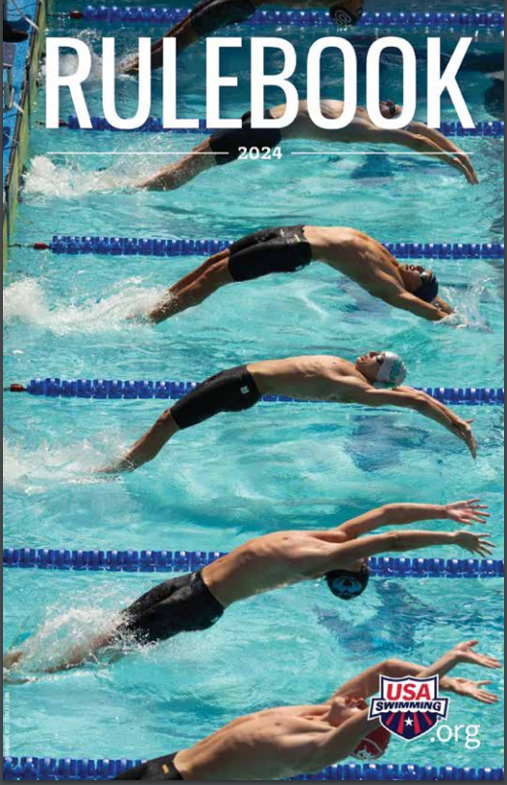
PERTINENT RULEBOOK SECTIONS
Glossary
Article 101 – 105: Technical Rules
Article 201 & 202: Classes of Competition, Sanctions & Approvals
Article 204 & 205: Senior Program, Age Group Program
Article 207: USA Swimming Championships
Article 304 & 305: Code of Conduct, Athlete Protection
Article 502: Membership
Article 701 & 702: Open Water
USMS Rules

Slide 5
AGE-GROUP STANDARDS
Swimmers must be members of USA swimming, except as defined in 202.6 for foreign swimmers.
Eligibility to compete in a particular age-group is determined by their date of birth on the first day of the meet.
For swimmers 12 years and younger, sessions must be completed within 4 hours except for championship and open water events.
Provisions in meet announcement are rules governing the meet as long as they are not in conflict with USA Swimming rules.
Scratches / no-show policies and penalties will be established in the meet announcement. Common MNSI & mandatory USA Swimming Championship policies are 207.11.6 → No-show swimmers “… will be barred from all further individual and relay events of that day” → See MNSI Scratch Rule

Slide 6
NUMBER OF EVENTS
Preliminaries & Finals Meet – 3 individual events per day
Timed Finals Meet – 6 individual events per day USA Swimming
Combined Preliminary / Final Events & Timed Finals -- 3 individual events per day unless entered exclusively in timed final events
Mixed Classification Meet – May enter in age-group & other classification as long as maximum number is not exceeded
Maximum number of events can be reduced by the meet announcement

Slide 7
RELAYS
Relay teams may not compete as unattached and the team members
must be from the same team/club
Clubs with 2 or more relays must classify them as A, B, etc.
Mixed relays:
For meets below the LSC Championship level - do NOT need to be comprised of 2 male/2 female. Lead-off time can be loaded into SWIMs. (Manually add lead-off as a swim-off event.)
LSC Championship and above - must be comprised of 2 male & 2 females to be a legal relay.
Times for relay should be provided and no changes permitted after
entry
Composition of relay team may change between prelims & finals
Names & order must be submitted prior to the start of the heat & no changes are permitted after the start of the race – even to lane timer
It is important to get all the relay names in the data base correctly
Need names to check eligibility
A relay without names won’t load into SWIMS
When do you want names due? (ex: 1 hour before the event)

Slide 8
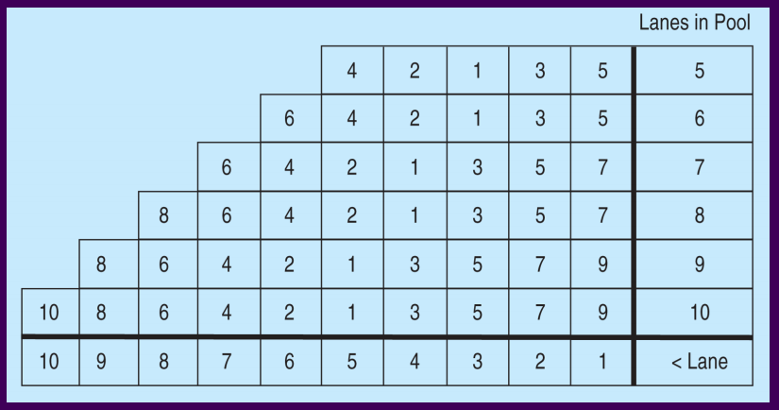
LANE ASSIGNMENTS
Lane assignment is based on seed times descending from fastest to slowest starting from the center lane
Lane assignment of same times (0.01) are determined by draw except in some cases for finals (where a tie could create doubt as to who is eligible)

Slide 9
TIMED FINALS SEEDING
Swimmers shall be listed fastest to slowest with order of identical times determined
by draw & “no-times” considered the slowest
Horizontal Seeding -- Last heat includes swimmers with fastest submitted times, next to last heat includes next fastest swimmers, etc. UNLESS MEET ANNOUNCEMENT HAS SEEDING AS FASTEST TO SLOWEST
All heats seeded according to standard lane assignments
No heat initially seeded with less than 3 swimmers (2 or more heats)
Places are determined on time basis
No attempt to resolve ties (0.01) & tied swimmers are awarded the same place
(ex: 2 swimmers tie for 3rd place - both are awarded 3rd place, no one is awarded 4th)

Slide 10
PRELIMINARY SESSION SEEDING
For Preliminary events, swimmers shall be listed fastest to slowest with order of identical times determined by draw & “no-times” considered the slowest
Circle Seeding
Last 3 heats – Fastest swimmer in last heat, second fastest in 2nd last heat, third fastest in 3rd last heat, fourth fastest in fastest heat, etc. for < 400 yards; for 400 and above, circle seed two fastest heats.
All other heats seeded according to standard lane assignments [Horizontal Seeding] UNLESS MEET ANNOUNCEMENT HAS SEEDING AS FASTEST TO SLOWEST (in which case the first heat is the fastest heat, last heat is slowest heat)
No heat initially seeded with less than 3 swimmers (for 2+ heats)
A swim-off is performed when 2 or more swimmers have achieved the same time (to 0.01 sec) & seeding would result in placing in different heats for finals (e.g. tied for 8th in an 8 lane pool)

Slide 11
FINALS SESSION SEEDING
Final seeding is based on times achieved in preliminary sessions after any swim-offs (Note – there may be more than one preliminary session before a finals session)
Finals heats may be seeded with less than 3 swimmers
Always fill finals heats from fastest (championship) heat to slowest (bonus or consolation) heat

Slide 12
ORDER OF HEATS
Normally swum slowest to fastest
Preliminaries or Timed Finals -- Normal order of heats may be reversed by swimming fastest heat first
Finals -- Order of B & C (consolations & bonus) heats may be reversed and swum following the A (final) heat
Sometimes events and heats may alternate (e.g. Women’s 800 Free Heat 1, Mens’ 1500 Free Heat 1, Women’s 800 Free Heat 2, Men’s 1500 Free Heat 2, Women’s 800 Free Heat 3, …)
Order of heats must be designated in advance in the meet announcement
You will RARELY have to manually seed an event, but you should know how.

Slide 13
OFFICIAL TIMES
Official times can be achieved during – 1) Any heat, 2) Swim-off, 3) Legal lead-off leg of relay, 4) Time trial, and/or 5) Split time from official start to completion of an initial distance of a longer length (provided event is legally completed). For disqualified relays, the lead-off split is a legal split providing the lead-off swimmer is not the reason the relay was DQ’d (false start, stroke violation)
Times are for event swum regardless of stroke performed (Ex: Any stroke
performed in a Freestyle event is a freestyle time)
All times shall be resolved to 0.01 seconds with digits representing thousands dropped with no rounding
Backup timing must be provided except when watches are the primary system
No swimmers are required to reswim in the event of equipment failure
Secondary & tertiary times are recorded, but only used to corroborate or correct missing or inaccurate primary results.

Slide 14
TIMING EQUIPMENT
Fully Automatic (Pads)
Primary: Touchpads
Secondary: Button(s)
Tertiary: Watches
Semi-automatic (Buttons) or (approved) cameras
Primary: Two Buttons per lane
Secondary: Watches
Manual (Stopwatch)
Primary: Three watches per lane
May use Combination
Automatic system for 50s and longer
Watches for 25s

Slide 15
TIMING SYSTEM PRIORITIES
Primary System
Determines official time unless malfunction determined
Options
Automatic timing
Semi-automatic – 2 or 3 buttons per lane, each operated by separate person
Manual – 3 watches per lane, each operated by a separate person
Secondary System
Must be used unless watches are primary
Precedence equal to or lower than primary system
Options
Semi-automatic – 1, 2 or 3 buttons per lane
Manual – 1, 2 or 3 watches per lane
Tertiary System
At least 1 manual watch must be provided - unless primary or secondary system is watches or secondary system is video system
If using pads and buttons, still require at least one watch per lane

Slide 16
TIMING JUDGE
Determining the official time is one of the most important jobs of the Administrative Office
Rule 102.24 – Timing Rules
Understand the use of primary and backup timing systems
Understand how to apply the rules for using a backup time when you have determined a primary system malfunction
Order Of Finish is another piece of information.
Use common sense and a consistent procedure.
BUT – don’t get wrapped up in the procedures and make a good primary time into a bad time!

Slide 17
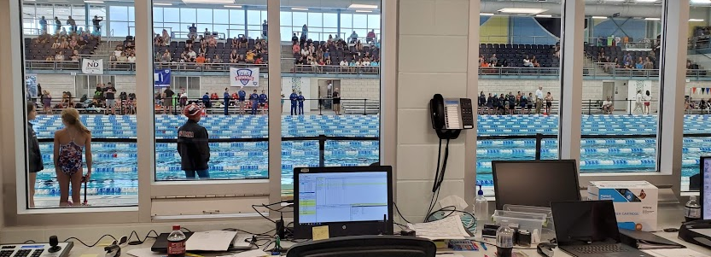
Admin Responsibilities & Best Practices

Slide 18
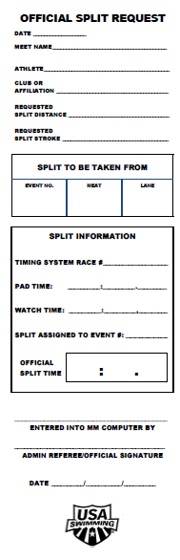
FORMS
Number of different sources for checklists, forms and templates:
USA Swimming Website: https://www.usaswimming.org/officials/popular-resources/officials-documents
Meet Manager:
Distance Counting Sheets, Officials Assignment Forms, DQ log, Relay Take Off slips, etc.
MNSI Website
DQ Slips
Other AO/AR’s: *Request access to Tracy’s Admin DropBox folder*

Slide 19
WORK-FLOW AND PRIORITIES
As an Administrative Official, you are required to balance priorities and deadlines while maintaining quality and accuracy
Allocate work if you have an admin team
Maintain consistency
You can not sacrifice quality and accuracy, but you also can’t ignore
deadlines
Example 1 Prioritize Tasks
At a Prelims/Finals meet, processing preliminary event results are a very high priority
At a timed finals meet, processing results have no real time pressure and may have a lower priority
Example 2 Positive Check-In
Make sure you have enough time to do all that needs to be done
If you have multiple events, do them in batches rather than all at once
Heat sheets for coaches, then timer sheets, then heat sheets for officials

Slide 20
MEET ENTRIES
Entry Chair for the meet handles club entries & loads them into Meet Manager…Unless You are the Entry Chair, this will be done prior to your arrival at the table [At minimum verify the following:]
Entry components
On paper (by hand, manual)
From Hy-Tek, TeamUnify or other electronic means
OME (USA-S Online Meet Entry)
Managing Entries
Hanging files by team
Dedicated folders in email, computer
Monitoring
Time limits, entry limits, meet size
Session reports
Checking Entries
Error and exception reprts
Hy-Tek – wrong age group, qual times, etc.
USA-S – reg issues, proof of time
Psych sheets
More eyes are better than two
Changing Entries
Maintain integrity of database
Paper trail – Computer Change Form
Document any changes
Forms on MNSI and USA-S website

Slide 21
EVENT SEEDING
Pre-Seeded [most common form in MN Swimming]
After entry deadline, seed all events
Print heat sheets, lane timer sheets, session reports
Timelines
Back up meet!!!!!
Do NOT reseed events after printing heat sheets
NT's assigned randomly to lanes…
re-seeding will result in CHANGES
Missing swimmers will result in empty lanes
Deck Seeded [typical @ Prelim/final meets ]
Advance preparation and staffing
Print lists for check-in
Psych sheet
Print lists by gender, by age group, by time or alphabetically; by team?
Ensure accuracy
Must be able to tell check-ins, scratches and no shows
Process scratches
Backup!!
Print meet programs (heat sheets)
Give to meet management for copying and distribution
Print lane timer sheets and session report
(timeline)
Download events to timing system and scoreboard

Slide 22
SEEDING ISSUES / PROBLEMS
Late or Forgotten Check-in
Determine Meet Referee’s preference
Be CONSISTENT and FAIR
Communicate with ALL the people who need to know
Meet Ref
Announcer
Deck Referee
Timing console, computer operator
Timers
Coaches
Entry Problems [Not caused by Athlete or Club]
Track down reason for error
Don’t punish an athlete for a clerical
mistake
Find a place for him/her to swim
Create a new heat if necessary
Reseed ONLY if necessary (CLEARLY MARK
THE RESEED)
Communicate to all who need to know

Slide 23
RESEEDING
If you MUST need to reseed …
Consider gravity of situation [i.e. First meet of season vs. Championship]
Seek input from Meet Ref
Consult with/listen to coaches
Put swimmer(s) in empty lane in early heat vs. reseeding for correct placement
Reseeding
Make correction or adjustment, and reprint meet program for that event only
Mark as RESEED
Copy on colored paper -- Different color for each event if multiple reseeds
Announce reseed, availability of reseeded programs, post near blocks
Print new lane timer sheets
Distribute heat sheets to deck officials, timing system operator, announcer and timers
COMMUNICATION IS KEY WHEN YOU RESEED

Slide 24
TIMING JUDGE PROTOCOLS
Watch the clock starts and finishes … Note a late start or late touch(es)
Review times as they are imported into Meet Manager
Is there a consistent pad or button malfunction?
While waiting for lane timer sheets, print CALC screen reports for heats with potential timing adjustments
Review lane timer sheets ASAP after the event and compare to meet software
data
Notes:
You can delegate this to your timing system operator, who always will be focused on the pool
Are timers pushing buttons? Is one timer consistently late?
Watch timers, ask Head Timer to make corrections
Ask host equipment person to look into and fix
Are timers recording times, and recording correctly?
Spot check MM data vs. watches to assure no heat malfunction

Slide 25
Adjustment Guidelines
When using Automatic Timing: “When recorded by properly operating automatic equipment, the pad time shall be the official time.” Rule 102.24.4A
You must prove the pad time incorrect
Use button times, watch times, order of finish
Which of the times do you consider accurate?
How consistent is the starter’s order of finish?
Meet Manager makes this fast
Practice makes for fluency and consistency
Notes:
You can delegate this to your timing system operator, who always will be focused on the pool
Are timers pushing buttons? Is one timer consistently late?
Watch timers, ask Head Timer to make corrections
Ask host equipment person to look into and fix
Are timers recording times, and recording correctly?
Spot check MM data vs. watches to assure no heat malfunction

Slide 26
PRIMARY TIMING SYSTEM MALFUNCTION
Difference between pad & backup times are greater than 0.30 seconds highlights a potential problem, or
Place Judge(s) report a different order of finish, or
It is reported that the swimmer missed the touchpad or had a soft touch.
Never Take a Good Pad Time Away from a Swimmer!
Computer programs help this task
Never mix watch and button times!!

Slide 27
TIMING MALFUNCTION ADJUSTMENT - LANE
For Meet Manager – make sure the meet is set up to follow USA Swimming/FINA timing rules!
Use the backup time (do not correct)
Average of buttons or middle button time if three buttons used
If no button –
Average of watches or middle watch time if three watches used
Verify against order of finish
Note the change and why on timing system printout

Slide 28
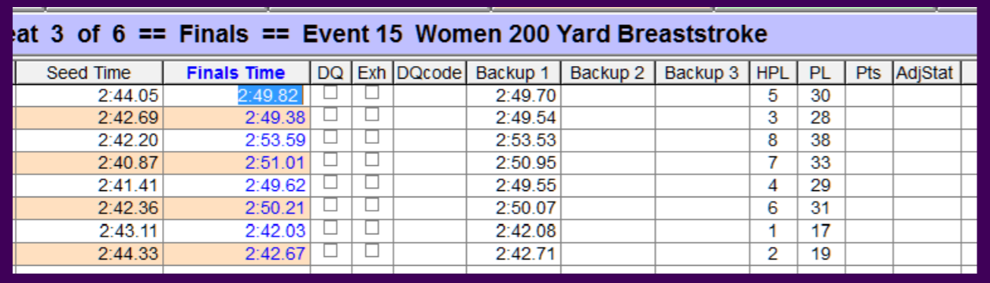
PRIMARY TIMES SUPPORTED BY TWO BACKUP BUTTONS AKA a “Clean Heat”
This is what is supposed to happen!
If one backup button – verify order of finish and watch time and/or ask if there
were any soft touches
AdjStat column shows adjustment status:
Blank
?: Needs research
A: Time Adjusted
K: Pad time verified OK

Slide 29
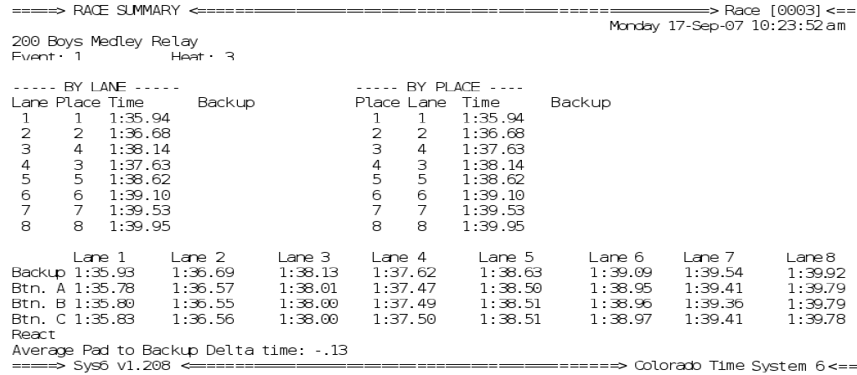
PRIMARY TIMES SUPPORTED BY TWO BACKUP BUTTONS Colorado Timing System Printout Sample
This example shows how multiple buttons will be displayed on the CTS printout…Note: This shows that the Automatic Backup Time Adjustment was NOT turned off...This should be done prior to a USA Swimming Sanctioned Meet.
Pad times for all lanes
Backup buttons agree with pad times to within 0.3 seconds
Pool using 3 buttons

Slide 30
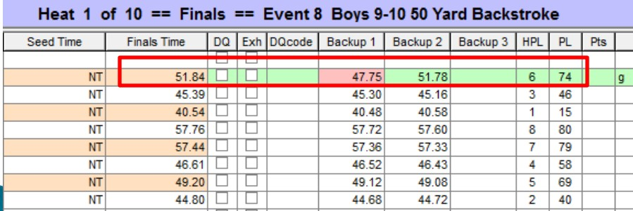
BACKUP BUTTONS DISAGREE…ONE SUPPORTS PRIMARY TIME
Usually a valid time, verify with Order of Finish and watch time, ask
about soft touches
Don’t delete the bad button time

Slide 31
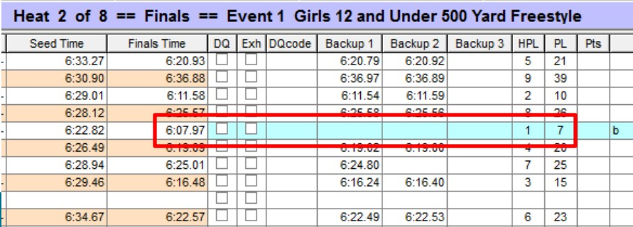
NO BACKUP BUTTONS
Need to verify Order Of Finish and watch times. Ask about soft touches
If pad is not verified by the watch and OOF, DO NOT enter the watch time(s) into the button fields. Annotate what you are doing and enter the watch time (or average watch time) as the Finals Time on the timing system printout.

Slide 32
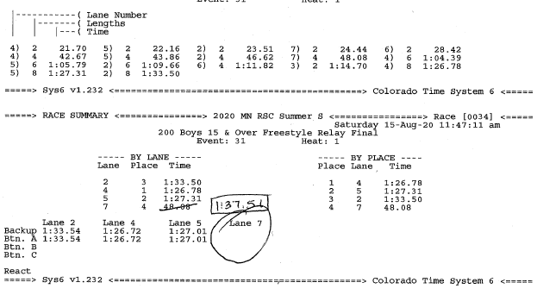
NO BACKUP BUTTONS Colorado Timing System Printout Sample
OOF - 4527

Slide 33
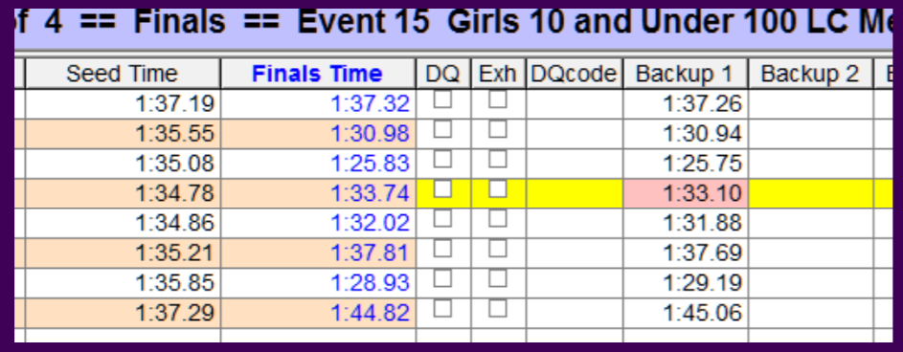
LANE MALFUNCTION (LATE PAD)
May need to verify with Order of Finish and watch time. Use average of buttons if there are two, middle value if there are three.

Slide 34
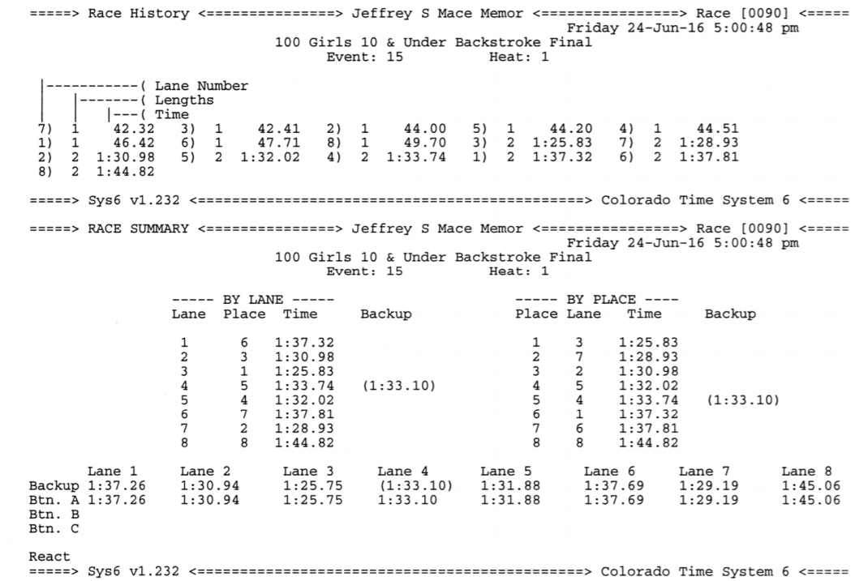
LANE MALFUNCTION (LATE PAD) Other Reports – Colorado Timing System

Slide 35
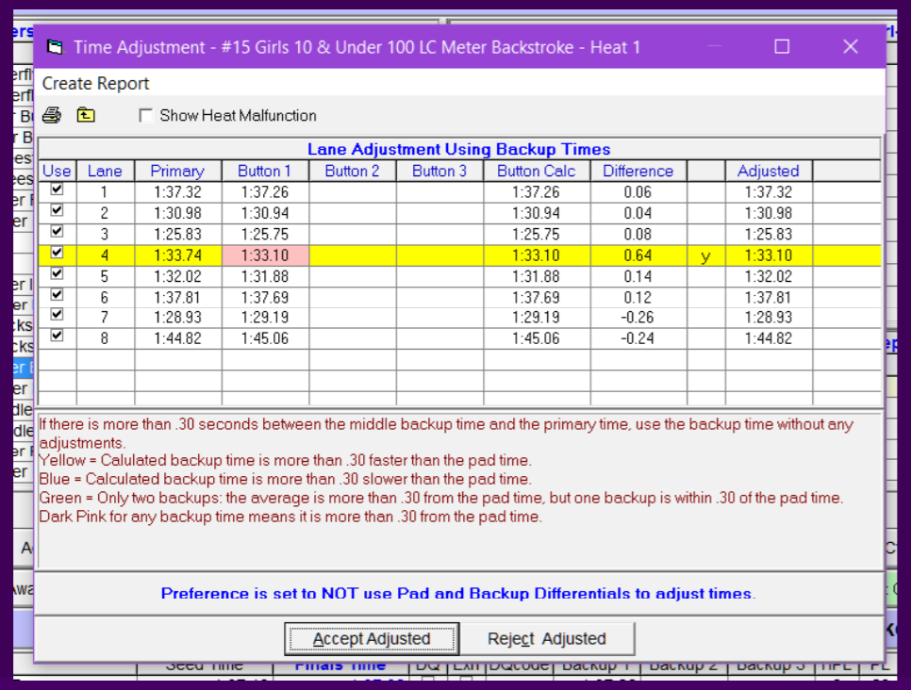
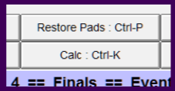
LANE MALFUNCTION (LATE PAD) Other Reports – MM Calc Screen

Slide 36
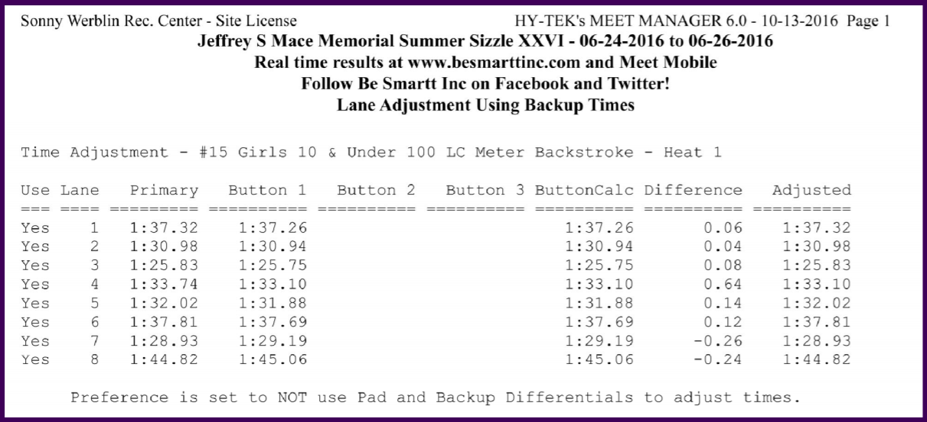
LANE MALFUNCTION (LATE PAD) Other Reports – MM Calc Screen/Printout

Slide 37
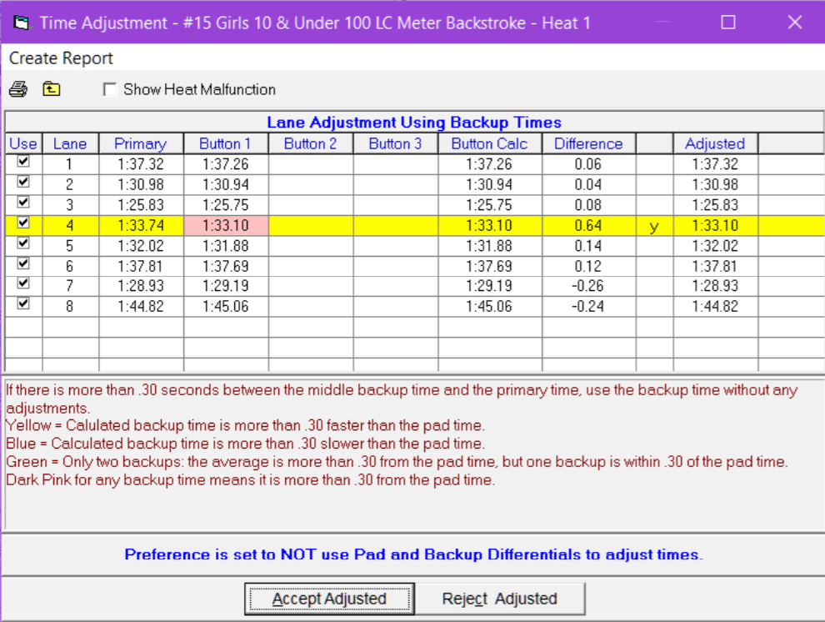
LANE MALFUNCTION (LATE PAD) Adjustment
Need watch times from lane times: 1:33.10, 1:33.03
Backup times support the button
Don’t use watch times for anything else
Accept Adjusted

Slide 38
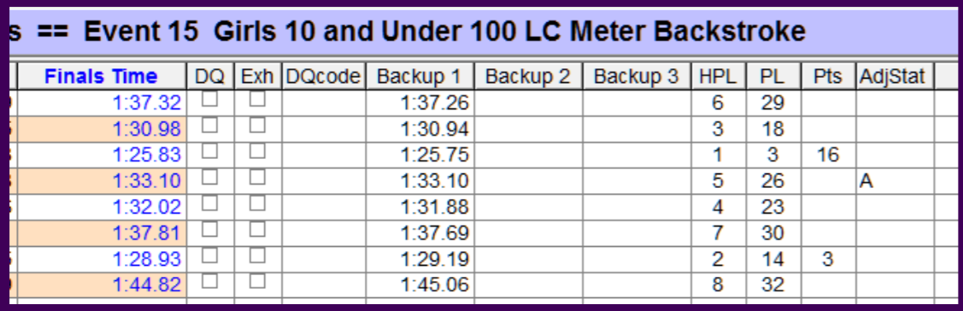
LANE MALFUNCTION (LATE PAD) Adjustment
Note A in AdjState column

Slide 39
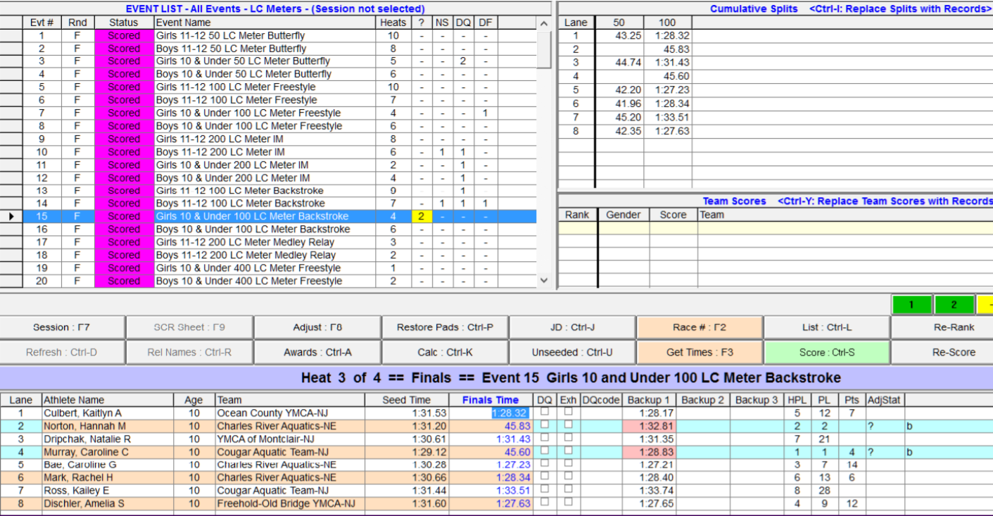
Early Pad?

Slide 40
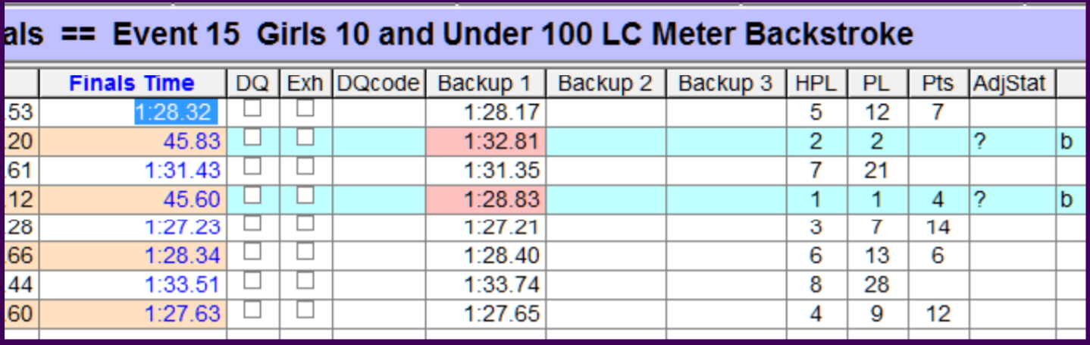
Early Pad?
Problem lanes highlighted in blue
Most cases slightly early times will be real – late buttons
This is special case: no finish pad, time is last split

Slide 41
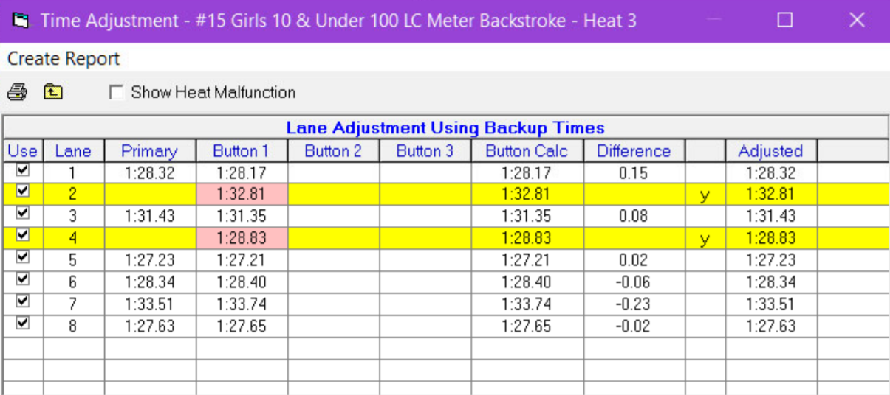
Early Pad? MM Calc Screen Adjustment
MM will default to take the fastest time.
Operator will need to put the checkmark in the USE columns for Lane 2 and 4 in this case and THEN Accept Adjusted

Slide 42
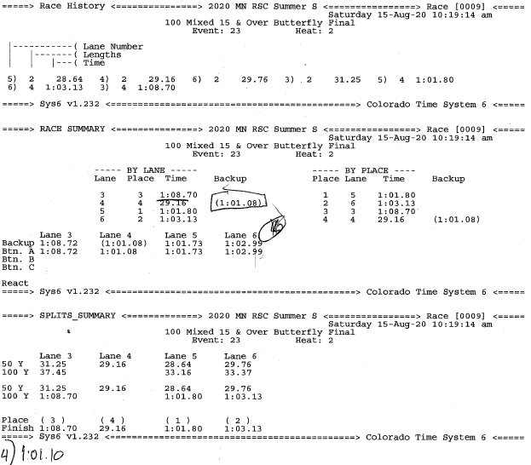
Early Pad? Colorado Timing Printout Sample
Lane 4: 1:01.10
Watch supports button
Accept Adjusted

Slide 43
OTHER SCENARIOS
No Pad Time – use Button time(s) after verifying with Order of Finish and watches
Late Button – Use watch times, Order of Finish to verify pad time. Probably inattentive timer.
No Pad Time, No Button Times – use watch time(s) after verifying with Order of Finish
No Pad Time, No Button Time, No Watch Time – get Order of Finish, then adjust finals time to fit the OOF. (Use coach time to verify a piece of the puzzle)
If time doesn’t agree with Order of Finish and you are confident of OOF, use Judge’s Decision for placing – don’t make up a time.
ALWAYS DOCUMENT WHAT YOU DID. Anyone looking at the paperwork later should be able to determine what you did.

Slide 44
HEAT MALFUNCTION
What happens when the timing system starts late? Or not at all?
Always encourage/insist timing system operator to do a manual start on a late reset
Some electronic data is better than none!
You’ll now have finish times that are correct relative to each other but are too fast.
Don’t just use the watch times!
Especially in a multi-heat event
Take timing system difference into account
You know your pads are late
DETERMINE AVERAGE DIFFERENCE BETWEEN PADS AND WATCHES Meet Manager will do the calculation, but you will have to do this by hand for the exam.

Slide 45
TIMING MALFUNCTION ADJUSTMENT - HEAT
Sum differences between pad and calculated watch time divided by the number of lanes.
Lane | Pad | Calc Watch Time | Variance | Heat Adj. | Official Time
1 | 52.12 | 55.14 | 3.02 | + 3.05 | 55.17
2 | 51.56 | 54.61 | 3.05 | + 3.05 | 54.61
3 | 51.09 | 54.18 | 3.09 | + 3.05 | 54.14
4 | 50.12 | 53.18 | 3.06 | + 3.05 | 53.17
5 | 49.78 | 52.90 | 3.12 | + 3.05 | 52.83
6 | 49.06 | 52.06 | 3.00 | + 3.05 | 52.11
 |  |  | 18.34 | Total difference
 |  |  | 3.05 | Average difference
Add the average difference to each pad time to calculate the official time for each lane.

Slide 46
DOCUMENTING TIMING DISCREPANCIES
Get watch times(s) for the lane in question, compare to pad and button
WRITE WATCH TIMES AND OOF ON Timing System Printout
If pad time is reasonably close to watch time, check OOF, and note on
CALC report/lane timer sheet “PAD OK” and INITIAL
NO MEET MANAGEMENT SOFTWARE ADJUSTMENT
If button time is reasonably close to watch time, check OOF, and you believe there is an issue with the pad, note on Timing System Printout “Use BUTTON” and INITIAL
COMMUNICATE TO MM OPERATOR TO ACCEPT SOFTWARE ADJUSTMENT ON CALC SCREEN
If there is no button time and pad is invalid, compute average difference between valid pads and watches, apply to watch time and enter in “Finals” time column
DOCUMENT
Review order of finish after adjustments to support your decision
INCLUDE ADJUSTMENT DOCUMENTATION WITH EVENT PAPERWORK

Slide 47
VERIFY RESULTS
Enter DQs and codes
Before publishing event results – REVIEW THEM
Are all the timing adjustments completed and documented
Are there any times that appear unreasonably fast or slow
Are NS, DFS, DQ’s correlated with Deck Referee sheets and DQ slips
Were there other notes on the timer sheets
Are there Ties (can affect finals from preliminaries) – notify the Deck Referee for potential Swim Offs

Slide 48
BEFORE YOU START THE MEET
Checklist
Take Deep Breath & Remain Calm
Meet loaded in timing console?
Entries to scoreboard?
Timing system tested?
Heat sheets (meet programs) generated & distributed?
Lane Timers sheets printed & distributed?
Proper heat sheets to Officials?
Personnel ready?

Slide 49

END OF MEET
Complete all the paperwork
Check with the Meet Referee before you leave
Take paperwork with you unless host is keeping it
Thank support team
Back-up meet to a flash-drive
Send Back-Up to LSC Times Coordinator (For MN - Michael Bougie bougieml@msn.com)

Slide 50
Questions?
Remember there are MANY resources available.
The best way to learn is to practice – at meets!
Thank you for your participation!
Tracy Meece tjmeece1974@gmail.com

Slide 51
Appendix
Additional Resources
These resources will be sent to you after clinic
Admin Pre-Meet Checklist (Timed Finals Meet)
Colorado Timing System Printout Samples
Daktronics Timing System Printout Samples
SST Timing System Printout Samples
Equipment hook-up directions/photos – Coming Soon!
Quick Guide – USA Timing Adjustment Guide

