Slide 1


Slide 2

GLOW 2024
USA Swimming, Illinois, Iowa, Michigan, Minnesota and Wisconsin Swimming
Thank You to the Village of Pleasant Prairie, The Rec Plex & Patriots Swimming!
Officials Team
Meet Director: Amanda Schleede
Meet Referee: Mike Mellock
Admin Referee: Andrew Olson
Independent Safety Officer: George Geanon
Entry Chair: Michael White
Administrative Official: Sarah Olson

Slide 3
Thursday June 27 – Clinic
Mike Mellock - Meet Referee
10:40 AM: Arrive for Clinic Check In
11:00 AM: Open Water Clinic @ Lake Andrea
Report To Registration Area Before Clinic To Receive Clinic Ticket
All Athletes Must Have Clinic Ticket To Participate In The Clinic
All Athletes Will Pick Up Clinic Ticket At Completion Of The Clinic
One lap of the course will be allowed after the clinic once the safe staffing of guards has been established.

Slide 4
Race Procedures
Mike Mellock - Meet Referee
USA Swimming Rules
Gear & Apparel – FINA Logo
Wet Suits
Recommended For All Other Races If Water Temperatures Under 64.4 F
This Is An Unescorted Swim
Watercraft
Yellow Flag / Red Flag Infractions
Slip Streaming, Interference
Jewelry, Watches, Fingernails, Toenails

Slide 5
Race Procedures
Mike Mellock - Meet Referee
Start Times - Report To Registration Area No Later Than 45 Minutes Prior To Race
Suit Check (Suit Manufacturer And Model)
Nail Check
Get Race Number
Pre-race Meeting Approximately 15 Minutes Prior To Race
Be Prepared To Swim
Athletes Proceed To Staging Area, Volleyball Courts After Meeting
All Participating Athletes Must Present Race Ticket To Enter The Water
Athletes Receive Bag Tag Back Upon Exit – Do not leave the race area without Race Bag Tag
Notes:
R

Slide 6
Race Procedures
Mike Mellock - Meet Referee
Race Numbers & Check-in
All Athletes Must Have Race Ticket To Participate
Start/Finish Procedures
In Water Start (Line Of Sight) – Boat/Blue Buoy and Shore
In Water Finish (Slap Board)
All Athletes Must Take Race Ticket At Finish Of Race
Withdraw Procedure / Designated Cut-off Time
Abandoning The Race
Protests
Inclement Weather/Contingencies
Emergency Recall Signal

Slide 7
June 27 – Race Time!
Mike Mellock - Meet Referee
1:00 PM: Race Registration & Check In Opens For 3K Athletes
2:45 PM: MANDATORY Coaches Meeting
Held In The Beach House Pavilion
2:15 PM: Course Open For Warm-Up (Between Buoy 2 & 3)
During Rest Of Day, Warm-Up / Cool Down Available @ Beach Area

Slide 8
Race Day Schedule – 3K
Mike Mellock - Meet Referee
3:15 PM: MANDATORY Participant Pre-Race Meeting
All 3k Race Participants
Held On The Beach Inside The Fence In Front Of The Pavilion
Immediately Following: Open 3K Athletes Line Up East Of Pavilion
Athletes Need To Be Prepared To Swim Immediately After Meeting
3:30 PM: Roll Call/ Check – Volley Ball Courts
3:45 PM: First Wave Of 3K Begins – Women’s 3K to start ~ 5 minutes after Men’s.
Awards for 3K Will be presented by each LSC at their choice of time and location.

Slide 9
Race Day Schedule – 1K & 2K
Mike Mellock – Meet Referee
3:00 PM: Check in Begins for Race Participants
Warmups held in front of the pavilion in the roped off area. NOT ON THE COURSE
4:15 PM: Mandatory Athlete Meeting – In front of the pavilion in the sand. After the meeting we will head to the volleyball courts with the 1K athletes.
Plan on racing immediately after the meeting if you are swimming the 1K race. There will be one heat with combined genders.
4:45 PM: Estimated Start for 1K – Both Boys and Girls – One Loop
5:15 PM: Estimated Start for 2K – Both Boys and Girls – Two Loops

Slide 10
Course
Mike Mellock - Meet Referee
Course Overview
Clockwise Course (Right Turns)
Three Laps – 3K
Two Laps – 2K
One Lap - 1K
Turns – Yellow Tri (Right)
Sighting Buoys – Orange Tomato
Start – In Water Line Of Sight
Finish
Orange Tomato shows the opening of the Finish Chute. Slap Board Finish
All Athletes Required To Pick Up Race Ticket
Notes:
Pencil buoys be careful barnacles

Slide 11
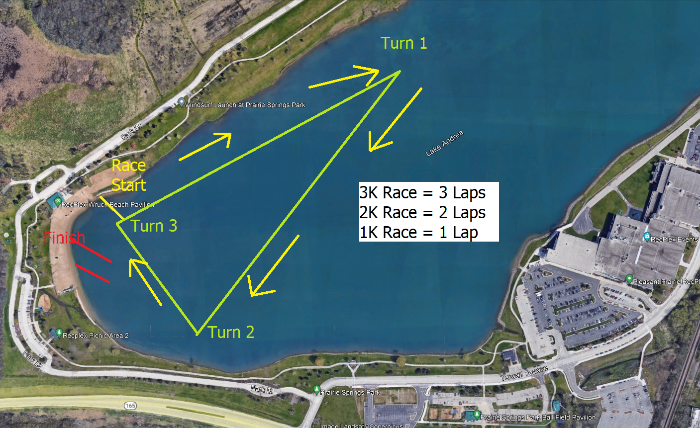

Slide 12
Lake Andrea Beach
Jada Myers - Local Event Director
Temperature
Depth
Current
Marine Life
Water Quality
Restrooms
Please No Parking in the Beer Garden lot.

Slide 13
Abbreviated Safety Plan
George Geanon - Event Safety Director
Personnel
Lifeguards – Certifications
Immediate Response
EMT’s, AED’s
EMS Location And Estimated Response Times
Hospital Location
Shade And Beverages
Communications With Safety Personnel On Course
Safety Craft

Slide 14
Abbreviated Safety Plan
George Geanon - Event Safety Director
Current Conditions
Forecast
Water Temp
Air Quality
Missing Athlete Protocol
Abandonment Procedure
Signals
Athletes Must Check In With An Official
Athletes Must Collect Their Race Tag

Slide 15
Additional Logistics
Mike Mellock - Meet Referee
Announcer
Will Provide Live P.A. Updates
Timing
Slap Board Finish
HK Timing System
Video Backup

Slide 16
Questions?
Thank You!

