Slide 1
USA Swimming and Wisconsin Swimming
Starter Clinic
Clinician Name
Presentation Prepared by USA Swimming National Officials Committee
&
Wisconsin Swimming Officials Committee

Slide 2
Clinic Overview
Introduction
Philosophy of Starting
Starting Rules
Elements of the Start/Techniques of Starting
Developing Good Habits and a Routine
Questions

Slide 3
Philosophy of Starting
GOAL: A fair start for all swimmers
Three main aspects to understand
    - Knowing when the field is ready to assume the starting position
    - Knowing when the field is ready to be sent
    Knowing when it is necessary to intervene so that these two goals may be realized
Notes:
ISI Starter Basics Video: Philosophy of Starting @ 3:30 https://youtu.be/GAMheq0BLDU?t=212

Slide 4
The Mindset of a Starter
The STARTER reads the field, to determine when THE FIELD is ready to start––Not the other way around!
PATIENCE, PATIENCE, PATIENCE
Control your emotions so that the swimmers can control theirs!
Notes:
ISI Starter Basics Video: Mindset is Key @ 3:45 https://youtu.be/GAMheq0BLDU?t=225

Slide 5
Starting Rules
From Section 101.2 of the USA Swimming Rulebook
  When the swimmers and officials are ready, the Referee shall signal with an outstretched arm to the Starter that the swimmers are under the Starter’s control.
  On the Starter’s command “take your marks”, the swimmers shall immediately assume their starting position, in the forward start, with at least one foot at the front of the starting platform or the deck. Swimmers starting in the water must have at least one hand in contact with the wall or starting platform. When all swimmers are stationary, the Starter shall give the starting signal.

Slide 6
Starting Rules
From Section 101.2 of the USA Swimming Rulebook
  When a swimmer does not respond promptly to the command "take your marks," the Starter shall immediately release all swimmers with the command "stand up" upon which the swimmers may stand up or step off the blocks.
  A swimmer shall not be disqualified for an illegal starting position at the start if the race is permitted to proceed. Enforcement of the correct starting position is the responsibility of the Starter.
Notes:
ISI Starter Basics Video: The Starting Procedure @ 5:45 https://youtu.be/GAMheq0BLDU?t=335

Slide 7
Two Parts of the Start
Knowing when the field is ready to assume the starting position
Knowing when the field is ready to receive the starting signal

Slide 8
Before Each Heat
Looking at swimmers behind the blocks
Short whistles
Long whistle(s)
Be in position and ready to go at long whistle

Slide 9
“The First Part of the Start”
Patience as the swimmers settle into position
Forward Start––One foot at front of block
Backstroke Start––Toes not curled over gutter
Once all swimmers are in position, ready for the command

Slide 10
“Take Your Marks”
Conversational tone
Inviting the swimmers to swim
Slightly descending tone
Statement, not a question
Delivered in a relaxed, but confident way
“Close the door” “Pass the Salt” “I love you”
Notes:
ISI Start Basics Video: “Take Your Mark” at 8:05 https://youtu.be/GAMheq0BLDU?t=485
and
Part 3 – Response to the Command @ 15:55 https://youtu.be/GAMheq0BLDU?t=955

Slide 11
“The Second Part of the Start”
Wait for the swimmers to become stationary
Stationary does NOT necessarily mean motionless
Stationary = Establishes vertical plane at front of block
Send the swimmers once all are stationary

Slide 12
If Things Don’t Go As Planned….(For ANY Reason!)
“Stand, please”
To be delivered more softly and extremely calmly
PATIENCE to allow swimmers to refocus before giving the command again
Notes:
ISI Start Basics Video: “If thinks go wrong…” @ 17:55 https://youtu.be/GAMheq0BLDU?t=1075

Slide 13
Once The Heat Has Started….
Hold microphone open and in position until heads surface, in case necessary to recall
Starter can recall a heat for any reason that caused swimmers to not have a fair start
Recall = No Swimmers Charged with False Start
Mark any empty lanes in starter program
Notes:
ISI Starter Basics Video: “After the Start” @ 12:35 https://youtu.be/GAMheq0BLDU?t=755

Slide 14
The False Start
A Swimmer STARTING early—breaking his/her stationary position before the start
Record violation by notating on heat sheet
Dual confirmation procedures
Refer to the USA Swimming “What is a false start?” document with scenarios and guidelines.
Notes:
ISI Starter Basics Video: “False Starts” @ 9:05 https://youtu.be/GAMheq0BLDU?t=545
and
Starts, False Starts and Recalls 10:17 https://youtu.be/GAMheq0BLDU?t=617

Slide 15
Where to Stand
Within approximately 5 meters from start of pool
Want to be able to observe entire field but also distinguish between individual lanes
Starter chooses first, referee adjusts to starter

Slide 16
Becoming Familiar With Equipment
Always test microphone, they are all different!
Test volume, be sure you can be heard from all lanes!

Slide 17
Other Things to Say (And Not To Say!)
Refer to the swimmers as “ladies” and “gentlemen”
NEVER deviate the language of “Take your marks,” and “Stand, please”
“Relax, please” or “Swimmers, relax” for prolonged delay
“Lane __, toes, please,” if necessary to lower toes in backstroke
“Thank you, ladies (gentlemen),” to clear pool
Additional instructions only as directed by referee

Slide 18
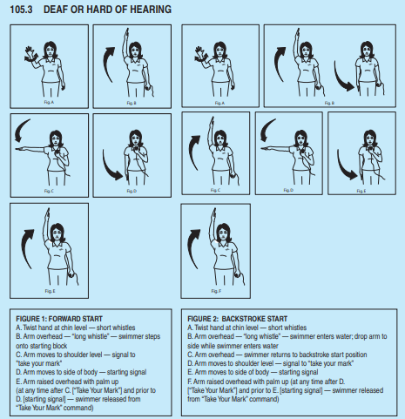
Other Possible Starter Responsibilities
Timers Briefing
Sound warning signal for distance events
Adaptive Starts for Athletes with disabilities
  See USA Swimming National Disability Committee “Article 105” and USAS Rulebook
Notes:
ISI Starter Basics Video: “Adaptive Starts” @ 20:45 https://youtu.be/GAMheq0BLDU?t=1245

Slide 19
How to proceed to certification:
Take the USA Swimming online Starter test
Review “The Professional Starter” and the “Starter and Deck Referee Situations and Resolutions” documents.
Apprentice 5 sessions, over at least 3 meets, with at least 2 mentors, using the “Apprentice Starter – Checklist” to document training.
Practice, practice, practice!
The more experience you gain, the more comfortable you will be!

Slide 20
Additional Training Resources
Illinois Swimming Starter Training Videos
  “Officials Training - Starter Basics”
  “The Starting Process”
  “False Start Scenarios” (Refer to “What is a false start?” document)

Slide 21
QUESTIONS?

