Slide 1

Artistry of an Organized Admin Official
Tracy Meece MN Swimming

Slide 2
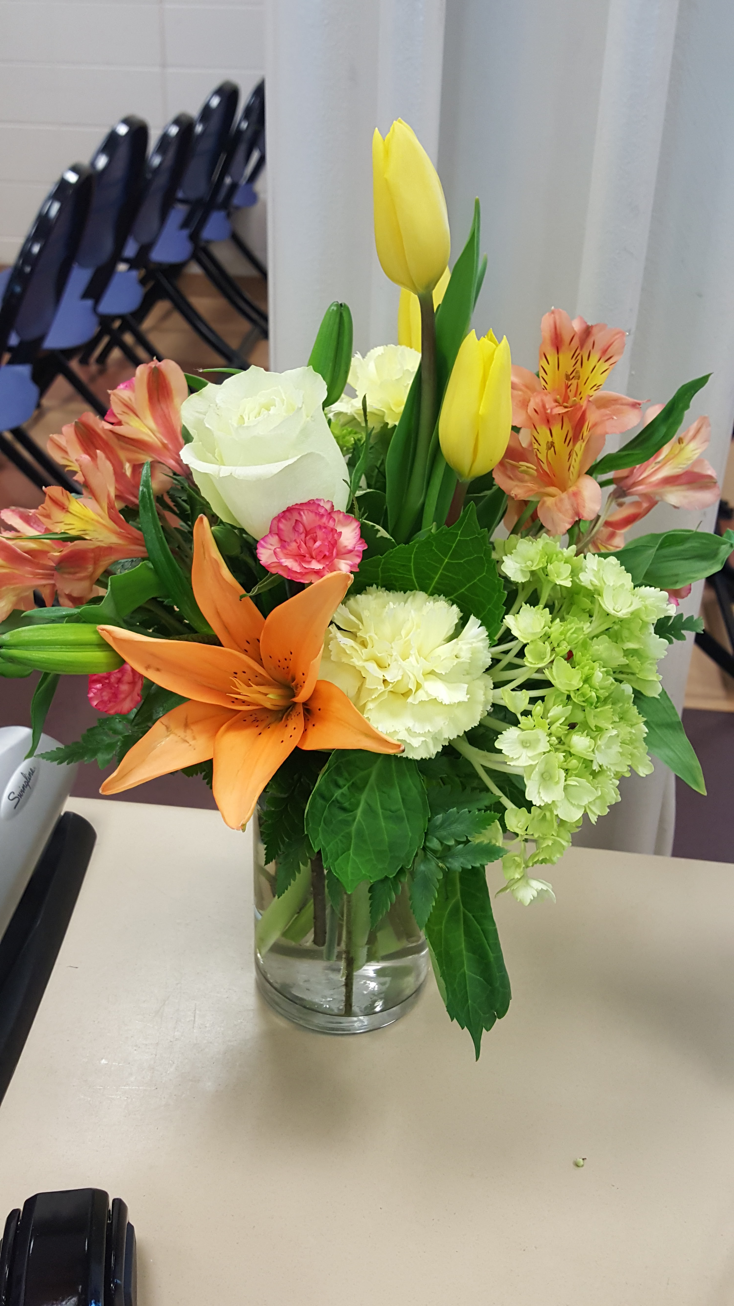
What Is an Admin Official?
Assistant to and delegate of Meet Referee
Involved with all “dry” side details of the meet
Works closely with/oversees administrative staff for the meet
Meet Director
Equipment person
Entry Chair
Software Operator (Hy-Tek/Meet Manager)
Timing System operator
Clerk of course
Ensure fair & accurate times are recorded with traceability

Slide 3
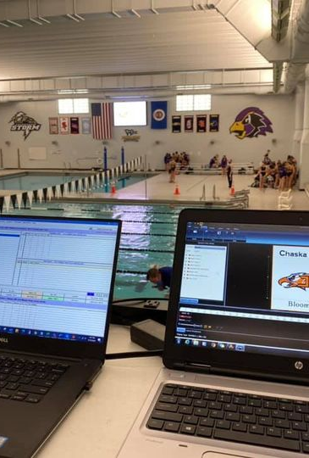
Admin Official Philosophy
Don’t reinvent the wheel
Follow a “standard” process that all can follow
Use standard forms
Be proactive
Be alert for potential problems - minimize or eliminate them
Be approachable and helpful
Customer service is KEY!
Maintain a paper trail
Document why you did something, who did it – initials
Provides an audit trail
Always keep the Admin Referee (if there is one) and/or the Meet Referee in the loop.

Slide 4
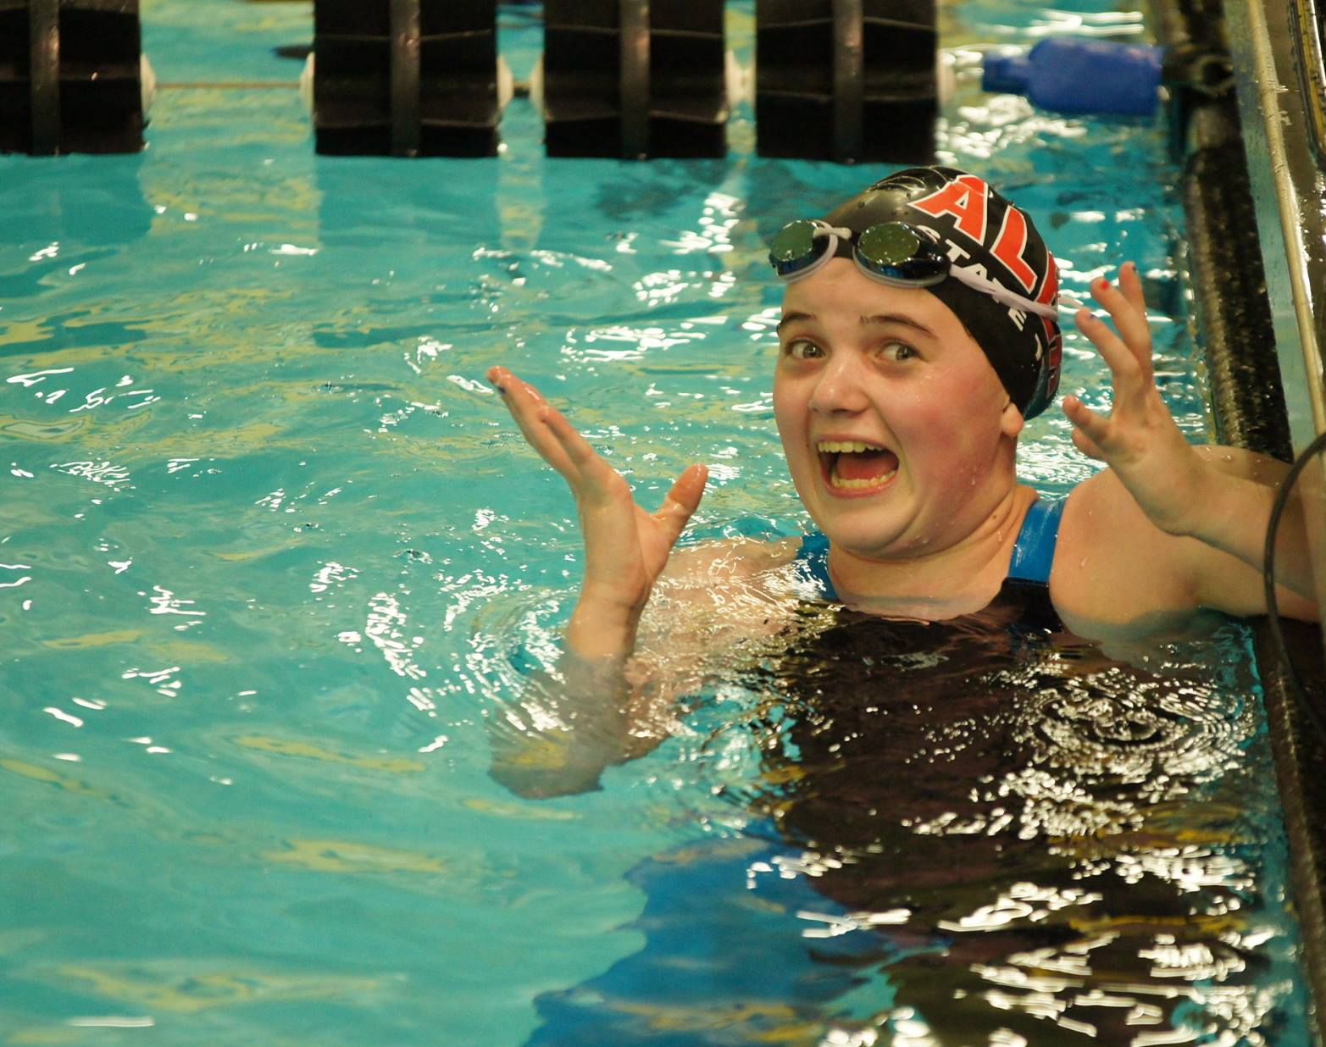
You’re the admin…Now what?

Slide 5
Meet Announcement Familiarize yourself with key information: * Eligibility
*Entry Requirements
* Deadlines (entries, check-in, scratches)
* Awards
Introductions Meet Referee, Admin Referee, Meet Director, Entry Chair
Check Meet Set-Up - Request a Meet Back-Up
Use Quality Control Check-List to go thru the meet
Work with Entry Chair to fix any problems

Slide 6

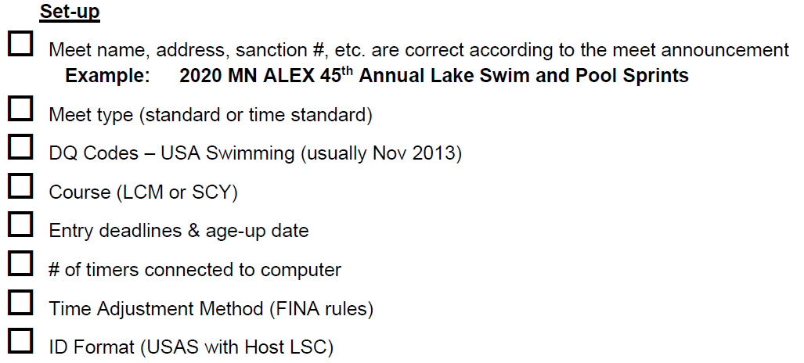

Slide 7
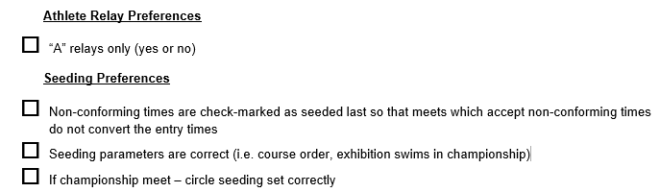

Slide 8
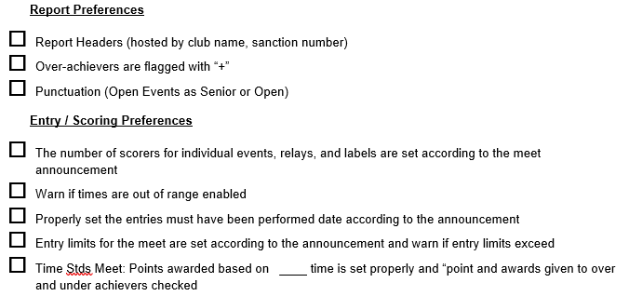

Slide 9
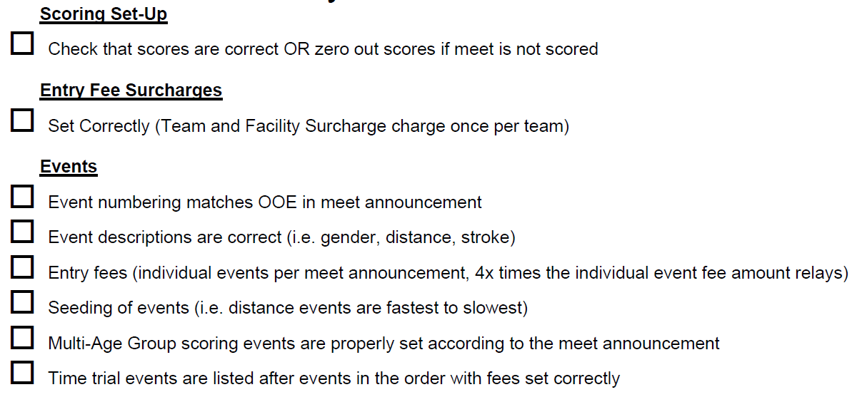

Slide 10
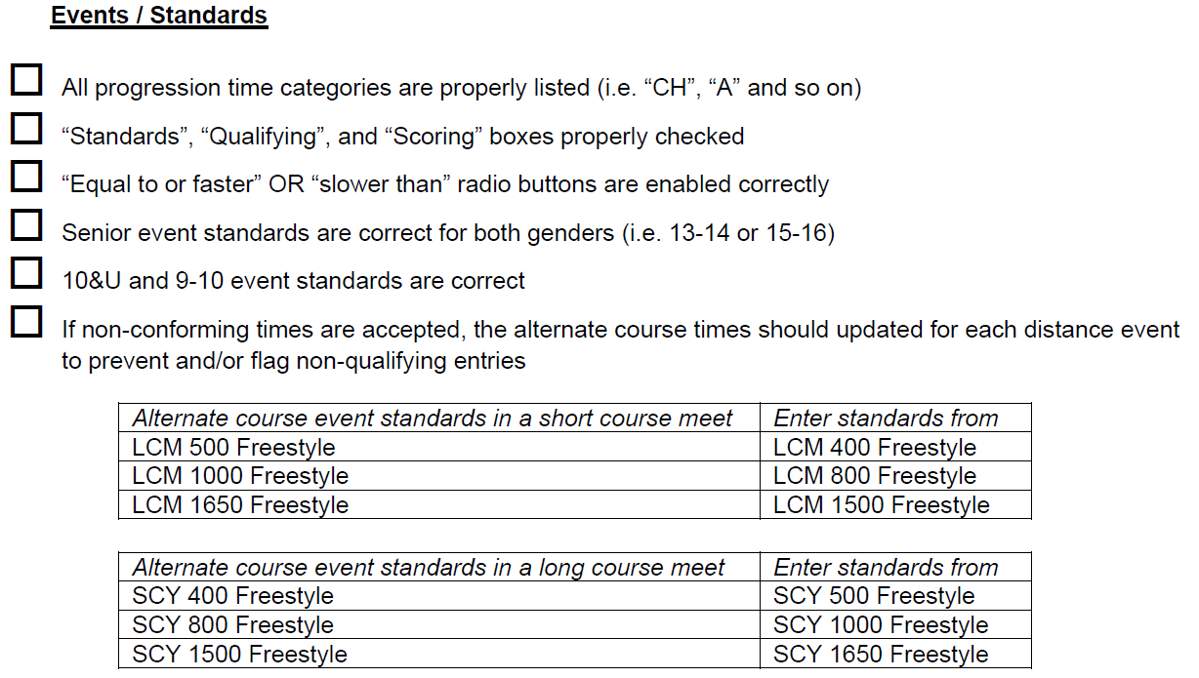

Slide 11
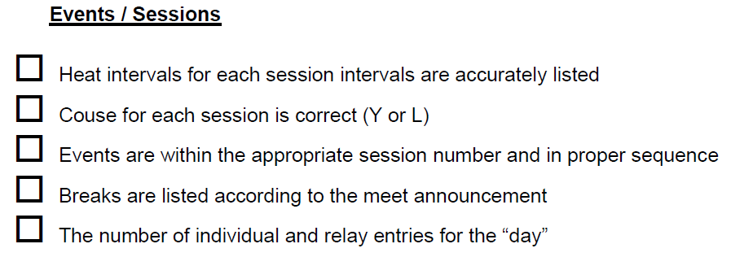

Slide 12
Meet Documentation
Psych Sheet – list of swimmers in each event – typically sorted fastest to slowest
Session Report – order and start time for each event in a session
Check-In Sheets – for positive check-in events
Scratch sheets or cards
Heat Sheets – events in order with seeding

Slide 13
Checking Entries
Error and exception reports
Hy-Tek – wrong age group, qualifying times, etc.
USA-S – registration issues, proof of time
NOTE: If changes are made…document!
Computer Change Form

Slide 14
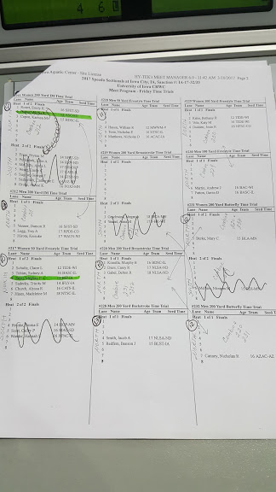
Event Seeding
Pre-Seeded Meets (most common)
After entry deadline, seed all events
Work with Entry Chair and Meet Referee to finalize timelines (breaks, session start times)
Print heat sheets, lane timer sheets, session reports
Timelines
Back up meet often!
DO NOT reseed events after printing heat sheets
NTs are assigned randomly to lanes
Re-seeding WILL results in CHANGES
Missing swimmers will result in empty lanes

Slide 15
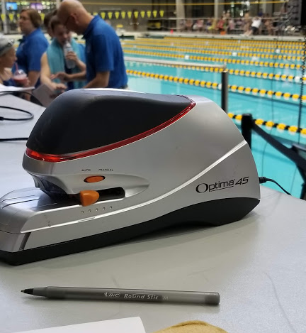
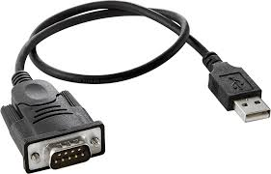
Meet Time… What to bring?
Meet Binder
Meet Information
Session Reports
Final Meet Recon
File System and Binders
Pens/pencils/highlighters (have extras as someone always asks)
Stapler/extra staples
Clips/paperclips
Ruler
Post-it Notes
Tape (Scotch & Masking Tape)
Colored paper for re-seeds/deck-seeded events
3-hole punch
Scissors
Rubberbands
Flashdrive
Extra Cables/Ext Cords
DQ Slips
Wristbands
Extra Forms – Counter, sign-in

Slide 16
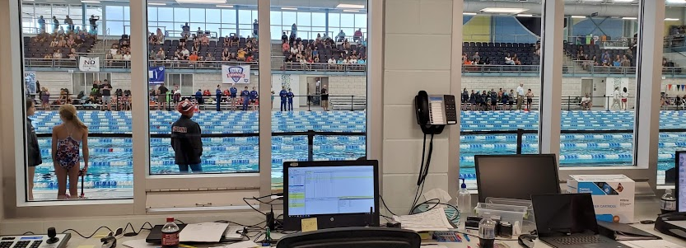
Where will admin be set up?
On Deck
In Meet Management Office

Slide 17
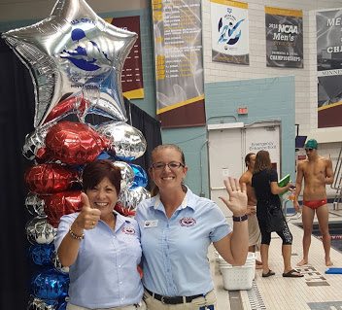
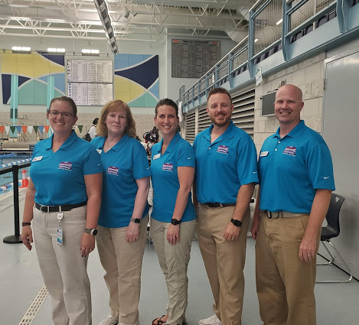
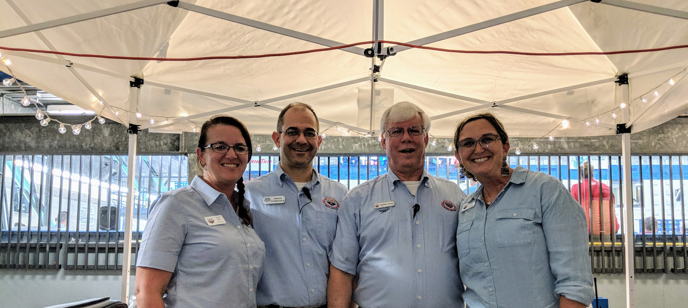
Do you have an admin team?
Current Session
Clerk of Course
Future Session
Computer Operator

Slide 18
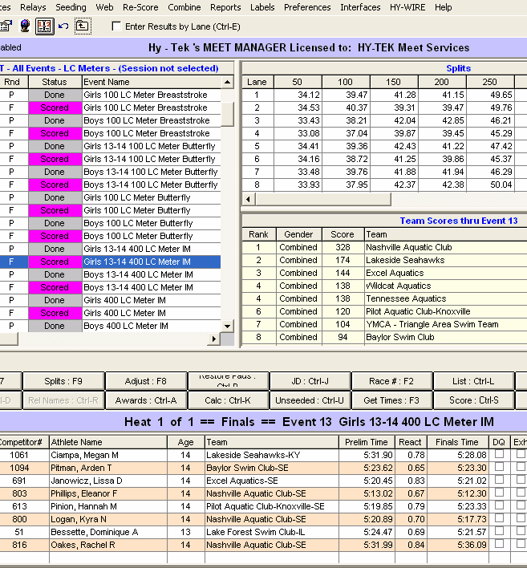
Local Database Settings & Other Checklist Items
Run Screen – List & Score Preferences
Time Standards included
Scoring Set Up Correctly (see MM Scoring & Awards Settings Handout)
Footers (graphics do NOT transfer with back-up)
Meet loaded into timing console?
Names to scoreboard?
Timing System tested?
Proper heat sheets to Officials?
Lane timer sheets printed & distributed?
I typically add the host club’s license file to my flash drive just in case I need to create any reports after the meet.

Slide 19
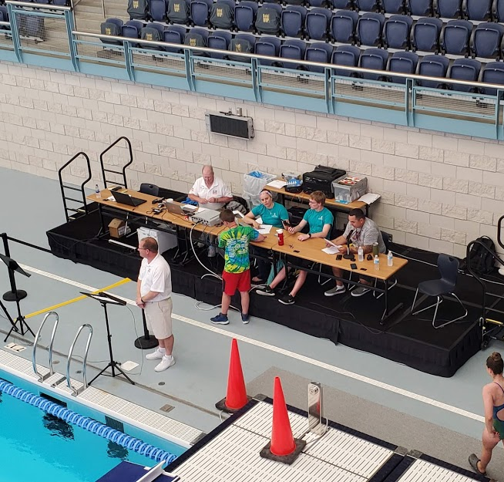
Responsibilities During/After the Meet See Admin COC Responsibilities Document – This also includes What to Print List
Reconcile Times
Code DQ’s (if not using DQ slips w/codes)
Review Results before posting
Officials Split Requests
Get Back-Up of MM File-Post meet
Store meet paperwork

Slide 20
Questions? The best way to learn is to practice – at meets! Get a meet manager license from your club or LSC, download a meet back-up and play around a bit. Contact me anytime with questions or to be added to my Admin DropBox folder (I ask that you add whatever you’d like…don’t delete what others have created) Tracy Meece tjmeece1974@gmail.com 320-247-0940

