Slide 1




SPORTS NUTRITION FOR SWIMMERS
Kelly Pritchett, PhD, RD, CSSD
Leah Dambacher, MS, RDN

Slide 2
QUIZ TIME
KAHOOT!
Notes:
https://play.kahoot.it/v2/?quizId=320b404b-5c31-4030-a275-6ab4354d14c8

Slide 3
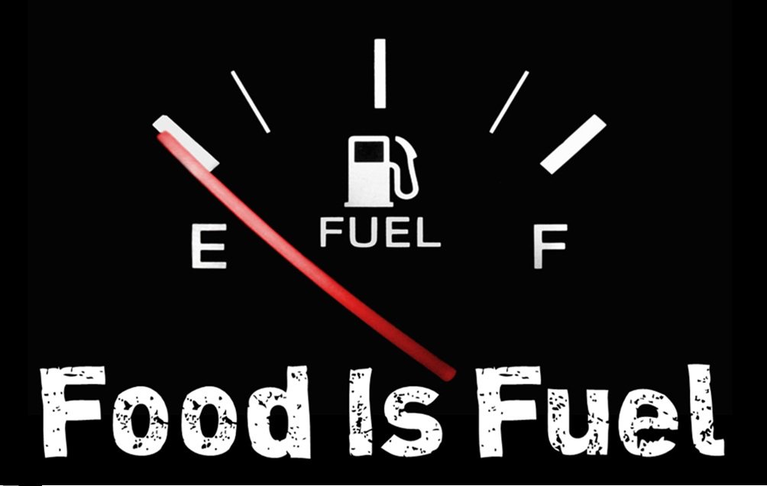
Why is nutrition important for athletes?
Energy levels & performance
Enhanced recovery
Reduced risk of injury and illness
Confidence
Enjoyment & Lifelong benefits

Slide 4
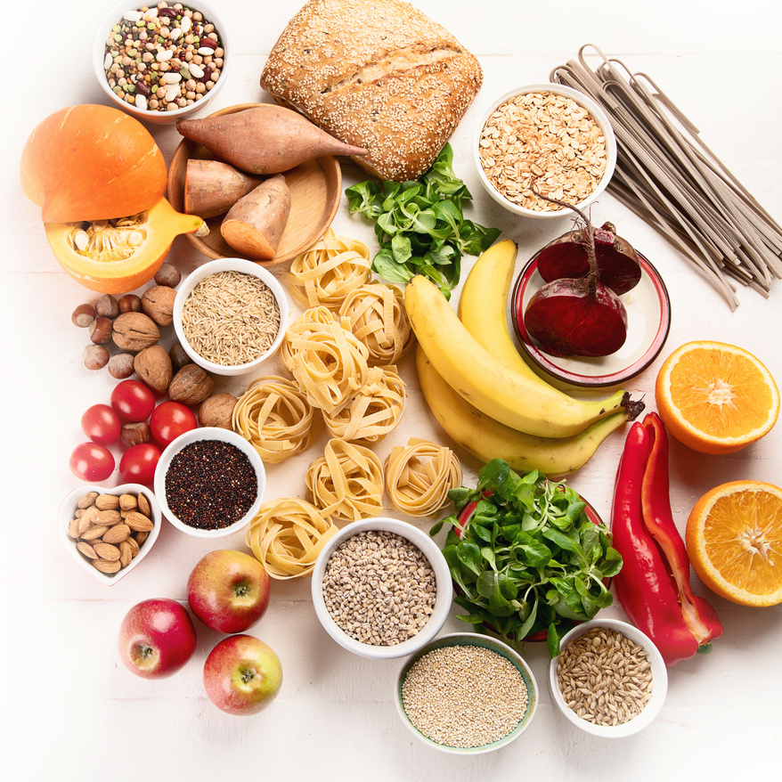
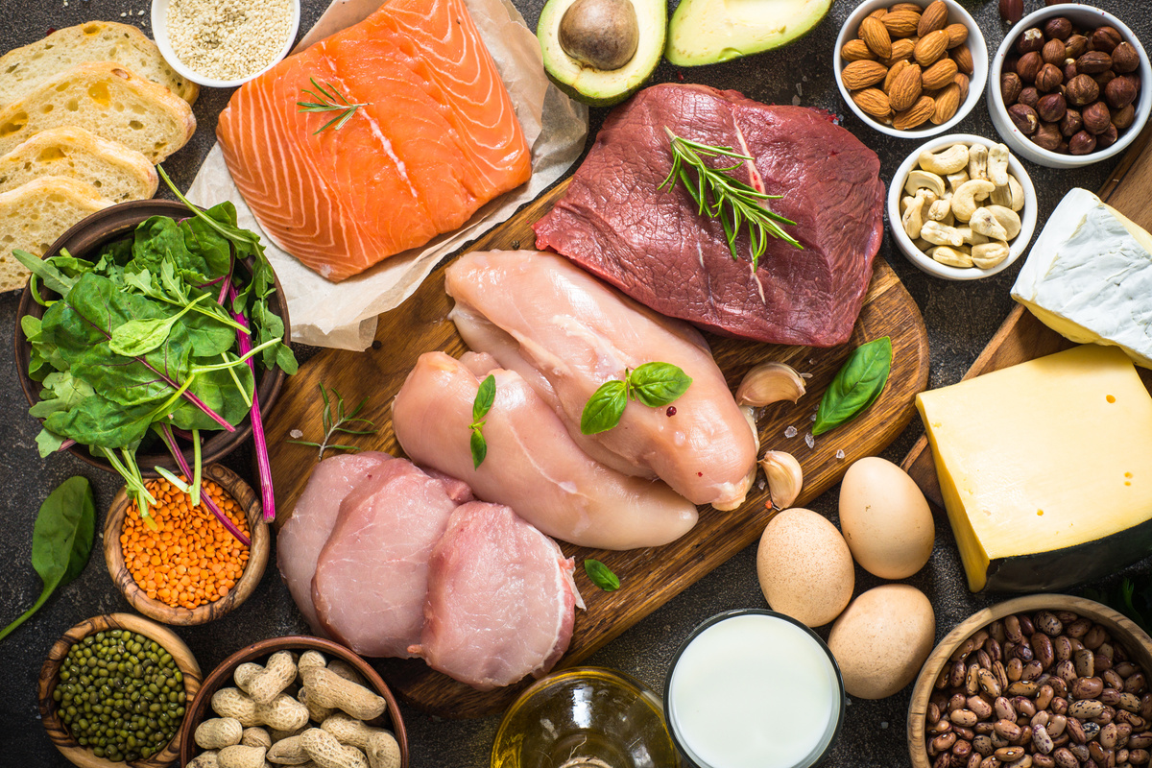
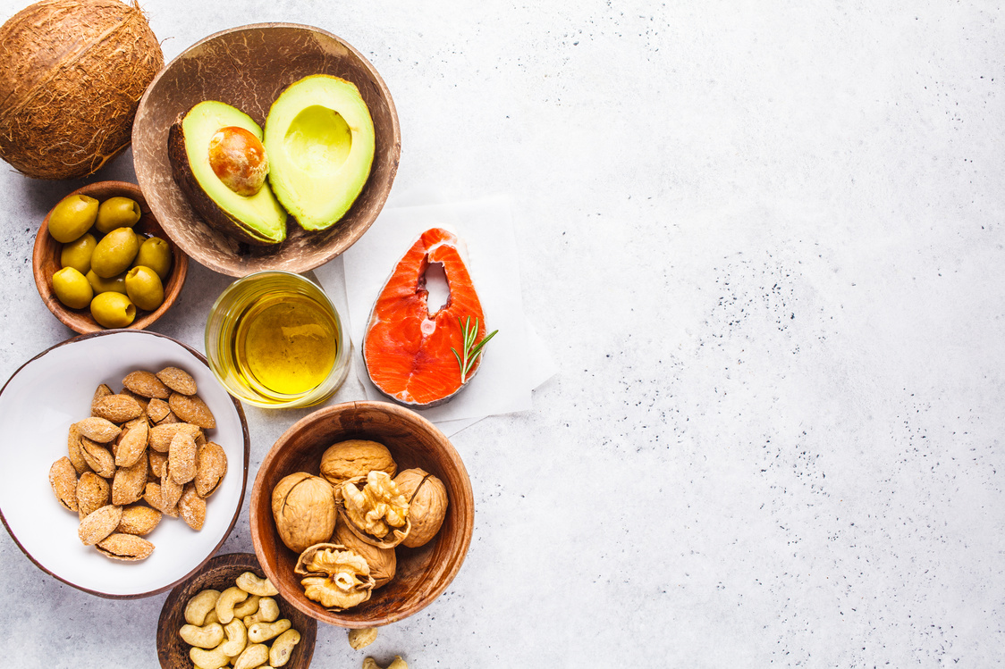
Sources of Fuel
CARBOHYDRATES
  Main source of fuel during exercise
  Need: depends on weight & training intensity
  Before, During, & After exercise
  Ex: starches/grains, fruits, vegetables, dairy
PROTEIN
  Structural component for muscles
  Small amount of fuel
  Need: depends on weight
  Poultry, fish, beef, eggs, tofu, nuts/seeds, dairy
FAT
  Secondary source of fuel
  Need: ~25% total calories
  Ex: oils, nuts/seeds, avocado, fish

Slide 5
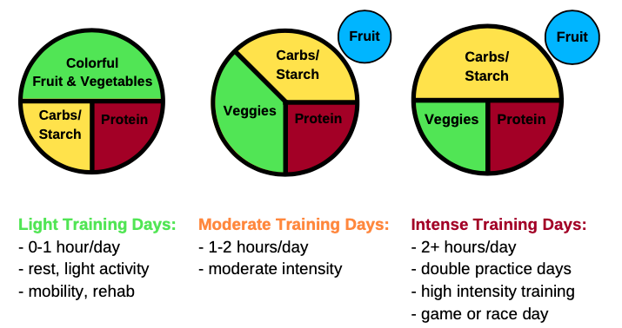
Athlete Performance Plate
Notes:
Depends on: training intensity, duration, goals, time of training season
Real life examples of each performance plate

Slide 6
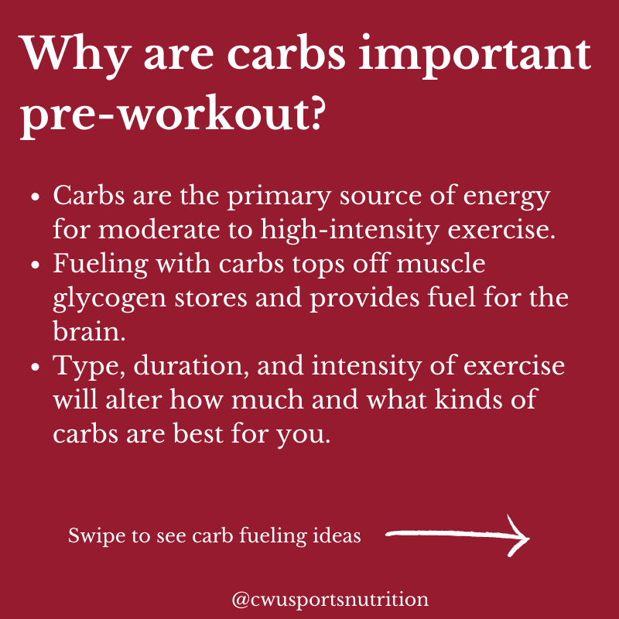

Slide 7
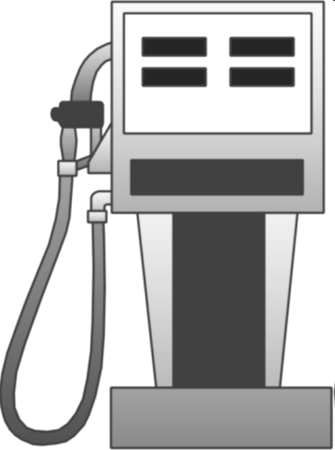

Energy from
"FUEL for the work required"
Glycogen→ Energy stored in muscle & liver
Excellent for ALL sports!!
Glycogen
Liver and Muscle
Glycogen
Notes:
7

Slide 8
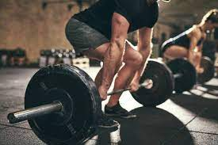
The Power of Protein
Q: What does protein do?
A: Repair & rebuild muscles
Q: How much do you need?
A: 0.5-0.8 g/lb BW daily
- Ex: 150lb athlete:
150lbs x .7g/lb = 105 grams/day
Good sources:
4 oz chicken breast
1 c milk
5 oz Greek yogurt
1/2c Quinoa
1/2c Beans
Eggs
1/2c cottage cheese

Slide 9




Vitamins & Minerals to Consider
IRON: Carries oxygen to the tissues.
Deficiency: Tired, shortness of breath, poor endurance, cold, pale skin, high heart rate, frequent injury, recurring illness and irritability
Female athletes age 14-18: 15 mg/day. Males age 14-19: 11 mg/day
CALCIUM: bone development, heart/muscle contraction, nerve function
Deficiency: body breaks down bones to get more
90% peak bone mass by age 18
Male + Females age 9-18: 1300 mg of calcium daily.
VIT AMIN D: calcium absorption, muscle contraction, immune function
Risk for deficiency: indoor sport, dark/extremely fair skin, sunscreen use/limited sun exposure
Male + Female age 1-70: 600 IU per day, or 10-30 min sun exposure
SPORTS PHYSICAL + BLOOD WORK
Common for athletes to have low Iron + Vitamin D levels.
When making the appointment for a physical: Ask for blood work + Add iron, ferritin, & vitamin D labs
  Complete Blood Count – does not include a ferritin/Vitamin D labs!

Slide 10
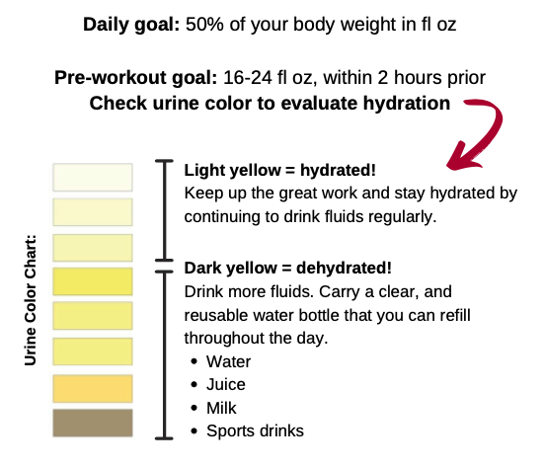
Hydration
Dehydration = cause of fatigue & poor performance
Water needed to transport nutrients to muscles
  Helps to remove waste
Notes:
Daily: 8-12 cups
Before: 2-3 cups 2-3 hours before
During: 1 cup every 20 min (4-8 sips)

Slide 11
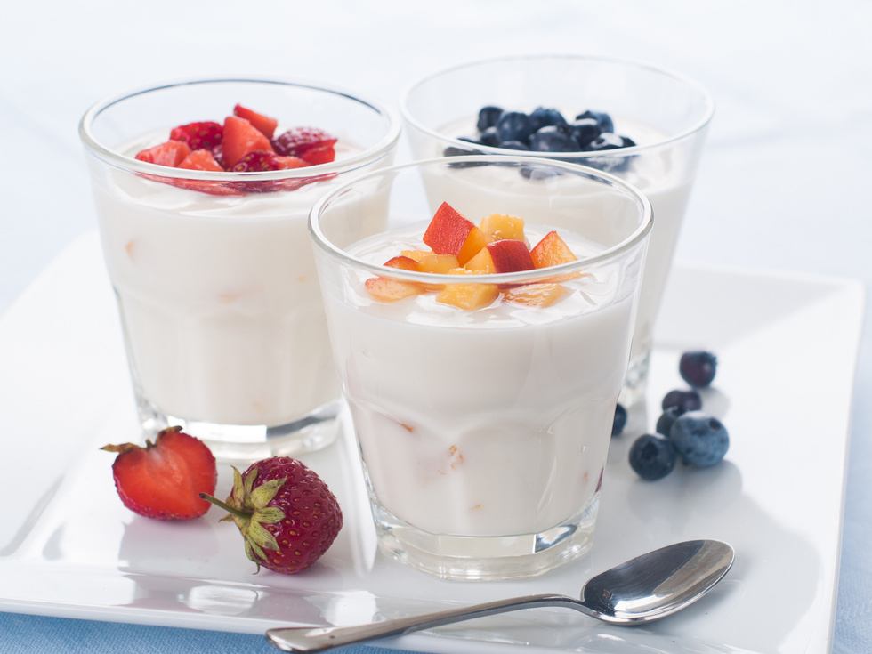

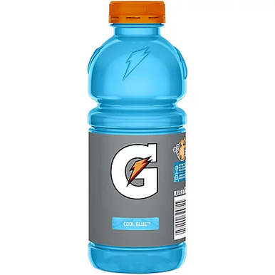
Pre-Fueling & Hydration
  Pre exercise meal ~2-3 hr prior
    Low in fat and fiber, high in carb, moderate in protein
  Short on time?
    Choose easily digestible carbs - toast, yogurt, applesauce
  Can't tolerate food prior?
    Choose a liquid meal - smoothie
  Hydration considerations
    2-3 cups ~2-4 hr prior
    1 cup ~10-15 mins prior
    Electrolytes
Remember, it's always best to practice fueling strategies prior to competition day!

Slide 12
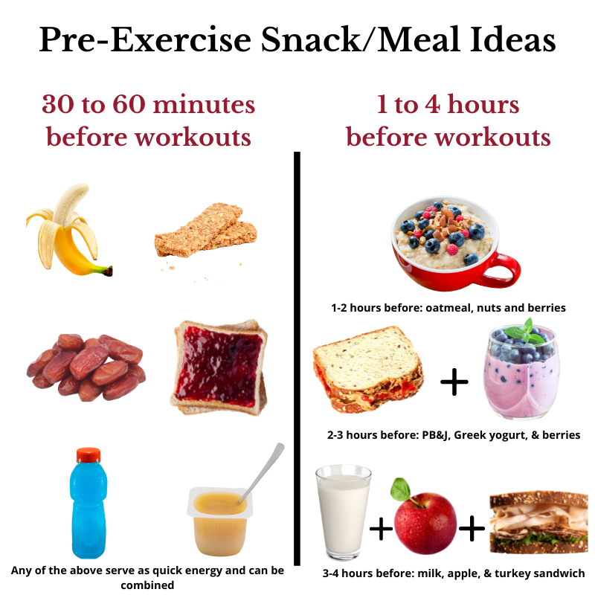

Slide 13
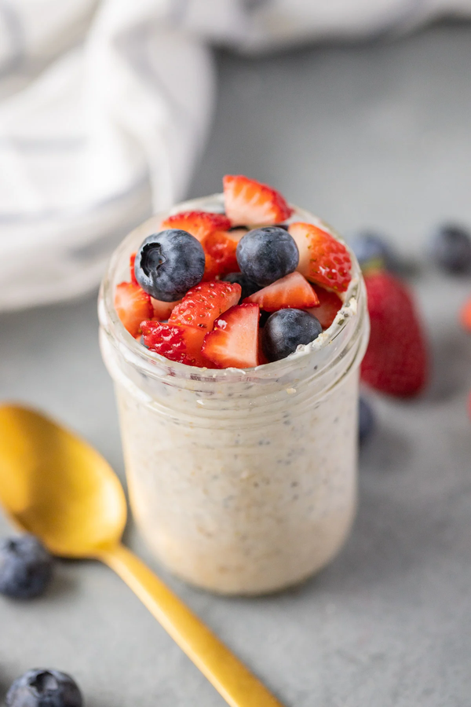
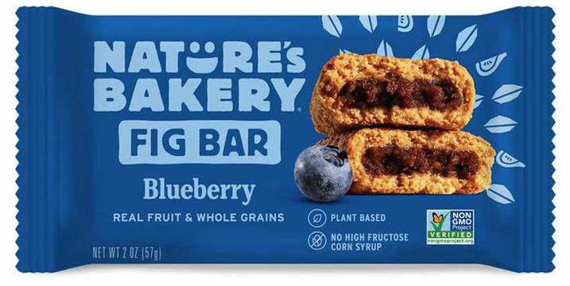
Other Options for On-The-Go Pre Fueling
  ~3-4 hr before
    Overnight oats w/ berries
    Bagel w/ nut butter, fruit, & water
    Granola, cereal w/ milk, fruit, & water
  ~1-2 hr before
    Granola bar w/ pretzels, fruit, & water
    PB&J
  30-60 min before
    Banana & water
    Fig bar
    Sports drink

Slide 14
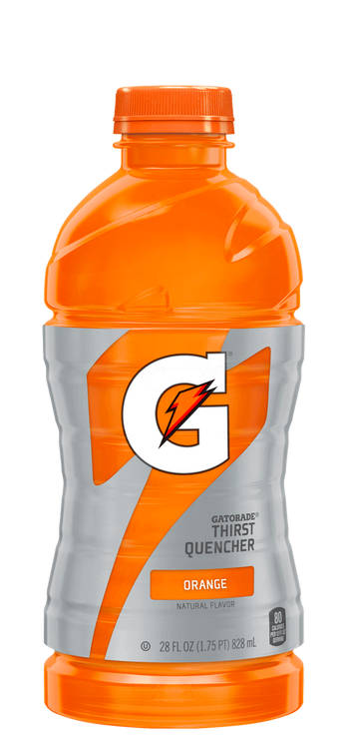

During Fueling & Hydration
  Quick carbs at breaks or between races
    Sports drinks, applesauce packet, fruit snacks
  Hydration
    Sip at breaks ~4 to 6 sips/15 min
      Avoid dehydration
  More time in between races?
    Aim for quick lunch/snack options
      PB&J, fig bar, banana, granola bar, crackers, choc milk
Notes:
1 cup = 4-8 sips
~20 oz/hour

Slide 15
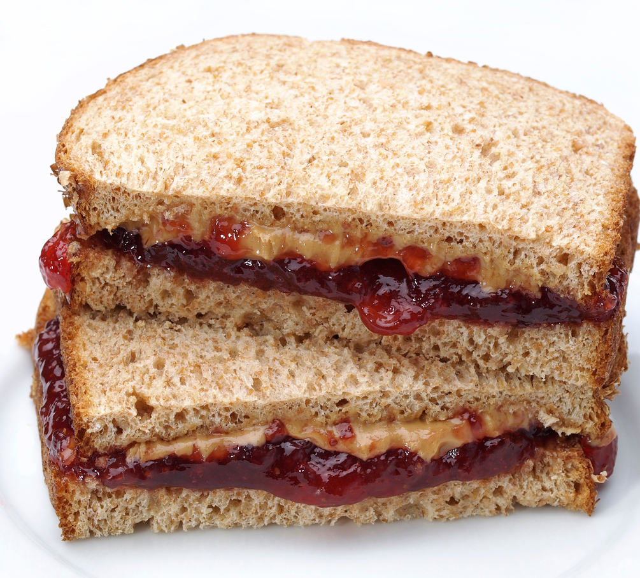
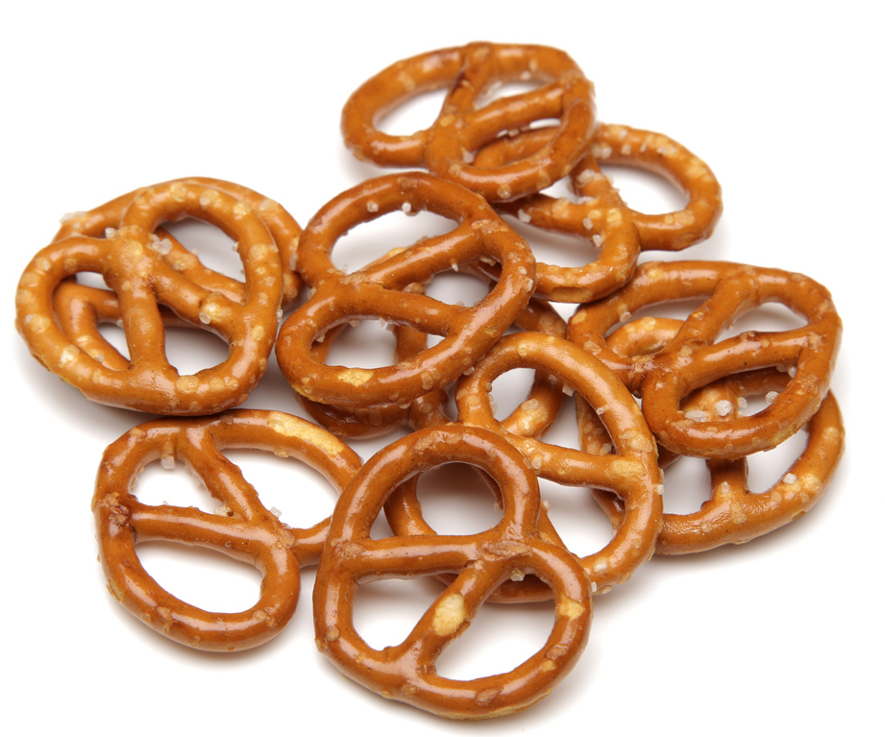
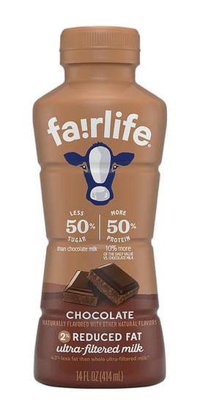
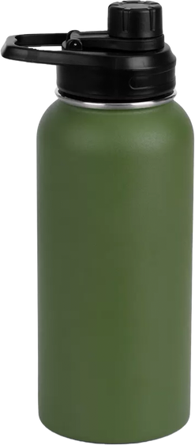
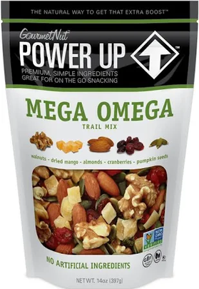
Post Fueling & Hydration
  Easily digestible carbs post-game
    Choc milk, fruit, pretzels, sports drink
  ~30-45 mins
    High carb & moderate protein
    Choc milk, turkey sandwich/PB &J, fruit
    Trail mix & fruit
    Repeat 2 hours post exercise
  Rehydrate!
    Carry a water bottle, sip often
    Replace electrolytes
    20-24 oz fluid for each lb lost

Slide 16
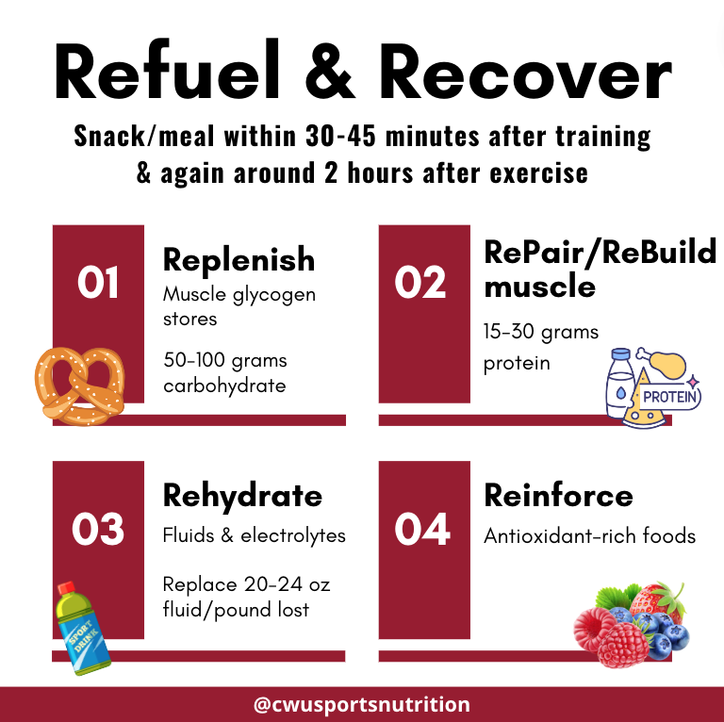
“You aren’t finished with your training until you’ve done your recovery nutrition"

Slide 17

Travel Nutrition
  Plan to bring your "Magic” meal with you if needed
  Stay hydrated - take small, frequent sips
  Pack usual snacks/meals
  Cooler/lunch box
  Freeze extra water bottles
  Salty snacks
Notes:
Nothing new on meet day

Slide 18
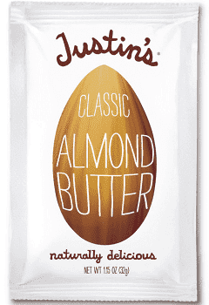
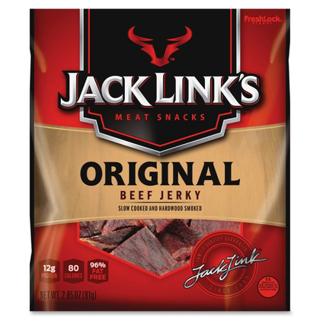
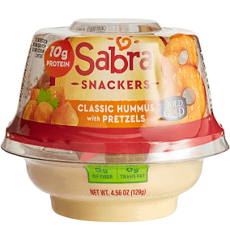
Additional On The Go Snacks
  Overnight oats
  Energy balls
  Jerky
  Tuna packet w/ crackers
  Crackers w/ nut butter
  Nuts
  Dried fruit
  Smoothie
  Protein bar
  Hummus & veggies/pretzels
  Cheese sticks
  Hard-boiled egg

Slide 19

OPTIMIZING ENERGY AVAILABILITY
Goal: regular eating schedule that optimizes energy levels throughout the day AND during workouts

Slide 20


@CWUSPORTSNUTRITION

Slide 21
QUESTIONS?
@CWUSPORTSNUTRITION

Slide 22
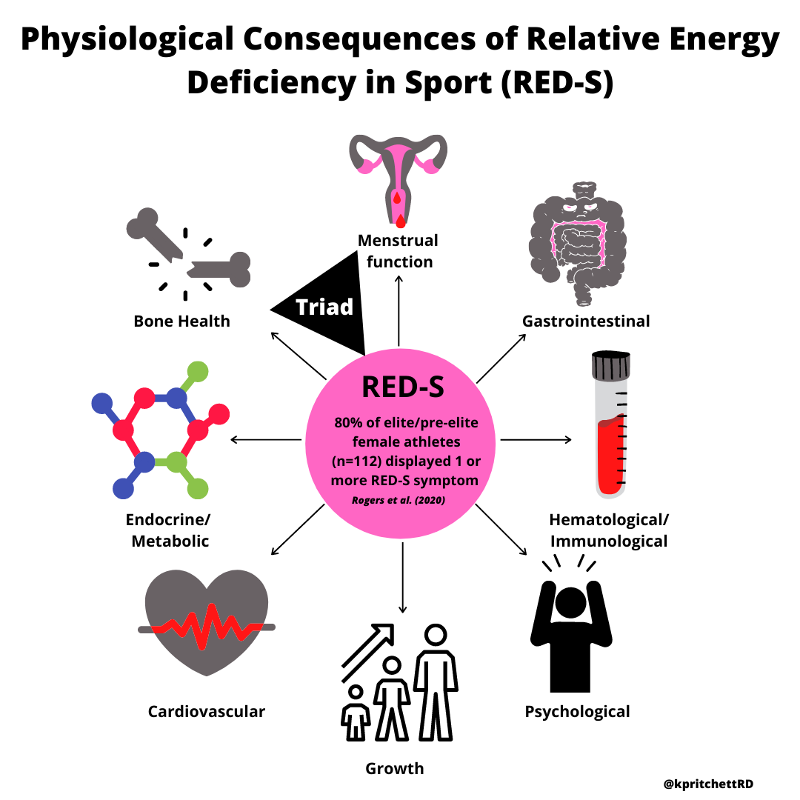
Underfueling has physiological consequences

Slide 23
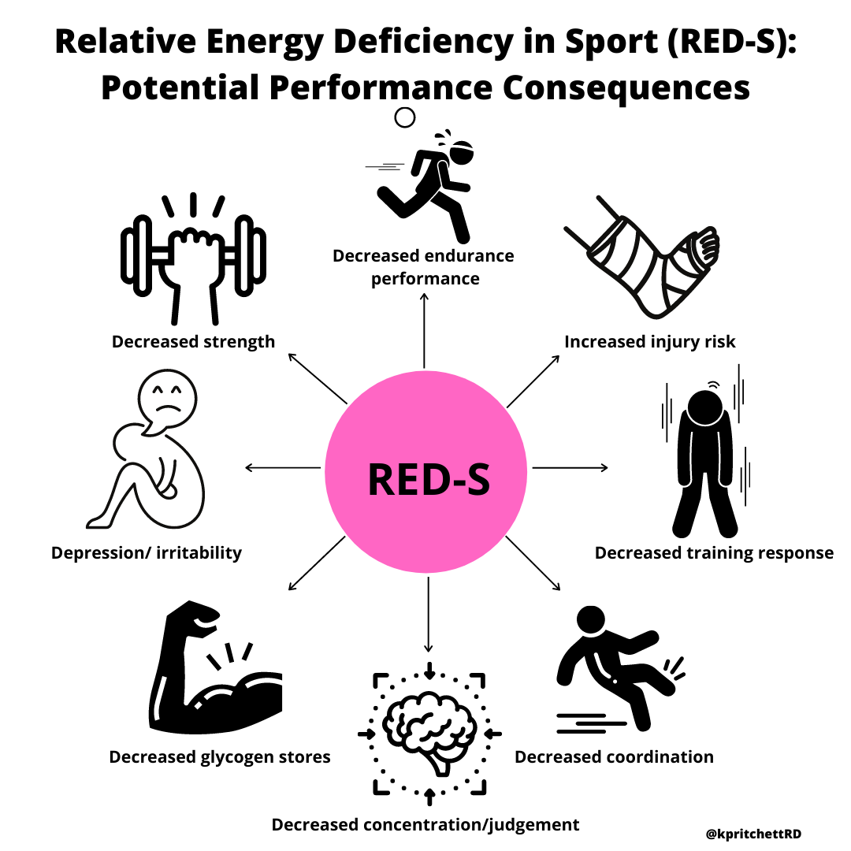

Slide 24
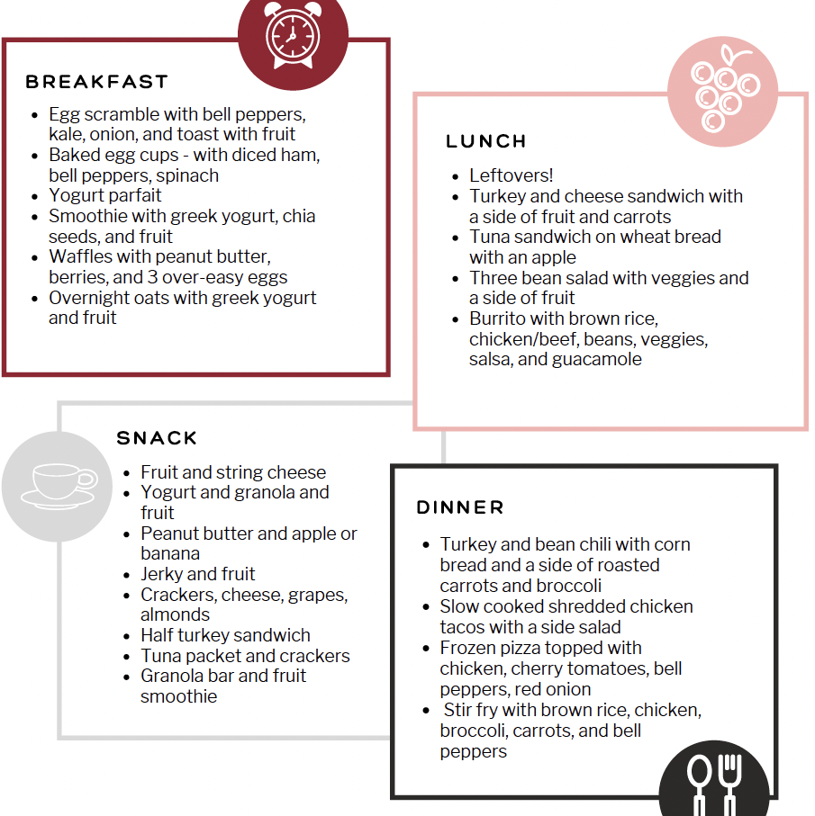
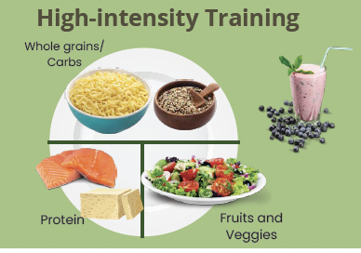

Slide 25
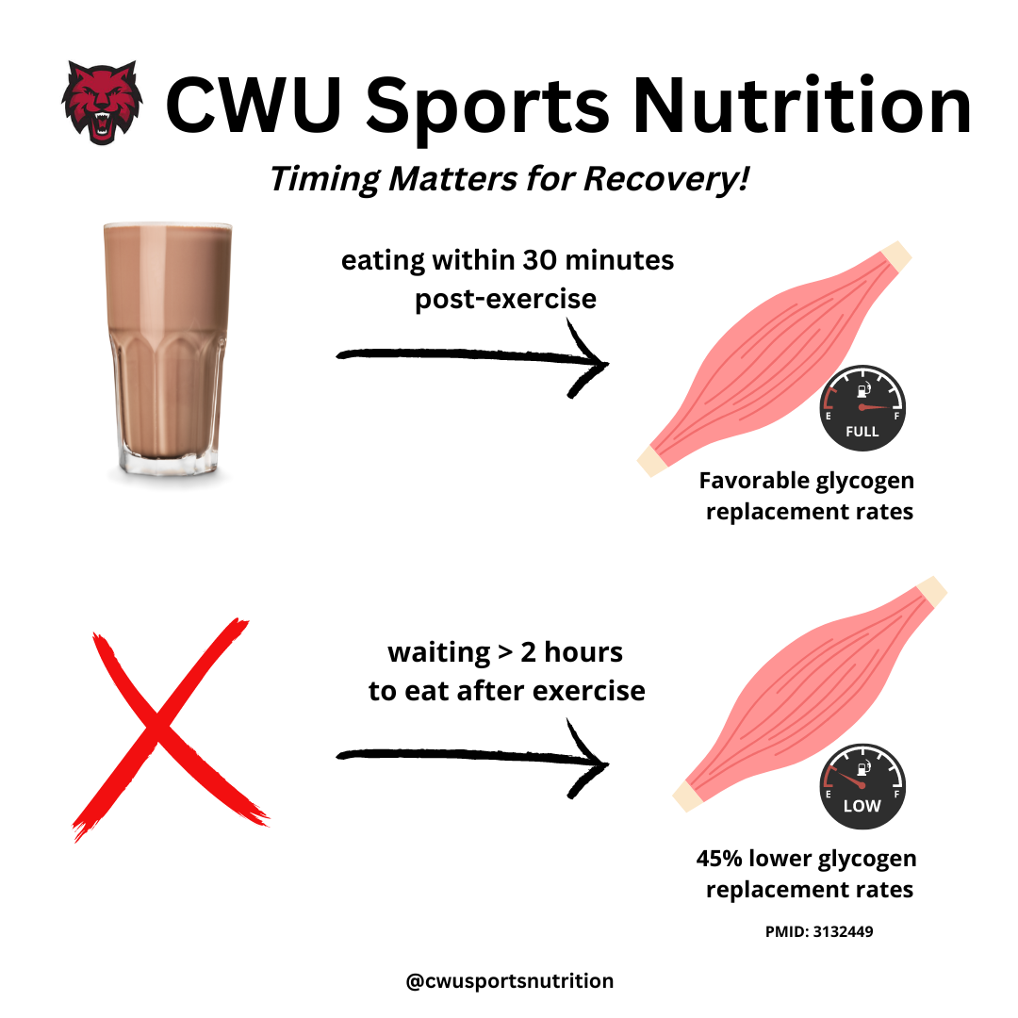

Slide 26
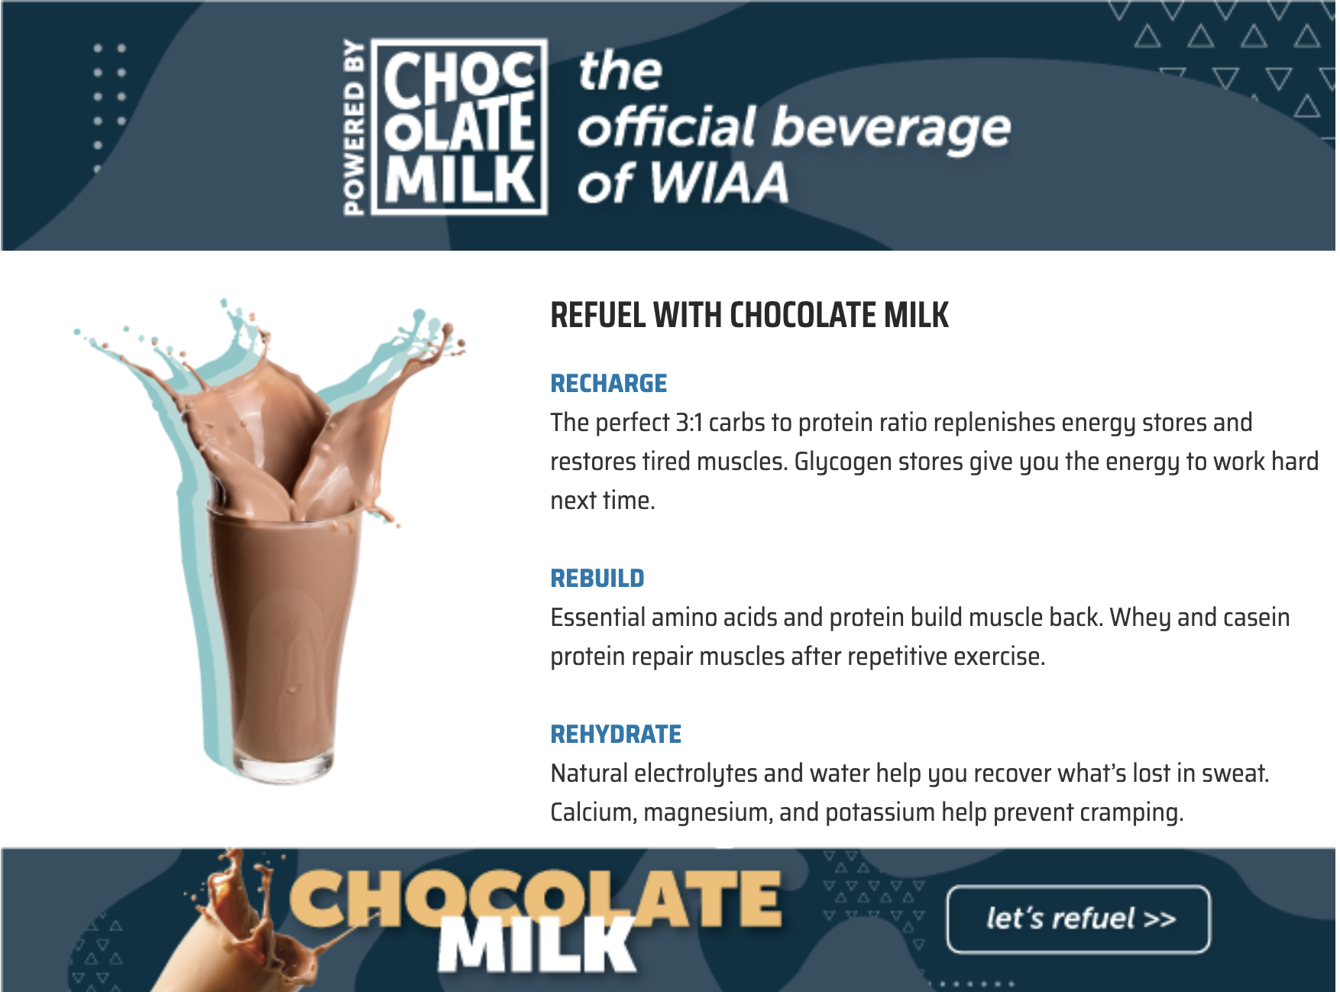
Chocolate Milk for Recovery
Notes:
Why?
Readily available
Relatively inexpensive
Similar kcal content as carbohydrate replacement beverages
CHO: PRO ratio
Provides fluids, sodium
High in calcium
Main Ingredients: Cow’s milk, sugar, cocoa, salt, vitamin A & D3

Slide 27
Remember this if you remember nothing else:
  Carbs are important
  Hydrate before, during, and after
  Carbs + Protein within 30 minutes after exercise

Slide 28
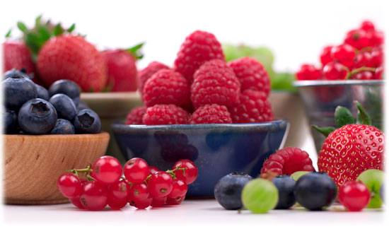
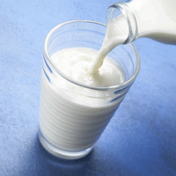
Athlte Nutrition Overview
Common Athlete Challenges
Lack of knowledge
Poor choices when eating out
Busy schedule
Relying on convenience foods
Supplements and sports foods

