Slide 1
Elgin Cyclones Swim Team
Parent Information Night Winter 2026
Wednesday, September 17th, 2025
Virtual

Slide 2
Section 1: Staff
IN THIS SECTION, WE WILL LEARN:
Who the staffers of ECST are.
What their roles are.

Slide 3
ECST Staff
Director, Head Coach & Senior Group Coach
Nathaniel Bohrer (nathaniel.bohrer@elginil.gov)
Gold Group Coach
Jayden Trevino (coachjayden@elgincyclones.org
Silver Group Coach
Julius Markowski (coachjulius@elgincyclones.org
Bronze Group Coach
Jayden Trevino (coachjayden@elgincyclones.org)
Pre-Team Group Coach
Cindy Kracen (coachcindy@elgincyclones.org)

Slide 4
Booster Club
Normally, the Cyclones have a booster club that meets the second Wednesday of the month at 6pm.
Discuss, plan, and prep upcoming events (meets, volunteering, events)
Brainstorm ideas for engagement for public and for swimmers.
If you’re interested in having a hand in the ongoing ECST schedule on the day-to-day and the big season picture, reach out to Nathaniel Bohrer.

Slide 5
Officials
All USAS teams have parent officials attached to their club
ECST has none at this point, all left with graduating seniors
Officials on the team are required to host the number of meets we’re looking to host moving forward, so we need at least 6 on staff at all times (will take more though!). Currently looking at 2 inbound, hoping for at least 4 more!
USAS training and membership fees covered by ECST, as well as your USAS membership fees for any swimmers on the team while a registered official. Training process is relatively simple, and generally short. Officials interested should be fully certified as S&T or Admin before Blizzard Blast 2025.
Chat with Nathaniel Bohrer for more information and/or to start the process if interested!

Slide 6
Section 2: Registration
IN THIS SECTION, WE WILL LEARN:
How to register a new swimmer.
How to re-register a returning swimmer.
What the registration fee structure and payment options are.

Slide 7
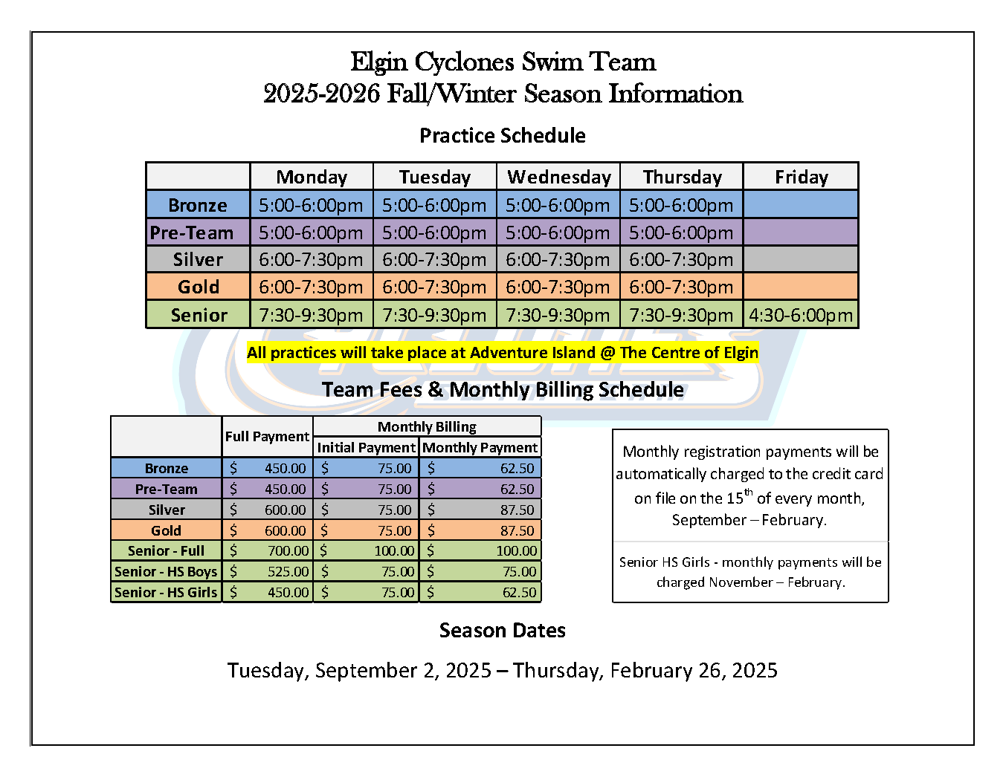
New Swimmer Registration
Open evaluations and enrollment
One morning event, happens ahead of every season!
Generally placed into Bronze/Pre-Team unless already a swimmer
Moving onto further teams is based on a combination of age, performance, competitive milestones, and perceived effort.
Fees are to right, there is no change in fee amount for pay-in-full or monthly installment billing.
Prices may seem high, but they are ~$40-200+ dollars less expensive per month compared to nearby swim teams
Monthly payments are assessed the 15th of each month automatically, if there are issues you will receive an email notifying you of whatever trouble has happened.
Be sure to check your bank statements to confirm charges have been successful.

Slide 8
Returning Swimmer Registration
If you’re registering again after having been on the team previously, there is no re-evaluation (we know how your swimmers swim)
An email/phone call with Nathaniel is sufficient for registration with confirmation of the following:
Monthly billing or pay in full
Confirmation of last 4 digits of card you wish to use
Will need to hop on a call/meet in person if not already on file
T-shirt size of swimmer(s)
This will cut down on the google forms needed for special order apparel.
Fees are cheaper in the summer, winter season lasts 2 additional months!

Slide 9
Section 3: Swim Seasons
IN THIS SECTION, WE WILL LEARN:
What the seasons are for a full swim year.
What to expect from each (hint: it’s not terribly different).
In-meeting – WebTrac Demo!

Slide 10
Winter Season (General)
Winter season runs from the first week after Labor Day to the end of February
Fees are higher – longer season
Our yearly picture day occurs in late October/early November during winter season
Our yearly team banquet occurs in March following the winter season.
We will have home meet this winter season, aiming for more next year.
Blizzard Blast 2025 (Dec 12-14)

Slide 11
Summer Season (General)
Summer Schedule – General
Begins first or second week of April
Indoor from April to end of May
Outdoor (Wing Park Family Aquatic Center/ Lords Park Family Aquatic Center) from June to end of season
Regionals mid-July, only time-qualified swimmers continue.
First meet ~first full weekend of May, ~1-2 meets per summer season.

Slide 12
Section 4: Website(s)
IN THIS SECTION, WE WILL LEARN:
What is SportsEngine Motion (Team Unify)?
How to access the team website through SportsEngine Motion.
What you can do on the website.
How to access the SportsEngine Motion app.
In meeting – website deep dive!

Slide 13
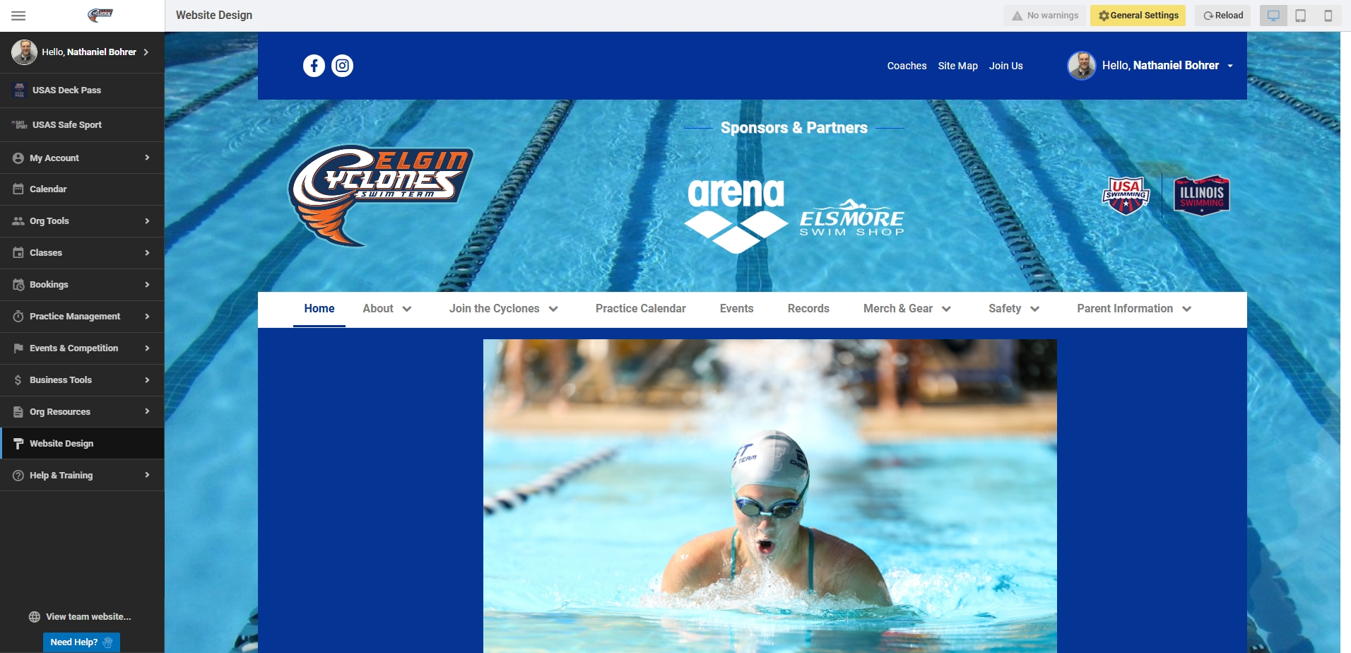

What is SportsEngine Motion?
SportsEngine Motion (formerly Team Unify) is our internal organization website, as well as our outward facing website host.
It is also an app, which skips the facing website straight to the internal format. There is less functionality on this version, but it is useful for short, quick needs.

Slide 14
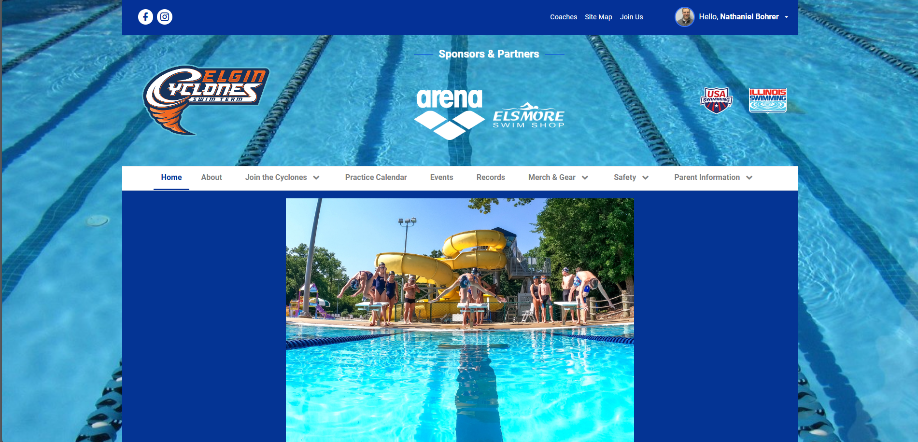
The Website
www.elgincyclones.org
Redirects to our SportsEngine team site
What can you do on the website?
See practice schedule
View and commit for team events, meets, etc.
Access the USA Swimming registration portal
Access the Elsmore and GoldStar stores.
View pertinent information for a variety of swim-team related concerns.
And more! ☺

Slide 15
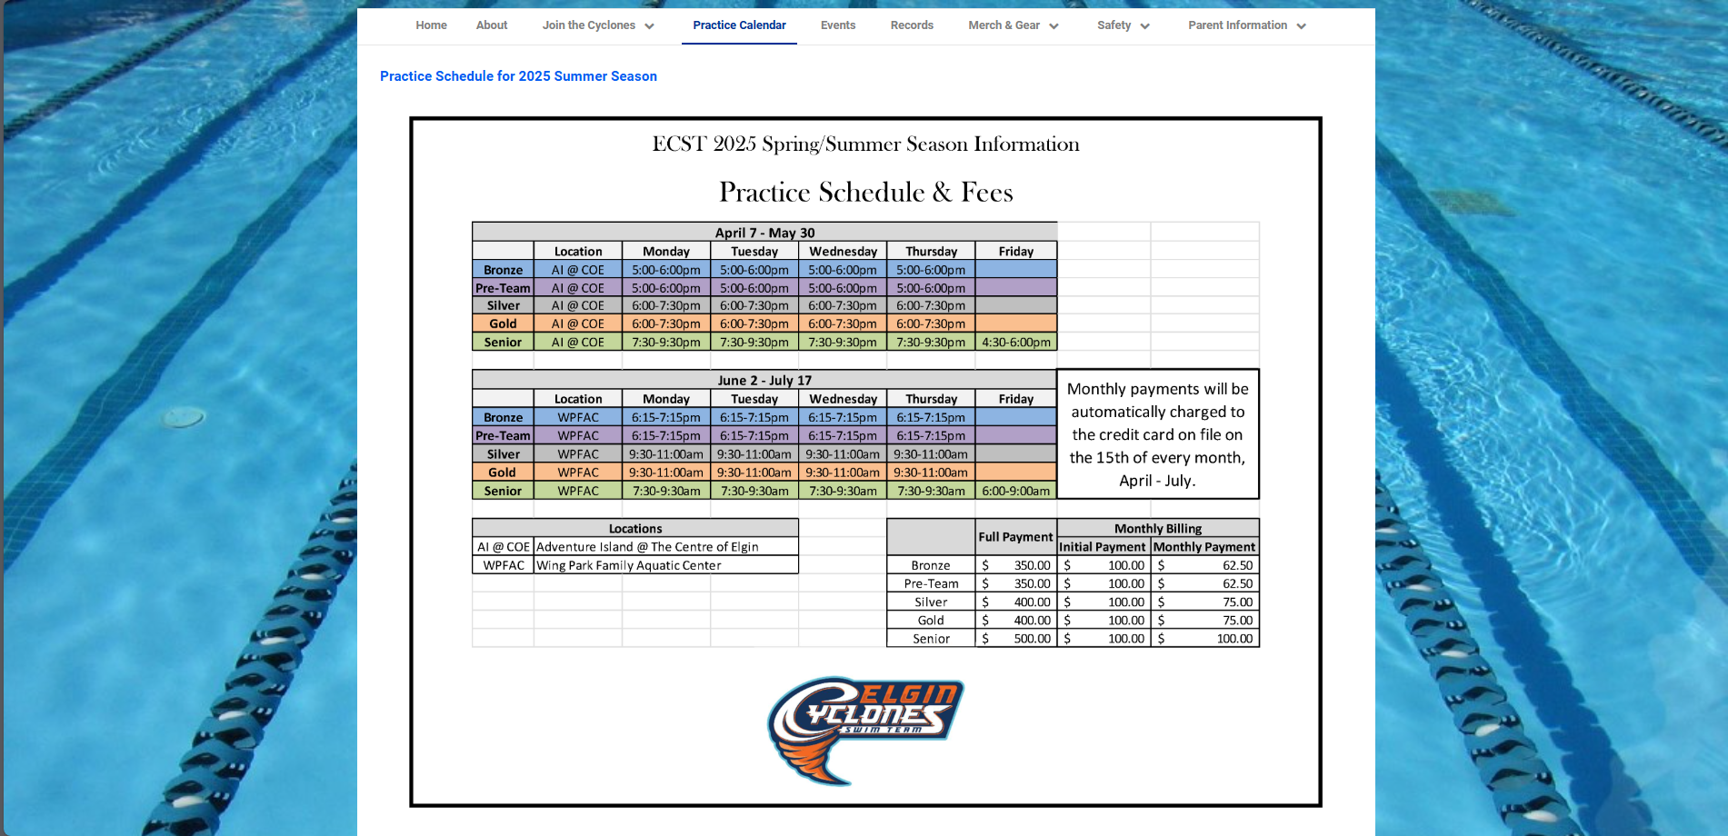
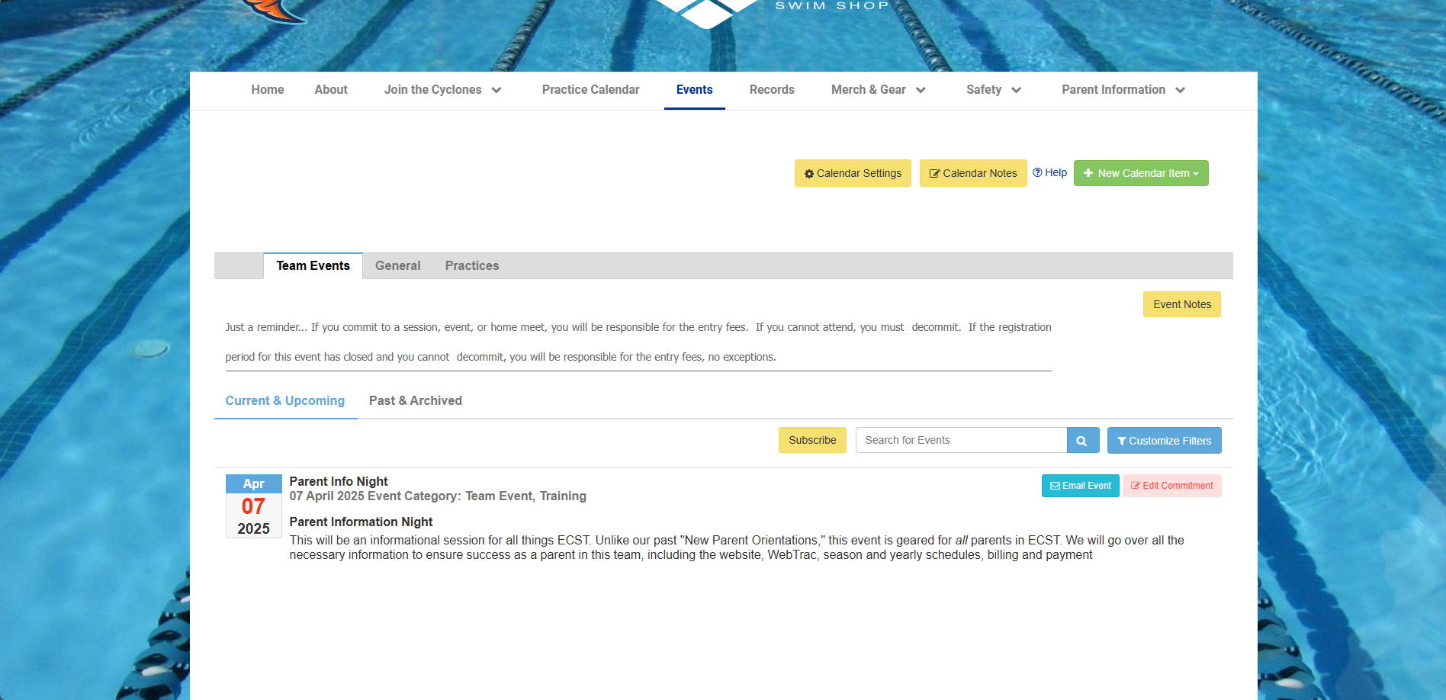
Viewing Schedules
Practice Schedule
Located under “Practice Calendar”
Contains the PDF practice schedules for the full summer season (along with the fee structure)
Team Events
Found under “Events”
Full calendar for all posted team events from meets to meetings.

Slide 16
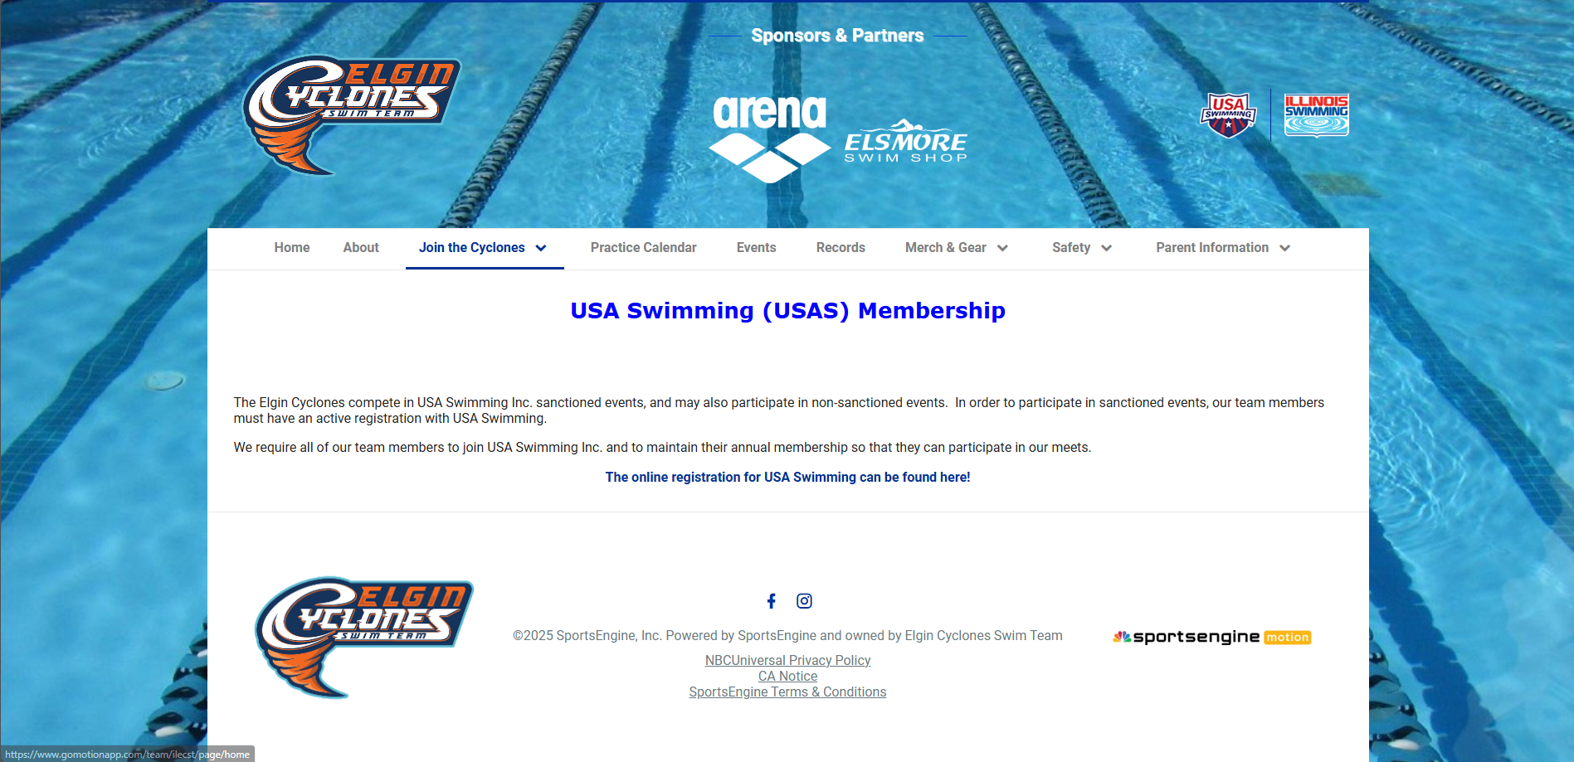
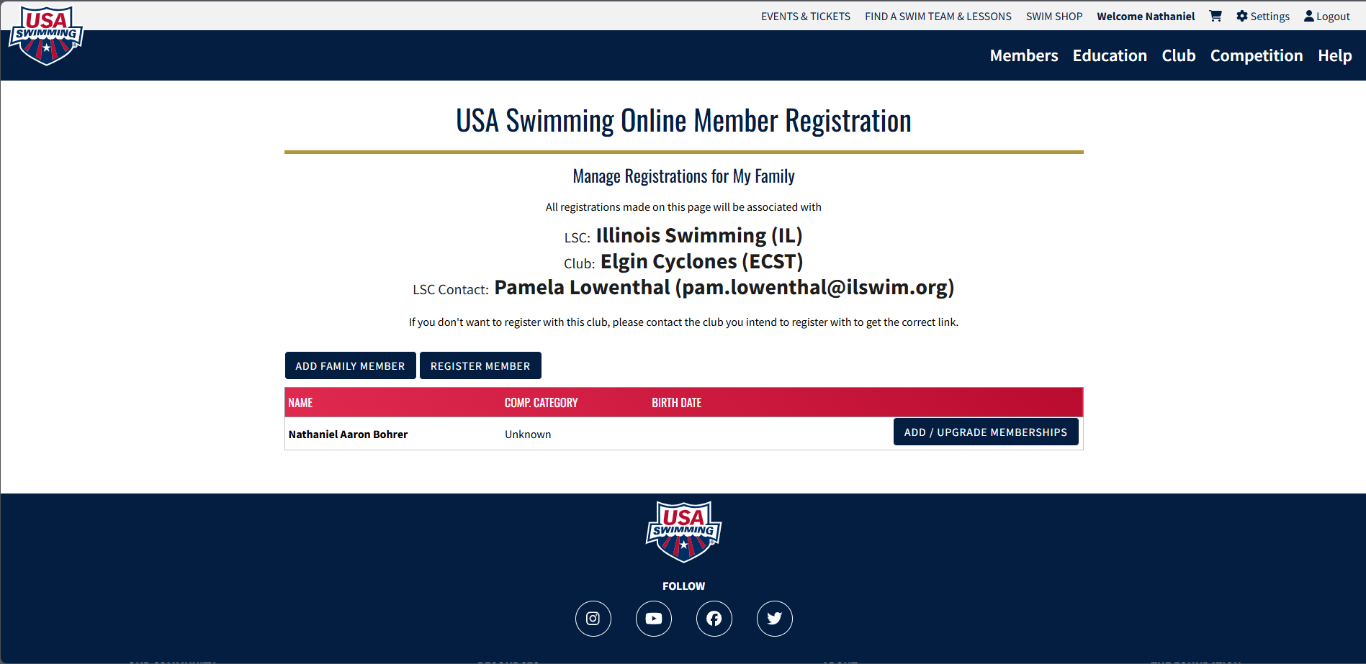
USA Swimming Membership Portal
The portal to register your swimmer (and yourself) with USA Swimming can be found under “Join the Cyclones” - “USA Swimming Membership”
By clicking through the link on the website, you are redirected to USA Swimming’s Website, where you will have to sign in.
As I already have a membership, this is the screen that appears. A new member will have the chance to create a new parent account and subsequently add an athlete account for competition.

Slide 17


Apps!
USAS app
View membership information, member cards, standing, upcoming USAS certified competitions by competitor.
SportsEngine Motion app
View and commit to events, meets, etc.
View practice schedules and attendance history.
Meet Mobile
View heet sheets for ongoing and past meets during and after the meet (membership is $19.99/year for full visibility.

Slide 18
Section 5: Practices
IN THIS SECTION, WE WILL LEARN:
Swim practice schedules.
What to expect in practices.
Layout
Season planning
What to expect from practicing (as a swimmer and as a parent).

Slide 19
Practice Schedule
Practice will take place at Adventure Island @ The Centre of Elgin all winter
100 Symphony Way, Elgin, IL 60120
This winter, the pool will be closed after BB-early January 2026. we will practice in an alternate location TBD.

Slide 20
What does a swim practice look lik?
Early Season
Technique focused, remembering or learning how to swim for exercise.
Lower yardage and/or less intense.
Building or re-building a “base.”
Slowly ramp distance and intensity ahead of first meet of season, continue building to either:
Championship meet.
Strong meet opportunity.
Late Season
Goal specific workouts
Could be a specific meet, likely a specific time for a specific event
May differ by athlete and even change meet to meet.
Generally, moderate-high intensity and length until taper begins
Taper – a period of effort/intensity decrease ahead of an important meet, intended to increase form while decreasing fatigue.

Slide 21
Please Remember!
As a multi-effort sport, swim practices may look drastically different across the season, a month, a single week, or even between athletes
Based on upcoming meets, season goals, swimmer events, overall relative effort.
Most practices are a mix of high-intensity efforts and longer endurance efforts, with technical elements highlighted through specific drilling.
Will be adjusted throughout the season by your swimmer’s coach.
Will not be the same across events, age groups, etc.
IMPORTANT: Let the coaches coach! What works for another swimmer may be infeasible for your swimmer. If you have any urgent questions, they will be happy to answer them after a practice.

Slide 22
Section 6: Meets
IN THIS SECTION, WE WILL LEARN:
How to register(commit) a swimmer for a meet.
What is a swim meet?
Schedule
Events
Heats
Awards
What is meet mobile?
ECST Home Meets
Championship Meets
Time cuts

Slide 23
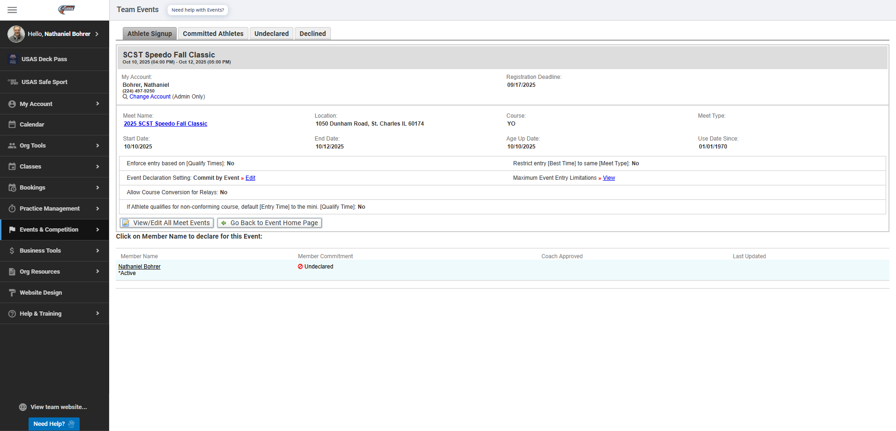
Committing for a Swim Meet
Swim meet participation is an expected portion of your time on ECST, as a competitive (recreation) swim team. We are currently requiring at least partial participation in 1 meet a month at minimum.
Swim meet commitment is decided by the coach and parents based on skill of swimmer and personal availability.
Commitment can be done by athlete on SportsEngine Motion through the specific event in “Events & Competition”, clicking into the meet itself, clicking on your athlete, and selecting “yes” while potentially selecting events/sessions/days you’re able to compete.
There are individual fees associated with each meet, comprised of heat entry fees, athlete surcharges, as well as USAS fees. These are separate from your Registration fees.

Slide 24
Meet Fees
Meet fees from any month are assessed the 1st of the following month (or closest weekday)
Fee amount dependent on what was billed
How many events did your swimmer enter the water for?
Was there an athlete surcharge?
What USAS fees are required?
What IL Swimming fees are required?
Any unpaid fees will be left on your account as due, can be paid through WebTrac.
Will receive an email notifying you of any failed charges.
Please check your bank statements to ensure successful billing periods.
These fees are unrelated to the registration fees, or other one time fees.

Slide 25
Swim Meet?!
Prepare your swimmer!
Night before – carbs (like a lot of carbs), lots of sleep, stretching, mindfulness.
Day of – calorie sufficient meal in advance of meet, consistent routine with minimal rush, arrive early, check in with coach. Swim hard.
Meal should be a couple hours in advance of meet start.
Meets are stressful, more so with more voices. Let your team coach take care of your swimmer. Your job is to enjoy the spectacle of a meet and cheer hard for the team.
Like a track meet, swimming is event based. Your swimmer may have a gap between meet start and their event, or between two events in the day.
Will warm up ahead of meet with team, will likely NOT need to warm up again
If needed, the coach will get that scheduled and your swimmer taken care of.
Please keep direct communication with coaches to a minimum during meets, there are tons of moving parts as is.

Slide 26
Swim Meet Layout
Swim meets are broken into Events, which each have several heats determined by committed athletes.
Awards are given based on event, not heat (there may be some heat winner trinket but no ribbon).
For example:
Event – 100y Freestyle
Heats – 6 (8 swimmers each heat)
48 total swimmers in event, of which the top 8-16 will receive a ribbon for placement.
Heats are seeded by time (seed time), generally fastest to slowest or slowest to fastest.
Lanes are also seeded by time, the fastest heat seeds will get lanes 4/5.

Slide 27
Swim Meet Layout (Continued)
On a bigger scale, swim meets are divided into “Sessions”
Meets may be (normally) 1-7 sessions.
If your swimmer is not in a session, you are not required to attend that session
There will be a warmup and positive check-in
DO NOT FORGET POSITIVE CHECK-IN
Sessions can be no more than 4 hours long, broken into constituent events based on required heats per event.
Generally, younger kids swim early and older kids swim late.
Generally, distance is early in the course of a meet, and relays are placed towards ends of sessions.

Slide 28
Home Meets
Volunteering Requirements
Meets are an enormous undertaking, requiring all hands to make successful. Because of this, we require all families of the team to volunteer at least 2 sessions for every child enrolled.
Variety of needed jobs including marshalling, admissions, concessions, and more!
Home Meets this season
Blizzard Blast 2025
Home Meets in 2026
Spring Splash (May 2026)
Regionals (pending approval)
Pumpkin Plunge (October 2026)
Blizzard Blast (December 2026)
Other volunteering opportunities at team events and/or potential fundraisers outside of meets

