Slide 1

Administrative Official Webinar
Notes:
Spelled out Administrative – and took out the redundancy of Training Webinar

Slide 2
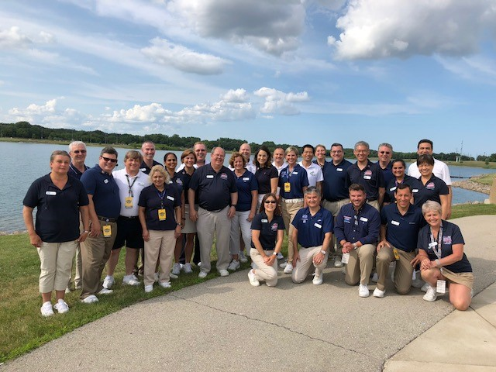
Welcome
Webinar housekeeping
Monitor your audio
Keep video active
Introductions
Name and Club
Children who swim
Why are you becoming an Admin Official?
Your goals for today

Slide 3
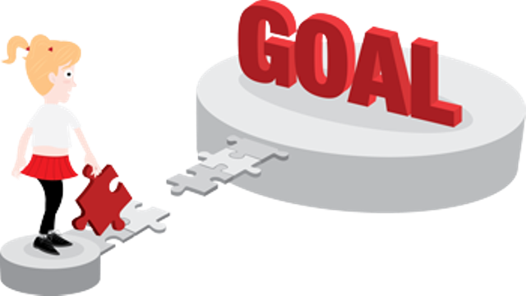
Webinar Goals
Answer your questions!
Walk through the AO process to ensure understanding and clarify timing adjustments
Get you ready for on-deck training
Untangle Registration and Certification

Slide 4
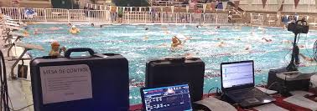
Being an
Admin Official

Slide 5
Important Qualities of Officials
Benefit of doubt to swimmer
Safety-focused
Equitable
Professional
Consistent
Team Players
Impartial
Athlete-focused
Knowledgeable
Committed

Slide 6
Knowledge
Impartiality
Consistency
A Good Official

Slide 7

AOs Power Meets
The smooth running of meets is our job
We certify times

Slide 8
Before a Session

Slide 9
Entry Process
Session Reports

Slide 10
Entry Process
Session Reports
Qualifying Times

Slide 11
Entry Process
Session Reports
Qualifying Times
Entry Limits

Slide 12
Entry Process
Session Reports
Qualifying Times
Entry Limits
Registration

Slide 13
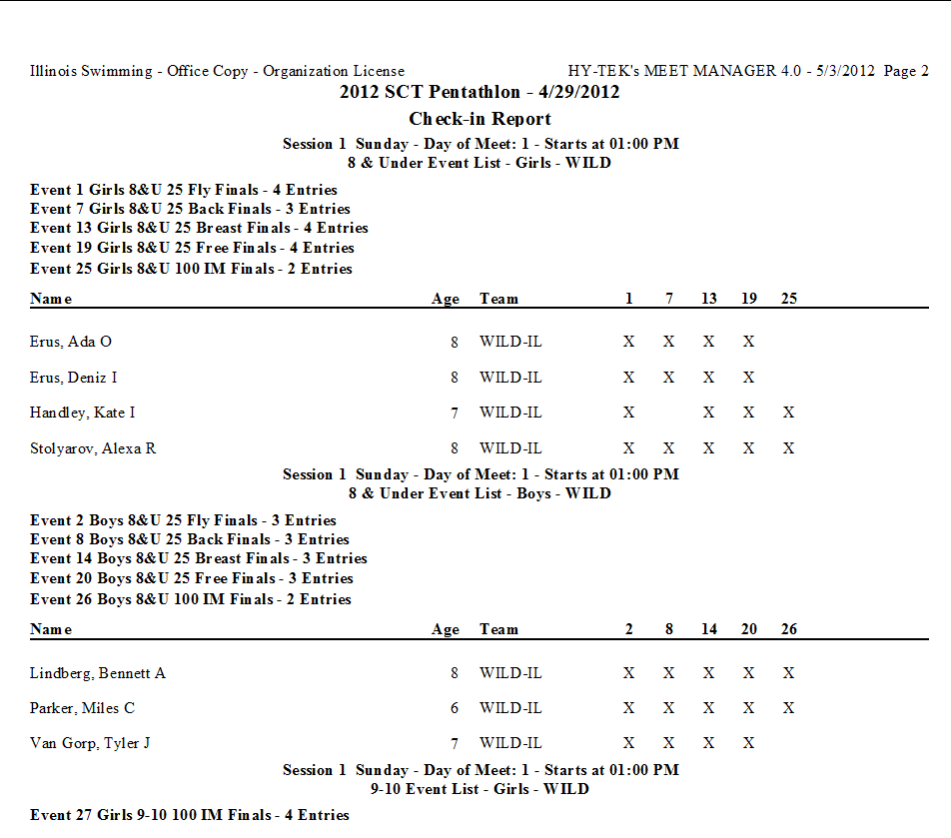
Positive Check-In

Slide 14
Seeding Rule Quirks
PRELIMS/FINALS
20 athletes in an 8-lane pool
Rule: Top 3 heats circle seeded
Lane | 1 | 2 | 3 | 4 | 5 | 6 | 7 | 8
Heat 1 |  | O | I | C | F | L | R
Heat 2 | T | N | H | B | E | K | Q
Heat 3 | S | M | G | A | D | J | P

Slide 15
Seeding Rule Quirks
PRELIMS/FINALS
20 athletes in an 8-lane pool
Rule: Top 3 heats circle seeded
TIMED FINALS
18 athletes in an 8-lane pool
Rule: No less than 3 in a heat
Lane | 1 | 2 | 3 | 4 | 5 | 6 | 7 | 8
Heat 1 |  | O | I | C | F | L | R
Heat 2 | T | N | H | B | E | K | Q
Heat 3 | S | M | G | A | D | J | P
Lane | 1 | 2 | 3 | 4 | 5 | 6 | 7 | 8
Heat 1 |  |  | R | P | Q
Heat 2 | O | M | K | I | J | L | N
Heat 3 | G | E | C | A | B | D | F | H

Slide 16
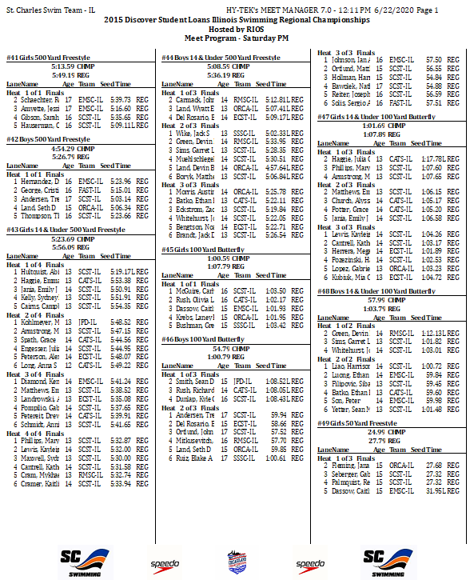
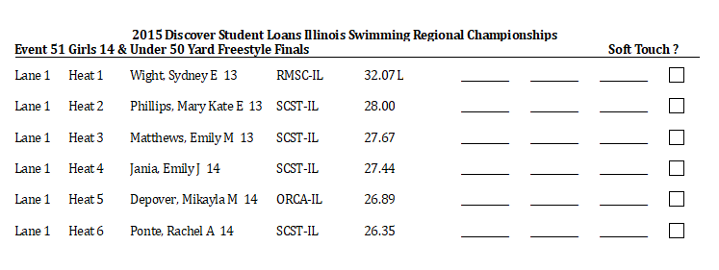
Finishing Touches
Heat Sheets
Lane Timer Sheets
Upload to Timing System

Slide 17
Timing Judge

Slide 18

Where Times Come From
Automatic
Timing
Timing systems are ranked by accuracy
Semi-Automatic
Timing
You’re a detective!
Manual
Timing
Order of Finish

Slide 19
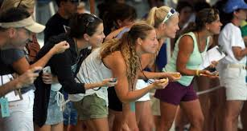
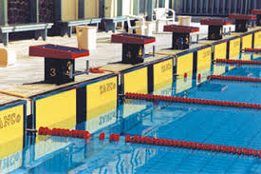
Timing Judge Basics
Primary timing systems presumed correct
Heat malfunctions – late system start
Lane Malfunctions – bad pad/touch
Don’t change time without a good reason
“.30 seconds or greater”

Slide 20
Heat Malfunction
Lane | Pad | Button | Watch 1 | Watch 2 | Avg Watch | Diff | Official Time
1 | 2:17.24 | 2:17.45
2 | 1:56.99 | 1:57.13
3 | 1:57.38 | 1:57.45
4 | 2:13.32 | 2:13.60
5 | 2:13.39 | 2:13.53
6 | 2:23.73 | 2:23.94
What the computer sees.
How do you know what (if anything) is wrong?

Slide 21
Heat Malfunction
Lane | Pad | Button | Watch 1 | Watch 2 | Avg Watch | Diff | Official Time
1 | 2:17.24 | 2:17.45 | 2:19.24 | 2:19.27
2 | 1:56.99 | 1:57.13 | 1:59.00 | 1:59.02
3 | 1:57.38 | 1:57.45 | 1:59.41 | 1:59.51
4 | 2:13.32 | 2:13.60 | 2:15.36 | 2:15.41
5 | 2:13.39 | 2:13.53 | 2:15.44 | 2:15.60
6 | 2:23.73 | 2:23.94 | 2:25.75 | 2:25.78
Watches LOOK wrong!
Order of finish – 2-3-4-5-1-6

Slide 22
Heat Malfunction
Lane | Pad | Button | Watch 1 | Watch 2 | Avg Watch | Diff | Official Time
1 | 2:17.24 | 2:17.45 | 2:19.24 | 2:19.27 | 2:19.25 | 2.01
2 | 1:56.99 | 1:57.13 | 1:59.00 | 1:59.02 | 1:59.01 | 2.02
3 | 1:57.38 | 1:57.45 | 1:59.41 | 1:59.51 | 1:59.46 | 2.08
4 | 2:13.32 | 2:13.60 | 2:15.36 | 2:15.41 | 2:15.38 | 2.06
5 | 2:13.39 | 2:13.53 | 2:15.44 | 2:15.60 | 2:15.52 | 2.13
6 | 2:23.73 | 2:23.94 | 2:25.75 | 2:25.78 | 2:25.76 | 2.02
 |  |  |  |  |  | 12.33/6 = 2.05
Difference is even across the heat
Order of finish – 2-3-4-5-1-6

Slide 23
Heat Malfunction
Lane | Pad | Button | Watch 1 | Watch 2 | Avg Watch | Diff | Official Time
1 | 2:17.24 | 2:17.45 | 2:19.24 | 2:19.27 | 2:19.25 | 2.01 | 2:19.29
2 | 1:56.99 | 1:57.13 | 1:59.00 | 1:59.02 | 1:59.01 | 2.02 | 1:59.04
3 | 1:57.38 | 1:57.45 | 1:59.41 | 1:59.51 | 1:59.46 | 2.08 | 1:59.43
4 | 2:13.32 | 2:13.60 | 2:15.36 | 2:15.41 | 2:15.38 | 2.06 | 2:15.37
5 | 2:13.39 | 2:13.53 | 2:15.44 | 2:15.60 | 2:15.52 | 2.13 | 2:15.44
6 | 2:23.73 | 2:23.94 | 2:25.75 | 2:25.78 | 2:25.76 | 2.02 | 2:25.78
 |  |  |  |  |  | 12.33/6 = 2.05
Average added to pad (and button for potential lane malfunction)
Order of finish – 2-3-4-5-1-6

Slide 24
Lane Malfunction 1
Lane | Pad | Button | Watch 1 | Watch 2 | Avg Watch
1 | 38.10 | 38.35 | 38.52 | 38.11 | 38.31
2 | 41.02 | 41.31 | 41.20 | 41.30 | 41.25
3 | 38.60 | 38.22 | 38.30 | 38.28 | 38.29
4 | 38.41 | 38.44 | 38.20 | 38.66 | 38.43
5 | 35.18 | 35.57 | 35.52 | 35.26 | 35.39
6 | 35.43 | 35.63 | 35.31 | 35.50 | 35.40
2 OOF returns, they do not agree:
5-6-1-3-4-2
5-6-3-1-4-2
Lane 3:
Early button
OOF Mixed
Watch Supports Button

Slide 25
Lane Malfunction 1
Lane | Pad | Button | Watch 1 | Watch 2 | Avg Watch
1 | 38.10 | 38.35 | 38.52 | 38.11 | 38.31
2 | 41.02 | 41.31 | 41.20 | 41.30 | 41.25
3 | 38.60 | 38.22 | 38.30 | 38.28 | 38.29
4 | 38.41 | 38.44 | 38.20 | 38.66 | 38.43
5 | 35.18 | 35.57 | 35.52 | 35.26 | 35.39
6 | 35.43 | 35.63 | 35.31 | 35.50 | 35.40
2 OOF returns, they do not agree:
5-6-1-3-4-2
5-6-3-1-4-2
Lane 5:
Late button
OOF and watch support pad

Slide 26
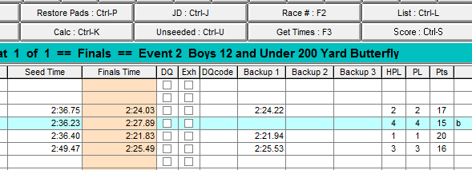
Lane Malfunction 2
No button
OOF: 5-3-6-4
Watch: 2:27.50

Slide 27
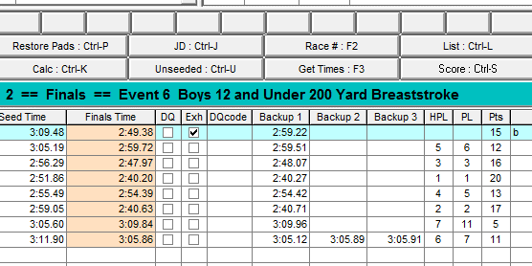
Lane Malfunction 3
Late button
OOF: 4-6-3-1-5-2-8-7
Watch: 2:49.50

Slide 28
Lane Malfunction 4
Lane | Pad | Button | Watch 1 | Watch 2 | Avg Watch | Official Time
1 | 4:44.91 | 4:44.83
2 | 4:45.35 | 4:43.72
3 | 4:46.82 | 4:46.74
4 | 4:47.68 | 4:47.66
5 | 4:45.50 | 4:44.44
6 | 4:47.17
Order of Finish: 2-5-1-3-6-4

Slide 29
Lane Malfunction 4
Lane | Pad | Button | Watch 1 | Watch 2 | Avg Watch | Official Time
1 | 4:44.91 | 4:44.83 | 4:44.71 | 4:45.09 | 4:44.80
2 | 4:45.35 | 4:43.72 | 4:44.01 | 4:43.91 | 4:43.96
3 | 4:46.82 | 4:46.74 | 4:46.58 | 4:46.88 | 4:46.72
4 | 4:47.68 | 4:47.66 | 4:47.91 | 4:47.21 | 4:47.56
5 | 4:45.50 | 4:44.44 | 4:44.22 | 4:44.19 | 4:44.20
6 | 4:47.17 |  | 4:47.22 | 4:47.41 | 4:47.
Order of Finish: 2-1-5-3-6-4

Slide 30
Lane Malfunction 4
Lane | Pad | Button | Watch 1 | Watch 2 | Avg Watch | Official Time
1 | 4:44.91 | 4:44.83 | 4:44.71 | 4:45.09 | 4:44.80 | 4:44.91
2 | 4:45.35 | 4:43.72 | 4:44.01 | 4:43.91 | 4:43.96 | 4:43.72
3 | 4:46.82 | 4:46.74 | 4:46.58 | 4:46.88 | 4:46.72 | 4:46.82
4 | 4:47.68 | 4:47.66 | 4:47.91 | 4:47.21 | 4:47.56 | 4:47.68
5 | 4:45.50 | 4:44.44 | 4:44.22 | 4:44.19 | 4:44.20 | 4:44.44
6 | 4:47.17 |  | 4:47.22 | 4:47.41 | 4:47. | 4:47.17
Order of Finish: 2-5-1-3-6-4

Slide 31
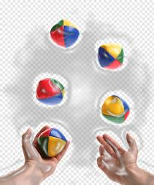
No Traditional Data
Nothing from timing system
No watches
Athletes cannot be made to re-swim
What do you do?

Slide 32
Finishing Events
and Scoring

Slide 33
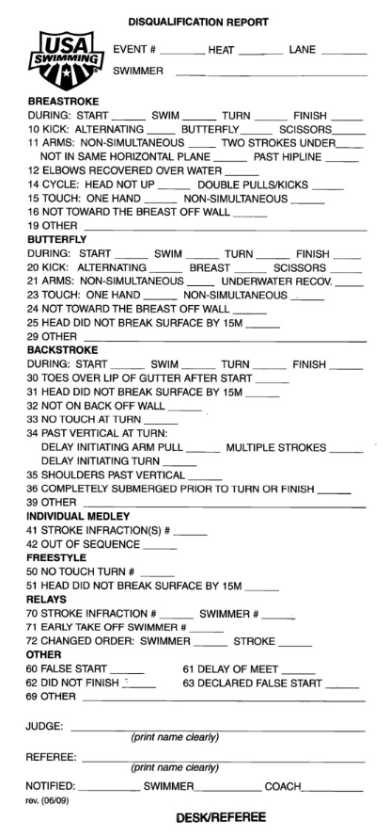
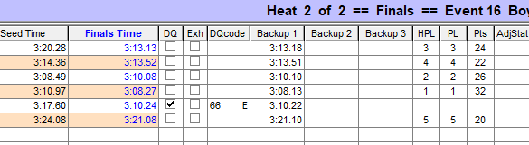
DQs/No Shows

Slide 34
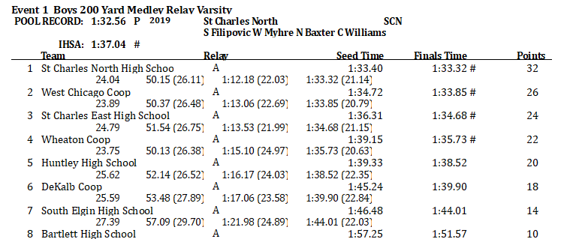
Scoring

Slide 35
Registration and Certification

Slide 36

Registration
Member Registration
Background Check
Good for two years – not tied to calendar year, keep track on your own
Renewal less expensive
Athlete Protection Training
Annual program
Through USA Swimming website
Pay annual fee at this time
Register online through Illinois Swimming
Generally opens September of the prior year
Through USA Swimming website
Concussion Training
One time only
Through CDC or NFHS websites
Email certificate to Illinois Swimming office

Slide 37
Certification
On Deck Training
5 sessions at 3 meets
Sessions 2 hours long with at least 25 starts
Online Test
“Certification – Stroke and Turn/Timer” Test
Pass with 80%
Paperwork
Complete checklist
Send to committee with training cards
Can take offline
2 different trainers
Contact with the meet referee in advance

Slide 38
Recertification
Keep Registration Current
Athlete Protection
Recertification Standards
4 sessions worked per year
Background Check
Membership
No particular position required

Slide 39
Other Resources
USA Swimming
Illinois Swimming
Rulebook
Website
Deck Forms
Interpretations
Forms
Safe Sport
Website
Rulebook
Stroke Brief
Timer Brief
Policies
OTS

Slide 40
Feedback
Are you ready to go?

