Slide 1

Referee Training Webinar
Notes:
Waiting room screen

Slide 2
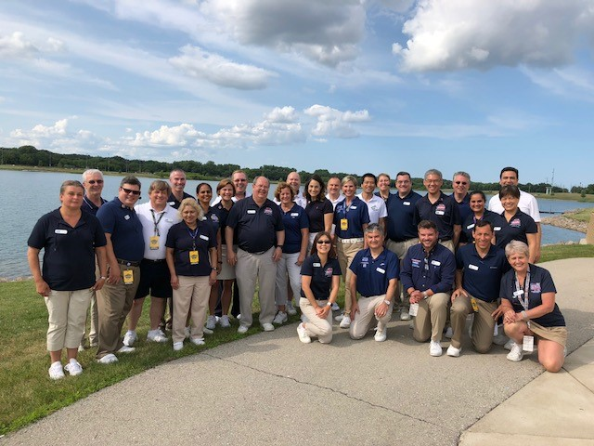
Welcome
Webinar housekeeping
Monitor your audio
Keep video active
Introductions
Name and Club
Children who swim
Why are you becoming a referee?
Your goals for today

Slide 3

Our Focus
Prepare you to train on deck
Understand the roles of referees
Meet Referees
Admin Referees
Deck Referees
Have a discussion and tackle your questions!
Talk about rules but focus on the “why”

Slide 4
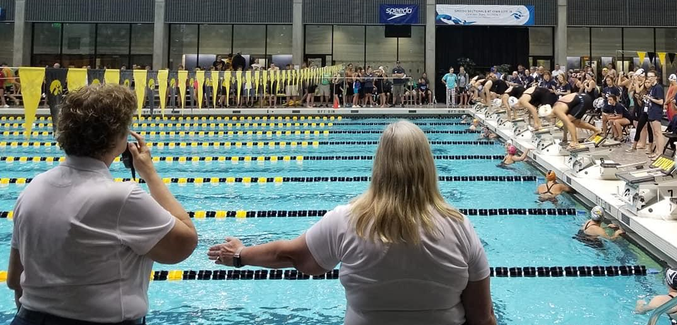
Core Philosophy

Slide 5

Safety
The safety of the athletes is our foremost concern and guides all other decisions

Slide 6
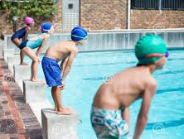
Athlete Focus
Finding ways to say “yes”
Fairness versus looking the other way
Inclusion: Rule mandates, common sense dictates

Slide 7
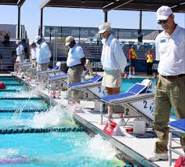
Leadership
Leading the deck
Mentoring other officials
Nurturing, teaching, enforcing:
Benefit of the doubt
Uniform conditions
Impartiality
Professionalism

Slide 8
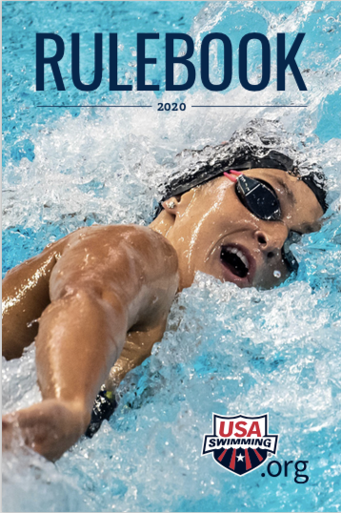
The Rules
Responsible for your own knowledge
FINA, USA Swimming and Illinois Swimming
More than just the rulebook

Slide 9
Meet Management

Slide 10
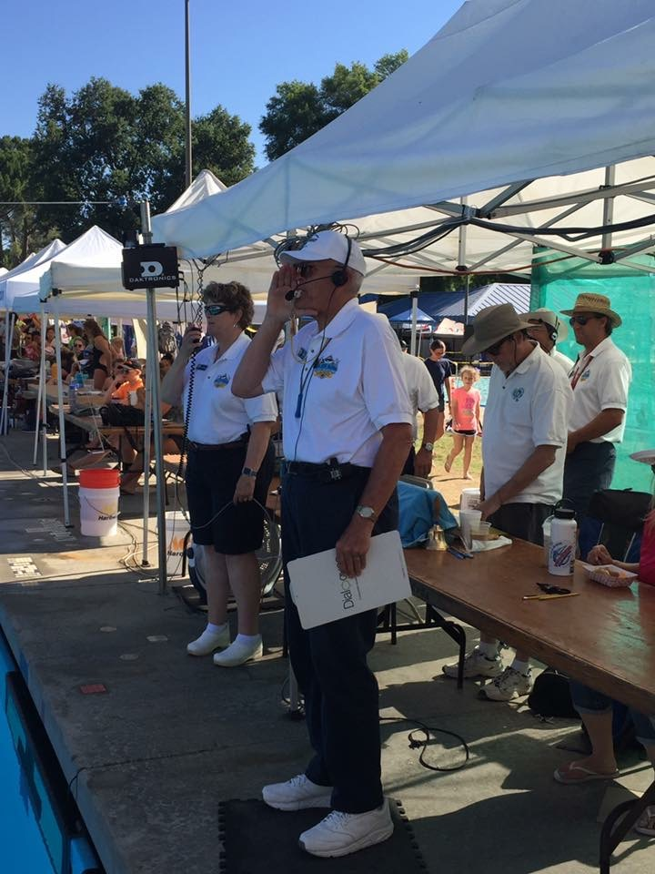
Responsibilities
Ensure safety
Manage heats and timelines
Verify disqualifications
Aid Admin Officials
Resolve coach concerns

Slide 11
Safe Sport
ARTICLE 304 - CODE OF CONDUCT
304.1 The mission of USA Swimming is to encourage participation and the pursuit of excellence in all aspects of swimming. USA Swimming grants the privilege of membership to individuals and organizations committed to that mission.
Safe Sport issues
Cameras and cell phones
Deck changing
Sportsmanship
Bullying
How do you enforce?

Slide 12
MAAPP
RULE 202.4 – REQUIRMENT FOR SANCTION
(M) Meet Packet shall contain the following statement: "All applicable adults participating in or associated with this meet acknowledge that they are subject to the provisions of the USA Swimming Minor Athlete Abuse Prevention Policy ("MAAPP"), and that they understand that compliance with the MAAPP policy is a condition of participation in the conduct of this competition."
What it is and who it covers
Athletes 18 and over, too
Use in briefings, timer meetings and coaches’ meeting

Slide 13

Deck Safety
Pre-session checks:
Blocks
Deck Traffic
Marshals
Things to know:
Emergency action plans
AED locations
Phone for 911
Guards?

Slide 14
Timelines
RULE 205.3 – PROGRAMS AND EVENTS
With the exception of championship and open water meets, the program in all other age group competition shall be planned to allow the events for swimmers twelve (12) years and younger to be completed in four (4) hours or less per session (prelims, finals, timed finals). Events for the same 12 & under swimmers shall be limited to one session per day, except for prelim/final meets where events for 12 & under swimmers may be offered in both prelims and finals.
Planning versus execution
Meet recon process
What happens if you are over?

Slide 15
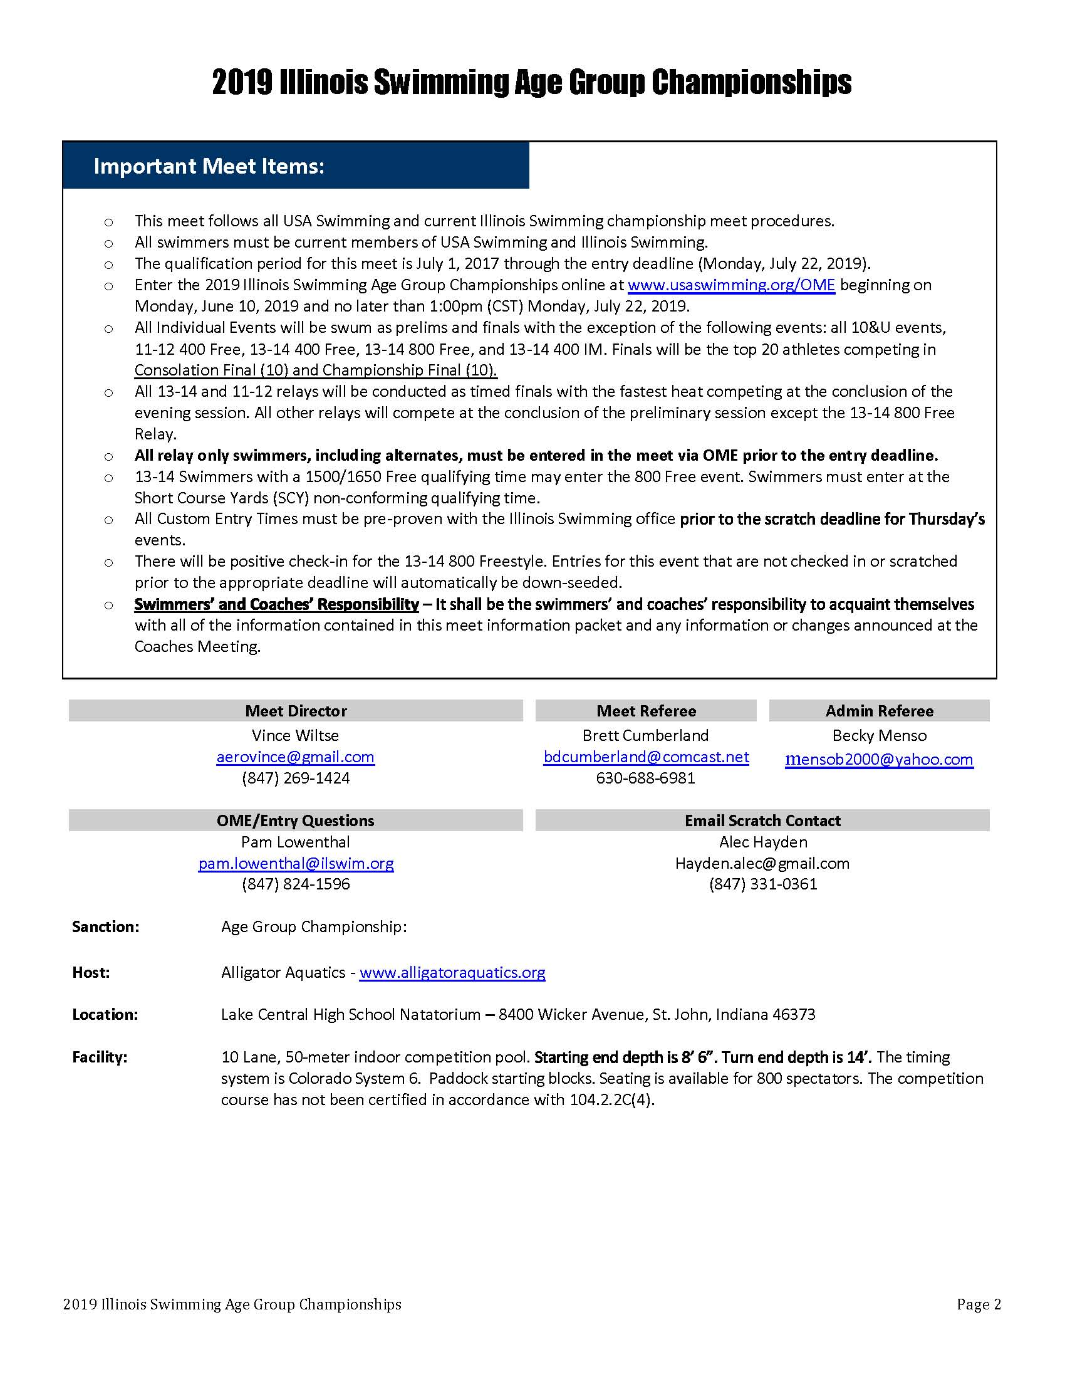
Meet Packet
Where it all begins
Session structure
Penalty meet?
Breaks
Staffing needs

Slide 16
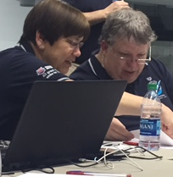
Admin Functions
Entries
Know your admin functions
Timing system resets
Deck seeding
Closing events

Slide 17
Working with Admin
RULE 102.11 – REFEREE
.7 Shall make an immediate investigation when an apparent malfunction of the automatic or semi-automatic timing equipment has occurred, to determine whether the swimmer finished in accordance with the rules and/or if there was an actual equipment malfunction.
How much can you delegate to AOs?
When to get involved
How can you help?

Slide 18
Aiding Inclusion
RULE 102.11 – REFEREE
.9 May modify any rule for a competitive swimmer who has a disability. Any such modification shall be in accordance with Article 105 of the USA Swimming Rules and Regulations, shall affect only the current meet, and shall not set a precedent.
Work with athletes and representatives
Listen and understand

Slide 19
Modifying Rules
RULE 105.1– GENERAL
.1 Authority - The USA Swimming Rules & Regulations grant the Referee the authority to modify the rules for the swimmer with a disability. Disability is defined as a permanent physical or cognitive disability that substantially limits one or more major life activities.
Personal Assistants
Start modifications
Stroke and turn judge instructions

Slide 20
Leadership, Management and Mentoring

Slide 21
Role Under the Rules
RULE 102.11 – REFEREE
.1 Shall have full authority over all officials and shall assign and instruct them; shall enforce all applicable rules and shall decide all questions relating to the actual conduct of the meet, the final settlement of which is not otherwise assigned by said rules; can overrule any meet official on a point of rule interpretation, or on a judgment decision pertaining to an action which the Referee has personally observed.
Overall authority
Mentorship is in the rules
When to reverse a judge

Slide 22
Meetings
RULE 102.11 – REFEREE
.1 Shall have full authority over all officials and shall assign and instruct them…
Credentials
Briefing: what makes good instruction
What are you trying to accomplish?

Slide 23
Other Conversations
RULE 102.11 – REFEREE
.1 Shall have full authority over all officials and shall assign and instruct them…
“Meetings” means more than the main officials’ meeting
Who else should you talk to?
Admin
Starters
Meet Referee
Meet Director

Slide 24
Assignments
RULE 102.11 – REFEREE
.1 Shall have full authority over all officials and shall assign and instruct them…
Considerations for your deck:
Experience
Even coverage
Relief
Other considerations:
Training
Mentorship

Slide 25
Staffing
RULE 102.10 – OFFICIALS
.3 For all swimming meets or time trials, except dual meets, there should not be fewer than the following…. [Officials other than the Referee and Administrative Official may act in more than one officiating capacity]…. Referee, Starter, 2 Stroke & Turn Judges, Administrative Official.
.4 Minimum Number of Officials Required for Dual Meets - 1 Referee, who may also act as a stroke and turn judge, 1 Starter, 1 Other Stroke and Turn Judge (may be the Starter), 1 Administrative Official…
How many is this?
Why are the rules different?
How can you be creative?

Slide 26
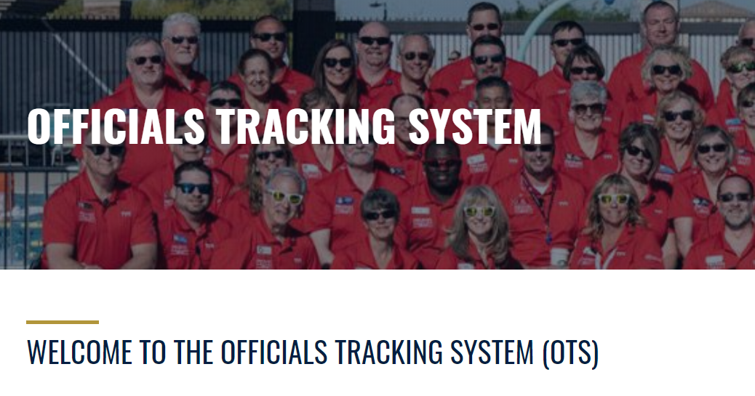
OTS/Reports
Officials’ sessions
Enter correct positions
Meet reports
Session start/stop times
DR/SR/AO of record

Slide 27
Running a Session

Slide 28
Whistles
RULE 101.01 – STARTS
.2A At the commencement of each heat, the Referee shall signal to the swimmers by a short series of whistles to remove all clothing except for swimwear, followed by a long whistle indicating that they should take and maintain their positions on the starting platform, the deck, or in the water. In backstroke and medley relay events, at the Referee’s first long whistle, the swimmers shall immediately enter the water and at the second long whistle shall return without undue delay to the starting position.
What are you communicating to athletes?
What makes a better experience for the athletes?

Slide 29
Extending the Arm
RULE 101.01 – STARTS
.2B When the swimmers and officials are ready, the Referee shall signal with an outstretched arm to the Starter that the swimmers are under the Starter’s control.
RULE 102.11 – REFEREE
.3 Shall signal the Starter before each race that all officials are in position, that the course is clear, and that the competition can begin.
Change your mentality when you change positions.
What are you looking for to be “ready?”
Do flyovers affect your decisions?

Slide 30
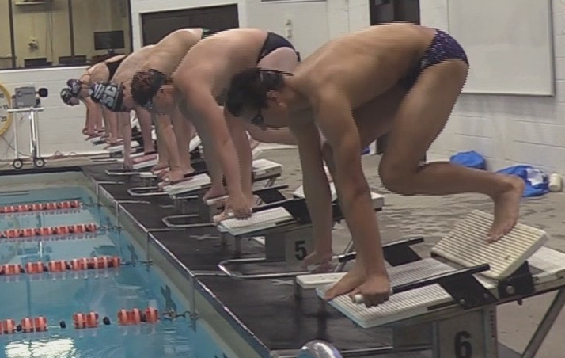
“Take Your Mark”
RULE 101.01 – STARTS
.2C On the Starter’s command “take your mark,” the swimmers shall immediately assume their starting position, in the forward start, with at least one foot at the front of the starting platform or the deck. Swimmers starting in the water must have at least one hand in contact with the wall or starting platform. When all swimmers are stationary, the Starter shall give the starting signal.
What does stationary look like?

Slide 31
“Stand, Please”
RULE 101.01 – STARTS
.2D When a swimmer does not respond promptly to the command "take your mark," the Starter shall immediately release all swimmers with the command "stand up" upon which the swimmers may stand up or step off the blocks.
Purpose of “Stand, please”
Effects on heats
Dealing with an impatient starter
When to step down a heat

Slide 32
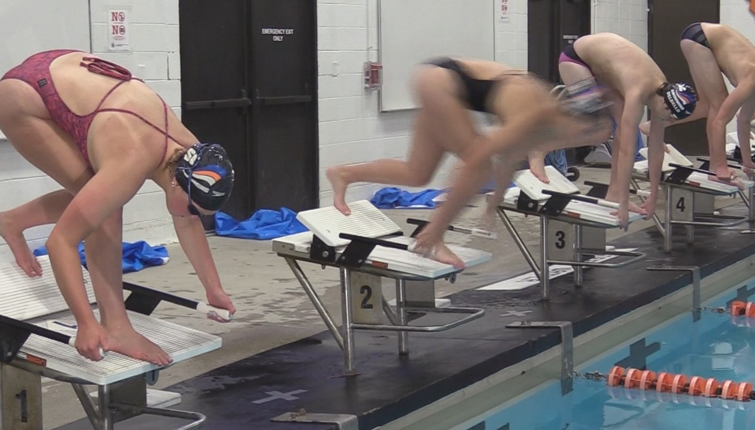
False Starts
RULE 101.1.3 – FALSE STARTS
A. Any swimmer starting before the starting signal is given shall be disqualified if the Referee independently observes and confirms the Starter’s observation that a violation occurred.
Dual confirmation
What movement constitutes a false start?

Slide 33
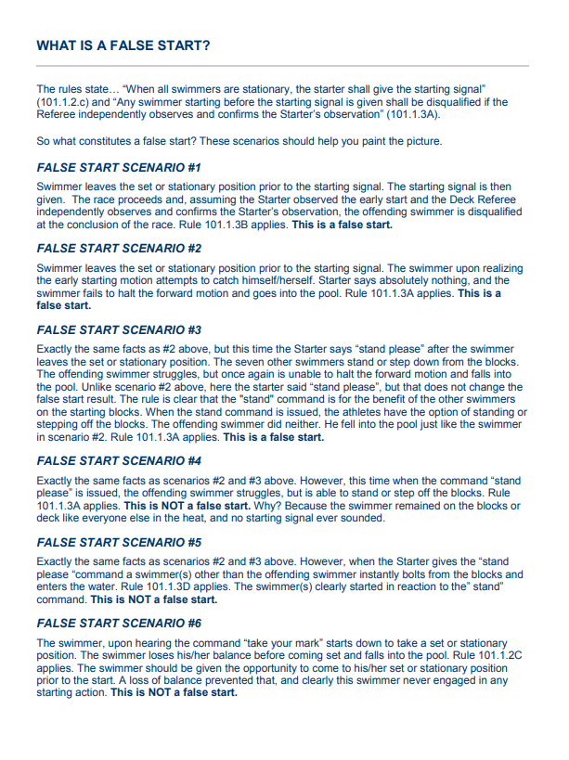
The “Scenarios”
Questions from the video?

Slide 34
Recalls
RULE 101.01 – STARTS
.3C If the recall signal is activated, no swimmer shall be charged with a false start and the Starter shall restart the race upon signal by the Referee.
When is a recall appropriate – should you do it?
What are the implications – what comes next?

Slide 35
What are you watching?
RULE 102.11 – REFEREE
.2 Has the authority to disqualify a swimmer(s) for any violation of the rules that the Referee personally observes and, except for false starts, shall at the same time raise one hand overhead. If the Referee does not make such a signal there shall be no disqualification.
Jurisdiction
When should you act on it?

Slide 36
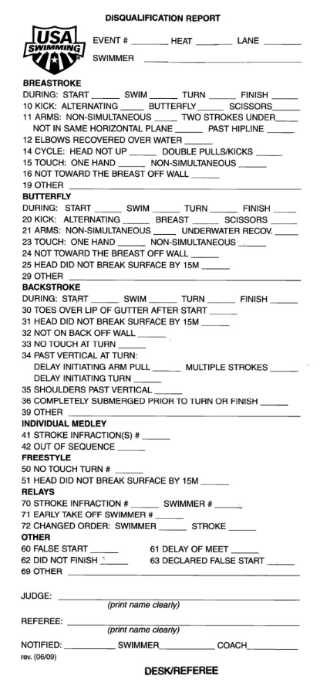
DQs
Referee’s role
What should you watch for?
Paperwork trail.
When there is too much to do…
Work with your table

Slide 37
Questioned Calls
RULE 102.11 – REFEREE
.1 …[S]hall enforce all applicable rules and shall decide all questions relating to the actual conduct of the meet, the final settlement of which is not otherwise assigned by said rules; can overrule any meet official on a point of rule interpretation, or on a judgment decision pertaining to an action which the Referee has personally observed.
Coaches advocate for their swimmers and can be allies in problem solving
Keep communication positive
Listen; be calm, not defensive
Understand the issue and investigate
Use your team; ask for advice
Continuing conversation with MR

Slide 38
Protests
RULE 102.23 – PROTESTS
.1 Protests against the judgment decisions of starters, stroke, turn, place and relay take-off judges can only be considered by the Referee and the Referee’s decision shall be final.
Questions for MR vs. protest
What is the nature of a protest?
Meet Jury issues

Slide 39
Training and Certification

Slide 40

Certification
On Deck Training
6 sessions at 4 meets
Sessions 3 hours long with all strokes
Online Test
“Certification – Referee” Test
Pass with 80%
Paperwork
Complete checklist
Send to committee with training cards
Can take offline
3 different trainers, certified 2 years or more
5th or 6th sessions with ISI Certified Trainer

Slide 41
Recertification
Keep Registration Current
Athlete Protection
Certification Standards
10 sessions worked per year
Work champ meets
Background Check
Membership
Continuing Education Units
Extra testing
Be a meet referee
Many more

Slide 42
Other Resources
USA Swimming
Illinois Swimming
Rulebook
Website
Deck Forms
Interpretations
Forms
Safe Sport
Website
Rulebook
Stroke Brief
Timer Brief
Policies
OTS

Slide 43
Feedback
Are you ready to go?

