Slide 1

Stroke and Turn Webinar

Slide 2
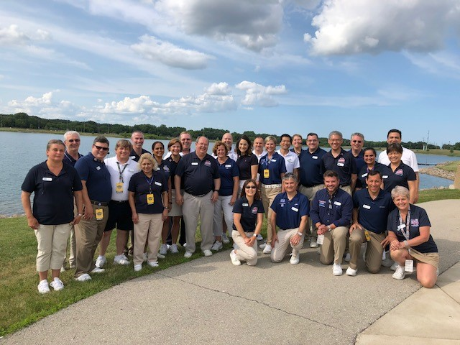
Welcome
Webinar housekeeping
Monitor your audio
Keep video active
Introductions
Name and Club
Children who swim
Why are you becoming a referee?
Your goals for today

Slide 3

Webinar Goals
Answer your questions!
Clarify stroke and turn judge rules, issues and protocol
Get you ready for on-deck training
Untangle Registration and Certification

Slide 4
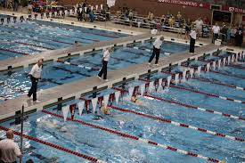
Being a Judge

Slide 5
Important Qualities of Officials
Benefit of doubt to swimmer
Safety-focused
Equitable
Professional
Consistent
Team Players
Impartial
Athlete-focused
Knowledgeable
Committed

Slide 6
Knowledge
Impartiality
Consistency
A Good Official

Slide 7
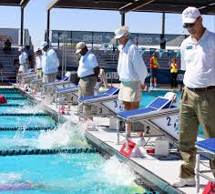
Making this Work
Officials’ Meetings
Position Assignments
Jurisdiction
Protocols
Handling DQs

Slide 8
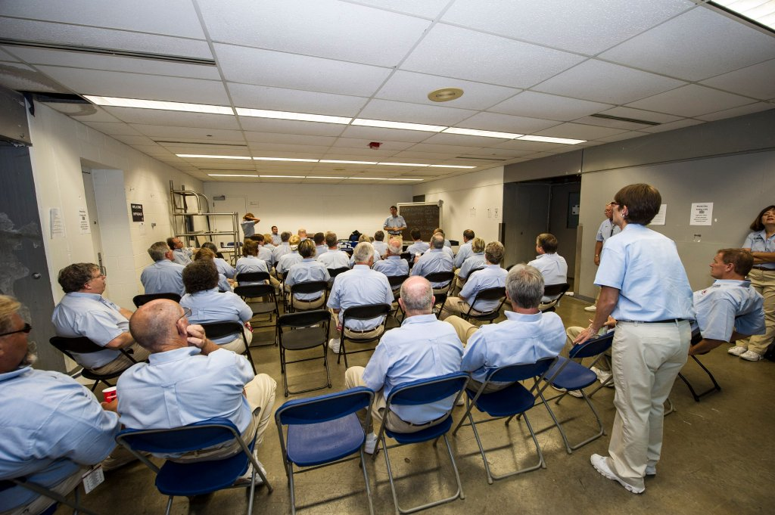
Official’s Meetings
How we start every session
Stroke briefing
Assignments/ Jurisdiction/ Protocol
News
Social

Slide 9
Position, Protocol and Jurisdiction
What you watch, and from where:
Stroke judges
Turn judges
Stroke and turn judges

Slide 10
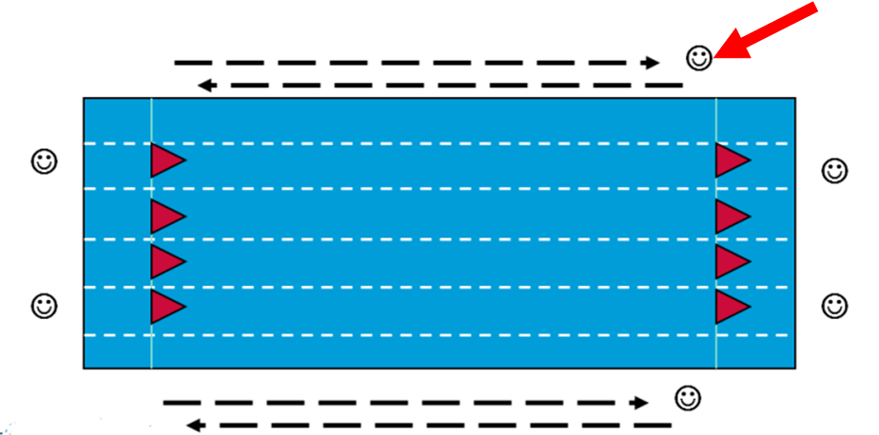
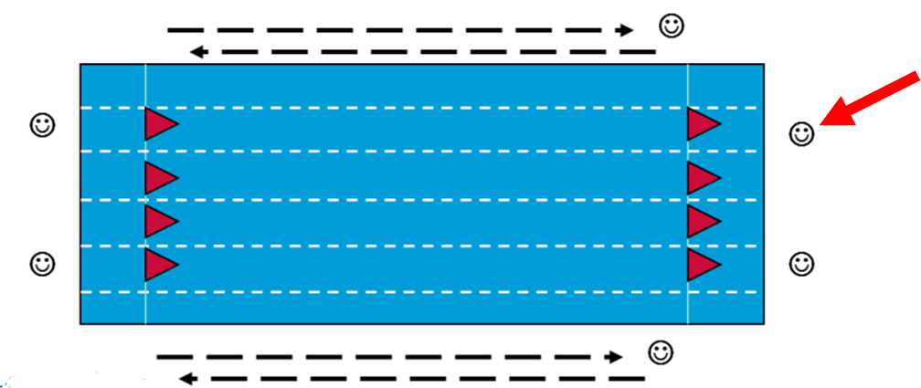
Position, Protocol and Jurisdiction
Stroke judges
Turn judges/
Stroke and
turn judges

Slide 11
Making Calls
See an infraction – raise your hand
Continue to observe your jurisdiction
Complete DQ slip when you can

Slide 12
Stroke Brief

Slide 13
Observing Swims
Key terms to understand and use in communication
Start
Stroke
Kick
Turns
Finish

Slide 14
Rules for Every Stroke

Slide 15
Rules for Three Strokes

Slide 16
Rules for
Two Strokes

Slide 17
Rules for
One Stroke

Slide 18

Any other stroke questions?

Slide 19
Medleys and Relays

Slide 20
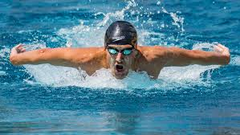
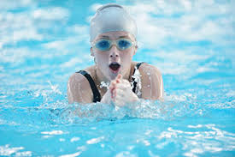
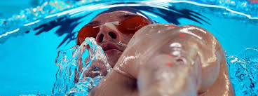
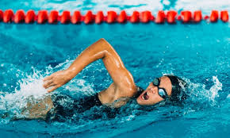
Medleys
Ind. Medley: Fly, back, breast, free
Medley Relay: Back, breast, fly, free
Freestyle not the three competitive strokes
Each stroke style one-fourth the distance

Slide 21
Medleys
Stroke and turn rules for each stroke apply
Transitions use finish rules
Freestyle turns – toward breast before propulsive movement

Slide 22
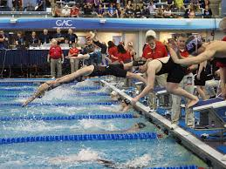
Relays
Four swimmers
No swimmer swims more than one leg
Judging relays:
Single or dual confirmation
“Toes to nose”

Slide 23
Registration and Certification

Slide 24

Registration
Member Registration
Background Check
Good for two years – not tied to calendar year, keep track on your own
Renewal less expensive
Athlete Protection Training
Annual program
Through USA Swimming website
Pay annual fee at this time
Register online through Illinois Swimming
Generally opens September of the prior year
Through USA Swimming website
Concussion Training
One time only
Through CDC or NFHS websites
Email certificate to Illinois Swimming office

Slide 25
Certification
On Deck Training
5 sessions at 3 meets
Sessions 2 hours long with at least 25 starts
Online Test
“Certification – Stroke and Turn/Timer” Test
Pass with 80%
Paperwork
Complete checklist
Send to committee with training cards
Can take offline
2 different trainers
Contact with the meet referee in advance

Slide 26
Recertification
Keep Registration Current
Athlete Protection
Recertification Standards
10 sessions worked per year
Background Check
Membership
No particular position required

Slide 27
Other Resources
USA Swimming
Illinois Swimming
Rulebook
Website
Deck Forms
Interpretations
Forms
Safe Sport
Website
Rulebook
Stroke Brief
Timer Brief
Policies
OTS

Slide 28
Feedback
Are you ready to go?

