Slide 1

Starter Training Webinar

Slide 2

Welcome
Webinar housekeeping
Monitor your audio
Keep video active
Introductions
Name and Club
Children who swim
Why are you becoming a referee?
Your goals for today

Slide 3

Our Focus
Prepare you to train on deck
Understand the starter’s role and mindset
Have a discussion and tackle your questions!
Talk about rules and procedures but focus on the “who” and “why”

Slide 4
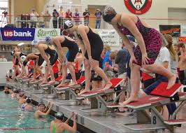
The Starter’s Mindset

Slide 5
Qualities of a Good Starter
Self-contained
Calm
Good read of swimmers
Prepared
Patient
Focused
Observant
Pleasant
In the moment
Conversational
Experienced
Team Player

Slide 6
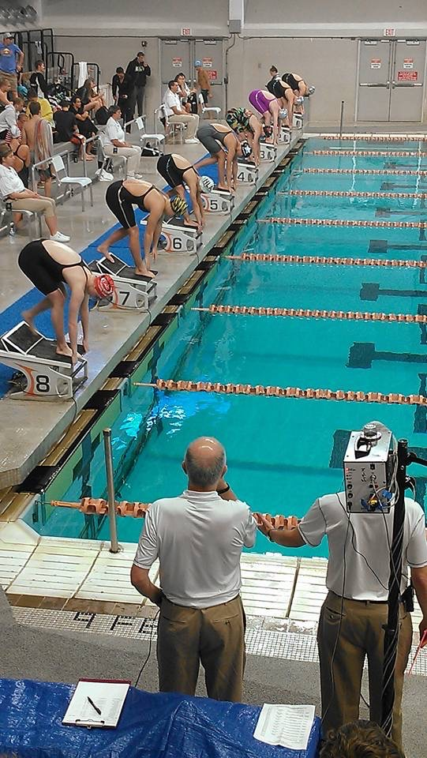
Delivering a Fair Start
Three components
When are swimmers ready to hear TYM
When are they ready for start signal
When/if should you intervene

Slide 7
Mechanics of the Start

Slide 8
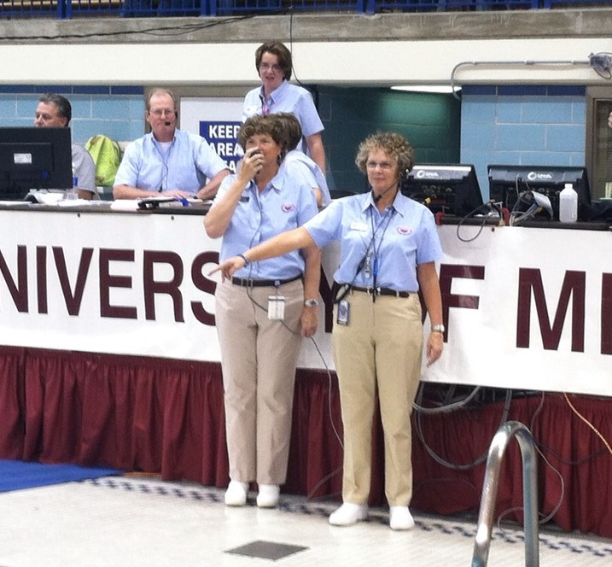
Where to Stand
Within approximately 5 meters from start end of pool
Able to observe entire field AND distinguish between individual lanes
Starter chooses position, referee adjusts to starter

Slide 9
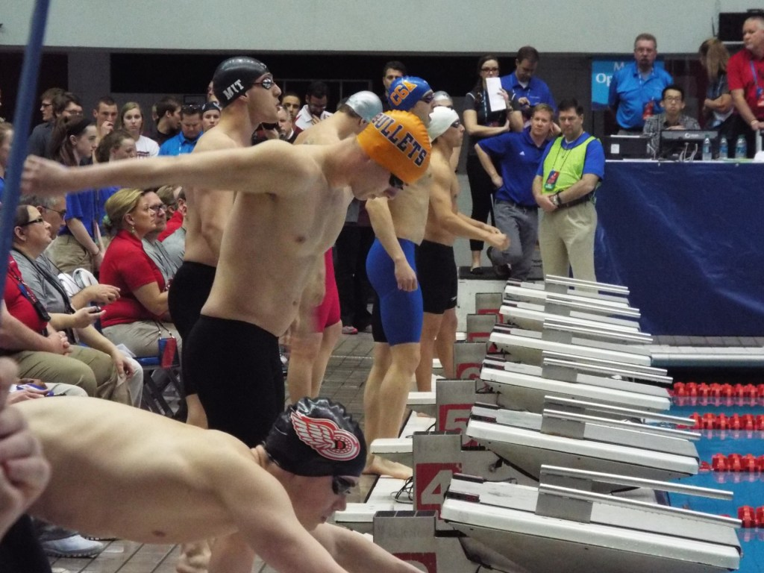
Before the Heat
Stand calmly, be pleasant
Watch swimmers behind the blocks
Short whistles
Long whistle(s)

Slide 10
Getting the Heat
RULE 101.01 – STARTS
.2B When the swimmers and officials are ready, the Referee shall signal with an outstretched arm to the Starter that the swimmers are under the Starter’s control.
What does “under your control” mean?
What tells you swimmers are ready to hear TYM?
What is your mindset?

Slide 11
Before “Take Your Mark”
Patience as the swimmers settle on the blocks
Watch and wait for them to be ready for your invitation

Slide 12
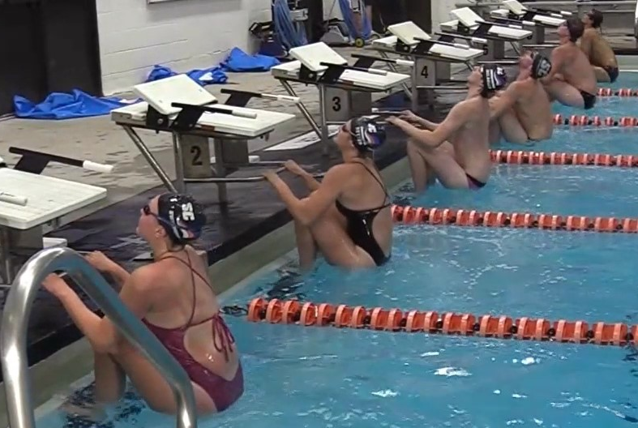
“Take Your Mark”
Conversational tone
Inviting the swimmers to swim
Statement, not a question
Delivered in a relaxed, but confident way

Slide 13
“Take Your Mark”
RULE 101.01 – STARTS
.2C On the Starter’s command “take your mark,” the swimmers shall immediately assume their starting position, in the forward start, with at least one foot at the front of the starting platform or the deck. Swimmers starting in the water must have at least one hand in contact with the wall or starting platform. When all swimmers are stationary, the Starter shall give the starting signal.
What does “stationary” mean?
What does it look like?
Where is your focus?

Slide 14
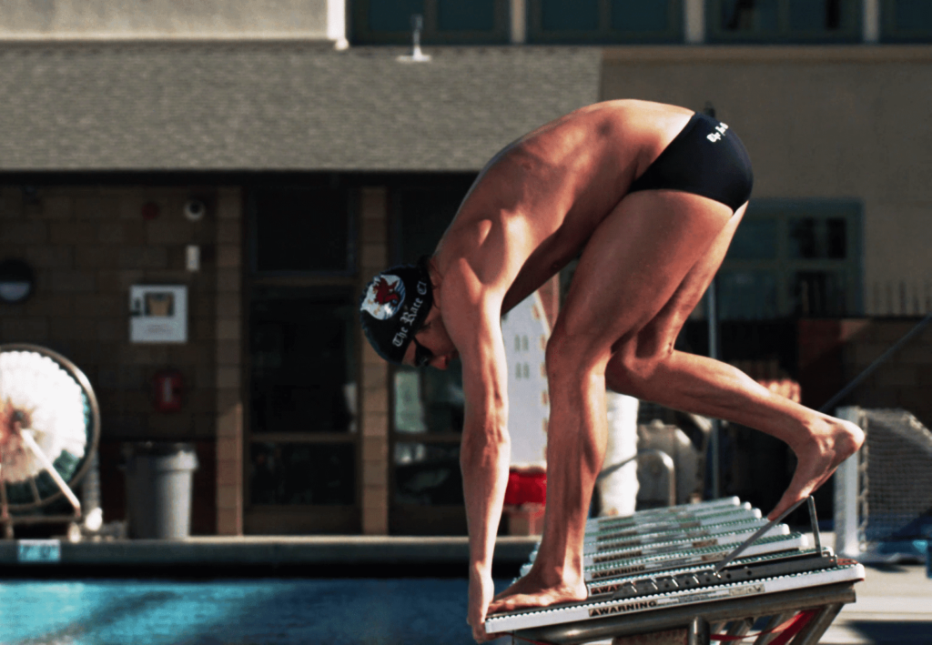
What Does Stationary Look Like?

Slide 15
Backstroke
RULE 101.4 – BACKSTROKE
.1 The swimmers shall line up in the water facing the starting end, with both hands placed on the gutter or on the starting grips. Standing in or on the gutter, placing the toes above the lip of the gutter, or bending the toes over the lip of the gutter, before or after the start, is prohibited. When using a backstroke ledge at the start, the toes of both feet must be in contact with the end wall or face of the touchpad. Bending the toes over the top of the touchpad is prohibited.
Where will you stand?
What will stationary look like?
What will you do if toes are not correct?

Slide 16
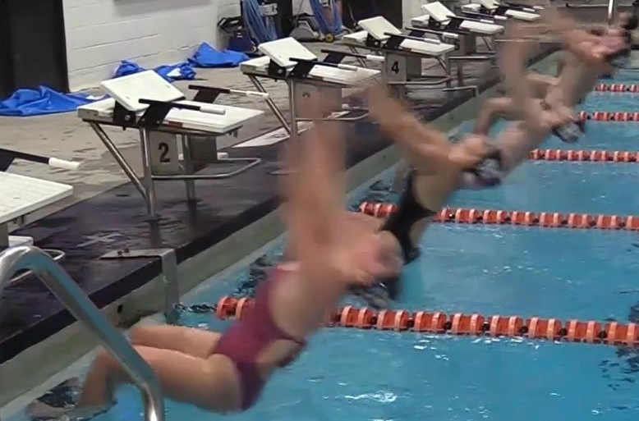
The Start Signal
Be patient as swimmers become stationary
Check for proper foot position
Give start signal when all swimmers are stationary

Slide 17
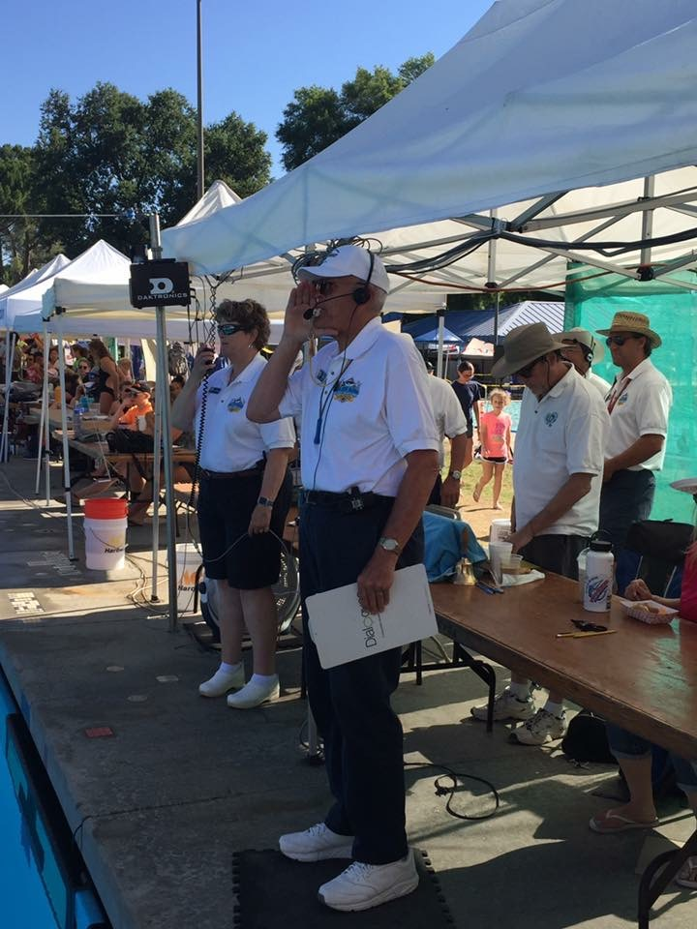
Using “Stand, Please?
When things don’t go as planned:
“Stand, please”
Softly and with great calm
PATIENCE to allow swimmers to refocus
Inviting TYM

Slide 18
“Stand, Please”
RULE 101.01 – STARTS
.2D When a swimmer does not respond promptly to the command "take your mark," the Starter shall immediately release all swimmers with the command "stand up" upon which the swimmers may stand up or step off the blocks.
How patient is patient?
Will swimmers reset themselves?
What’s the effect of stand on the heat?
When do you use “step down, please”?

Slide 19
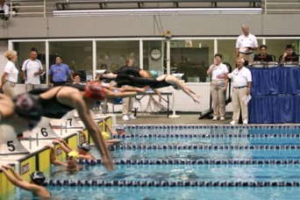
After the Start
Watch swimmers until heads up
Keep microphone open and in position in case recall is needed
Mark potential false starts
Mark any empty lanes on starter heat sheet
Turn to watch next heat behind blocks

Slide 20
False Starts

Slide 21
False Starts
RULE 101.1.3 – FALSE STARTS
A. Any swimmer starting before the starting signal is given shall be disqualified if the Referee independently observes and confirms the Starter’s observation that a violation occurred. Swimmers remaining on the starting blocks shall be relieved from their starting positions with the “stand up” command and may step off the blocks.
What is a starting movement?
What protocol do you follow to record/report a false start?
What about the swimmers on the blocks?

Slide 22
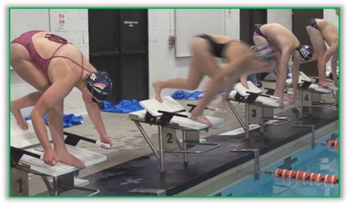
Starting movement prior to the start

Slide 23
“Stand, Please”
RULE 101.1 – STARTS
.3D A swimmer who would otherwise be charged with a false start may be relieved of the charge if the false start was caused by the swimmer’s reaction to the “stand up” command.
Questions?

Slide 24
False Starts
RULE 101.1 – STARTS
.3B If the starting signal has been given before the disqualification is declared, the race shall continue without recall. If the Referee independently observes and confirms the Starter’s observation that a violation occurred, the swimmer or swimmers who have false started shall be disqualified upon completion of the race.
What is stationary?
Where is your focus?
What protocol do you follow to record/report this false start?

Slide 25
Recalls
RULE 101.01 – STARTS
.3C If the recall signal is activated, no swimmer shall be charged with a false start and the Starter shall restart the race upon signal by the Referee.
When might this happen?
Should it happen?
What happens next?

Slide 26
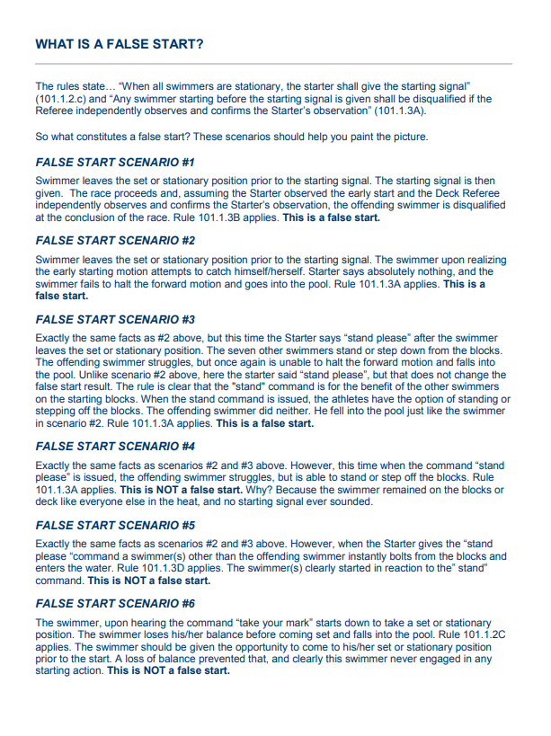
The “Scenarios”
Questions from the video
Other False Start issues?

Slide 27
Starting Athletes with Disabilities

Slide 28
Athletes Requiring Adapted Starts
Respond to their needs
More time getting on the blocks?
More time assuming starting position?
May start in the water, on deck, or sit on the starting platform
May need more time getting out of pool
Focus, but don’t fixate
Avoid standing heat
Hold the same expectations

Slide 29
Athletes with Hearing Impairments
RULE 105.3 – DEAF AND HARD OF HEARING
.1 Deaf and hard of hearing swimmers require a visual starting signal, i.e., a strobe light and/or Starter’s arm signals. The Referee may reassign lanes within the swimmer’s heat, i.e., exchanging one lane for another, so that the strobe light or Starter’s arm signal can more readily be seen by the deaf or hard of hearing swimmer. Standard Starter’s arm signals are shown in Figures 1 and 2. A false start rope is required in the event of a recall, provided the meet host is notified by the entry deadline that a deaf or hard of hearing swimmer will be participating.
Hand signals required
Recall rope required
Stand closer to referee for easier communication

Slide 30
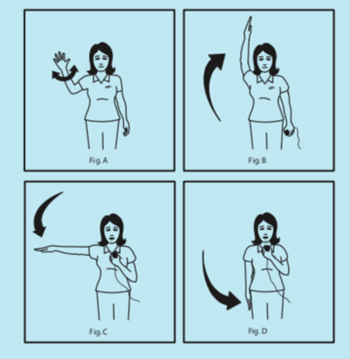
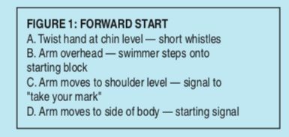
Hand Signals – Forward Starts
1
2
3
4

Slide 31
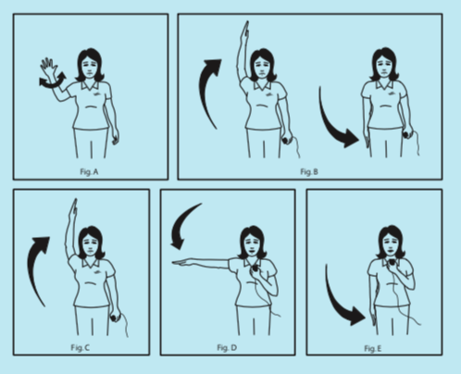
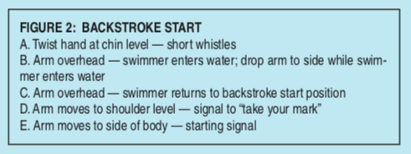
Hand Signals – Back Starts
1
2
3
4
5

Slide 32
Other Things…

Slide 33
Other Things Starters Say
Refer to swimmers as “ladies” and “gentlemen”
ALWAYS “Take your mark” and “Stand, please”
“Relax, please” for longer delay
“Lane “X”, toes, please” to lower toes in backstroke
“Thank you, ladies (gentlemen)” to clear pool

Slide 34
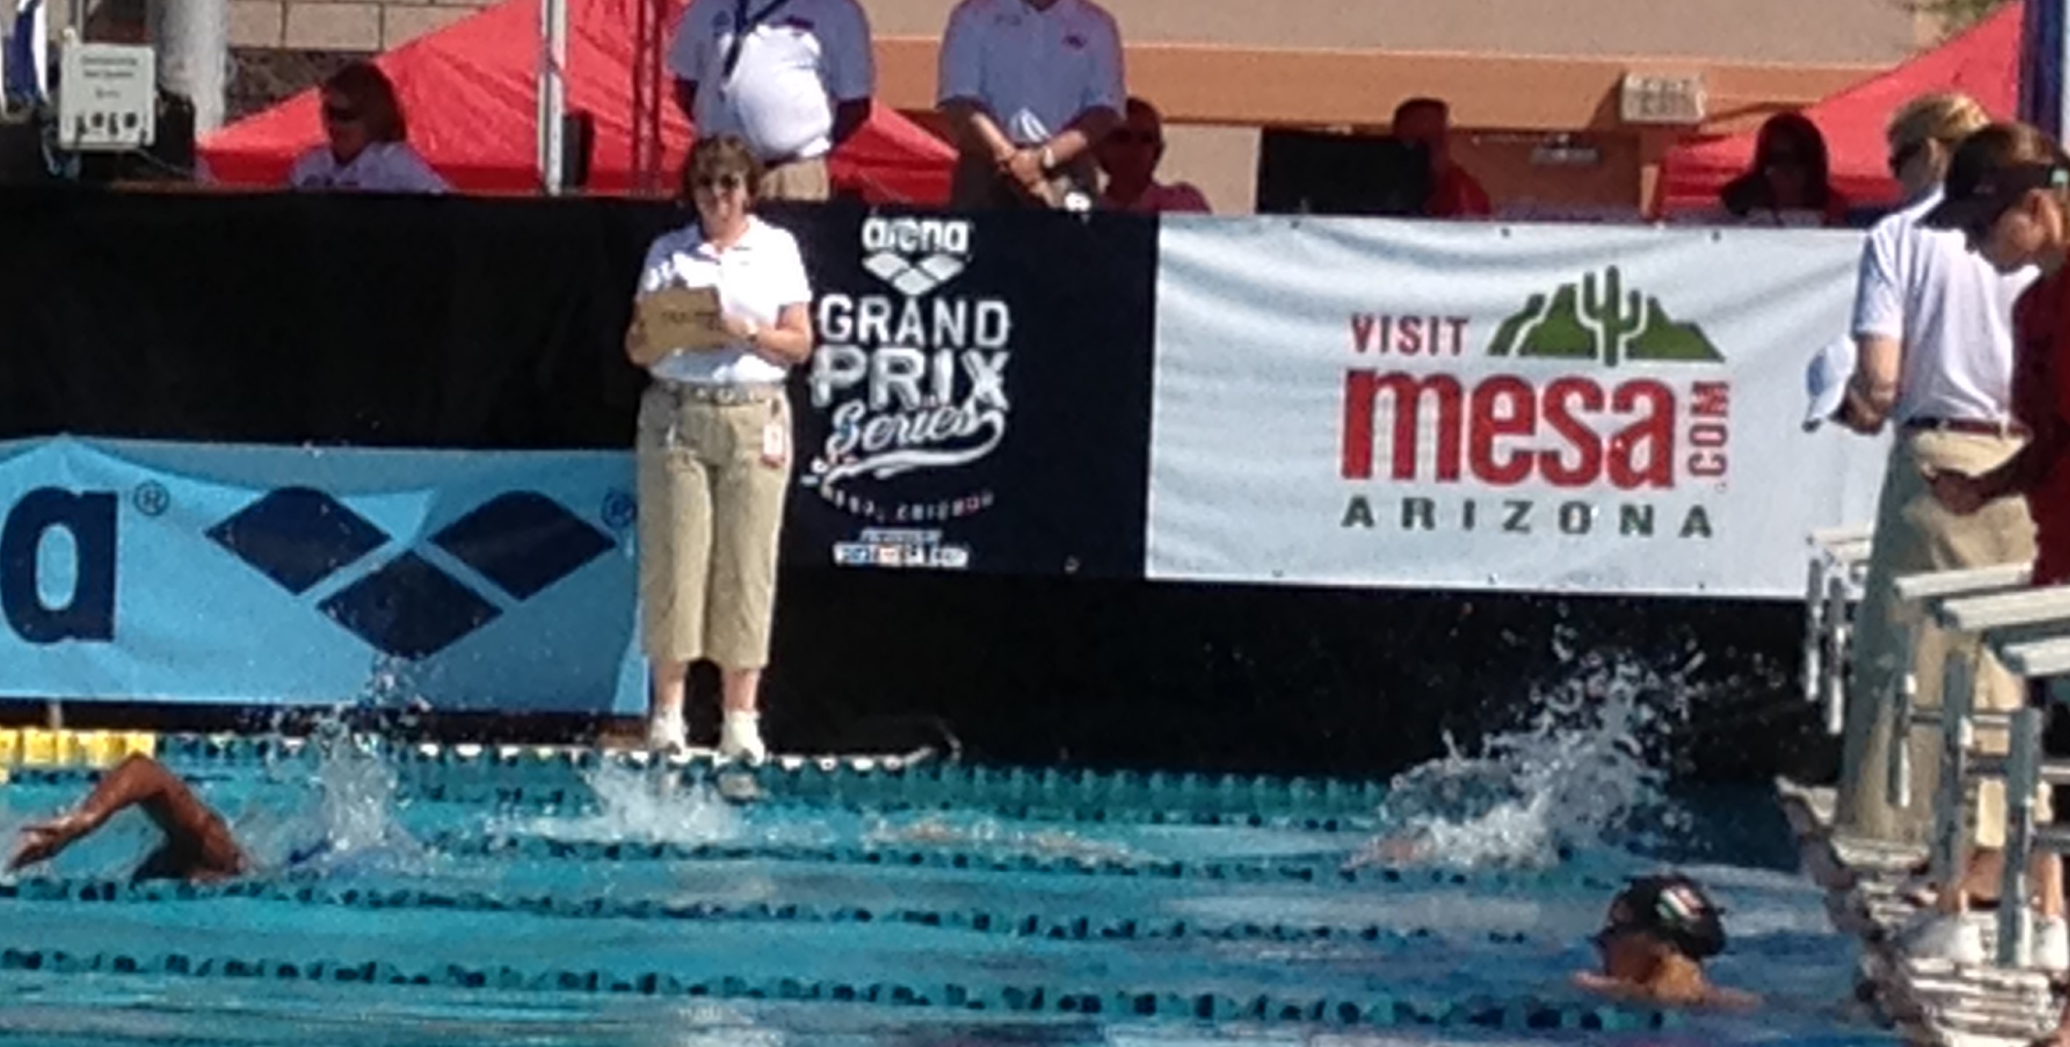
Other Things Starters Do
Pre-session checks
Timers’ meeting
Use the online brief
SafeSport/MAAPP
Order of finish
Counting lengths
Ringing bells

Slide 35
“There is a lesson to be learned from every start…
Learn the lesson – forget the start.”

Slide 36
Training and Certification

Slide 37

Certification
On Deck Training
5 sessions at 3 meets
Sessions 2 hours long with at least 25 starts
Online Test
“Certification – Starter” Test
Pass with 80%
Paperwork
Complete checklist
Send to committee with training cards
Can take offline
3 different trainers
30-minute introduction session

Slide 38
Recertification
Keep Registration Current
Athlete Protection
Recertification Standards
10 sessions worked per year
Background Check
Membership
No particular position required

Slide 39
Other Resources
USA Swimming
Illinois Swimming
Rulebook
Website
Deck Forms
Interpretations
Forms
Safe Sport
Website
Rulebook
Stroke Brief
Timer Brief
Policies
OTS

Slide 40
Feedback
Are you ready to go?

