Slide 1

2025/26 Season Information
Revised 8/2025

Slide 2

Table of Contents
Training Groups
Practice Schedule
Swimming Equipment
Pool Information
Fees
Payment
Withdrawal
Safe Sport
Code of Conduct
Volunteer Requirements
Team Apparel
Swim Seasons
Meet Schedule
Meet Information
Communication

Slide 3
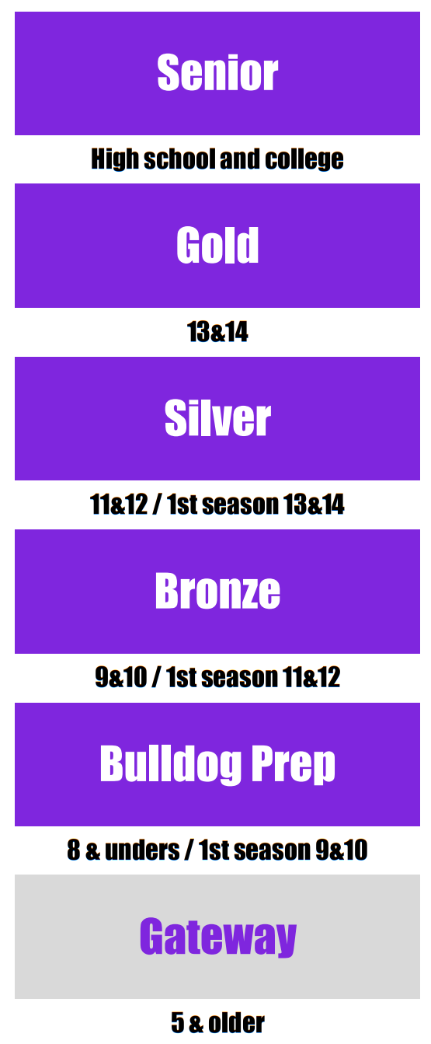
What training group will my swimmer be in?
Training Groups
BBSC uses an aged based structure, divided into 5 Training Groups.
If you have a child not yet ready for the entry training group, we offer the GATEWAY program to build the skills necessary to transition from swim lessons to competitive swimming.

Slide 4
Gateway Program
Training Groups
This group is designed to help swimmers who have completed traditional swim lessons transition to competitive swimming.
Swimmers will be placed in this group if they are able to swim one length (25 yards) of the pool with freestyle or backstroke.
This group will help to refine swimmers freestyle and backstroke and increase endurance in order to prepare the swimmers for competitive swim team practices.
Gateway coaches will be in the water with athletes giving instruction and creating a safe and fun environment.
Gateway is a 2 week program, Monday through Thursday. Email brownsburgswimclub@gmail.com for upcoming session dates.
$125 per 2 week session.

Slide 5
Bulldog Prep
All 8 and under and first season 9-10 year olds.
This training group is the starting point for swimmers to begin competitive swimming. Swimmers in this group are required to know freestyle and backstroke. Swimmers in this group will be required to maintain training for up to an hour in the pool at a time.
Swimmers in this group will be instructed on the basics of competitive swimming and will learn all 4 strokes as well as starts and turns. Swimmers will also learn about how swim practice works, learning how to read a pace clock and how to count distances in the pool.
Training Groups
Bronze
9-10 year olds with one season with BBSC.
This group is our top developmental group for 10 and under swimmers. Swimmers in this group must be able to demonstrate all 4 strokes and have the endurance to swim for a 1.5 hour training session.
In this group, swimmers will look to improve in all areas and begin to focus on competing.
Silver
11-12 year olds and first season 13-14 year olds.
This is our first level of our age group program. Swimmers must demonstrate stroke proficiency in freestyle and backstroke and have the endurance required to complete a 1.5 hour training session to swim with Silver. This group will focus on furthering our swimmers development, creating greater strength and endurance and working on improving technique.

Slide 6
Gold
13-14 year olds.
This group’s focus will be preparing these swimmers for Senior group and high school swimming.
This group will have 2 hour training sessions and focus on improving times and sharpening technique. Swimmers in this group will be proficient in all 4 strokes.
Training Groups
Senior
High school and college swimmers.
This group will be for all swimmers who are in high school or college. This group will focus on preparing swimmers to compete at all levels (National through regional).
This group will focus on strengthening swimmers’ bodies and minds and is a culmination of every level of our program.

Slide 7
What is the practice schedule?
Bulldog Prep - 5 days a week (4 weekdays and Saturday), 1 hour practices.
Bronze - 5 days a week (4 weekdays and Saturday), 1.5 hour practices.
Silver - 6 days a week, 1.5 hour practices.
Gold - 6 days a week, 2 hour practices. Additional practices during summer.
Senior - 6 days a week, 2.25 hour practices. Additional summer practices.
During HS season (Nov – Feb), high school home meets may alter team practices.
The schedule is updated on the PRACTICE CALENDAR on the website. We try and have at least 1-2 months in advance scheduled. You can subscribe to the calendar to ensure you have the current and correct schedule conveniently on your phone calendar. Instructions are on the website.
Practice Schedule
How often should my swimmer come to practice?
Practices are not mandatory. Talk with your child’s coach and determine the amount of practices that best fit your family’s schedule.
However, the more you attend, the better you will get, the more fun it becomes! Your swimmer will get to know teammates better, gain endurance, and have more opportunities to work on stroke, turn and start technique if they consistently make practices.

Slide 8
What equipment does my swimmer need?
Swimming
Equipment
PRACTICE EQUIPMENT
Gateway: kickboard (team provides)
Bulldog Prep: kickboard & fins (team provides)
Bronze: kickboard, fins & pull buoys (some fins and all pull buoys - team provided)
Silver: kickboard, pullbuoy, and fins
Gold: kickboard, pullbuoy, fins, snorkel, paddles
Senior: kickboard, pullbuoy, fins, snorkel, paddles.
TEAM CAPS
All swimmers will be given a free BBSC cap upon initially joining the club. Members will be responsible for purchasing all replacement caps. Requests for further silicone caps ($10) can be made directly to the coaches at practice during the season and the charge will be applied to your monthly bill.
We will periodically have an order for personalized caps - your swimmers name on the side. Personalized caps are $25/2 caps.
SWIMSUIT
Swimsuits are often based on swimmer preference on cut and style; we do not have a mandatory team suit at this time.
Technical suits are recommended for swimmers 13 and up. If you would like to get your swimmer a tech suit before that you are more than welcome to but the benefits vary based on the swimmer.
Our team vendor is Elsmore Swim Shop.
Practice
Caps
Swimsuits

Slide 9
How much will this cost me?
Fees
USA SWIMMING REGISTRATION FEE
All swimmers are required to be a Member of USA Swimming for Insurance Purposes.
New Members will now pay this directly to USA Swimming. Swimmers Returning to BBSC will be charged this fee when it is time for their swimmer to Renew.
$98/year Premium USA Membership per Swimmer for Year-Round swimmers
$47.50/year Flex Membership per swimmer for Seasonal swimmers (limit 2 meets per year). Seasonal swimmers wishing to swim more than 2 meets must pay for a Premium membership. You can upgrade at any time during the year by paying the difference.
MEET ENTRY FEES
Swimmers are responsible for paying entry fees to all competitions in which they are entered. Fees are paid in advance of the meet, so if a swimmer is unable to attend due to sickness or other commitment, you are obligated to pay the fee.
Likewise, host clubs are not required to refund fees for cancellation of meet sessions due to uncontrollable circumstances, ie. inclement weather. These fees vary depending on the type of competition and number of swimmers entered.
They generally range from $20 - $40 per meet. Meet entry fees are automatically applied to your monthly bill. There are no entry fees for Intrasquad meets.
USA Swimming
Meet Entry

Slide 10
How much will this cost me?
Fees
TRAINING FEES
All swimmers pay a yearly $125 registration fee due at time of registration. This non refundable fee covers BBSC team cap, BBSC team shirt, team parties, Bulldog of the Day awards, additional training equipment, and other miscellaneous items.
For families with multiple swimmers, there is a 20% discount for the second swimmer and 30% discount for the third swimmer. Any additional swimmers have no monthly fees.
Fees vary by Training Group and are non-refundable. Training fees are paid monthly in 9 payments for year-round swimmers. Dues are billed on the first of each month, September – May.
For families who wish to swim just the Summer or Winter season (a 4-month commitment), monthly fees are indicated in the separate table on the next slide. These families will still be required to work their volunteer sessions for that season.
Per USA Swimming’s Outreach program, BBSC provides financial assistance for those families that are part of the free-and-reduced lunch program. Families will need to provide documentation of their participation. Email brownsburgswimclub@gmail.com for assistance.
Training

Slide 11
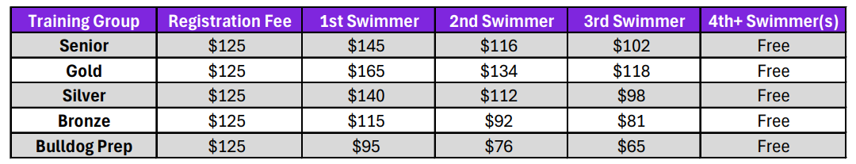
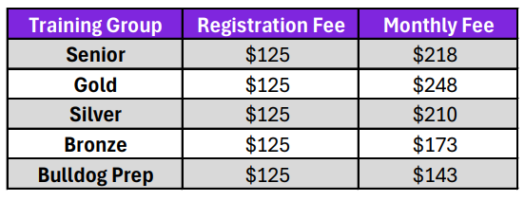
Standard Training Fees
(9 months, Sept-May)
Fees
Training
Summer or Winter Season Fees
(4 months only)

Slide 12
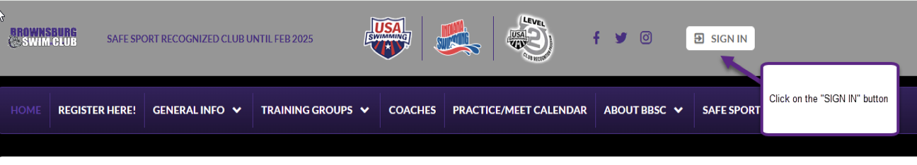
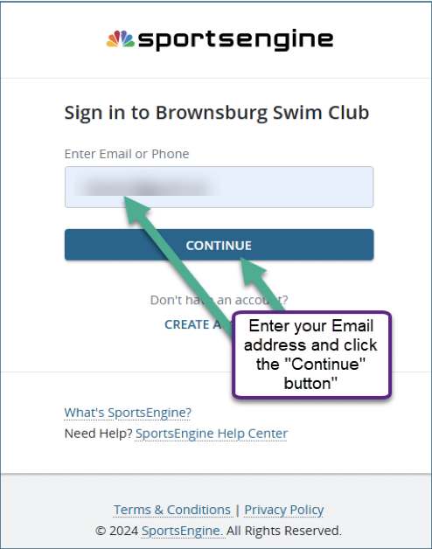
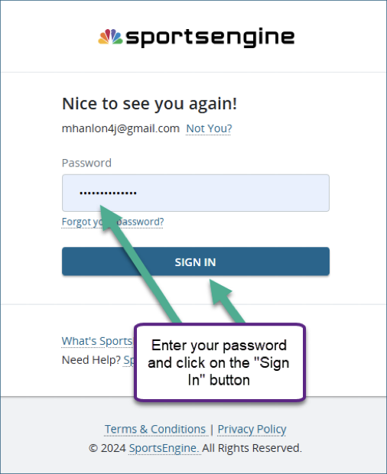
How do I pay?
Payment
Fees are paid online at the BBSC website - this happens automatically on the first of each month. We require all members to use a credit/debit card and/or to enable direct bank processing (ACH) to pay your monthly dues and other expenses i.e. meet fees, personalized caps.
1
2
3

Slide 13
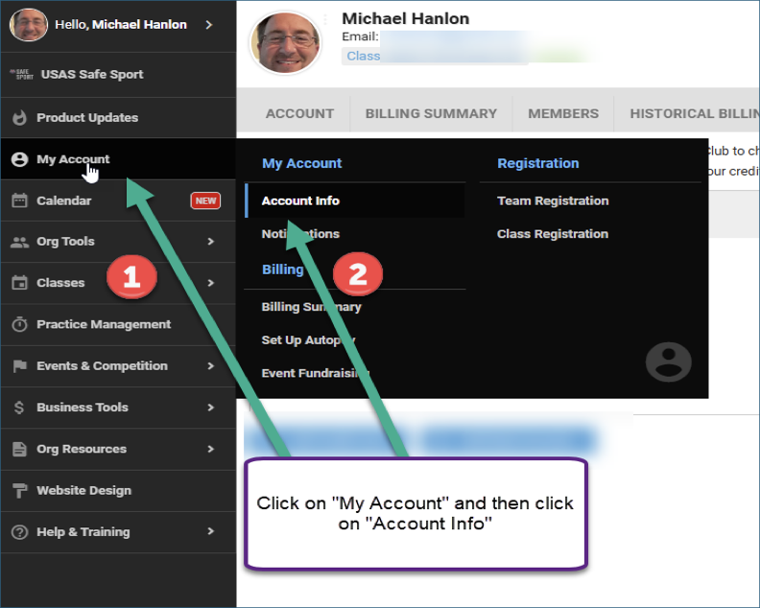
Payment
4

Slide 14
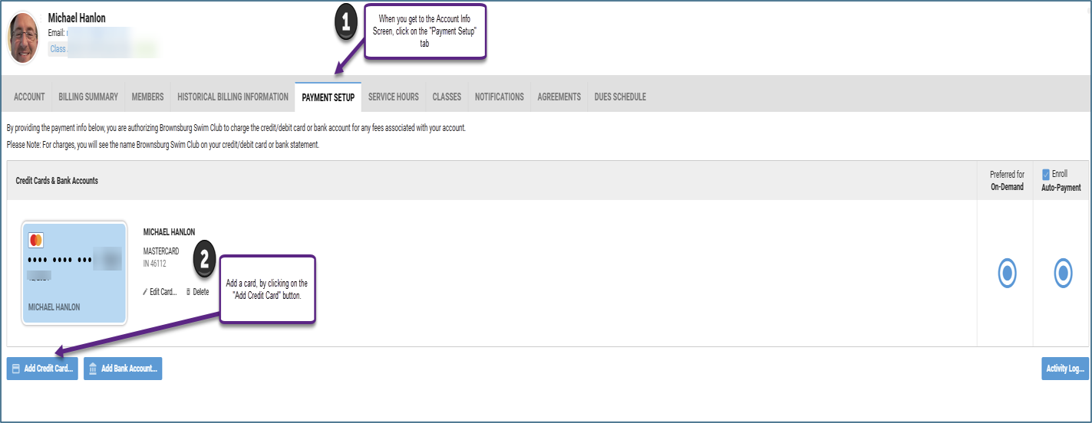
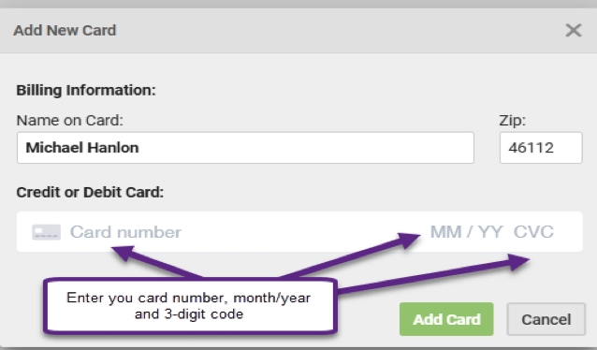
Payment
5
6

Slide 15
What if my swimmer doesn’t like it?
We offer a two-week trial period for you to decide whether or not your swimmer is going to commit to the club. If you are still unsure at that point, please contact the Club Administrator to be considered for an extension to decide. All families who commit to swim after the two-week trial period are obligated to pay 100% of their swimmers’ fees. If you have already paid the Membership fees for the month and withdraw in the two-week trial period, you will be issued a refund of those fees.
Withdrawal
SafeSport
Code of Conduct
Is BBSC a SafeSport sanctioned club?
Brownsburg is a SafeSport sanctioned club. USA Swimming’s top priority continues to be keeping our athletes safe. No form of abuse has a place in our sport. USA Swimming is committed to reducing the risk of abuse in swimming and increasing awareness of red flag behavior through its SafeSport program. All adults working with athletes are responsible for creating an abuse-free environment.
Is there a code of conduct?
A CODE OF CONDUCT will need to be signed by swimmers and parents at the start of each season. This will help communicate expectations of athletes, coaches and parents. Most clubs in USA Swimming require a code of conduct.

Slide 16
Do I have to volunteer at swim meets?
BBSC hosts 2-3 Regular and/or Championship Meets each year. Over 50% of BBSC’s budget is covered by hosting meets. Volunteering at meets allows BBSC to keep training fees low.
In order to host meets, families are needed to fulfill worker sessions. Worker sessions are required to be fulfilled even if you don’t have a swimmer swimming in the meet.
Session sign-ups are on the website approximately one month before the meet. There will be a Job Signup button on the Team Events page next to the specific meet.
Families are required to work 2 sessions per swimmer with a family maximum of 4-5 sessions per meet, with an additional session for the Circle City Classic. Families that do not fulfill their worker sessions will be billed $100 per missed session.
For the 2024/25 season, the following meets have required worker sessions:
CIRCLE CITY CLASSIC - IUPUI Natatorium - January 24-27, 2025.
3 sessions per swimmer with a family maximum of 5 sessions.
INDIANA SWIMMING DIVISIONAL MEET - BHS - March 2025.
2 sessions per swimmer with a family maximum of 4 sessions.
BBSC SUMMER SPLASH - BHS - July 2025.
2 sessions per swimmer with a family maximum of 4 sessions.
Volunteer Requirements

Slide 17
Does my swimmer get any BBSC gear?
Each year, every swimmer will receive a free team BBSC T-Shirt. Colors and designs will change from year to year.
Each March, swimmers qualifying for a Championship Meet will receive a free BBSC Championship Team T-Shirt.
Team Apparel
Can I order team apparel for myself?
If parents wish to order team apparel, visit Team Sports Apparel in Brownsburg. They can apply our logo to clothing bought in store or to an item you bring in.

Slide 18
What does Short Course and Long Course mean?
Swim Seasons
Meets are swum in Short Course or Long Course pools.
SCY stands for Short Course Yards.
SCM stands for Short Course Metres.
LCM stands for Long Course Metres.
Competitions will designate one of these three courses for their meet. Generally, the swim season is divided between Short Course Yards (September - March) and Long Course Metres (April - August).
BROWNSBURG HIGH SCHOOL POOL
BHS has a 50-metre pool that can be divided with moveable bulkheads to create 2 separate 25-yard pools and a bonus 4-lane section. With the new renovation, the pool will also be 25 yards wide, allowing for 10 competition lanes. Lane lines may also be placed perpendicular to the length of the pool.

Slide 19
What is the meet schedule?
The meet schedule is posted on the MEET CALENDAR - TEAM EVENTS page on the website. You can subscribe to the Event Calendar (Meets) and the Practice Calendar separately, ensuring you have current and correct information on your phone calendar. Instructions are on the website.
At the start of each season the meet schedule for the entire season is posted, so you can plan ahead.
Meet Schedule
How do I sign up for a meet?
Step by step directions are on the website under HOW TO SIGN UP FOR A MEET.

Slide 20
What meets should my child be swimming?
Intrasquad
Intrasquad meets will resume once we return to the BHS pool. These are for BBSC swimmers only. Highly recommended for all swimmers in Bulldog Prep and above.
These usually occur on a weeknight or on a Saturday morning instead of practice. It particularly gives new swimmers experience before attending an away meet and is a chance for your younger swimmer to race in their own pool.
We will recruit parents from the stands to help time. Sessions usually last 1- 2 hours.
Invitationals/Regular Meets
Swimmers have the opportunity to attend 1-2 meets per month (on weekends) during each season. Swimmers are encouraged to attend, but it is not required.
Talk to your child’s coach about what meets are suitable for them. Sessions usually last 4 hours or less.
Championship Meets
Swimmers are eligible based on specific time standards. During the season your swimmer will be working toward achieving these time standards. The two main meets they will work to qualify for is the Indiana Swimming Divisional Meet and/or the Indiana Swimming State Meet. These occur at the end of each season - Short Course in March, and Long Course in July/August.
The most recent time standards can be found on the Indiana Swimming Time Standards website or the OnDeck app.
Young swimmers should look to the Divisional time cuts as a first major goal. More elite swimmers look past State to Zone, Speedo Sectional, Jr National or Olympic Trial cuts.
Meet Information
- Meet types

Slide 21
What happens at a meet?
Warm Ups are typically held 45-60 minutes before the start of the meet. Swimmers are expected to be on deck 15 minutes before warm ups start.
The event number and event name should be written in sharpie on the swimmer’s arm (E 3 - 50 back). The coaches will help write the Heat and Lane numbers. Throughout the meet, the announcer will say First Call and then the event. The swimmers, with the assistance of the coaches, will go behind the blocks when their event is called.
Swimmers will sit in the designated team area with their teammates. Pack a few towels, something to wear over their suit (jacket, parka or sweatshirt), shoes to wear on deck, a few healthy snacks and a water bottle (No glass containers).
It is very helpful if the swimmers stay on their designated area, unless they are lined up to swim, swimming or talking to the coaches. This helps the coaches find the swimmers for their events. Plus, they have a lot of fun entertaining each other.
Prior to an Invitational/Regular Meet, review the meet letter. The meet letter is located on the MEET CALENDAR - TEAM EVENTS tab. Click on the name of the specific meet and scroll down the page to see the Meet Letter link. This will be posted closer to the date of the meet, when the hosting team has finalized the letter.
This letter provides directions, parking instructions, warm up times and the event order.
If there are relays at the end of the meet, your swimmer should check with the coach to make sure it is ok to leave the meet. If there are no relays, swimmers may leave after their last event of the day.
After each race, your swimmer should go and talk to their coach. Coaches provide praise and possibly one or two things to work on. Please note that most of the items to work on are identified at practice, not meets.
Meet Information

Slide 22
Who officiates at the meets?
On deck at a swim meet, officials wear white polo shirts and navy bottoms. They enforce the technical rules of swimming, so the competition is fair.
Officials are trained before being certified, and officials are largely all parents of current or retired swimmers. We encourage parents who are interested to get involved and attend our club training sessions.
To host meets, we need officials. Becoming an official is one of the best ways to support the club. Officiating takes the place of your volunteer requirements at our hosted meets.
How to become an official
Meet Information
Officiating
DQs
What if my child gets disqualified?
DQ’s are disqualifications and they happen when an official observes an infraction of the technical rules of swimming. It means the swimmer will not receive an official time and are not eligible for an award in that event.
This happens quite often with a new/younger swimmer when they are still learning the four strokes. It lets them and their coach know what portion of their stroke needs to be corrected.
Your swimmer may be upset - the coaches and officials are very understanding, and it is no big deal - all swimmers get disqualified at some time.

Slide 23
How does the club communicate with members?
Communication
BBSC website - Practice and Meet Calendars can be easily accessed (consider subscribing to the calendar to get practice information in real time), as well as all information pertinent to BBSC.
Weekly newsletter during each season sent via email, text message and posted on the Band App.
Email - Major information will be sent by email to club members.
Text messages/Push Notifications - Opt in to receive Text Messages/Push Notifications on your Teamunify account on the website. This is how we get information out quickly if there's a last-minute practice change or updates to meets.
BAND App - Download the Band app. This app allows BBSC members to communicate directly with coaches and other parents for updates and questions. The weekly newsletter will be posted and other pertinent information. This works kind of like a Facebook feed that is run directly by BBSC.
If you need to contact your child’s coach or have a question, please email brownsburgswimclub@gmail.com or post a question on the Band App. Coaches will be monitoring email and Band.

Slide 24
How do I view my swimmers’ times?
Is there an app for that?
Communication
Meet Mobile - Meet mobile provides real-time meet results and standings from anywhere, anytime. These are all unofficial results, but it helps to track along during a meet. Many teams also include heats and lanes, a psych sheet, and sometimes a heat sheet. It is worthwhile to spend the $9.99 for the annual subscription.
OnDeck - Free for club members. Sign in with your BBSC website login. You can see future events your swimmer is signed up for, past results, etc. It’s a little more limited than the website, but it’s good for on the go. You can also access your child's best times (it has their entire history of best times for each event by meet) and you can see how close they are to a Championship time standard cut. It also has updated time standards to qualify for Championship meets.
USA Swimming - App related to the USA swimming website.

