Slide 1
First Aid Kits
Allan Meier
Starre Haney

Slide 2
Facility Provided Kits

Slide 3
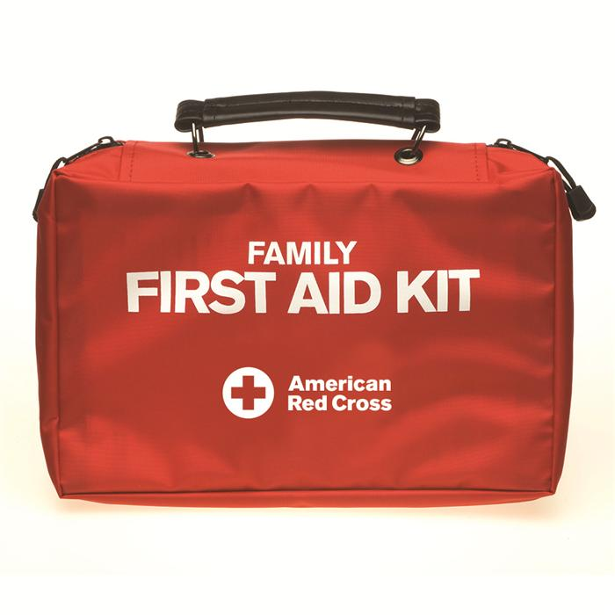
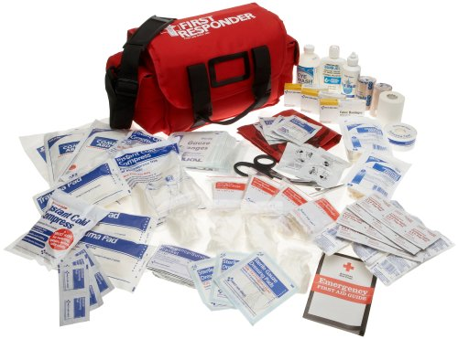
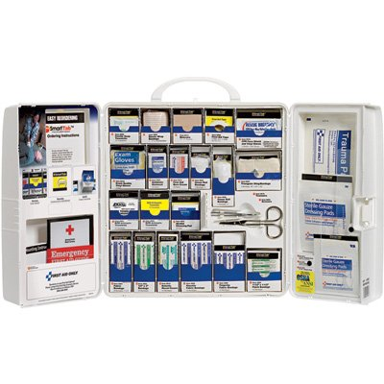
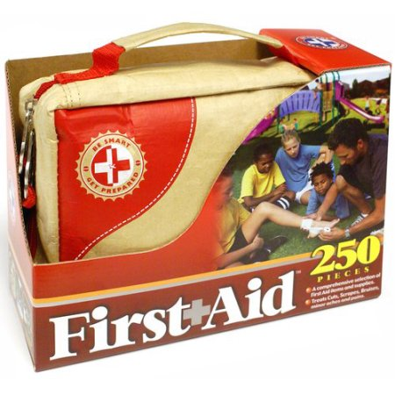
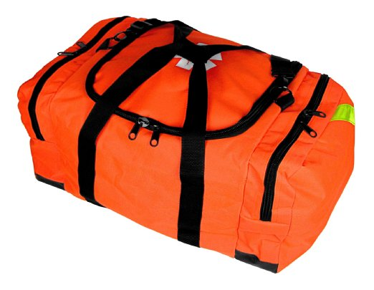
Team Kit?
Notes:
What size kit you need will be based on team size, whether or not you run meets, swim camps or other big events.
Whether you have access to other first aid kits- life guard station etc.

Slide 4
First Aid Kit Contents Will Vary
Orange Dixie kit comes in a uniquely designed first responder bag which organize your equipment. Bag has a waterproof bottom. Included Items:
1 - Stethoscope
1 - Aneroid Sphygmomanometer (BP cuff w/gauge)
1 - CPR pocket mask
1 - Foil Baby Bunting
1 - 5½" Bandage Scissors
1 - Diagnostic Penlight
1 - Kelly 5½" Straight Forceps
1 - CPR Face Shield with 2 Gloves (medium, latex)
1 - Dixie Emergency Airway Kit (set of 6: 40-110mm)
1 - Rescue Blanket
1 - Instant Cold Pack
1 - 2" x 2" Koolaburn® Burn Dressing
1 - 4" x 4" Koolaburn® Burn Dressing
1 - Glucose Gel Tube
1 - Wire Splint
1 - Tourniquet
1 - Seat Belt Cutter
16 - 4" x 4" Sterile Gauze Pads
1 - Wire Splint
1 - Tourniquet
1 - Seat Belt Cutter
16 - 4" x 4" Sterile Gauze Pads
10 - 1 x 3" Sheer Bandages
10 - 3/4 x 3" Sheer Bandages
10 - 2 x 4 1/2" Bandages
10 - Fingertip Bandages
10 - Knuckle Bandages
2 - 2" Stretch gauze Roll
2 - 3" Stretch gauze Roll
2 - 6" Stretch gauze Roll
6 - 5" x 9" Surgical Dressings/ Abdominal pads
1 - Multi-Trauma Dressing
10 - Alcohol Prep Pads
10 - PVP Prep Pads
4 - Oval Eye Pads
2 - 1" Cloth Tape
4 - Triangular Bandages w/Pins
20 - Ammonia Inhalants
4 - Sting Pads

Slide 5
Red Cross Large Workplace Kit Contents
10 Patch plastic bandages, 1-1/2" x 1-1/2"
25 Fabric bandages, 1" x 3"
25 Plastic bandages, 3/4" x 3"
10 Fingertip fabric bandages
10 Knuckle fabric bandages
1 Elastic bandage wrap, 2" x 5 yds
10 Butterfly wound closures
1 Triangular sling bandage, 40" x 40" x 56"
10 Gauze dressing pads, 2" x 2"
10 Gauze dressing pads, 3" x 3"
1 Conforming gauze roll, 2"
1 Conforming gauze roll, 3"
1 Trauma pad, 5" x 9"
20 Alcohol cleansing pads
20 BZK antiseptic towelettes
10 Castile soap towelettes
10 First aid/burn cream packs, 0.9 g each
10 Antibiotic ointment packs, 0.9 g each
1 First aid tape roll, 1/2" x 10 yd.
Scissors, 1 pair
10 Moleskin blister prevention bandages, 2" x 2"
1 American Red Cross Emergency First Aid Guide
Latex-free vinyl gloves, 2 pairs
Stainless steel tweezers, 1 pair
1 CPR face shield and vinyl gloves set

Slide 6
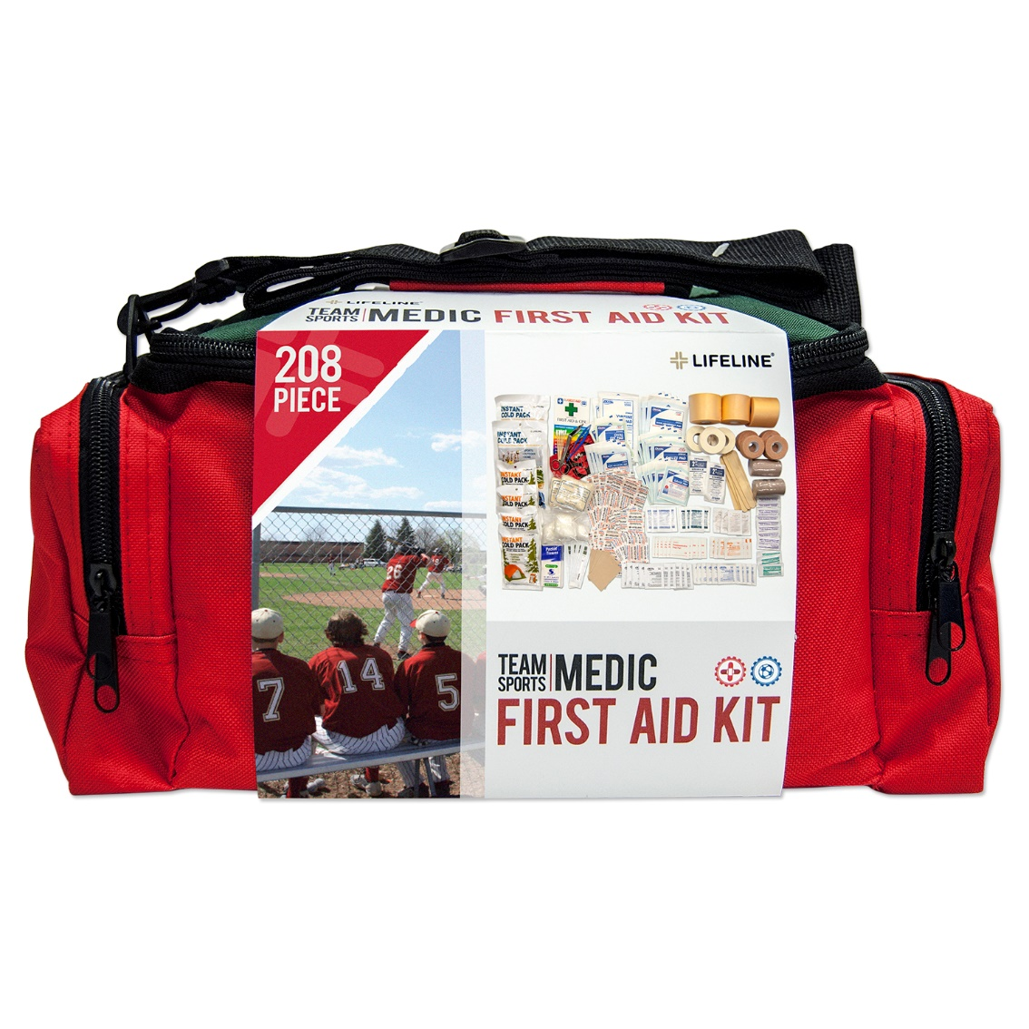
Sports Team Kits

Slide 7
First Aid Contents
1 First Aid Booklet
1 Stainless Steel Scissors
1 Tweezers
3 Pair Vinyl Gloves
3 Safety Pin
5 Cotton Tipped Applicator
2 Eye Pad
4 Disposable Thermometer
8 Wood Finger Splint
4 2” X 3” Moleskin
4 Small Instant Cold Pack
2 Large Instant Cold Pack
1 Pack Pocket Tissue
1 Hazardous Material Bag
10 Alcohol Prep Pad
10 Iodine Prep Pad
6 Sting Relief Pad
10 Antiseptic Towelette
3 Hydrocortisone Cream
8 Triple Antibiotic Ointment
4 Acetaminophen Packet
4 Ibuprofen Packet
4 Antacid Tablet
Notes:
AHA recommends ASA 325 mg for chest pain or possible heart attack

Slide 8
Kit Contents
20 3/8” X 1-1/2” Bandage
25 3/4” X 3” Bandage
5 Knuckle Bandage
5 Knee/Elbow Bandage
15 Wound Closure Strip
5 2” X 2” Sterile Gauze Pad
5 3” X 3” Sterile Gauze Pad
2 5” X 9” Combine Dressing
5 2” X 3” Non-adherent Dressing
5 3” X 4” Non-adherent Dressing
2 2” Conforming Gauze Roll
2 3” Elastic Bandage
2 Triangle Bandage
4 Co-flex Bandage Roll
3 Pre-wrap Roll
3 1” Adhesive Tape Roll

Slide 9
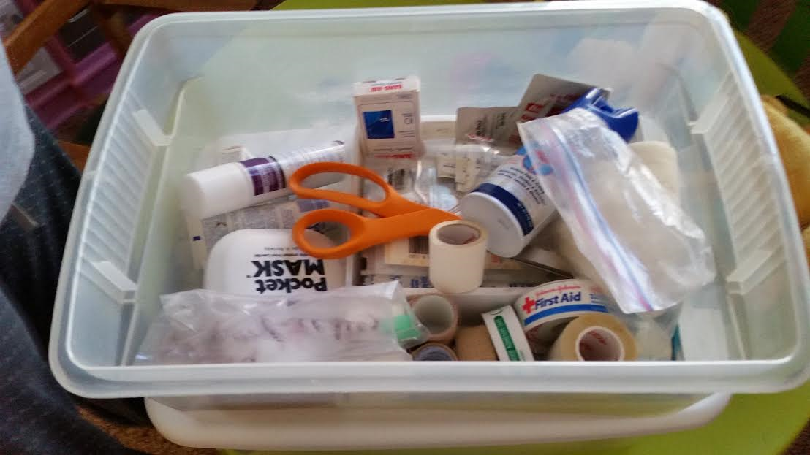
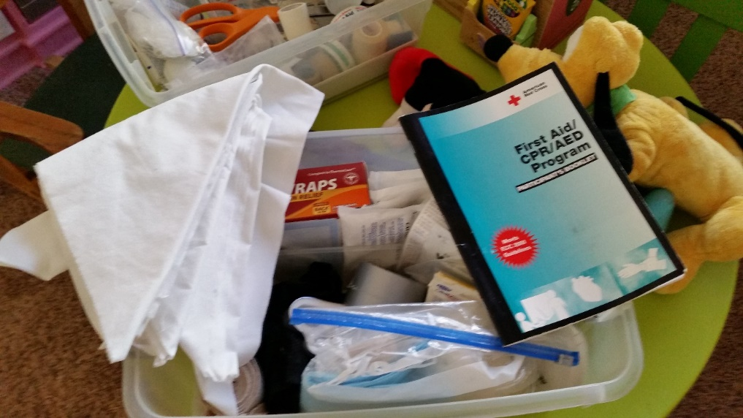
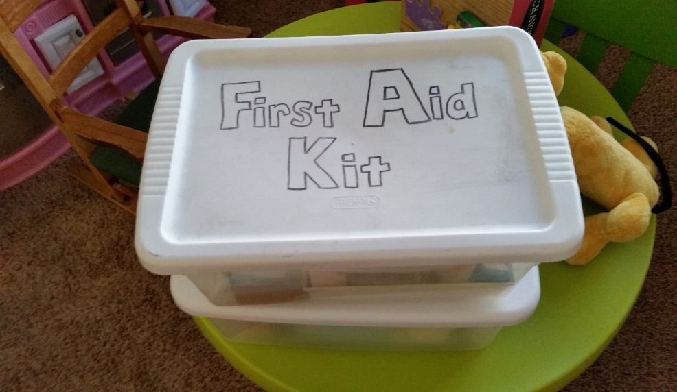
Make Your Own

Slide 10
Team Kit Maintenance
Inventory-Check List (Laminate)
Expiration Dates for medications
Opened dates for multi use bottles/tubes
Assign Responsibility
Check & Restock before and after each meet or event held
Check & Restock after injury/use
Check & Restock quarterly/monthly
Don’t forget to complete Report of Occurrence when used
Notes:
Person needs authority to make purchases and restock or to follow up that it was done.

Slide 11
Restock
Can order items on-line
Use local discount store
Use local pharmacy/grocery store

Slide 12
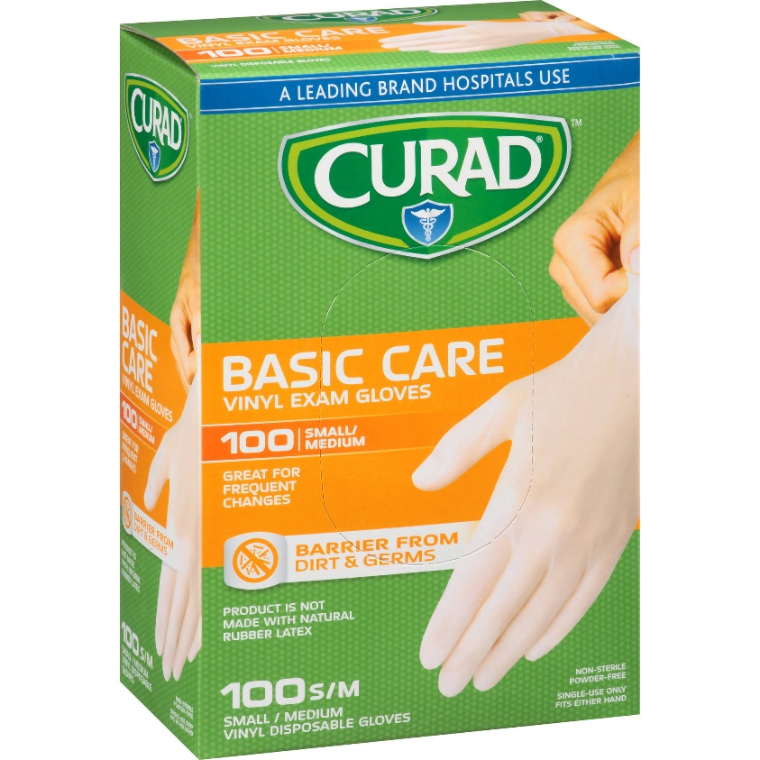
Non Latex Gloves

Slide 13
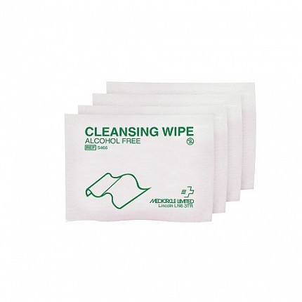
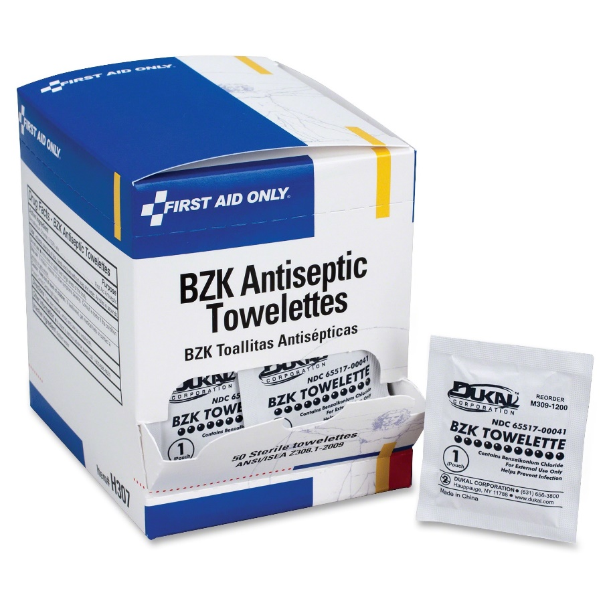
Wound Cleanser-Disinfectant
Notes:
If soap and water at a sink is not practical –can use castille soap packets and water. Antiseptic wipes

Slide 14
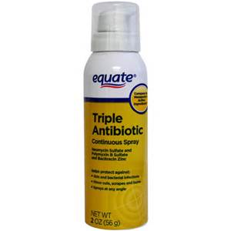
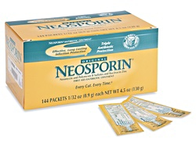
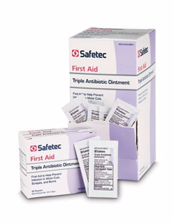
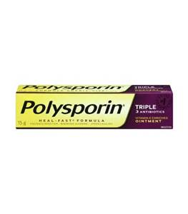
Antibiotic ointment
Notes:
Single use packets best

Slide 15
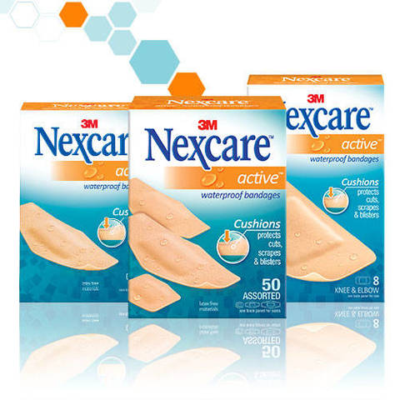
Bandages

Slide 16
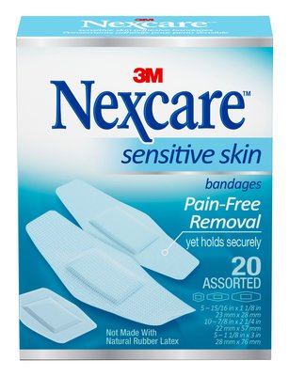
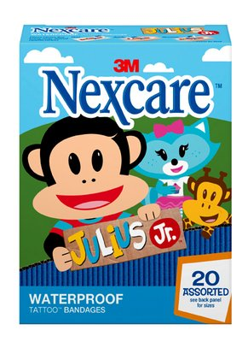
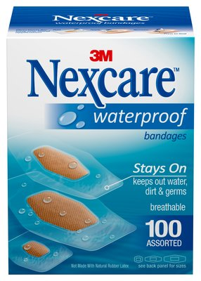
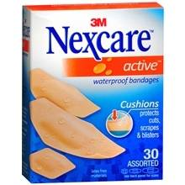
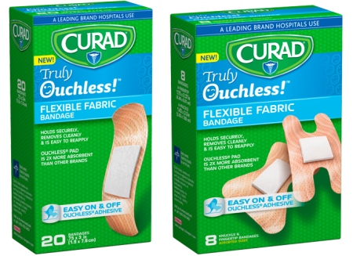
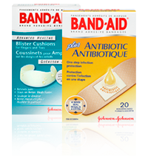
Lots of brands, colors, & designs

Slide 17
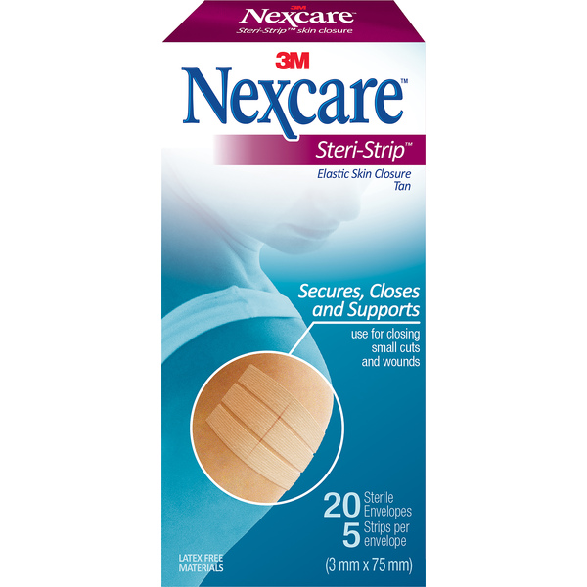
Wound Closure Strips

Slide 18
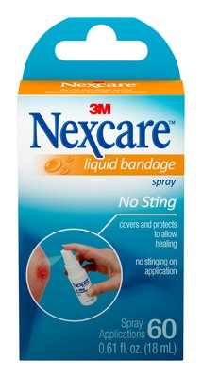
Liquid Bandage

Slide 19
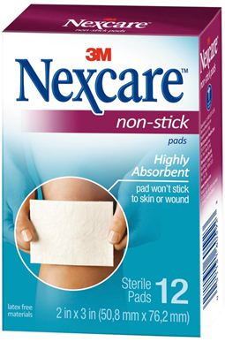
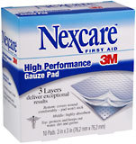
Gauze Pads vs Non Adherent Dressing
Notes:
Both are needed

Slide 20
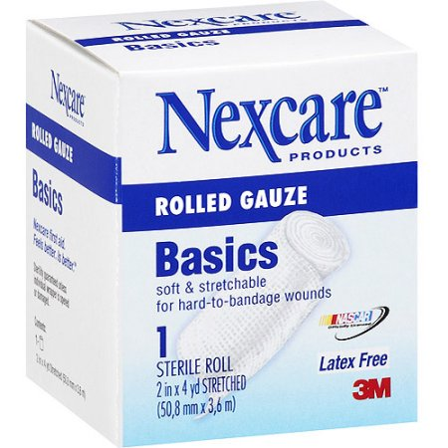
Rolled Gauze-Kling Dressing

Slide 21
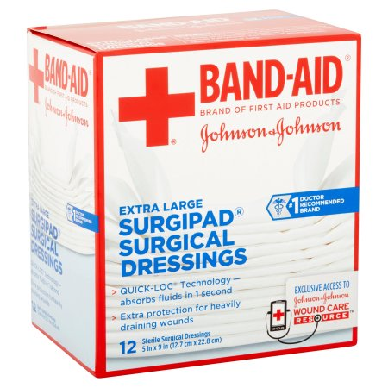
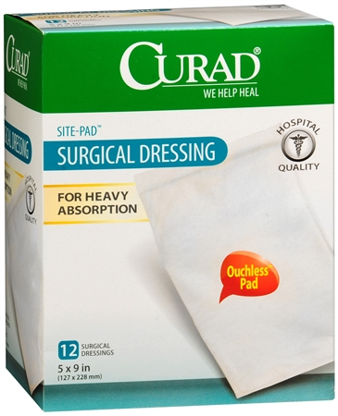
Combine-Surgical Dressing-Trauma Dressing

Slide 22
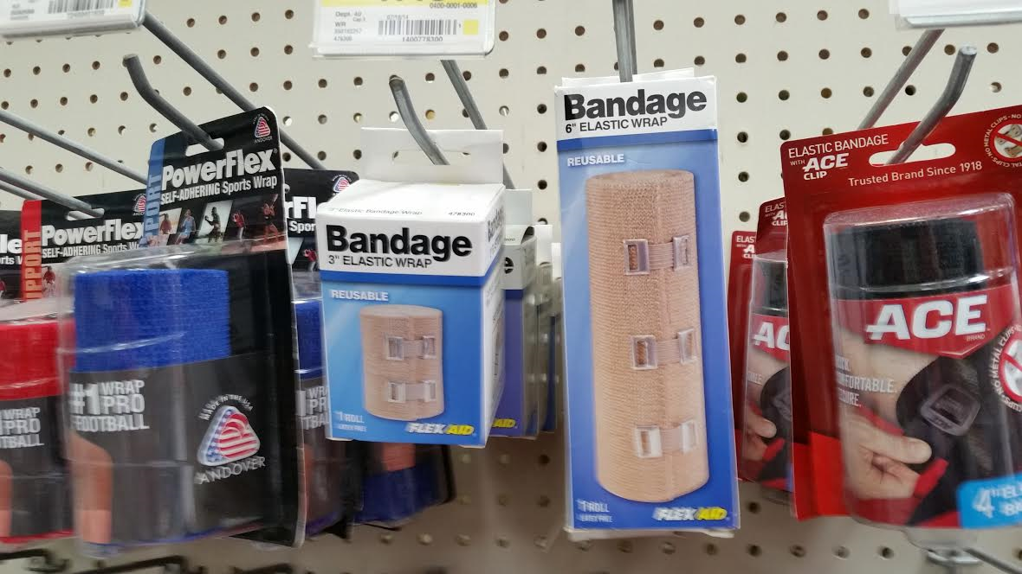
Ace Wrap-Elastic Wrap

Slide 23
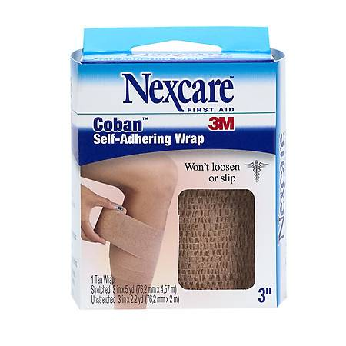
Adhesive Bandage Wrap
Notes:
Co flex is another brand

Slide 24
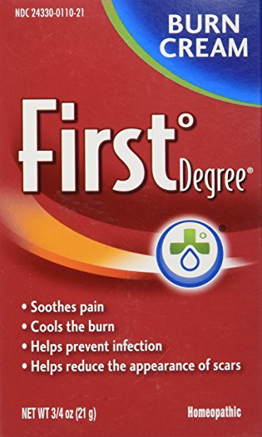
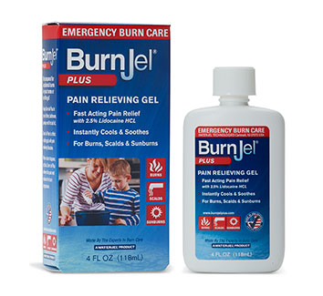
Burn Care

Slide 25
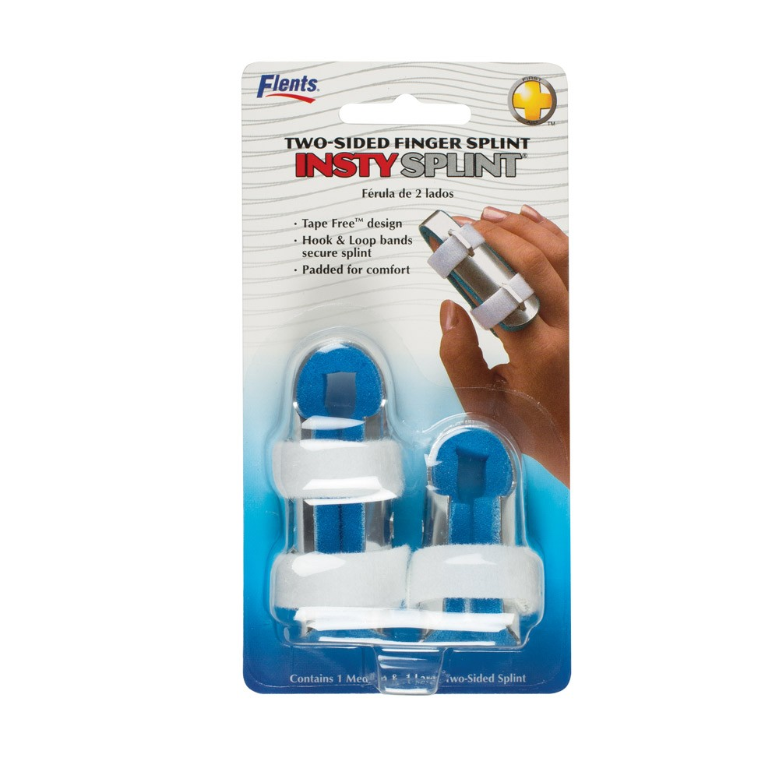
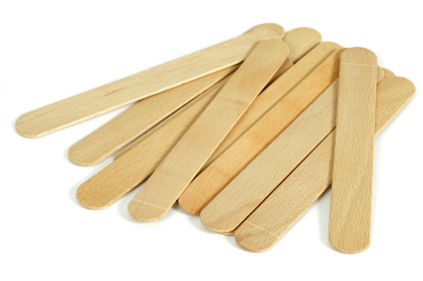
Finger Splints

Slide 26
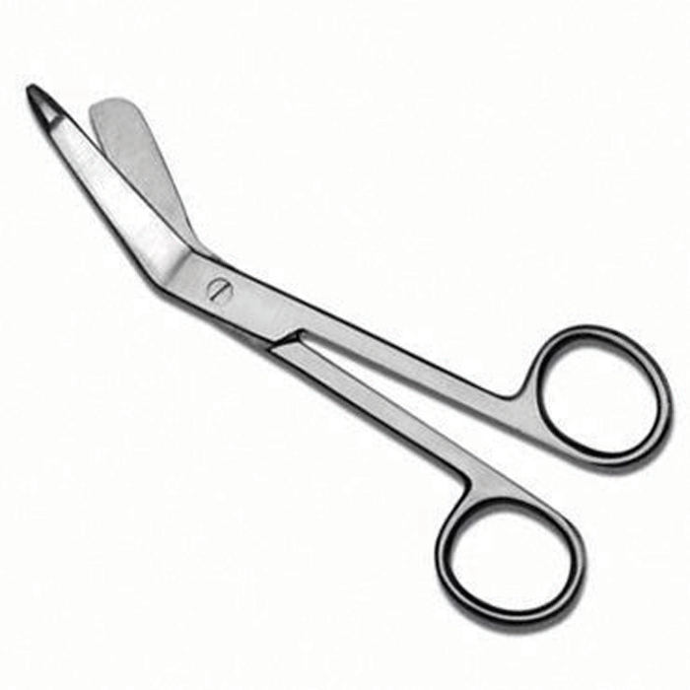
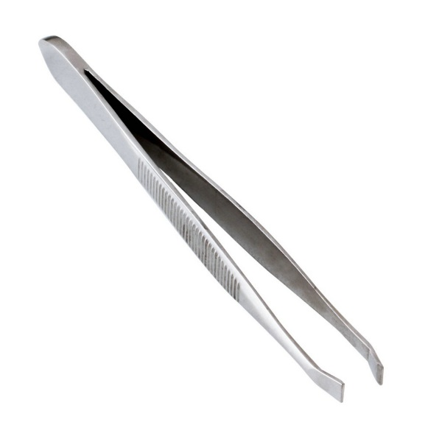
Helpful Tools

Slide 27
QUESTIONS ?

