Slide 1
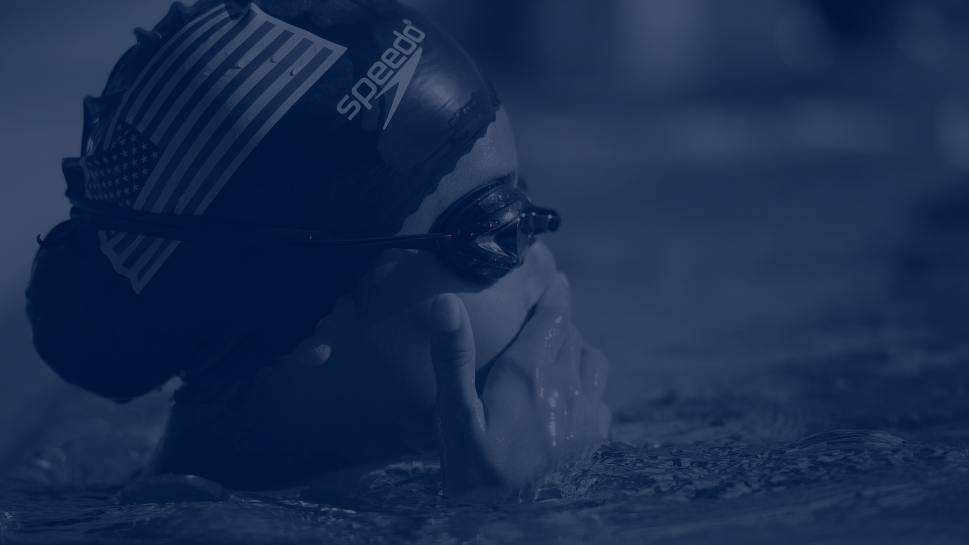
Welcome New Families!

Slide 2
About Our Team
Mission statement
Our core beliefs
How our team is run
Coaches
Board
Parent Volunteers
Practice Locations
Required Equipment
Fee Schedule
Policy Review
Volunteer Requirements
Practice Schedule
Meets
Helpful Links

Slide 3
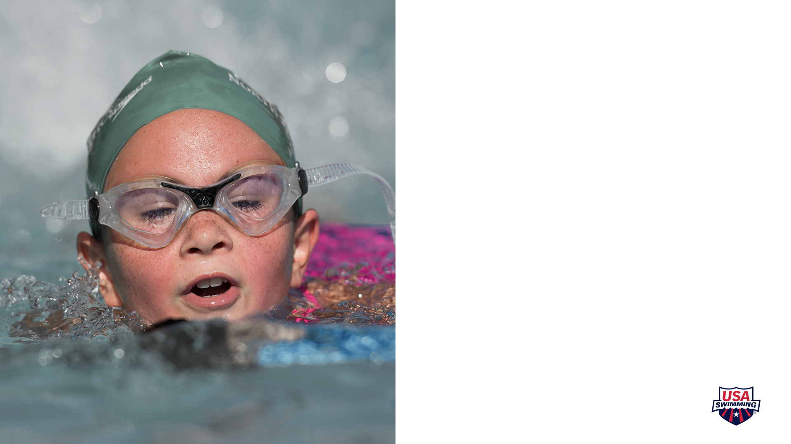
Mission statement
Our mission is to create and maintain a swim club that embodies the spirit of competitive swimming. Our club will emphasize the foundation for a healthy lifestyle focusing on the benefits of physical exercise, good nutrition, and mental training through goal setting. We will encourage swimmers to become well-rounded individuals with a healthy balance of family, school, friends and swimming. Sea Devils Swimming will provide a safe and supportive environment for swimmers at all levels of competitive swimming, starting with the beginning swimmer through high school. Our club will work together with the community and school district to achieve the greatest mutual success.

Slide 4
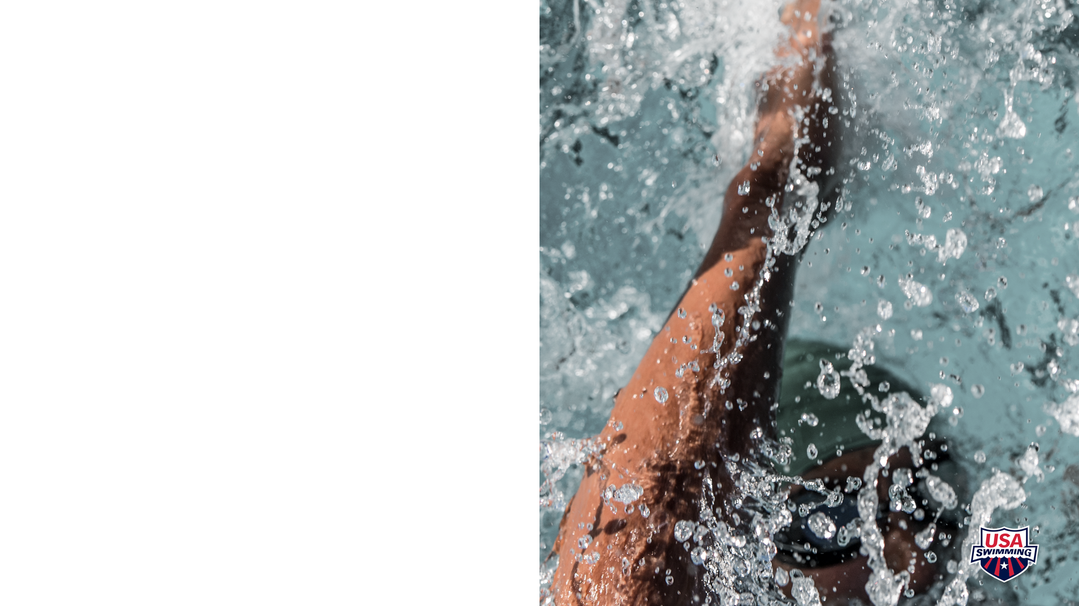
Our Core Beliefs
All swimmers welcome
Emphasize team unity and spirit.
Focus on improving swim techniques and conditioning.
Coaches provide constructive feedback.
No tolerance for humiliation or coercion.
Coaches prioritize safety and discipline.
Disciplinary actions communicated promptly to parents.
Optional away meets; understanding of family commitments.
Encouraged participation in home meets.
Reliance on family volunteers for smooth operations.
Support for swimmers in multiple sports.
Flexibility for school team participation.

Slide 5
Meet Our Coaches
Coach Terri
Head Coach
tuelmoser@aol.com
Coach Grant
Strength/Conditioning Coach
Co-lead Minnows, Guppies, Sharks, Senior
granttmoser@gmail.com
Coach Cory
Tadpoles/Red/Yellow
forslcor@gmail.com
Coach Dave
Black/Masters/Administrator
SDVLCoachDave@gmail.com

Slide 6
Meet Our Coaches
Coach Montana
Sharks
lawre474@morris.umn.edu
Coach Amber
Minnows/Guppies
ajeckstein27@gmail.com
Coach Jon
Minnows/Guppies
jonkemp056@gmail.com

Slide 7
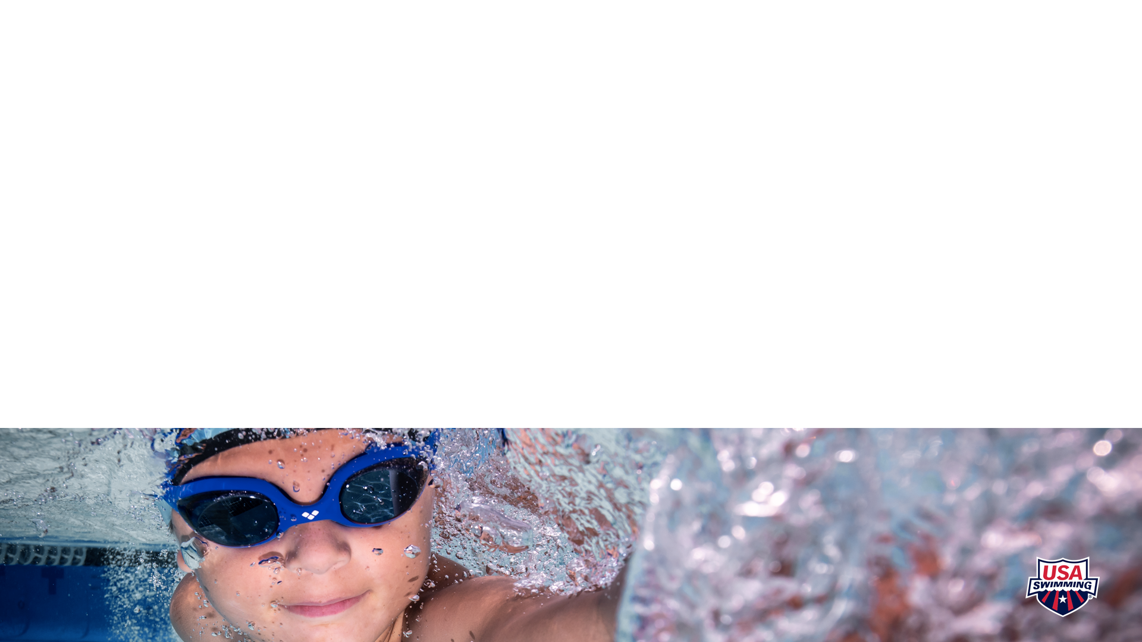
Meet the Parent Board
Steph Louder (President)
president.seadevils@gmail.com
John Crosland (Treasurer)
treasurer.seadevils@gmail.com
Robin Gordon (Registrar)
registrar.seadevils@gmail.com
Tiffany Hartman (Director of Communications)
communications.seadevils@gmail.com

Slide 8
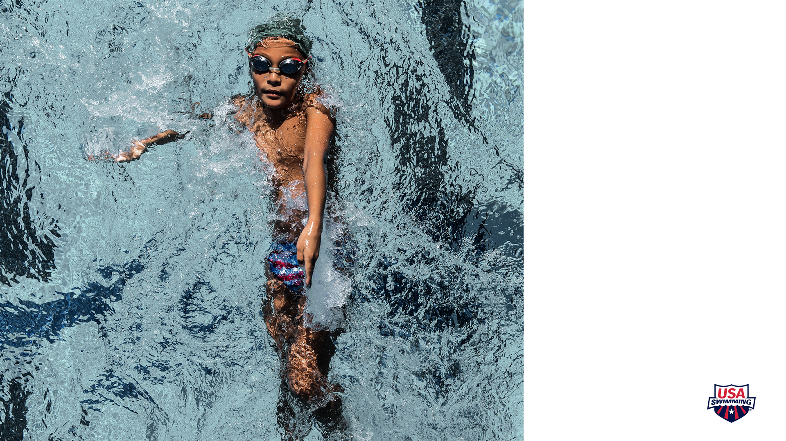
Practices facilities include:
St. Michael Middle School East
4862 Naber Avenue NE, St. Michael, MN
VandenBerge Middle School
948 Proctor Ave, Elk River, MN
Big Lake High School
501 Minnesota Ave, Big Lake, MN

Slide 9
Required Equipment
Minnows and Guppies
Team Cap
Mesh Bag
Goggles (2 pair)
Practice-appropriate suit
Fins
Kickboard
Sharks, Red, and Yellow
Team Cap
Mesh Bag
Goggles (2 pair)
Practice-appropriate suit
Fins
Kickboard
Snorkel
Pull Buoy
Finis Agility Hand Paddles (required for Yellow Group)

Slide 10
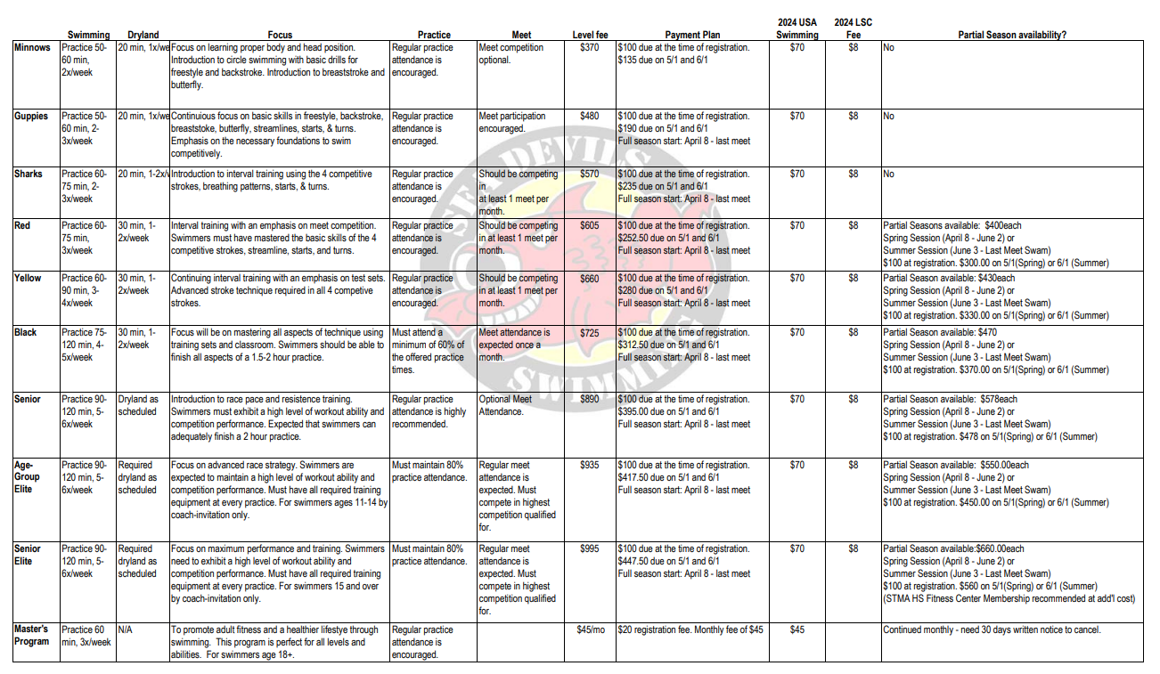
Spring/Summer 2024 Fee and Level Grid

Slide 11
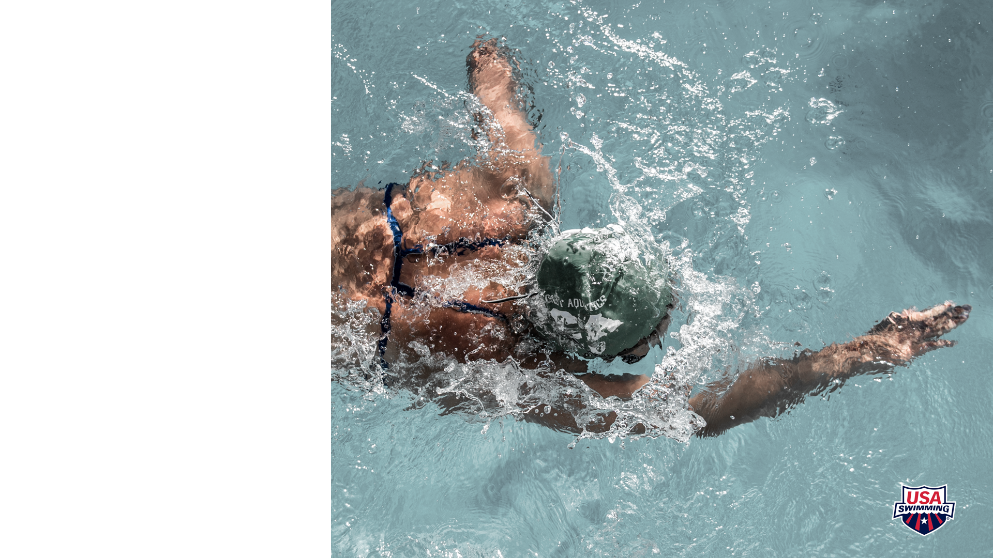
LATE PICK-UP POLICY
At the conclusion of practice, there will be a 15-minute time period allowed for all swimmers to
shower, dress, and exit the locker rooms. Swimmers will not be allowed to remain in the pool area
or locker rooms beyond that 15-minute time period
Failure of a parent to pick up their swimmer within that 15-minute timeframe will result in a fine. $20 will automatically be charged to the family’s account for each 15-minute time increment the swimmer remains at the facility. Charges will continue to accrue each 15 minutes until the swimmer is picked up.
Notes:
To provide a guideline ensuring prompt pickup of swimmers from practices, meets and team events. Our primary concern is for the swimmer’s safety followed by the utilization of our coach’s time.

Slide 12
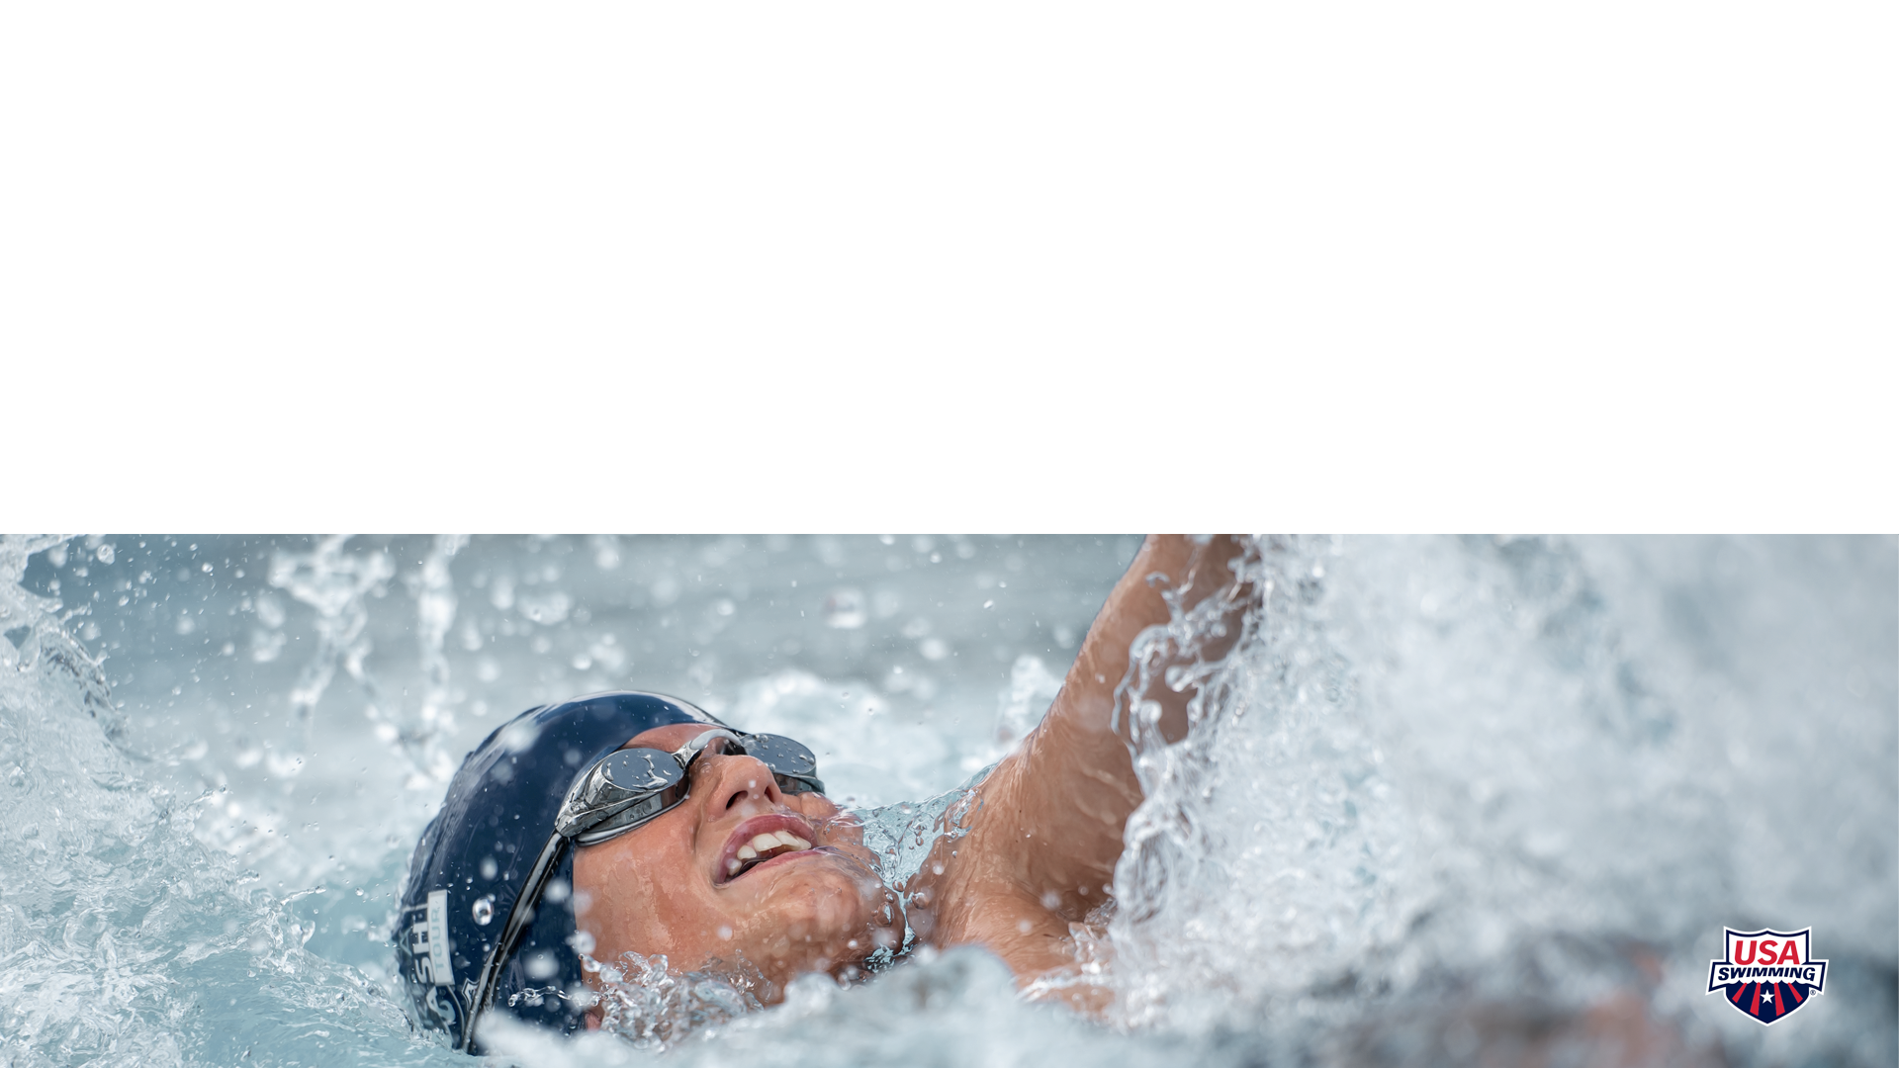
Volunteer Requirements
For the 2024 Long Course Season there is a requirement of 1 volunteer points for all families.
Here are some links with instructions:
Volunteer Position Descriptions
How to Sign Up for Jobs (or remove sign ups)
How to: View Current Completed Hours/Points

Slide 13
Practice Calendar
Practice calendars are typically posted 1 month at a time - we will provide this to you ASAP, we are dependent on schools and Community Ed schedules to be done first.
DL – Dry Land

Slide 14
Meet Schedule
Registering for swim meets is done entirely through our web site. All meets are set up at the beginning of the season and will initially include the date(s), host team and location, and eligibility. We post more detailed information about each meet as the host teams release it.
How to Register (or Decline) a Meet
Link to step-by-step tutorial of how to register (or Decline) a meet and selecting events

Slide 15
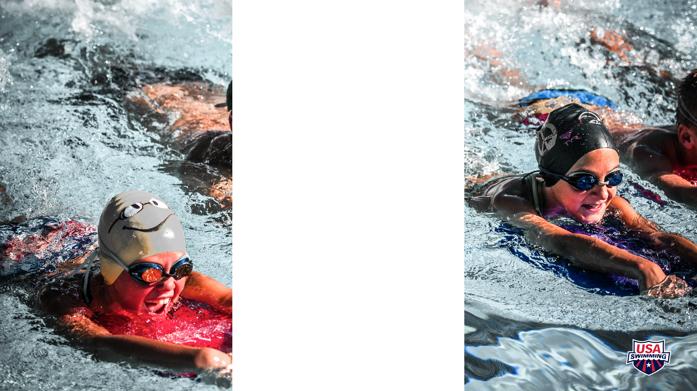
Let’s Connect!
Find us on Facebook!
MN Sea Devils Parents
Connect with other swim parents – connect, ask questions, or even carpool options!

Slide 16
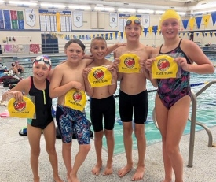
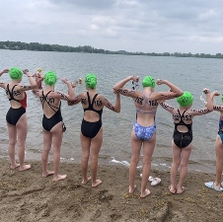
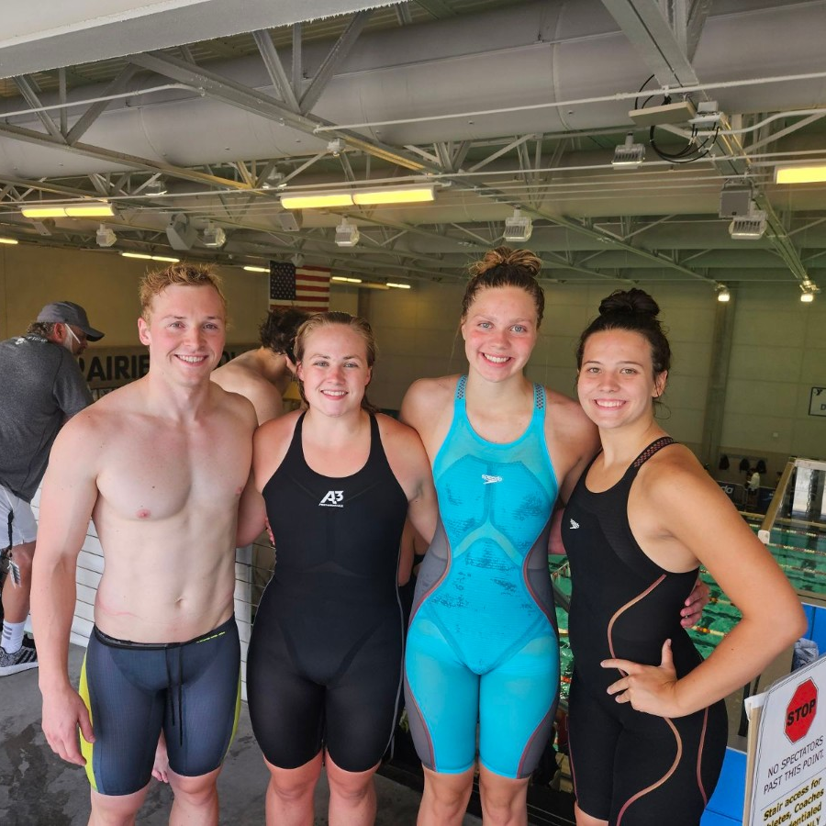
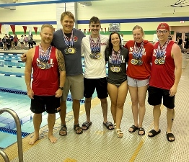
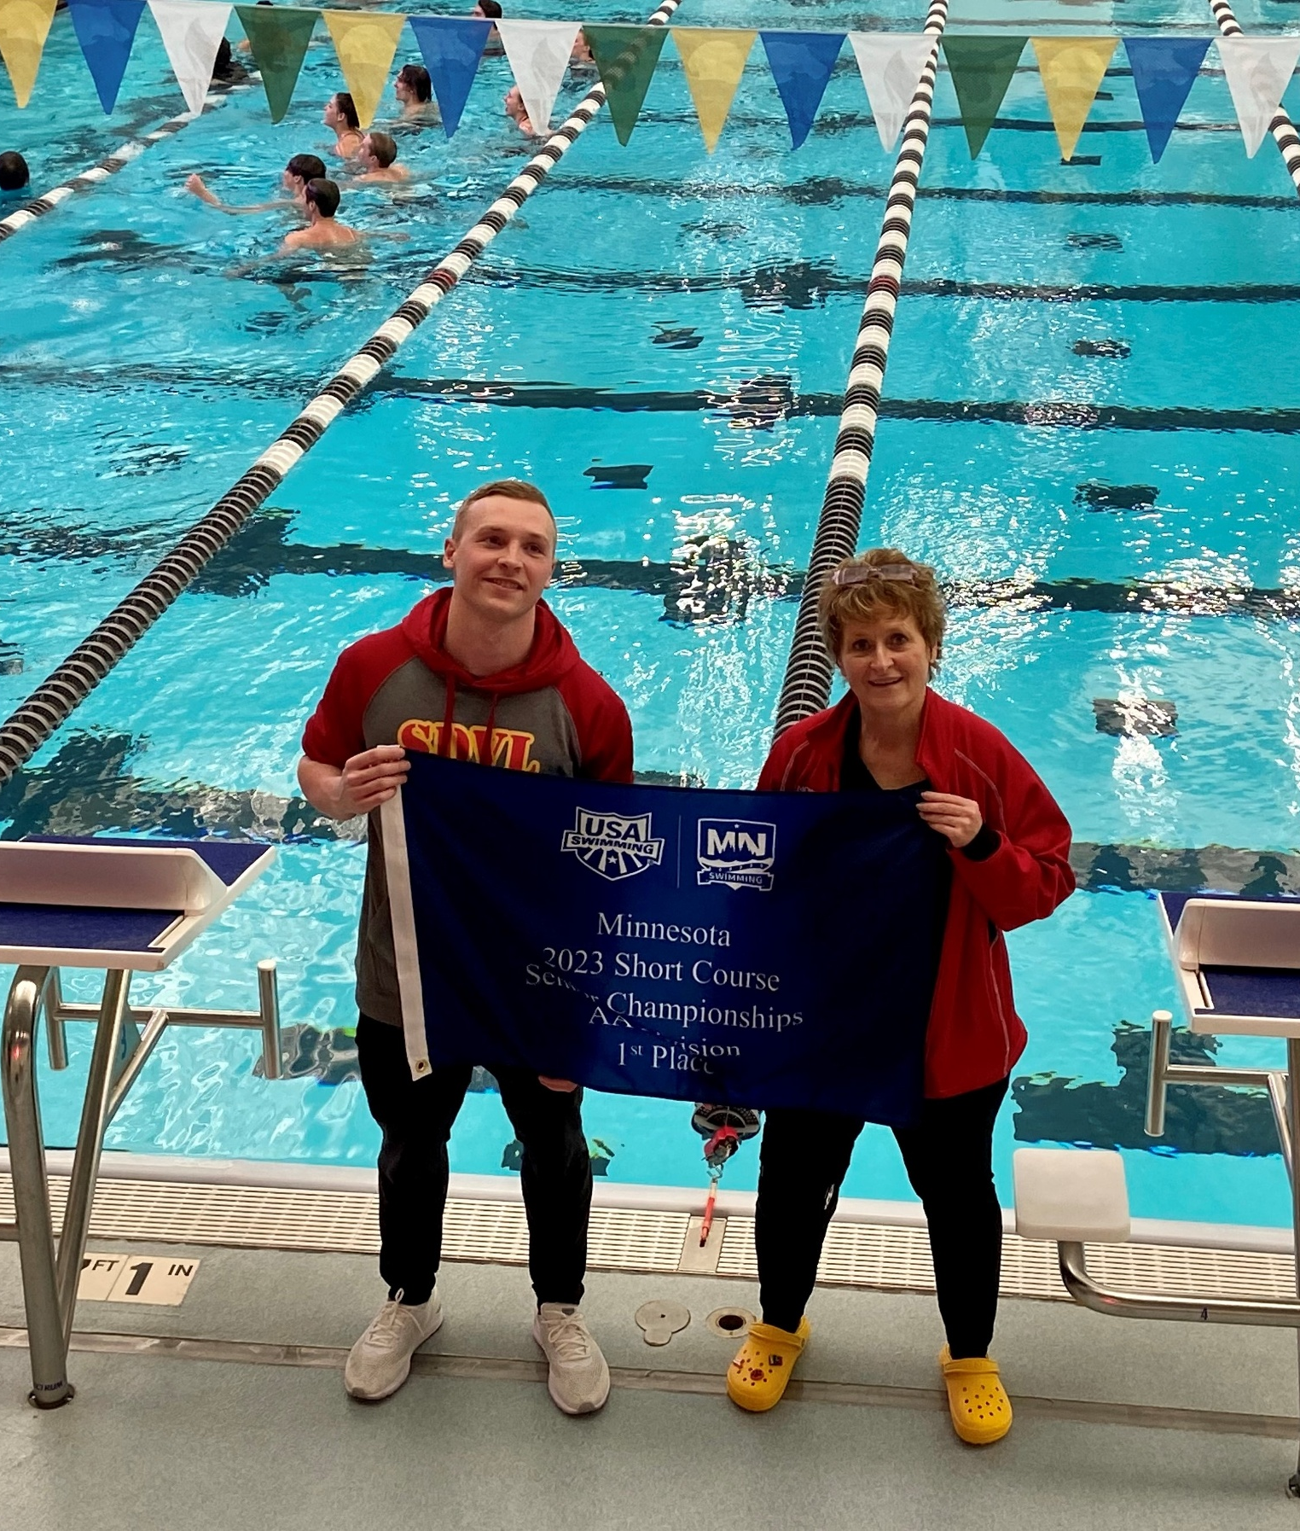
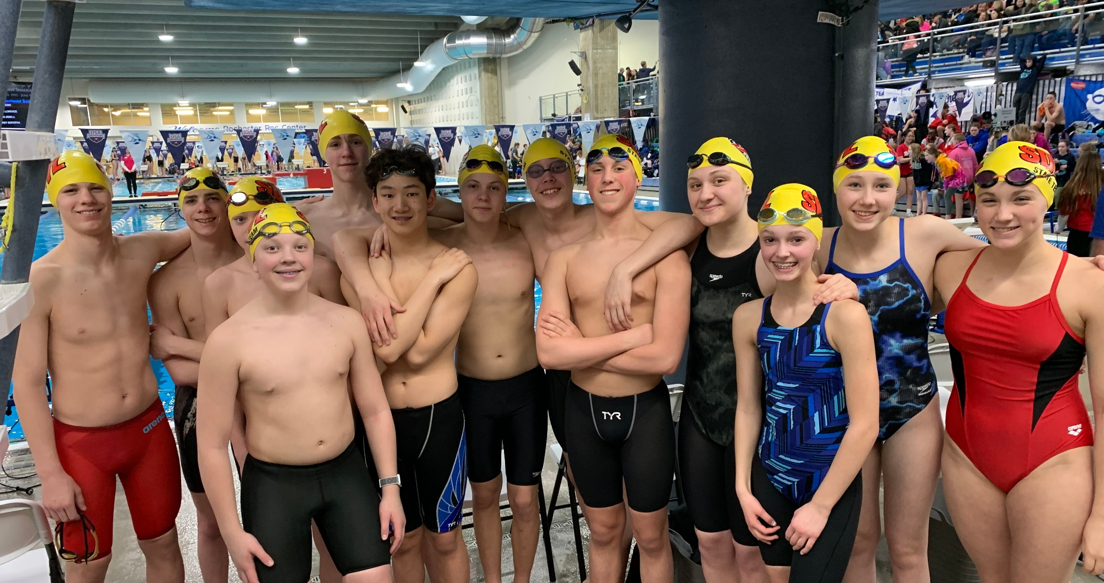
Questions?

