Slide 1

COLLEGE INFORMATION NIGHT

Slide 2
EARLY STEPS
Start with a list of at least 10 items
Try to look at items when looking for colleges
    Good academics
    Intended major
    Team spirit/great teammates
    Good relationship with coaching staff
    And some more specific:
      AC in the dorm room
      Long course and short course yards pool
      Honors college

Slide 3
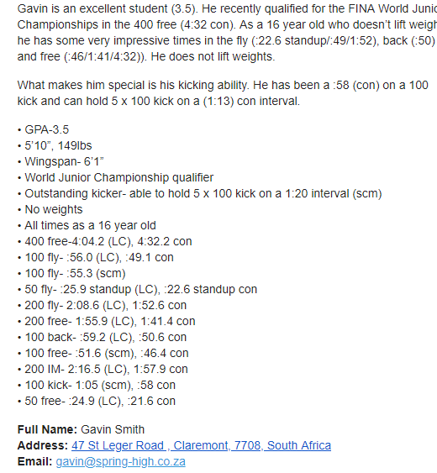
CREATE A LETTER - MAKE SURE TIME PROGRESSIONS AND GPA AND TEST SCORES ARE CLEARLY VISIBLE ​

Slide 4
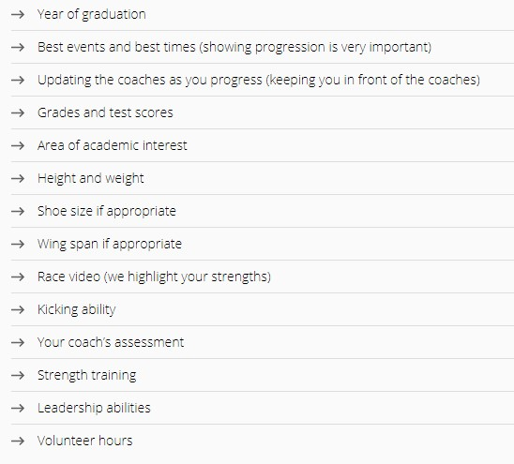
SWIM SWAM'S COLLEGE RECRUITING TIPS
https://swimswam.com/secrets-college-recruiting/

Slide 5
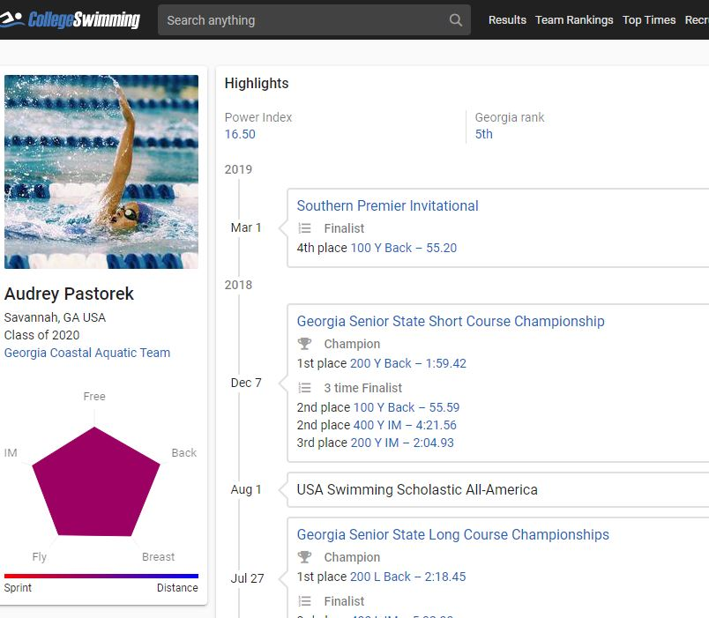
collegeswimming.com
https://www.collegeswimming.com/

Slide 6

FILL OUT QUESTIONNAIRES​
  Usually can be found at the school athletics website under swimming
  Look for "prospective recruits questionnaire"
  Filling this out shows coaches that you are interested in the team and also provide them with all the info they should need to know about you.

Slide 7
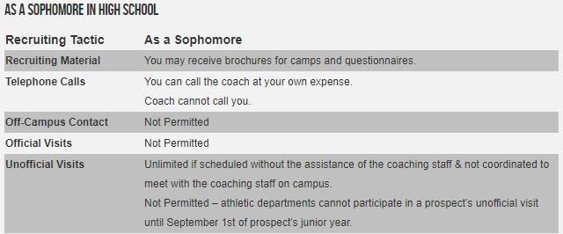
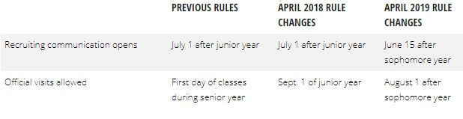
No contact before June 15 of Sophomore year​​
SOPHMORE YEAR
https://swimswam.com/ncaa-recruiting-rules-change-allow-earlier-recruiting-official-visits/​
​
https://recruitlook.com/recruiting-calendar/ncaa-division-i-recruiting-rules/swimming/​
​

Slide 8
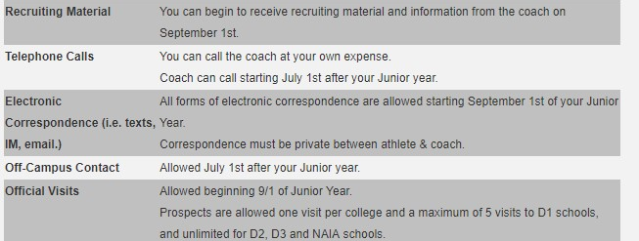
You can call the coach at your own expense.
Coach can call starting June 15th Sophomore year.
All forms of electronic correspondence are allowed starting June 15th of the sophomore year.
Correspondence must be private between athlete & coach.
Allowed August 1st after your Junior Year
Allowed beginning August 1st of the Junior year
JUNIOR YEAR

Slide 9
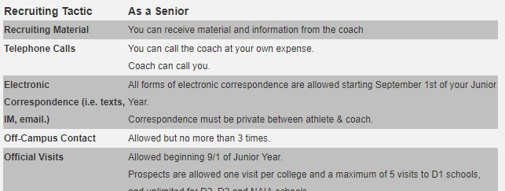
SENIOR YEAR
All forms of electronic correspondence are allowed starting
June 15th of your Junior year
Allowed beginning August 1st of junior year

Slide 10
YOU CAN TAKE AS MANY AS YOU WANT
USUALLY JUST CONTACT COACH AND
ARRANGE THE FEW HOURS MEETING
RECEIVE THE TOUR AROUND THE CAMPUS
GET A CHANCE TO QUICKLY SEE THE TEAM
NOTHING CAN BE PROVIDED FOR FREE!!!
NO OVER NIGHT STAY
UNOFICCIAL vs OFFICIAL VISIT
YOU CAN TAKE ONLY 5
ARRANGED BY THE COACHES AND USUALLY PAYED BY THE TEAM
NO LONGER THAN 48 HOURS (FRIDAY NOON TO SUNDAY NOON)
FRIDAY MOSTLY MEETINGS
SATURDAY ACTIVITY WITH THE TEAM/SWIM MEET
SUNDAY MEETING WITH THE COACH
TIME TO ASK ALL THE QUESTIONS YOU HAVE AND JUST SUMARIZE YOUR EXPERIENCE
OVERNIGHT STAY IN THE DORMS
MEALS AND SOME KIND OF FUN CAN BE PAYED FOR
CANNOT ASK HOST TO BUY YOU OR GIVE ANYTHING YOU CAN TAKE HOME WITH YOU.

Slide 11
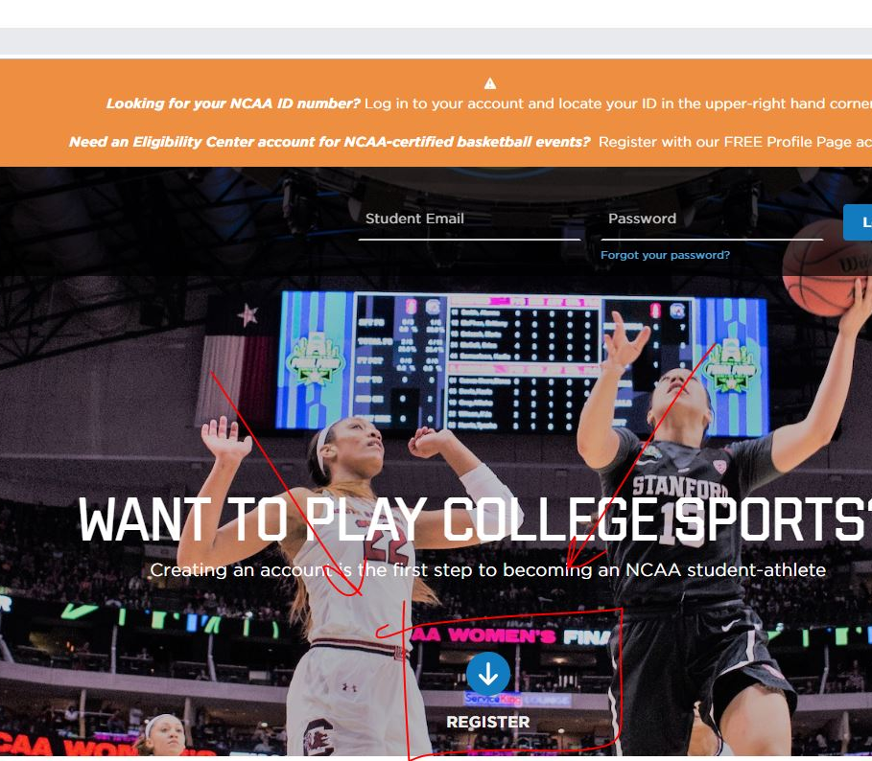
NCAA ELIGIBILITY CENTER
register before June 15th of senior year
core courses
sliding scale
ACT V SAT (when to take)- do not send to schools until you have the scores
amateurism

Slide 12
Application/ academic scholarships
apply early!
FULL RIDE IS HARD TO GET: COMBINE ACADEMIC AND ATHLETIC SCHOLARSHIP!
Academic money
  GPA
  TEST SCORES
no waving of fees

Slide 13
Athletic scholarships/signing period
Early and late (November/April)
  D-1 : Women 14.0 Men 9.9
  D-2 : about half
  D-3 no money (max not min.)
based on value to the program ( top 16/ top 8/ NCAA)
money available based on graduating class!
minimum 3 events!!!
  Usual events order is on the next slide.
  More good events you have = more valuable you are for the team

Slide 14
THINGS TO PAY ATTENTION TO:
recruiting coaches (used car salesman) - they all are going to tell you that team feels like a family and that everything is perfect: you have to decide how do you feel about it.
Athletes Choice – this is maybe the biggest decision of your early life and THINK BEFORE DECIDING!
  major (should be swimmers choice)
  Team
  Coaches
Let parents be involved: but this is mostly swimmers decision.
  Go somewhere you would be the happiest.
Pay attention to the social media - be aware of what you are posting online
ALCOHOL

Slide 15
Q and A
Thank you!

