Slide 1
Use Ipad/Phone for Pool End Video And Pool Side Video

Slide 2
Things to Think About
1. The swimmers featured are Olympians and or NCAA College level swimmers. Focus on what they are doing. Be in awe of how fast they are but focus on what they are doing.
This is a safe place. When viewing videos other swimmers on our team, be supportive. No one should be made fun of or made to feel badly. If so, tell a coach.
Just because you are not doing all of the things we talk about does not mean that you are not a good or great swimmer. Not all things work for all swimmers. You are you.

Slide 3
Session 1
Using Powerpoint in Conference Room or on Deck Freestyle Video on You Tube
Start at 7:39
https://www.youtube.com/watch?v=T1OY_yQBiXM

Slide 4
Using Powerpoint in Conference Room or on Deck Freestyle Video
Start at the Beginning of Vide0
https://www.youtube.com/watch?v=T1OY_yQBiXM

Slide 5
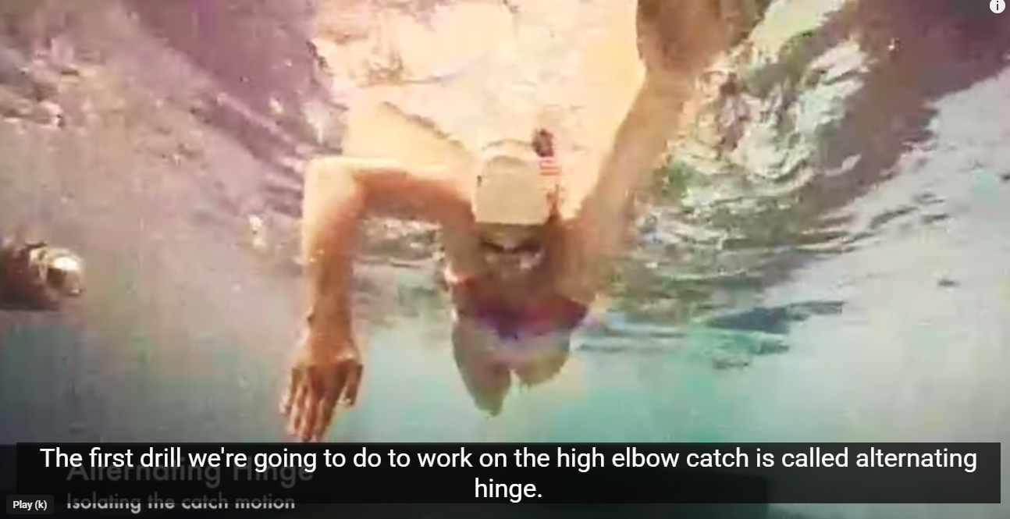
Alternating Hinge Drill

Slide 6
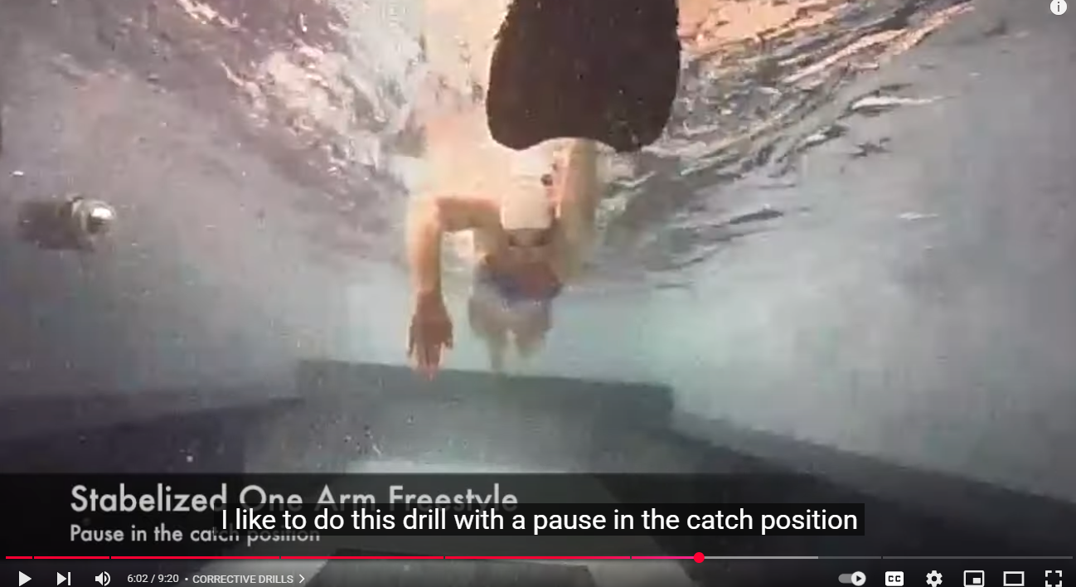
Stabilized One-Arm Freestyle

Slide 7
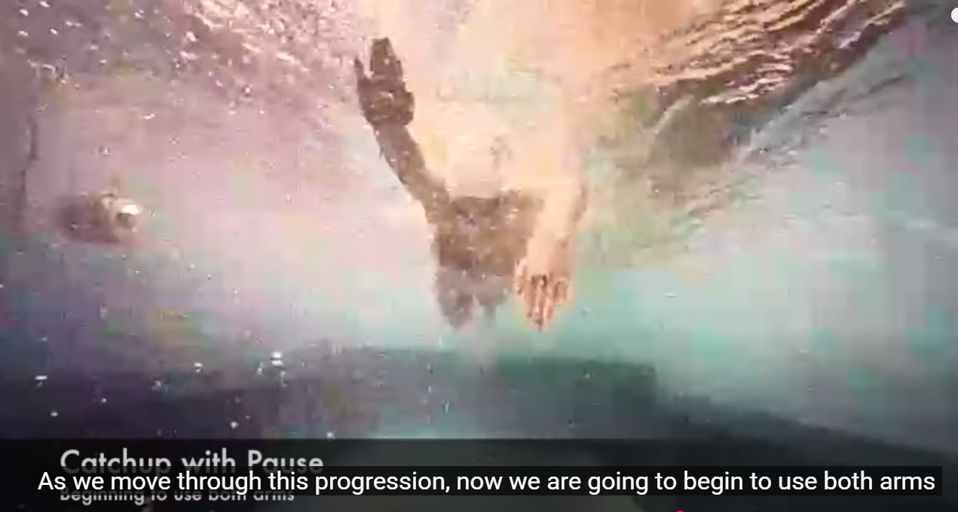
Catchup or Without Pause

Slide 8
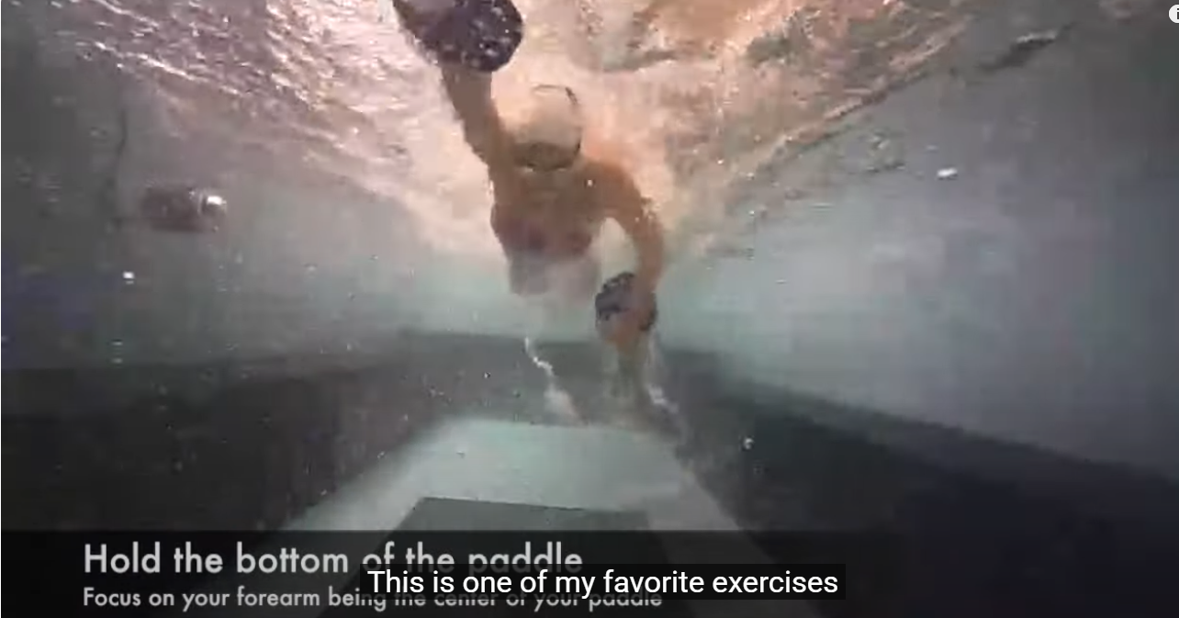
Fist Drill With Paddle or without

Slide 9

Fist Drill
https://www.youtube.com/watch?v=HH0TlKA-UFU

Slide 10

Catchup Drill
https://www.youtube.com/watch?v=qpczzwoXbyQ

Slide 11
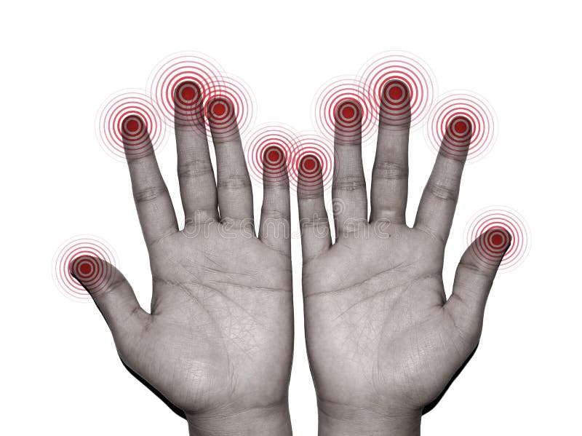
Fingertip Drag
https://www.youtube.com/watch?v=O_muRVVNpaQ

Slide 12
Name a Freestyle Drill

Slide 13
BACK TO THE POOL
Apply What you have learned
Work on Drills
Coach Suggestions
Head Forward-not nescessarily down
High Catch-get hand and arm around water
Rotate
Careful flipping out or “roostering” at end of stroke-may cause over rotation
Avoid zipper drill – places too much emphasis on hand and arm too close to the body—swing hand/arm out
Faster breathing—catch a breath
Develop a longer pull
Lots of kicking!

Slide 14
Session 2 Freestyle Review

Slide 15
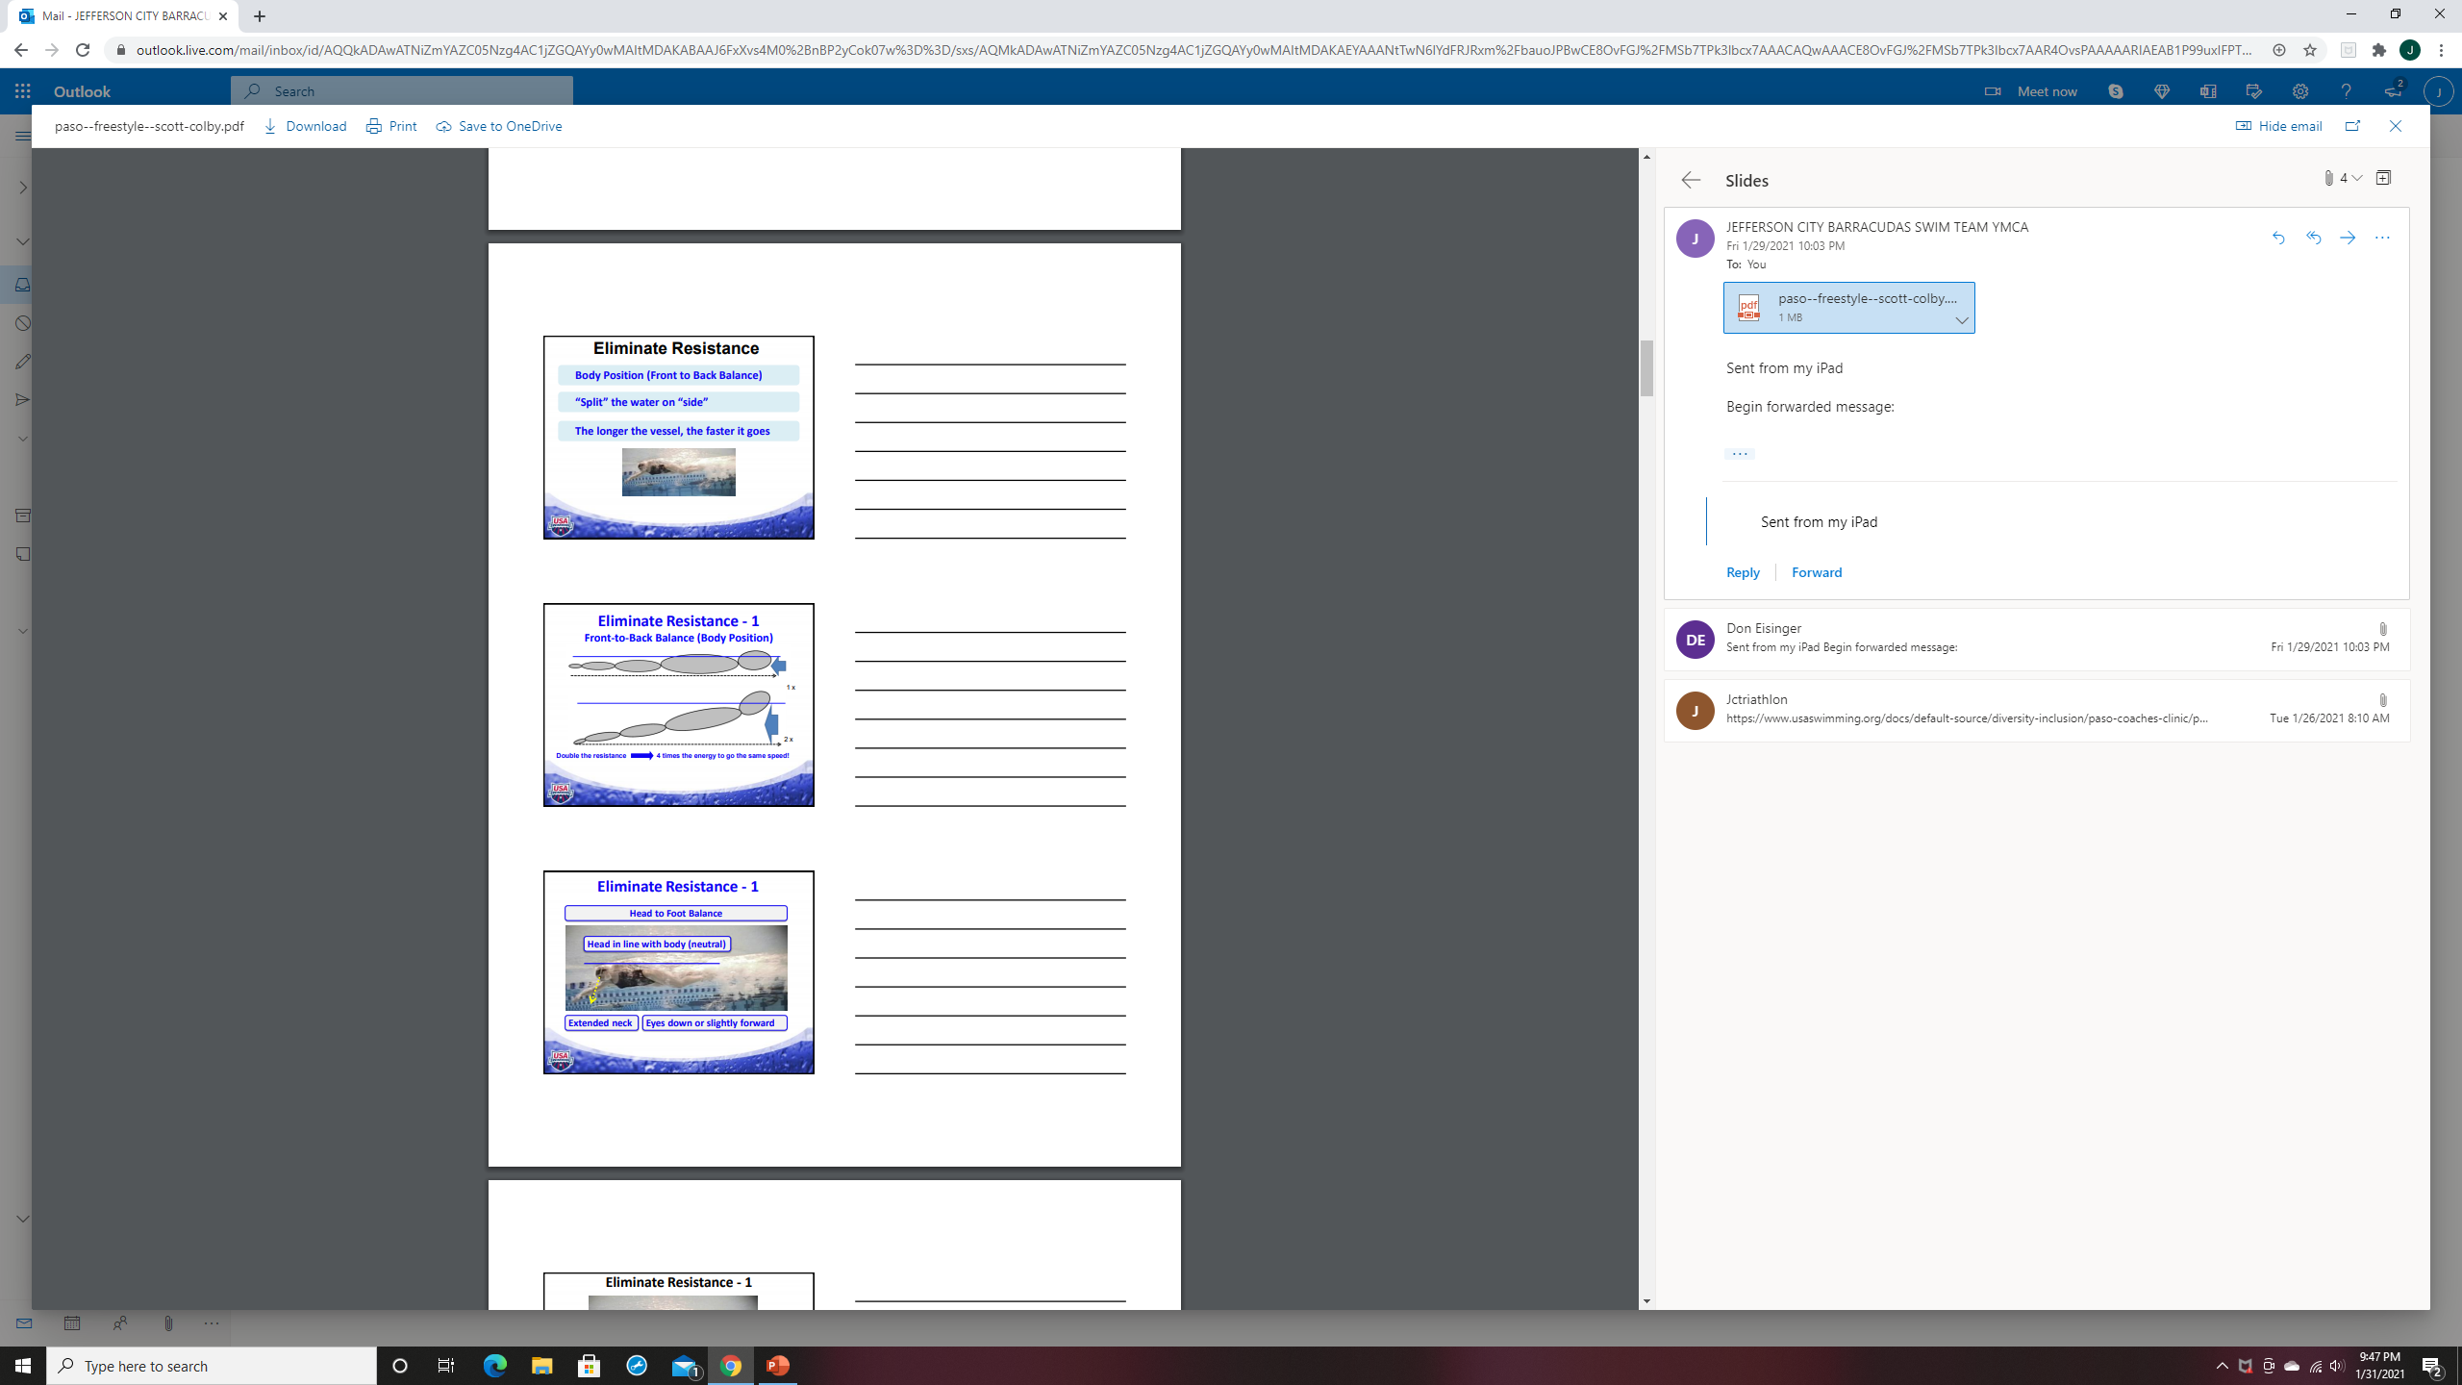

Slide 16
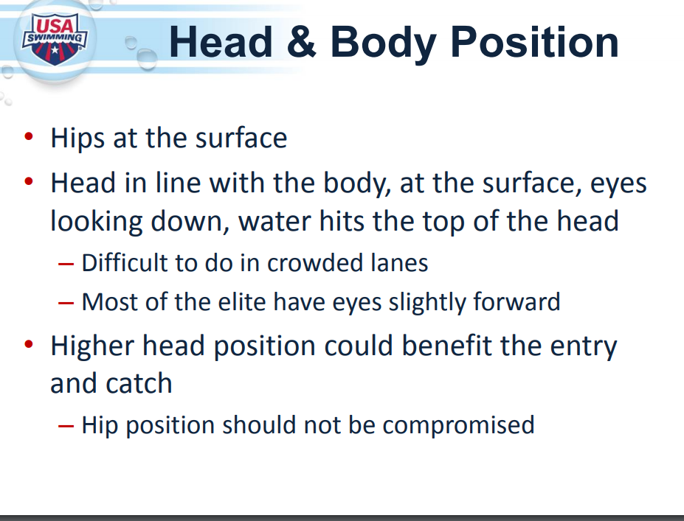

Slide 18
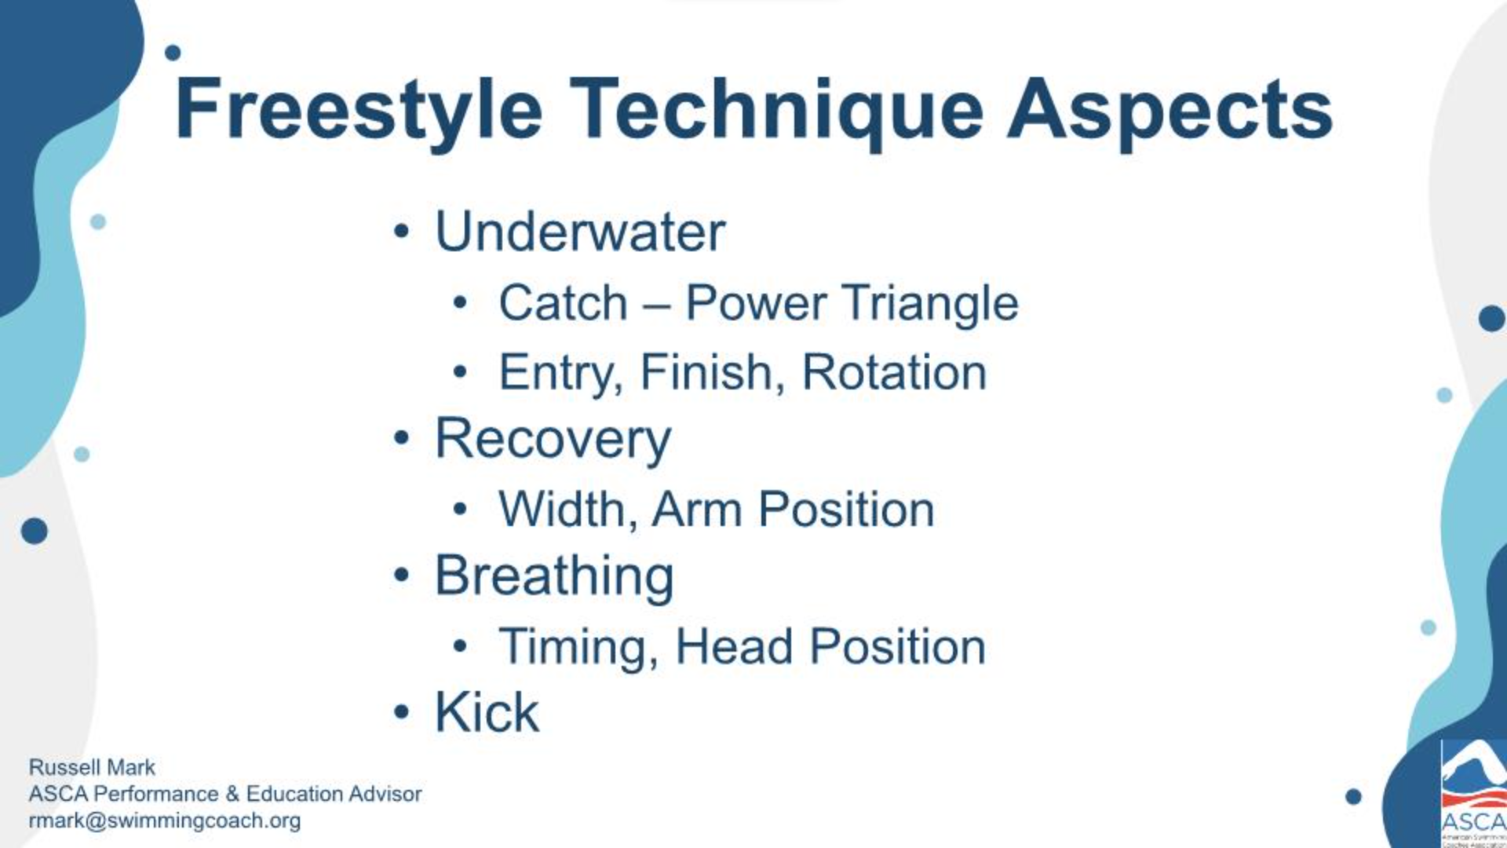

Slide 19
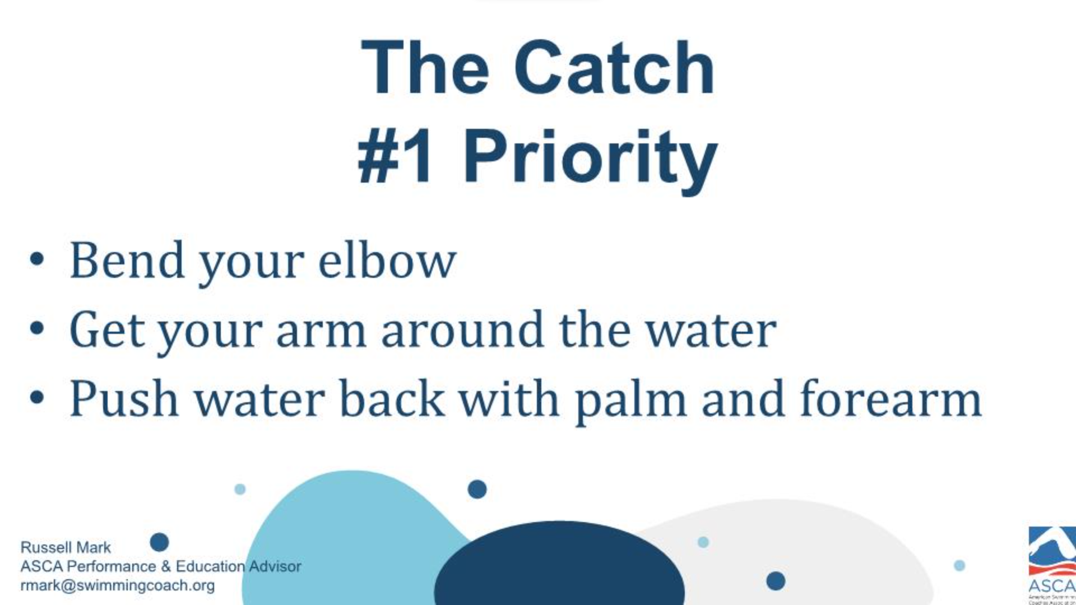

Slide 20
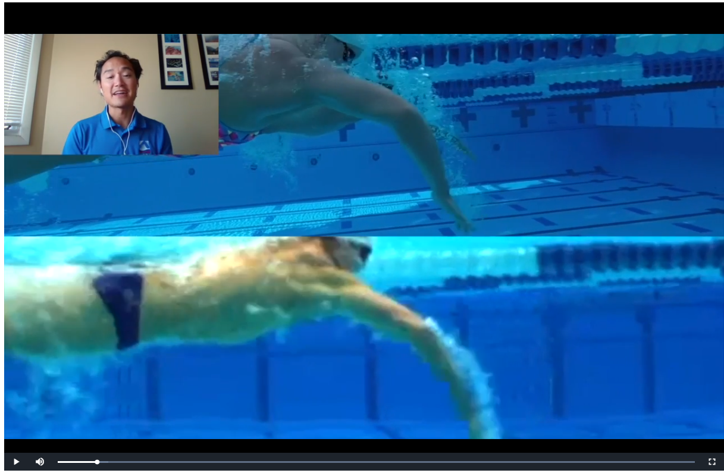

Slide 21
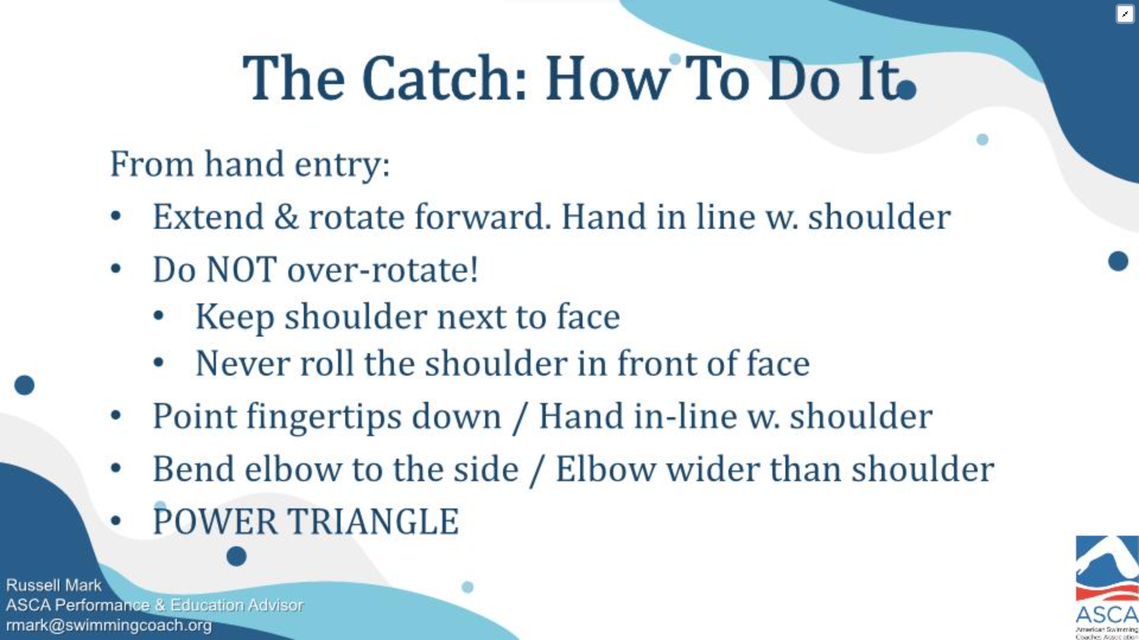

Slide 22
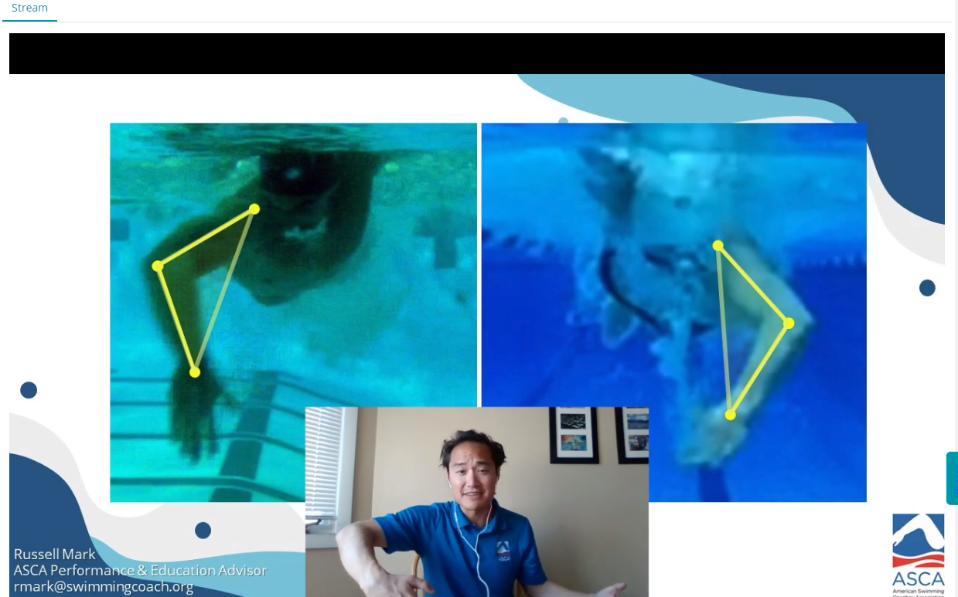

Slide 23
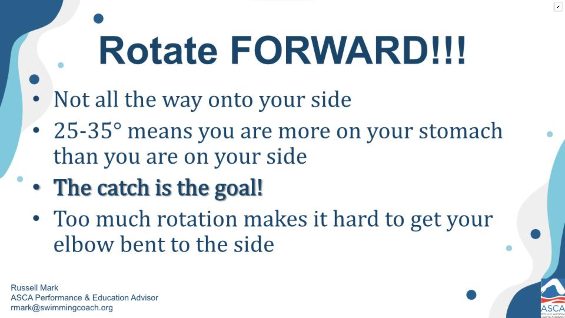

Slide 24
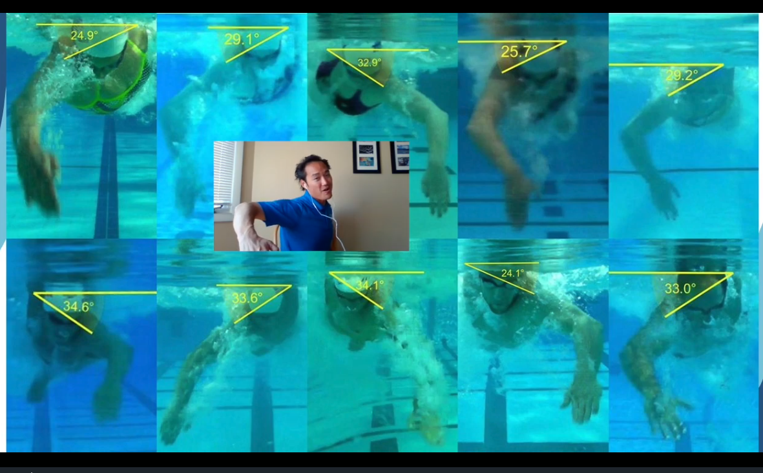

Slide 25
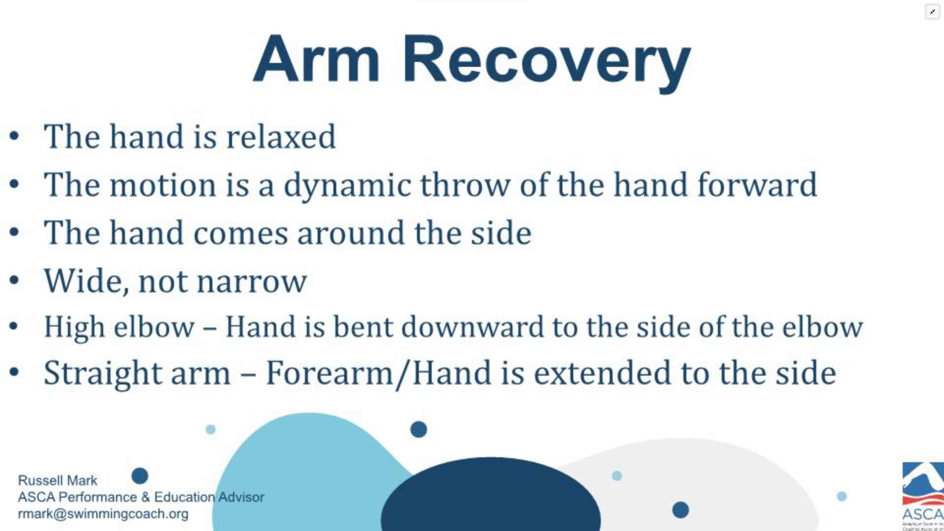

Slide 26
Session 3 Kicking, Turns and Diving

Slide 27
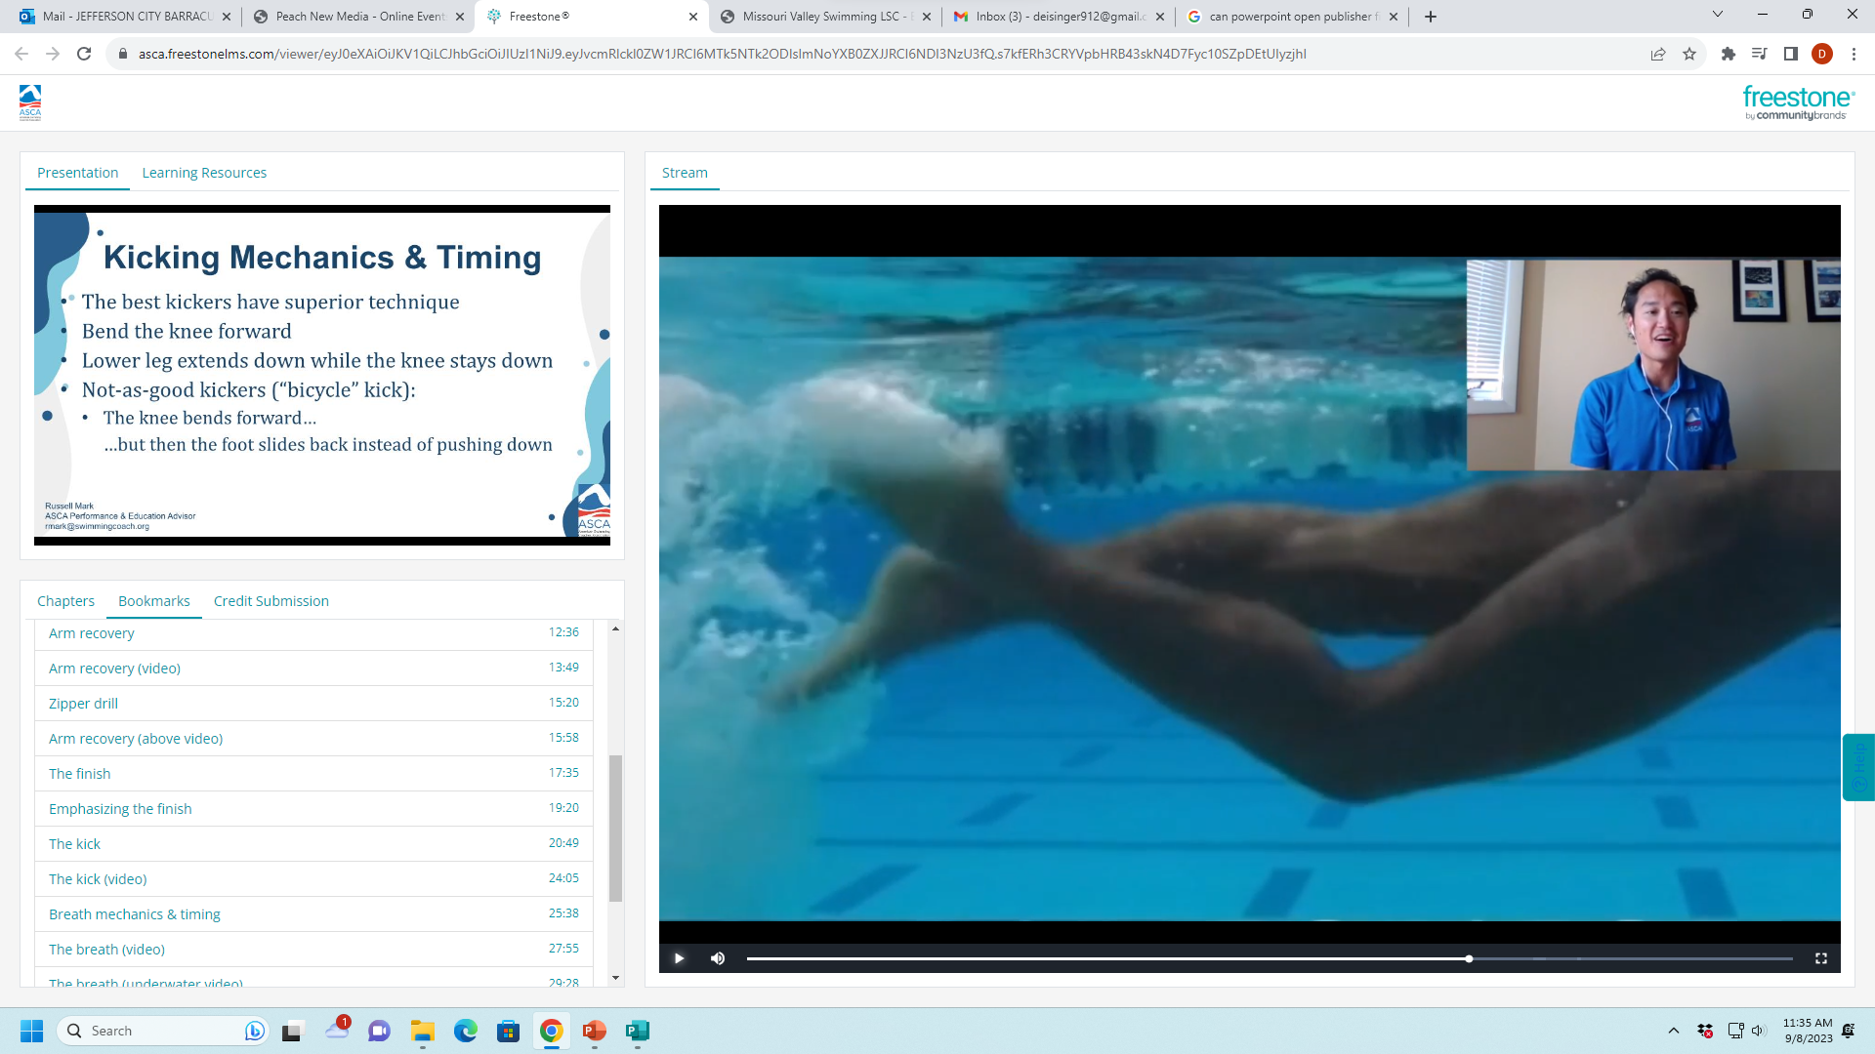

Slide 28



Slide 30








Slide 31
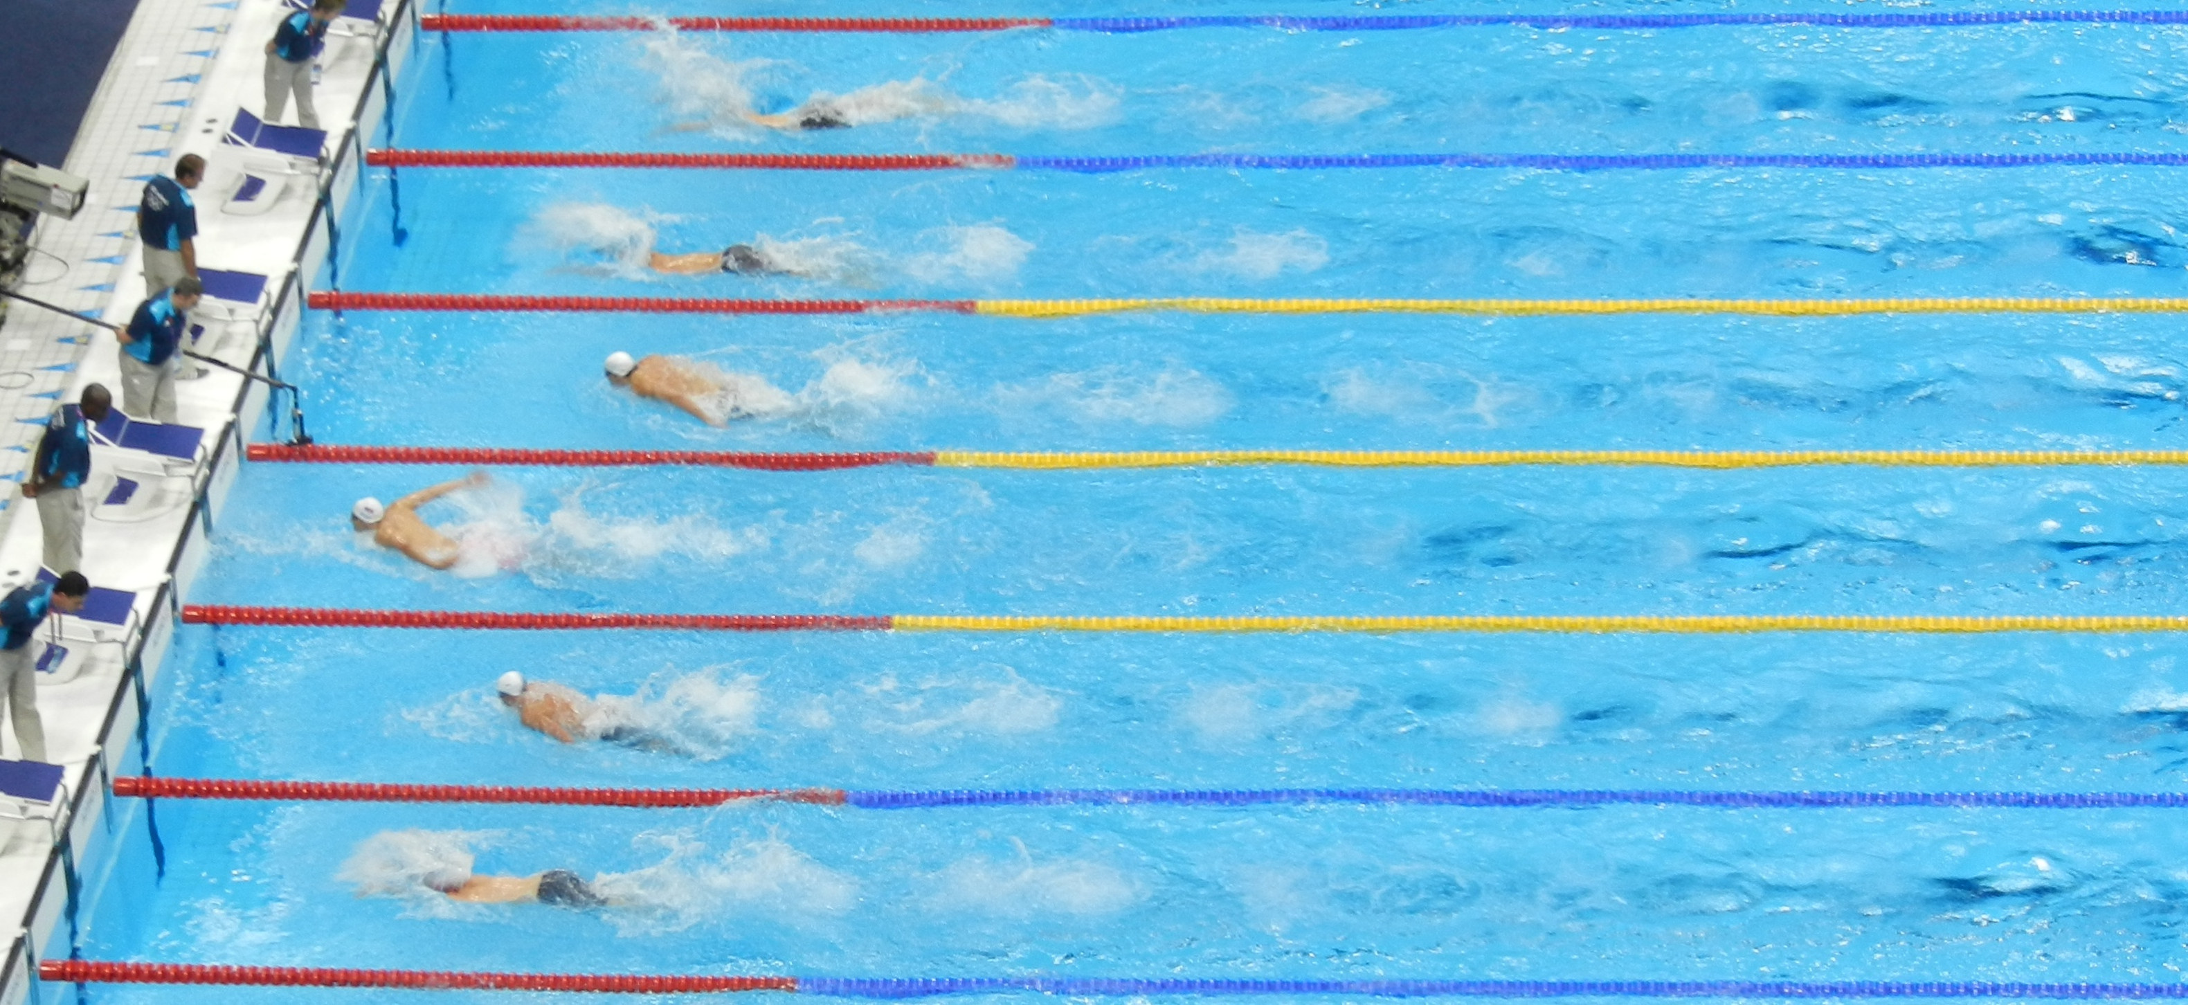
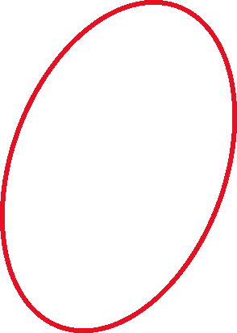
Flip Turn
Breathe Early in the Turn Zone NOT just before the wall
Not Before the wall!

Slide 32
Flip Turns
Short Version of Flip Turns
https://www.youtube.com/watch?v=0eg_PX0TVQE
Move video to 11 minute mark
https://www.youtube.com/watch?v=9mNJOT41kQk

Slide 33
Diving
https://www.youtube.com/watch?v=ywgLoeSGu5Y

Slide 34
What Did You Learn?
If you have a freestyle goal for this year, what is it?

Slide 35
101.5 FREESTYLE .1 Start — The forward start shall be used. .2 Stroke — In an event designated freestyle, the swimmer may swim any style, except that in a medley relay or an individual medley event, freestyle means any style other than butterfly, breaststroke or backstroke. Some part of the swimmer must break the surface of the water throughout the race, except it shall be permissible for the swimmer to be completely submerged during the turn and for a distance of not more than 15 meters (16.4 yards) after the start and each turn. By that point the head must have broken the surface.
.3 Turns — Upon completion of each length the swimmer must touch the wall.
.4 Finish — The swimmer shall have finished the race when any part of his person touches the wall after completing the prescribed distance

Slide 36
The End

Slide 37
These are extra slides—not needed.

Slide 38
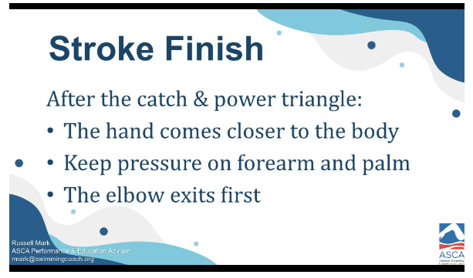

Slide 39
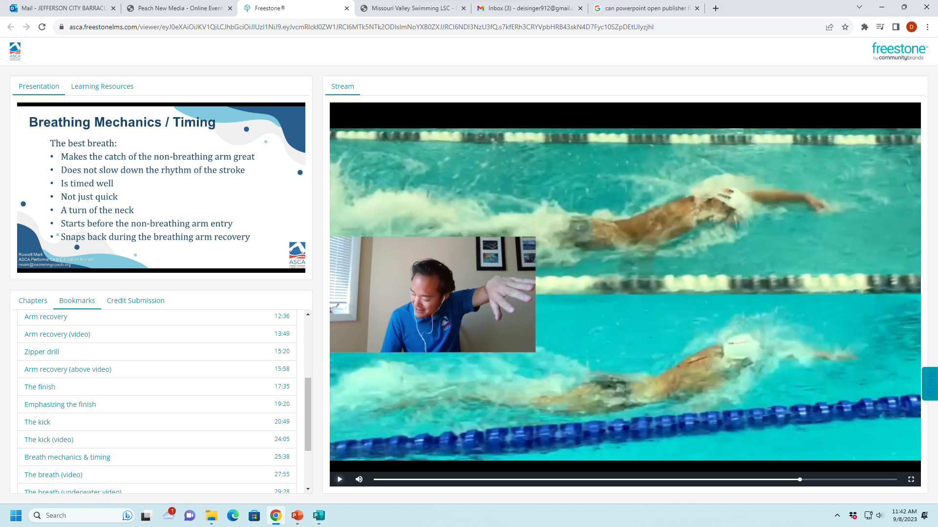

Slide 41
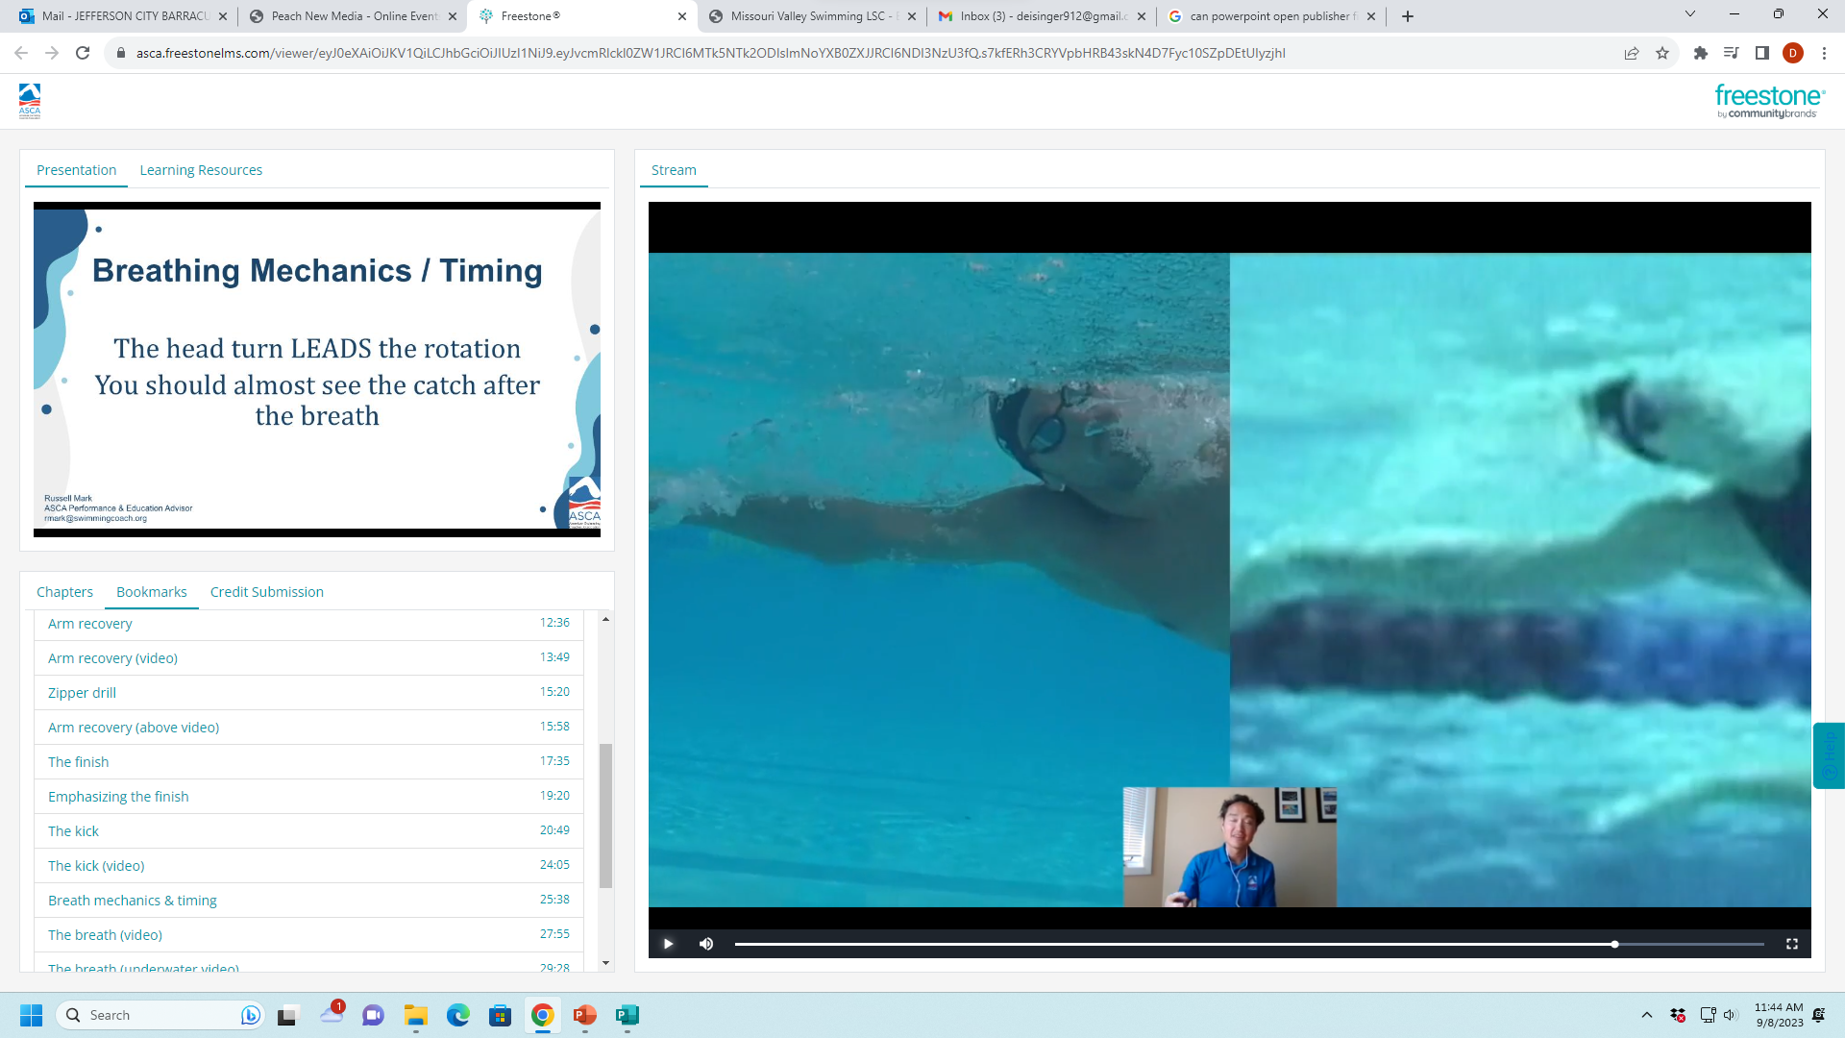

Slide 43
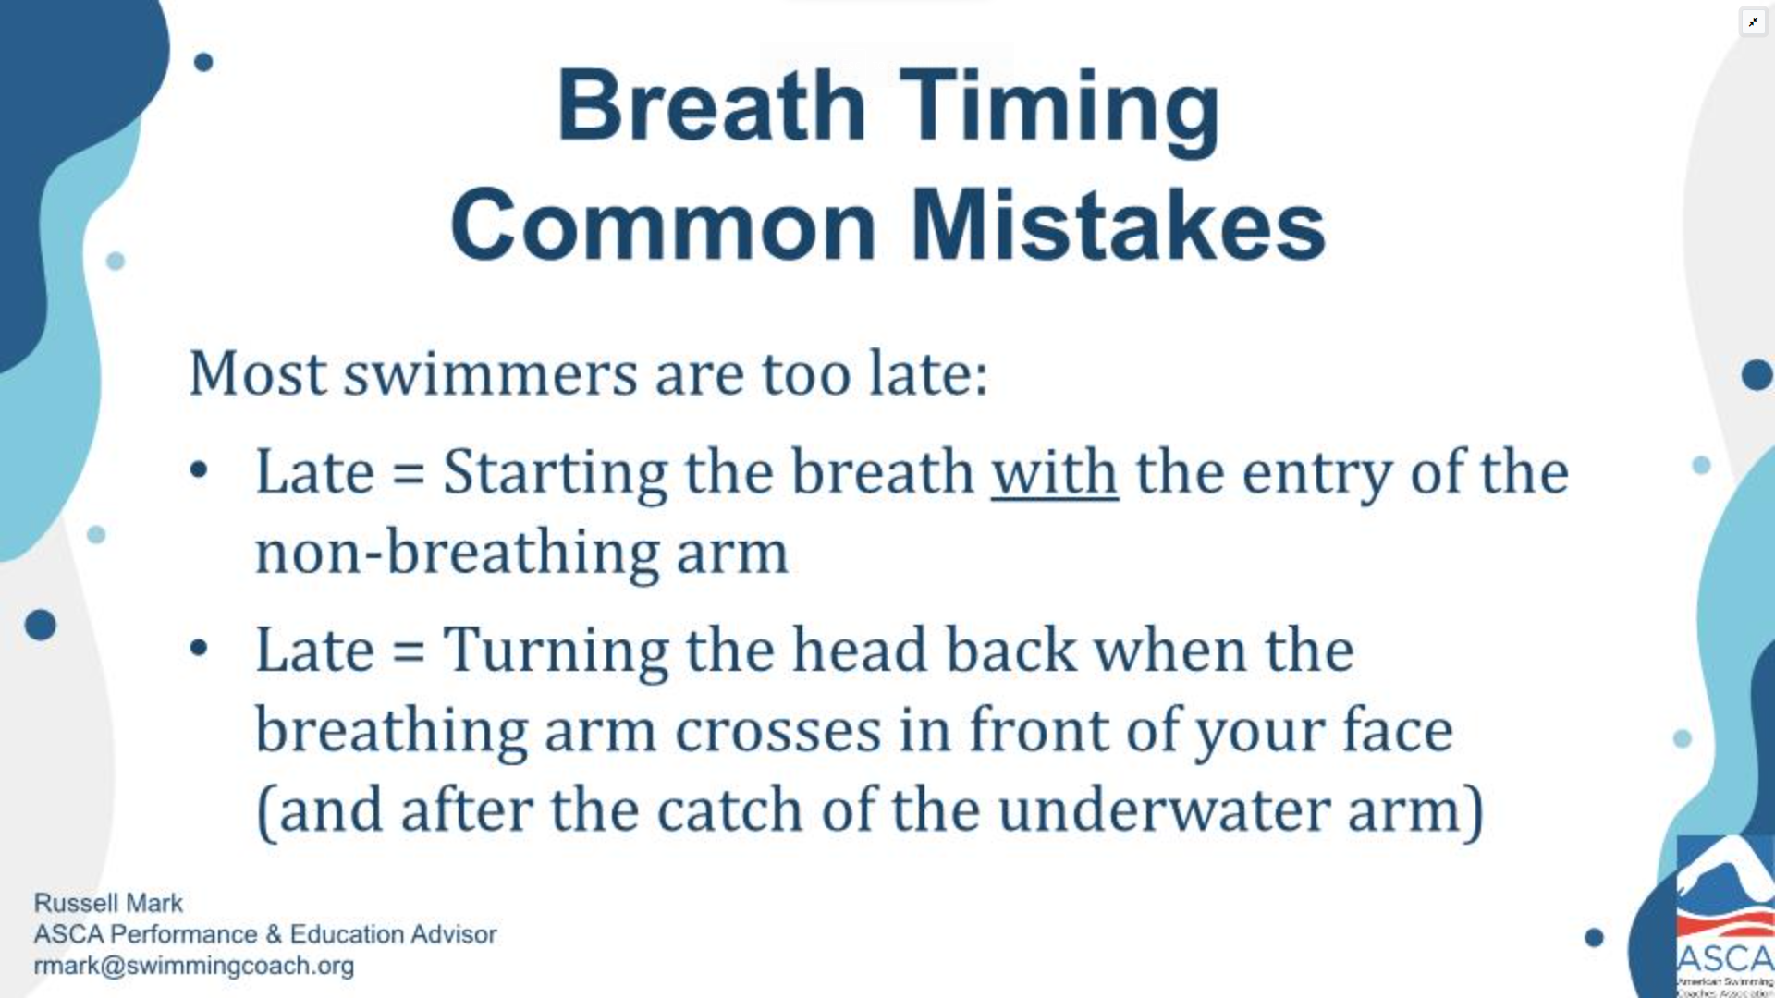

Slide 44
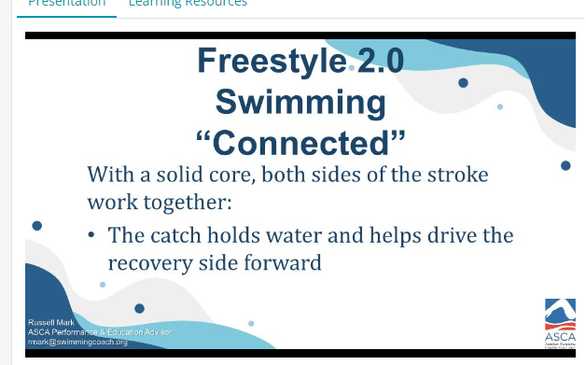

Slide 45
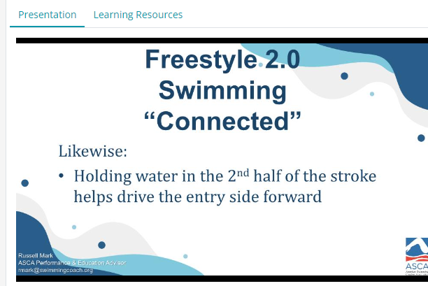

Slide 46
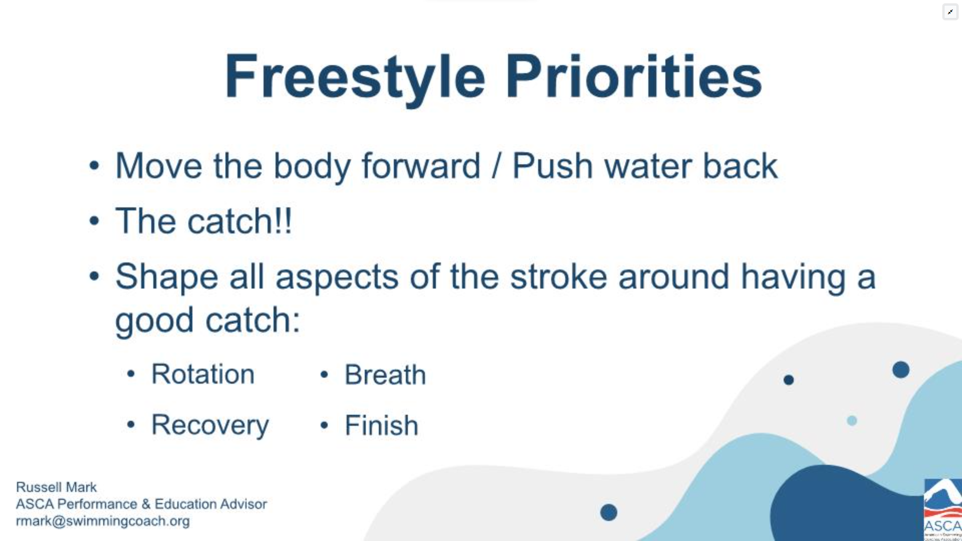

Slide 47
