Slide 1

Annual Parents Meeting
Short Course 25/26

Slide 2
Welcome
Season so far!
Future Meets
Time/Group changes (Jan-Mar)
Fundraising
Board Nominations
Just the Facts - Recap

Slide 3
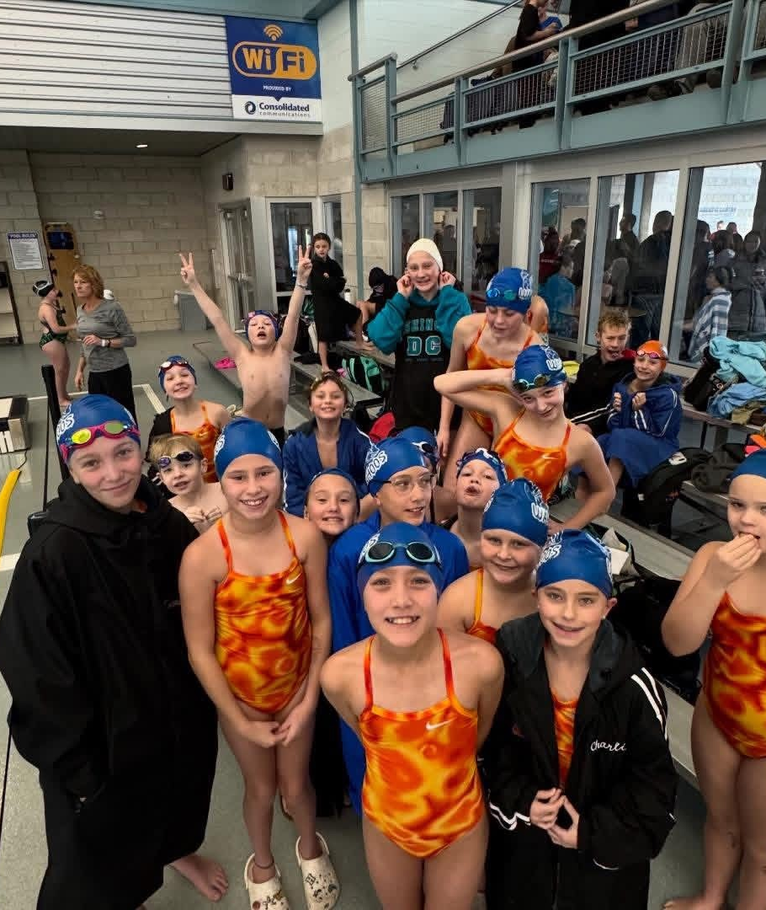
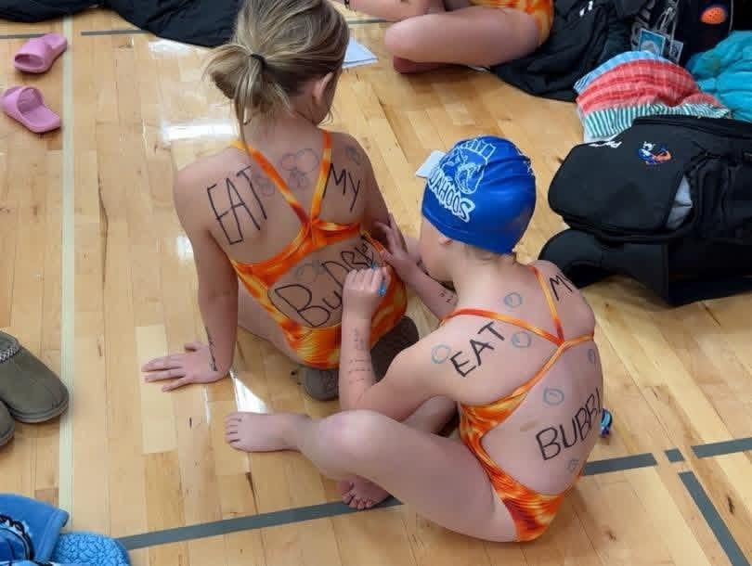
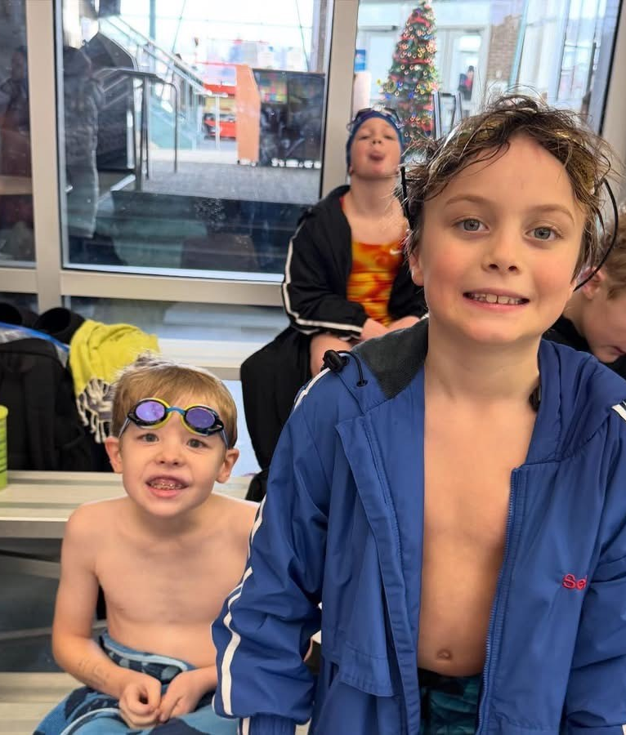
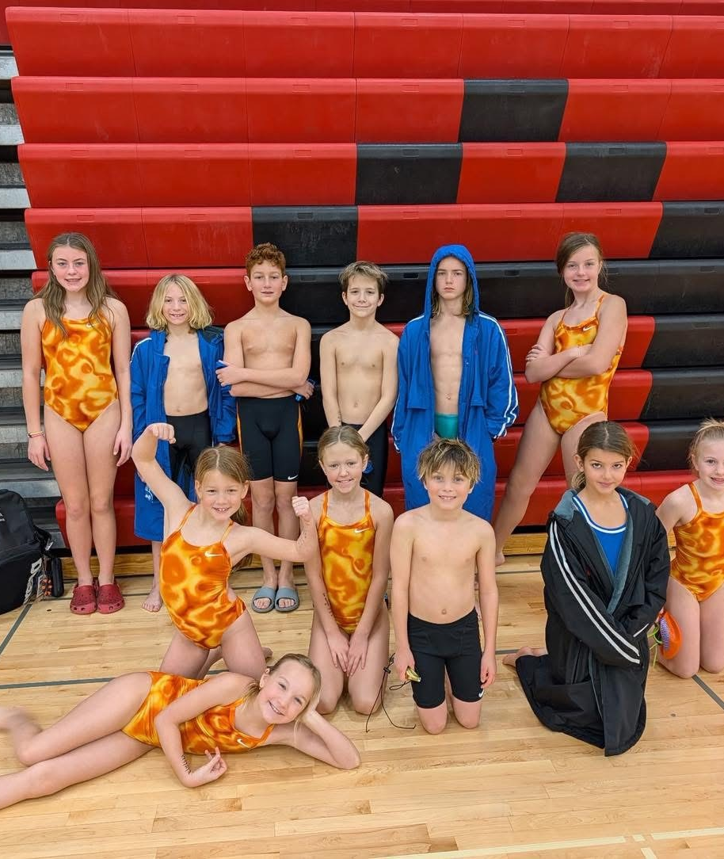
Season So Far!
5 meets & 1 isquad
11 kids swim in their first meet!
Every child who has swum in a meet has a PR!
  Working Hard and Having FUN!!

Slide 4
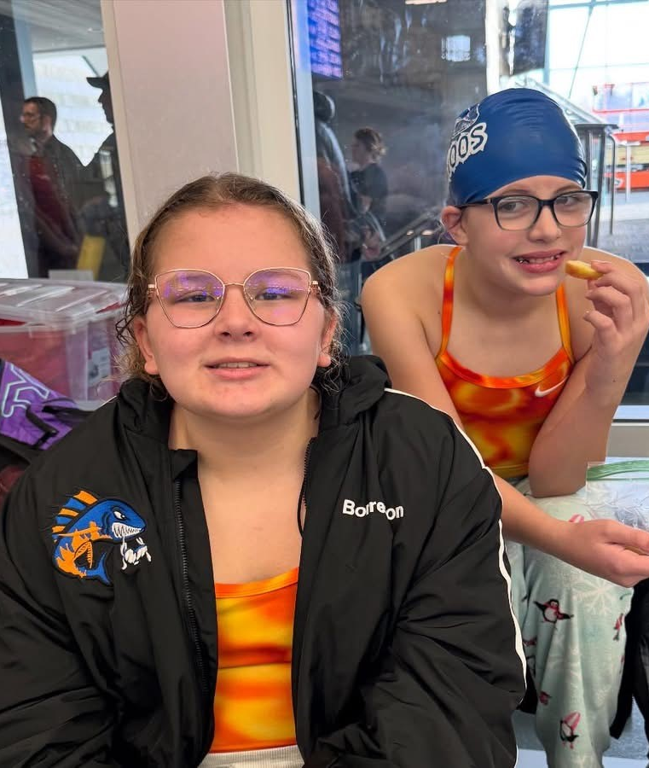
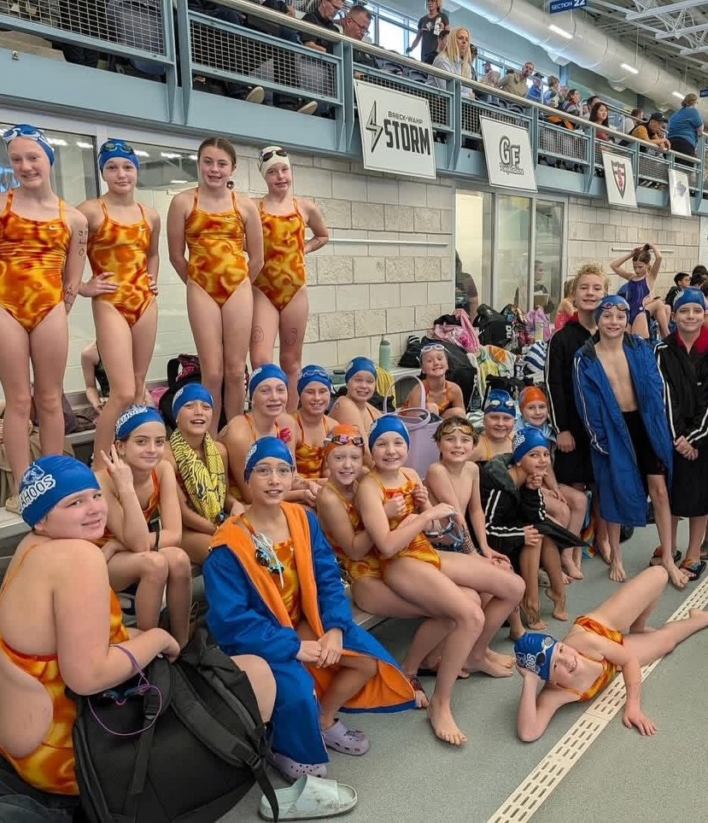
Future Meets
Watertown 17-18 Jan
FMY 1 Feb
Prochnow WF 7-8 Feb
Marlins Invitational Moorhead 14 Feb
10U State WF 21-22 Feb
WF Last Chance 8 Mar
11 O State WF 19-22 Mar

Slide 5
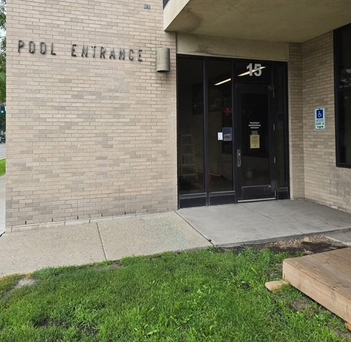
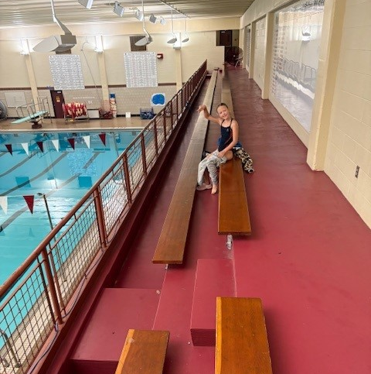
Time & Group changes?
January 5th
Senior / White will start at 6pm – Coach Walls
Orange Group – same time – Coach Amanda
Blue Group – same time – Coach Molly & Coach Chelsea
Lessons program will start in Jan and have 1 lane – Coach Sam
Monthly fee increase $5 Senior, $10 all other groups

Slide 6
Upcoming No Swim Days
Dec 19th Boys HS Meet – Come cheer them on!
Christmas Break – Dec 22 – Jan 02 - No formal group work; will publish dates and times swimmers can come do workouts, or just swim. Times will be lifeguard / coach dependent.
Jan 8th Boys HS Meet – Come cheer them on!
Jan 30th Boys HS Meet – Come cheer them on!
Feb 20th Boys HS Meet – Come cheer them on!

Slide 7


Fundraising?
Sponsorship / Donations Forms
  Located on the Website
Pizza Ranch
Funds4shoes
  All information will be emailed and uploaded to the Website
Salvation Army
  EARN those booster hours!

Slide 8
Board Nominations
Send your nominations to RRVYWahooBoard@gmail.com
Send nominations to the BoD email on or before Dec 20th.
Names will be placed on an email ballot in alphabetical order.
Each family will be able to cast one vote for each open position.
Results will be published and effective in after confirmed at the first BoD meeting in Jan.
Sarah Abrahamson
Stacy Cokeley
Laura Dahlen
Leslie Hesse
Drew Lehan
Nancy Nelsen Hutton *
Shawn Peterson

Slide 9

It’s where?
www.rrvwahoos.com
Register with USA Swimming for 2026!
My Account
  Service hours tab
Meets & Jobs

Slide 10
Just the facts – RRV Wahoo aquatic club family handbooK
Expenses
Monthly Tuition
Booster Fees
Swim Meet Costs
Swim Caps
Billing Policy (2 weeks notice REQUIRED to pause)

Slide 11
Just the facts – RRV Wahoo aquatic club family handbooK
Practice
Varies by group and time of year
Generally, between 6-8pm
Do not arrive more that 10 mins early
Group guidelines
Placement may change / coach will discuss with parent prior

Slide 12
Just the facts – RRV Wahoo aquatic club family handbooK
Swim meets! FUN
Individual time/skill improvement – set goals
Positive attitude – support your teammates& show great sportsman ship
Sign up as soon as possible for meets (they open and close quickly)
Read all the information posted to the event file
Swimmers need to remain with team on deck.
Team cap required! Team suit is optional / suit must be competition compliant

Slide 13

The End!

