Slide 1

25/26 Short Course
Parents Meeting

Slide 2
Welcome
Introductions
Who are we?
Todays Topics
It's where?
What’s changed now that we are out of the Hyslop?
Just the facts (Family Handbook)
Breakout time to visit with coaches, board members, other parents

Slide 3
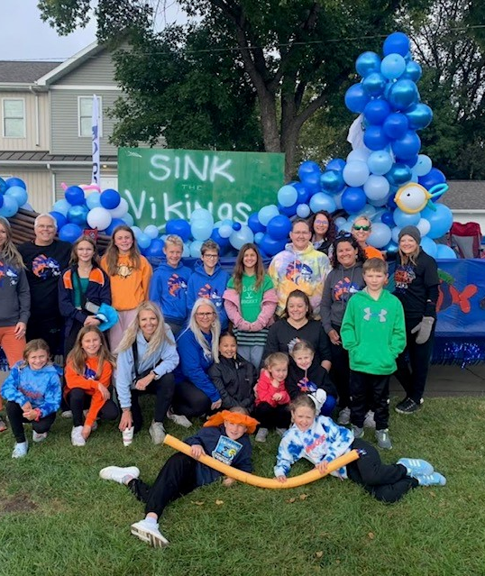
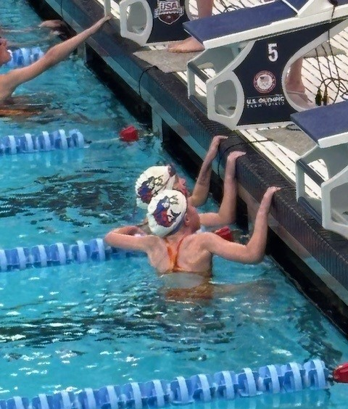
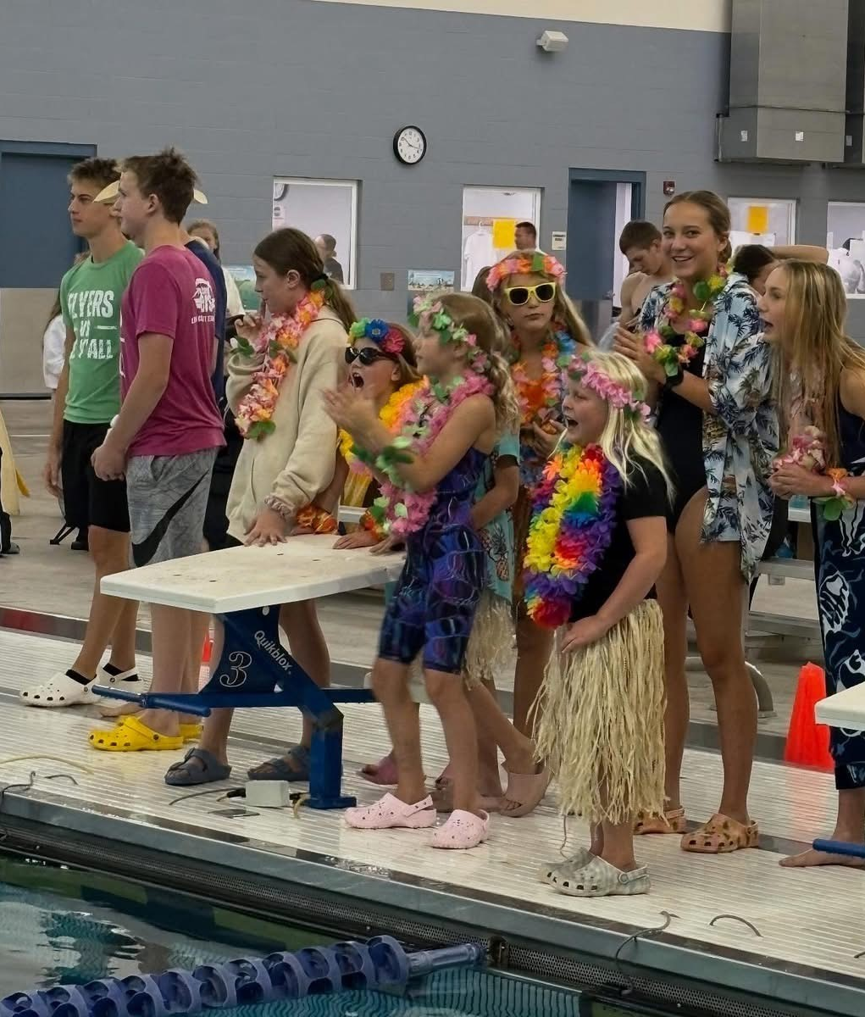
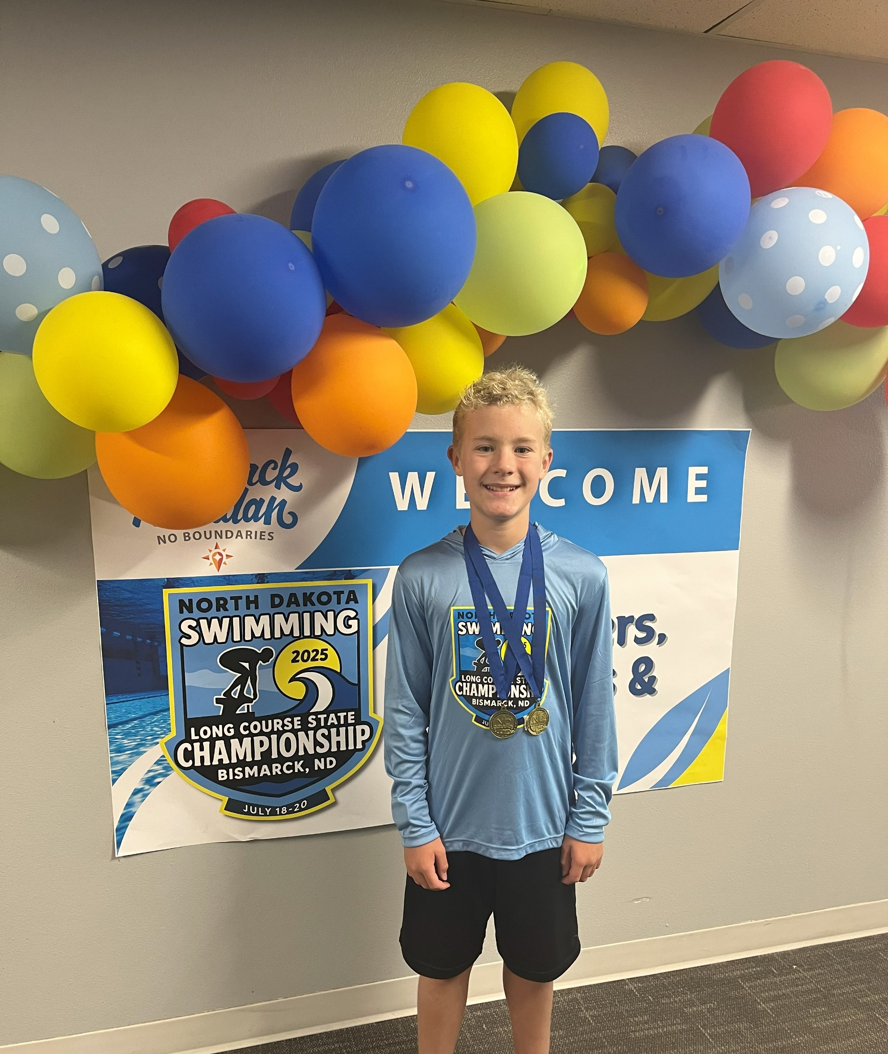
Introduction
Who are we?
Red River Valley Wahoos Aquatics - USA Swimming Competitive Team
Swimming is an individual sport and a team sport.
Each swimmer will have independent goals and reach for those goals, from swimming in a meet for an official time for a race to qualifying for national meets. Success is reaching a personal goal. Success is loving your sport and having fun! Success is being an amazing teammate and cheering for your friends. Success is showing your sportsman ship.

Slide 4
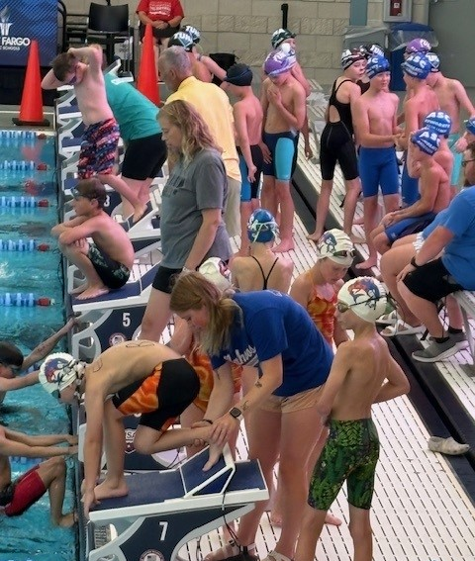
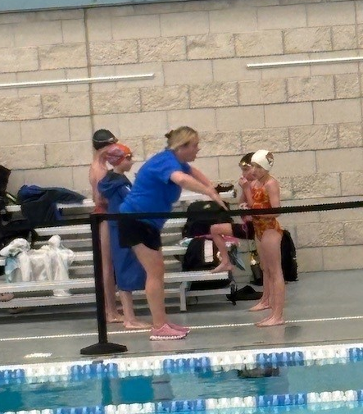
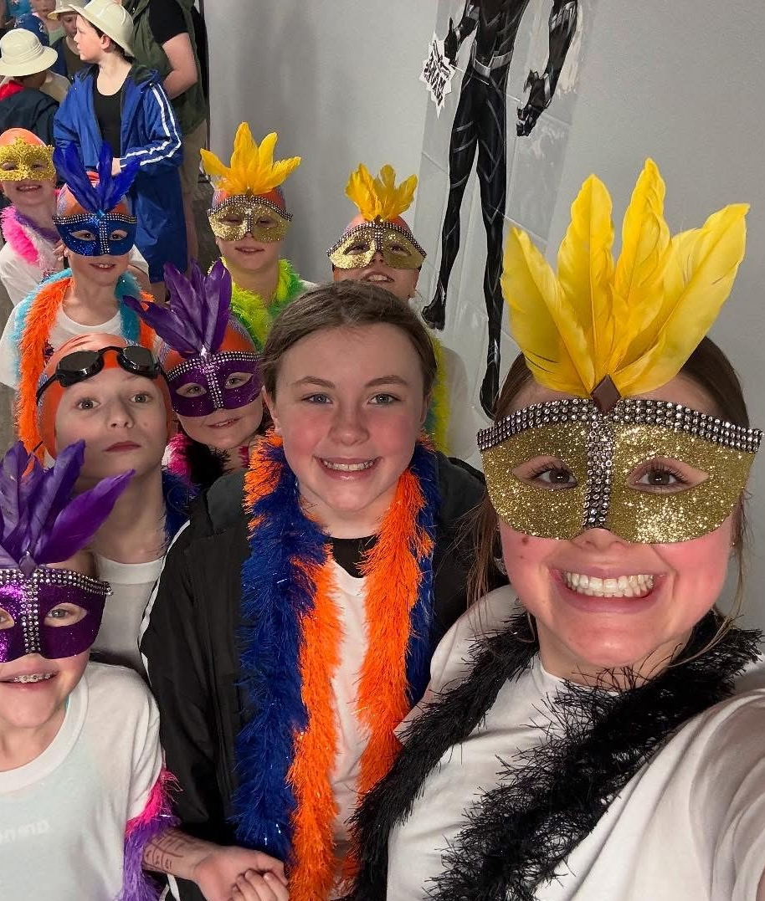
Coaches
Head Coach Bryan Walls
Senior Group
Head Age Group Coach Amanda Werle
White Group
Assistant Coach Molly Halsa
Orange Group
Assistant Coach Sam Pulkrabek
Blue Group
Assistant Coach Chelsea Mellenthin
Blue Group

Slide 5
Board members
RRVYWahooBoard@gmail.com
Send any questions to us!
Sarah Abrahamson
Stacy Cokeley
Laura Dahlen
Leslie Hesse
Drew Leehan
Nancy Nelsen Hutton
Shawn Peterson

Slide 6

It’s where?
www.rrvwahoos.com
Register with USA Swimming
Register for the Short Course Season with the Wahoos
My Account
Service hours tab
Meets & Jobs

Slide 7
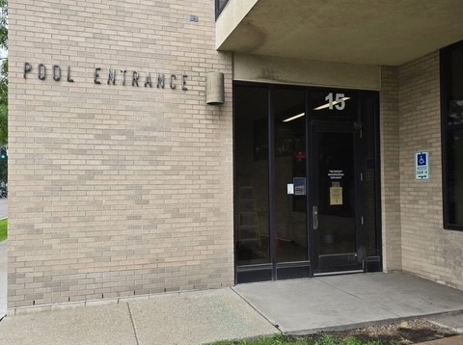
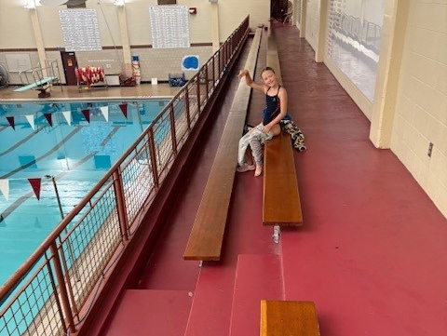
What’s changed?
Central Pool for all groups! Enter Door 15
Coats street shoes must be left upstairs
No shoes/boots on pool deck
Space and facilities are limited
Parents must sit upstairs

Slide 8
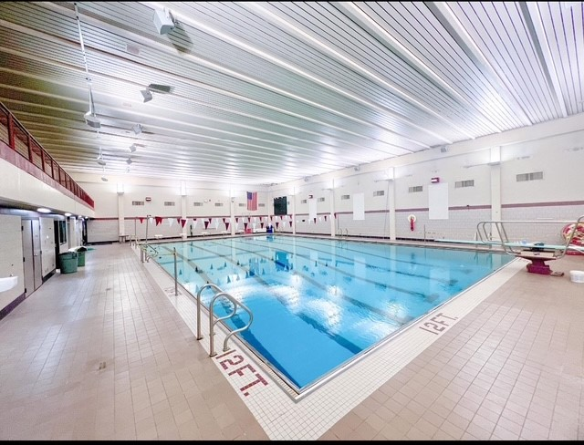
What’s changed?
The size of the pool! 6 Lanes
Changing / Shower facilities
Restroom for spectators –
Access
Parking

Slide 9
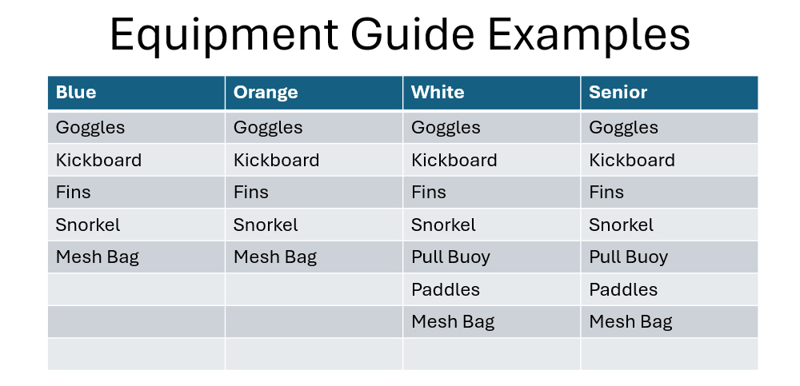
WHAT’S Changed Space Shared equipment

Slide 10
Just the facts – RRV Wahoo aquatic club family handbooK
GROUP | Monthly Tuition
Blue | $90.00
Orange | $100.00
White | $110.00
Senior | $135.00
Expenses
Monthly Tuition- Billed 1st of month automatically. (2 week notice is REQUIRED to pause billing)
Booster Fees- Billed 1st of Month on month following End of Season
Meet Fees & Coach Travel Fees – Both billed at time of Coaches Entry Submittal
Swim Caps – 1 provided to each swimmer; additional available for purchase $5.00
Coaches Travel Fees
Avg No. Attendees | Avg $ per Attendee
Fargo Area - 20 | $ 20.00
Distance Meets - 16 | $ 55.00

Slide 11
Just the facts – RRV Wahoo aquatic club family handbooK
Expenses

Slide 12
Just the facts – RRV Wahoo aquatic club family handbooK
Practice
Varies by group and time of year
Generally between 6-8pm
Do not arrive more that 10 mins early
Group guidelines
Placement may change / coach will discuss with parent prior

Slide 13
Just the facts – RRV Wahoo aquatic club family handbooK
Swim meets! FUN
Individual time/skill improvement – set goals
Positive attitude – support your teammates& show great sportsman ship
Sign up as soon as possible for meets (they open and close quickly)
Read all the information posted to the event file
Swimmers need to remain with team on deck.
Team cap required! Team suit is optional / suit must be competition compliant

Slide 14
Just the facts – RRV Wahoo aquatic club family handbooK
RRV Family Agreement
Parent Code of Conduct
Swimmers Code of Conduct
Initialed and Signed Agreement DUE on or before first day of practice
Turn into any board member or send photo of signed page to RRVYWahooBoard@gmail.com

Slide 15
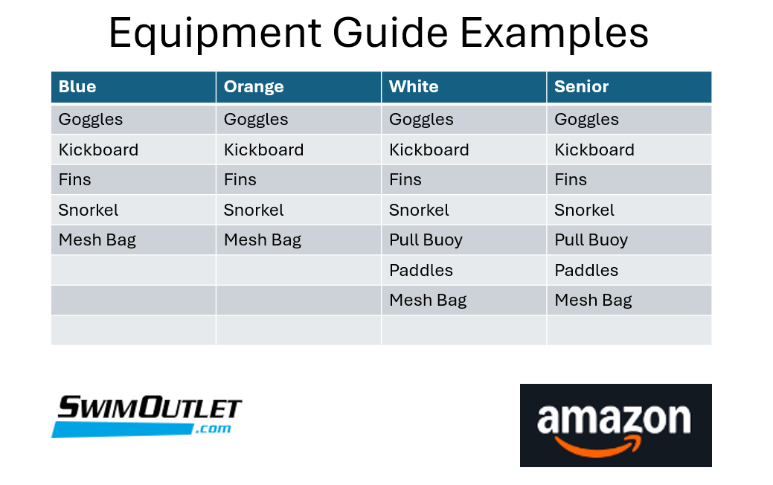

Slide 16
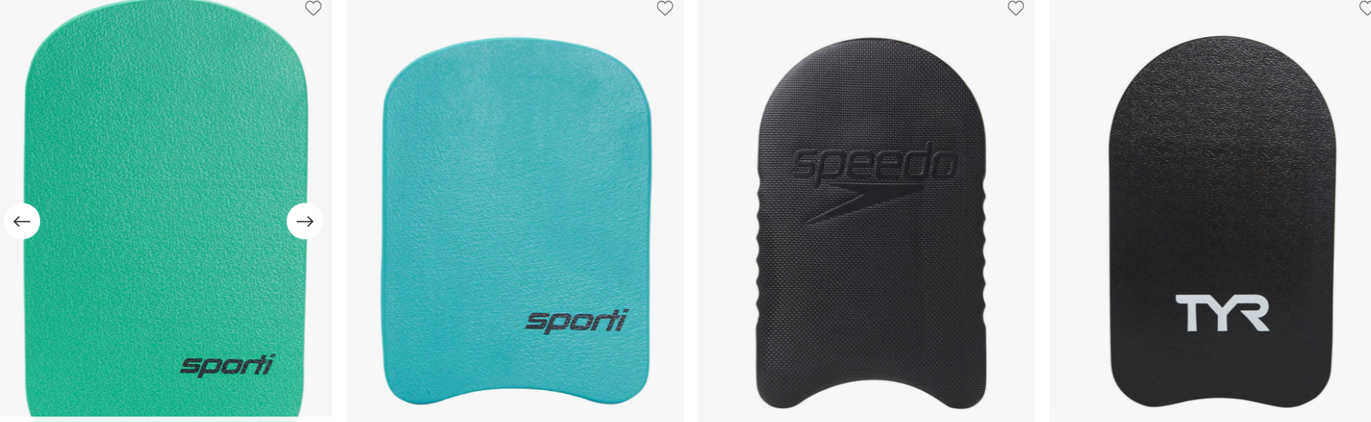
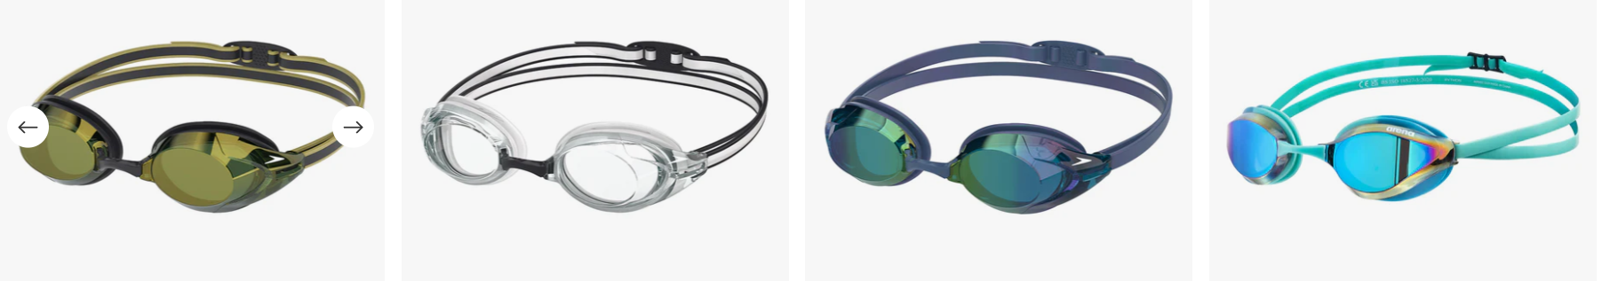
Any style, does not need to be a specific brand or expensive.

Slide 17
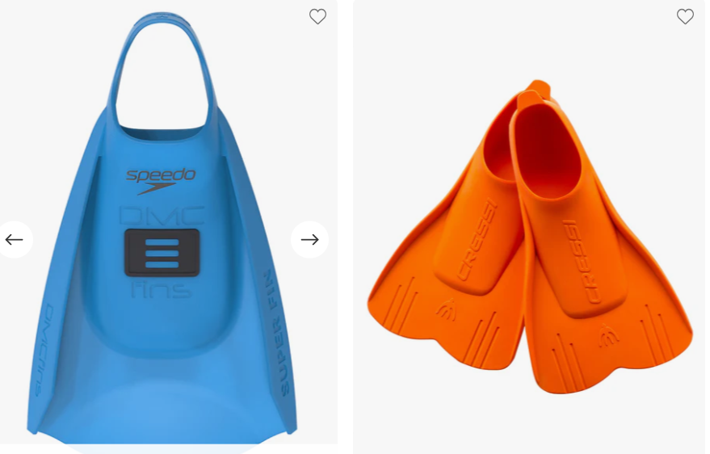

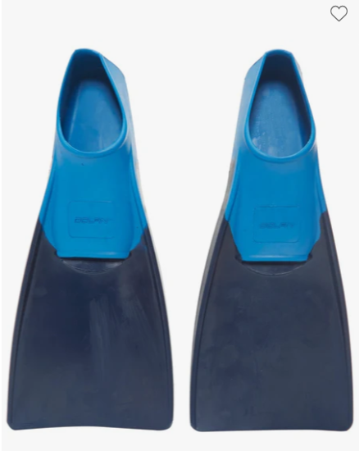
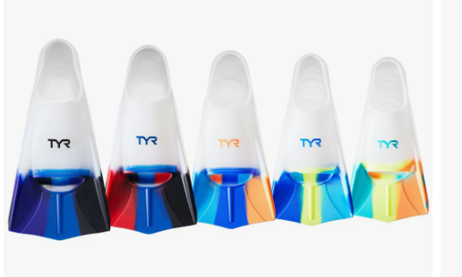
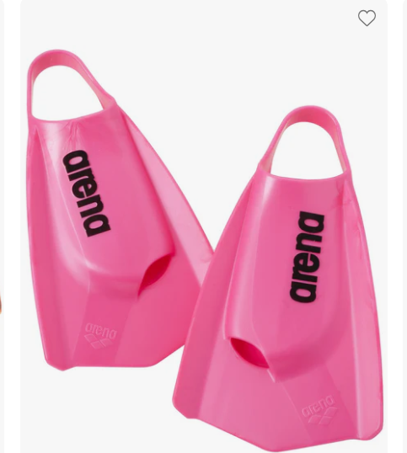
Any style medium length fin. Does not need to be a specific brand or expensive.
X
No long fins

Slide 18
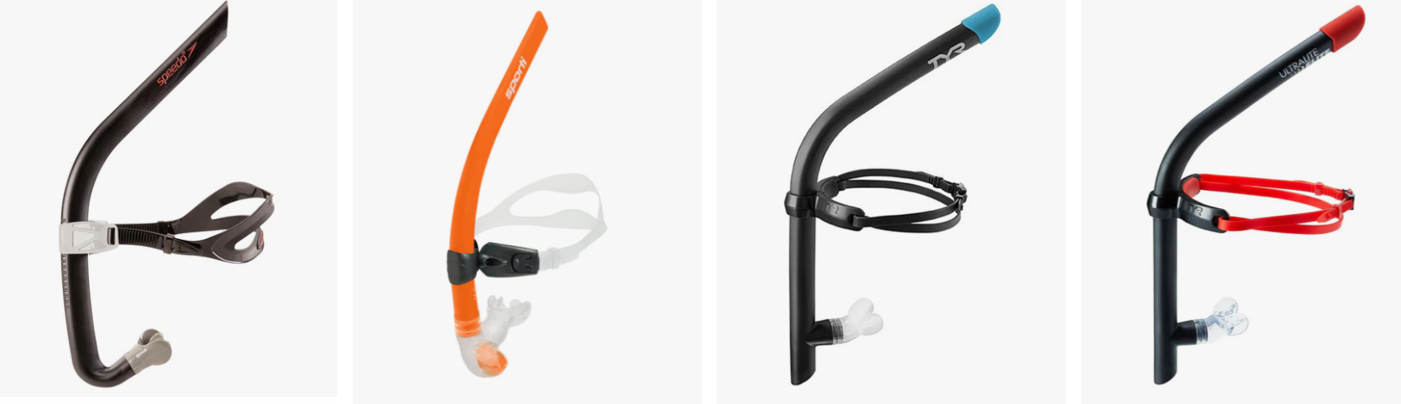
Any brand of swim snorkel (not scuba snorkel), does not have to be expensive.

Slide 19
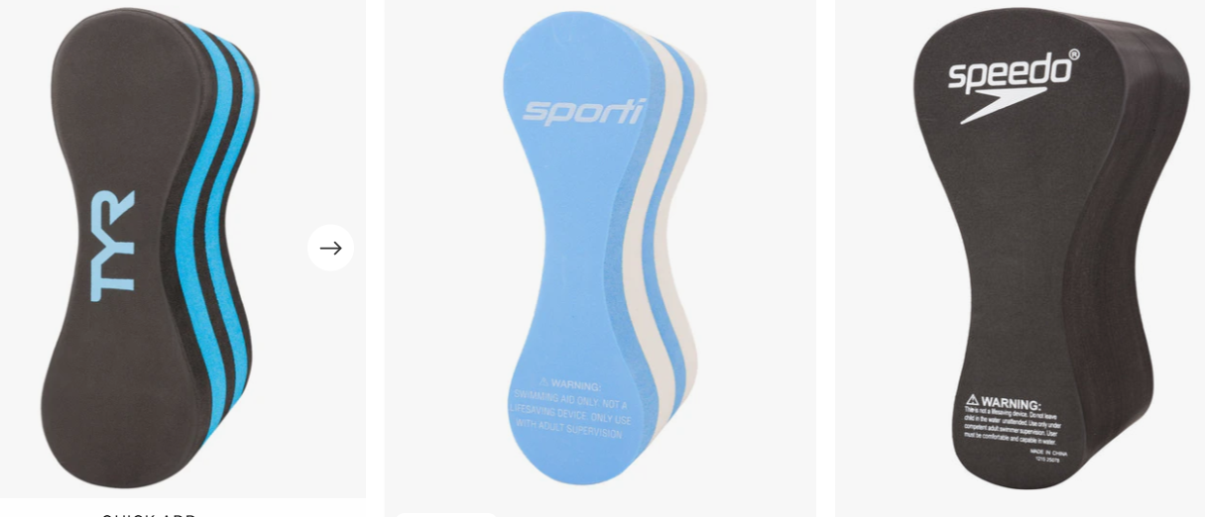
Any style, does not need to be a specific brand or expensive.

Slide 20
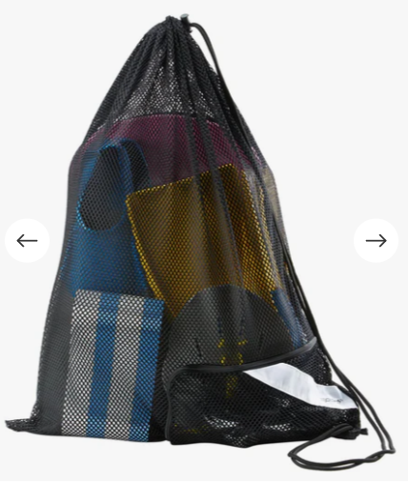
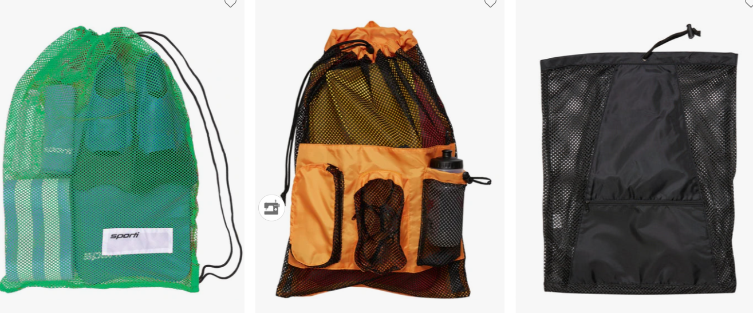
Any style, does not need to be a specific brand or expensive.

Slide 21
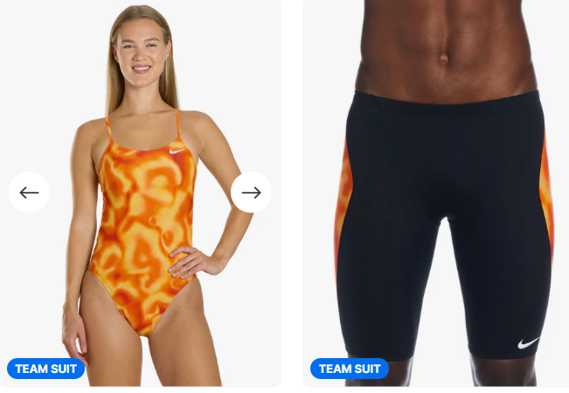
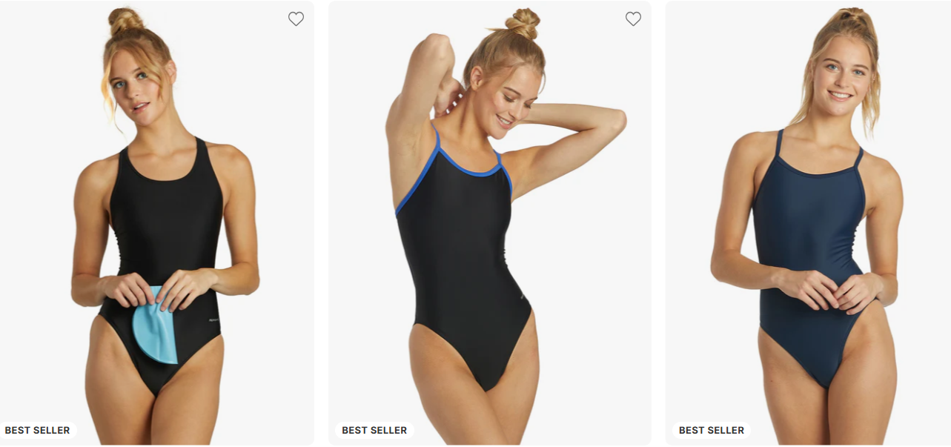
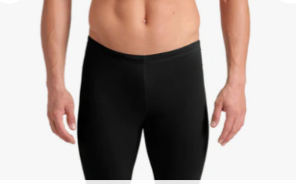
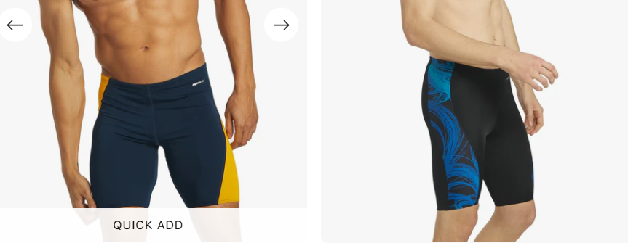
Team suits can be found on Swim Outlet
If you do not wear a team suit, please wear a suit that is predominately black or blue.

Slide 22
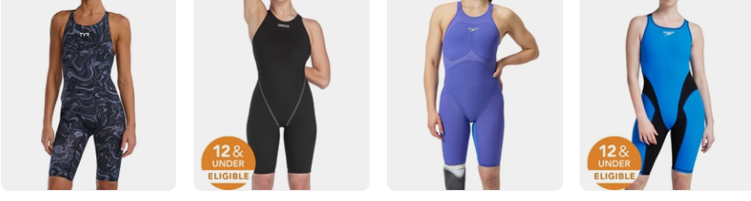
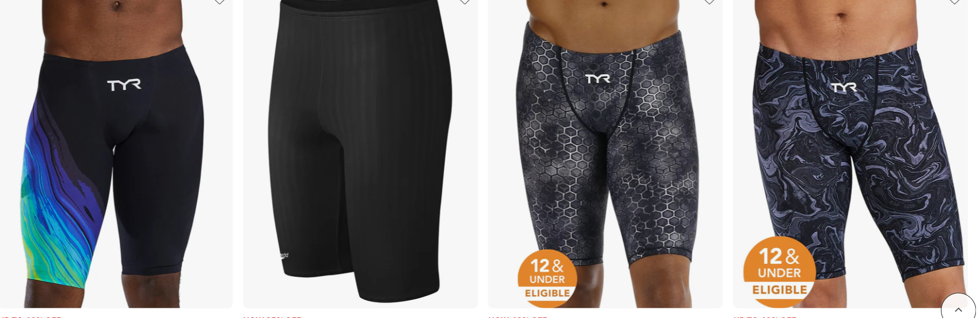
Tech Suits are not required for any swimmer. If your swimmer chooses to wear a tech suit for a major competition, any color, brand or style is acceptable. If your child is 12 years of age or under the suit MUST be an eligible 12U compliant suit.

Slide 23

The End!

