Slide 1
Parent Information

Slide 2
Welcome to the Arlington Muskies Swim Team
Our goal of the program is to provide a fun learning experience for each child and to be able to produce well-rounded swimmers in a competitive environment.
Each participant will have opportunities to compete in swim meets against other Park districts.
The Muskies compete within the Northern Illinois Swim Conference (NISC), which is the governing body of the program and make up By-Laws that we will need to obey. The By-Laws can be found here

Slide 3
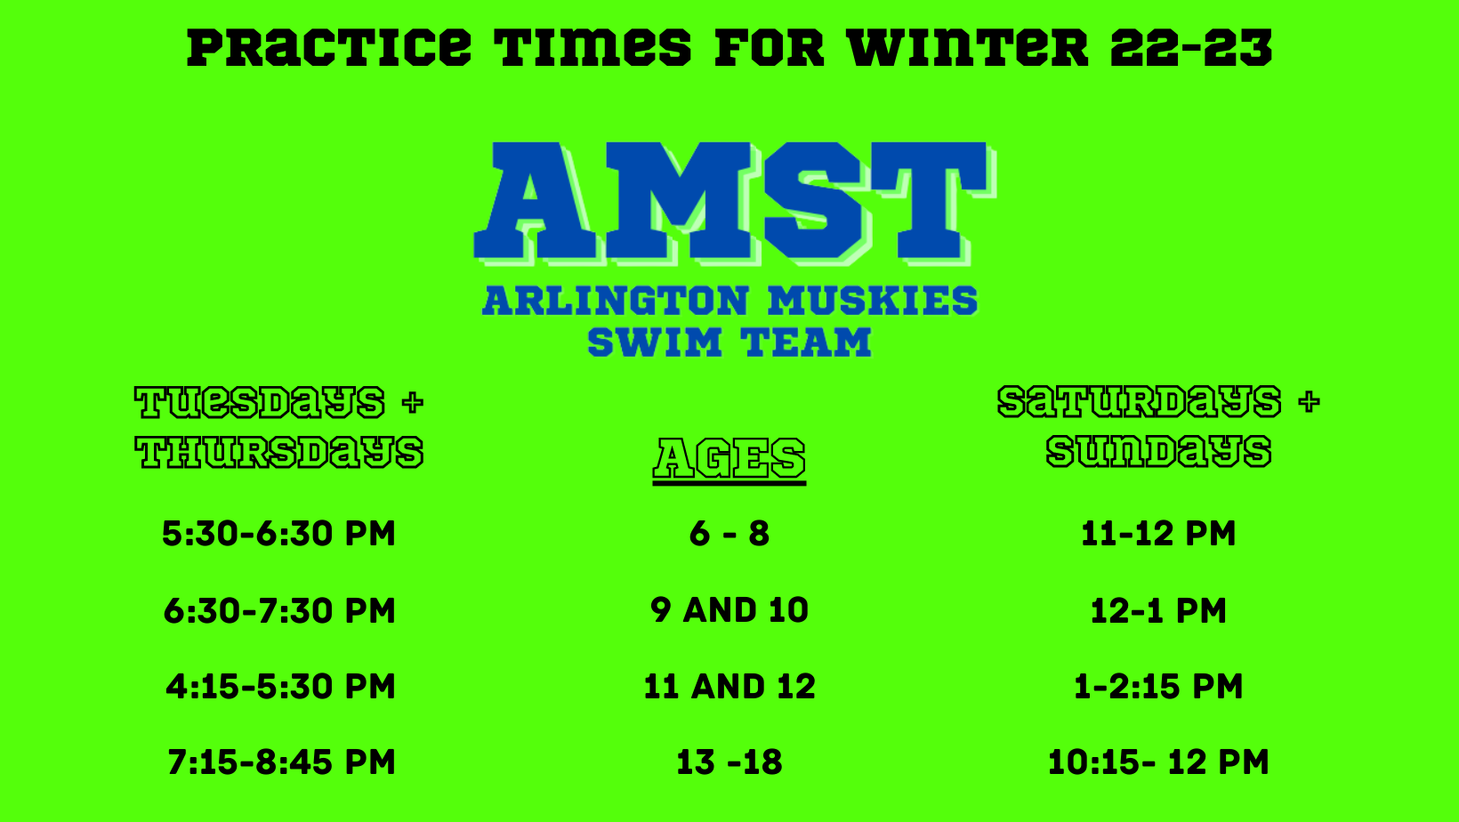
Schedule
It is recommended that each parent subscribe to he schedule on TeamUnify. This way the practice and meet schedule can appear on your phone.
For Meets= Click Here!
For Practices= Click Here!

Slide 4
Practices
The team will be practicing 4 days a week, unless there is a swim meet.
We will be building on their skills by improving technique, increasing their endurance, and pushing them to swim faster.
During practices, swimmers will be expected to participate as best as they can.
We encourage them to have fun, but not to be distracting for swimmers and coaches who want to focus and work hard.
If a swimmer is expressing any pain, they may sit out for a little bit to see if the pain goes away. If the pain continues we will contact the parent.
We will also be contact parents for any ongoing concerns of behavior or pain expressed.

Slide 5
Swim Meets
We encourage everyone to participate in swim meets!
Swimmers must be committed to a meet in TeamUnify to participate.
A swimmer may swim up to 3 individual events and 1 relay, or they may swim 2 individuals and 2 relays.
We will try to get everyone in 3-4 events per meet; however their may be circumstances where they may swim only 2 events.
Upon committing to a meet, please use the notes, to alert coaches of any time conflicts you may have.

Slide 6
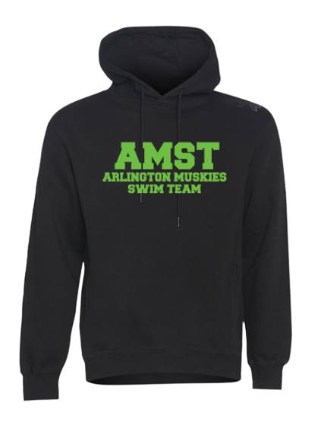
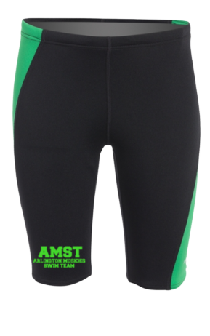
Muskie Apparel
Show some spirit!
Each participant will be given a free t-shirt
There is a team store through Swim Outlet, which has a variety of options of other Muskies gear. Click here to view
We do not have a mandatory uniform, but we ask that boys wear jammers and that girls wear a one-piece swimsuit.

Slide 7
Coaches
Age Group Leaders
8 and Under: Zoie
9 and 10: Sammi
11 and 12: Ila
13 and up: Ryan
Assistant Coaches
Zoie
Connor
Noah

Slide 8
Questions
For any questions or concerns, please contact:
Rob Gussy
Aquatic Supervisor
rgussy@ahpd.org
847-577-3047

