Slide 1
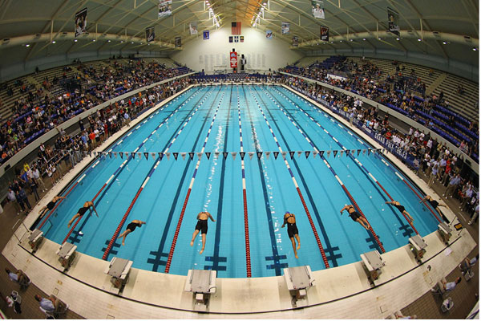
Age-Group Development
A whole-istic approach…
Don Heidary
Orinda Aquatics, USA Swimming
The American Swimming Coaches Association
Presented to Swim Ireland Coaches Clinic 2013

Slide 2

…to a puzzling concept

Slide 3
Age-Group Development: Introduction
Rather than examining one specific area of age-group swimming, this presentation will offer a broad-based approach to building a strong foundation within an age-group program, as well as building a culture that produces not only success, but development at all levels, with swimmer retention and career longevity.
Most coaches believe that Senior success begins at the age group level, and focus extensively on technique and/or training with younger swimmers. While these are the two main drivers in development, this talk will suggest that there are numerous other critical components of a strong age-group program; areas that go well beyond technique and training, with most being on the “dry” side of the process. And while many will contend that age-group success can be defined by producing younger swimmers who rank high nationally, I would argue that true success should be measured at each level of ability, in retention of athletes, in longevity of careers (collegiate swimming), in emotionally well-balanced athletes who create a positive, integrity-driven culture, and in elite performance. The focus of age-group swimming should be as much on process and culture as on talent, as we can control the former.
This presentation suggests that the building of an age-group program in analogous to assembling a puzzle. The first and most critical step is to secure the corners of a puzzle (or the “cornerstones” of the program). We would define these as: 1) disciplined technique, 2) efficient training, 3) coach competence, and 4) structure, organization, and planning. The next phase in development is to secure the borders of the puzzle (or the “framework” of the program), in a sense holding everything together. The right and left borders of this puzzle are integrity and discipline. In a grossly oversimplified view, this would equate to (integrity) doing everything correctly, with respect for all aspects of the program, and (discipline) performing at the highest and most productive levels of effort and intent. The top border is “connection” or swimmer relationships. Everything is enhanced with a strong connection between coach and swimmer. We have seen even the brightest coaches allow swimmers and programs to slip away because they are not connected to their athletes. The lower border or “base” of the program is culture. Culture is the tailwind that creates flow to a team’s or coach’s vision. It is analogous to a river flowing downstream with program momentum or a coach having to paddle upstream.

Slide 4

With regard to the other “pieces” of the (age-group) puzzle, we have identified over forty. With the corners, borders, and the puzzle pieces identified, we also offer some perspective on the (assembly) process, exploring concepts such as time frame, priorities, fluidity, methodology, and management. The ultimate goal of an age-group coach should be to 1) develop or lay the groundwork for great careers, 2) develop great athletes who embrace the athletic process, and 3) develop leaders who become role models for the process and the entire organization, thus defining the culture. My brother and I have been coaching swimming for over thirty-five years with extensive experience coaching large summer-league programs, large high school programs, and have twenty years with Orinda Aquatics, a program that we founded. The programs have all been nationally competitive and grounded in discipline, integrity, technique, and culture. We have worked with swimmers of all ages and abilities and sought to develop close relationships (and partnerships) with each. We have no “burnout” (100% retention) and all of our swimmers (eighty in high school) look to swim in college. We truly believe that a “whole-istic” approach is not only more productive, but healthier and more fulfilling for all involved. We wish you the best in your assembly and in piecing together an extraordinary picture of “success.” Don

Slide 5


Thank you again for the invitation and the opportunity to be with you.
It is truly an honor.
A very special thank you to
John Leonard and
The American Swimming Coaches Association
And to Finis, whose equipment is invaluable to our teams’ development

Slide 6
It’s All There! All of the information you need. (well, almost all)
From an internet search for:
“Swimming technique” –
“Best swimming technique” –
“Swimming training” –
“Best swimming training” –

Slide 7

The results of the search?
Swimming technique – 21 Million
Best swimming technique – only 11 Million
Swimming training – 162 million
Best swimming training – only 103 million
So the search is over. You have everything you need!

Slide 8
If the information is there, why isn’t every age-group program great?
And what else is there to coaching and developing young athletes?

Slide 9
Soooooo… What is the answer to age-group success?
Train more?
Drill more?
Play more?
Yell more?

Slide 10

And, what makes a great… Swimmer? Athlete? Group? Team? Leader? Career? Experience? Do you know? Do the kids? Do the parents?

Slide 11
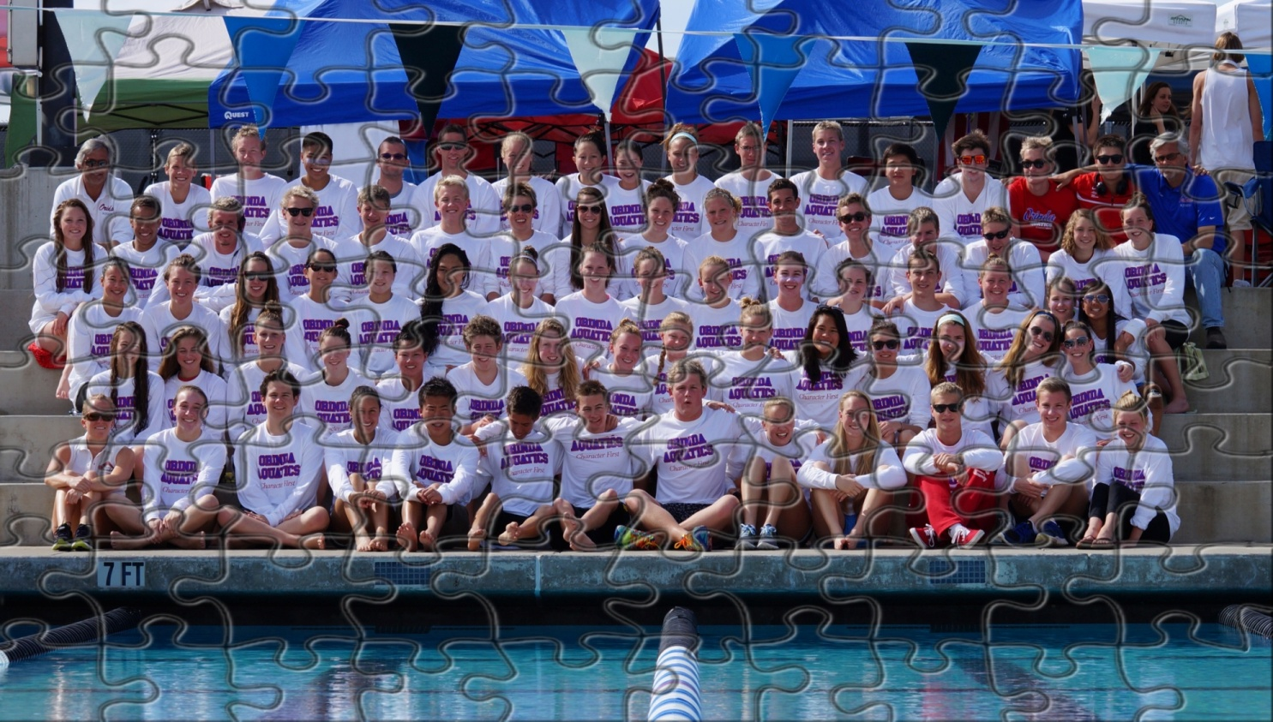
Is there a clear picture of success? Do you have one?
This presentation is about …

Slide 12
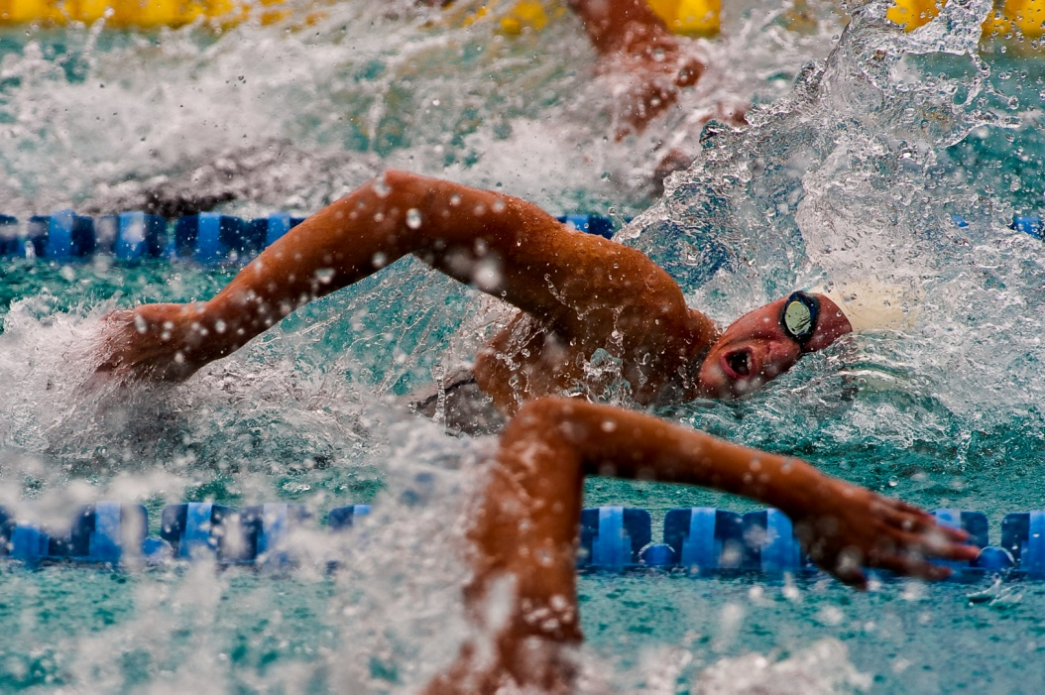
Developing Swimmers Building Careers

Slide 13
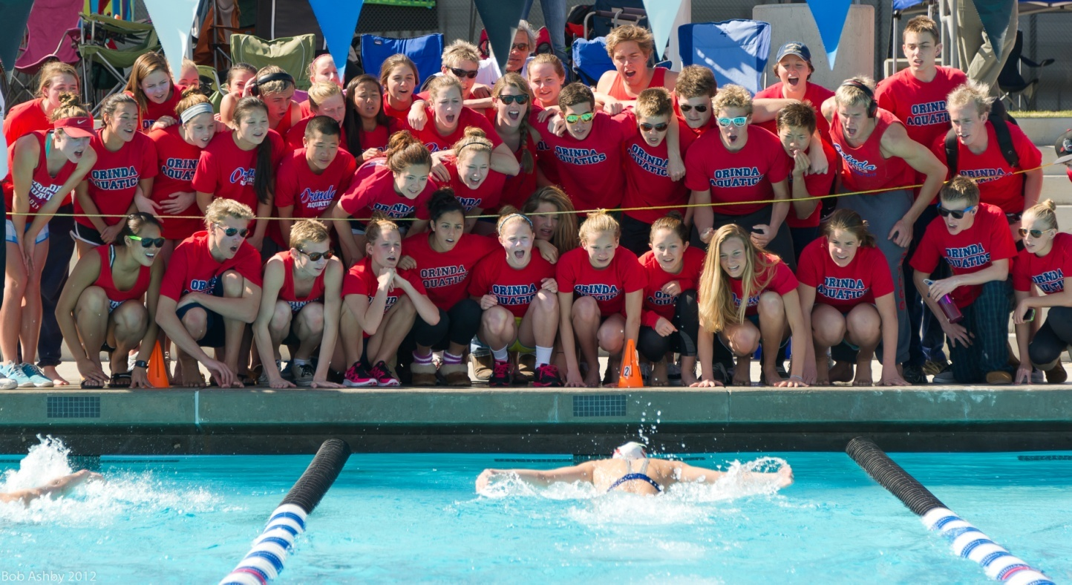
Developing Programs Building Teams

Slide 14

It is about the pieces and, the assembly
It’s about what lies beyond the millions of websites, drills, and sets, and the more common pieces of the age-group puzzle.

Slide 15
Don/Ron Heidary, Orinda Aquatics
25 years with large, successful, summer-league programs (200-250 swimmers)
Coached all ages everyday
Technique driven (aggressive, daily in-water lessons)
Highly disciplined/integrity-driven backdrop
30 years with large, successful, high school programs (100+ swimmers)
Understand teenage mentality/social challenges
Short season to develop culture and success
Won twenty (NCS) Section Championships
Steven Stumph set National Record in Breaststroke at 53.3
200 Medley Relays 1:30.5, 1:32.5, 400 Free Relay 3:01
20 Years at Orinda Aquatics (averaged 125 swimmers)
Aggressive character-driven culture
Relationship driven
Highly productive at regional/national levels
One of the top “smaller clubs” in USA (number one in 2009)
Have won Sectionals, Far Westerns, JO’s
Men finished 3rd at USA Junior Nationals (long course 2012)

Slide 16
Overview
Introduction
The Puzzle
The Process/Assembly
Corner(stones)
Borders/Framework
The (other) Pieces?
Vision – the “glue”
Puzzle Review
Conclusion

Slide 17
Introduction

Slide 18
Age-group Swimming conceptually looks like this
Age-group Swimming
Drift
(not really sure)
Realize Potential
(very happy)
Quit
(very unhappy)

Slide 19
Age-group Swimming In reality, it looks like this. Why?
Age-group Swimming
Drift
Far too many
Realize Potential
Quit
Too many

Slide 20
A question for you...
If the same workout (and drills) was given to ten coaches…
Would there be ten different experiences?
How would the workouts differ in effectiveness?
How would the swimmers respond? Why?
What if you did that for a month? A season? A career?
Is it possible that with the same information, some will achieve greatness and other will languish or quit?
What lies behind the “numbers”, the set?

Slide 21
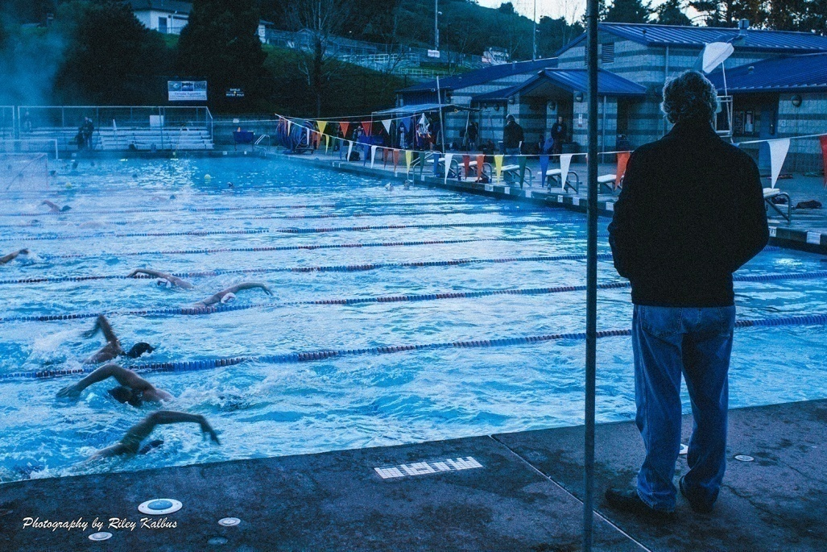
Another Question?
If you had the best drills/technique and the best training plan (of all 200 million) from Olympic coaches, would you produce the best swimmers, or elite athletes?

Slide 22
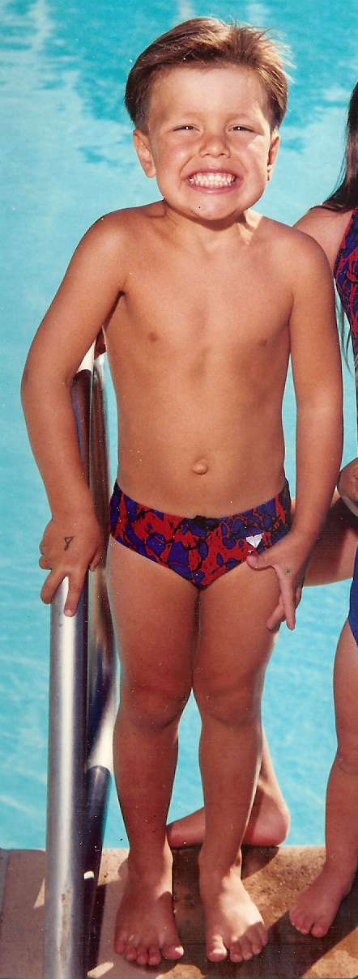
Cute kid! What next?

Slide 23
What does he want to get out of sports? fun, friends, success, life skills, scholarship, self-esteem, glory…
What do his parents want out of sports for him?
Who will he become as an athlete and as a person through sports?
A leader and role model?
Burned out, disconnected, or socially adrift
Will he reach his true potential? When? How? How will you know?
Will he make your team better? Inspire others?
Will swimming make him a better person?
Will he be competing five years from now?
What will he reflect on twenty years from now?

Slide 24


Will his success depend on - talent, luck, yardage, or process?

Slide 25
The Puzzle

Slide 26
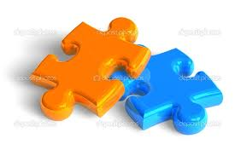

What are the pieces of the age-group puzzle?
Training? Technique?

Slide 27
Focusing on one piece (or two) of the puzzle is analogous to focusing on a nice piece of furniture in a house with cracks in the foundation and a roof that leaks.
What if there are many pieces of this puzzle, and they must fit together, and the “foundation” MUST BE strong to create and maintain lasting success?
And that the roof (culture) does not leak.

Slide 28
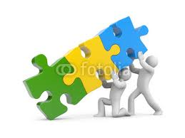
What are some of the other pieces?

Slide 29
We can start here…
Skill Development
Race development
Athletic maturity
Perseverance
Leadership orientation
Team Commitment
Parent-swimmer relationships
Dry land (fitness/strength)
Injury prevention
Coaching philosophy
Coaching continuity/fluidity
Knowledge/competence
Coaches (prior) experience
Equipment
Facility
Group progression policy/criteria
Academic focus
Efficient training
Fun/activities
Ego management
Board
Time frame (horizon)
Compassion
Local Landscape (of competition)
Parent Education
Culture
Integrity
Discipline philosophy
Workout presentation
Planning
Goals setting process
Coach relationship with Board
Conflict awareness/resolution
Connection to kids
Daily monitoring of activity (all)
Swimmer interaction
Value creation
Passion and perspective
Flexibility
Elite group success
Vision
Financial position of team

Slide 30


Surprisingly, these break down to:
Wet: 5
Dry: 37

Slide 31
“but that’s not swimming” While you may not see these as relevant, if your goal is to develop healthy, positive, and highly productive careers, teams, and cultures, they are critical.
A great kid begins to hang out with a bad influence
Parental pressure breaks a kid emotionally
Ego erodes swimmer’s team commitment and sense of self
Major stroke inefficiencies are not corrected (“telling” is not correcting)
Local team recruits your kids. Parents see better value away.
Swimmer gets injured (due to poor technique)
Discord with the BOD forces a passionate coach off the staff
Staff members at odds, delays swimmer advancement
Outburst at swimmer damages relationship
Coach doesn’t feel “ownership” – doesn’t care
Talented swimmer does not connect with coach
Top two star swimmers don’t get along – causes division in locker room/group
Low numbers equals low pay – coach leaves
No role models
Swimmer injured from unregulated dry land
A bullied swimmer quits
National group does not perform well, young families leave
Over trained kid burns out
Undertrained kid doesn’t reach potential
BOD wants kids to have “fun”, you want to win
BOD wants to win, you want to have fun

Slide 32
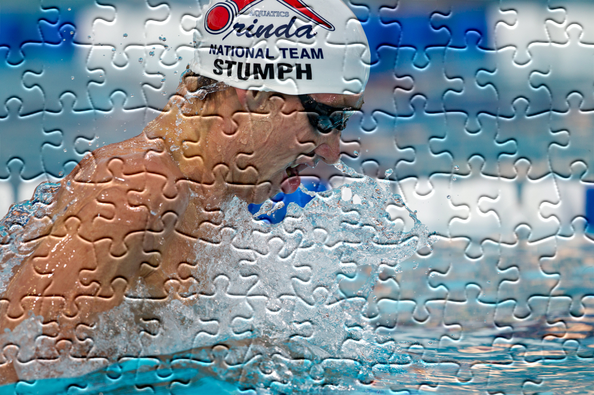
What is the picture of a strong age-group program?
Steven Stumph: 1:55.88 200 Breast, 53.3 100 Breast - first one to help, most humble one on the team, leader, inspiration, relentless work ethic
What is your (picture) vision?

Slide 33
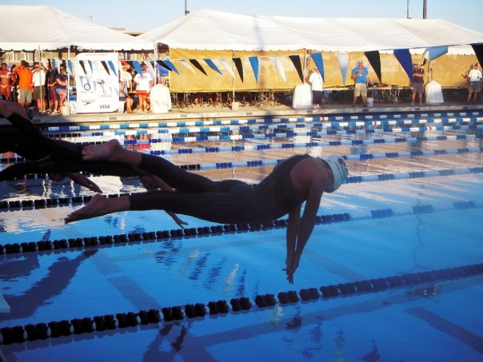
A: They enjoy the sport (happy)
B: They continue to improve (look good)
C: They are consummate team players (nice)
D: A large program (big)
E: A profitable program (rich)
F: The program is successful (fast)
G: The program is really successful (really fast)
H: The sport becomes a life anchor (virtues)
I: They are inspirational athletes/role models (leaders)
J: There is a great team environment (culture)
K: A culture that perpetuates success and fulfillment

Slide 34
The correct answer?
Should be all
(or most of) the above.
(if you don’t care about money)

Slide 35
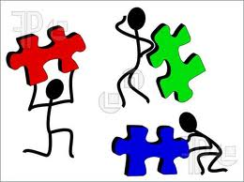
The Assembly (process)

Slide 36
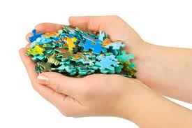
Note: Assembly Instructions…
Do NOT come with the athlete!

Slide 37

Do you have an assembly plan/strategy? Do you know in which direction you are headed? With the kids? With the program?

Slide 38

Do you have all of the pieces?
Can you secure the “corner”(stones)?
Do you have the borders/frame-work?
Do you know how they fit together?
Do you have the “glue” (vision) that will hold this puzzle together?

Slide 39

Begin with macro perspectives
The athletic process - implied respect and maturity; the path of most resistance
The leadership process – leaders care, give, and help – they are the gateway
The team process – team first, teammates first
The life process – be a person of integrity

Slide 40
Everything Should Flow (connect)
Technique
Training
Racing
Team

Slide 41
Priorities Rank/weigh the following in their importance to a young swimmer achieving maximum success and fulfillment?
Talent
Technique
Training
Integrity/Maturity
Perseverance/Work ethic
Leadership/Team Commitment
Parent relationships
Dry land (fitness, strength, injury prevention)
Coaches knowledge/competence
Coaching philosophy/vision/passion

Slide 42
My List - ?
Coaching philosophy/vision/passion
Coaches knowledge/competence
Talent
Integrity/Maturity
Technique
Perseverance/Work ethic
Training
Leadership/Team Commitment
Parent Relationships
Dry land (fitness, strength, injury prevention)

Slide 43

Find Real Purpose
Don’t be a resume builder
Be…
A stroke builder
A race builder
An athlete builder
A career builder
A leader builder
A team builder
An experience builder

Slide 44

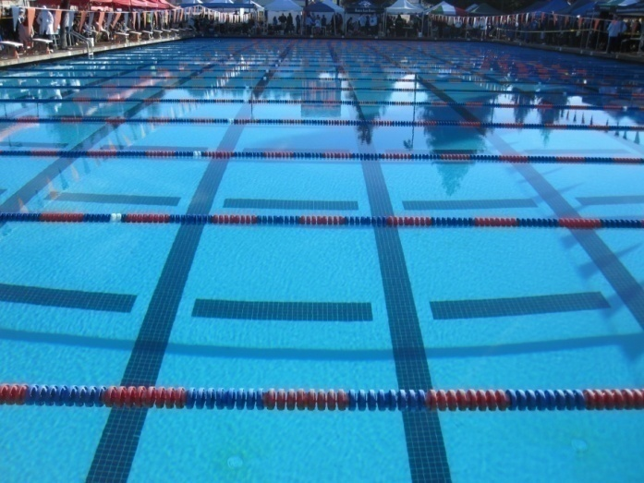
Seek to create value in:
Success
Fulfillment
Growth
Relationships
Team

Slide 45
The Ultimate Goal? to achieve, or be something significant
Reach potential
Achieve a significant personal goal
Become a team leader
Inspire others
Become elite through process

Slide 46
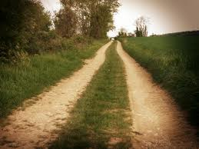
Run Parallel Paths of…
Developing talent (a success anchor)
Developing relationships (personal connection)
Developing team (a rising tide)
Developing culture (a way of life)
Everyday

Slide 47
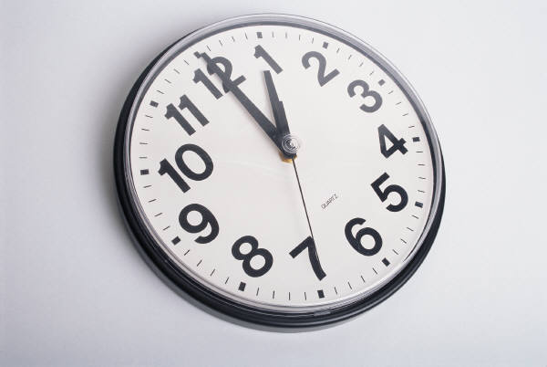
Time Horizon
The coach must pursue each path with an eye, and an awareness, on three time frames:
Short-term – every day
Medium-term – growth in your program
Long-term - growth beyond your program (or to potential)

Slide 48
Don’t make it simply ability driven or numbers driven.
There is no shortage of information (as you have seen). There is a shortage of process.
Make it process driven.
“We have a really fast kid.”
What about the rest of the team?
“We really grew this year.”
How did you grow?

Slide 49
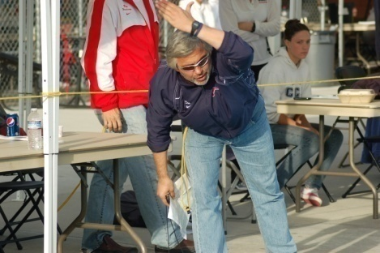
Impact Coaching
Doing drills or building strokes better than anyone
Giving workouts or preparing kids to race better than anyone
Knowing a lot/teaching a little, or knowing enough and teaching A LOT
Having a schedule, or planning each day for an extraordinary career
Knowing kids or deeply connecting with them

Slide 50
There must be a fluid transfer of:
Drills
Skills
Methodology
Training
Testing
Language
Dry land
Expectations
Goals
Development perspective
Leadership
Character expectations
Staff skill/expectation

Slide 51
Fluidity/Flow Through:
A
Developmental
Ages 4-8
B
Age-group
Ages 9-12
C
Senior - Elite
13+

Slide 52
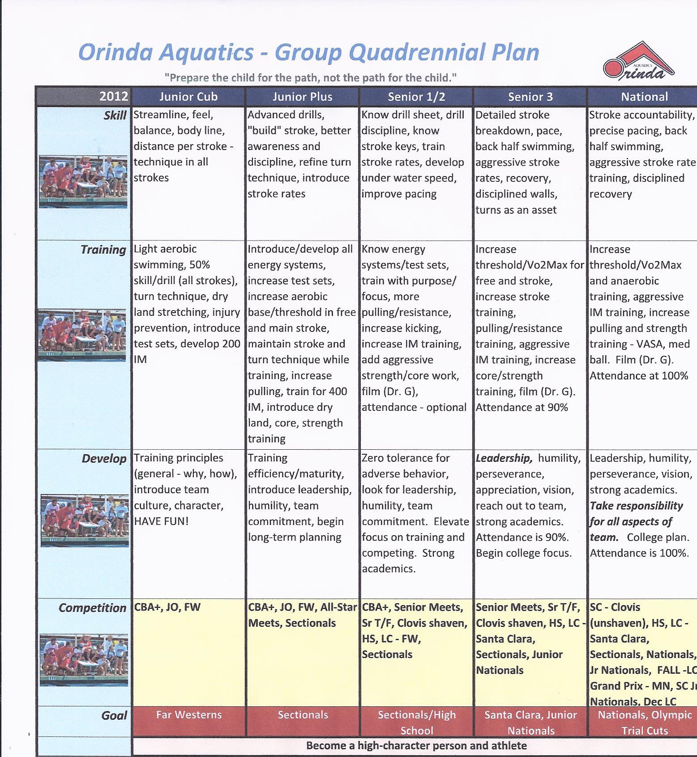
OA Sample “Quad Plan” or group progression

Slide 53

Common Mistakes in Age-Group Coaching
Coaches don’t connect with kids (no partnership/shared vision)
Talent is not aggressively developed
Swimmers do not become “athletes”/embrace the process
Mid-level or weaker swimmers are left to languish
Lack of discipline (or poorly administered)
Poor technique (or drills are done but not grounded)
Training is not tied to efficiency
Technique errors are not corrected early and aggressively
Behavior issues
Kids are not tied to team/leadership
Poor (or no) role models (athlete and coach)
No long-term perspective
Over train early (neglect emotional toll)
Racing/competition is not kept in context to career and life
Both success and “failure” are over-played
Coaching turnover or lack of continuity
Overzealous parents not educated, sold, or tempered

Slide 54

Before we get started, how would you rate your…
Technical development (of kids)?
Training plan/effectiveness
Coaching competence?
Program structure (day to season)?
Program integrity?
Program discipline?
Swimmer “connection”
Team culture?
Vision (articulated)?
Your ability to help someone reach their potential?

Slide 55
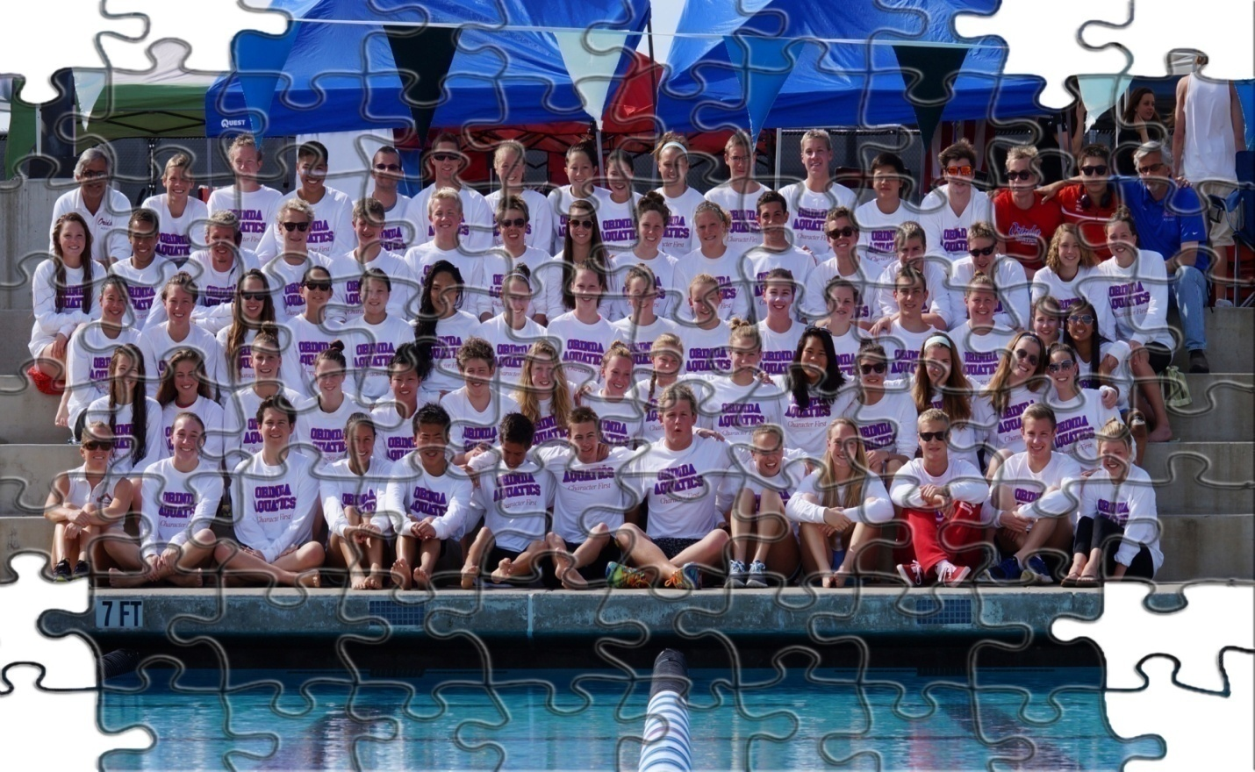

The Corner (stones)
Of a strong age-group program.

Slide 56
The Corner (stones)
Technical Development
A path/plan of efficiency
Training
Efficient, intelligent, and process-based
Coach Competence
Knowledge, passion, drive – to develop talent, AND team
Organization Planning
A path and structure for success for everyone

Slide 57
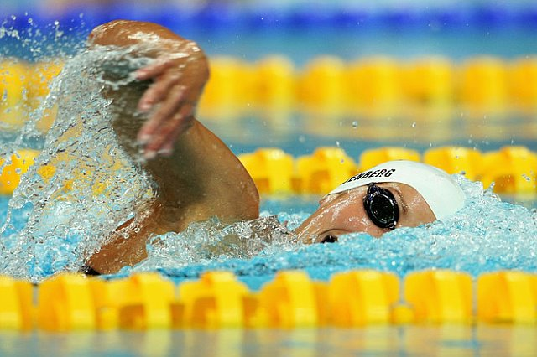
1) Technical Development
Kim Vandenberg: Beijing Bronze Medal, Melbourne World Championships Silver Medal

Slide 58
Thoughts
“A person who aims at nothing is sure to hit it.” unknown
“Act the part and you will become the part.” William James
Have a technique vision

Slide 59
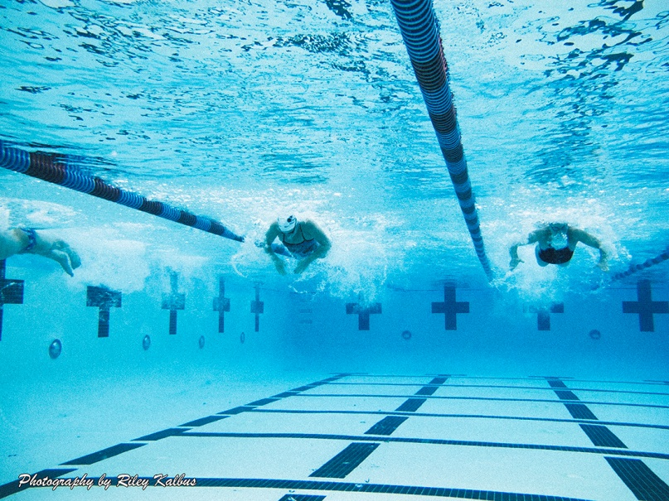
“Excellence is never an accident.
It is always the result of high intention, sincere effort, and intelligent execution; it represents the wise choice of many alternatives. It is choice, not chance, determines your destiny.” Aristotle

Slide 60
Technically Speaking
What is your technique vision?
What is your technique philosophy?
What is your technique methodology?
What is your technique implementation plan?
How does technique fit into training?
How does technique fit into racing?
How do the kids respond?

Slide 61
Technique Stages (you must be adept at all three)
Education/instruction
Explain, teach, demonstrate
Structure, discipline, expectation
Repetition
Controlled execution
Structure, discipline, expectation
Enforce – the difference maker
Execution under duress/fatigue

Slide 62
Technique Concepts
Must become a platform to train from
Perfect practice makes perfect
Every stroke is an opportunity to improve
Penny in the piggy bank (get rich over time)
Take pride in technique
Take ownership of your technique
Efficiency is the quickest path to improvement
Like ironing the wrinkles out of shirt
200 streamlines/2,500 strokes per workout
No set, lap, or stroke should be wasted

Slide 63
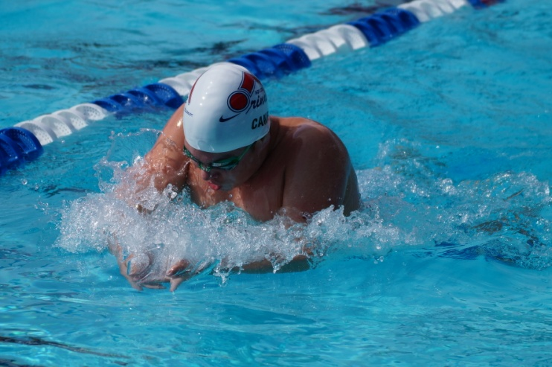

Drill Series/Progressions Create progressions for each phase of stroke development
Four kick
Four scull
Four drill, stroke isolation
Use in combination
Use in progression
Use at various speeds:
Recovery
Moderate
Endurance
Speed
Use as an anchor to build stroke from.

Slide 64
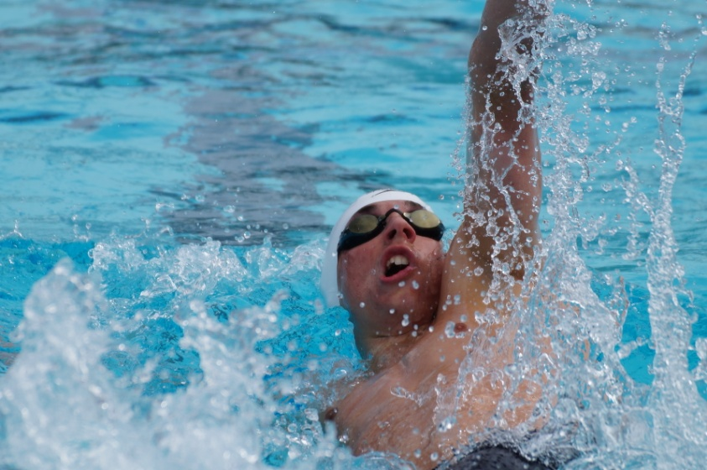
Drills – Enhanced (equipment)
Paddles – resistance/strength
Snorkel – balance/body line
Parachute – resistance (catch)
Fins – speed/support
Anti-paddles – forearm/feel
Long belt – resistance/speed
Tempo trainer – stroke rate/tempo

Slide 65
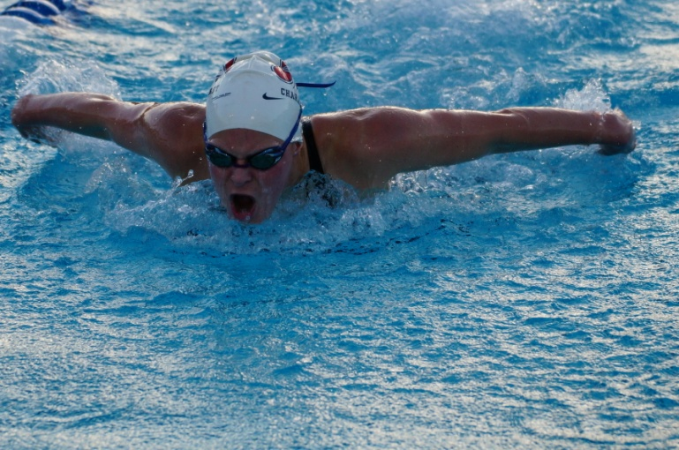
Technique Education
Drill series (to build stroke)
Four stroke keys (fundamental)
Four personal stroke keys
Triggers
Cues
Video
Film
Daily accountability by swimmer
Daily commitment by coach

Slide 66
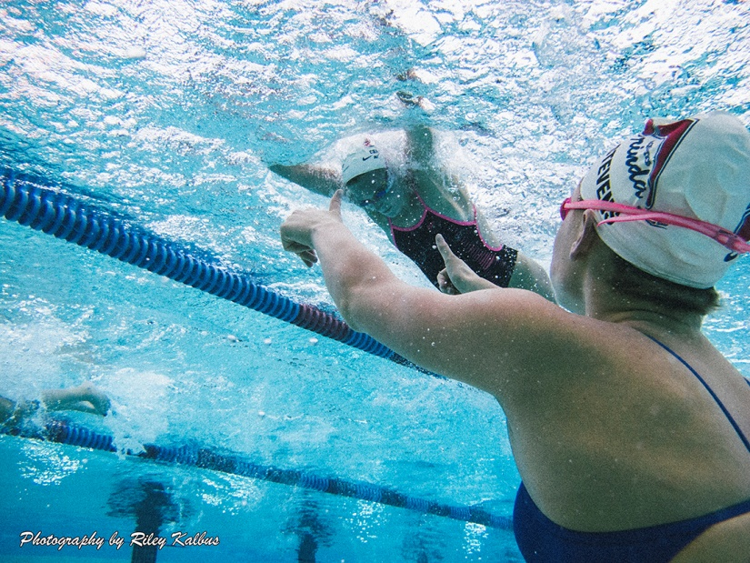
Technique Instruction
Verbal
In water demonstration
Video (example)
On deck physical demonstration
Video swimmer (above and below)
Have kids watch each other

Slide 67
Some Stroke Cues
Fly
Hold kickboard in front to avoid narrow entry
Feather/brick hands (no splash)
Reach for ends of lane lines
Show diamond on pull
Hold tennis ball under chin
Angel wings
Back
Set head/balance glass
Show shoulder
Thumb lead/wave to team
Slice cake
Arm wrestle
Free
Kickboard
Train track
Black line below
Pocket
Fin (shake)
Barrel
Breast
Elevator door
Tennis ball
Shoot through tube
Pull down – light bulb
Throw a ball – connect! Feel hip lead, trunk rotation, arm follows, etc.

Slide 68
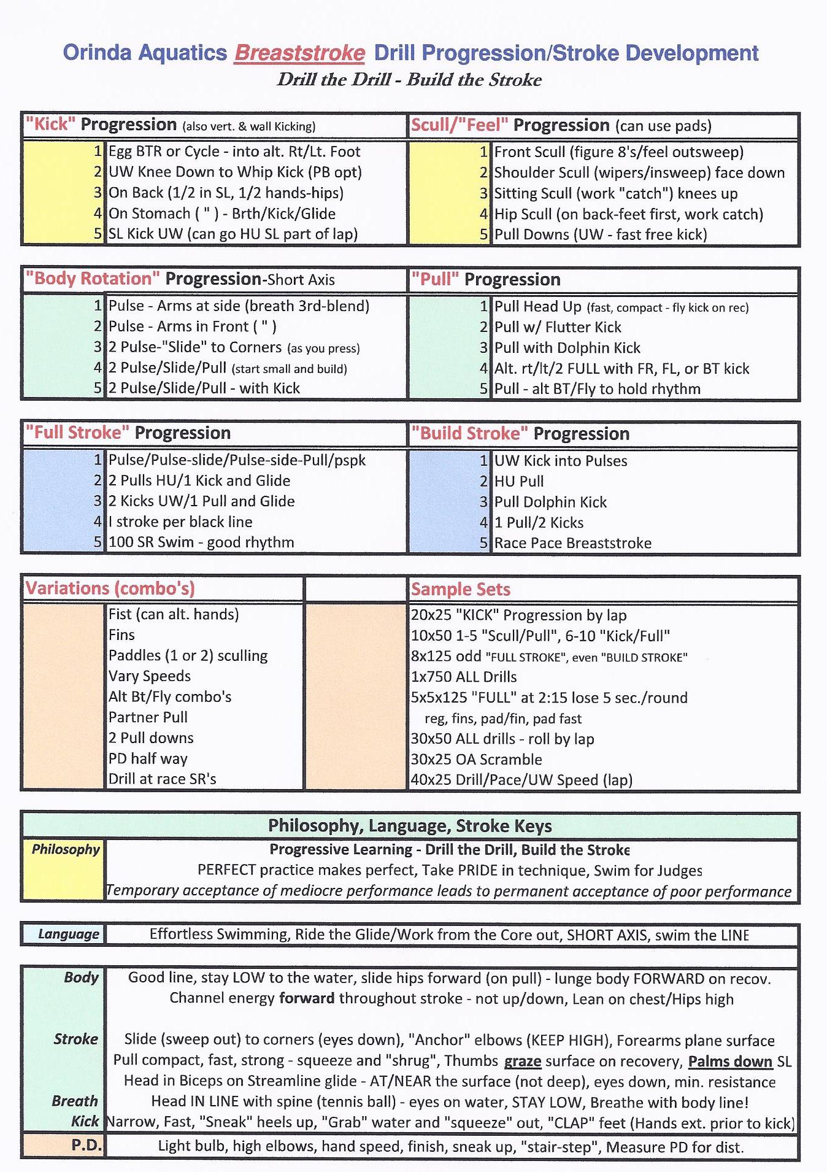
Sample Drill Sheet - Breast

Slide 69
8 & Under Free Drill
(note: video of 8 & under catch-up freestyle with kick board was shown here. Kick were methodical with stroke – “pocket, shark fin, low breath, fast feet, etc.)
It is not the drill…
It is the presentation, explanation, teaching method, and connection to kids (be a pirate – show one eye!)
Components:
Extension of lead arm hold board, head position – set/eyes down, quick/low breath, leg drive through breath, relaxed low recovery (ALL critical to senior swimming)

Slide 70
Training Technique
Drill execution
Repeat drill if done incorrectly
Watch each swimmer each lap
Take snapshot in 2 strokes
One comment each lap, each kid
Be as aggressive as training or dry land
Variables
Stroke counts
Stroke rates
Intervals
Breathing patterns
Distance under water (kicks, etc.)
Equipment
Leg drive
Black lines
Stroke count (one per crossing lane)
Stroke pull (outline black line below you)

Slide 71
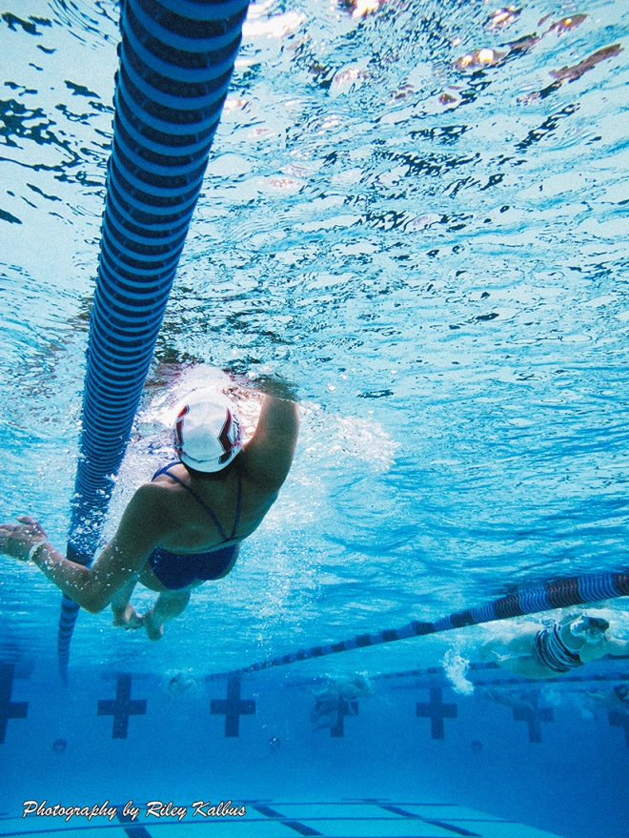
Stroke Error Analysis
Find the problem and NOT the symptom (follow the trail)
Make sure swimmer knows the problem and the cause
Give drills, queues, triggers to solve
Video swimmer
Have a sense of
urgency to fix

Slide 72
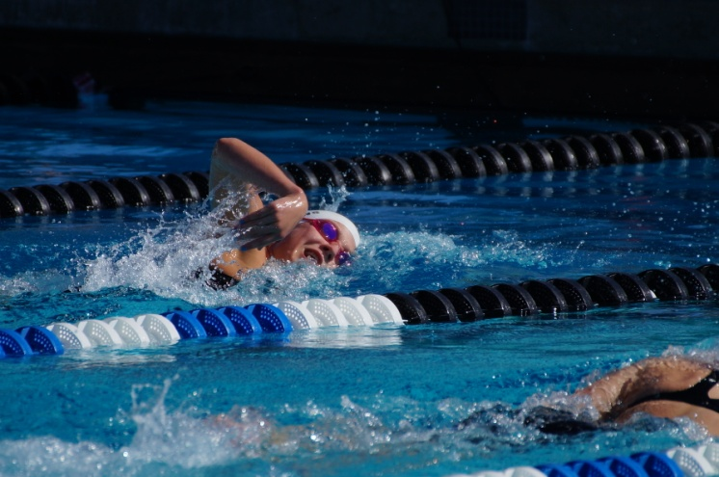
Error Example - Free
Problem: arm crosses under body causing:
Weak pull – dropped elbow
Late/high breath
Hips push out
Feet cross
Early exit - hand leads (low elbow)
Risk of injury
Poor coach response:
“try not to let your feet cross.”

Slide 73
Fixing the problem
Drills
Catch up/stroke isolation (hands 11 & 1)
10 count/lift-switch
Transfer tennis ball /stick– hold/transfer
Snorkel
Paddles
Fins to carry speed
Alternate breath
Look for pulling hand
Cues
Black line
Pull over barrel (high elbow)
Stroke count
Video
Give stroke count
Partner watch

Slide 74
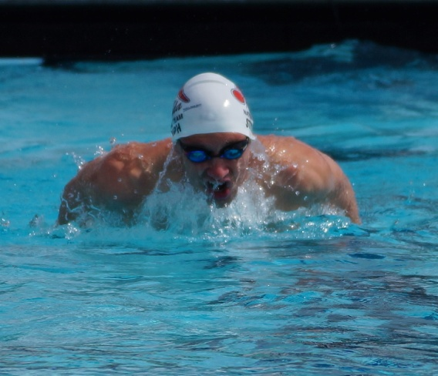
Error Example - Fly
Problem: Head dips in fly with “double hips”
Coach: “Don’t bounce so much”
Evaluation:
Hands are slipping through ahead of down-kick, causing the kick to push the head down and the hips up (a second time)
Correction:
Set hand in front (don’t hurry entry)
Hold one count
Wear paddles for more water/resistance
Push head forward

Slide 75
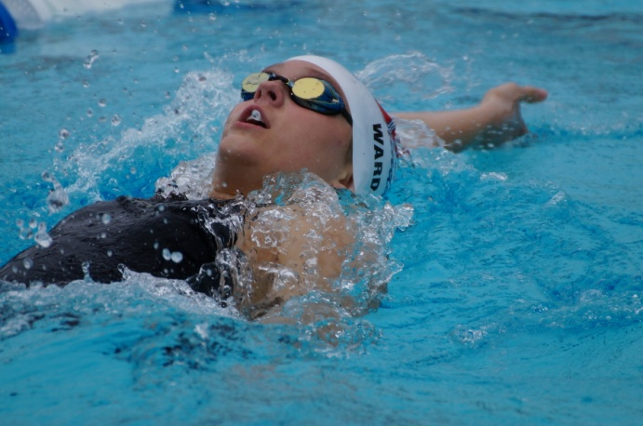
Error Example - Back
Problem: Head sets/tips slightly to right
Coach: “you are going crooked”
Evaluation:
Keeps left shoulder high and catch shallow with straight arm pull and slow turn over. Body pushes to left side because of overreach on right.
Correction:
Side kick, one arm 3-left/1 right, balance cup on forehead. Video.

Slide 76
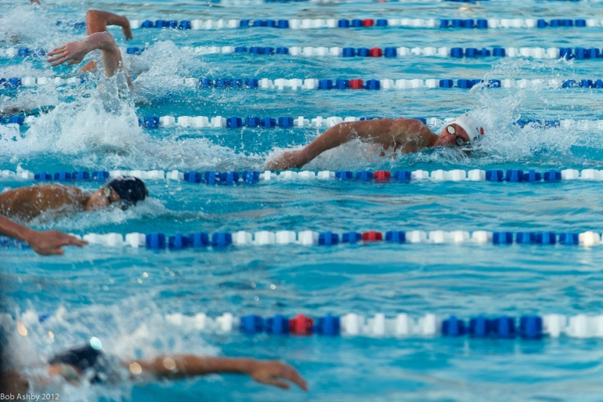
Technique Transition
Fundamental (aggressive)
(younger/developing – more teaching
Drills
Progressions
Keys
Cues
Triggers
Meticulous detail (advanced/elite – more accountability)
All aspects of stroke
Every inch
See example evaluations (next)

Slide 77
Steven Stumph: Develop specific areas to continue improvement in Breast and IM
 | Ratings 1-10 Notes: 1) 10 is "achievable" perfection, 2) Scale is in the context of a "World Class" swimmer
 | Note: IM is the development all strokes individually both technically and in training (develop the parts and the whole will improve)
 | Freestyle |  | Backststroke |  | Butterfly |  | Breaststroke
Body Position | Head Position-too high-relax it | 5 | Head/Body Position |  | Timing of stroke & breath | 4 | Keep head down on glide | 4
 | - Keep head in line w body | 5 | - chin moves to left | 4 | - pulse ahead of entry | 4 | - lean on chest | 6
 | - Hips need to ride higher | 6 | - left should sit low | 4 | - head uw at entry | 5 | - keep hips high on glide | 6
 | - breath too high (angled) | 5 | - rotate sooner ahead of pull | 4 | - stay extend thru hips | 4 | Maintain tight streamline | 5
 | - Rotate more to left off br | 5
Stroke | Stay extended on breath | 6 | Right hand catch too shallow | 4 | Catch under shoulders | 4 | Head down on out sweep | 5
 | - Catch w higher elbow | 5 | catch sooner both arms | 4 | Lean/pulse into catch | 5 | Wider out sweep | 6
 | - Finish stroke farther back | 5 | develop stronger, deeper pull | 5 | Breathe later at finish of stroke | 3 | Higher elbows on catch | 4
 | Relaxed hand recovery | 3 | Train at 40 SR w max pull | 5 | 2nd kick meets hands at exit | 2 | Lead in sweep with thumbs | 4
 | Kick through breath | 7 | Train at 44 stroke rate | 6 | More power w 2nd kick | 3 | Keep pull in front | 4
 | Kick higher and stronger | 7 |  |  |  |  | No dip of hands on recovery | 3
Training | Train at 12-13 SPL to lengthen | 6 | Must train w three objectives |  | Must train w three objectives |  | Hold streamline when tired | 4
 | Work on technique when tired | 5 | 1) better stroke balance | 5 | 1) better timing on breath | 4 | Focus on power pull when tired | 5
 | Swim moderate at 10-11 SPL | 6 | 2) build SR w/o losing DPS | 5 | 2) develop power 2 bt kick | 3 | Train at 5 spl w 40 SR | 6
 | Consistent breathing pattern | 6 | 3) develop uw speed | 5 | 3) develop uw conditioning | 5
 | Improve UW & breakouts | 8
Turns | Technique | 8 | Leave approach arm in front | 5 | Technique is good | 7 | Technique general | 7
 | Approach | 6 | Cross arm hold more water | 5 | Speed of turn | 5 | Speed of turn | 5
 | Spin fast | 8 | Don't roll head up-roll too slow | 5 | Work SL off wall | 7 | Pull down | 5
 | Tighter streamline off wall | 8 | Bigger dolphin kicks-push hips | 4 | Work SL kicks UW | 5 | - hold to 2 1/2 bl | 5
 | Work kicks to maintain speed | 8 | Improve speed UW | 6 |  |  | - power pull & dolphin kick | 4
 |  |  |  |  |  |  | - hands recover ahead of kick | 4
 |  |  |  |  |  |  | - speed thru breakout | 5
Challenges | Must improve recovery to improve catch and pull |  | Must slow SR to improve rotation & catch |  | Feel timing of and develop power 2-bt kick |  | Train hard but be perfectly efficient
General | Work ethic | 10
 | Maturity/Focus | 10
 | Receptive to changes | 10
 | Ability to make changes | 10

Slide 79
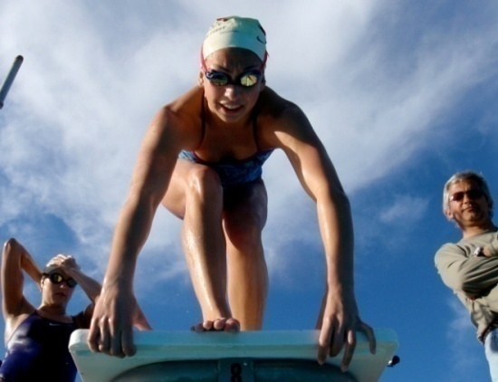
Let’s “Start” Here
Never false start
Technique is critical but discipline is key
False starts occur for one of two reasons:
Reaction from tense muscles (anticipation)
Loss of balance from weight shifting forward
Methodology: relax, balance, react

Slide 80
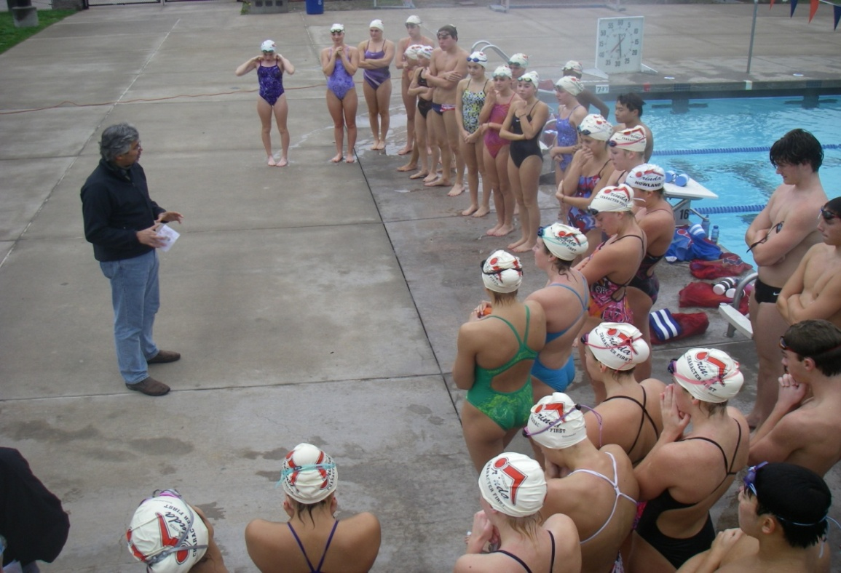
2) Training
“If a man has any greatness in him, it comes to light, not in one flamboyant hour, but in the ledger of his daily work.”
Beryl Markham, English author (1902-1986)

Slide 81
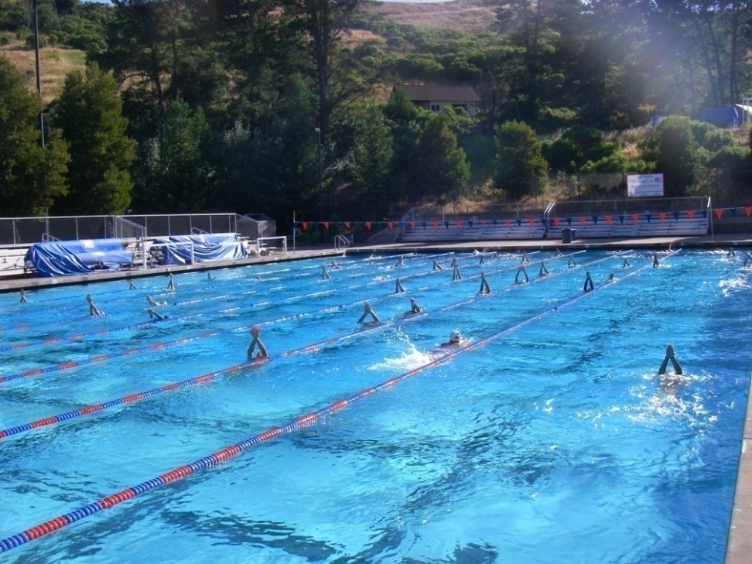
“Many of the greatest achievements of the world were accomplished by tired and discouraged people who kept on working.” unknown
“Don’t ask for a light load, but rather a strong back.” unknown
Vertical streamline kicking on back, long course

Slide 82
Educate kids on training and the development cycle
Efficiency
Training
Racing
Have a training vision.

Slide 83
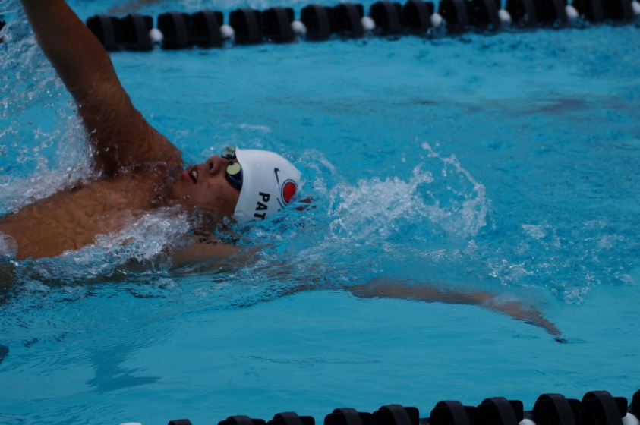
Training Aspects (all)
Train the stroke (back to technique) – (efficiency)
Train the body (physically)
Train the race (ultimate objective)
Train the walls (race within the race)
Train the mind (intellectual/understanding)
Train the psyche (emotional balance – long-term perspective)

Slide 84
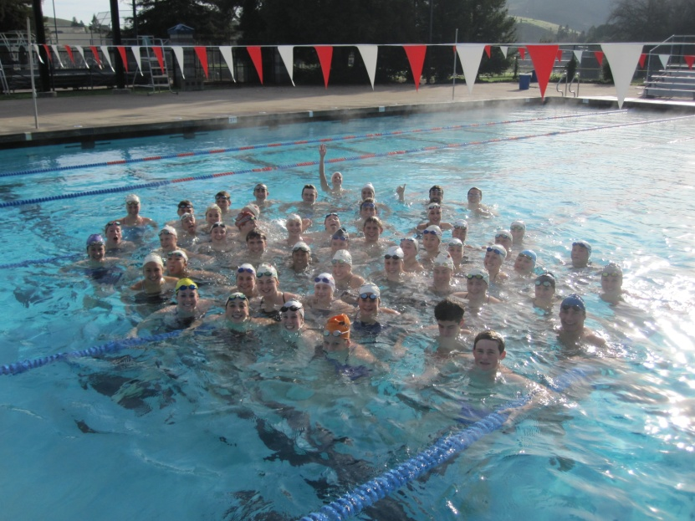
Ask yourself as a coach: Is this the best workout for…
Today?
This week?
This season?
Your career?
Your stroke?
Your race?
Your well-being?
As a coach, you are making that decision and creating the above list – every day!

Slide 85
Training vs. Technique part 1
Parent: How was workout?
Swimmer: Easy. We just did 25’s.
Parent: Are you even tired?
Swimmer: No?
Parent: How are you going to improve if you don’t swim more? All of the other teams train a lot.
Reality: coach ran a structured workout of 25’s/50’s with an efficiency focus. The “easy” swimming was to reinforce the drills and skills. Stroke improved.

Slide 86

Training vs. Technique part 2
Parent: How was workout?
Swimmer: Hard. We swam a lot!
Parent: Are you tired?
S: Yes. Very.
P: Good.
Reality: stroke is breaking down. Poor streamlines and wall technique. While there is bravado now with the swimmer, there may be fallout emotionally, later on.

Slide 87
Stroke Rate vs. Stroke Length
Swimmer swims a race with a longer stroke working on DPS.
Gets second to a swimmer with a fast stroke rate.
Parent says: if you just moved your arms faster you would have won!
Swimmer swims a race with a fast stroke working on turnover.
Gets second to a swimmer with a slower, longer stroke.
Parent says: if you just lengthened your stroke you would have won!

Slide 88
Educate Parents
Philosophy
Process
Long-term development
Goals in perspective
Importance of technique/efficiency early
Tired vs. better
Training pan:
By age/development
By group
Throughout career

Slide 89
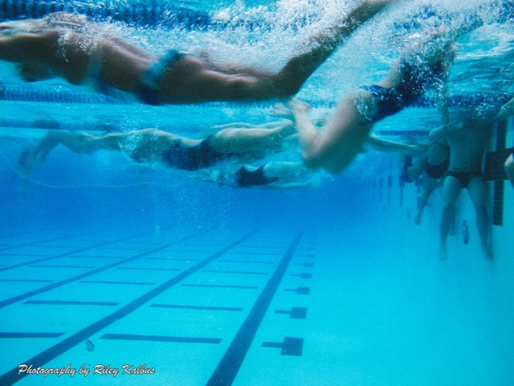
Educate Kids Training “Awareness” Cycle
Understanding
purpose
Integrity
execution
Discipline
for max effort
Team Support
Training culture
Attitude
embrace work

Slide 90
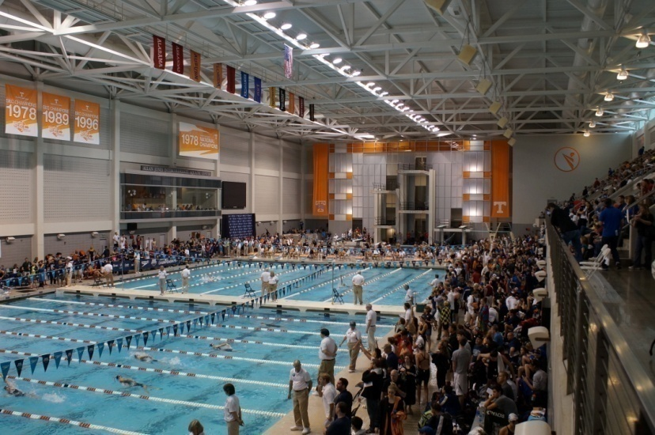
Training Areas/Focus
Light Aerobic
Warm-up/recovery
Drills
Kick/scull, body position
Perfect technique swimming
Endurance
Moderate
Threshold
Higher-intensity
Maintain technique
Speed
Commit to efficiency
Wall oriented
Turn speed
Turn speed in training
Legality
Breakout distance/timing
Speed/endurance under water
Train all strokes/IM
Will help IM/off strokes
May not know best stroke/event until later years

Slide 91
Test/Monitor
Threshold/Endurance
Interval
Stroke count
Heart rate
Vo2 Max (higher intensity)
Speed
Kick - various
Underwater
Turn time
Flip & open
Turn Master
Pull-down distance
Dive to 15m

Slide 92
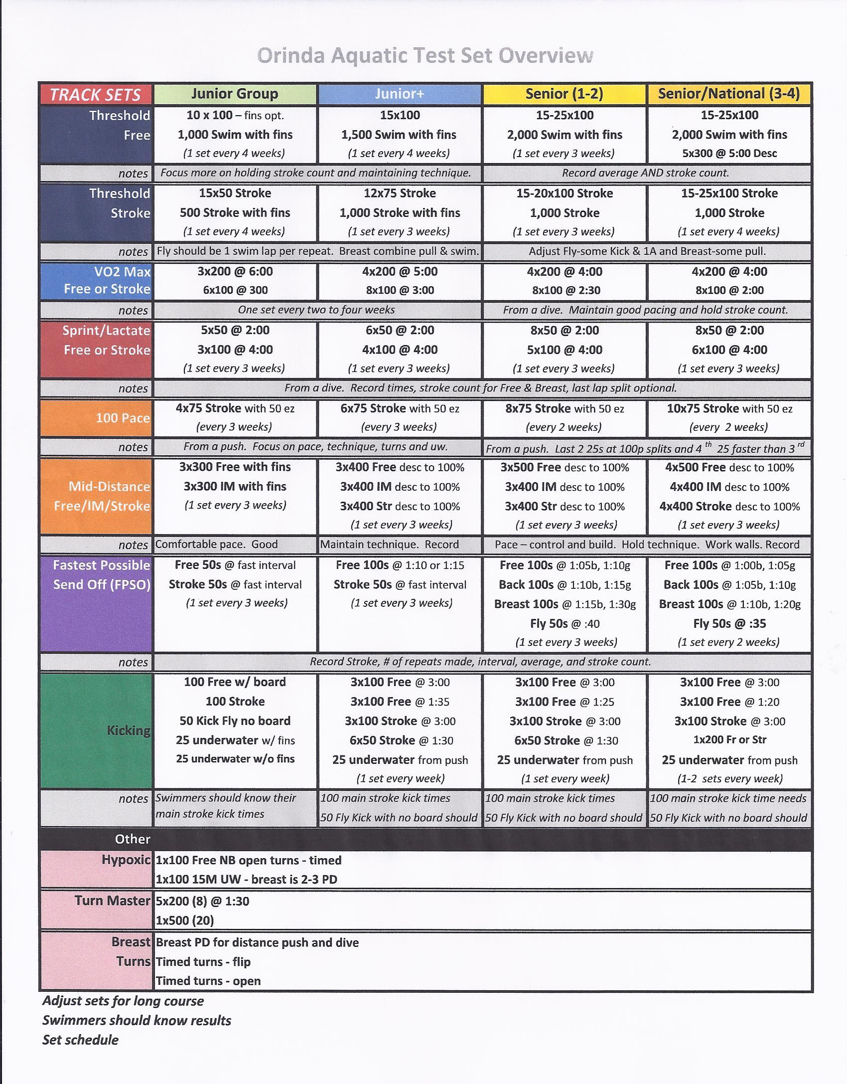
some we use

Slide 93

Controlled Training
Train Drills (or integrated)
Stroke counts
Stroke rates (slower or faster)
Breathing patterns
Alternating or controlled
Kicks/distance underwater
Heart rate
Black line (in bottom)
For stroke distance
UW kick distance
Short sets
Leg drive

Slide 94
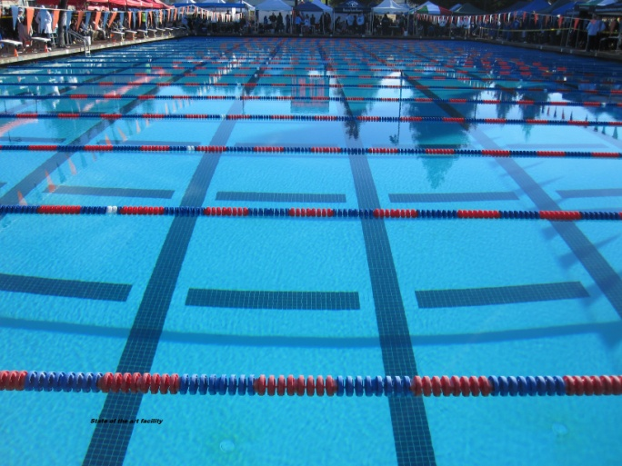
Train-ique?

Slide 95
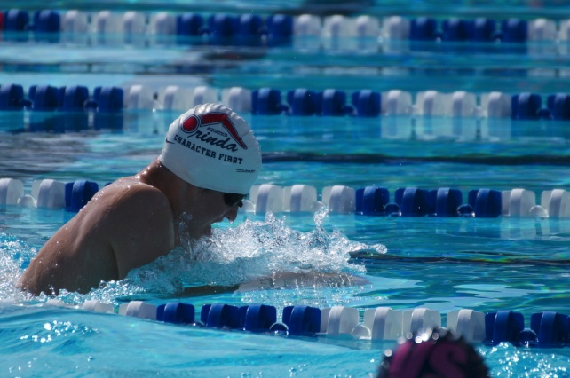
Breaststroke Training simple
12x50 Breaststroke on 50 - go
7x 100 Breaststroke on 1:45 - go
400 Breast
“work hard”
What are you working on?
What is controlled?
What is enforced?
What is the net result?
How does it help race?
How does the stroke evolve?

Slide 96
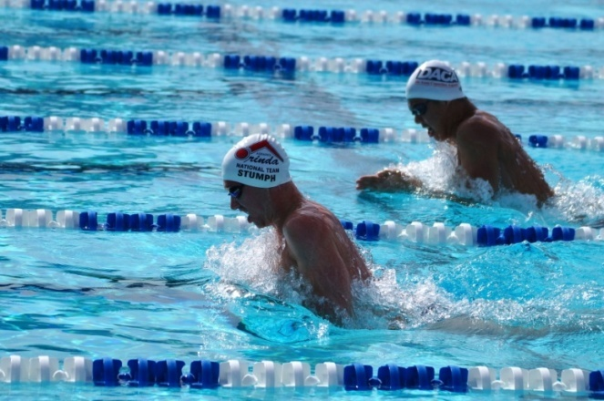
Breaststroke Training controlled
Three Rounds (same yardage)
8x25 Breast pull (fins) – flutter kick (works horizontal/streamlined position), fins to carry speed, 4 SPL, power pull, fast hands on recovery Cues: open elevator doors, anchor elbows, later breath, tennis ball, shoot threw the tube. (can use snorkel or paddles)
1x50 Vertical SL breast kick (abs/core, legs, body line) FAST
4x25 Breast pull (fins) – dolphin kick (works short axis/hips), fins to carry speed, 10 SPL, set SR to 44 (100 pace), CUES: quick elevator, tube.
1x50 Vertical SL breast kick (abs/core, legs, body line) FAST
4x25 Breast swim – 6 SPL, hold focus on above, PD half way, SR 38
2x50 Breast swim – same
1x100 Breast swim – same
Intervals (desc. by round)
25’s: 35, 30, 25
50’s: 55, 50, 45
100: desc. 1-3
Pull downs: carry speed (to trigger point). 3/2/1, light bulb, stair step
Turns: all legal, fast – elbow, hand, hot wall, spin fast, etc
Accountability: do it right.
Understanding: stroke keys/cues, personal keys
Elevator doors, anchor elbow, hips, tub, hot wall, etc….

Slide 97
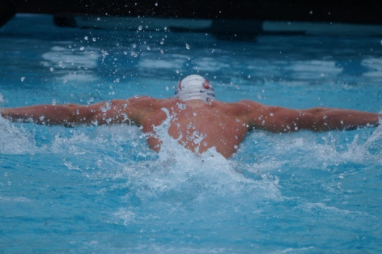
Butterfly Training simple
12x50 Fly on 50 - go
7x 100 Fly on 1:45 - go
400 Fly – drill/swim
“work hard”
What are you working on?
What is controlled?
What is enforced?
What is the net result?
How does it help race?
How does the stroke evolve?

Slide 98

Butterfly Training controlled
Three Rounds (same yardage)
What is importance? technique, efficiency, endurance, UW, race orientation
Two rounds
12x25 @ 30
Five kicks off each wall
Breathe 1/1 – hold on B.O. every 4rth lap is 15m UW max
Exaggerate – Set/press, catch, kick (by lap)
Hold 8 SPL (depending on size/age)
50 vert SL dolphin kick
Anything wrong and it doesn’t count
Have swimmers watch trailing swimmer
8x25 @ 25 with fins
Eight kicks off wall (at kick rate .40)
Hold 5 SPL (depending on size/age)
100 vert SL dolphin kick
4x25 @ 20 with fins
Hold shaven race pace, breathing pattern
8 kicks/15m last wall
50 UW fly kick max
1x100 Fly timed (1/2 UW each wall) (fins or not)
every line you don’t make adds a second to time
Hold race breathing
Desc 25’s
100 EZ
CUES: can use tempo, set outside of kickboard, no splash, show diamond, tennis ball under chin

Slide 99
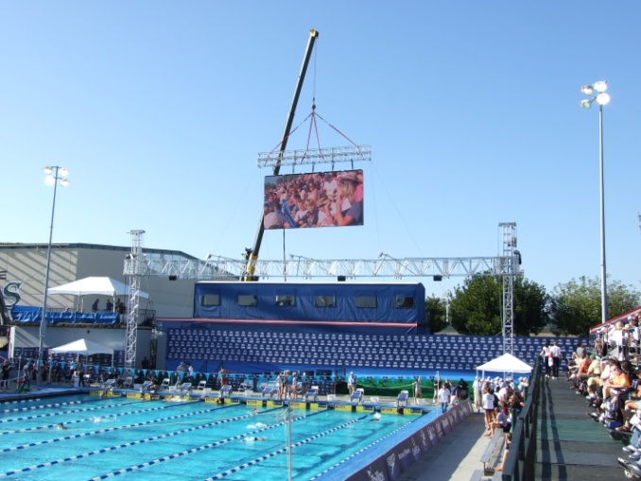
500 Free’s or ?
20x25 @ 25 to feet
Catch-up
All out leg drive (with breath)
Breathe right, 3rd, left, 0
8-10 SPL
20x25 @ 20 - fins
½ catch-up
All out leg drive
Breathe 3rd
4th lap UW
Goal: 10x100 Free @ 1:10
Hold 1:00
10 strokes per lap
Strong kick (during breath)

Slide 100
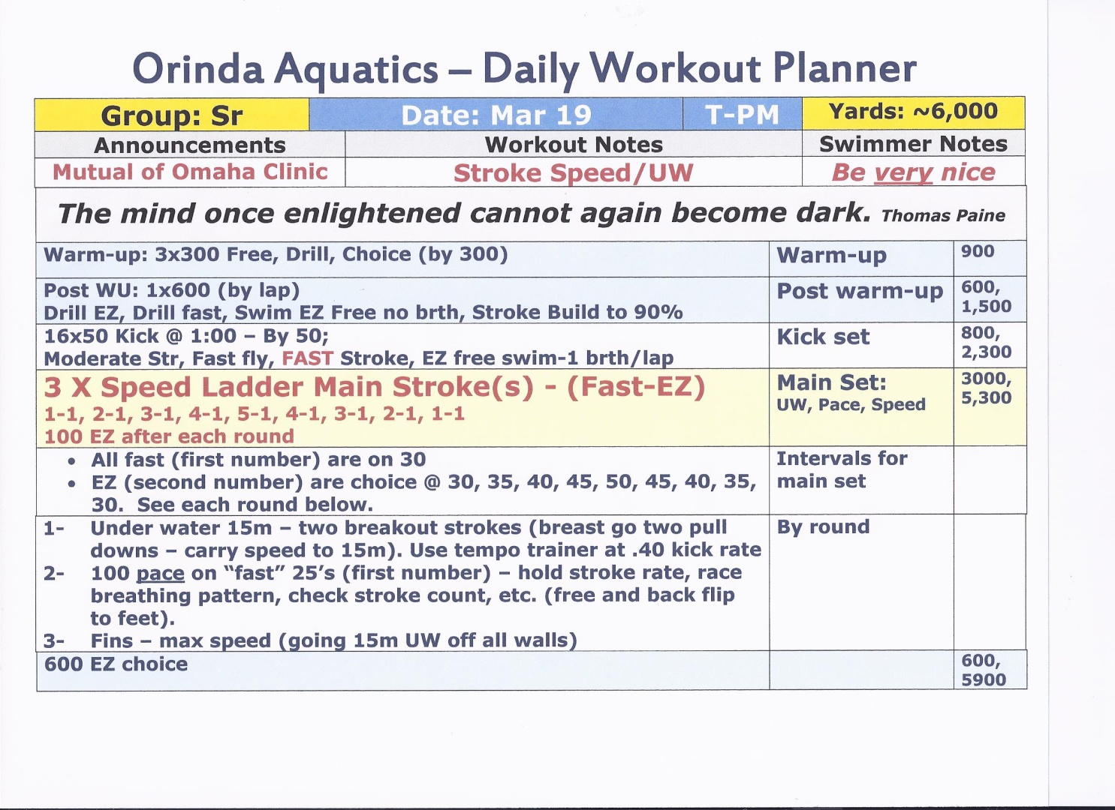
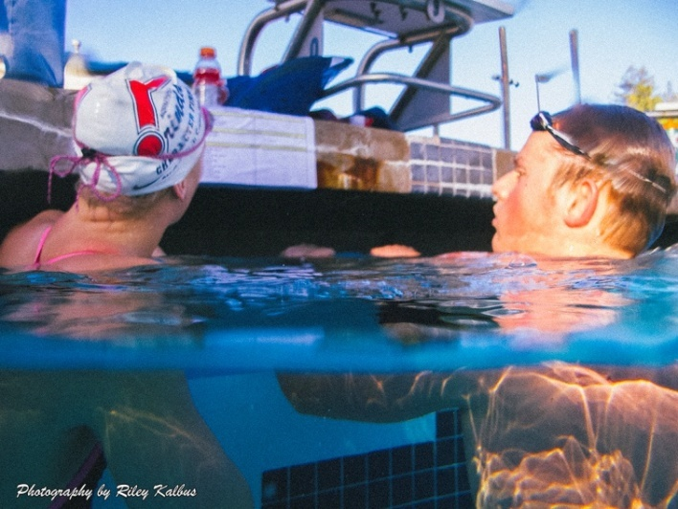
Sample Workout
Workouts are reviewed on deck prior to practice, and also printed and given to each lane to place on the wall above the gutter for constant view. The sheet also has reminders and a quote.

Slide 101

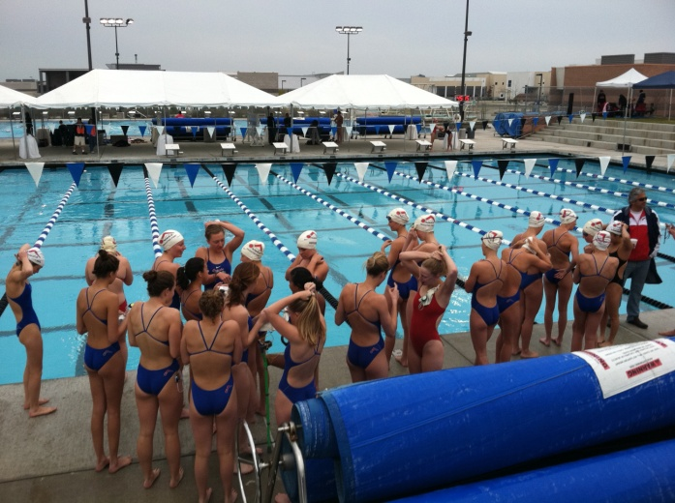
Sample Workout Overview (goal – creative, challenging, work weakness, work season)
Yards: 7,000
Focus: Stroke pace to walls/UW
Three stations (3 stations within a station)
1-Speed kick, moderate paddle swim
2-Build to walls/work UW/pace
3-Aggressive UW/turn work, stroke/video review, goal sheet, Vasa Trainer
Group comingled
Partner evaluation (interaction)
Goal sheets/team commitment
Video glasses
Vasa Trainer
Turn Master
Fins
Paddles
Snorkel

Slide 102
Presenting the Workout (as or more critical than the workout itself)
Take a deep breath, and … you’re on

Slide 103
Delivering… A Great Workout
“Plan your progress carefully; hour-by hour, day-by-day, month-by-month. Organized activity and maintained enthusiasm are the wellsprings of your power.”
Paul J. Meyer

Slide 104

Preparation
Evaluate the prior days/weeks workouts to prepare the next practice.
Fit the workout into the week, the month, the cycle, the season, and your swimmers’ careers! Know the team flow/process.
Commit to create the most motivating, inspiring, challenging workout possible – everyday! Make them think. Make them work.
Inspire them to come back tomorrow even more motivated. Make the workout an experience and not just a practice.
Make sure the workout is written, planned, rehearsed, and ready to be presented.
Think about any issues, announcements, events, highlights, introductions, articles, challenges, etc.

Slide 105

Evaluations
1. Integrity
If you asked your swimmers to swim 21x50 Freestyle @ 44 with 12 SPL (strokes per lap), alt. breathing, 2 lines out in a SL, and you told them that you would be in the office, what would they do? Why? Do you trust them implicitly? Do they trust you implicitly?
2. Work Ethic
How would you evaluate the work ethic of your group? Do they like to work hard? Do they embrace it and see the benefit? How do you sell it? Command it? Demand it?
3. Attitude
Monitor the attitude as you would the pool chemicals or temperature. As the chemicals will dictate the quality of the water, so too will the swimmers’ attitude dictate the quality of the workout!
4. Motivation/Energy level
Monitor energy level/motivation from the time they walk in the gate/door, as they walk out of the locker room, get in, warm-up, etc. If the group lacks motivation/energy, is it you? Them? The WO? The team?
5. Yourself
Every time you leave the workout, evaluate yourself, your workout, and how the kids responded to you and your workout. Be honest with yourself. Commit to be better tomorrow. Ask kids, parents, etc.

Slide 106
Goal Setting
“Happy people plan actions,
they don’t plan results.” D. Wholey

Slide 107

“If you want to be happy, set a goal that commands your thoughts, liberates your energy, and inspires your hopes.” Carnegie

Slide 108
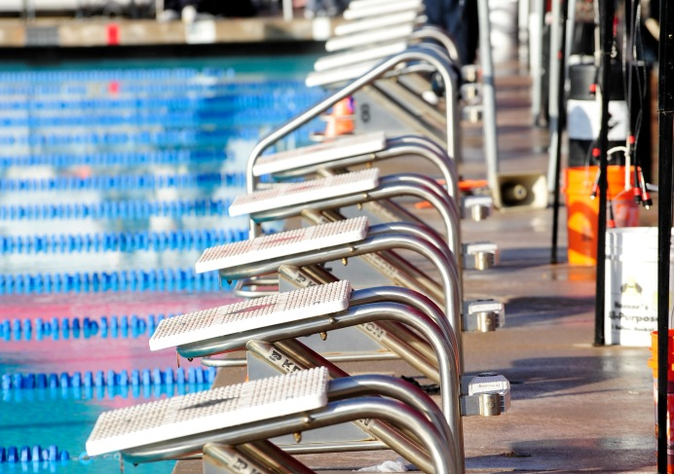
Broad Goals (in order)
Good person
Good athlete
Good teammate
Good swimmer
Most only care about #4

Slide 109

Age-Group Goal Setting
“If you don’t know where you are going, any path will do.”
Goals are critical to maintaining focus and direction, but goal setting should only be a positive aspect to sports and not introduce negative or self-defeating implications.
1) Always begin with Big Picture Goals. They are the most significant part of goal setting and should include:
Attending practice and being on time
Putting in extra time
Training hard
Training smart
Being positive (even in challenging times)
Being enthusiastic
Supporting your teammates in achieving their goals
Acting with integrity
2) Once you feel you have accomplished these goals, move on to more specific goals:
Work on starts
Work on streamlines
Work on turns (always legal)
Speed under water
Work on breathing patterns
Know race strategies
3) After you feel you have been successful with the broader goals, and are willing to commit to specific goals, you should then:
Assess your realistic potential
Talk to your coach
Set goal times (use time standards as guidance)

Slide 110
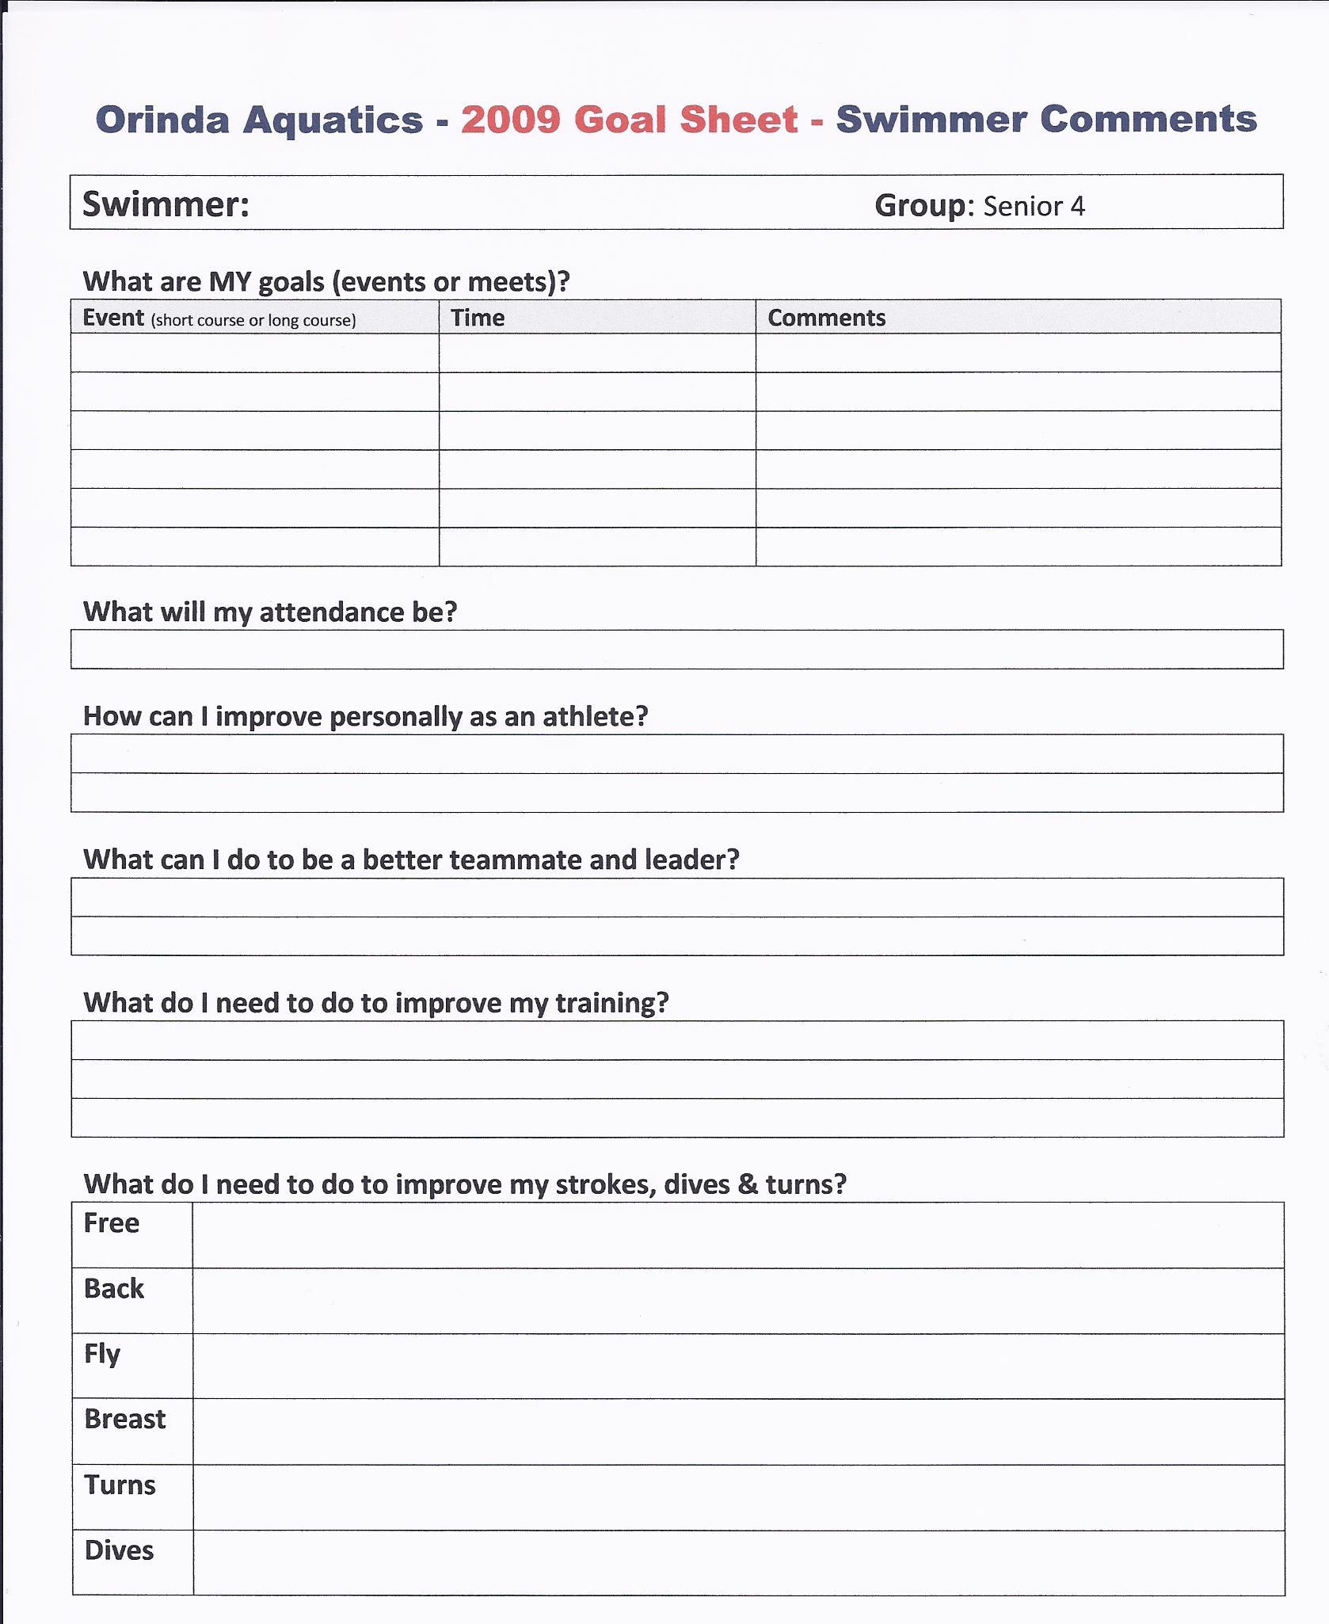
Goal Sheet - Simple

Slide 111
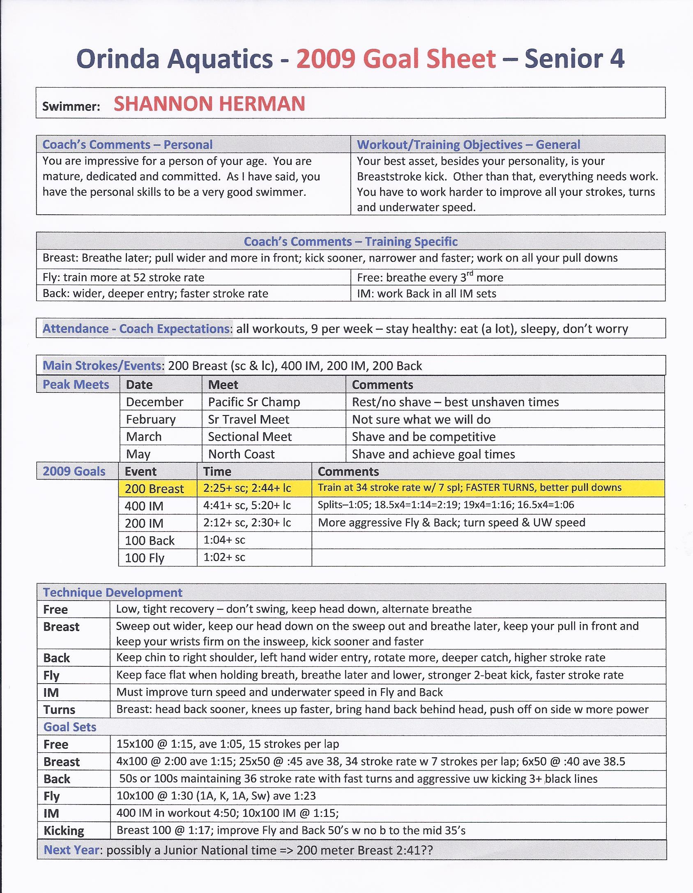
Goal Sheet - Detailed

Slide 112
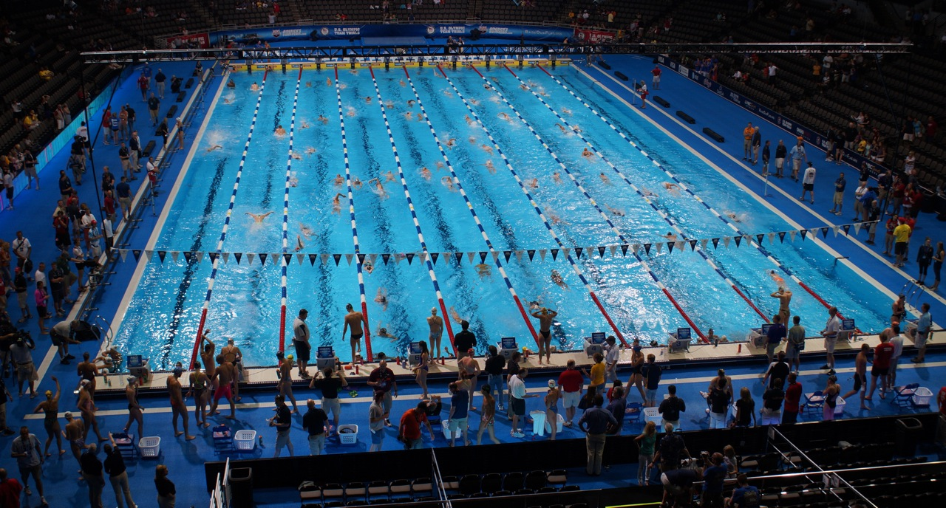
Know what you are training for.

Slide 113

3) Coach Competence
The greatest coaches have been the greatest students.

Slide 114


Do you have ten years of experience or one year of experience repeated ten times?
Get better every day in every area!

Slide 115

Thoughts on Learning/Growing
What do you know?
What don’t you know?
How will you know either?
What is your coaching philosophy based on?
Be an information sponge
ASCA
Information/articles/audio
Schools
Certification
Periodicals
Videos
Websites (all 200 million of them)
Research
Filter information
Meet with head coach regularly
Have a mentor
Be open-minded – do not stay narrow in view or perspective
Visit clubs
Lose ego
Ask for feedback

Slide 116


Meets – another classroom
Watch (the best) kids
In all areas
Team attire
Team area
Warm-up (drills/methodology, discipline)
Warm-down/recovery
Watch races at higher level meets
Starts
Turns
Pacing/race strategy
Breathing pattern
Underwater discipline
Finishes
Dialogue with the coach
Rapport with team
Coach race analysis

Slide 117
Look in the Mirror
Evaluate yourself – who is grading you?
Deck presence
Kids response
To training
To teaching
To you!
Preparation
Athletic evolution of kids
Don’t be naive – know why kids develop
Skill development
Starts
Turns
Legality
Fundamental development
Race development
Relationships with coaches
What parents think about you

Slide 118

There is no excuse. The coach must be accountable for development.
“They don’t get it.”
“They don’t listen.”
“They are immature.”
“They do not understand.”

Slide 119
4) Planning, Organization, & Structure
“Planning is bringing the future into the present.” Alan Lakein

Slide 120
It is said the most people spend more time planning a vacation than they do their life. What about your coaching life, or your team’s life, not day-to-day tasks, but a road map to an incredible environment or culture that breeds character, success, and fulfillment. DH

Slide 121

What to Plan?
Everything!

Slide 122
Some things…
Sets
Tests
Workout
Day
Week
Cycle
Season
Year
Career
Competition plan
Dry land
Activities/social
Swimmer meetings
Parent meetings
Groups
Expectations
Discipline
Relationships
Team success

Slide 123
Workout Organization
Have a workout/group meeting prior to every workout to review;
The workout or main set
The objectives and purpose
Organization and equipment needed
Administrative issues
Reiterate why we are here; swimming, season, sports, life
Get in as a group/team (no individuals)
Always have each swimmer in the proper lane for the right reason
Rotate swimmers based on set objective (get them out on the deck)
Heats (drills/technique/speed)
Stroke Groups (match up)
Random (count off – team building)
Mix ages, gender, group (forced separation)
Interval (threshold/endurance)
Game
Challenge

Slide 124

Continued
Constantly monitor the swimmer’s:
Focus
Integrity
Work ethic
Body language
Response to coaches
Response to the workout
Response to teammates.
Stopping
Talking
Watching clock
Focus, eye contact, support of teammates
Streamline, Stroke Drill, Stroke Rate, Heart Rate
Be willing and ready to alter or change the workout to improve quality.

Slide 125

Workout Rotation Kids are moved (organization) depending on set/focus

Slide 126

Swimmer Notes an expansive spreadsheet with notes, goals, evaluations, etc.

Slide 127

Weekly Training Plan Sample weekly training plan
A weekly schedule of coaching assignments and focus will help with planning.

Slide 128

Swimmer Training Plan Sample swimmer notes
If you have the time and ability to do so, a detailed sheet per swimmer will help with tracking of stroke development and workout performance.

Slide 129


Meet Management
Structure
Entries
Arrival
Stretch
Meeting
Warm-up
Meeting
Racing
Check in with coach
Race
Warm-down
Meet with coach
ALWAYS positive
Find value in every swim – to learn and move forward
Finals – better/faster
Relays even faster
Support team
Team area
Positive
Cheer
Clean up

Slide 130

Staff
General:
Like-minded
Pursue same vision/mission/values
Same development philosophy
Meetings
Conference calls
Ongoing dialogue about kids
Workout
Fifteen minutes early
Engage kids
No sitting/professional
High energy/high caring
Connect
Personal
Technique
Training

Slide 131

The Borders
(Framework)

Slide 132
1) Integrity
Maintains respect/trust on all fronts (better in all areas)
2) Discipline
Maintains structure, focus, effort, and safety
3) Connection
Links coach to swimmer and swimmer to process
4) Culture
Provides a blanket that wraps your team in its vision-wind at your back

Slide 133
The “borders” or framework all connect!
Connection
Discipline
Culture
Integrity
(your)
Puzzle

Slide 134
“Integrity…
has no need of rules.”
Albert Camus
This is a team theme and is repeated constantly.

Slide 135

“One of the truest tests of integrity is the blunt refusal to be compromised.” Chinua Achebe
“Character is that which reveals moral purpose, exposing the class of things a man chooses and avoids.” Aristotle

Slide 136

Integrity Kids must have:
Respect for the athletic process
Respect for team process
Respect for the support process
Respect for the workout/training
Respect for the meet process
Appreciation for everyone and everything

Slide 137

Respect for the athletic process:
Schedules
Training
Effort
Perseverance
Challenge/adversity
Sacrifice

Slide 138

Respect for team process
A greater good
Team goals
Team environment
Team activities
Celebrate the success of others
Team championship meet

Slide 139

Respect for the support process
Coaches (all levels)
Staff
Facility
Parents
Officials

Slide 140

Respect for the training process
On time
Positive
Prepared
Set objectives
Stroke focus
Purposeful
Supportive

Slide 141

Respect for the meet process
Arrival
Attire
Team area (stay, keep clean)
Events, finals, relays
Team support, cheering
Dealing with “poor” swims
Dealing with “good” swims

Slide 142

Ultimate Goal
A leader and a role model

Slide 143
We don’t demand integrity because we want nice kids. What we want are:
Leaders and role models
Elite athletes
People who put the team first
Kids who care
People who we trust implicitly
Athletes who will do what we ask
And swimmers who will maximize their potential and their career

Slide 144
Integrity can be a platform from which all things are drawn.
Technique
Training
Relationships
Careers
Organization

Slide 145
A Perpetual Leadership Model
Elite
Leadership
(required)
Senior
Character-Driven
(no tolerance)
Age Group
Athletic Principals
(implied consent)

Slide 146
How?
Expectations
Accountability
Constant dialogue
Meetings
Articles
Quotes

Slide 147
How does integrity frame your program?

Slide 148

Discipline

Slide 149
“If we do not discipline ourselves, the world will do it for us.” William Feather
“Many of life’s circumstances are created by three basic choices: the disciplines you choose to keep, the people you choose to be with, and the laws you choose to obey.” Charles Millhuff

Slide 150

Everything
is disciplined:
Safety
Behavior
Warm-up
Stroke
Training
Work
Dry land
Meets
Racing

Slide 151

“We are what we repeatedly do, excellence then is not an act, but a habit. ”
Aristotle
“Discipline is the bridge between goals and accomplishments.” --JIM ROHN

Slide 152
How does discipline frame your program?

Slide 153

Connection

Slide 154
Connection
“Build for your team a feeling of oneness, of dependence on one another and of strength to be derived by unity.”
Vince Lombardi

Slide 155
Too often we focus on the wrong thing…
Try to fix a stroke in someone who doesn’t work hard
Condemn a parent without trying to bring them into the process
Try to win a meet with a team that has no identity
Criticize a team for not caring when they don’t know what to care about.
Coaching five disconnected kids is less productive that coaching fifty connected ones.

Slide 156
Coaching (connection) ?’s
Do you view coaching as a job or a privilege?...a little extra money or the opportunity to touch and impact the lives of children?
Are you making a difference in the quality of the swimmer, the group, the team, the culture? Are YOU a role model? Is your job more about you or them?
How do you think kids interpret what you say? Do you connect?
If a parent observed your coaching style, how would they define your “presence” on the deck?
If a parent observed all of the clubs in your area, how would they rate you and your effectiveness on the deck?
Do you watch every swimmer? Does every swimmer know that they are being watched?

Slide 157

Command of Workout
Voice/Communication (it’s not how loud, but how effective)
Explain sets from various locations (ONLY with full attention)
Communicate with everyone from anywhere on the deck
Communicate during turns, breaths, and between repeats
Pull swimmers out of the water (individual, lane, group, or WO)
Position on Deck (be visible, change position, don’t be predictable)
Middle, Corner
Lane by lane
Across the pool
In office or in conversation
Read EVERYTHING
Eye contact, response, body language, etc

Slide 158

Catch phrase (example)
“Let’s be great today”
“Let’s make this the best workout of your life!”
“Be the athlete you envisioned”
What if this had to be the best workout of your life – in every way?
Shock the system (good or bad – no complacency – anything is possible!)
Pizza/Bowling
“Start over”
End workout (for visionary reasons)
Be creative (memorable) – 1,000 yd vertical SL dolphin kick (para)
Safety (1-safety, 2-integrity, 3-productivity)
No one leaves the pool without talking to the coach
The coach is made aware of any problem, issue, etc., immediately
Three point entry/miscellaneous activity
Challenge swimmers every day as athletes, as people, and as a team.

Slide 159
There must be implicit trust between coach and swimmer in all things.

Slide 160
“The best way to lead people into the future is to connect with them deeply in the present.”
James Kouzes and Barry Posner
“There are teachers with a rare ability to enter a child’s mind; it’s as if their ability to get there at all gives them the right to stay forever.”
Michael Lewis, Coach

Slide 161

Levels of Development
Coach runs workout/swimmer shows up
Talk to about stroke (may or may not connect)
Talk to aggressively about stroke
Pull out of water
Watch constantly
Connect personally (care)
Talk about attendance and commitment (link)
Watch demeanor in all aspects
Encourage areas of improvement
Arrive earlier, focus, help more, talk to others
Talk about leadership attributes
Demand leadership skills
Begin giving leadership responsibilities (set up, tasks, lead stretching, etc.)
Explore life/social choices (easy transition) – the “concepts”
From an athletic perspective
From a personal perspective
Give articles, shares a story, talk about past successes
Talk about life skills that are critical to be a “good person”
Relationship with parents
Academics
Mentoring/inspiring others
Demand them (fully connected)

Slide 162
Stages - Macro
Take from name on roster to someone who connects
Take from someone who connects to someone who is committed
Take from someone who is committed to a high-character athlete
Take from a high-character athlete to a high-character person
Take from a high-character person to a leader (and someone you trust implicitly and will do anything for)

Slide 163

Connection to Parents
Partnership with parents/family
Educate, explain, listen, sell
Bring them into the process
Understand their role
Why are they here?
What are they looking for?
What are they expecting?
What do they think about you?
What do they think about the program?

Slide 164
Must be on the same page. Must be connected.
Career
Swimmer
Parent
Coach

Slide 165

The mediocre leader tells.
The good leader explains.
The superior leader demonstrates.
The great leader inspires.
William Arthur Ward

Slide 166
Connection Quiz
Pick three athletes – stronger, mid-level, novice. How “connected” are you?
Attendance percentage
Attendance conflicts
Effort – why
Focus – why
Maturity
General dedication
Leadership potential
Family support
Academic aptitude
Social positioning/skills
Training strengths/weaknesses
Main stroke strengths/weaknesses
Race (main event) strengths/weaknesses
How do they fee about you? (like, respect, etc.)
How do they feel about the team?
Do they help?
Potential as a swimmer
Are they happy?
as a swimmer
as a person

Slide 167

Culture

Slide 168

“That is true culture which helps us to work for the social betterment of all.” Henry Beecher

Slide 169
Culture Questions
What is your culture?
How has it evolved?
By whose vision?
What dictates it now?
Does it foster technical development?
Does it foster work ethic?
Does if foster team pride and spirit?
Does it foster success – at the individual level or the team level?
Does it create a coach-swimmer connection?

Slide 170

You are either flowing down a river or having to paddle - every day.

Slide 171
Over coach
Over care
Create a cultural advantage

Slide 172

Other Pieces of the Puzzle
What are the other pieces of your puzzle?

Slide 173

What are other pieces of your age-group puzzle?

Slide 174

Vision
“Leadership is all about painting the Vision, giving people something worthwhile to follow.” unknown

Slide 175

The glue that holds everything together

Slide 176
Sell Your Vision
Pools don’t change
Buildings don’t change
Institutions don’t change
Organizations don’t change
And for the most part, people don’t either (they will go where they are led).
It is Vision that is the critical variable. But as most of you are visionary, selling it is as important as seeing it.

Slide 177
I don’t have the answers on training or technique. The questions and the answers continue to change, but I do know that this is a profession about service, and about changing lives, and that success will always be driven by an articulated vision. DH

Slide 178

Be Visionary
Can you see/articulate your vision for:
Technique
Training
Staff
Discipline
Integrity
Culture
Relationships
Parents
You
“The most pathetic person in the world is the person who has sight but has no vision.” Helen Keller

Slide 179

A Pop Quiz

Slide 180
Let’s Write a Workout
Goal: (they must get better!)
4,000 for 11-12, 5,000 for 13-14, 6,000 for 15+
Challenging, creative, and interactive
Makes them better and more motivated for the next workout
Add a life lesson/concept (work ethic, attention to detail, team, etc.)
Four short sets
With emphasis on:
Underwater speed, build effort, some speed
Technical stroke cues/triggers (to focus on)
Technical controls: stroke counts, stroke rates, kicks UW (count or kick rate), breathing pattern/breath control
Use three of the following (fins, paddles, parachute, pacer, snorkel, long-belt)
Note: How do you explain it, where do you stand, how do you interact, how do you monitor? How does it fit into you team, training, and plan?

Slide 181

A Near Perfect Race
Steven Stumph
200 Breaststroke
Junior National Record, 1:55.88
Also broke national high school record in 100 Breaststroke at 53.3

Slide 182
Race Review
Goal:
Hold stroke through 125 (40 Stroke Rate/6 Strokes Per Lap – one black line - don’t hurry), “ride the glide”
Was 2nd at 50
Build last 75 (went to 7 SPL) without dropping elbows (note: last 100 was 15.0’s)
Win turns/win last 50
Mistakes?:
Long into walls (hurried stroke early)
Head rode high on pull down and out-sweep
“Built too early”

Slide 183

The Race Preparation
Four years of uncompromising work
Four years of meticulous attention to detail
Four years of unconditional commitment to the team and the process (and to leadership)
Moderate volume/highly efficient training
A positive workout group/team culture
Overcame double hip surgery a year and a half earlier
Coaches who watched him every day and cared deeply for his personal and athletic success.

Slide 184
The Puzzle Pieces all Fit (corners and borders)
Technique (every day, every stroke)
Training (efficient, technique-driven)
Coach Competence (we hope)
Planning - everything
Integrity - impeccable
Discipline - relentless
Connection - fully
Culture – was the leader

Slide 185

The “puzzle” also supported the team ()
No burnout
Highly positive
High character
No disrespect
Highly successful (USA Swimming and high school)
Incredible culture
Travel with 75 teenagers – no chaperones

Slide 186
Puzzle Evaluation

Slide 187


Grade your…
Corner (stones)
Technique
Training
Coaching
Structure
Borders (framework)
Integrity
Discipline
Connection
Culture

Slide 188
Name one thing you can add to each…
Corner (stones)
Technique
Training
Coaching
Structure
Borders (framework)
Integrity
Discipline
Connection
Culture

Slide 189
And don’t forget…
Skill Development
Race development
Athletic maturity
Perseverance
Leadership orientation
Team Commitment
Parent-swimmer relationships
Dry land (fitness/strength)
Injury prevention
Coaching philosophy
Coaching continuity/fluidity
Knowledge/competence
Coaches (prior) experience
Equipment
Facility
Group progression policy/criteria
Academic focus
Efficient training
Fun/activities
Ego management
Board
Time frame (horizon)
Compassion
Local Landscape (of competition)
Parent Education
Culture
Integrity
Discipline philosophy
Workout presentation
Planning
Goals setting process
Coach relationship with Board
Conflict awareness/resolution
Connection to kids
Daily monitoring of activity (all)
Swimmer interaction
Value creation
Passion and perspective
Flexibility
Elite group success
Vision
Financial position of team

Slide 190
How is your assembly process?

Slide 191
Conclusion

Slide 192
Some things you do as coaches…
Communicate clearly to (different age groups)
Remain positive - everyday
Deal with pressure - everyday
Be energetic (everyday)
Be creative
Analyze (every meet)
Organize large groups
Supervise large groups
Occasionally, deal with the unreasonable
Teach (various age groups and ability levels)
Motivate (various age groups and ability levels)
Negotiate (with various ages and personality types)
Manage staffs
Discipline (various ages and personalities)
Plan (short-term and long-term)
Set goals (short-term and long term)

Slide 193
Main things you do…
Challenge the human spirit
Challenge physical potential
Create and sell a vision
Be a dealer in hope
Fulfill lifelong dreams

Slide 194
And of course,
Assemble a puzzle,
every day!

Slide 195

What really matters in coaching, and in life…
Passion/drive
Perspective
Knowledge
Integrity
Caring
People
Culture

Slide 196
My Fortune Cookie
I have a fortune from 25 years ago that still sits on my desk. It says:
“Depart not from the path which fate has assigned you.”

Slide 197

I wish you the very best in your “assembly” (on the path which fate has assigned you)

Slide 198
Thank you!
Don Heidary
Orinda Aquatics
OrindaAquatics.org
OAswimcoach@aol.com

Slide 199
Questions?

Slide 200
Notes/To-do:

