Slide 1
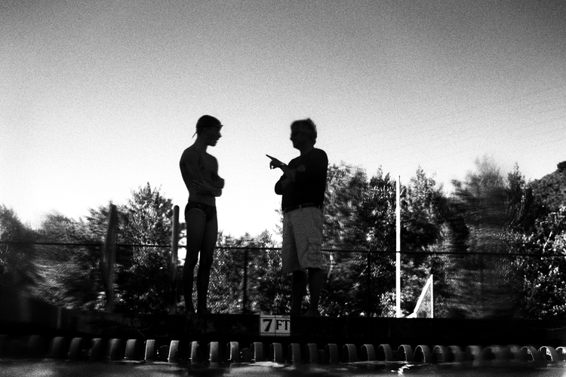

The Art of Athlete Management
Don Heidary
The World Swimming Coaches Association
June 12, 2024

Slide 2

We know – not really very interesting. You want drills, sets, and… cool stuff
This miiiiiiiiiiiiiiiiiiight be even better!

Slide 3

“This is a program where lives are changed the moment one steps on deck. The program, fostered and lived by, for 25 years, teaches children to be a good teammate, friend, leader, and person, and yes, even a great athlete and swimmer. I have spoken and met with dozens of alumni from different graduating classes, while their journeys may differ, they all had the same message - It was the life lessons, the encouragement, the tough love, the support, work ethic, the selflessness. the kindness, the belief they had in each person, the love and laughter. I am personally changed and continue to strive to do better and be better.”
Testimonial
This is athlete (and life) management at a high level, where it matters most.

Slide 4


Viewing and analyzing the athlete from every angle
To connect everything

Slide 5
Bio –
45 years of experience
Summer-league
High school
Orinda Aquatics, USA Swimming
ASCA Board (taught Level 1, 2, 4, 5)
WSCA Board (Coach Education)
All programs have been:
Culture-driven
Performance-driven
Highly successful
And all have been relationship driven by high-level athlete management

Slide 6
from roster
to high-level athlete
to leader

Slide 7

Why is it important?
It ties the coach to the athlete
It ties the athlete to the process
It builds accountability and culture
And it gives the greatest chance to reach one’s potential (in swimming and in life).

Slide 8

- How well do you know each athlete? - How well should you know each athlete? - What do you track and monitor? - Is your evaluation and management at a level that transforms your culture and performance?

Slide 9

Have a vision of each swimmer as a high performing (to potential) athlete and a leader/role model. And then, “manage” your way to both.

Slide 10


An exercise – Choose a mid-level athlete As we move through these areas, see how well you know that athlete

Slide 11
Areas of athlete management and oversight

Slide 12

The roster Athlete/Group evaluation

Slide 13
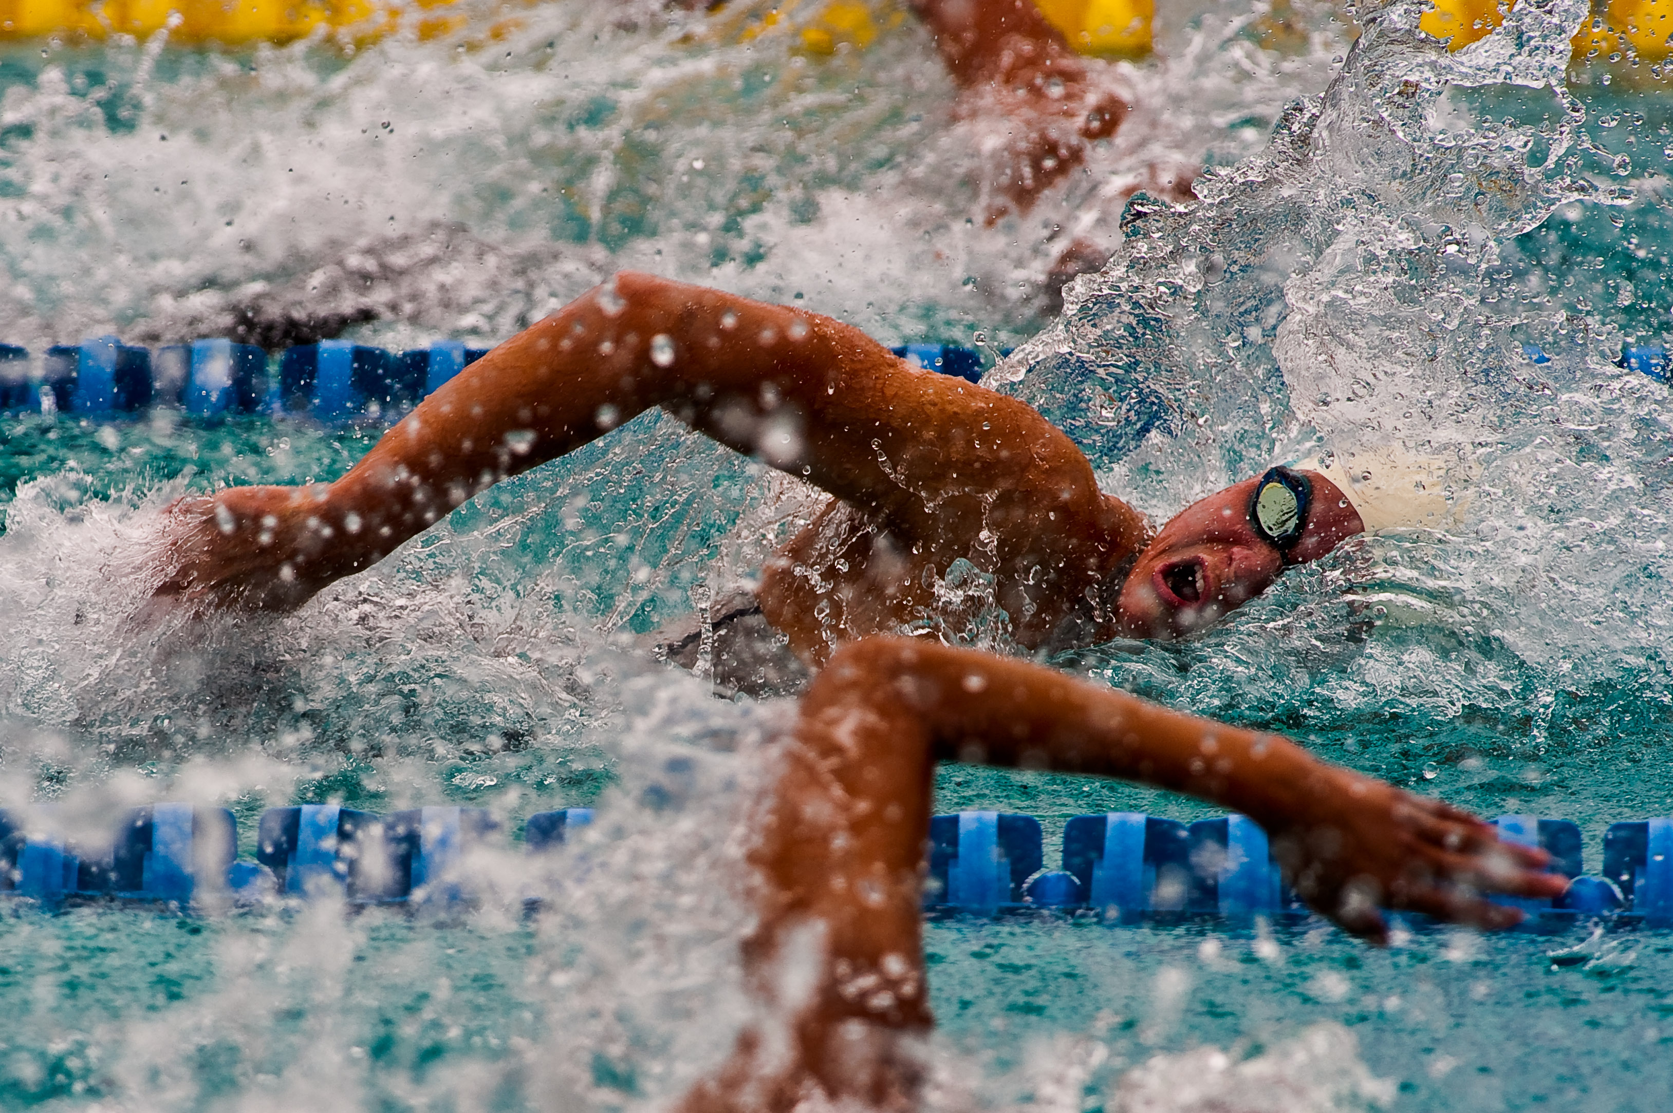
The roster Group evaluation Technique evaluation Training evaluation/test sets & set tracking

Slide 14
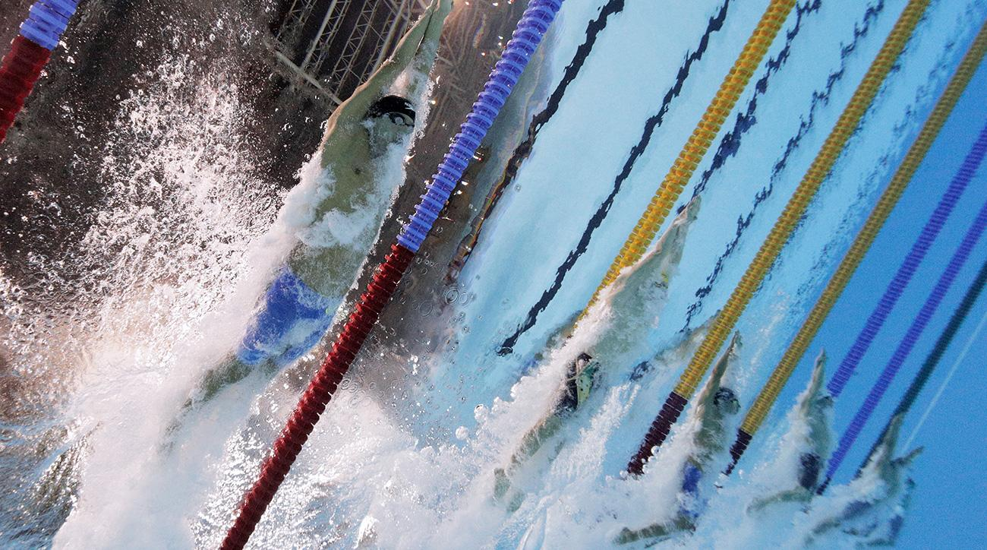
The roster Athlete/Group evaluation Technique evaluation Training evaluation/test sets and tracking Meet plan and evaluation Race plans (review & analysis) Goals - Short-term and Long-term

Slide 15
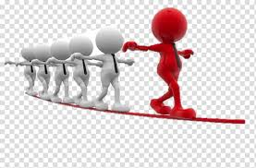
The roster Athlete/Group evaluation Technique evaluation Training evaluation/test sets and tracking Meet plan and evaluation Race plans (review & analysis) Goals - Short-term and Long-term Key to personal growth/leadership Keys to performance development Knowing and supporting any personal of family issues

Slide 16

The roster Athlete/Group evaluation Technique evaluation Training evaluation/test sets and tracking Meet plan and evaluation Race plans (review & analysis) Goals - Short-term and Long-term Key to personal growth/leadership Keys to performance development Knowing and supporting any personal of family issues Weekly/Monthly notes Parent issues/note Misc: Buddy/Mentor relationships, job, etc.

Slide 17
The roster Athlete/Group evaluation Technique evaluation Training evaluation/test sets and tracking Meet plan and evaluation Race plans (review & analysis) Goals - Short-term and Long-term Key to personal growth/leadership Keys to performance development Knowing and supporting any personal of family issues Weekly/Monthly notes Parent issues/note Misc: Buddy/Mentor relationships, job, etc. College support/status Relationship evaluation Character/leader/trust evaluation

Slide 18
The roster Athlete/Group evaluation Technique evaluation Training evaluation/test sets and tracking Meet plan and evaluation Race plans (review & analysis) Goals - Short-term and Long-term Key to personal growth/leadership Keys to performance development Knowing and supporting any personal of family issues Weekly/Monthly notes Parent issues/note Misc: Buddy/Mentor relationships, job, etc. College support/status Relationship evaluation Character/leader/trust evaluation Meeting management/daily check-in

Slide 19

Let’s look at each

Slide 20
The Roster
Name (preferred) | Health/injury
Address, phone, etc. | Gear (all)
Age, grade, age-up | Equipment (all)
School (high School) | Came from…
Parent/emergency | Reason joined…
Buddy assigned | Received gear

Slide 21
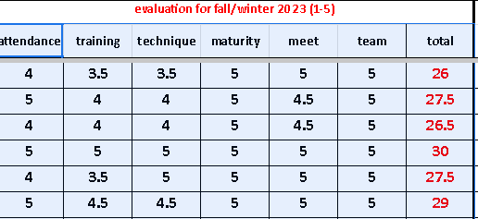
Athlete/Group Evaluation
Six Areas | 1-5 | Note
Attendance | 4.5 | Misses occasionally for church
Effort | 4 | Does a good job but could push harder
Technique | 3.5 | New to the team, strokes are short and off balance
Maturity | 5 | Extremely mature (and humble and caring of others)
Meet Commitment | 4.5 | Attends all meets. Should swim more off-stroke events and distance
Team Commitment | 5 | An innate leader who looks to help at all times
Group Note: 1) fit, 2) move up candidate, 3) move down candidate

Slide 22
Level |  | Note | summer comment | attendance | training | technique | maturity | commitment | total | attendance | training | technique | maturity | commitment | total
Futures |  | good | training better | 4 | 3.5 | 4 | 5 | 4.5 | 21 | 4 | 3.5 | 3.5 | 5 | 4.5 | 20.5
Futures |  | good | training better- shoulder | 4 | 4.5 | 4.5 | 5 | 5 | 23 | 4 | 4 | 4 | 5 | 4.5 | 21.5
Jr Nat |  | good | training better | 5 | 5 | 5 | 5 | 5 | 25 | 4.5 | 5 | 5 | 5 | 5 | 24.5
Futures |  | good | some shoulder issues | 4 | 4 | 4.5 | 5 | 5 | 22.5 | 4 | 3.5 | 4.5 | 4.5 | 5 | 21.5
Sectionals |  | good | needs help w all strokes | 4 | 4 | 4 | 5 | 5 | 22 | 4 | 4 | 3.5 | 5 | 5 | 21.5
Futures |  | good | generally good | 4.5 | 5 | 4.5 | 5 | 5 | 24 | 4.5 | 5 | 4.5 | 4.5 | 5 | 23.5
Sectionals |  | Campo? | working on Free | 3.5 | 3.5 | 4 | 3.5 | 4 | 18.5 | 3.5 | 3.5 | 4 | 3.5 | 4 | 18.5
Jr Nat |  | good | lots of physical & emotional issues | 3.5 | 3.5 | 5 | 4 | 4 | 20 | 4 | 4.5 | 4.5 | 4 | 4 | 21
close to Sect |  | attend? | Bk sets good | 2.5 | 3.5 | 3.5 | 5 | 3 | 17.5 | 2.5 | 3.5 | 3.5 | 5 | 3 | 17.5
Futures |  | good | Improving UW | 4 | 3.5 | 4 | 5 | 5 | 21.5 | 4.5 | 3.5 | 4 | 4.5 | 5 | 21.5
Jr Nat |  | attend? | training better | 4 | 4 | 5 | 4.5 | 4 | 21.5 | 3.5 | 4 | 4.5 | 4 | 3.5 | 19.5
Sectionals |  | good | working hard | 4.5 | 5 | 5 | 5 | 5 | 24.5 | 4 | 4.5 | 4.5 | 4 | 5 | 22
Sectionals |  | good | Free training ? | 2 | 2.5 | 3.5 | 5 | 5 | 18 | 2 | 2.5 | 3.5 | 5 | 5 | 18
close to Sect |  | good | great kid - DPS | 3.5 | 3.5 | 4 | 5 | 5 | 21 | 4 | 3.5 | 4 | 5 | 5 | 21.5
Sectionals |  | good | good- uw & kick poor | 3.5 | 3.5 | 4 | 5 | 5 | 21 | 3.5 | 3 | 4 | 5 | 5 | 20.5

Slide 23
Technique Evaluation
Stroke | Note
Fly | Hands cut in on entry and slide outside of body. Needs to set wider to find rhythm and power. Work 2-bt kick.
Back | Right arm over-reaches (lift up and push out), get head back, left pull is too deep and straight
Breast | Out sweep is too wide, and head rolls up too early. Narrow kick.
Free | Left arm crosses under body on breath, breath is high and late, right arm pull releases early.
Turns | Open turn – head too high, draw heels into hips. Flip turn – head drift deep (tighten rotation)
Starts | Chin is tucked on exit, legs are relaxed on entry
You can grade each stroke OR each segment of the stroke – catch pull, recovery, entry, head position, breathing, etc.
For each stroke, every athlete should know:
Three stroke keys specific to their stroke
Three general stroke keys (to a perfect stroke)
THE MAIN THING
Additionally
Turn keys (and cross-over turn)
Start keys
Underwater keys
Filming: Has the athlete been filmed?

Slide 24
Training Organization/Tracking
Name | 1x25 UW Str | 1x100 str K | 1x200 str K | Threshold Fr - Interval, SC, HR | Threshold Str – interval, SC, UW, HR | Speed Fr 5x100 @ 2:00 | Speed Str 8x50 @ 1:00 | Challenge Set 20x100 @ FPSO | Pace Sets 16x50 @ FPSO (4-fr)
Jason | 14.5 | Br 1:30 | 3:20 | 100’s @ 1:15, 14, 178 | 50’s free @ 35 – held 31, 12SPL
Susie | 13.9 | Fly 1:22 | 2:58 | 100’s @ 1:20, 13, 188 | 50’s bk @ 35 – help 38SR, 8KUW
Bobby | 16.1 | Fr 1:19 | 2:52 | 100’s @ 1:20, 15, 168 | 50’s @ 40 breast – help 37 w/ 6SPL
Other things to track in training sessions are:
Turn time
Pull-down distance (one full)
SCAT (stroke count and time 50’s)
Turn Master sets
100/200 breast at 3 strokes per lap)
100 back at 15m each wall
Target stroke rates, stroke counts, and kick counts in pace sets
Mile and or 800 IM (fins)

Slide 25
 | Sr 3/2 - 20x100@ 115 - 1/9 | Sr 3/2 20x100 3/20 |  |  |  |  | Sr 3/2-20x50 fpso 1/10
3x100 Free desc; int, times, SC | En2 Free 100s: #, int, ave, sc | 20x100@1:20 | En3 Free 300: time, sc | En2 Stroke 100s: stroke, #, int, ave | En3 Stroke 300s: stroke, time | FPSF Free 100s | FPSF Stroke | Sp1 100 Free CU 8/10 spl
1:15; 04--02-01; 14 spl | 12x100 @ 1:15, ave 3, sc 14 |  |  | Fly; 12; 1:30; ave 12 | Fly ?? - 25 1A/50 Sw | 5x100 @ 1:10 - good ave | 4x50 Fly @ :40 | 1:01
1:15; 03--02-01; 14 spl | 12x100 @ 1:15, ave 3, sc 14 |  | 3:06 - 14 spl | Back; 12; 1:20, ave 8 | Back 3:20 | 5x100 @ 1:10 - good ave | 5x100 Bk @ 1:15 | 1:02
1:15; 02-00-58; 13 spl | 12x100 @ 1:10, ave 3, sc 13 |  | 3:02 - 13 spl | Back; 12; 1:15 - ave 6 | Free 3:00; Back 3:10; Breast 3:55 | 5x100 Fr @ 1:05 - ave 1:01 | 5x100 Bk @ 1:10; 3x100 Bt @ 1:20; 3x50 Fly @ :35 | 57
1:15; 02-01-58; 13 spl | 12x100 @ 1:10, ave 3, sc 13 |  | 3:02; 13 spl | Fly; 12; 1:20; ave 12 | Fly 3:30 - 25 1A/50 Sw | 5x100 Fr @ 1:05 - ave 1:01 | 3x50 Fly @ :35 | 58
1:15; 02-01-59; 13 spl | 12x100 @ 1:10, ave 3, sc 13 |  | 3:04 - 13 spl | Fly; 12; 1:20; ave 10 | Fly 3:25 - 25 1A/75 Sw | 5x100 Fr @ 1:05 | 5x50 Fly @ :35 | 57
1:15; 58-55-53; 13 spl | 12x100 @ 1:10, ave 58, sc 13 |  | 2:55 - 13 spl |  | Free 2:55 | 5x100 Fr @ 1:00 |  | 52
 |  |  |  | Fly; 12; 1:20; ave 8 | Fly 3:25 - 25 1A/75 Sw | 6x100 Fr @ 1:05 | 5x50 Fly @ :35 | 59
1:15; 00-58-55; 13 spl |  |  | 2:59 - 13 spl | Fly: 12; 1:20; ave 8 | Fly 3:20 - 25 1A/50 Sw | 6x100 Fr @ 1:05 - 13 spl | 5x50 Fly @ :35 | 54
1:15; 03--02-01; 14 spl | 12x100 @ 1:15, ave 3, sc 14 |  |  | Back: 12: 1:20; ave 9 | Back 3:30 | 4x100 @ 1:05 | 4x100 Bk @ 1:15 | tbd
1:15; 58-55-53; 12 spl | 12x100 @ 1:10, ave 58, sc 12 |  | 2:54 - 13 spl | Breast; 8; 1:15; ave 8; 5 spl | Breast 3:30 - 5 spl | 4x100 Fr @ 1:00 | 3x100 Bt @ 1:10 | 52
1:15; 05-03-01; 14 spl | 12x100 @ 1:15, ave 3, sc 14 |  |  | Back: 12: 1:15; ave 6 | Back 3:17 | 5x100 @ 1:10 - good ave | 5x100 Bk @ 1:10 | 1:02
1:15; 00-58-54; 13 spl | 12x100 @ 1:10, ave 58, sc 13 |  | 2:58 - 13 spl | Fly: 12; 1:20; ave 5 | Fly 3:30 - 25 1A/50 Sw | 6x100 Fr @ 1:05 - 13 spl | 5x50 Fly @ :35 | 55
1:15; 01-59-57; 13 spl | 12x100 @ 1:10, ave 2, sc 12 |  | 2:59 - 13 spl | Back: 12: 1:15; ave 4 | Back 3:15 | 5x100 @ 1:05 | 6x100 Bk @ 1:10 | 55
 |  |  |  |  | Kick 200 Back |  |  | tbd
1:15; 01-59-57; 13 spl | 12x100 @ 1:10, ave 0 sc 13 |  | 2:56 - 13 spl | Fly; 12; 1:20; ave 9 | Fly 3:25 - 25 1A/50 Sw | 10x100 Fr @ 1:05 - 13 spl | 5x50 Fly @ :35 | 56
1:15; 03--02-01; 14 spl | 12x100 @ 1:15, ave 3, sc 14 |  |  | Fly: 12; 1:20; ave 12 | Fly 3:30 - 25 1A/50 Sw | 3x100 Fr @ 1:05 | 4x50 Fly @ :35 | 1:00

Slide 26
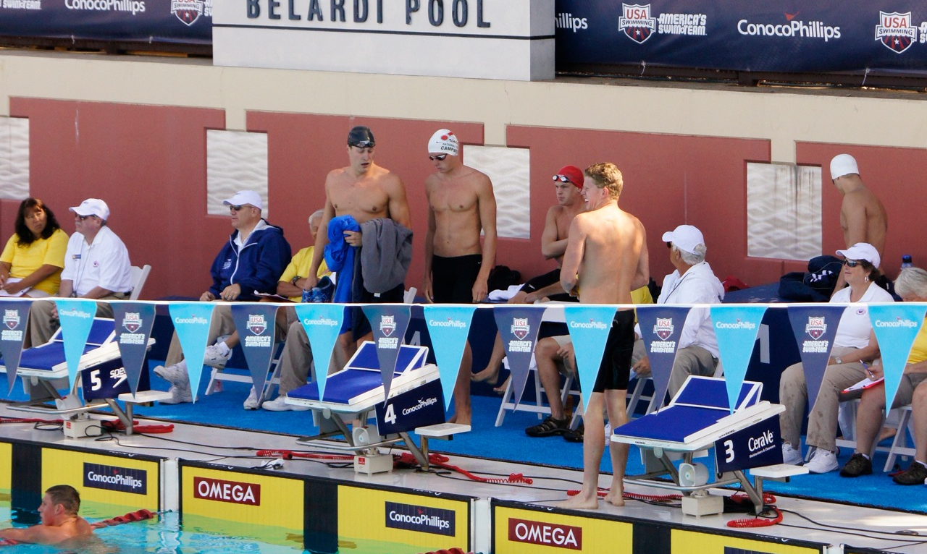
Meet Plan
-Here, have the calendar laid out with all meets and open weekends.
-Code (color) each meet by regular (swim through), short rest, peak (taper/shave)
-List events by day below the meet name and make entry notes
After each meet, make notes on good, bad, etc. including meet process and race quality
The plan and the notes should flow to high-level performance

Slide 27
League Meet events | League meet notes | North Coast events | North Coast notes | Walk On Meet SCY | Walk On Meet LC
 |  |  |  | SAME ORDER SC/LC: 200 Bt, 100 Fr, 200 Bk, 200 Fly, 200 Fr, 200 IM, 100 Bk, 500 Fr. 100 Bt, 100 Fly, 400 IM, 50 Fr, 1650
April 28-30 |  | May 6-7 |  | May 8 | May 8
50 Fr 24.2, 100 Fly 57.3 | fast suit, no shave | 50 Fr, 100 Flly | goal top 8, best times | decided not to go | 100 Fr, 100 Fly, 50 Fr
100 Fly 56, 100 Back 57 | prelims only, fast suit, no shave | 100 Fly, 100 Bk | top 8 Fly, Back ? | decided not to go
200 Fr 1:52, 100 Bt 1:04 | T reg suit, F fast suit, no rest | 200 IM, 100 Bk | IM 2:01 win, Bk 55 | 200 Bk, 100 Fly, 50 Fr | 100 Fr, 200 IM
200 Fr 1:53, 100 Fly 55.9; 200 FR LO 23.8 | T reg suit, F fast suit | 50 Fr, 100 Fr | 50 23.5, 100 50.9 | decided not to go | 100 Fr, 200 IM, 100 Bk
200 IM 1:58, 500 Fr 4:56 | fast suit trials, shave for finals | 200 IM, 500 Fr | consol IM, | 400 IM, 200 Fly, add ?
200 Fr 1:43, 100 Fly 53 | fast suit trials & finals, no shave | 200 Fr, 500 Fr | 200 final, 500 4:38 | 100 Fr, 100 Fly, add 50 | 200 Fr, 50 Fr
200 Fr 1:45.0, 100 Fr 48 | fast suit trials & finals, shave | 200 Fr, 100 Fr | 200 1:44 consol | 100 Fr, 200 Fr, 100 Bt | 100 Fr, 200 Fr, 50 Fr
200 IM 2:05, 100 Fly 55. | T fast suit - no finals | 200 IM, 100 Fly | IM 2:03 3rd, Fly 54 win | did not enter | 200 Fr, 100 Bk, 50 Fr
200 IM 2:01, 500 Fr 5:02 | fast suit trials, shave for finals | ? | IM ? | did not enter
100 Fr 52.6, 100 Bt 1:04.6 | fast suit trials, shave for finals | 100 Fr, 100 Bt | 100 Fr 52 consol, Bt 1:04 final | 100 Fr, 100 Fly, 50 Fr | 100 Fr, 100 Bt
reg suit 100 Fr 46, 50 Fr 21 | T reg suit, F fast suit | 50 Fr, 100 Free | 50 20.4, 100 44 low win | did not enter
200 Fr, 1:47.5, 500 Fr 4:46.1 | prelim only - shave | 200 Fr, 500 Fr | 200, 500 best times | 200 Fly, 1000 Fr
200 Fr, 500 Fr | fast suit trials, shave for finals | 200 Fr, 500 Fr | 200, 500 best times | 200 Bk, 200 Fly, 1000 Fr | 100 Fr, 100 Fly
200 IM 1:58, 100 Fly 52; Fr split 48.2 | fast suit trials, shave for finals | 200 IM, 100 Fly | IM 1:57 consol, Fly 51 consol | 200 Fr, 100 Bt, add ?

Slide 28
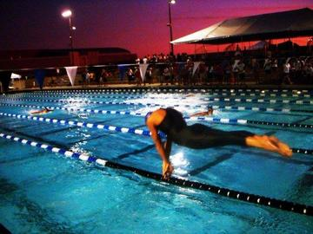
Race Plan
Event | Keys | Pace | SR/SC | UW | Breathing
200 back | Tempo/UW | 16.0 | 40 through 150, 42 at 175, close at 44+ | 10KUW to breakout ahead, then 7-8, close at 10 | na
100 fly | Stay long, UW | 14.0 | 55/7-8 (tbd) | 12 (15m), 8/8/10 | 1 up/1 down, breathe into wall but not on breakout
500 free | Hold DPS and balance, controlled early | 15 low; build last 75 | 38 SR/14 SPL | 3 kicks | Third – two to a side
Each swimmer should be able to articulate a race strategy (that should be trained for), in the above areas
Each race should be reviewed against that plan, and NOT by time alone.

Slide 29
Goals – Short Term and Long-Term and career management
Event Swimmer is 14 yr-old female | ST Goal | LT Goal | Note
100 back | 55+ | 53+ (Junior Nat’l) | MUST get better UW
200 back | 2:02.9 | 1:58+ (Junior Nat’l) | Must train at a higher level and maintain SR >40
100 fly | 59+ | 56+ | Much better UW, better landing
50 free | 24.5 | 23 low | Better UW, better left arm catch
Career Management
-athlete is 14 years-old, entering high school
-wants to swim at a high level
-is injury prone
-DO NOT overtrain; stay technique and UW focused; keep engaged

Slide 30


Keys to Performance Development
Always know and convey (macro) keys to development. These should be the primary drives to accelerated success. Examples might be:
General strength
Distance-per-stroke
Improve underwater endurance/speed
Better race pace

Slide 31

Keys to Personal Growth
These should be the primary drivers that elevate an athlete's maturity and growth. Examples might be:
Resilience
Self-confidence
Communication
Play a leadership role

Slide 32


Personal/Family Issues Are you aware? Can you help (lean in)?
Marital issues
Parent illness
Bullying at school
Depression
Health issues
Negative friend influence
Even ego needs management

Slide 33
Weekly/Monthly Notes
Track any relevant updates relating to technique improvements, good sets, issues, injury, attendance, etc.
This can prove to be a valuable resource at the end of the season or for a mid-season or parent meeting
wk Sept 18 | wk Sept 25 | wk Oct 2 | wk Oct 9
working on straight arm fr & uw - much better | good - worked on Fr head position, straight arm recovery, uw kick | missed all week - Caro trip; recruit trip to Williams | sick much of the week
Bk kick much better | ok - needs to work harder; sick most of week | back from being sick; ok | talked to me about sleep issues
training all strokes; Bk MUCH better | good - Bk sets working on all strokes & uw | training really well; much better Bk sets; Fri shoulder sore | MUCH BETTER BK & FLY - a focus for IM; Bt is very good

Slide 34
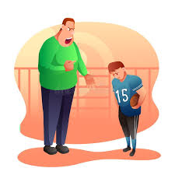
Parent Issues/Involvement
Parent’s’ involvement (absent or aggressive)
Pressure at home (threats to quit)
Critical of staff
Negative with other parents
Making meet/event decisions for athlete
“Coaching” their child
Etc., etc.
Keep notes

Slide 35

College Support (Juniors in High School)
General meeting (all)
Parent meeting (all)
Individual meeting
Parent meeting (athlete)
College list
Help with coach communication
Write letter of recommendation
Reach out to college coaches
Help with decision

Slide 36

MISC:
Track miscellaneous things like each athlete’s:
Big (or little) buddy
Group mentor or mentee
Job or workout responsibility such as; lane lines, pool covers, send-off’s, flags, locker room, dry land, new member support, etc.

Slide 37

Relationship Evaluation
Always know the depth of your relationship with each athlete (and why). Make every effort to close the gap with those you are not close to. You can track 1-5.

Slide 38


Character/Trust Evaluation
You should always evaluate athletes (kids) on a character/trust basis. This will become the iron-clad foundation of your program and team. It can be a simple 1-5 scale. The goal is all 5’s!
Do you trust the athlete implicitly?
Would you trust them if left a lone at a workout (I know, Safe Sport)
Would you trust them left alone at a hotel (teen)?
Would they make an outstanding team captain?

Slide 39

Meeting Management/daily check-in
Plan weekly meetings to connect larger messages to the group as a whole and to each athlete:
character/leadership
season plans
areas to improve
race strategy
Have daily check-in evaluations
How are you doing?
Workout grade?
Athlete: “A-”; Coach: “more like a B”

Slide 40

Conclusion
With adept and focused athlete management, and a 360-degree view, you will elevate:
Coach-athlete relationships
Athlete-team relationships
Athlete connection to the sport and process via-
Attendance, focus, and effort
Accountability
Career longevity
Aaaaaaaand performance

Slide 41
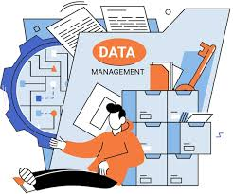
Process/Systems
Decide what to track
Decide how to track (excel/Google Sheets, other)
Decide when to track (which day of week)
Set elevated system for age-group, senior, national
Be consistent
Adjust process each year

Slide 42


Thank you! Questions?
Good luck with your athlete management!

