Slide 1



What Makes a successful age-group coach
The Needed Skills and How to Acquire Them
ASCA Age-Group Coaches Clinic
August 2015, San Diego, CA
Don Heidary, Orinda Aquatics

Slide 2
Speaker Bio
Summer League (20 years)
  Aggressive stroke-work coaching (in water lessons)
  Relationship-driven
  Aggressive teambuilding culture
High School (30 years)
  Aggressive culture/spirit focus
Orinda Aquatics (20 years), Founder
  170 year-round swimmers
  Culture driven/integrity-based
  VCC – 34th this year
  No discipline issues (100 teenagers)

Slide 3

“This is the true joy in life, the being used for a purpose recognized by yourself as a mighty one; the being a force in nature...” unknown
“I am of the opinion that my life belongs to the whole community, and as long as I live it is my privilege to do for it whatever I can. I want to be thoroughly used up when I die. For the harder I work, the more I live. I rejoice in life for its own sake. It is a sort of splendid torch which I have got hold of for the moment, and I want to make it burn as brightly as possible before handing it on to the next generation.” George Bernard Shaw
This is the way great coaches (and servants) think.

Slide 4

Performance is obvious, but what if you were responsible for...
Keeping attendance high
Retention
Kids’ emotional state
Career longevity
Intelligent racing
Injury prevention
Culture building
Embraced work ethic
Leadership orientation
Team values
Love for the sport
Athletic maturity
Team support/camaraderie
Academic performance
Earning unconditional trust and respect
Swimmer connection
College careers
The integrity of your workout
Parent education
Conflict resolution
Swimmer discipline
Swimmer demeanor at meets
Stroke development methodology
Locker room culture
Staff/BOD relationships
Key skills could be the transformative part of a young athlete’s career and of a young coach’s career.

Slide 5
“but that’s not swimming”
While you may not see these as relevant, if your goal is to develop healthy, positive, and highly productive careers, teams, and cultures, they are critical.
Over trained kid burns out
Undertrained kid doesn’t reach potential
A great kid begins to hang out with a bad influence
Parental pressure breaks a kid emotionally
Ego erodes swimmer’s team commitment and sense of self
Major stroke inefficiencies are not corrected
Local team recruits your kids. Parents see better value away.
Swimmer gets injured (due to poor technique/dry land)
Discord with the BOD forces a passionate coach off the staff
Staff members at odds
Outburst at swimmer damages relationship
Coach doesn’t feel “ownership” – doesn’t care
Talented swimmer does not connect with coach
Top two star swimmers don’t get along – causes division in locker room/group
Low numbers equals low pay – coach leaves
No role models
A bullied swimmer quits
BOD wants kids to have “fun”, you want to win
BOD wants to win, you want to have fun

Slide 6
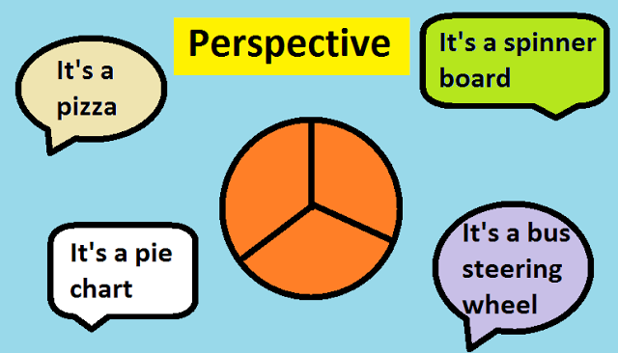


A Macro View
Do you learn more or teach better?
Do you swim more or training more efficiently?
To you draw kids in or weed kids out?
Are you a partner or an employee?
Do you coach talent or potential?

Slide 7

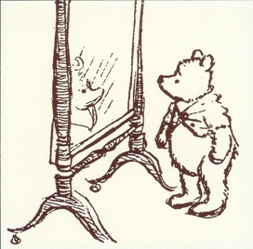
So, what does make a successful age-group coach?
What is your list? (list three)
What is the best thing you do as a coach?
In what area do you need to develop?

Slide 8

It’s All There
Swimming Technique – 34.4M
“Best” Swimming Technique – 28.7M
Swimming Training – 166M
“Best” Swimming Training – 158M
“Age-Group Swim Coaching Skills Needed to be Successful” - ~2,800,000
So I will quickly go through them
Notes:
So I will quickly run through 2.8M slides

Slide 9
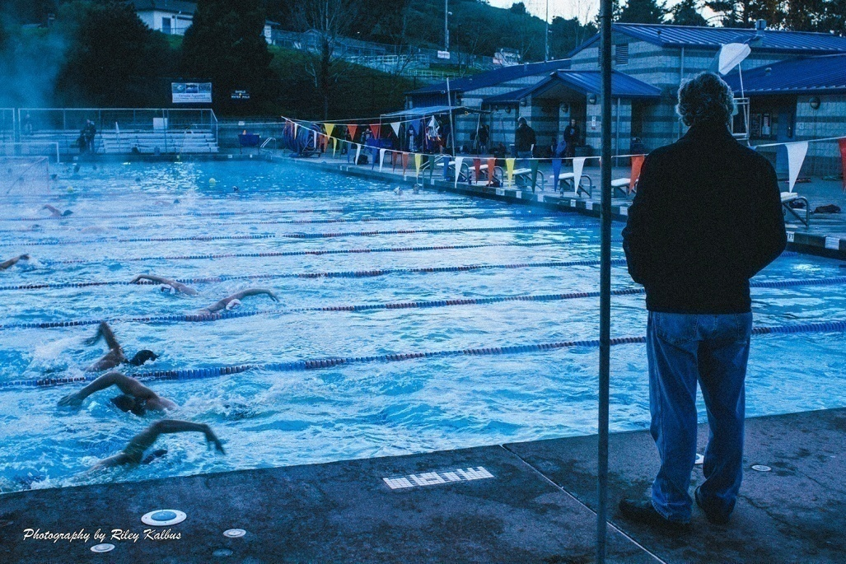
A Question?
If you had the best drills/technique and the best training plan (of all 200 million), would you produce the best swimmers, or elite athletes?

Slide 10
Another question for you...
If the same workout (and drills) was given to each of you…
Would there be 100 different experiences?
How would the workouts differ in effectiveness?
How would the swimmers respond? Why?
What if you did that for a month? A season? A career?
Is it possible that with the same information, some will achieve greatness and others will languish or quit?
What lies behind the “numbers”, the set?

Slide 11


If the information is there, why isn’t every age-group program great?
And what else is there to coaching and developing young athletes?

Slide 12


Spread the Wealth (?)
Secrets of the Millionaire Mind
Resource, knowledge, and success flow to a rare few
If this is true, what do they know that is not on the internet?

Slide 13

Regarding you, why do you coach?
No other job?
I was a good swimmer. Natural path?
Not sure what I really want to do?
Fits schedule
Money?
I'm good at it (I think)
Love children
Like teaching/swimming
Highly competitive (want to win)
Love teambuilding
Want to impact the lives of children

Slide 14


What is Your Development Plan?
Just figure it out
Read a lot
Watch others
Have an internal mentor
Have an outside mentor
I know everything!
You MUST have a growth plan!
Do you have 10 years of experience or 1 year of experience repeated 10 times?

Slide 15

What is your Career Plan?
No change
Become a Senior Coach?
Move to a bigger team?
Smaller ream?
Become a Head Coach?
Change careers?

Slide 16

What is Your Measure of Success?
Happiness (theirs)
Happiness (yours)
Keeping a job
Money
Like the people you work with
Performance (individual)
Team success
Team culture

Slide 17

Your Life in Terms of...
(is this working?)
Career
Passion
Family
Finances
Fulfillment
Purpose
If you could write your life’s story, is this it? What is?
If you could write your “hero’s journey”, is this it? What is?
Is this your “dent” in the universe?

Slide 18


(As a coach) Are you happy?
If yes, why?
If no, why not?

Slide 19
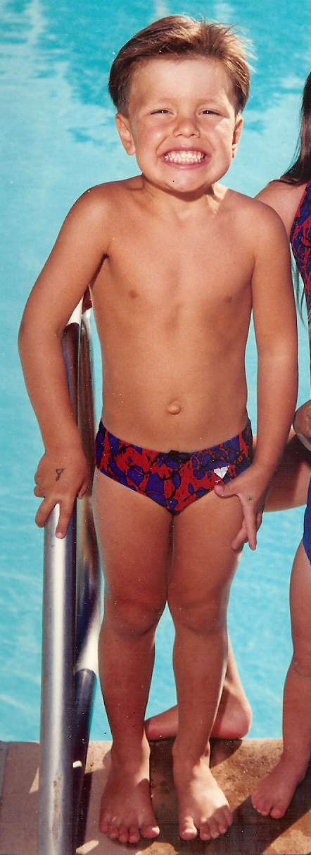
Cute kid!
What next?
(you will dictate)

Slide 20
What does he want to get out of sports? fun, friends, success, life skills, scholarship, self-esteem, glory…
What do his parents want out of sports for him?
Who will he become as an athlete and as a person through sports?
  A leader and role model?
  Burned out, disconnected, or socially adrift
Will he reach his true potential? When? How? How will you know?
Will he make your team better? Inspire others?
Will swimming make him a better person?
Will he be competing five years from now?
What will he reflect on twenty years from now?

Slide 21
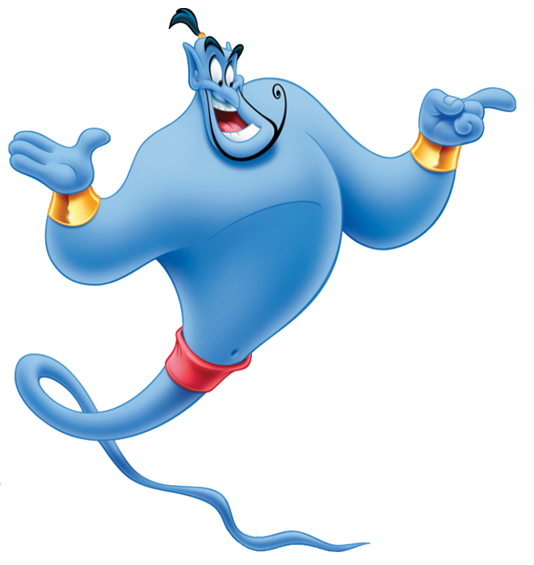
This is the awesome power you have.
You can and will impact careers and lives.
Doing nothing or not caring is as much an impact.

Slide 22
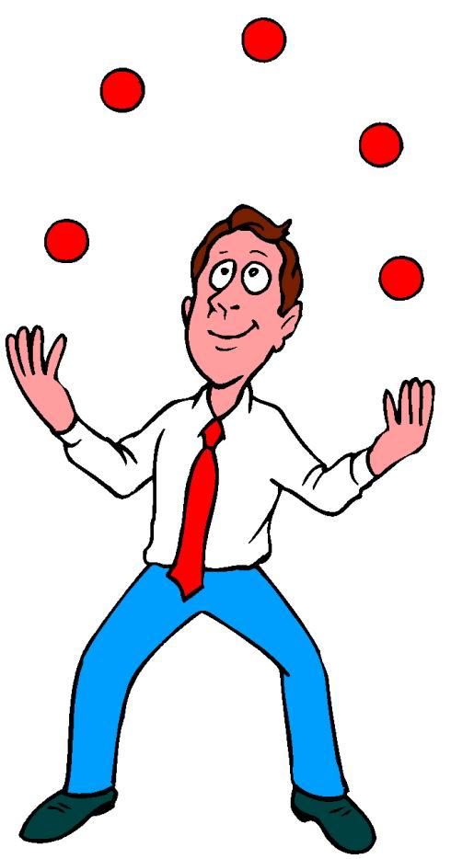
Skills
(beyond the wet side)

Slide 23

Skills
Be visionary (see the cathedral within the rock pile)
Integrity (in all things)
Organization & Planning/Swimmer analysis (a detailed review)
A command of the workout/deck presence
Creativity (think outside of the box)
Have a sense of urgency
Connection/Rapport (swimmers & parents)
Desire to be the best at what you do/to learn and grow
Desire to win (so that you will do anything to succeed)
Professionalism (would a CEO hire you?)
Commitment to team/understand your role
Culture-building
An innate desire to bring out the best in youth
Humility & Compassion
Have a life perspective on – Values, people, sports, kids, success, etc.

Slide 24

Without these skills, it will be harder to maximize...
Drill/technique work
Training
Teamwork
Culture
Athlete potential
Coaching careers

Slide 25

Skills – Grade Yours
Skill | You | Supervisor | Parents | Kids
1) Vision
2) Integrity (in all things)
3) Org/Planning, Swimmer Management/Analysis
4) Command/Presence
5) Creativity (out of the box)
6) Sense of urgency
7) Connection
8) Desire to be the best
9) Desire to win
10) Professionalism
11) Team-orientation
12) Culture Building
13) Desire to help youth
14) Humility & Compassion
15) Life perspective

Slide 26

1) Be Visionary
Why?
  This is more than a stepping stone. It is the foundation of the career and life of an athlete.
  This alone (your vision) can be the transformative force in your career and theirs.
How?
  Take a moment and image the greatest version of your group and your athletes – demeanor, rapport, support, training, technique, competition, adversity, etc.
  Write it down as an affirmation, package it and sell it to the group.
  Live it and demand it every day
  Again, see the cathedral within the rock pile

Slide 27
Vision
If you want to be happy, set a goal that commands your thoughts, liberates your energy, and inspires your hopes.” D. Carnegie
“No pessimist ever discovered the secrets of the stars, or sailed to an unchartered land, or opened a heaven to the human spirit.” Helen Keller
“We are limited, not by our challenges, but by our vision.” Unknown
“Build your own dreams, or someone will hire you to build theirs.” Farrah Gray

Slide 28

What is your vision -
For technique, training, group, culture, success?
Does it drive everything you do?
“Too many of us are not living our dreams, because we are living our fears.” Les Brown

Slide 29

2) Have Integrity in all That You Do
Why
  It will the most important aspect of your career and your relationship with athletes and parents. Be known as a person/coach of impeccable integrity. It will garner unconditional support for you.
  You ARE the role model. “Be” the role model.
  “A noble person attracts noble people.” von Goethe
How
  Commit to always do the right thing and say the right thing
  Always act in the best interest of your athletes and the team
  Always act and speak as if you were being observed by – BOD President, mother, most respected coach, etc.
  Draw a line in the sand on key issues, for you and the team
Notes:
If you don’t want kids to use bad language, wear inappropriate attire, be disrespectful, drink, etc. DONT

Slide 30
Integrity
“One of the truest tests of integrity is the blunt refusal to be compromised.” Chinua Achebe
“Character is that which reveals moral purpose, exposing the class of things a man chooses and avoids.” Aristotle
“No one will question your integrity if your is not questionable.” Nathanial Bronner Jr.

Slide 31
Integrity
“Integrity has no need of rules” Albert Camus
“If everyone were clothed with integrity, if every heart were just, frank, and kindly – the other virtues would be…useless. “ Moliere
“There are too many people who think that the only thing that's right is to get by, and the only thing that's wrong is to get caught.” ~J.C. Watts

Slide 32


What role does integrity play in your life? In your coaching career?
What lines will you not cross?

Slide 33

3a) Organization/Planning
Why
  Better planning is better productivity
  You appear prepared and professional
  People know you care
How
  Look at season, cycle, general training, stroke development, plan, etc. and how best to maximize, or be better.
  Work within the team system of development and progression plan

Slide 34

OA Sample “Quad Plan” or group progression

Slide 35
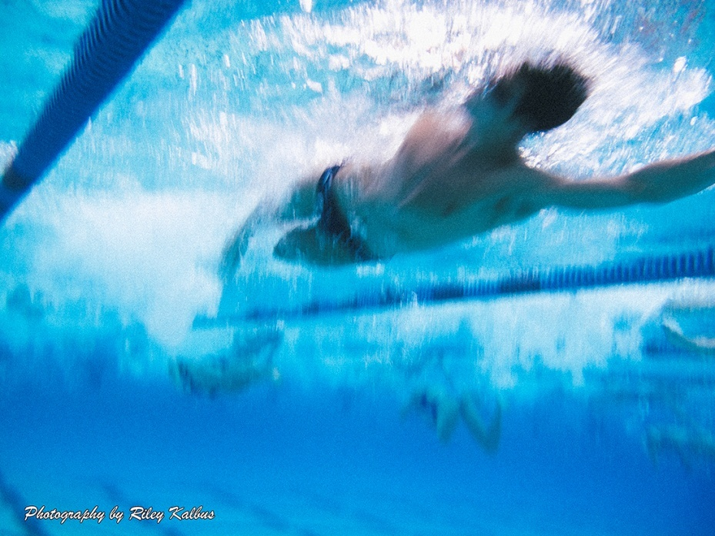
3b) Swimmer Tracking/Analysis
Why
  Keeps you connected
  Gives data/feedback
  Support swimmer/parent follow-up
How
  Detailed attendance
  Stroke keys/focus
  Track tendencies, habits, etc.
  Goal sets/tracking
  Grade effort, focus, maturity, team support
  We use SmartSheet

Slide 36
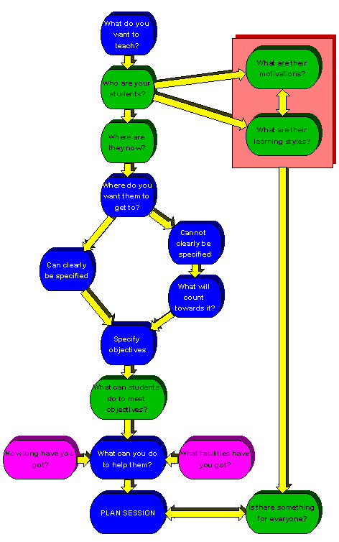
Organization
“Plan your progress carefully; hour by hour, day by day, month by month. Organized activity and maintained enthusiasm are the wellspring of your power.” Paul Meyer
“A goal without a plan is just a wish.” Antoine de Saint-Exupery
“If you don’t know when you are going, any path will do.” unknown

Slide 37

How organized/analytical are you?
Do you leave no stone unturned, in planning and swimmer management?

Slide 38
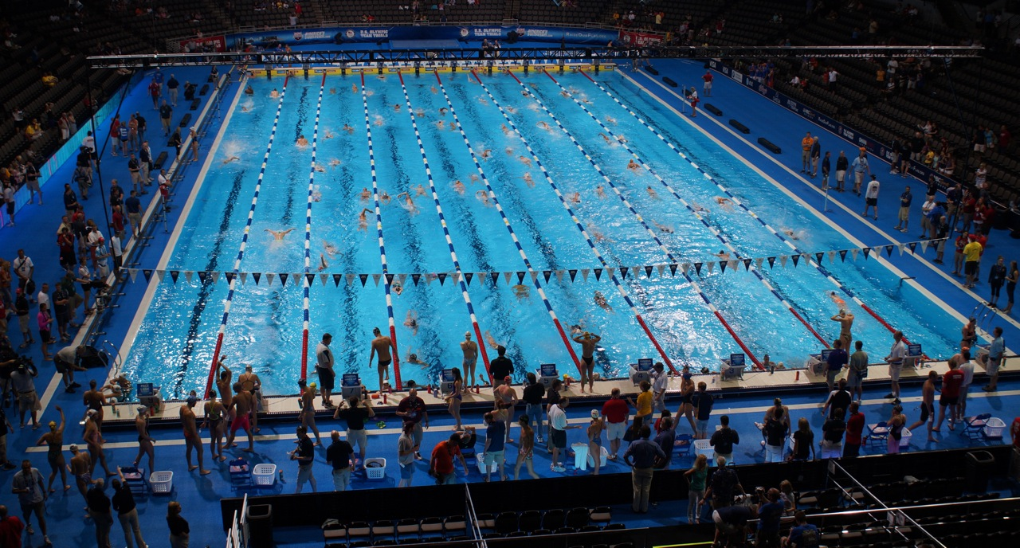
4) Command the Workout/deck
Why
  The greater the command, the great the efficiency and production
How
  Watch, engage, move, connect, demand
  Do they feel your presence at all times, in all lanes?
  Does the workout run exactly as you had envisioned?

Slide 39

Presence/Leadership
“If your actions inspire others to dream more, learn more, do more and become more, you are a leader.” John Quincy Adams

Slide 40

How is your command of the workout?
Do you have a captive audience?

Slide 41
5) Be Creative
Why
  Although the foundation of the sport will never change, approaches, style, and methodology will.
  This is a labor-intensive sport
  Attention is held more through a creative process than a repetitive one.
How – Think “out of the box” (but stay within system)
  Always ask if there is a better way
    Drills – change drill (fun, etc)
    Learning/games
    Set design
    Technology
    Language
    Meets/competition
    Challenge athletes

Slide 42
Creativity
“Creativity means to push open the heavy, groaning doorway to life.” Ikeda
“Uncertainty and mystery are the energies of life.” R. Fitzhenry
“Those who create are rare; those who cannot are numerous.” Coco Chanel

Slide 43

How creative are you?
What have you done that you would consider innovative?

Slide 44

6) Have a Sense of Urgency
Why
  Can expedite development dramatically
  Shows you care
  Expands thought process (find a way)
  You become more resourceful and creative
How?
  Ask, “what if I had to fix this problem today”?
    Technique, turn, attitude, conflict

Slide 45
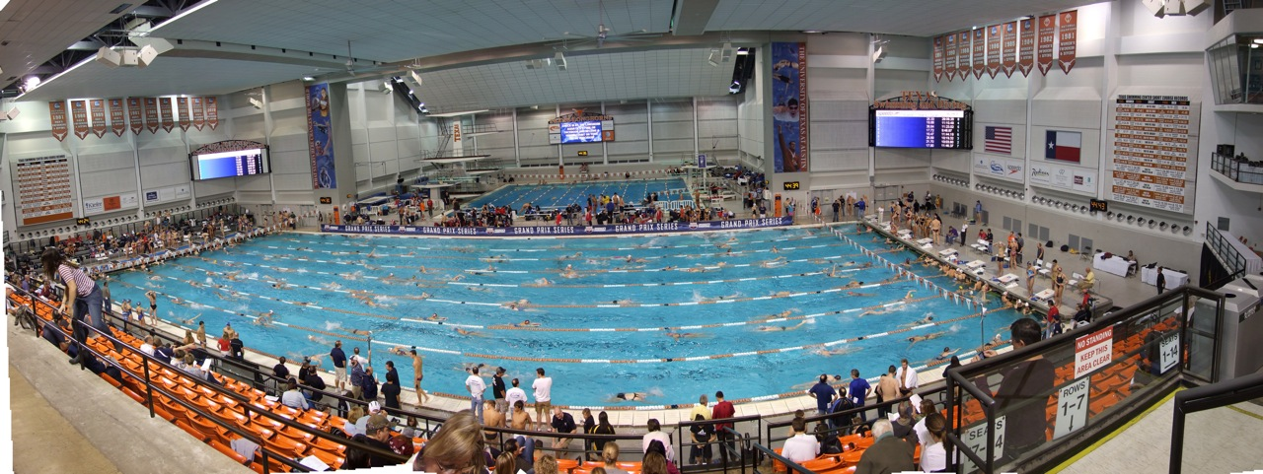
Urgency
“We can not solve our problems with the same level of thinking that created them” Albert Einstein
“The lesson will always repeat itself, unless you see yourself as the problem--not others.” Shannon Alder
“There would be times when we'd rack our brains on a problem, and think we'd considered every option, and then he'd redefine the problem or approach, and our problem would go away.” W. Isaacson on Steve Jobs
Notes:
Ronnie comment

Slide 46

Do you teach and coach with a sense of urgency?

Slide 47
7) Connection
Why
  The quickest way to transform relationships and athlete development is to connect at the highest level of person, athlete, swimmer, leader (see chart)
How
  Daily dialogue (one thing swim/one personal)
  Intense stroke feedback
  Ask for commitment in return
  Demand leadership
  Create value-added
  Give everything – ask for everything
  Write a note once a week to a swimmer (or parent)

Slide 48

Levels of Development
Coach runs workout/swimmer shows up
Talk to about stroke (may or may not connect)
Talk to aggressively about stroke
  Pull out of water
  Watch constantly
Connect personally (care)
Talk about attendance and commitment (link)
Watch demeanor in all aspects
  Encourage areas of improvement
    Arrive earlier, focus, help more, talk to others
Talk about leadership attributes
Demand leadership skills
  Begin giving leadership responsibilities (set up, tasks, lead stretching, etc.)
Explore life/social choices (easy transition) – the “concepts”
  From an athletic perspective
  From a personal perspective
  Give articles, shares a story, talk about past successes
Talk about life skills that are critical to be a “good person”
  Relationship with parents
  Academics
  Mentoring/inspiring others
Demand them (fully connected)

Slide 49

Stages - Macro
Take from name on roster to someone who connects
Take from someone who connects to someone who is committed
Take from someone who is committed to a high-character athlete
Take from a high-character athlete to a high-character person
Take from a high-character person to a leader (and someone you trust implicitly and will do anything for)

Slide 50

Connection
“The best way to lead people in the future is to connect with them deeply in the present.” Kouzes & Posner

Slide 51

How well do you connect with your swimmers?
Will they do anything for you, for the team?
Do they know they can count on you?

Slide 52

8) A Desire to Learn and Grow
(to be the best at what you do)
Why
  You owe it to those making an extraordinary commitment to you (and the sport) be the best you can be (should be inherent in all professions)
  All great coaches are obsessed with learning and growing
  The sport is in constant flux – training, technique, technology, competition
  Assume your competition is doing more...
How
  Be an information sponge (and filter)
  Seek out a mentor
  Use meets as a learning ground
  Learn from the best in coaching (what made them successful)
  ASCA resources/video library

Slide 53


Competence
“Knowledge is power. Information is liberating. Education is the premise of progress, in every society, in every family.” Kofi Annan
“To acquire knowledge, one must study; but to acquire wisdom, one must observe.” Marilyn vos Savant

Slide 54
Best
“Only the mediocre are always at their best.” unknown
“Act the part and you will become the part.” William James
To be your best, “you must do things you think you cannot do” Eleanor Roosevelt
Do you have ten years of experience or one year of experience repeated ten times?

Slide 55

Do you think/dream about being great at what you do, about being the best, about setting standards?

Slide 56
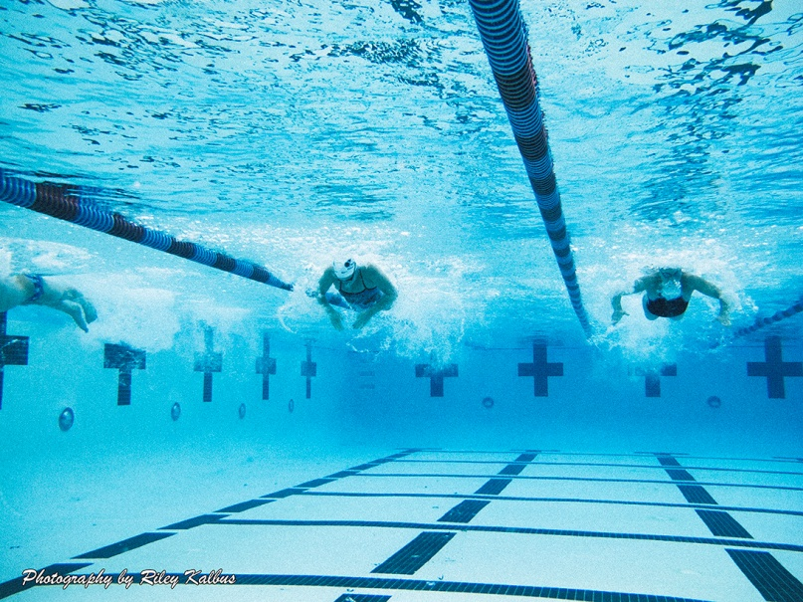
9) The Desire to Win
Why
  It is the reality of our sport and must drive the athletic process
  A burning competitive drive (will to win/denial to give in) fuels all great coaches
  Your competitiveness will fuel your group’s desire to achieve
How
  Develop a willingness and a deep desire to produce the best and most competitive athletes (team, community, nationally)
  Make sure they know the expectations and objectives (team and individual) and the path to success

Slide 57
Success
“Winning isn't everything, but the will to win is. Vince Lombardi
Winning isn't a sometime thing. You don’t do things right once in the while. Winning is habit, and unfortunately, so is losing. Vince Lombardi
“Excellence is never an accident. It is always the result of high intention, sincere effort, and intelligent execution; it represents the wise choice of many alternatives. It is choice, not chance, determines your destiny.” Aristotle

Slide 58

How would you describe your
desire/will to win?

Slide 59
10) Professionalism
Why
  Because you are a professional, AND you represent the entire coaching community. Coaching is one of the most impactful professions that exists and it should be presented as such (regardless of age)
  You are the face and image of the organization
  You are accountable.
How
  Be disciplined in appearance, langue, demeanor, interaction, social media
  Act like an owner or a partner of a business
  Would a CEO hire you? Would another team?

Slide 60

Professionalism
Read “The Uncommon Professional”
A common man in a mundane job inspired others and transformed lives simply as a result of his:
Professionalism
Attention to detail
And pride in work and execution

Slide 61

How would you describe your professionalism? How would others? Is it important to you?

Slide 62
11) Team Orientation
Why
  As an age-group coach, you are a critical part of the team process. Your efforts and philosophy must make the team as a whole stronger
How
  Understand the team goals and philosophy
  Understand the practices and policies with regard to development, swimmer placement, discipline, etc.
  Sell teamwork and team-first to your athletes

Slide 63

Team
“When spider webs unite, they can tie up a lion.” unknown
When he took the time to help the man up the mountain, lo, he scaled it himself.” Tibetan proverb

Slide 64
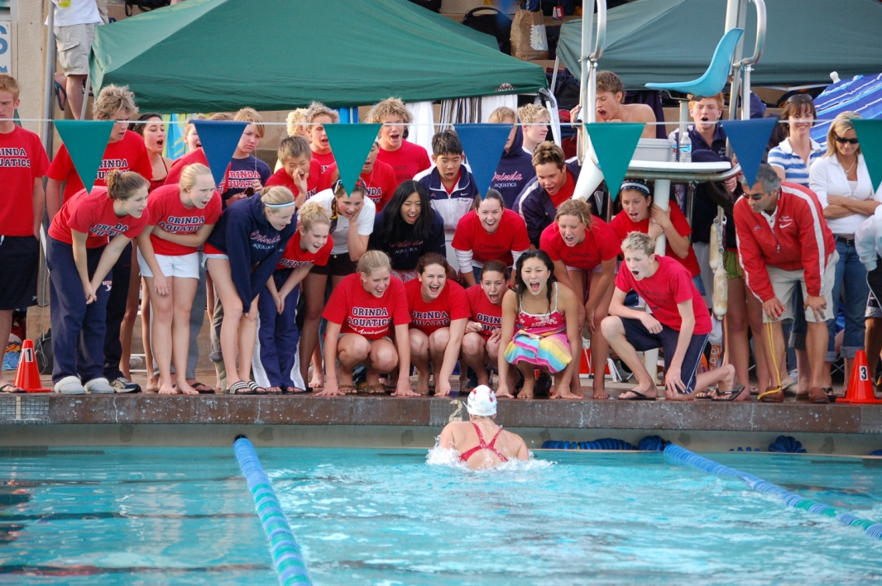
Do you always put the team first?
Is it the most important thing to you?

Slide 65
12) Culture Creation
Why
  Culture is the glue that holds everything together, like a perimeter fence. It contains. It perpetuates.
  It is like having the wind at your back, in training, in attitude, and in positive action.
  Key – it WILL define itself if you don't
How
  Back to vision, it must be defined, sold, implemented
  You should pursue a culture of technique, training, racing, team support, locker room, academic, etc.
  “This is who we are. There is no other way.”

Slide 66

Culture
“The welfare of each is bound up in the welfare of all.” Helen Keller
“To say that my fate is not tied to your fate, is like saying your end of the boat is sinking”. Hugh Downs

Slide 67
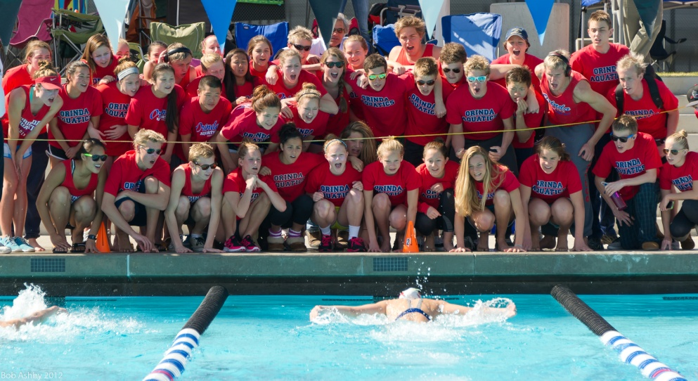
How would you describe your team/group culture? What drives it?
What role do you play?
Is it an asset or a liability to athlete development?

Slide 68
13) Desire to Change Lives
Why
The influence and impact an individual has on another is the greatest privilege we will ever enjoy. Sports and coaching provides one of the most opportune platforms. It is incumbent upon us to take advantage of this opportunity.
How
Incorporate life lessons, growth, and leadership into all facets of your program. While children will grow personally, your program will change in profound ways.

Slide 69
Youth
“There is no greater insight into the future than recognizing... when we save our children, we save ourselves.”
“One hundred years from now, it won't matter what car I drove, what kind of house I lived in, how much I had in my bank account, nor what my clothes looked like,
But, the world may be a little better because I was important in the life of a child.” Unknown

Slide 70

Do you embrace the great potential and power you have in influence and shaping a child's life (beyond swimming)?

Slide 71

14a) Live with Compassion
Why?
  Compassion can underlie all good things in a coach-athlete relationship. It leads to respect, appreciation, performance
  “We are all fighting a hard battle.”
How?
  Connect on a personal basis
  Do things outside of the coaching box –
    A card, a gift, a meeting, a resource, etc.
  Over coach, over care

Slide 72
Compassion
“If you want others to be happy, practice compassion. If you want to be happy, practice compassion. Dalai Lama
Houssaye wrote: "Tell me whom you love and I will tell you who you are.”
“There is more hunger for love in the world than for bread.” Mother Teresa
“Everything has beauty, but not everyone can see.” Confucius

Slide 73
14b) Humility
Why
  Too many careers have been derailed because of ego
  Humility keeps one striving to be more, do more, and give more
  Ego stunts professional growth, and everyone else is aware of it
How
  Take a “servant” perspective on coaching and life
  Know that ego really equates to insecurity

Slide 74

Humility
"Humility finds those who credit themselves, and credit finds those who humble themselves.“ unknown
“Humility is not thinking less of yourself, it is thinking of yourself less.” Rick Warren

Slide 75

What role do compassion and humility play in your coaching career?

Slide 76
15) Life Perspective
Why?
  Decades from now, will this have made any difference?
  Do you know...
    What matters in life
    What matters in sports
    What matter to an athlete
How?
  Know your (personal) core values, beliefs, and priorities and overlay them on to your coaching skills and philosophy
  Ask, does this make you a better person or not? Does it add value to your life (personal or athletic)?

Slide 77

Life
"No man can tell if he is rich or poor by turning to his ledger. It is the heart that makes a man rich. He is rich according to what he is, not according to what he has.” Henry Beecher
Try not to become a man of success, but rather try to become a man of value. Albert Einstein

Slide 78
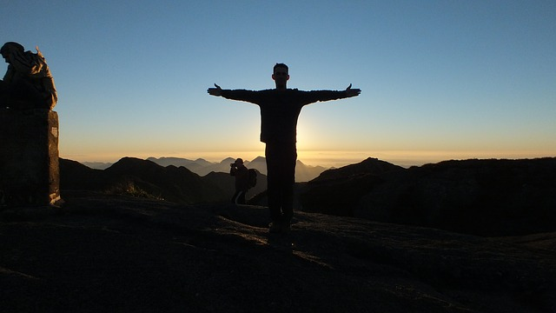
What is your life philosophy and what role does it play in your coaching?
Is this your “dent in the universe”?

Slide 79

Final Considerations

Slide 80

What about you?
What is your skill set?
What is your skill GPA?
Who grades you?
What motivates you?
Can your standards be higher than anyone’s?
Can you connect better than anyone?
Can you build a culture (that perpetuates)?
Can you change a life? Every life?

Slide 81

Be a Builder
Of culture
Of team
Of process
Of psyche
Of technique
Of perseverance
Of family and Unity
Not of resumes

Slide 82

Run Parallel Paths of…
Developing talent (a success anchor)
Developing relationships (personal connection)
Developing team (a rising tide)
Developing culture (a way of life)
Everyday

Slide 83

Time Horizon
The coach must pursue each path with an eye, and an awareness, on three time frames:
Short-term – every day
Medium-term – growth in your program
Long-term - growth beyond your program (or to potential)

Slide 84
How to Get Better – Wet Side
Technique
Walls/UW
Race Strategy
Strength
Attitude Mentality
Endurance

Slide 85
How to Get Better – Culture Side
Live with Integrity
Seek to Lead (make a difference)
Help - Always
Embrace Challenge
Always Positive
Care About Team/People

Slide 86
How to Get Better - Coach Side
Be THE role model
Pursue excellence from your athletes
Care more than any coach in the world
Give everything
Ask for everything
Pursue excellence in demeanor and understanding

Slide 87
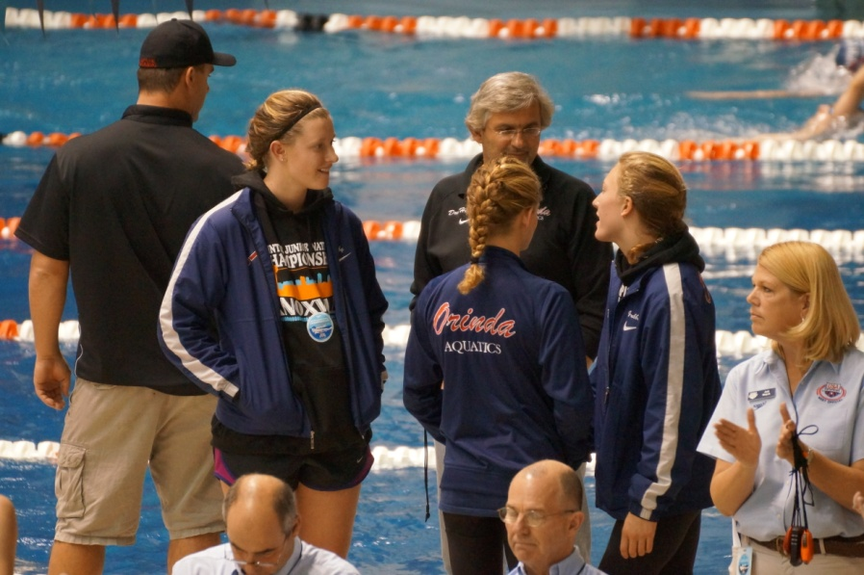
There is no excuse.
The coach must be accountable for development in all areas.
“They don’t get it.”
“They don’t listen.”
“They are immature.”
“They do not understand.”
With regard to technique, training, maturity, integrity, leadership, team commitment.

Slide 88

The right skill set (and the 200 million websites) will allow to do develop young athletes and young adults to levels they never thought possible.
Leadership is a privilege,
and coaching is leadership.

Slide 89

It has been an honor to be with you.
Questions?
Don Heidary
Don@OrindaAquatics.org

Slide 90
Thank you to the
American Swimming Coaches Association

