Slide 1
Swimming for life:
How PDST prepared me for a career in science and medicine
PDST Alumni Presentation
Nov 6, 2022
Jason Xu

Slide 2
Presentation topics
How swimming got me into my dream college
Why Swim?
  5 unexpected life-long lessons I learned from swimming
Swimming and productivity
  How swimming at PDST taught me to balance academics, work, life, and health

Slide 3

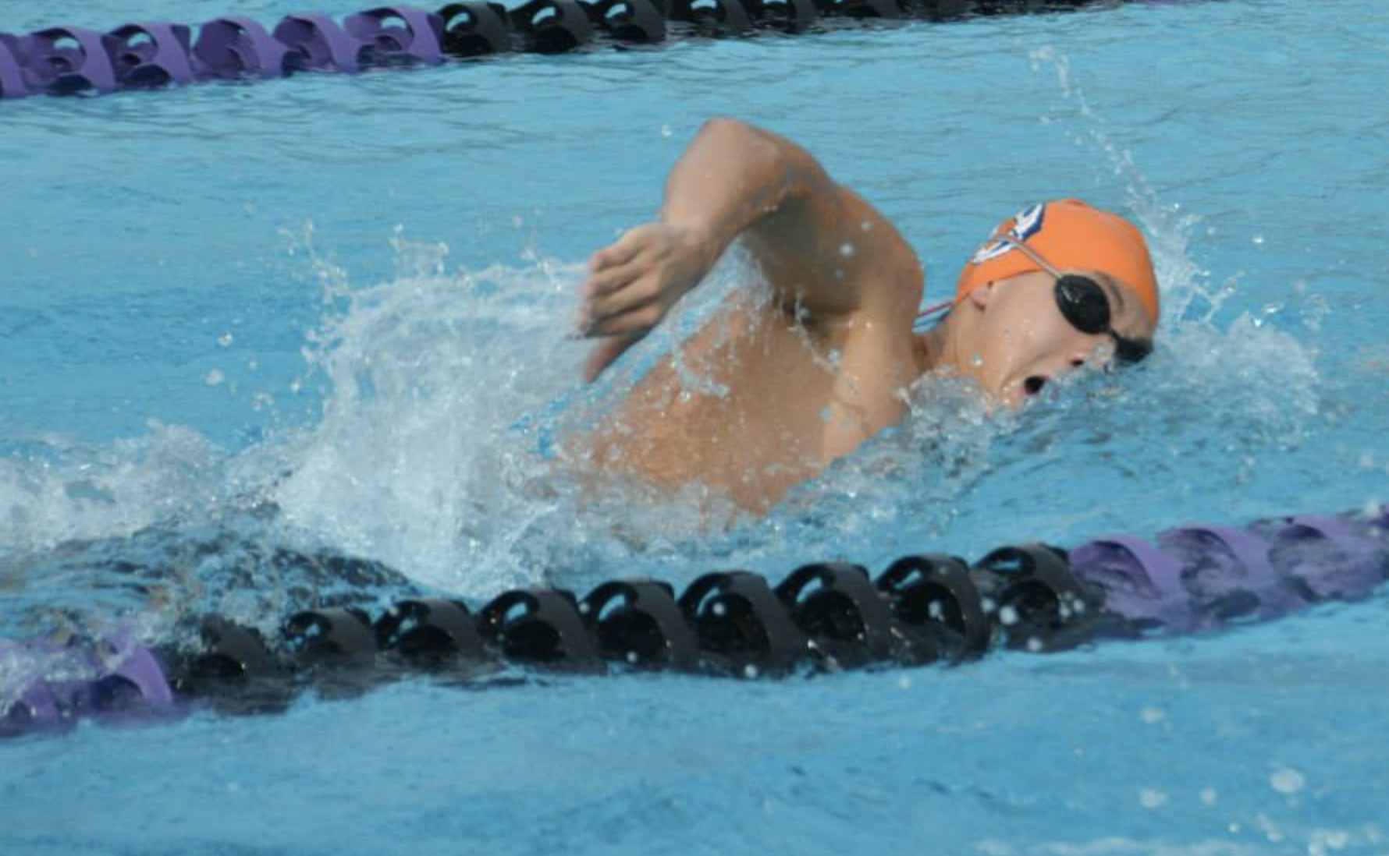



Who am I?
Interlake HS ’14
Pacific Dragons Swim Team
My Goals:
Use science to improve lives of cancer patients
2. Mentor the next generation of students to help with (1)
University of Pennsylvania
MD/PhD (‘18 - Present)
Cancer Genomics
Pomona College ‘18
Molecular Biology
https://en.wikipedia.org/wiki/Medical_Scientist_Training_Program
Notes:
To solve the worlds most pressing problems

Slide 4


How PDST helped me get into my dream schools
2014-2018
Molecular Biology
Acceptance Rate (2014) – 12.7%
Acceptance Rate (2022) – 6.7%
Acceptance Rate – < 4%
My admission to Pomona and other schools was a direct result of the training I received from Coach Xu and Coach Li
The lifelong lessons I learned from Coach Xu and Coach Li helped me interview at 11 MD/PhD Programs and land admission to my dream program
Swam FY/SO year at PPSD

Slide 5
Swimming and recruitment

Slide 6
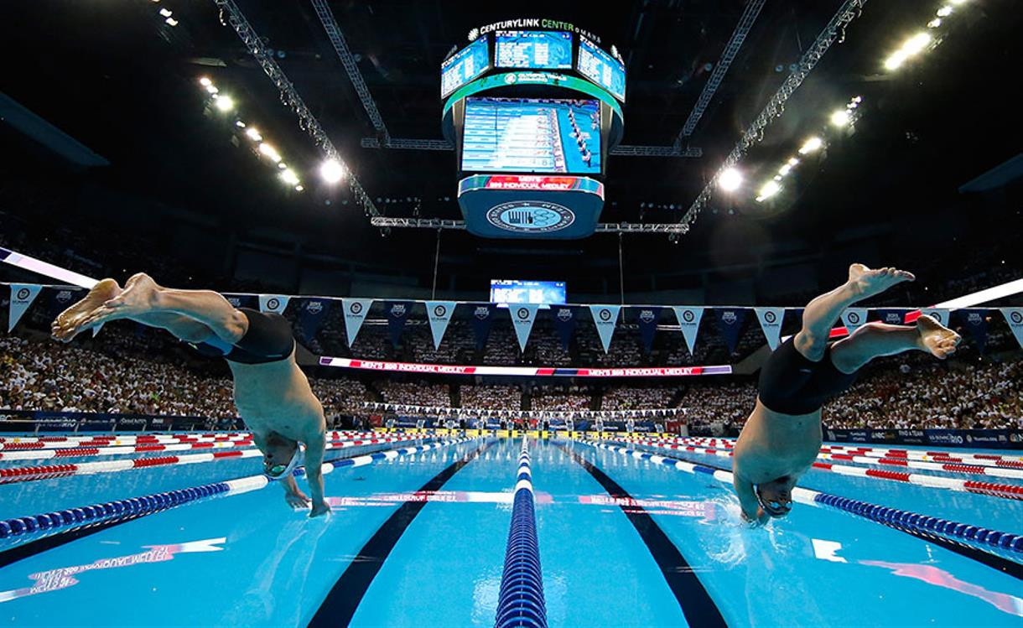
Swimming into college: what’s the target?
State Championships
Difficulty
US Sectionals
US Zone Team
US Jr Nationals
Us Nationals
Olympic Trials
US Olympic Team
Notes:
Look far & dream big
Translating ambition to action

Slide 7
Swimming into college: what’s the target?
Maybe your goal isn’t to make the Olympic swimming team. Know alternative exit points to get what you want:
State Championships
US Sectionals
Scholarship to D1 School of Choice (AT)
US Zone Team
US Jr Nationals
Us Nationals
Swim at top D3 College (JX)
Olympic Trials
US Olympic Team
Relevant talks: Long term planning: translating ambition to action
Notes:
Look far & dream big
Translating ambition to action

Slide 8


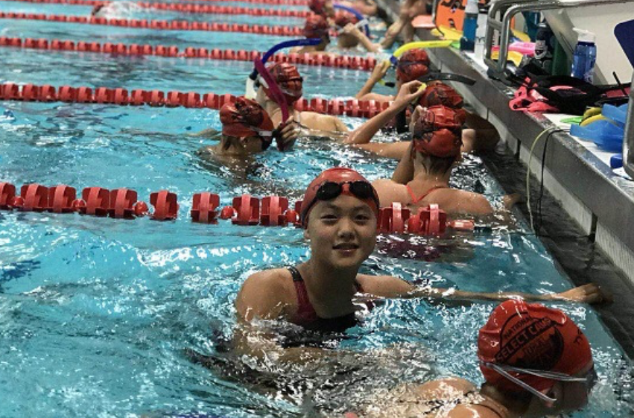
Case study: two former PDST swimmers
University of Penn
Pomona College
PRISM Program (BSD)
Lakeside HS
Stanford University
Jason Xu
PDST: 2008 - 2014
Pomona College Class of 2018
Pomona Pitzer Swim Team, 2014-2016
MD/PhD Student, University of Pennsylvania
Amy Tang
PDST: 2010 - 2021
Stanford University Class of 2025
Stanford University Swim Team 2021-Present
Intended Computer Science Major

Slide 9








College level recruiting: D3 vs D1
Schools that reached out to me
Schools I contacted first and were interested
Schools that were interested but non-committal
Schools contacted me first (A.Tang)

Slide 10

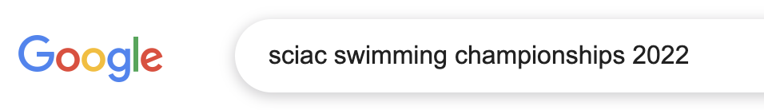
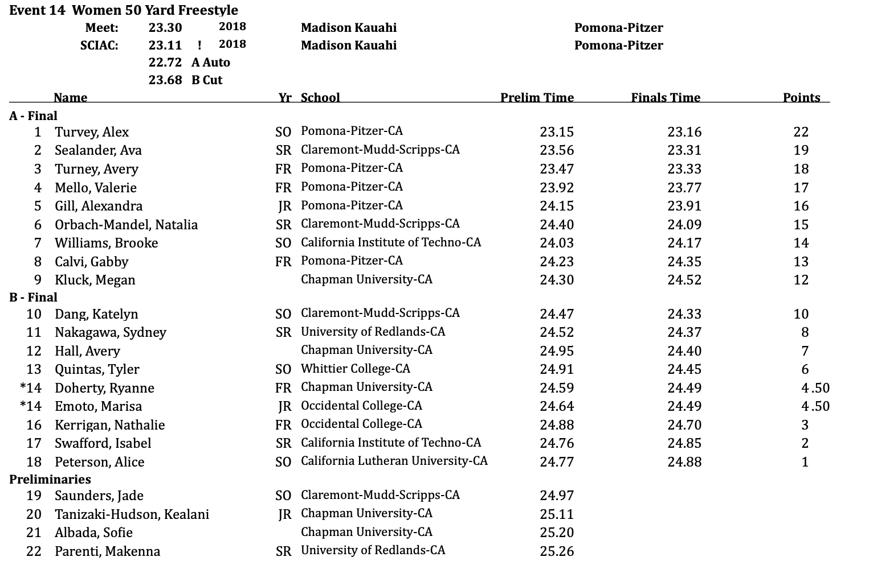

Swimming into college: what’s the target?
NCAA Qual Time
Final qualifying time
24.77

Slide 11
College level recruiting: D3 vs D1
Division 3 recruiting experiences:
Very school dependent
Combination of coaches reaching out vs swimmers reaching out to target schools
No guaranteed admission, but “pre-reads” offered for early applicants
Encouraged to apply ED/EA
Division 1 recruiting experiences:
Combination of coaches reaching out vs swimmers reaching out
Verbal Commits
Guaranteed Admission once committed
Scholarship Offers
Only Apply to 1 school at most

Slide 12
Cracking the code to America’s Top Schools
Jason’s take
  The value of great colleges is in the people you meet. Not the courses.
  Swimming can help get into college, but cannot make up for academics
  High level swimming is extremely challenging and time-demanding, particularly if you are pursuing academically challenging studies
  For me, practice efficiency & technique focused training was key to balance academics and swimming in middle & high school
Amy’s take

Slide 13
Swimming and career

Slide 14
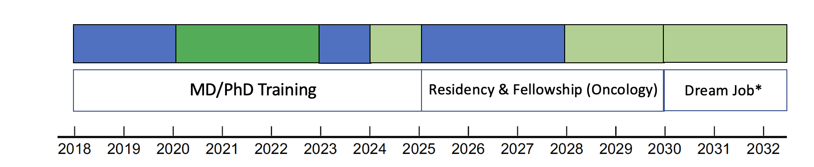
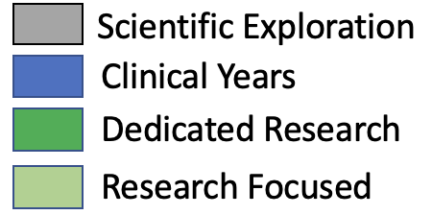
Goalsetting
7 Years
6 Years
Age: 35

Slide 15
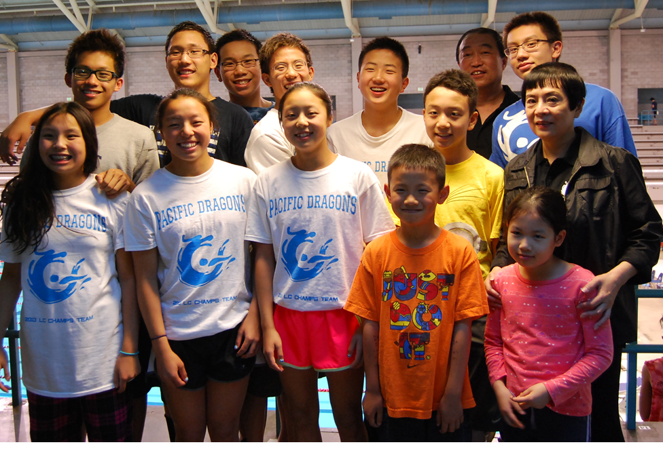
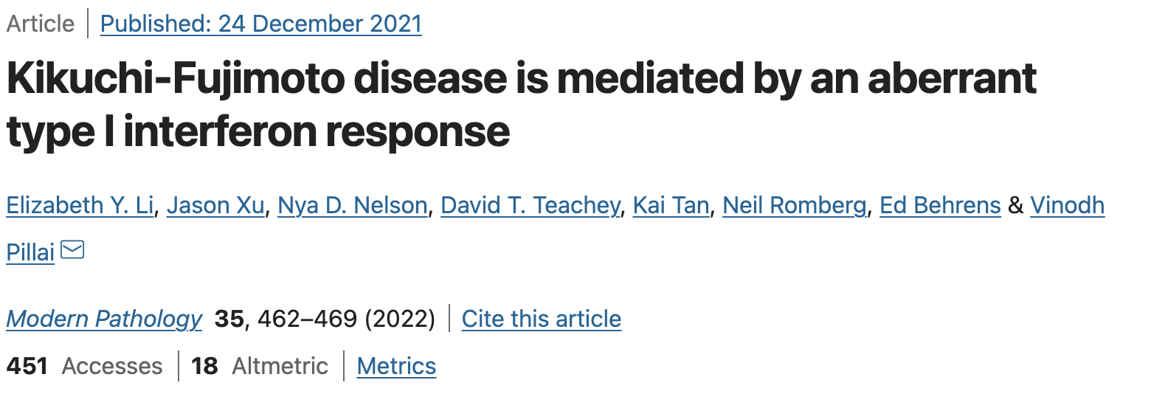
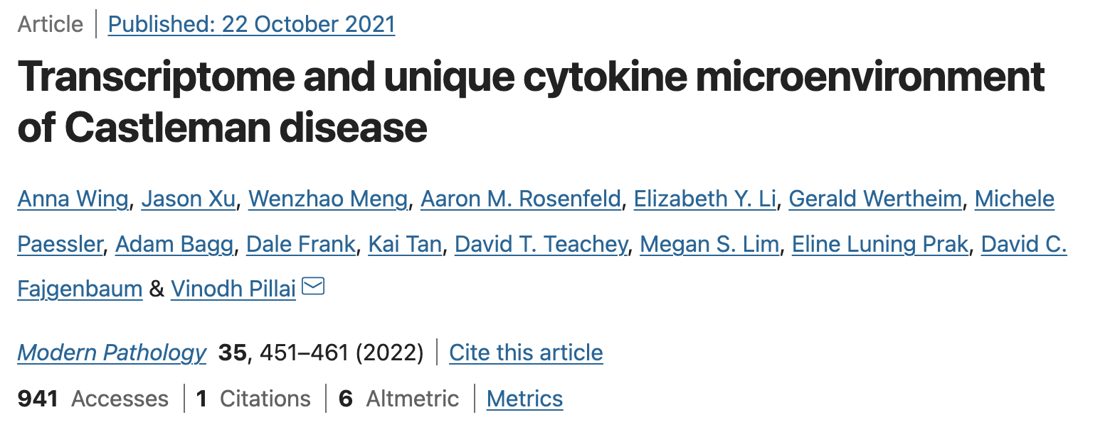
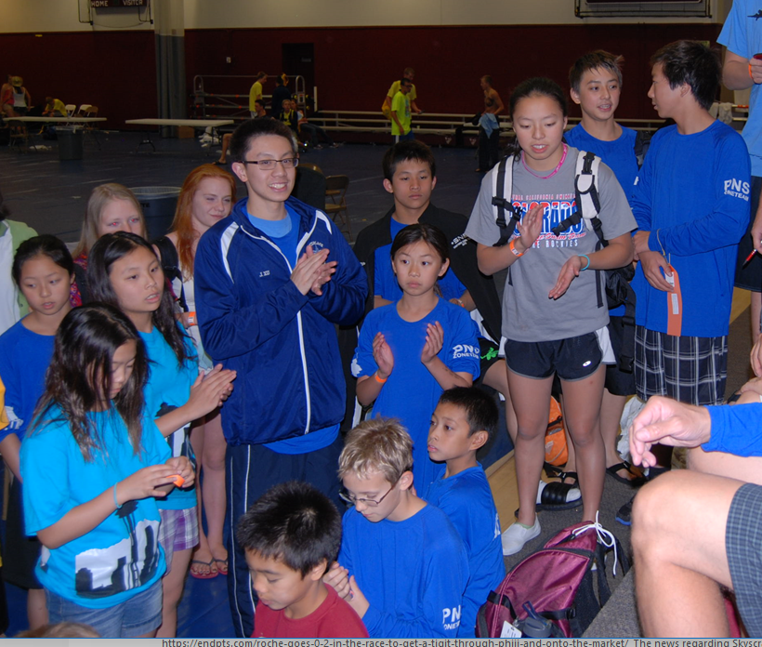

Collaboration
Swimming trains individual excellence,
but also teaches how to be a team player
PNS Champ Meet @ KCAC Pool; Federal Way, WA
Western Zone Champ Meet @ Grand Junction, CO

Slide 16
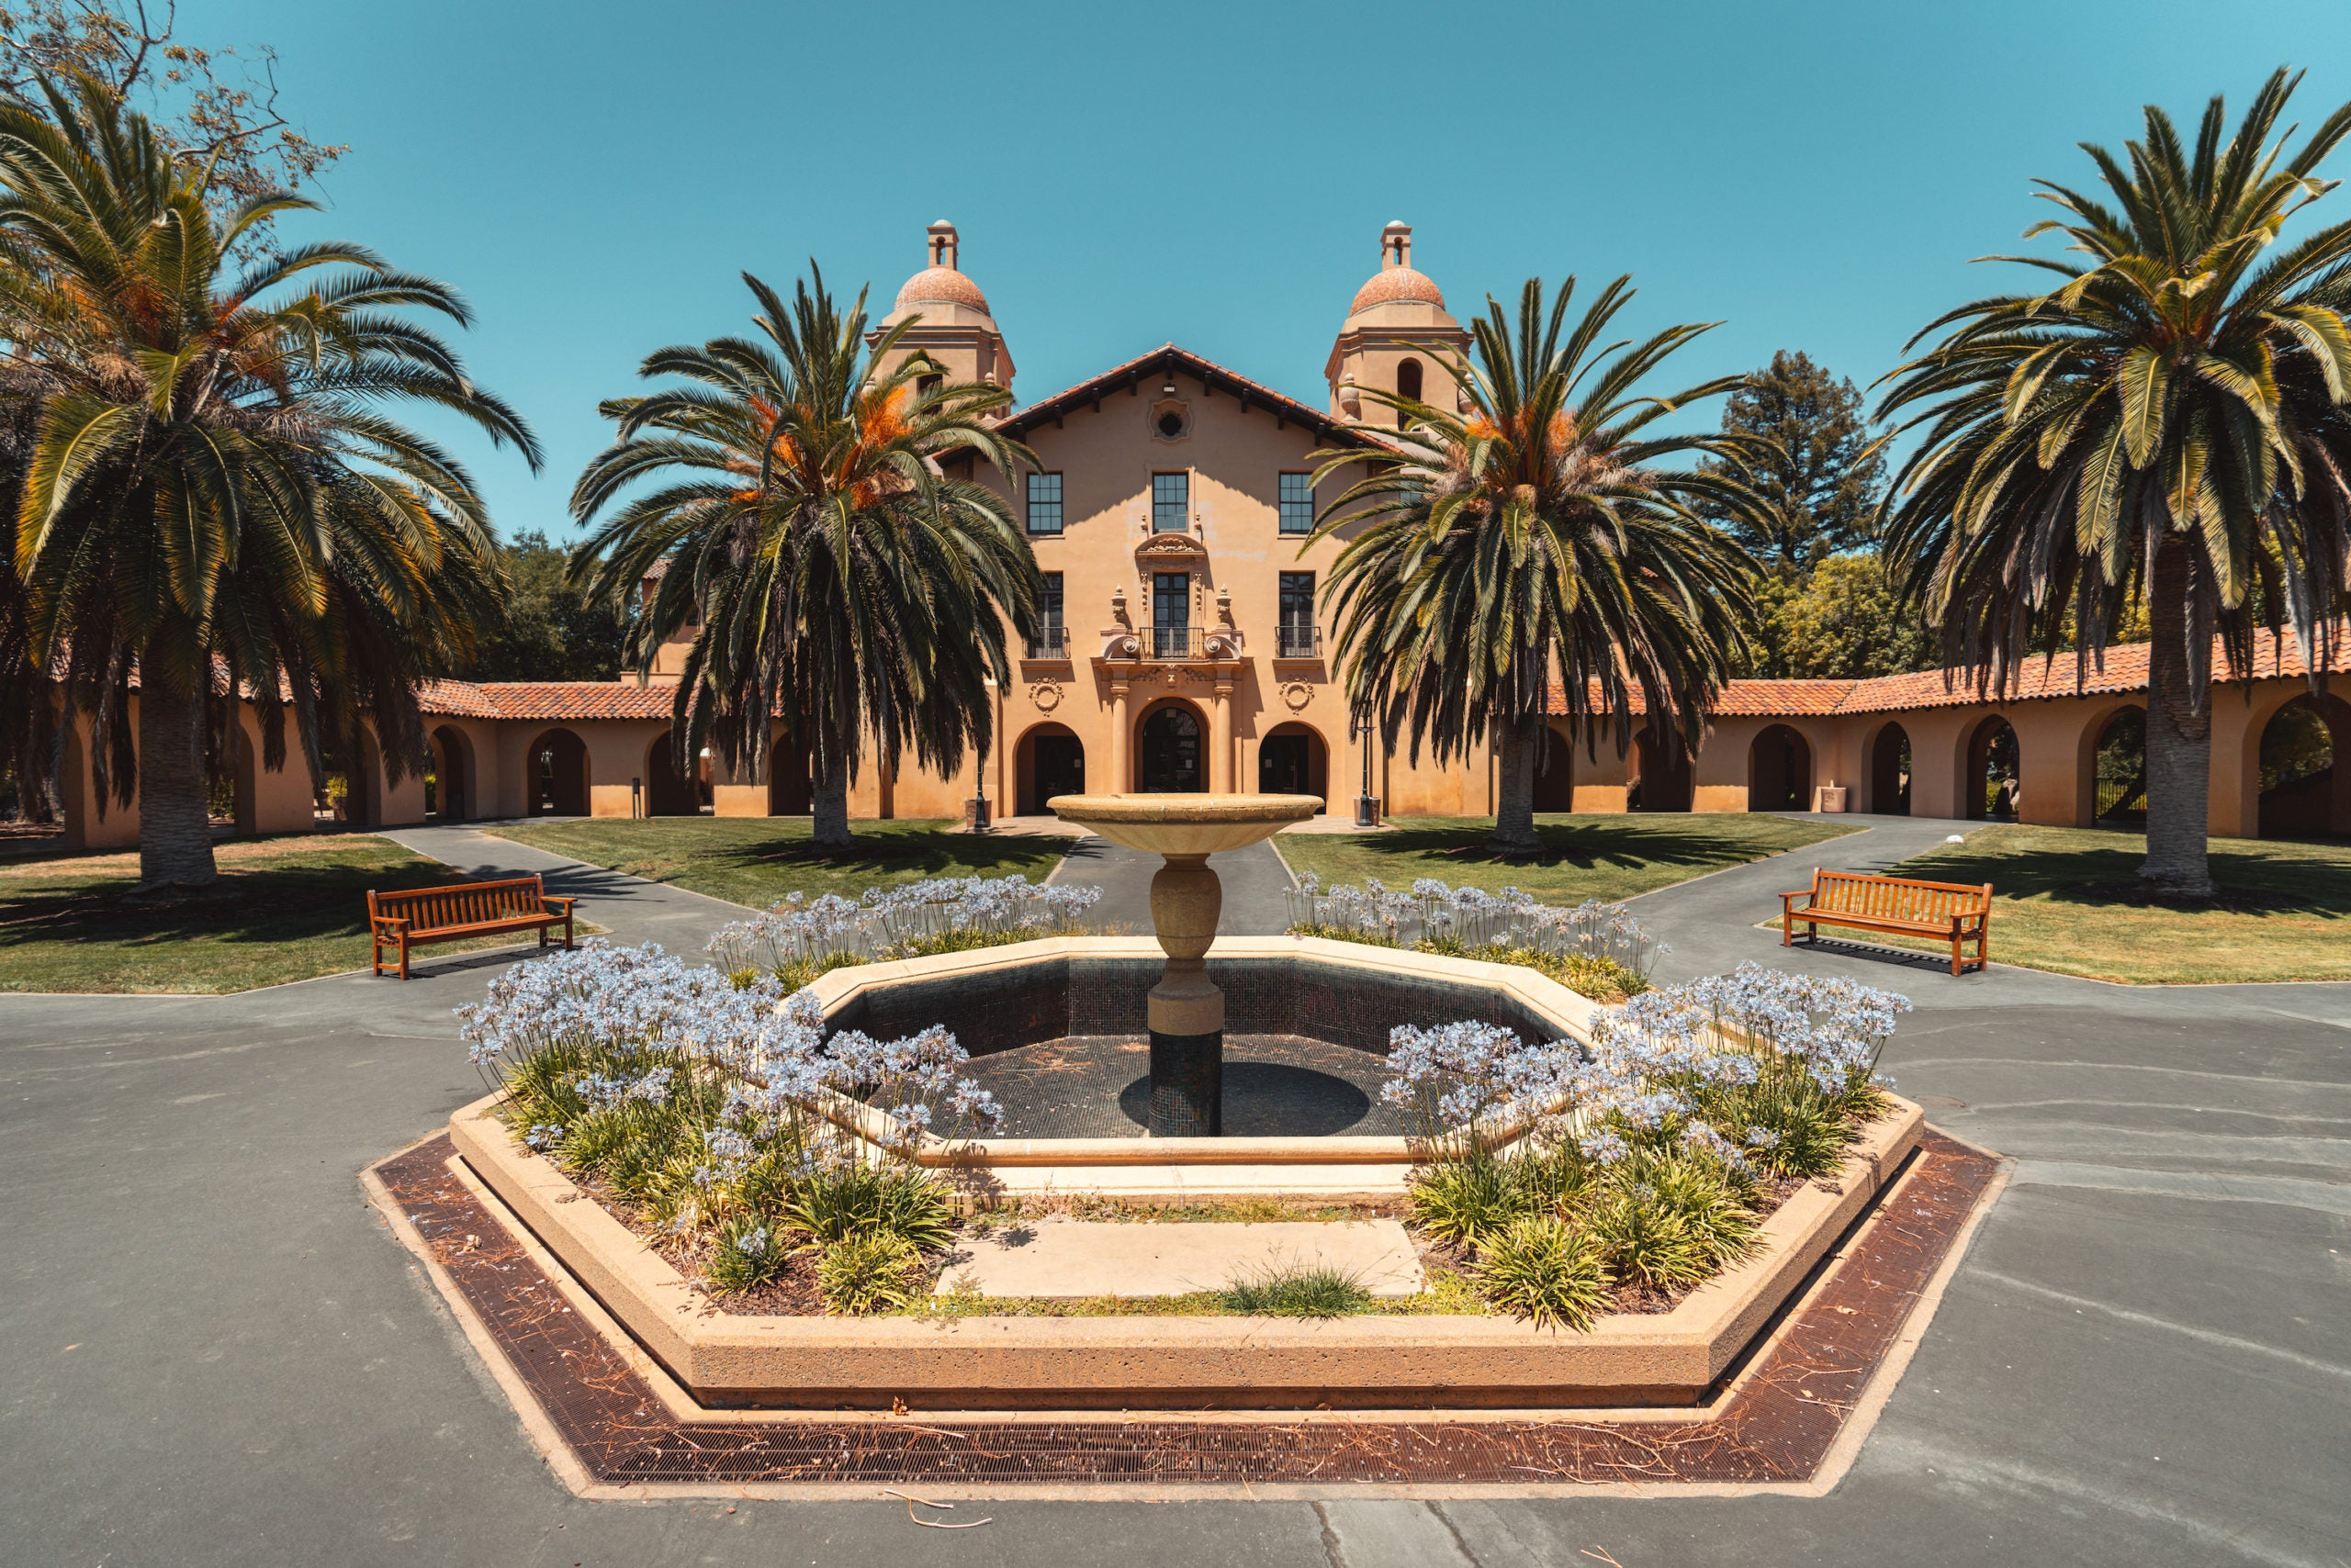

Perseverance through failure
2008 –first PNS champ time
2011 – first sectional time
2011 – first PNS final
2012 – first western zone time
Am I getting closer?
Interlake High School – 2/400
Pomona College – 1/60
Penn MD/PhD – 15/20 (H/S)
Stanford University – 2014 – Rejected – Went to Pomona
Stanford Medical School – 2018 – Rejected – Went to Penn
Stanford Internal Medicine – 2025 - ?
Stanford Oncology – 2028 - ?
Stanford Instructorship – 2031 - ?
Stanford Assistant Professor – 2034 - ?

Slide 17
Balancing swimming and academics

Slide 18
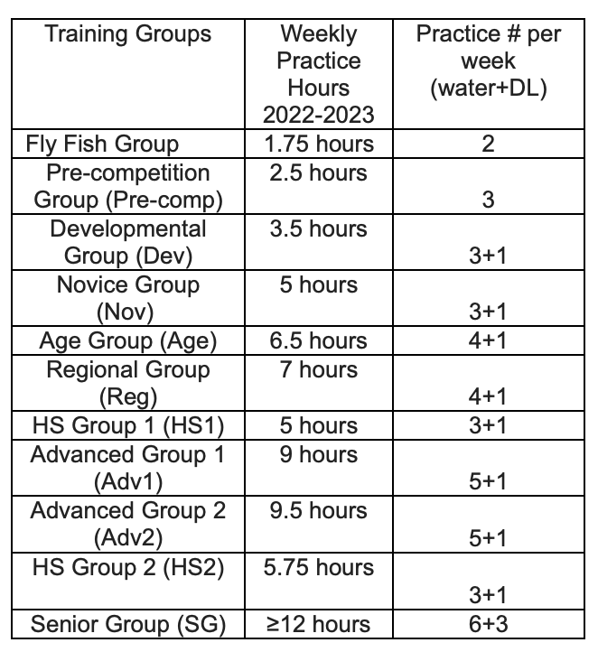
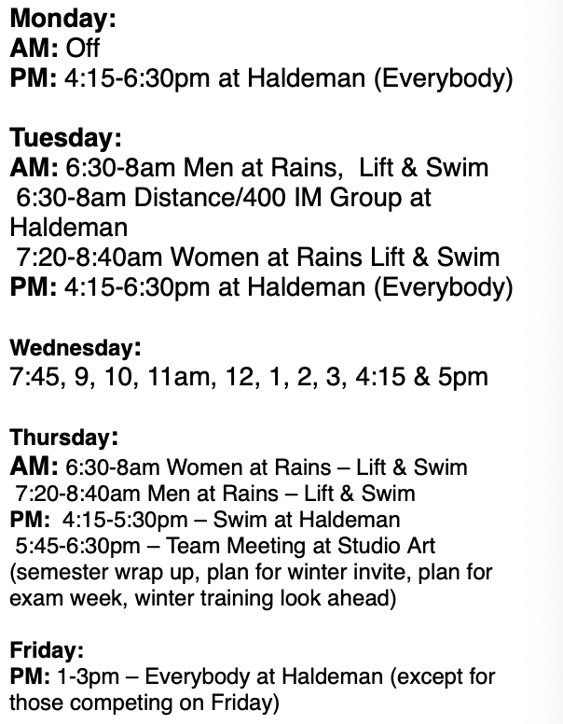
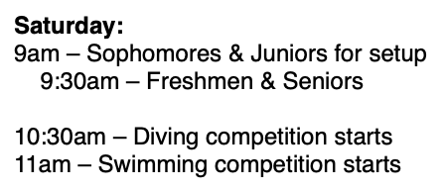
Swimming and Academics: Efficiency is key
My 12 hour swim week at PDST
My 30 hour swim week in College
Practice
Dryland
Team Meeting
Meet
Had I been able to continue my PDST training in college, I would’ve been able to succeed in the pool & in my pre-medical studies.
Notes:
Had I been able to continue my PDST training in college, I would’ve improved & been able to complete my pre-medical studies.

Slide 19


Strength or Technique?
Strength
-30 hours training + 5 hours lifting
-9000 yards / day
-“Garbage Yards”
-Doubles Practices
Technique
-30 min drill focused private lesson
-optimally designed sets
-3000-4500 yards a day
-Single Practice
Brute force approach (PPSD)
Work smart approach (PDST)
Notes:
Had I been able to continue my PDST training in college, I would’ve improved & been able to complete my pre-medical studies.

Slide 20
Swimming + Academics: my unique training environment
In this picture
MIT
Pitzer
Carnegie Mellon
Cornell
Washington University in St Louis
Pomona College
Brown
Tufts
Bowdoin
PDST made it normal to care about both school and swimming.

Slide 21
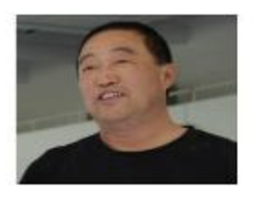
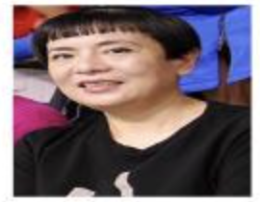
Swimming and Academics: Coaching
Coach Li & Xu saw me as a swimmer, but also as a future doctor. They cared about:
-spacing out meets to give me best chance of a best time
-what school I could attend
-my grades in school
-my interest in medical research
-my sleep
Coach, PPSD
My value is what I bring to the team:
-hours trained
-points scored
-meets attended
-weeks spent uninjured
-team event attendance
Notes:
His goal was not for me to spend as much time as I could in the pool, but rather, for me to be successful in life:

Slide 22
Swimming and high achievement

Slide 23
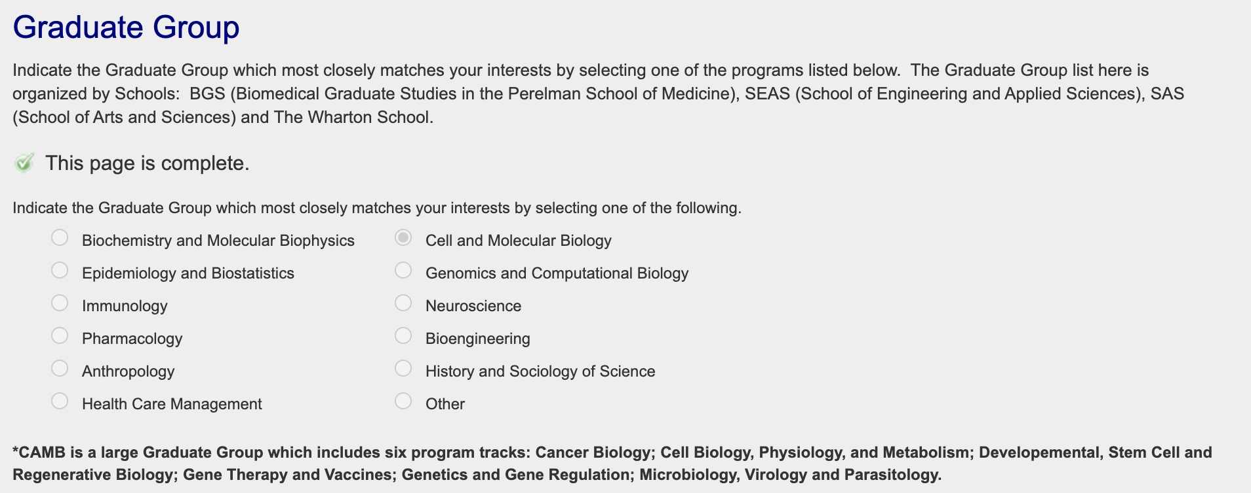
Lesson 1: play to your strengths
Notes:
Major/Graduate group choice

Slide 24
Lesson 1: play to your strengths
Things that fit my interests
Notes:
Major/Graduate group choice

Slide 25
Lesson 1: play to your strengths
Things that fit my interests
12
80
Number of students in each group
12
12
5
12
Notes:
Major/Graduate group choice

Slide 26
Lesson 1: play to your strengths
Things that fit my interests
12
80
Where I applied
12
12
5
12
Notes:
Major/Graduate group choice

Slide 27
Lesson 1: play to your strengths
Things that fit my interests
12
80
Where I applied
12
My Current Graduate Group
12
5
12
If I applied to genomics graduate group, I would not have gotten in!
Relevant Talk: Choosing a major when applying
Notes:
Major/Graduate group choice

Slide 28
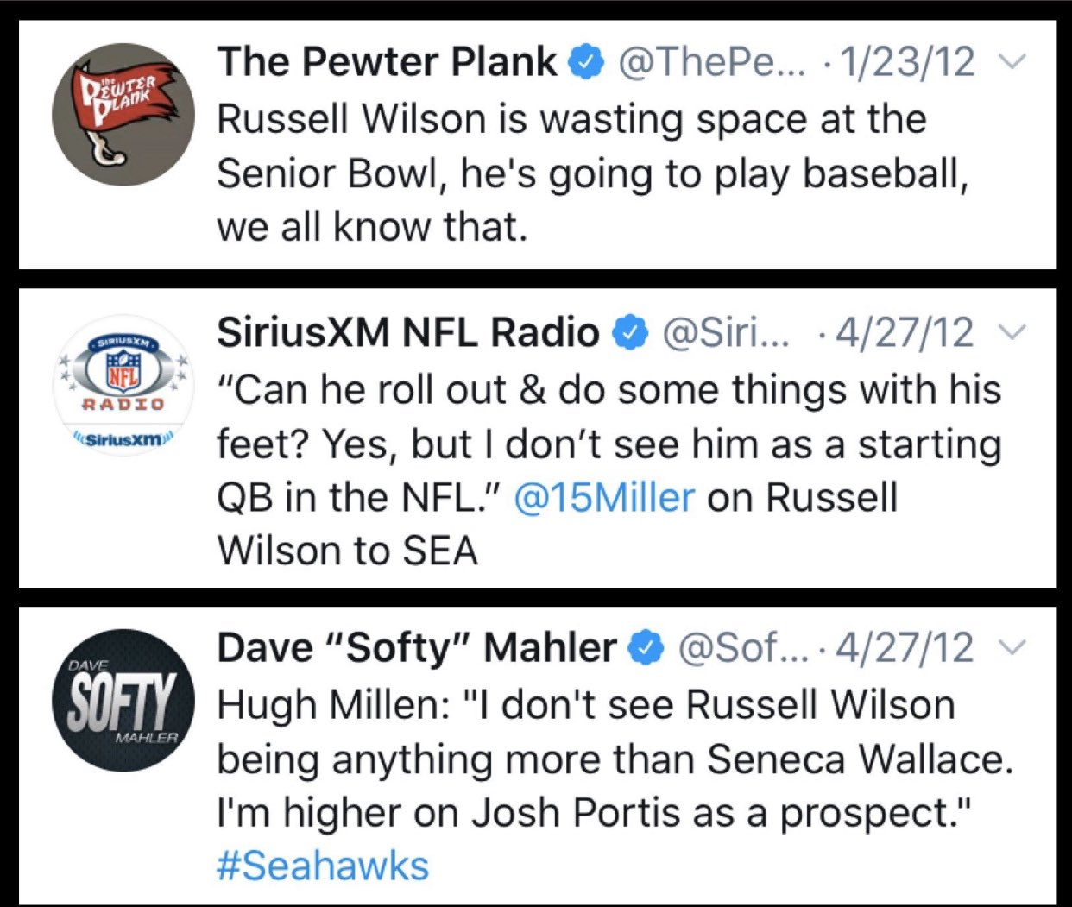
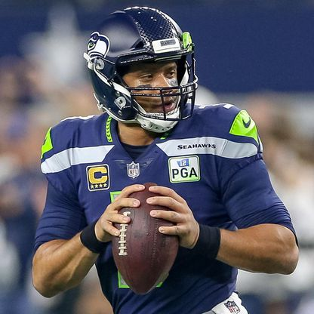
Lesson 2: Have confidence in yourself
Taken in 3rd Round of NFL draft
“Too short”
Won Superbowl in second year
5 QBs selected before him: 1 retired, 2 out of NFL, 1 backup, 1 starter
Russell Wilson, Seattle Seahawks QB
Superbowl Champion
Relevant talks: Bouncing back from failure

Slide 29
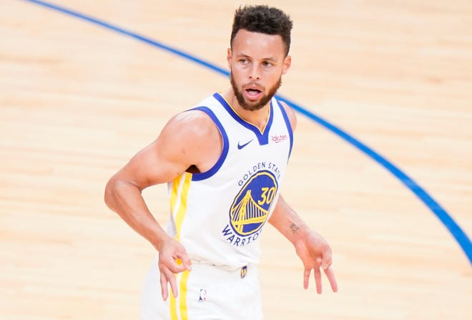
Lesson 2: Have confidence in yourself
3-star recruit out of HS
“Too frail to handle the physical rigor of high-level college basketball”
Played D3 Basketball at Davidson College
1st Unanimous NBA MVP
Lessons learned from Stephen & Russell:
Failure occurs to the best of us
Success is not quantified by one single moment
Passion x hard work = long-term success
Stephen Curry
Greatest 3 pt Shooter of all time
Fostered by mentors & environment
Relevant talks: Bouncing back from failure

Slide 30
Lesson 3: Know when to ask for help

Slide 31
Lesson 3: Know when to ask for help
Your Skillset & Background
All the advice out there
College confidential
Student doctor network
Reddit
WeChat forums
News articles
Good Advice
Trusted sources
Top posts
Relevant to you

Slide 32
Lesson 3: Know when to ask for help
Your Skillset & Background
3
All the advice out there
Good Advice
1
Great Advice helps you plan for success
Relevant to you
2
External advisors can help with 1, 2, & 3
Relevant talks: Finding advisors: how, when, and for what?
Notes:
Give you a framework to think about what advice is good vs bad.
External advisors can help you focus on the mission critical advice that is pertinent to selling yourself
They can also refine your skillset and background to be

