Slide 1
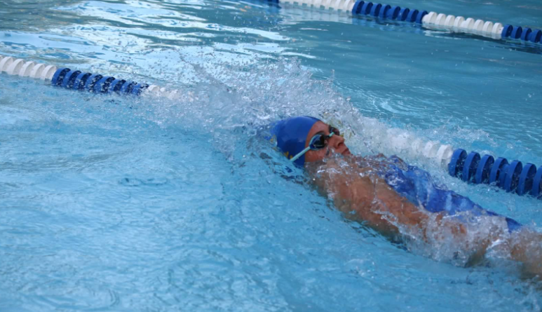
CSL SafeSport Approach
Summer 2024

Slide 2

Impact of SafeSport Act on all sports with athletes who are minors
Protecting Young Victims from Sexual Abuse and Safe Sport Authorization Act of 2017
Sports organizations must establish reasonable procedures to limit one-on-one interactions between an adult and an amateur athlete who is a minor… without being in an observable and interruptible distance from another adult
Consistent “abuse prevention” training to all adult members who are in regular contact with amateur athletes who are minors, and subject to parental consent, to members who are minors, regarding “prevention and reporting child abuse
Limit one on one interaction
Abuse Prevention Training
Any organization involved in youth sports held to an increased “standard of care” regarding reporting, training, policies and procedures, and periodic safety system reviews
Presence of more than one adult at every activity
Take-home/pick-up policy to prevent one-on-one situations with a child who was not picked up by parents after practice
Define appropriate touching of a child
Avoid socialization with participants outside of sponsored activities
Increased Standard of Care
Guidelines
Successful SafeSport implementation will positively impact our insurance rates

Slide 3
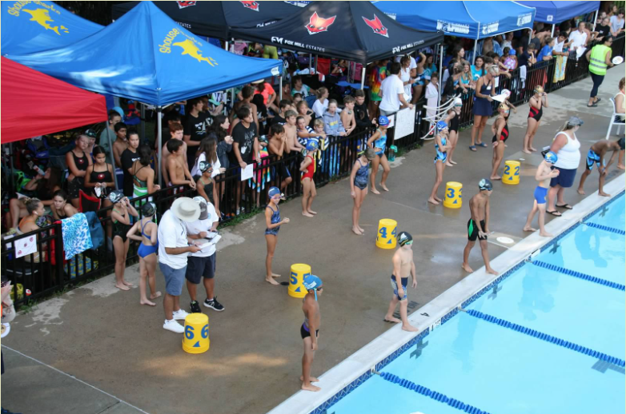
The CSL SafeSport 2024 Approach Focus on Training and Awareness
Training Groups for 2024 Season
Tracking Completed Training
Training Cost Responsibility
Roles to undergo SafeSport Core training for 2024 season:
Team Reps
Coaches 18 and over
Recommend free awareness training for:
Parents
Officials
Coaches under 18 (with parent’s permission)
Athletes (with parent’s permission)
Teams responsible to track coach and team rep completed training
Recognize completed SafeSport training as well as through other comparable programs
Teams cover cost of SafeSport Core training for their team reps and coaches

Slide 4
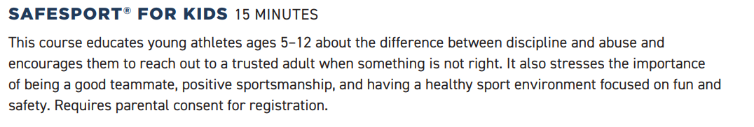

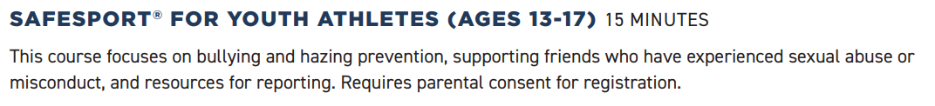
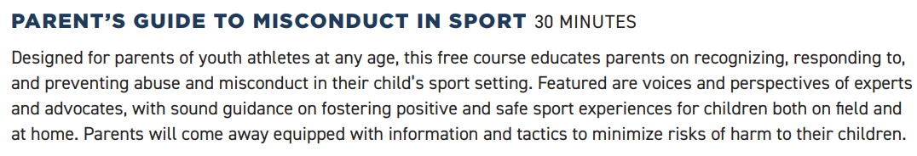
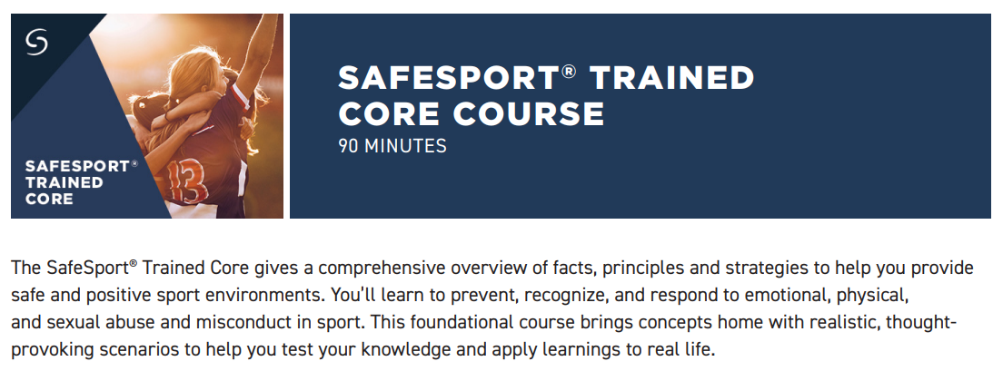
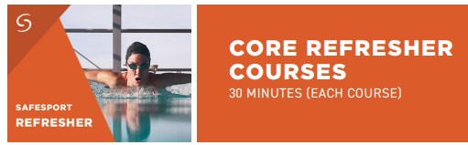
SafeSport Training Courses and Costs
Training Provider
Swimmers
Age 5 to 12
Age 13 +
Free
Parents
Volunteers
Free
Team Reps
Coaches
Annual Refresher Training $10 / Person
$20 / Person

Slide 5
Accessing SafeSport Training
SafeSport created emails with imbedded links for CSL teams to provide access to all self-purchase courses and Free Courses. The links to the training are included in emails sent to the team reps by the CSL SafeSport Lead, Deb Ramos.
YOU MUST USE THE LINKS PROVIDED IN THE EMAILS FOR THE TRAINING TO BE LOGGED.
Team Reps or other leadership must make this information available to Team Membership
A SafeSport training module will be updated on the updated CSL website as soon as we are able to post information there.

