Slide 1

Welcome to
Summer 2025

Slide 2
Parent meeting agenda
General team information
Parent Board introductions
Volunteering
Registration
Gear purchases
Questions and Answers

Slide 3
Team philosophy
We want to help every swimmer develop a love for the sport of swimming.
We believe that it is important that we expose all the swimmers to all of the strokes and encourage everyone to try every event.
We focus on quality and not quantity.
We want to encourage communication with the coaches. This includes issues such as leaving meets early, questions about DQs and what is going on at practice.

Slide 4
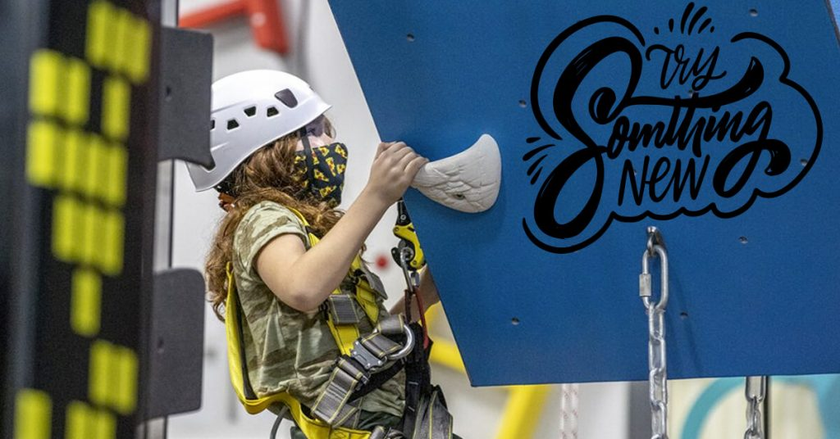

Slide 5
practice times and groups for 2025
Broken up by abilities instead of ages
It’s up to the parents to decide what group your swimmer belongs to.
Price reflects not only time, but number of coaches on deck. (Shorter time means more coaches)
We will work with parents to make sure all the swimmers are in the correct group.

Slide 6
Gold group
Early and late practice times
Early Gold AM time- 6:15 am to 7:30 am Monday-Friday
Late Gold AM time- 8:15 to 9:30 am Monday-Friday
Open to swimmers 13+. Special permission can be granted by the Head Coach for younger, advanced swimmers
2-3 coaches on deck
Swimmers should expect to swim around 2000 meters a day
Water Polo Fridays will only be during the early Gold Practice.

Slide 7
Purple group
Half of the team. Typically 9-12 year olds
3 different Purple AM times
6:30 to 7:30
7:30 to 8:30
8:30 to 9:30
Open to all ages but recommended for intermediate swimmers.
Your swimmer can move between times for a week or two if they have camps.
2-3 coaches on deck
Swimmers swim approx. 1500 meters

Slide 8
Green group
Green AM time- 7:30 am to 8:15 am Monday-Friday
If you have a Green swimmer and 8:30 to 9:30 works better for you, we will have a lane during the last purple group.
Open to all ages, recommended for beginning swimmers and younger (8 and under) swimmers *must be able to swim a 25 without touching the side*
4-5 coaches on deck
Distance depends on swimmers ability

Slide 9
Intro to marlins group
Tues/Thurs PM time- 5:30pm to 6:15 and 6:15 to 7:00pm
Restricted to age 10 and under, recommended for beginning swimmers or swimmers looking to check out what summer club swimming is all about.
2 coaches per lane
Limited to 12 swimmers per group (6 per lane)
Hopefully, the swimmers will feel comfortable trying out 1 meet.
Distance depends on swimmers ability

Slide 10
Tues/Thurs night practice
Tues/Thurs PM time- 5:00 to 7:00 pm
Open to all groups for swimmers who want to work on technique or make up practice.
6 lanes will be split into stroke work and regular practice depending on needs of the swimmers
3-4 coaches on the deck
Distance depends on swimmers ability

Slide 11
Wednesday night practice
Wednesday PM time- 5:00 to 7:00 pm
Open to all groups for swimmers who want to work on technique or make up practice.
Depending on need (make up or stroke work), we won’t go the whole time for younger swimmers.
No Intro to Marlins Swimmers
8 lanes will be split into stroke work and regular practice depending on needs of the swimmers
3-4 coaches on the deck
Distance depends on swimmers ability

Slide 12
Splash at Fossil Trace
We rent the pool from the City of Golden. Which means we will follow the City of Golden rules.
Pools are going to have very different rules. Just because AK can do something doesn’t mean we can.
We need to remember that the Marlins are just one of the patrons of pool. We have a great relationship with them and we want to keep it that way.

Slide 13
WEather
Colorado weather is hard to predict.
We won’t cancel practice unless we are 100% certain Splash will be closed.
It can be pouring rain at 5:00 and sunny at 5:15 (this has happened more times than I can count.)
The pool is heated, so we will have practice regardless of the outside temp.
We respect you as a parent to decide if the weather is ok for your swimmer.

Slide 14
Meets
State is July 25 - 27 at Splash.
League is July 18 - 20 at Anderson Pool)
You will still sign your swimmer up for events using the website. (For more info, see “Parent’s page” on our website.
Most meets are Saturday morning. They start early and are done before noon. The official schedule will be on the website.
Meets take a lot of people to run smoothly (and quickly). We need lots of parent help.

Slide 15
Social Events
Mock Meet & Ice Cream Social, Thursday 5/29
Swimmers can participate in races and grab some ice cream
Great for new swimmers who haven’t yet been to a regular season meet
Pancake Breakfast, June 13th
Swimmers and families are invited to have a full pancake breakfast when their practice session finishes
Swim Olympiad and BBQ Cook-off, July 10th
Evening at Splash to have dinner and participate in races, both serious and silly
Families are all invited to participate in races Earn volunteer hour credits by bringing 5 lbs of your own BBQ to share.
We will have a vote for the best BBQ – winner receives an extra volunteer credit!
End of Season Team Party, Tuesday 7/22
Evening at Splash with pizza, treats, & time to swim and play on the slides
Swimmer recognition with medals and coach appreciation

Slide 16
Parent Board
I’m the face of the Marlins, but these are the people who get all the work done.
Amanda Strouth- Communications & Registration
Ruth Brocko- Gear
Jenn Gomer - Social Events
Laura Waldrop - Treasurer
Maya Chain - On-boarding Treasurer
Rebecca Faverty - Volunteer Coordination
Diane & Jon Cain - At Large
Alison Bodor - Concessions Chair

Slide 17
Volunteering
The Marlins are great because of our Parents.
Best way to see your kid swim is to volunteer at swim meets. (Officials get to see every event!)
There are a lot of opportunities to volunteer if you can’t volunteer at meets. Check the website.
Each family is required to volunteer for 5 points.
One point is a timing shift, concessions shift, setup/cleanup shift, etc.
Full season opportunities are also available
Officials, Friday Bagel Servers, Head Timer, Home Meets Setup, Home Meets Tear Down, etc.
To make sure everyone does their part, we ask that every family writes a $250 “check” (We use your saved credit card). We only charge the card the end of the season if the family does not complete the volunteer requirements.

Slide 18
Important Dates
April 7th: 7:00am: Registration for returning members opens
April 8th: 7:00am: Registration for new members opens
Team store is open now, link on the website home page
April 21st: Team Store closes. **Important**
May 5th: 7:00am: First Batch of Volunteer positions open
May 19th - May 23rd: First week, evening practice
May 27th: First regular morning practice, team gear included with registration will be distributed that week
May 29th Mock Meet
May 30th: Last day for refund
May 31st: First Meet!
July 18-20: League Meet
July 22nd: Team Banquet
July 25-27: State Meet

Slide 19
REgistration
Register on the website using the “Registration” button in the upper right.
Discounts for multiple athletes from the same family.
Registration fee does not include gear.
No additional fees for meets.
Fees: $25 discount per sibling
Gold, Purple, Green Groups: $275
1st swimmer: $275, 2nd: $250, 3rd: $225, etc.
Intro to Marlins: $175
No Refunds after May 30th.

Slide 20
REgistration
Opens Monday, 4/7, at 7:00am for returning families. “Returning Family” status is by family, not swimmer.
Opens Tuesday, 4/8, at 7:00am for new families.
Please provide and verify your cell phone number. This is how we can contact you in case of an emergency.
We will close registration when we fill up. We want to make sure that everyone on the team has a positive experience. So, we want to keep the number of swimmers per lane manageable.

Slide 21
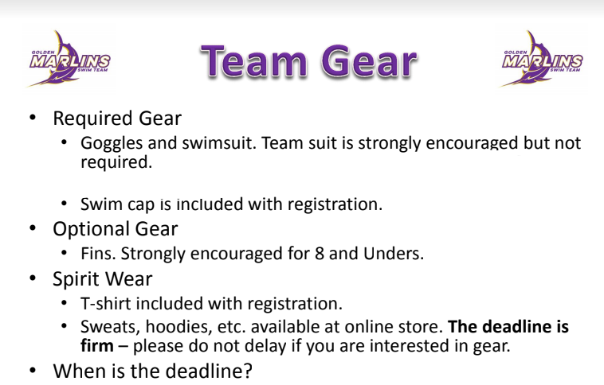
April 21nd!!

Slide 22
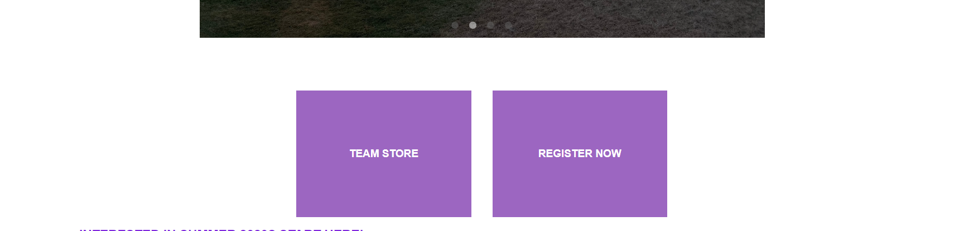
TEam STore is on the front page of the website
April 21st!!
April 21st!!

Slide 23
