Slide 1


Starter
YMCA of Greater Richmond
Training guide

Slide 2
Agenda
Starter Description
Training
Recertification
Main Responsibilities
Types of Starts
Calling the Starts
False Starts, Delays & Misconduct
Relay Take offs
Equipment
USA Swimming Video

Slide 3
Starter Description
The Starter is in control of the meet from the Referee’s signal until a successful start it completed. Electronic starters will be used at all meets. Each Branch is responsible for having a whistle available for backup. The visiting team should bring their electronic starter to the meet in case of a malfunction with the home team’s starter (if available).

Slide 4
Training
The Starter must review the YMCA approved training guide during the first year of service OR if certification is NOT continuously maintained. New Starters shall walk one full meet in order to complete the training.

Slide 5
Recertification
Work a minimum of two halves per year
Review the training guide as needed.

Slide 6
When walking a position…
Model
Watch the experienced worker in the position. Ask questions when you can.
Practice
Work the position yourself with the experienced worker monitoring
Feedback
Get feedback (both positive and constructive) on how you did from the experienced worker.

Slide 7
Starter Responsibilities
Your job is to get the swimmers on to the starting block (or in the water) and start each heat of each event.
Your main objective/purpose is to provide a fair start for all swimmers.
As always, the benefit of any doubt should go to the swimmer.

Slide 8
Starters Set the Pace of the Meet
Too fast and you can have false starts and incorrect timing information.
Too slow and you may be there late into the night.
The length of the meet is greatly affected by the performance of the Clerk of Course and the Starter.

Slide 9
In Water Starts
Certification by a coach of all swimmers is required before they can dive in the water at practice or at a meet.
All swimmers who are not certified to dive will be marked with a red band on their wrist.
If you see a swimmer with a red band on their wrist who is attempting to dive in, stop the heat and request that s/he get in the water.
Anyone is allowed to start in the water, even if s/he is certified to dive.
There may be special needs swimmers who will start in the water or have other accommodations; the Referee will alert you of these situations prior to the meet.

Slide 10
Out of Water Starts
Some swimmers may be certified to dive off the deck but not off the blocks- their shoulders will be marked with a green band on their wrist to indicate side certification.
If you see a swimmer with an green band on her/her wrist who is attempting to dive off the block, stop the heat and request that s/he dive from the deck.

Slide 11
Backstroke Starts
All backstroke events will start in the water.
Note that Medley Relays begin with backstroke.
In Backstroke, the swimmer is not allowed to put his or her toes over the lip of the gutter or pool.
If a Starter sees this, s/he should ask the swimmer to move his or her toes.
It is a disqualifiable offense if the swimmer does not move his toes or the toes go over the lip after the start.
Notes:
We have them wear bands? Is it a red band for in water starts?

Slide 12
Starts and Water Depth
USA Swimming Rules dictate that no swimmer shall dive into water that is less than four feet (4’) deep.
Many pools will require that starts at the turn end will be from in the water.
This only effects the 8&Under relays as the timers will move for the short distance for 8&Under events.
In pools where swimmers start from both ends, it will be necessary for the starter to move to the starting end (Champs only).
Notes:
We have them wear bands? Is it a red band for in water starts?

Slide 13
Conferring with the Referee
Meet with the Referee prior to the start of the meet to see if there are any special needs swimmers and also to see how the Referee plans to run the meet.
The Starter should remain in contact with the Referee throughout the whole meet.

Slide 14
Working with Timers
Before starting each heat, it is a good idea to make sure the timers are ready.
If the timers are taking too long, the Referee may be able to talk to the Head Timer so that it doesn’t slow the meet.
The timers will need to see the light of the starter mechanism since they will start their watches on the blink of the light rather than the sound of the horn that starts the swimmers.
Take note of where the light is when timers move. Can they still see it?

Slide 15
At the Start…
According to USA Swimming, the following is optional for the starter to do:
Announce the event (Typical)
For backstroke starts, give the command, “place your feet” (Up to the starter).
Use the meet program to determine how many swimmers should be at the block.
You can look or wait for a missing swimmer, but it may be that s/he has scratched.
Note that sometimes swimmers have difficulty getting around the timers.

Slide 16
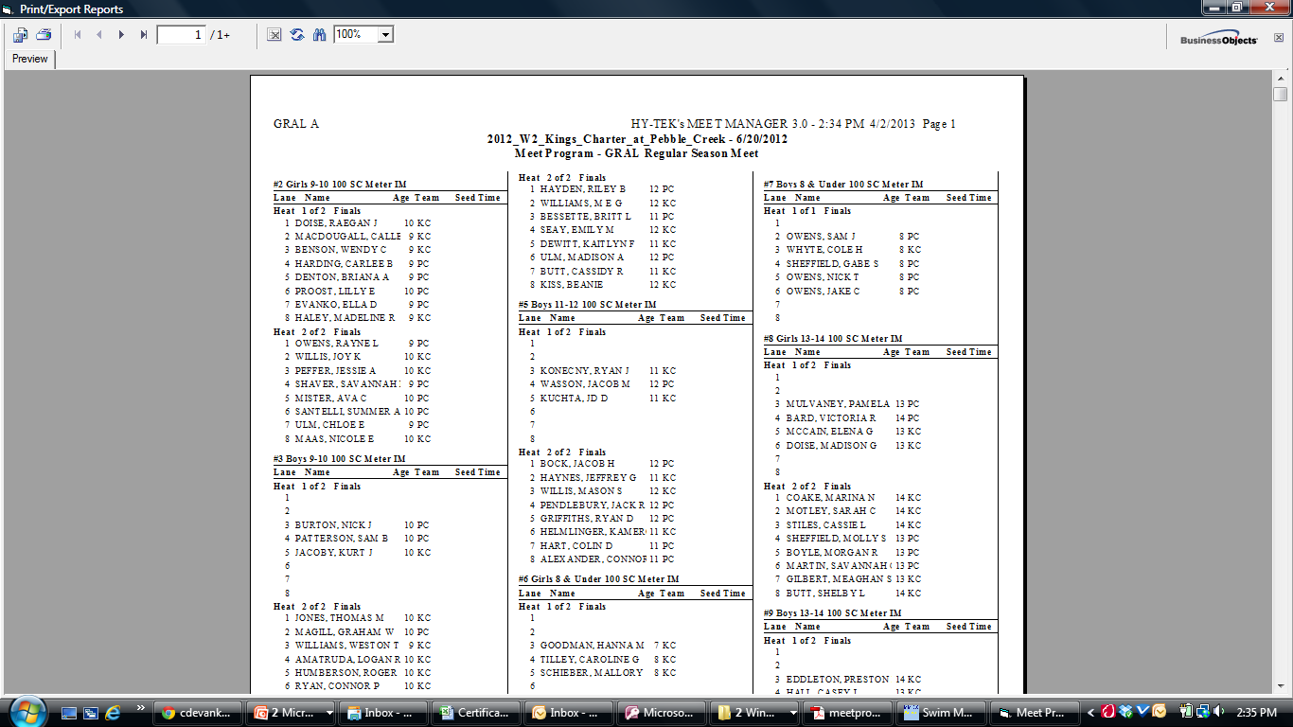
The Meet Program
Event Number and Name
Number of Heats
Note that these lanes will not have swimmers in this heat.

Slide 17
What the Starter Says..
“Event two, girls nine ten, one hundred meter IM, heat one of two.”
Most Starters will announce the event, although USA Swimming Rules says that it is optional. This can be said while the previous event is still swimming in the water, approaching their finish.
“Heat one step up.”
This lets the swimmers next in line know that their event is about to start.
“Take your mark.”
For subsequent heats… “Heat ____ step up… Take our mark.”
It is important to say the correct heat number for timer sheets, DQ cards, etc.
In backstroke, you should tell the swimmers to “Step in” when the last heat of the prior event has all exited the pool.
It is optional to say “place your feet” prior to “take your mark.”
If there is a reason to delay the start, say “Stand up” for all events except Backstroke, and “relax” for Backstroke.

Slide 18
What the Swimmers do..
When the starter give the “Take your mark” command, some part of the swimmer will usually move to their starting position
May swimmers will bend down to grab the block and/or move a foot to the front.
Swimmers must have at least one foot at the front of the block and must assume a stationery position.
The swimmer may grab any part of the block, or s/he doesn’t have to touch the block at all.
In Backstroke, after the “Take your mark” command, most swimmers will pull their upper bodies closer to the block or side of the pool.
Some younger swimmers may not do this.
If a swimmer looks wobbly or not ready, you can give the command “Stand up or Relax.”
If there is a loud noise, flash, or other occurrence that might cause a distraction to the swimmers or an unfair start, you should ask them to stand, then restart when the situation is clear.

Slide 19
False Starts
When a swimmer leaves the block or starting position prior to the start signal, this is called a False Start.
All swimmers are allowed one false start per event.
Upon the second false start of the same swimmer (observed by both the Starter and Referee), the Referee will write the card to disqualify the swimmer.
If you see a swimmer false start, you should hold down the signal button (which will repeat the signal over and over).
Then the recall rope will be dropped by the lifeguard.

Slide 20
Delay and Misconduct
The Referee and Aquatics Director is responsible for handling situations of delay and misconduct.
If a swimmer is purposefully delaying a start or showing other signs of misconduct, confer with your Referee so that they can inform the Aquatics Director.

Slide 21
The Starter Mechanism
Teams are responsible for having their own starter mechanisms.
Away teams should bring theirs to each meet in case of a home team starter malfunction (if available).
Your Aquatics Director is responsible for the starter mechanism.
This person should make sure it is plugged in for charging 24 hours prior to the meet.
This person also sets up the starter equipment at the meet.
If it necessary to have a whistle in case both starter mechanisms fail at the meet.

Slide 22
Ask your Aquatics Director to sample the equipment!

