Slide 1

Lassiter Swim and Dive
2020-21 End of season awards ceremony

Slide 2

Lassiter Invite Duck Raffle
FOCUS has been providing the FAST Fins Adaptive Swim Team since January of 2009. Every season we serve around 80 children and teens with special needs and their siblings by giving them the opportunity to be part of a team experience. FAST Fins provides eight separate practices across metro Atlanta supervised by physical and occupational therapists, recreation instructors, and experienced volunteers who provide a welcoming and supportive environment for swimmers to grow in their abilities. Swimmers practice for months in the spring and fall seasons leading up to the biannual intra-squad meet that brings all of our separate practices together to compete and celebrate their accomplishments. FAST Fins is always evolving to better serve our swimmers’ needs and FOCUS is constantly striving to provide the best programs for its families. We hope to keep swimming for years to come.
https://www.dropbox.com/s/4eltg5v9zjg7vtr/Audrey%20Swim%20Team%20Thanks.mp4?dl=0

Slide 3
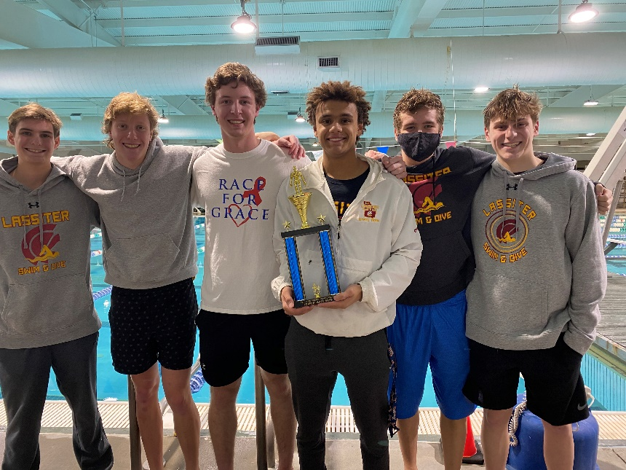
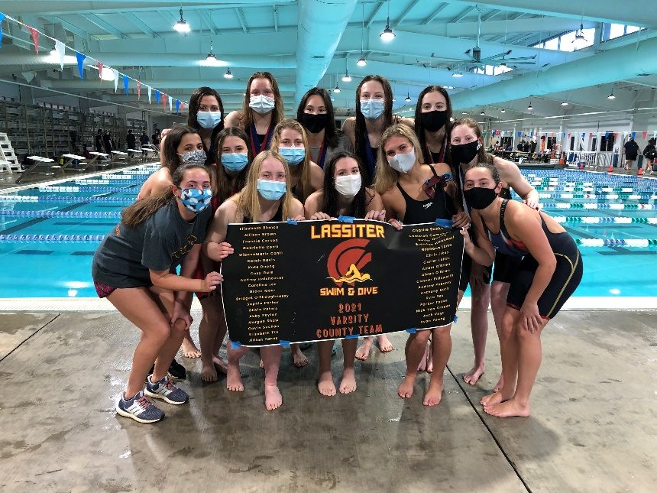
2020-21 Accomplishments
Boys
  4th Place Cobb County Championship
  6th Place GHSA 6A State Championship
Girls
  2nd Place Cobb County Championship
  1st Place GHSA 6A State Championship!!!

Slide 4
2020-21 VARSITY COUNTY
TOP 10: BOYS
Keifer Duong (8th 100 Breast)
Brendan Hausdorf (3rd 100 Free, 2nd 100 Breast)
Adam O’Brien (2nd 100 Fly, 4th 100 Back)
Carter Loftin (2nd Dive)
Parker Tanke (4th 200 IM)
Nick Van Vreede (10th 100 Back)
Brandon Lamb (7th 100 Breast)

Slide 5
2020-21 VARSITY COUNTY
TOP 10: GIRLS
Elizabeth Blanco (8th 50 Free, 2nd 100 Back)
Sophia Parker (5th 50 Free, 3rd 100 Fly)
Allison Brown (3rd 200 Free, 2nd 500 Free)
Francie Carson (2nd 200 Free, 1st 100 Free)
Elizabeth Tilt (1st 200 IM, 1st 100 Fly)
Bridget O’Shaughnessy (5th 200 Free, 3rd 500 Free)
GiannaMarie Conti (10th 200 IM)
Morgan Shaw (9th 100 Free)
Gavin Suchan (9th 500 Free)

Slide 6
Cobb Swim Coaches Association 1st Team All County
Elizabeth Blanco
Allison Brown
Francie Carson
Bridget O’Shaughnessy
Sophia Parker
Elizabeth Tilt
SWIMMER OF
THE YEAR!
Brendan Hausdorf
Carter Loftin
Adam O’Brien
*2nd Team and Honorable Mention is currently being voted on by coaches and will be emailed out ☺
*MDJ will also release a list in the coming weeks

Slide 7
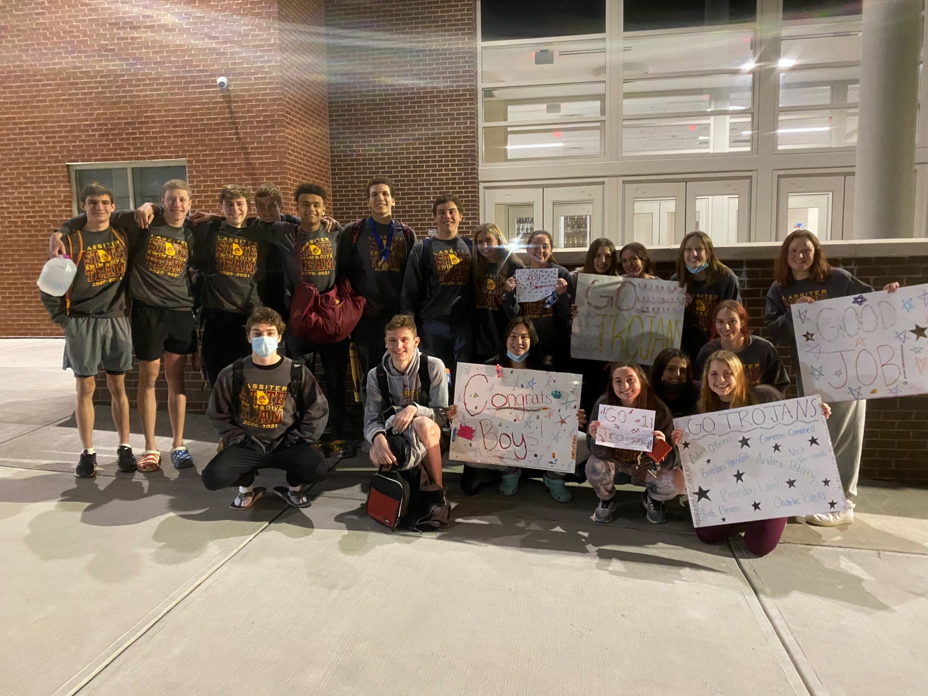
2020-21 State Team
Charlie Banks
Elizabeth Blanco
Allison Brown
Cameron Campbell
Francie Carson
GiannaMarie Conti
Sarah Davis
Elliot Elmore
Cosy Gale
Brendan Hausdorf
Audrey Holshouser
Brandon Lamb
Caroline Lee
Carter Loftin
Adam O’Brien
Olivia Peters
Bridget O’Shaughnessy
Sophia Parker
Abby Peyton
Andrew Pokorny
Morgan Shaw
Gavin Suchan
Parker Tanke
Elizabeth Tilt
Nick Van Vreede
Jillian Yanes
Shannon Yanes

Slide 8
2020-21 GHSA 6A State Championship Top 20: Boys
Elliot Elmore (11th 50 Free)
Brendan Hausdorf (5th 100 Free, 6th 100 Breast)
Brandon Lamb (11th 100 Breast)
Carter Loftin (2nd Diving)
Adam O’Brien (1st 100 Fly, 12th 100 Back)
Parker Tanke (12th 200 IM, 17th 500 Free)

Slide 9
2020-21 GHSA 6A State Championship Top 20: Girls
Allison Brown (2nd 200 Free, 2nd 500 Free)
Francie Carson (4th 200 Free, 2nd 100 Free)
Sophia Parker (6th 50 Free, 2nd 100 Fly)
Elizabeth Blanco (8th 50 Free, 3rd 100 Back)
Elizabeth Tilt (1st 200 IM, 1st 100 Fly)
Bridget O’Shaughnessy (5th 200 Free, 4th 500 Free)
GiannaMarie Conti (14th 200 IM, 19th 100 Back)
Audrey Holshouser (15th 50 Free, 12th 100 Fly)
Morgan Shaw (18th 50 Free, 20th 100 Free)
Gavin Suchan (16th 500 Free)
Cosy Gale (18th 100 Back)

Slide 10
State Relay Recognition
Boys 200 Medley Relay- 4th
Parker Tanke, Brendan Hausdorf, Adam O’Brien, Charlie Banks
Boys 200 Freestyle Relay- 15th
Elliot Elmore, Cameron Campbell, Brandon Lamb, Charlie Banks
Girls 200 Medley Relay- 2nd
Elizabeth Blanco, Elizabeth Tilt, Sophia Parker, Francie Carson
Girls 200 Freestyle Relay- 1st
Allison Brown, Elizabeth Blanco, Bridget O’Shaughnessy, Francie Carson
Girls 400 Freestyle Relay- 1st
Allison Brown, Bridget O’Shaughnessy, Sophia Parker, Elizabeth Tilt
Boys 400 Freestyle Relay- 7th
Parker Tanke, Elliot Elmore, Adam O’Brien, Brendan Hausdorf

Slide 11
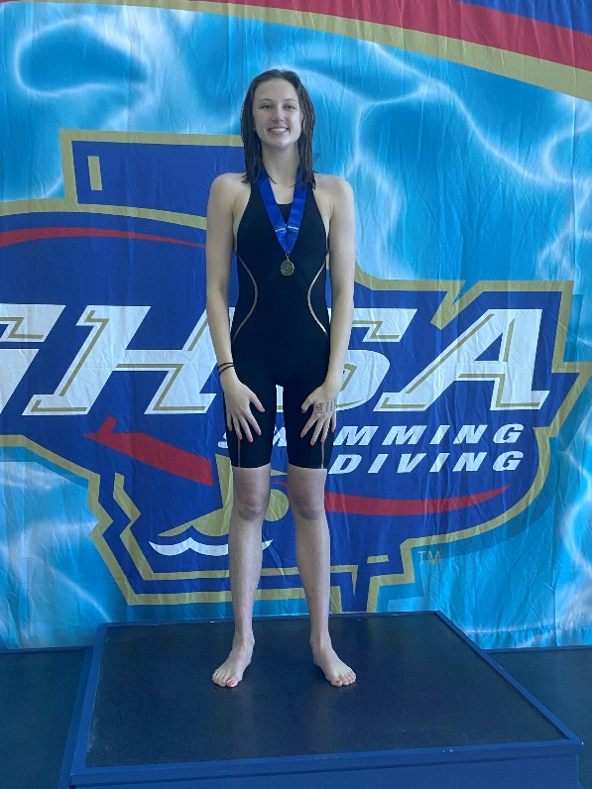
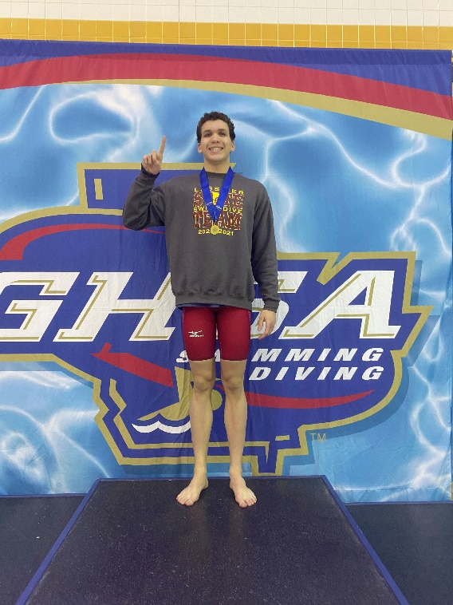
STATE CHAMPS!
Adam O’Brien
Elizabeth TIlt
100 Butterfly
200 IM
100 Butterfly

Slide 12
All America Qualifiers
Consideration
Carter Loftin- 11 Dives, County, 540.35
Elizabeth Tilt- 100 Fly, State, 54.81
Girls 200 Medley Relay- County Finals, 1:45.89
Elizabeth Blanco, Elizabeth Tilt, Sophia Parker, Francie Carson
Girls 400 Free Relay- County Finals, 3:30.31
Allison Brown, Bridget O’Shaughnessy, Sophia Parker, Elizabeth Tilt
Automatic
Adam O’Brien- 100 Fly, State, 48.86
Elizabeth Tilt- 200 IM, State, 2:00.27

Slide 13
2020-21 New School Records
Carter Loftin
11 Dives, County Meet, 540.35
Previous record from 2017
Elizabeth Tilt
200 IM, State Finals, 2:00.27
Previous record from last season
100 Fly, State Finals, 54.81
Previous record from last season
6 Dives, Divisional Meet, 291.20
Previous record from 2018
12 Dives, State Meet, 581.50
Notes:
59.11

Slide 14
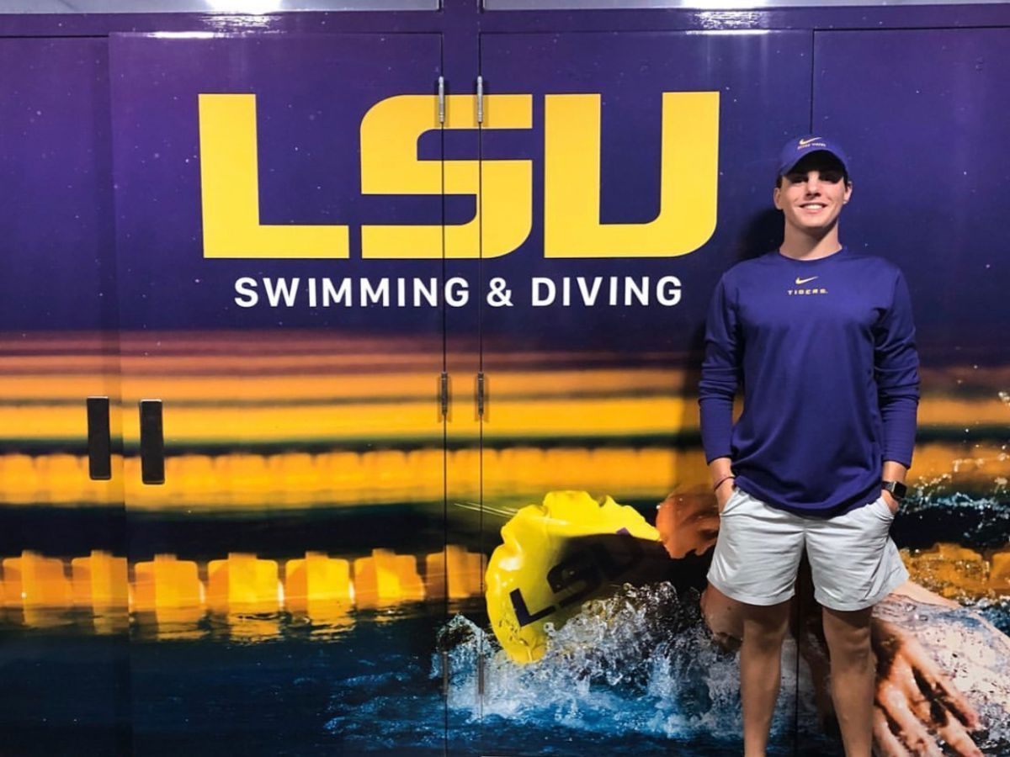
Class of 2021 Signees
Brendan Hausdorf
  Louisiana State University

Slide 15
Underclassmen
Letter and Certificate Presentation

Slide 16
Freshmen
Mackenzie Bryant
Nicole Cadavid
GiannaMarie Conti
Kate Duong
Elliot Elmore
Julian Farah
Cosy Gale
Tim Harrison
Kathryn Lindsley
Lindsey McCrea
Aidan O’Brien
Julia Randall
Anthony Rath
Thiago Silva

Slide 17
Sophomores
Griffin Dilworth
Emily Freeland
Maddie Hobby
Caroline Lee
Carter Loftin
Nicolas Magdusian
Grace Moore
Sophia Parker
Olivia Peters
Morgan Shaw
Ella Sortino
Gavin Suchan
Parker Tanke
Elizabeth Tilt
Bridget Walsh
Ronald Whitesel

Slide 18
Juniors
Charlie Banks
Elizabeth Blanco
Allison Brown
Francie Carson
Seth Claycomb
Gabriella Conti
Taylor Cushenberry
Keifer Duong
Riley Elliott
Alex Hill
Jake Lyons
Adam O’Brien
Bridget O’Shaughnessy
Abby Peyton
Andrew Pokorny
Kyle Rex
Kiera Shively
Jason Franklin- “Manager”

Slide 19
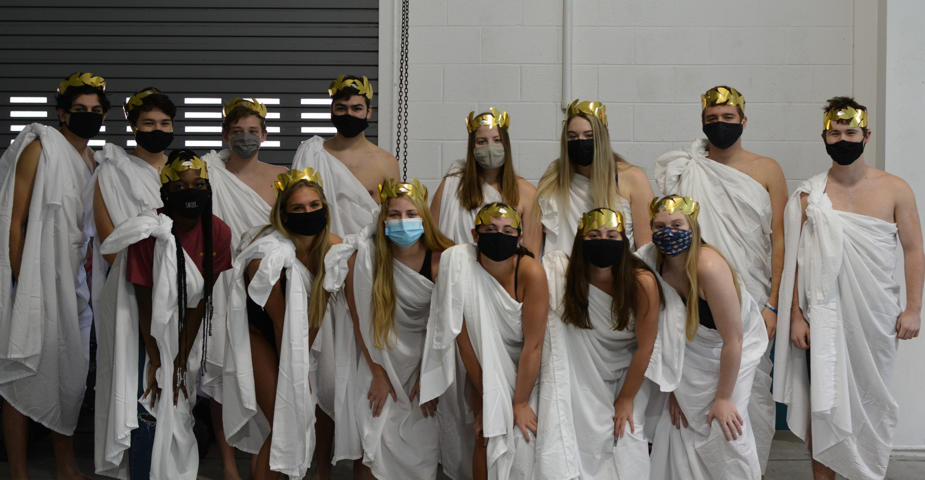
2020-2021 Senior Class

Slide 20

Seniors in the Classroom
Swimmers and Divers in the Class of 2021 have an average weighted GPA of 3.958!!
Academic All Americans- Varsity Letter Recipient with a weighted GPA of 3.75 or higher
*CSCA Scholarship due Friday!
Rebekah Andress
Ashton Baraji
Jack Coleman
Payton Crowe
Sarah Davis
Julia Gibson
Audrey Holshouser
Brandon Lamb
Connor Pillsworth
Jillian Yanes
Shannon Yanes

Slide 21
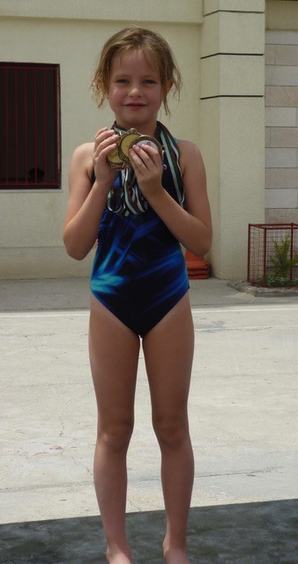
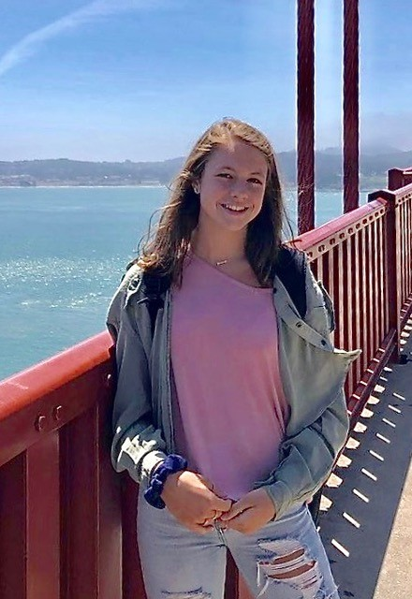
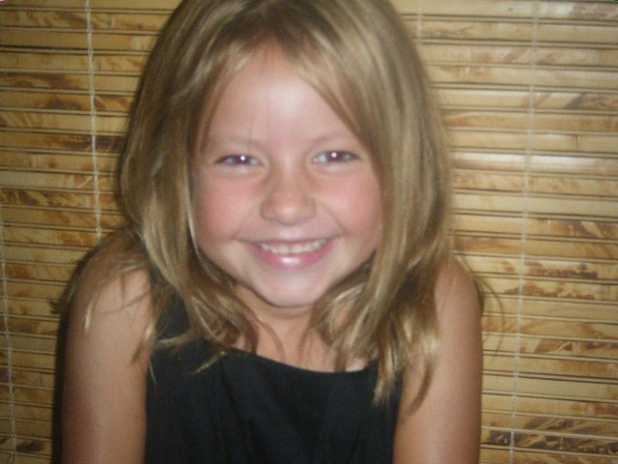
Rebekah Andress
4 year team member
Favorite Event: 100 Free
Favorite Memory: Swimming with her older sister Hannah on a Relay at State
Undecided college plans

Slide 22
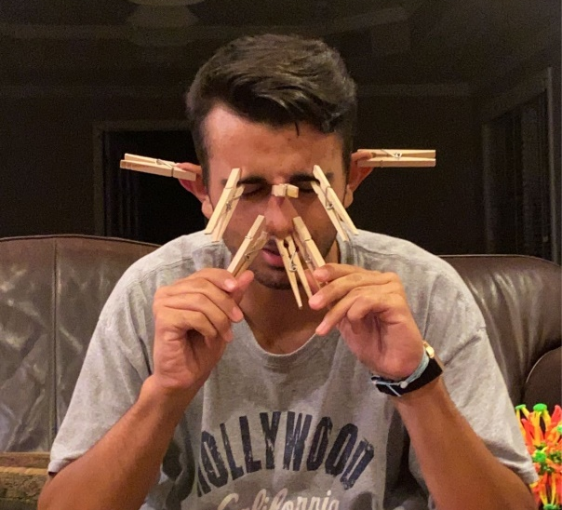
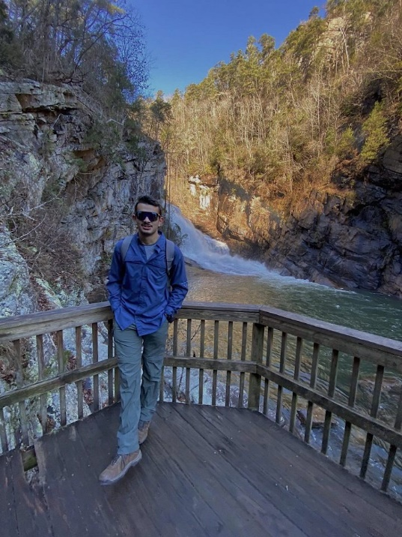
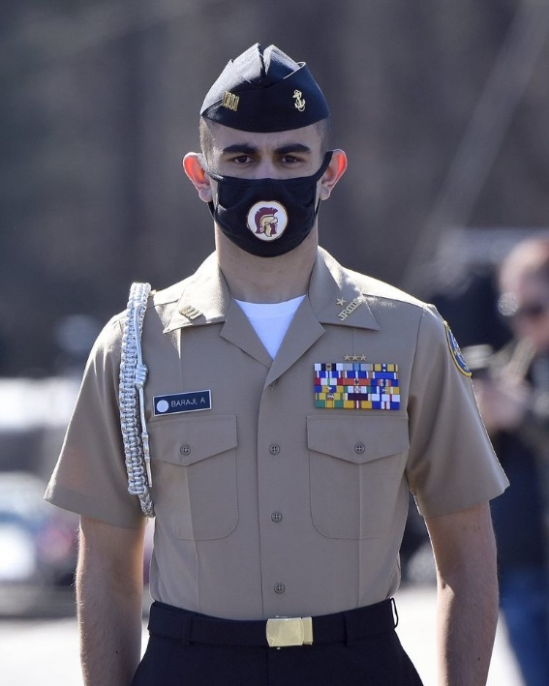
Ashton Baraji
3 year Team Member
Favorite Event: 50 Free
Favorite Memory: Going to Westminister
Plans on attending UGA

Slide 23
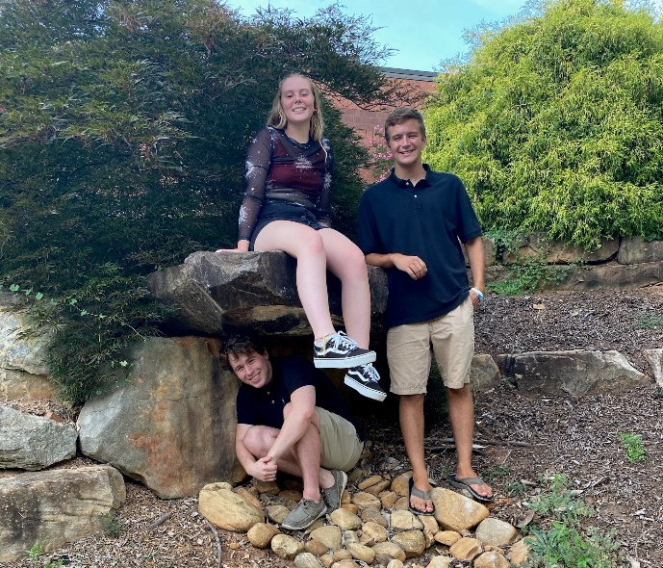
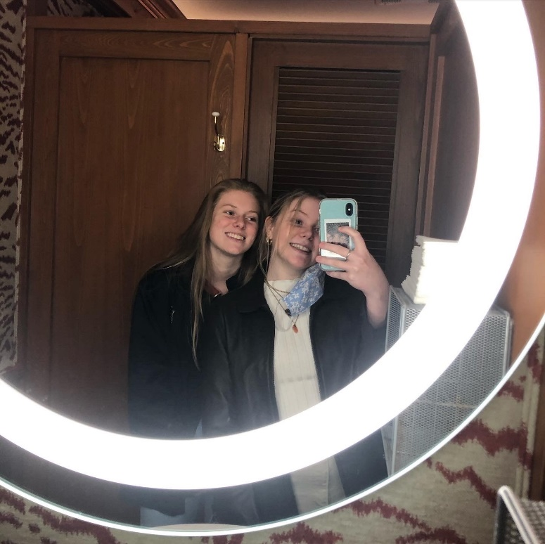
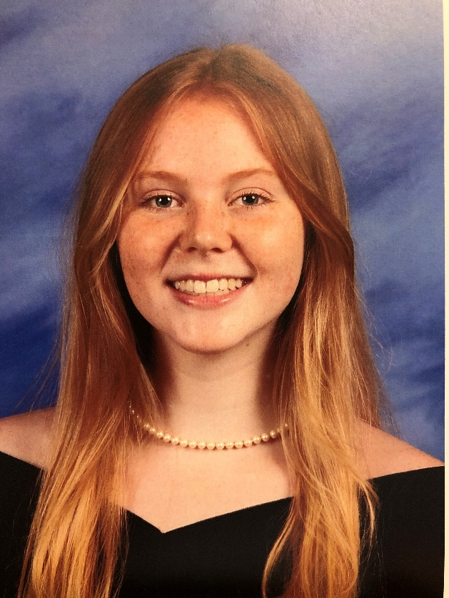
Payton Crowe
4 year team member
Favorite Event: 50 Free
Favorite Memory: Dropping time at Central and my friends Nick and Connor cheering me on and congratulating me at the end
Plans on attending SCAD or UGA and majoring in Fine Arts, pursuing a career as an artist

Slide 24
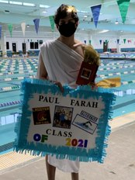
Paul Farah
2 year Team Member
Favorite Event: 100 Free
Favorite Memory: Last year’s Westminister meet
Hopes to one day become a lawyer.

Slide 25
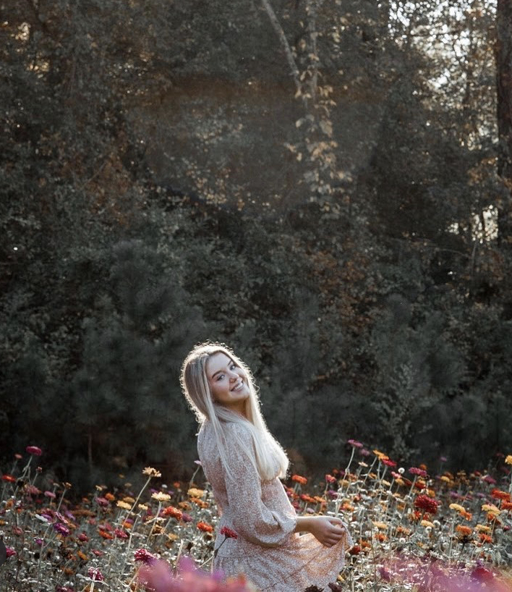
Julia Gibson
2 year team member
Favorite Event: 50 Free
Favorite Memory: Rubber Duck Fundraiser
Plans on majoring in finance next year

Slide 26
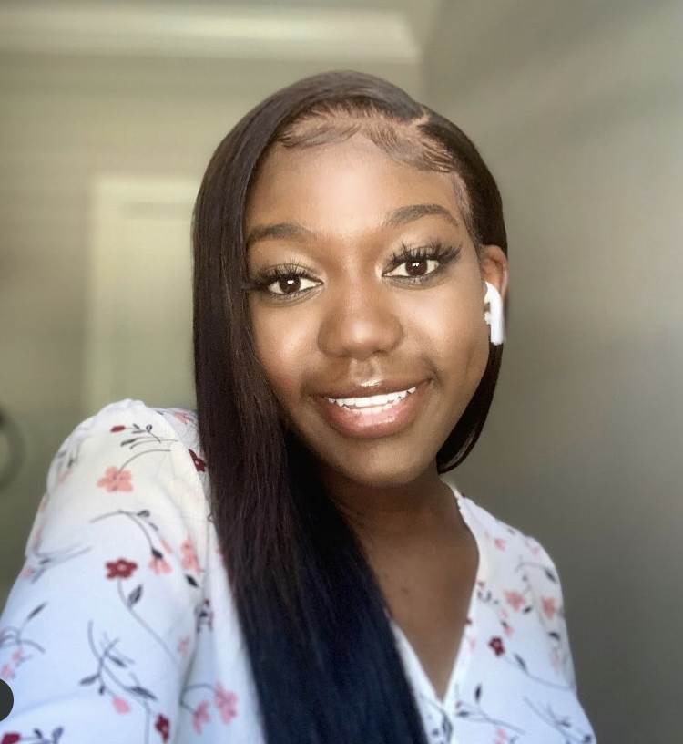
Jadah Jackson
3 year team member
Swim and Dive
Favorite Event: 100 Free/Breast
Favorite Memory: Bus rides to meets
Plans on attending a Historical Black College or University and start her own business

Slide 27
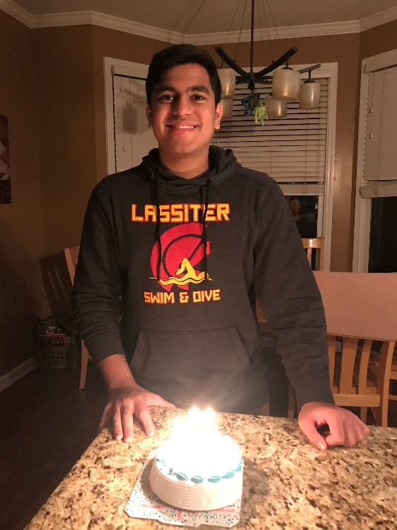
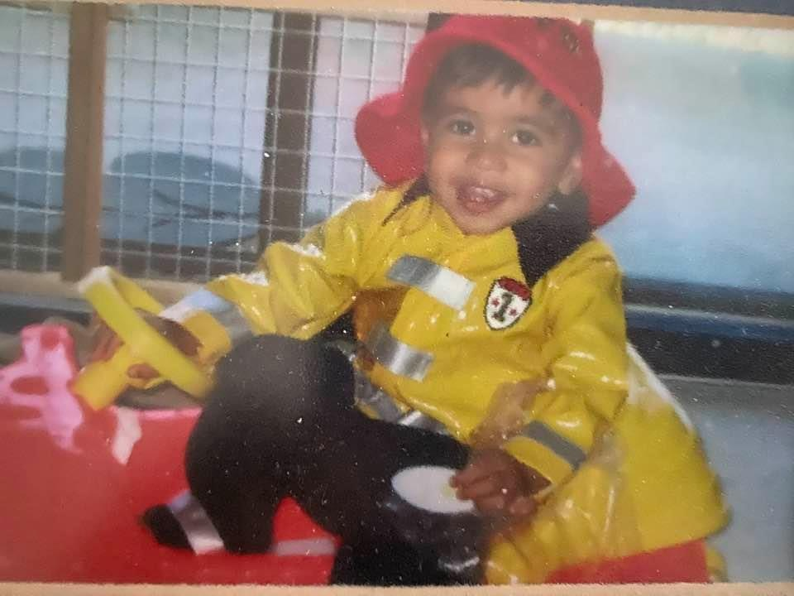
Nikhil Khant
4 year team member
Favorite Event: 50 Free
Favorite Memory: The Westminster meets
Plans on attending Georgia Tech and studying Mechanical Engineering

Slide 28
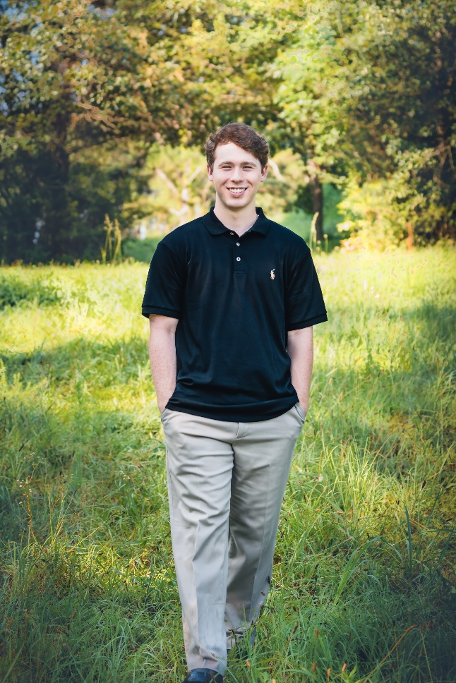
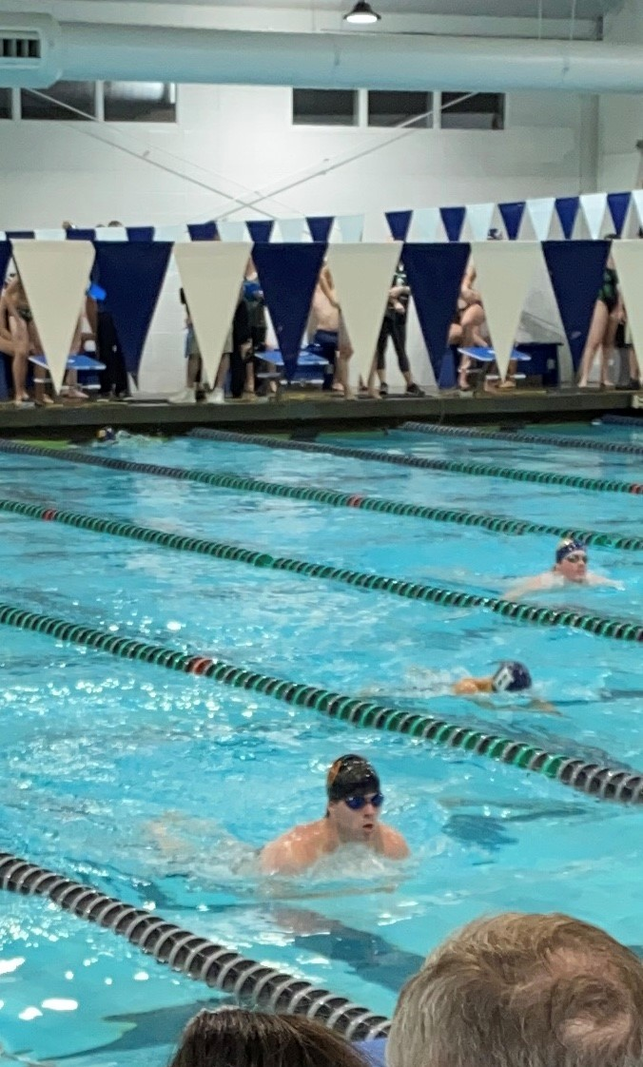
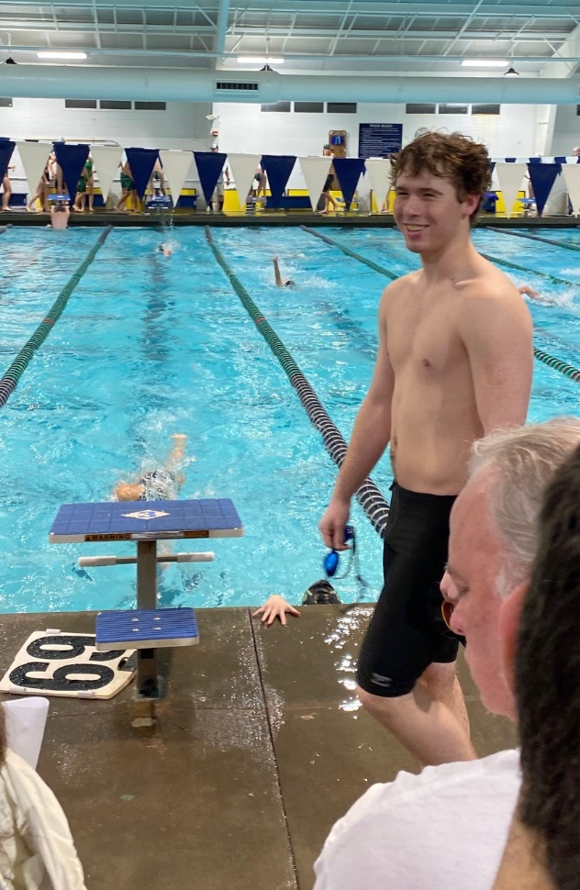
Connor Pillsworth
4 year team member
Favorite Event: 50 Free
Favorite Memory: Going to Waffle House after meets
Plans on attending college next year

Slide 29
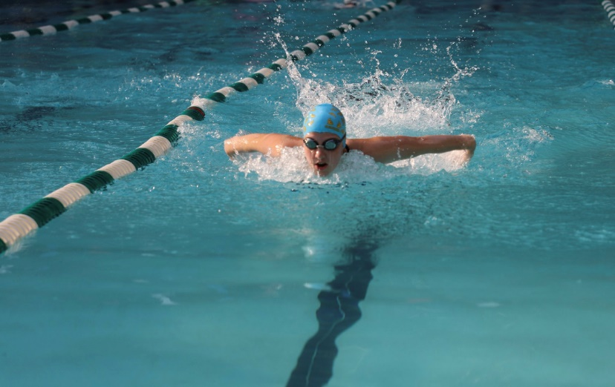
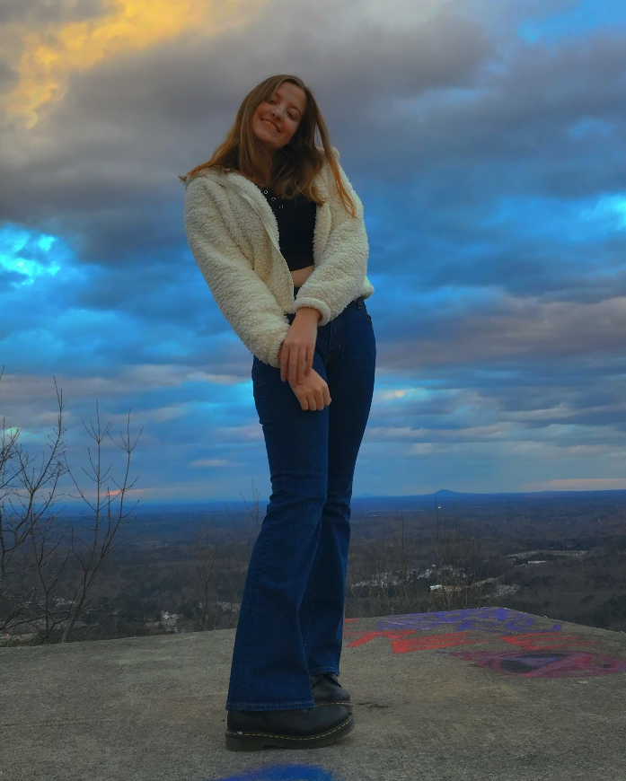
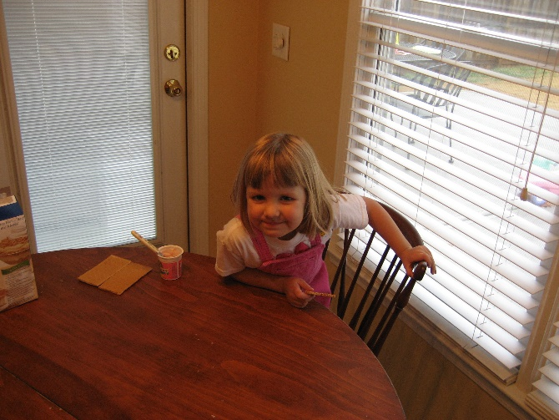
Lauren Rhodes
4 year team member
Favorite Event: 50 Free and 100 Back
Favorite Memory: Away meet bus rides
Plans on attending University of Alabama next year

Slide 30
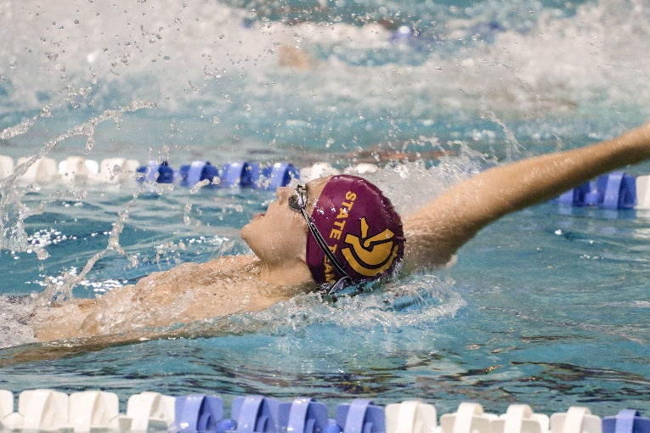
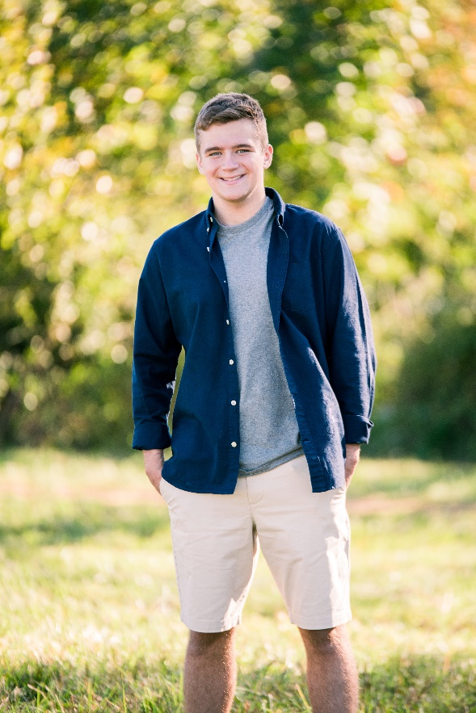
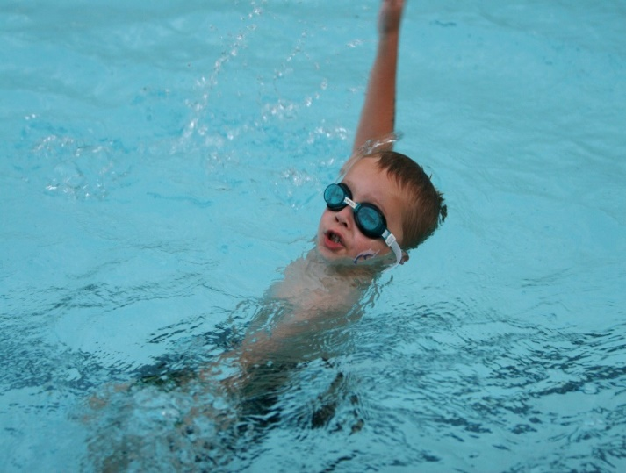
Nick Van Vreede
4 year team member
Favorite Event: 100 Back
Favorite Memory: Making the 100 Back State cut at County
Plans on attending college (TBD where!)

Slide 31
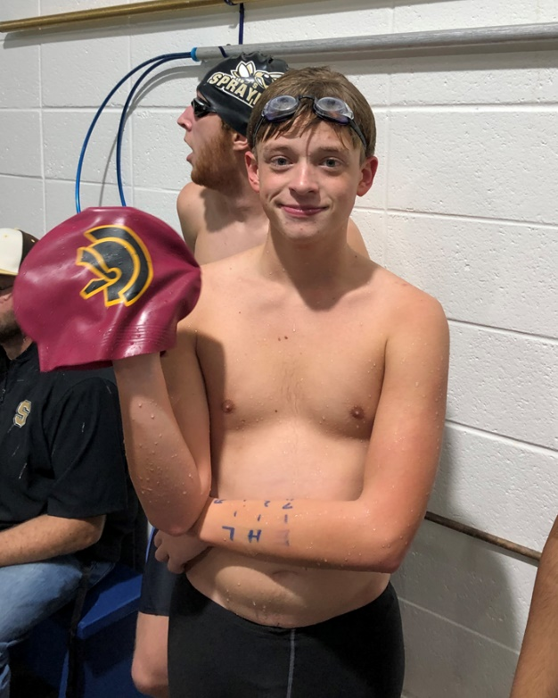
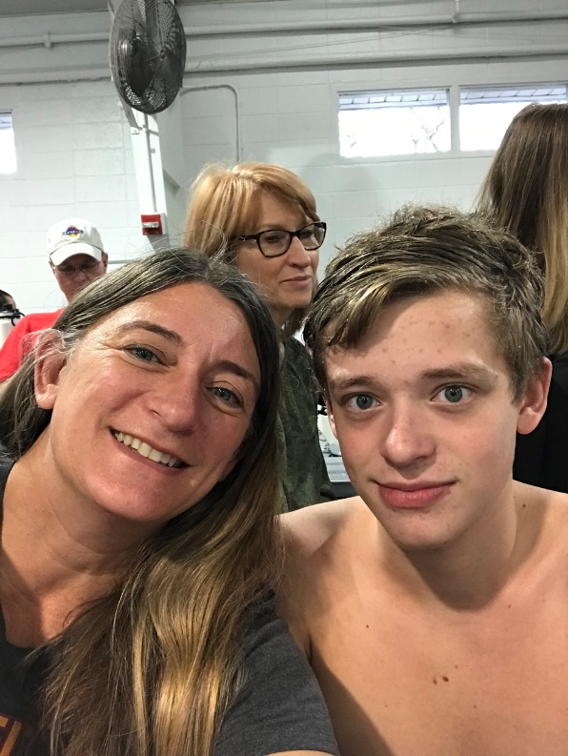
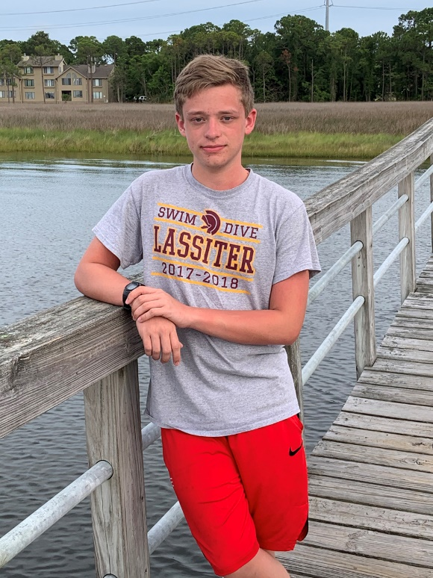
Jack Vogt
4 year team member
Favorite Event: 500 Free
Favorite Memory: Enjoying the swim banquets with friends
Plans on majoring in logistics and attending GSU

Slide 32
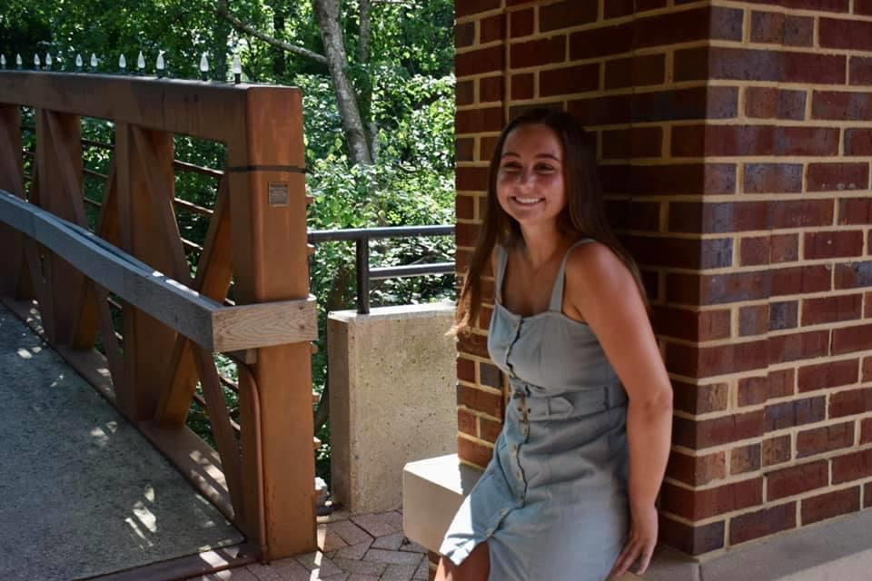
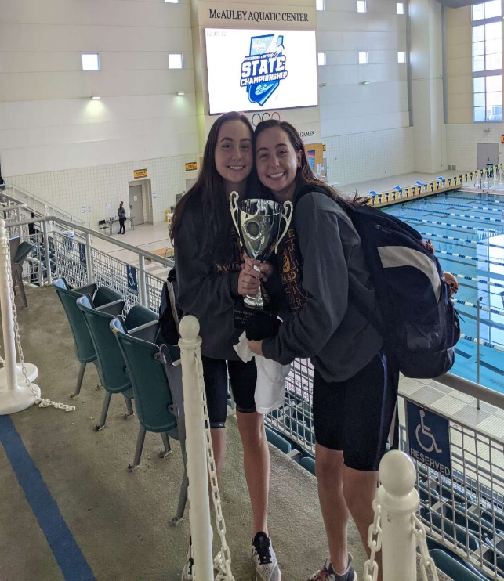
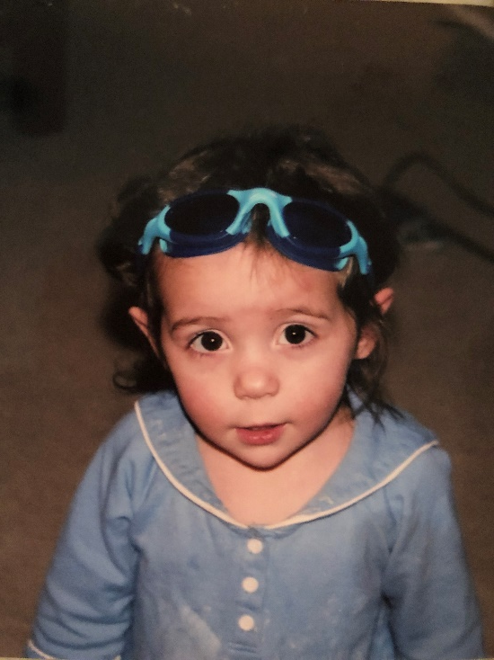
Jillian Yanes
4 year team member
Favorite Event: 100 Back
Favorite Memory: Being 2x STATE CHAMPS!!!
Plans on attending Colorado School of the Mines next year

Slide 33
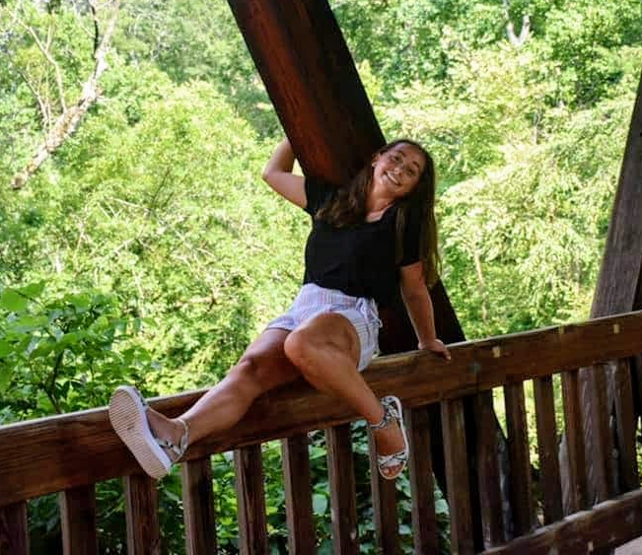
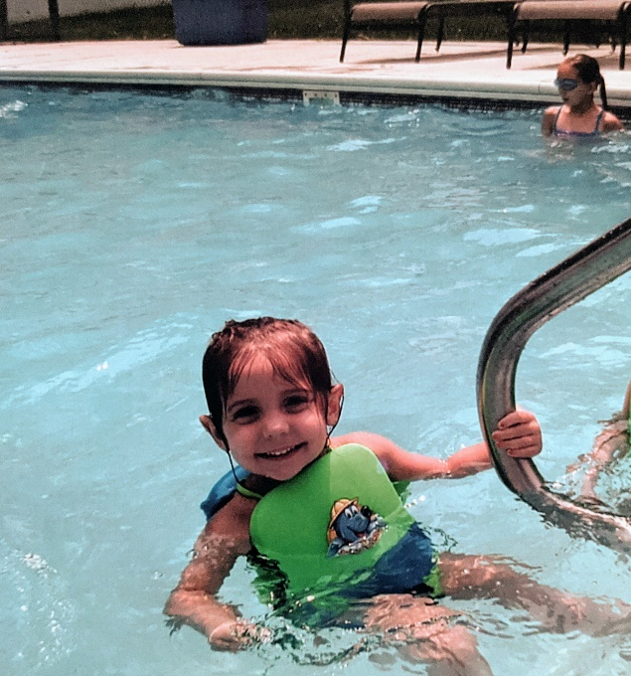
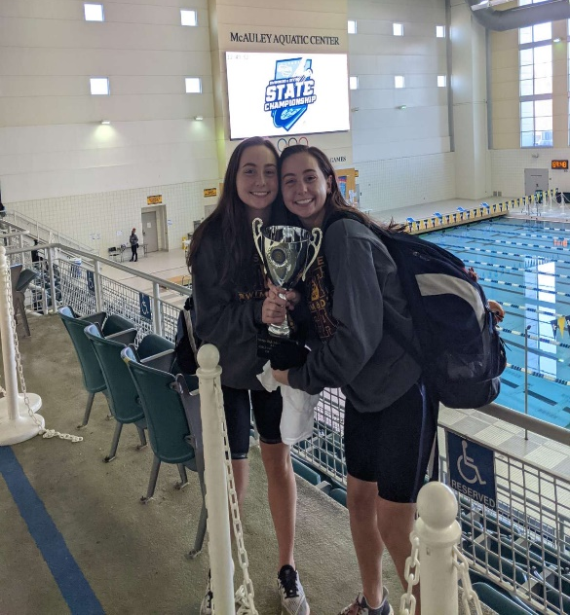
Shannon Yanes
4 year team member
Favorite Event: 100 Fly
Favorite Memory: Winning State TWICE!
Plans to attend University of Utah next year

Slide 34
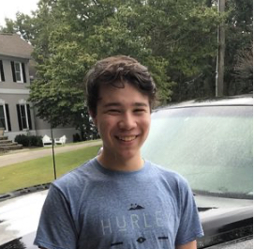
Ryan Young
4 year team member
Favorite Event: 50 Free
Favorite Memory: Going under 26 seconds in the 50 free
Wants to attend GA Tech and major in mechanical engineering

Slide 35
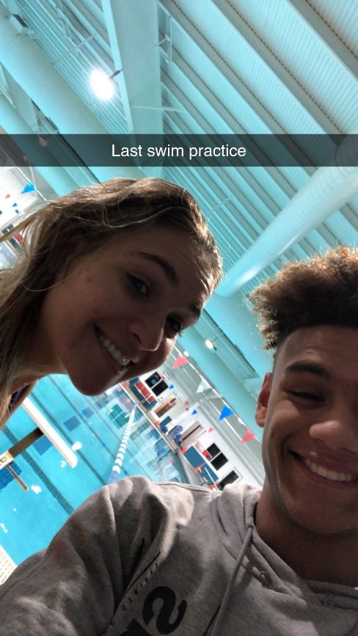
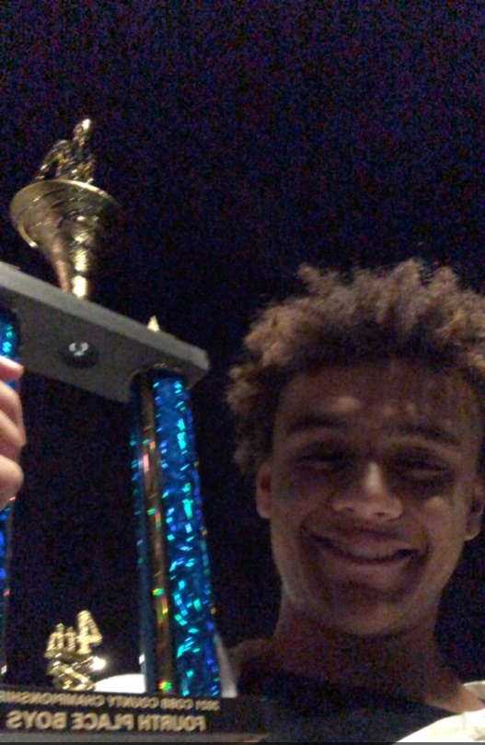

Cameron Campbell
4 year team member
Team Captain
Favorite Event: 100 Fly and 200 Medley Relay
Favorite Memory: Sophomore year county meet and watching the 400 free relay
Hopes to play centerfield for the Atlanta Braves

Slide 36
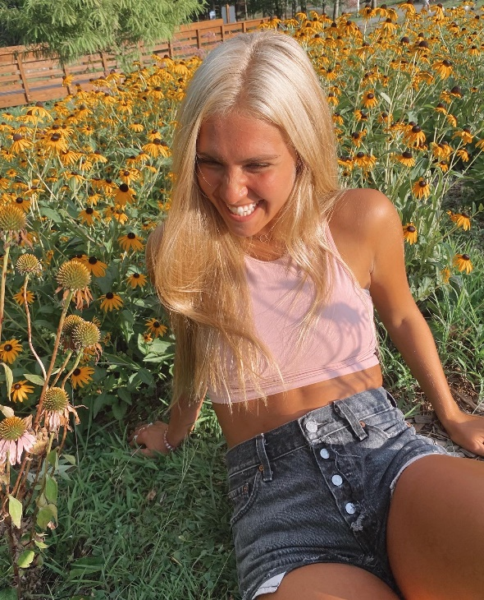
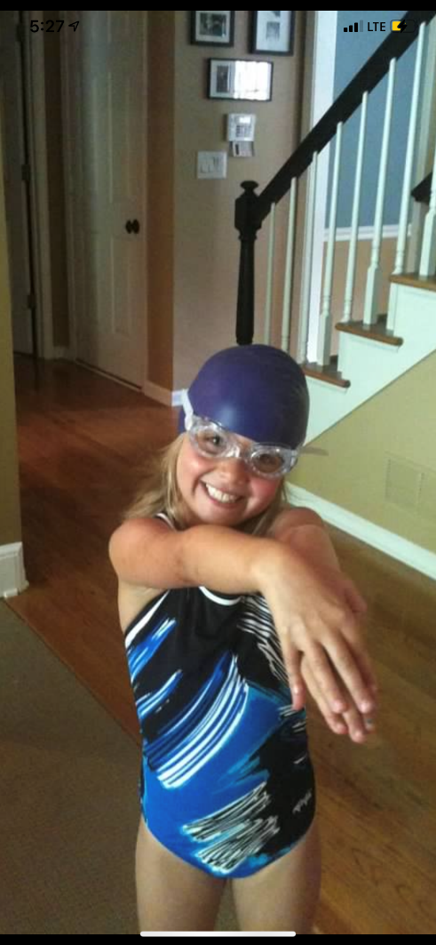
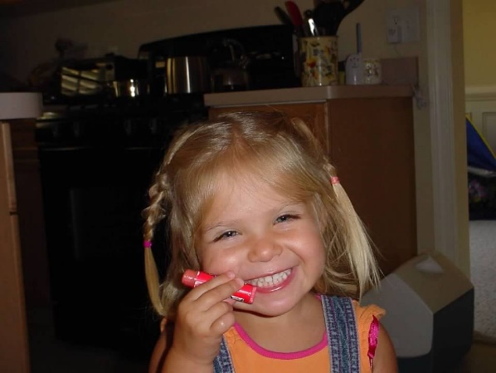
Sarah Davis
4 year team member
Team Captain
Favorite Event: 100 Fly
Favorite Memories: practicing with friends, going out after meets, making state senior year
Going to UGA and majoring in journalism or psychology, pre-law track

Slide 37
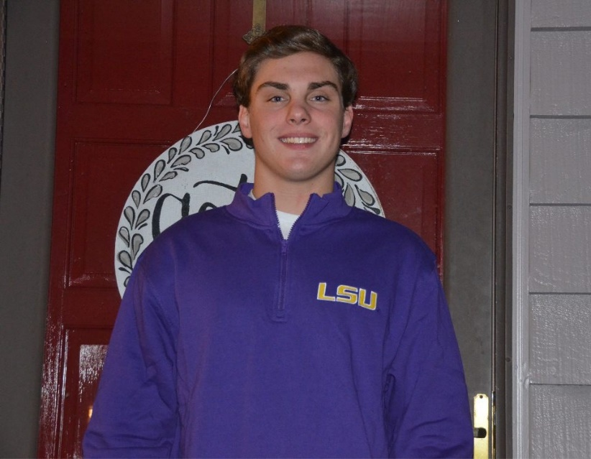
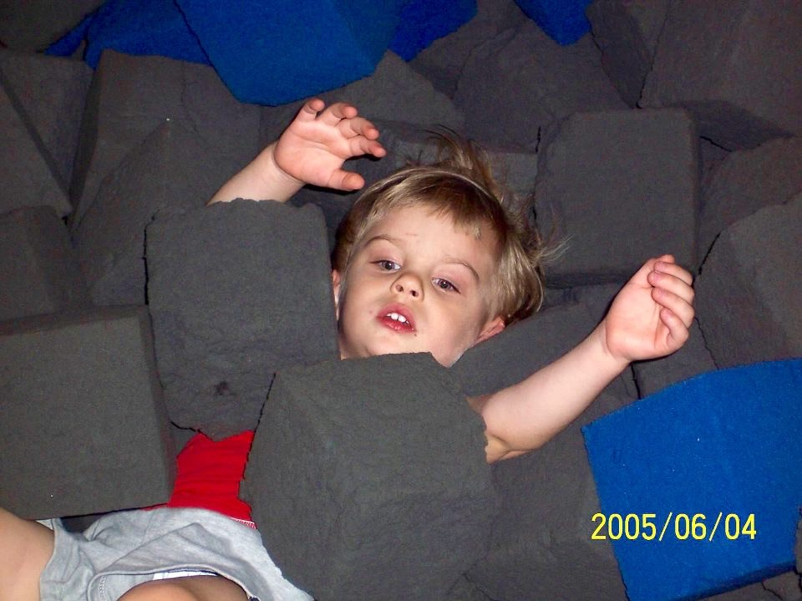
Brendan Hausdorf
4 year team member
Team Captain
Favorite Event: 200 IM
Favorite Memory: Girls winning State Junior year and Boys getting 2nd Freshmen year
Swimming at LSU next year and majoring in automotive engineering

Slide 38
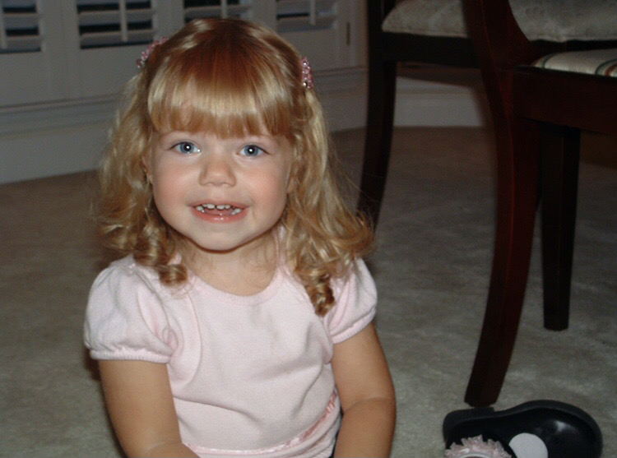
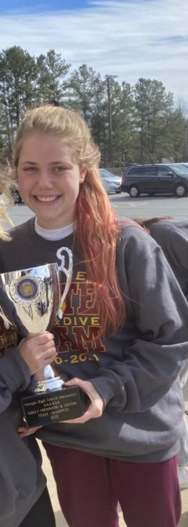
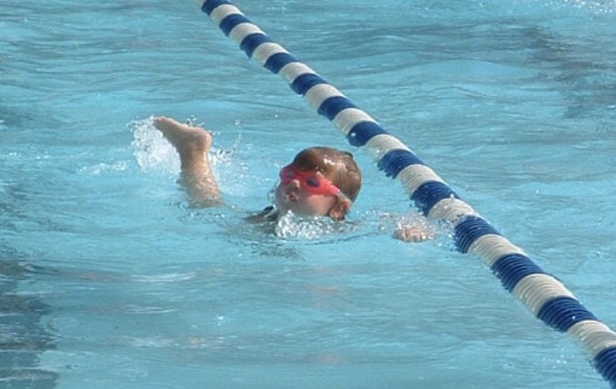
Audrey Holshouser
4 year team member
Team Captain
Favorite Event: 100 Fly
Favorite Memory: Winning State two years- back to back!!
Plans on attending Georgia Tech next year

Slide 39


Brandon Lamb
4 year team member
Team Captain
Favorite Event: 50 Free
Favorite Memory: County this year
Unsure about college plans

Slide 40
High Point Award
The High Point Award is given to a boy and a girl in each grade level. These swimmers or divers have contributed the most to the team point wise during the 2020-21 season. Point totals were based on all meets throughout the season and on individual as well as relay swims.

Slide 41
High Point Award Winners
9th
Elliot Elmore
Cosy Gale
10th
Parker Tanke
Sophia Parker
11th
Charlie Banks
Francie Carson
12th
Brendan Hausdorf
Audrey Holshouser

Slide 42
Most Dedicated Award
The most dedicated award is given to a boy and girl who has consistently worked hard towards their goals throughout the 2020-21 season. They have put forth a tremendous amount of effort and practice and it has shown in their times and performances at meets.

Slide 43
Most Dedicated Award Winners
Nick Van Vreede
GiannaMarie Conti

Slide 44
Spirit Award
The Spirit Award is given to a boy and girl who have shown a great deal of school and team spirit throughout the season. These recipients have consistently had a good attitude and have always been a presence at meets cheering on their teammates whenever possible.

Slide 45
Spirit Award Winners
Andrew Pokorny
Francie Carson

Slide 46
Rookie Award
The Rookie Award is given to a boy and girl who are first year team members who have made a huge impact on the team in their short amount of time on it. These recipients have consistently had a good attitude, work ethic and have contributed a lot to the team point wise at meets. We are glad to have these rookies ☺

Slide 47
Rookie Award Winners
Carter Loftin
Bridget O’Shaughnessy

Slide 48
Captain Award
The Captain Award is given to a member of the 2021 graduating class. These recipients have gone above and beyond the coaches expectations and have always been there to support the team in any and every way. They have been model athletes for the younger team members to look up to and the team and coaches will greatly miss them next season.

Slide 49
Captain Award Recipients
Brandon Lamb
Sarah Davis

Slide 50
2021-22 Captains
……………………….

Slide 51
2021-22 Swim & Dive Captains…
Charlie Banks
Allison Brown
Francie Carson
Jason Franklin
Abby Peyton

Slide 52
THANK YOU!!!!!!
To all Parents but especially these ones!
Executive Board
Lisa Peyton (CoPresident)
Jenny Gale (CoPresident)
*Kati Likes(Vice President)
Michele Franklin (Secretary)
Doug Tilt (Treasurer)
Committee Chairs
*Melissa Davis (Spirit Wear)
*Tammy Andress (Banquet)
Rhonda Tilt (Caps/Suits)
Michelle and Duane Whitesel (Driveway Painting and Banquet help)
Amy Moor (Spirit Wear)
*Amy Pillsworth (Driveway Painting)
*Tiffany Crowe (Driveway Painting)
Melinda Conti (Banquet help)

