Slide 1

Lassiter Swim and Dive
2023-24
End of season banquet
2/29/2024

Slide 2
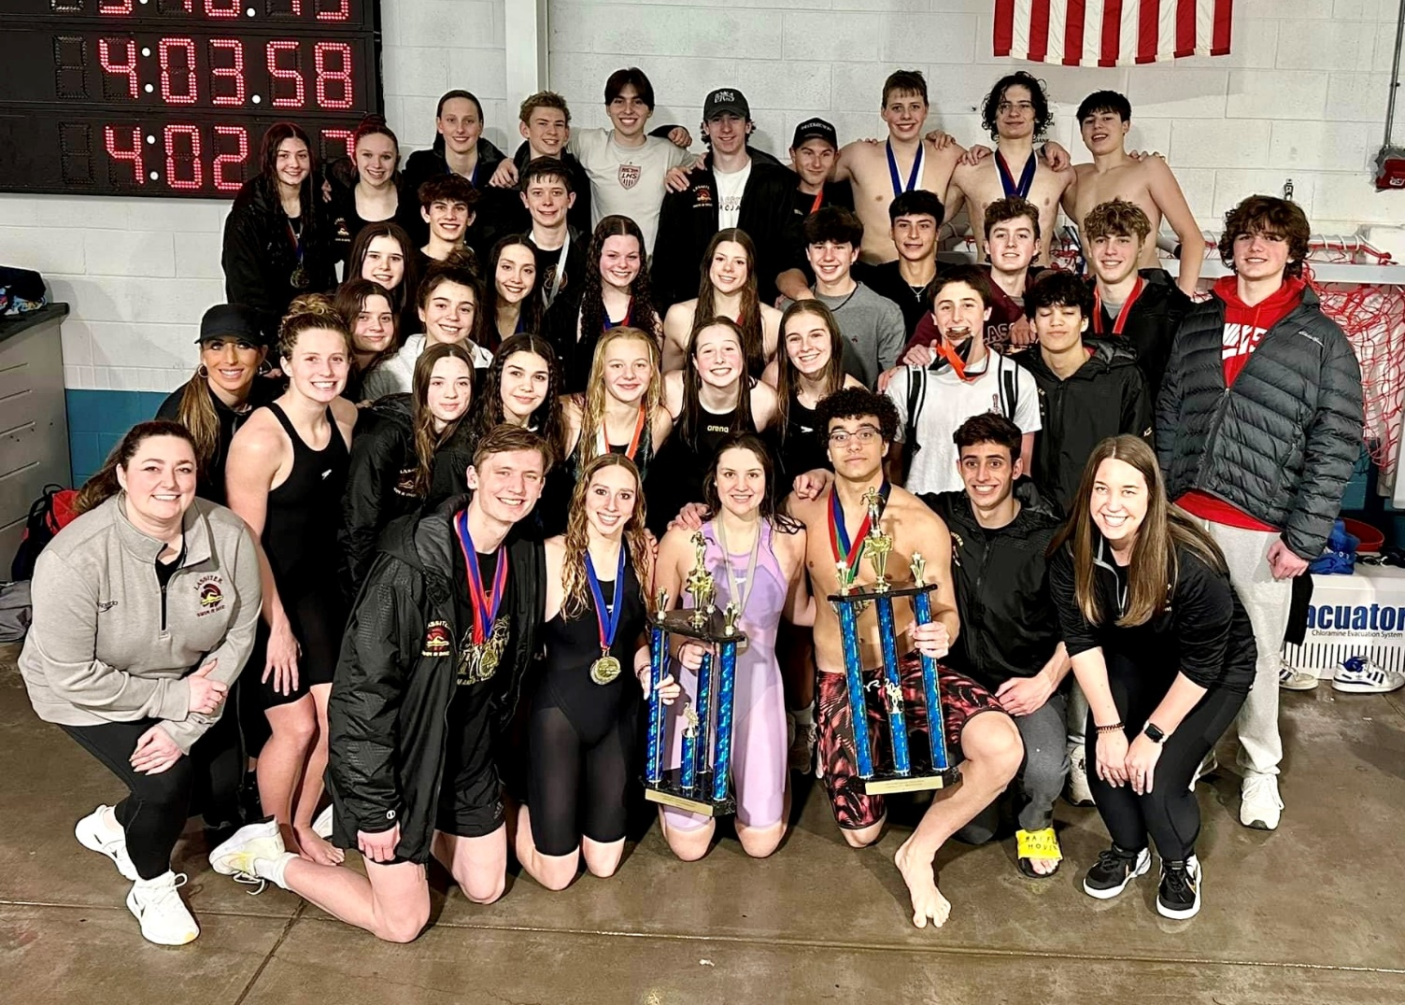
GO TROJANS

Slide 3

FOCUS FAST FINS
FOCUS has been providing the FAST Fins Adaptive Swim Team since January of 2009. Every season we serve around 80 children and teens with special needs and their siblings by giving them the opportunity to be part of a team experience. FAST Fins provides eight separate practices across metro Atlanta supervised by physical and occupational therapists, recreation instructors, and experienced volunteers who provide a welcoming and supportive environment for swimmers to grow in their abilities. Swimmers practice for months in the spring and fall seasons leading up to the biannual intra-squad meet that brings all of our separate practices together to compete and celebrate their accomplishments. FAST Fins is always evolving to better serve our swimmers’ needs and FOCUS is constantly striving to provide the best programs for its families. We hope to keep swimming for years to come.

Slide 4
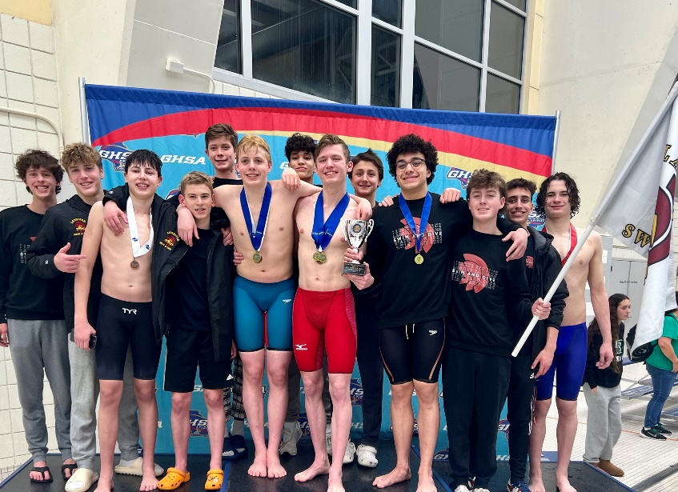
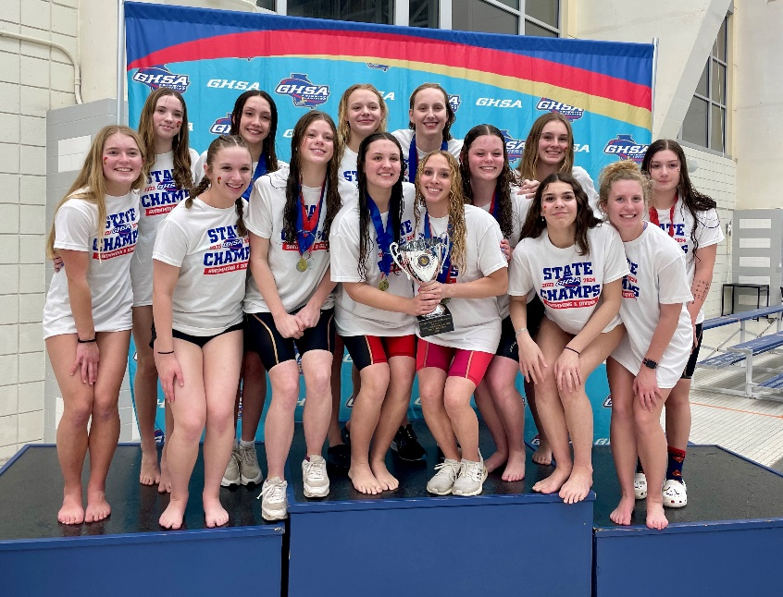

2023-24 Accomplishments
Boys
  2nd Place Cobb County Championship
  2nd Place GHSA 6A State Championship
Girls
  2nd Place Cobb County Championship
  1st Place GHSA 6A State Championship!!!

Slide 5
2023-24 VARSITY COUNTY
TOP 10: BOYS
Elliot Elmore (2nd 50 Free, 2nd 100 Breast)
Gavin Halusic (2nd 200 Free, 1st 100 Fly)
Daniel Horne (10th 50 Free, 8th 100 Breast)
Griffin Frankel (8th 200 IM, 9th 500 Free)
Cody Miles (1st 200 IM, 1st 500 Free)
Aidan O’Brien (5th 100 Fly, 9th 100 Back)

Slide 6
2022-23 VARSITY COUNTY
TOP 10: GIRLS
Cosy Gale (10th 100 Back)
Finnly Jollands (1st 50 Free, 1st 100 Back)
Kate Bradley (2nd 100 Fly, 1st 500 Free)
Rose Jones (1st 200 Free, 1st 100 Free)
GiannaMarie Conti (3rd 200 Free)
Ashlyn Loftin (8th 200 IM, 3rd 100 Breast)
Sophia Bucaj (10th 100 Free)
Maggie O’Shaughnessy (2nd 200 IM, 1st 100 Breast)

Slide 7
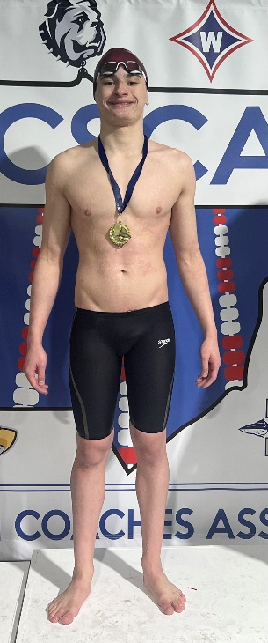
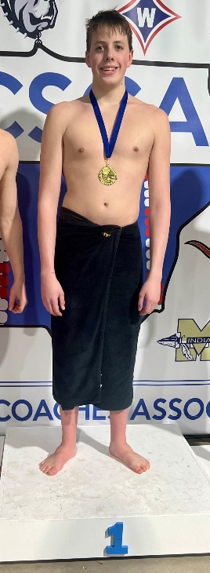
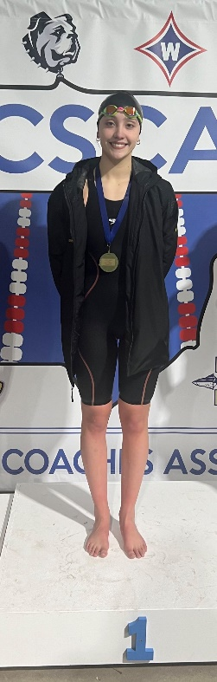
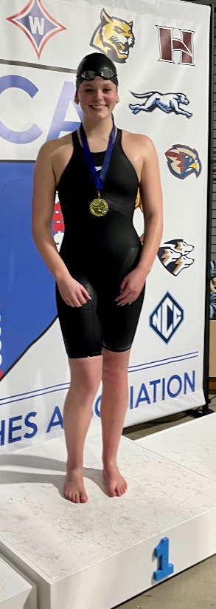
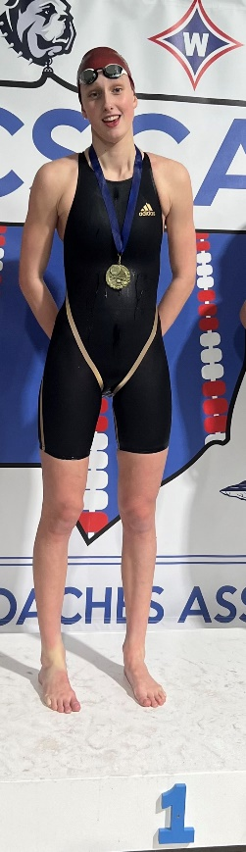
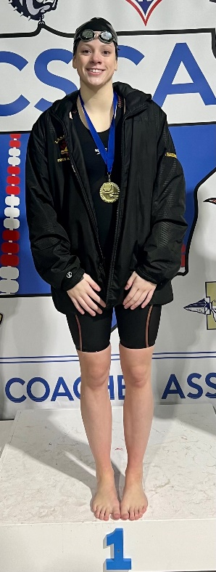
2023-24 County Champions
Gavin Halusic
  100 Fly
Cody Miles
  200 IM and 500 Free
Kate Bradley
  500 Free
Rose Jones
  200 Free and 100 Free
Finnly Jollands
  50 Free and 100 Back
Maggie O’Shaughnessy
  100 Breast

Slide 8
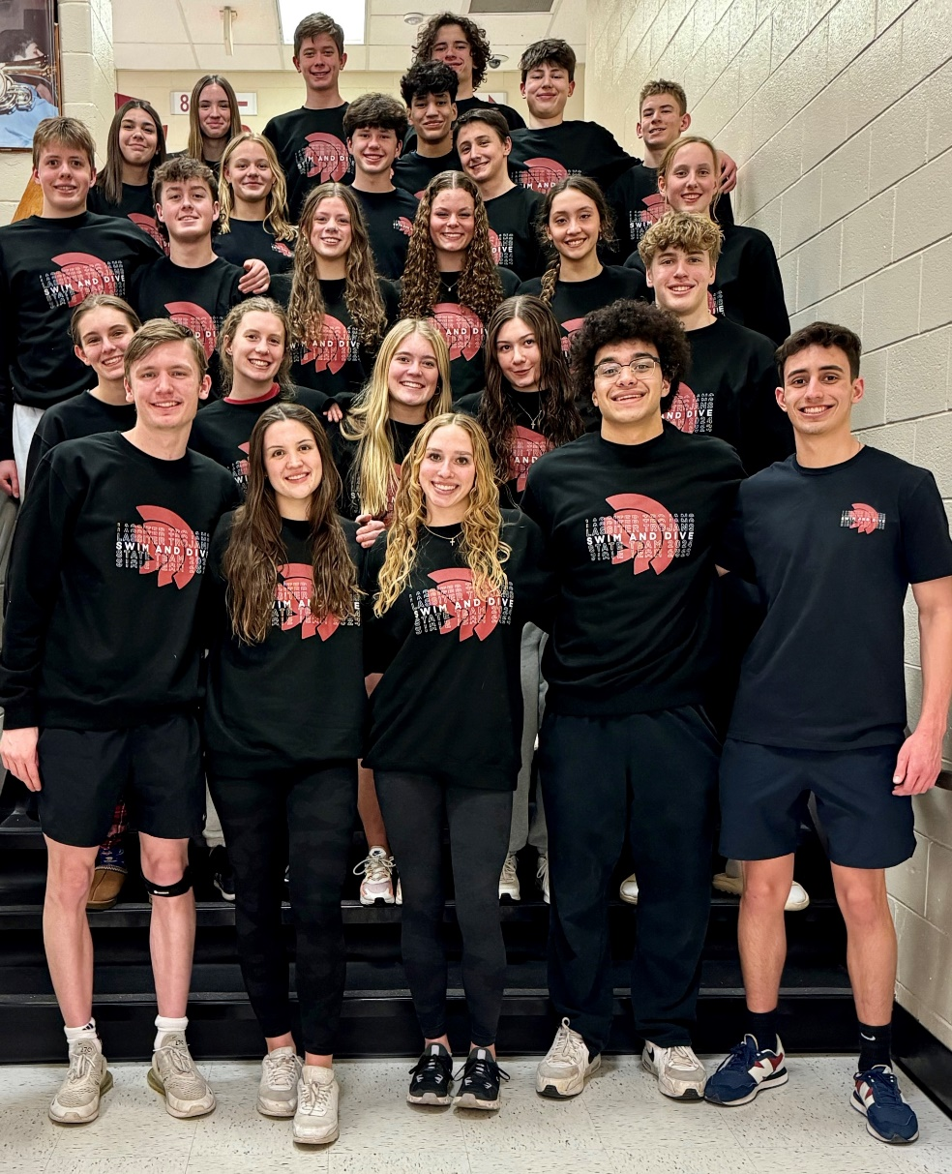
2023-24
State Team
Kate Bradley
Mackenzie Bryant
Sophia Bucaj
Mia Burgos
Gianna Conti
Kaden Doss
Elliot Elmore
Griffin Frankel
Alie Gale
Cosy Gale
Gavin Halusic
Daniel Horne
Finnly Jollands
Ethan Jones
Rose Jones
Ryan Kotarba
Jonathan Lewelling
Kate Lindsley
Ashlyn Loftin
Cody Miles
Austin Moon
Aidan O’Brien
Alex O’Brien
Maggie O’Shaughnessy
Elise Rasco
Grace Whalen
Henry Wines

Slide 9
2023-24 GHSA 6A State Championship Top 20: Boys
Elliot Elmore (4th 50 Free, 1st 100 Back)
Griffin Frankel (13th 200 IM, 7th 500 Free)
Cody Miles (3rd 200 IM, 1st 500 Free)
Aidan O’Brien (10th 100 Fly, 19th 100 Back)
Daniel Horne (13th 100 Breast)
Gavin Halusic (2nd 200 Free, 3rd 100 Fly)

Slide 10
2023-24 GHSA 6A State Championship Top 20: Girls
Kate Bradley (1st 100 Fly, 1st 500 Free)
Maggie O’Shaughnessy (2nd 200 IM, 3rd 100 Breast)
Gianna Conti (5th 200 Free, 11th 100 Fly)
Finnly Jollands (2nd 50 Free, 1st 100 Back)
Sophia Bucaj (17th 100 Free)
Cosy Gale (9th 100 Free, 12th 100 Back)
Rose Jones (1st 200 Free, 2nd 100 Free)
Ashlyn Loftin (13th 200 IM, 5th 100 Breast)

Slide 11
State Relay Recognition
Boys 200 Medley Relay-
1st (Elmore, Miles, Aidan O’Brien, Horne)
Girls 200 Medley Relay-
1st (Jollands, O’Shaughnessy, Bradley, Conti)
Girls 200 Freestyle Relay-
2nd (O’Shaughnessy, Bucaj, Conti, Jones)
Girls 400 Freestyle Relay-
1st (Jollands, Gale, Bradley, Jones)
Boys 200 Freestyle Relay-
5th (Horne, Jones, Aidan O’Brien, Halusic)
Boys 400 Freestyle Relay-
3rd (Miles, Jones, Elmore, Halusic)

Slide 12
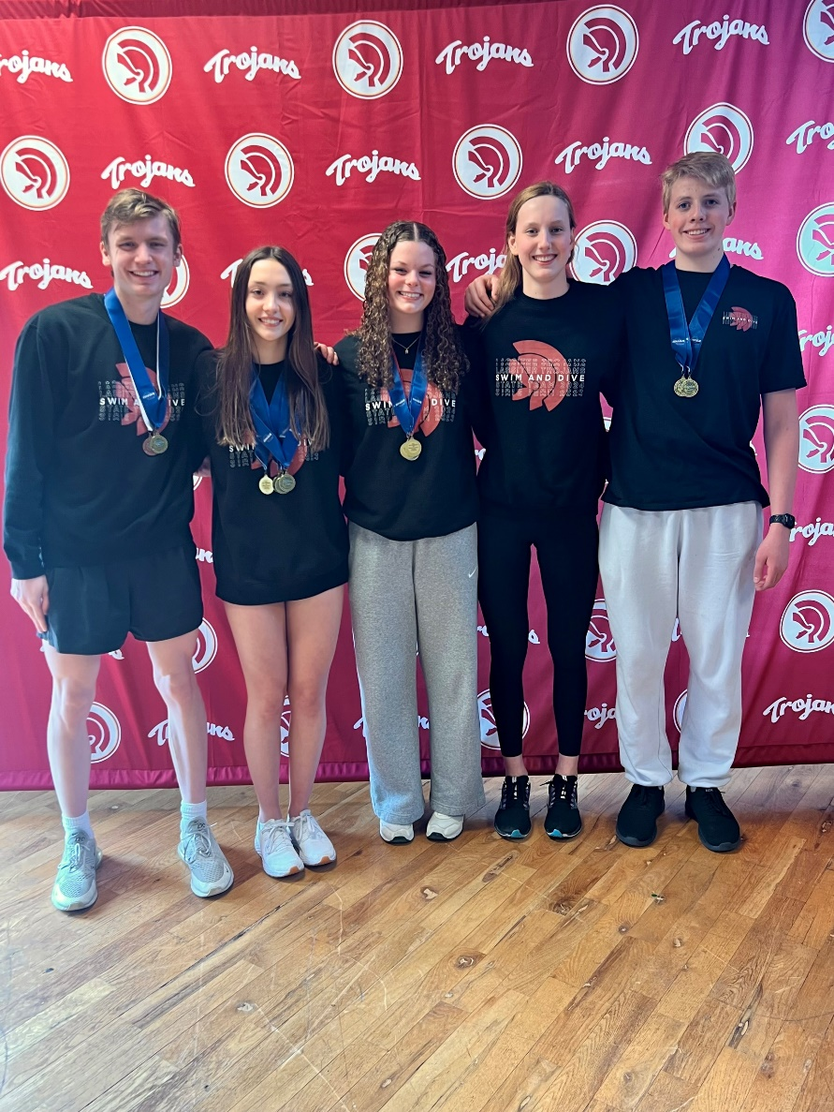
STATE CHAMPS!
-Elliot Elmore
100 Back
-Cody Miles
500 Free
-Kate Bradley
100 Fly and 500 Free
-Finnly Jollands
100 Back
-Rose Jones
200 Free

Slide 13
All America Qualifiers
Consideration
Boys 200 Medley- County Finals, 1:33.38
Elliot Elmore, Cody Miles, Aidan O’Brien, Gavin Halusic
Boys 200 Medley Relay- State Finals, 1:33.46
Elliot Elmore, Cody Miles, Aidan O’Brien, Daniel Horne
Girls 400 Freestyle Relay- County Finals, 3:30.46
Finnly Jollands, Kate Bradley, Sophia Bucaj, Rose Jones
Girls 400 Freestyle Relay- State Finals, 3:30.23
Finnly Jollands, Cosy Gale, Kate Bradley, Rose Jones
Kate Bradley- 100 Fly, State Finals, 55.23
Elliot Elmore- 50 Free, State Prelims, 20.66 and 100 Back, State Finals, 50.00
Finnly Jollands- 50 Free, State Prelims, 23.45
Automatic
Girls 200 Medley Relay- State Finals, 1:44.12
Finnly Jollands, Maggie O’Shaughnessy, Kate Bradley, GiannaMarie Conti
Finnly Jollands- 100 Back, State Finals, 54.66

Slide 14
2023-24 New School Records: Individuals
Elliot Elmore
50 Freestyle, State Prelims, 20.66
  Previous record from 2014
Finnly Jollands
50 Backstroke, State Finals, 54.66
  Previous record from 2011

Slide 15
2023-24 New School Records: Relays
Boys 200 Medley Relay
County Finals, 1:33.38
Elliot Elmore, Cody Miles, Aidan O’Brien, Gavin Halusic
  Previous record from 2018
  Also set County Championship Meet Record

Slide 16
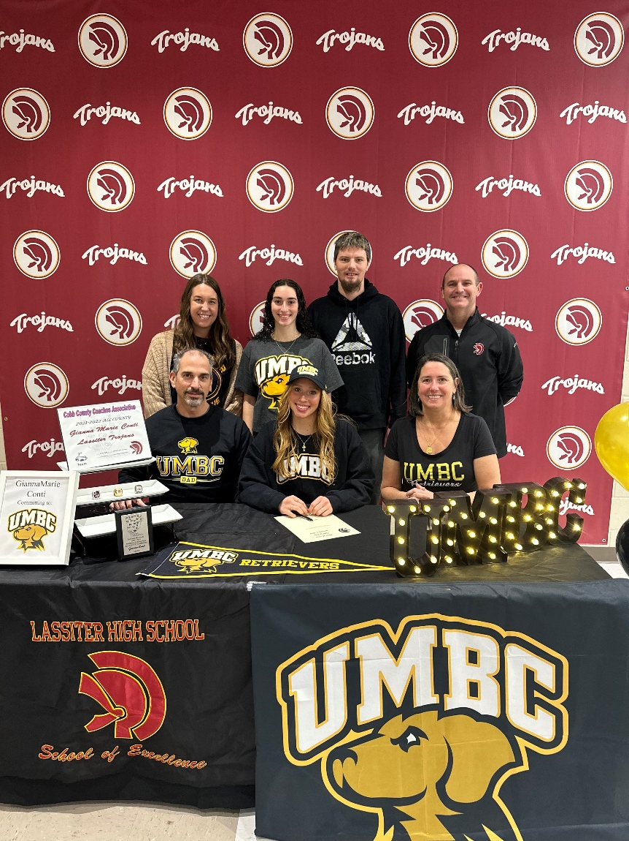

Class of 2024 Signees
GiannaMarie Conti
  University of Maryland, Baltimore County
  Swim

Slide 17
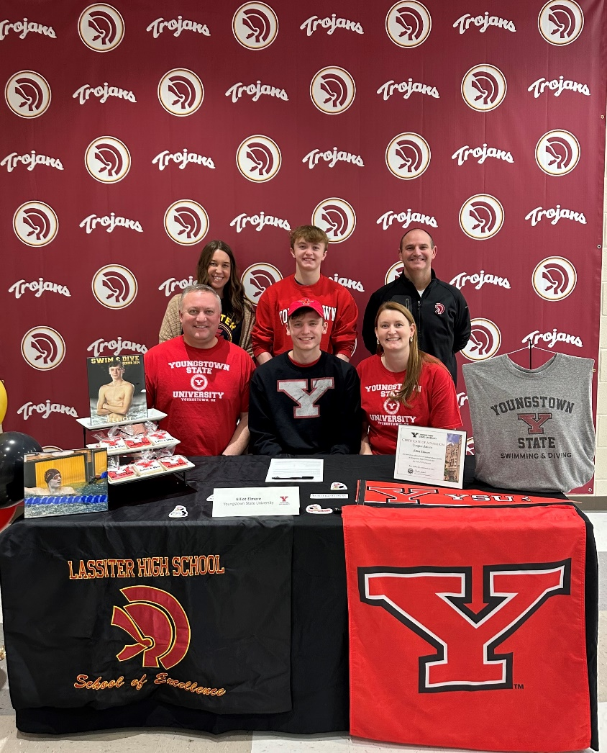

Class of 2024 Signees
Elliot Elmore
  Youngstown State University
  Swim

Slide 18
Underclassmen
Letter and Certificate Presentation

Slide 19
Freshmen
Aarya Ali
Ava Coon
Kaden Doss
Caleb Fincher
Emma Fincher
Alie Gale
Samantha Gregory
Gavin Halusic
Quintin Harrington
Shayla Intriago
Jake Judge
Emma Kehoe
Lillian Kikly
Caroline Miller
Dash Morris
Minke Mostert
Kennedy Orcutt-Kesicke
Asher Quigg
Mary Kate Randall
Sera Sternick
Mia Todorovac
Henry Wines

Slide 20
Sophomores
Mia Burgos
Sophia Cain
Josiah Catanzaro
Chloe Cummings
Griffin Frankel
Sarah Garber
Kaitlyn Gregory
Anna Heinrich
Ethan Jones
Will Joseph
Jonathan Lewelling
Ashlyn Loftin
Alex O’Brien
Dylan Parlier
Elise Rasco
Charlie Rath
Riley Sullivan
Tyler Thompson
Micah Villanueva

Slide 21
Juniors
Evelyn Barber
Kate Bradley
Mac Brune
Mathias De Araujo
Elizabeth George
Eva Godinez
Ben Harrison
Liam Holder
Oren Horak
Finnly Jollands
Rose Jones
Ryan Kotarba
Alexander Magdusian
Cody Miles
Annabeth Miller
Austin Moon
Maggie O’Shaughnessy
Marcelo Paez Benavides
Bryce Parker
Alexander Robinson
Elijah Ronemous
Gabriel Sayilgan
Annabelle Simmons
Alexis Thornton
Elisabeth Vogt

Slide 22


Order a State Champ 5peat Shirt!

Slide 23
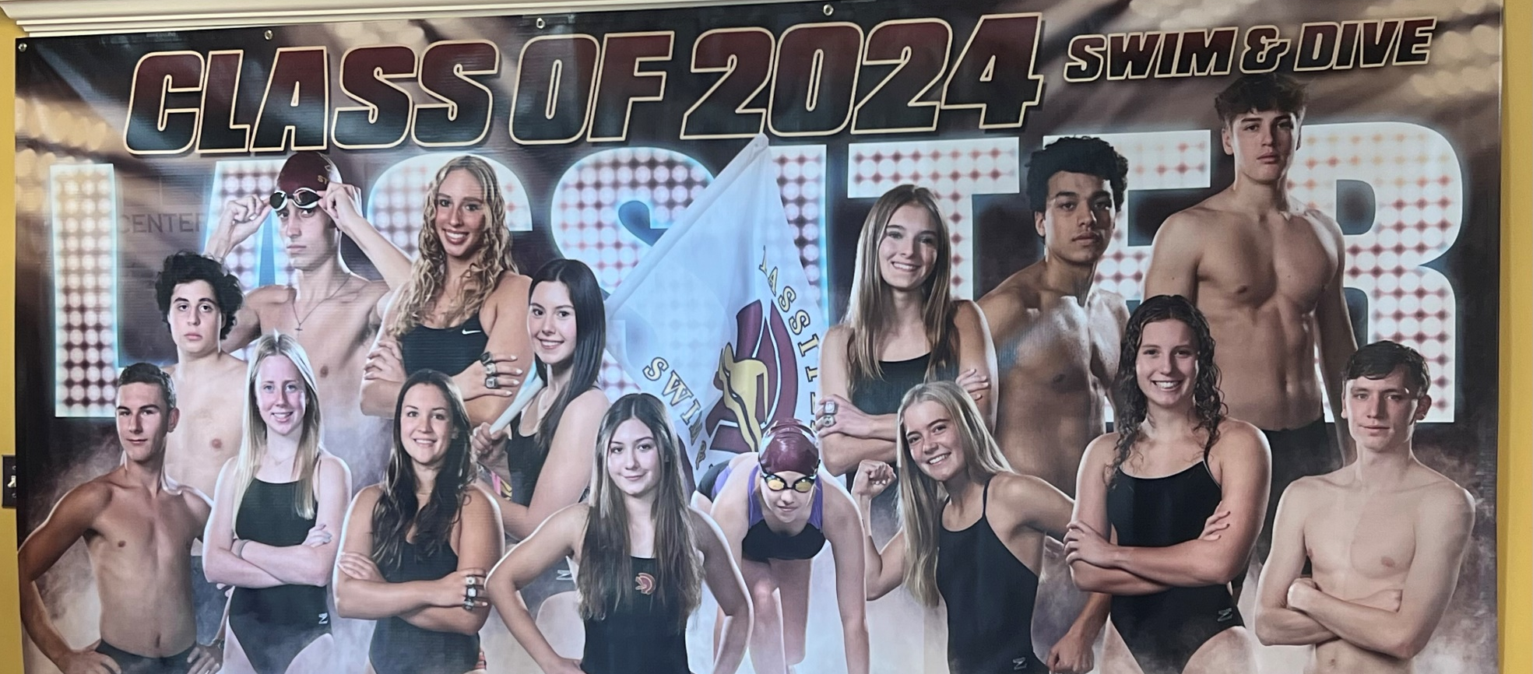
2023-2024 Senior Class

Slide 24

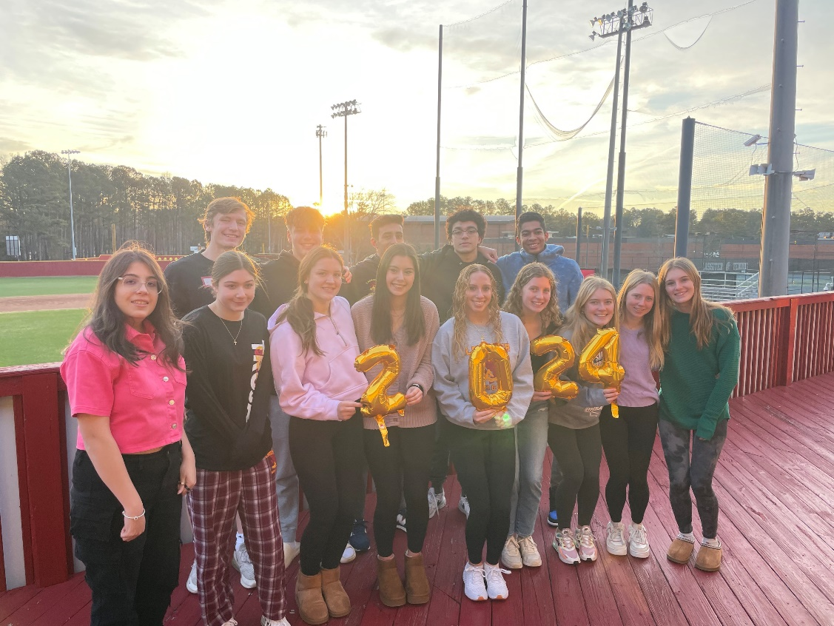
Seniors in the Classroom
Swimmers and Divers in the Class of 2024 have an average weighted GPA of 4.034!
Academic All Americans- Varsity Letter Recipient with a weighted GPA of 3.75 or higher
Mackenzie Bryant
Sophia Bucaj
David Cofield
GiannaMarie Conti
Tim Harrison
Grace Kehoe
Kate Lindsley
Aidan O’Brien
Julia Randall
Grace Whalen

Slide 25
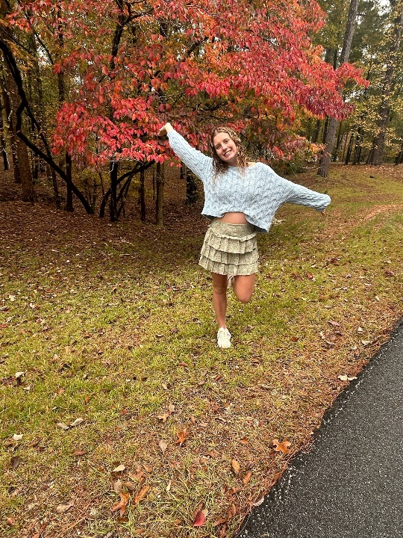
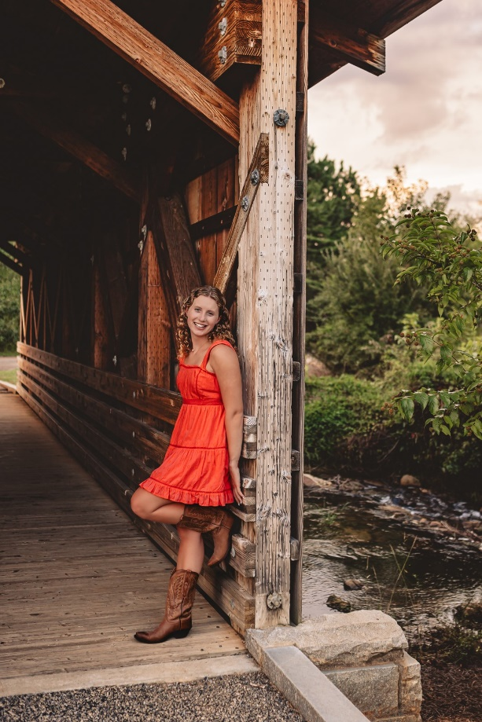
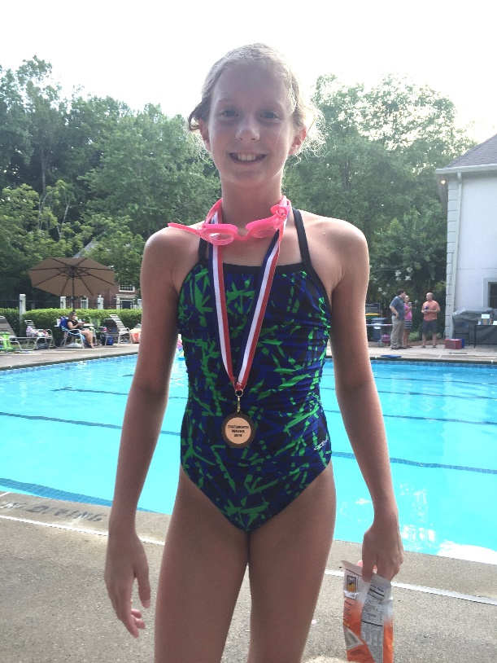
Mackenzie Bryant
4 year team member
Favorite Event: 100 Free
Favorite Memory: bus rides to and from away meets
Plans on majoring in Political Science or Business at UGA.
“I’m hungry.”

Slide 26
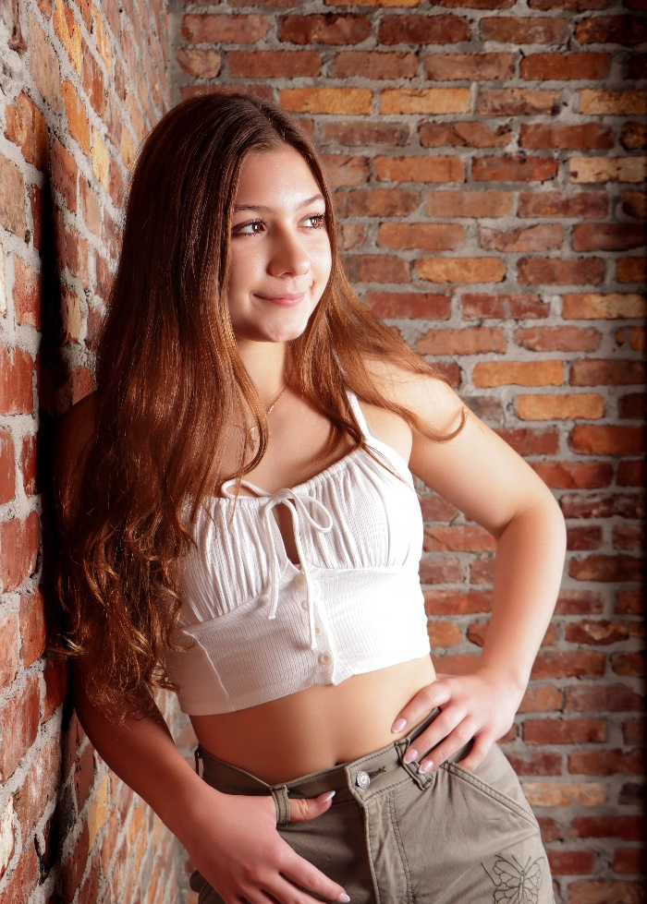
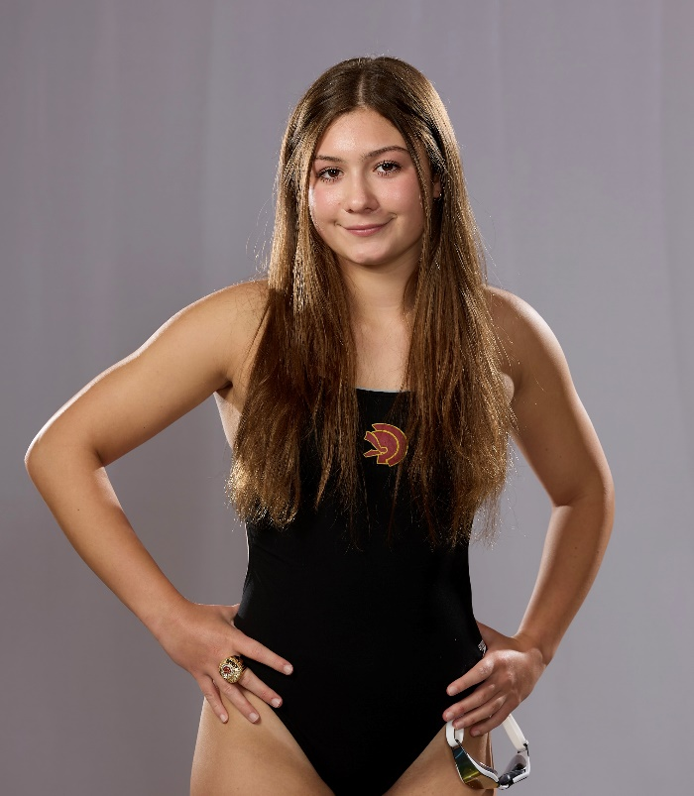
Sophia Bucaj
3 year Team Member
Favorite Event: 50 Free and 50 Fly
Favorite Memory: fun at county meets
Unsure on after high school plans
“No pain, no gain”

Slide 27
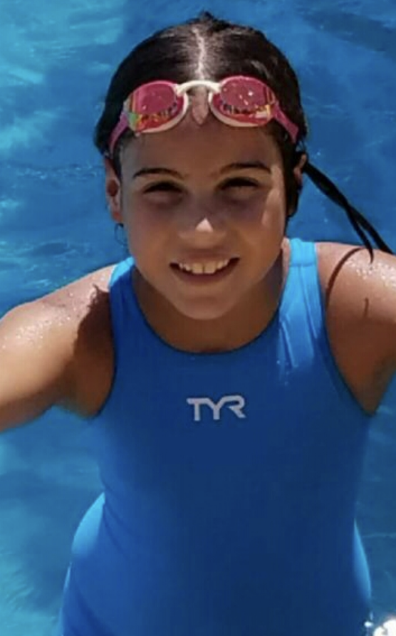
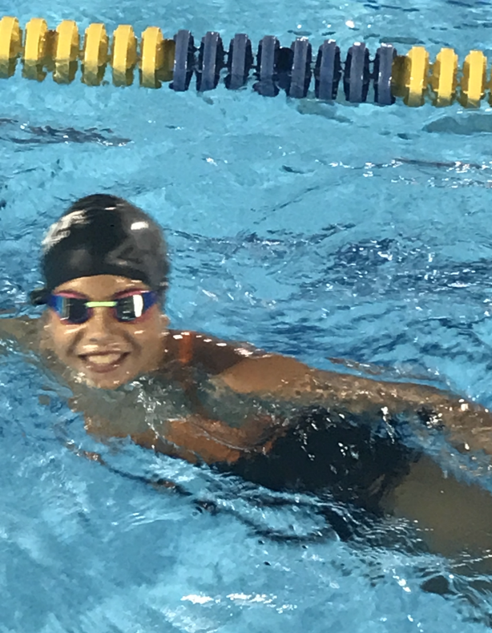
Nicole Cadavid
2 year team member
Favorite Event: Breaststroke
Favorite Memory: Competing in relays with teammates and the holiday white elephant party
Plans on majoring in Criminal Justice in college
“Never settle for less than your best.”

Slide 28
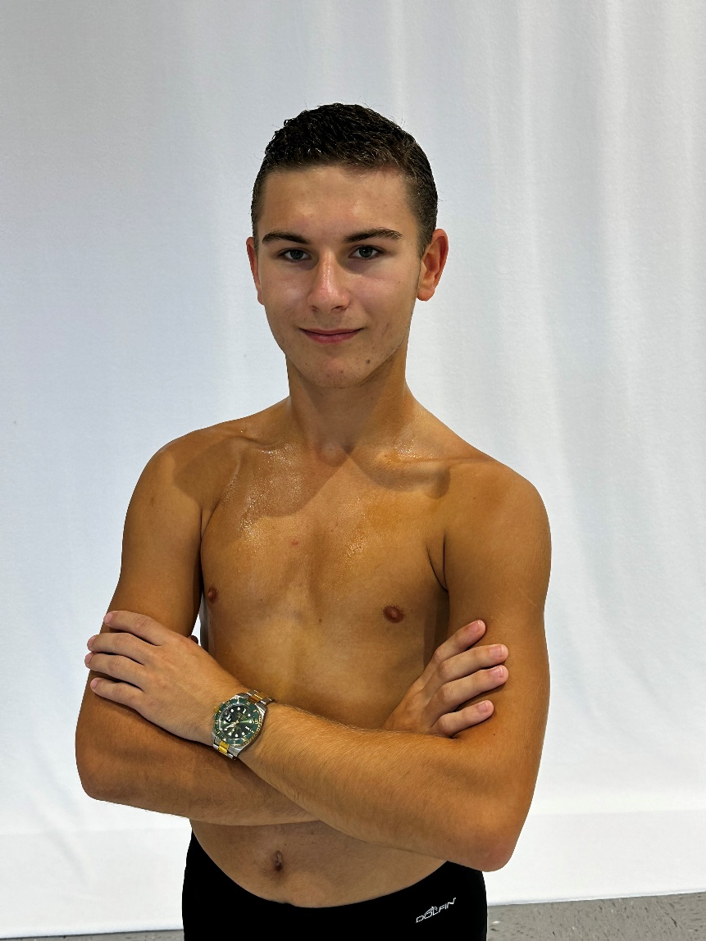
Thomas DenHaese
1 year team member
Favorite Event: Dive
Favorite Memory: Diving with Alum Alex Hill
Would like to attend The University of Miami and study engineering.
“If everything seems under control, you’re not going fast enough.”

Slide 29
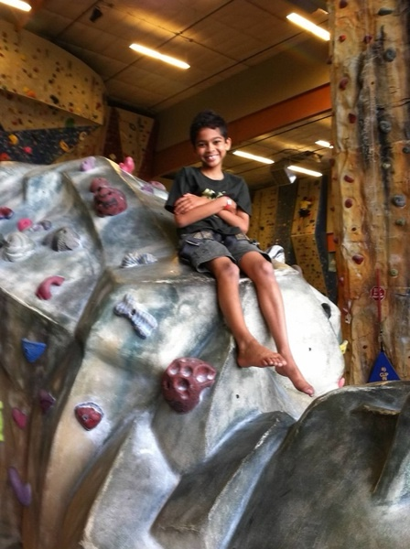
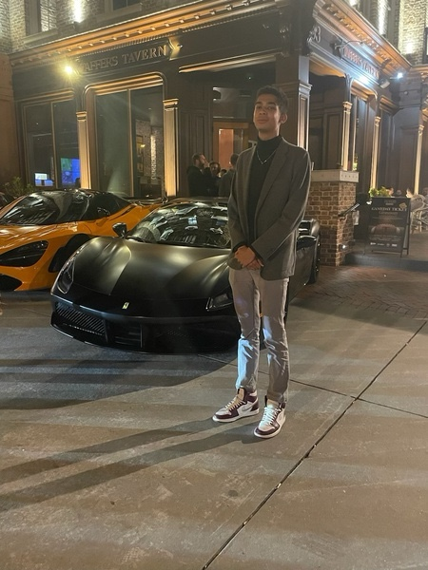
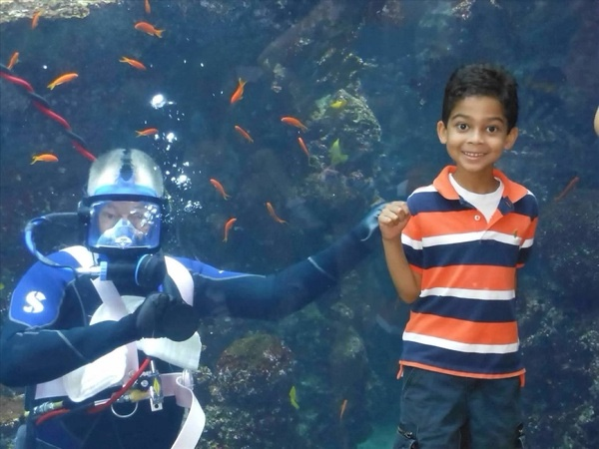
Tim Harrison
4 year team member
Favorite Event: 100 Free
Favorite Memory: Making friends
Plans on staying in state for college and studying business or history.
“If it doesn’t matter in 10 years, don’t worry about it.”

Slide 30
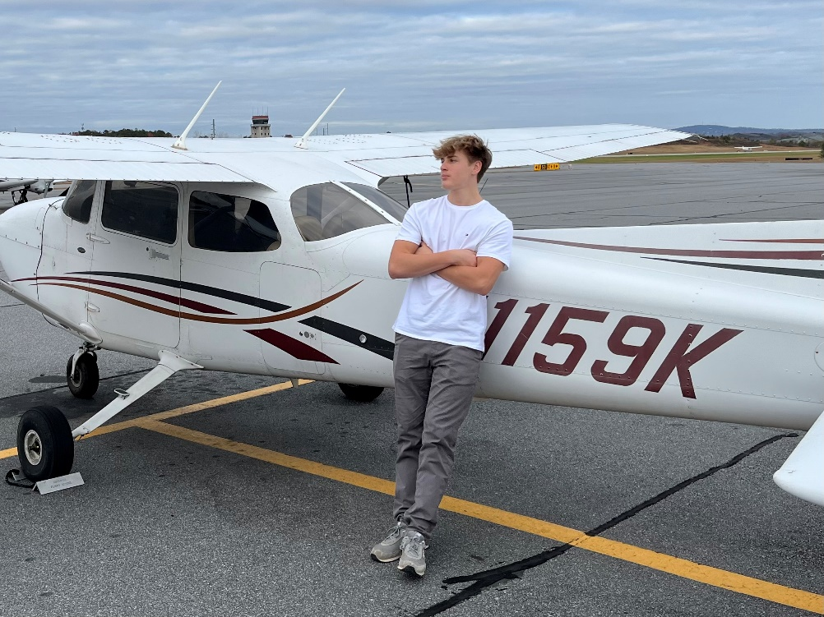
Daniel Horne
3 year team member
Favorite Event: 50 Free
Favorite Memory: Boy team bonding at David’s house
Plans on continuing his flight training to be an airline pilot.
“For me, money is not my definition of success. Inspiring people is a definition of success.” -Ye

Slide 31
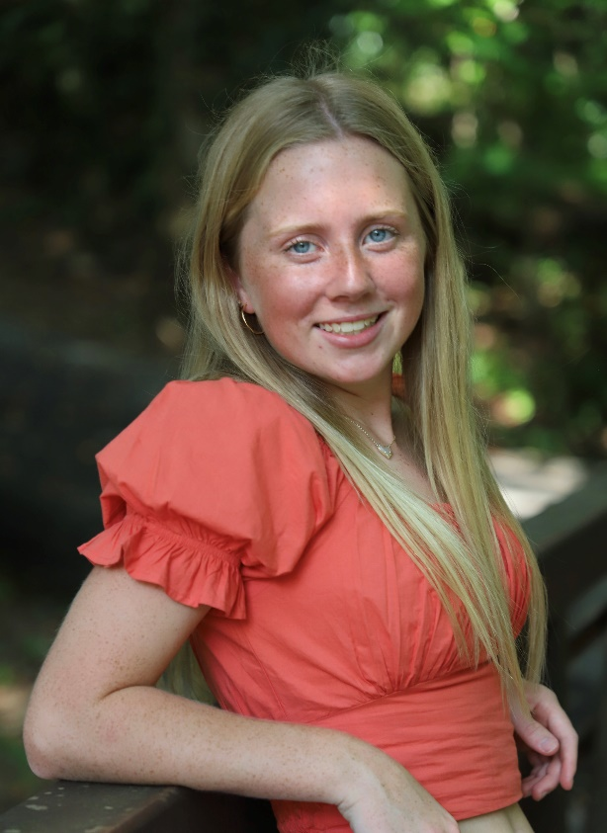
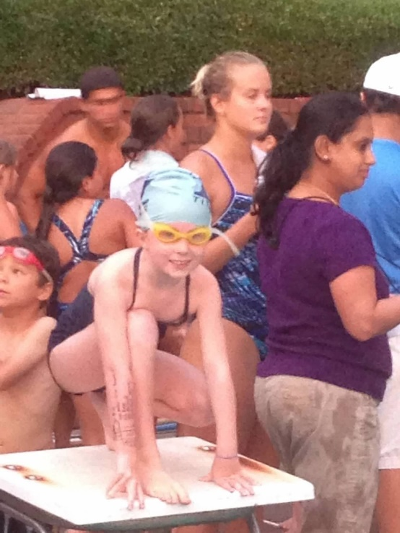
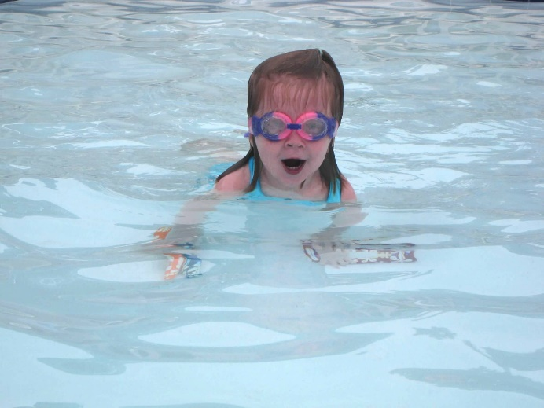
Grace Kehoe
1 year team member
Favorite Event: 100 Breaststroke
Favorite Memory: bus rides and food after meets
Plans on attending either UGA or Clemson and studying the medical field to potentially become a pediatric physical therapist.

Slide 32
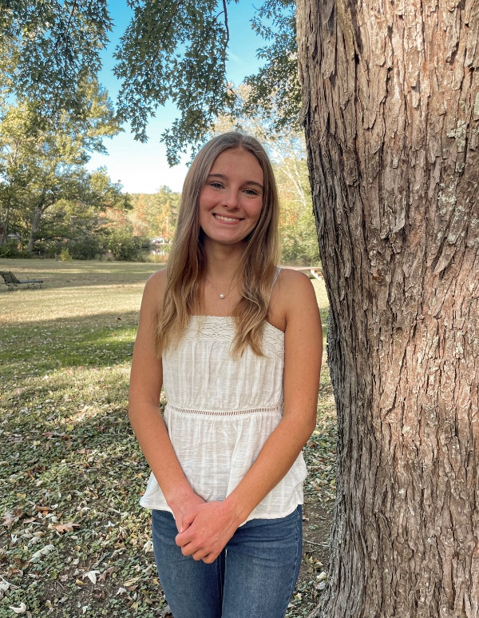
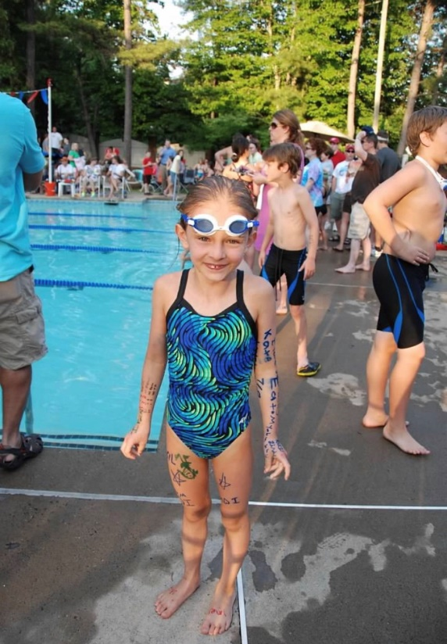
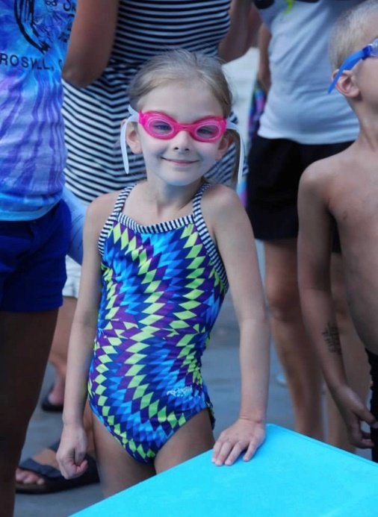
Kate Lindsley
4 year team member
Favorite Event: 100 Fly
Favorite Memory: Team sleepover between state prelims and finals 2023.
Plans on studying Chemical and Biomolecular Engineering at Georgia Tech.

Slide 33
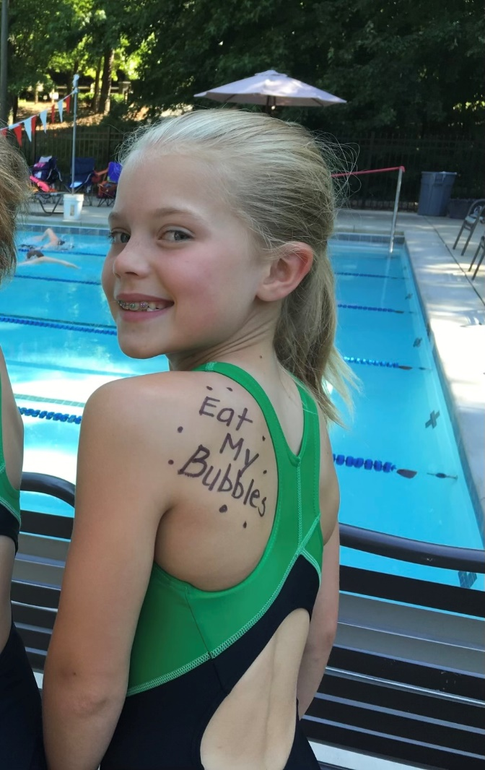
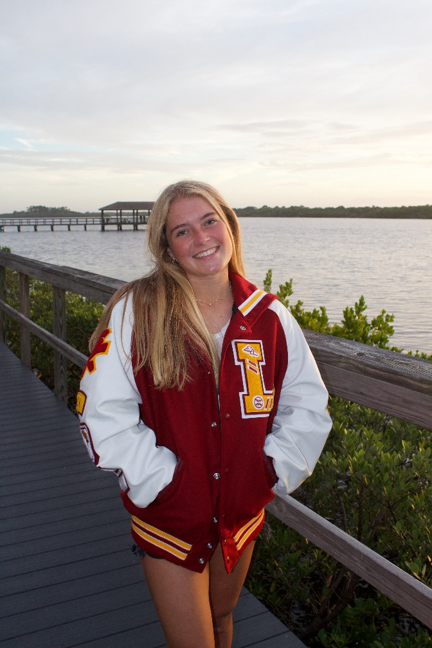
Grace Whalen
1 year team member
Favorite Event: 50 Free
Favorite Memory: Cookout after meets
Going to the University of Florida and majoring in Nutrition.

Slide 34
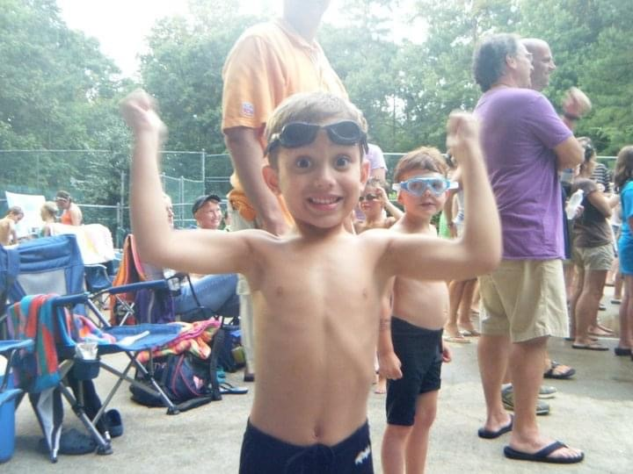
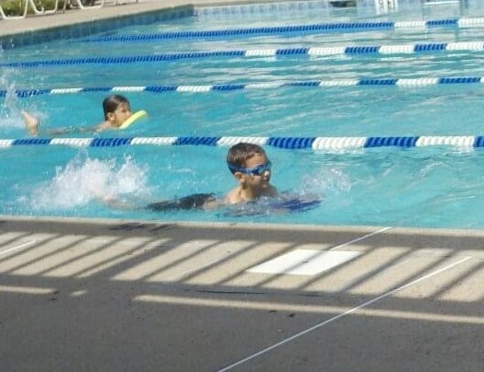
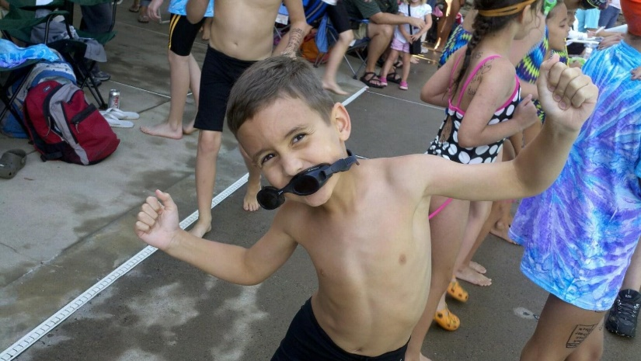
David Cofield
2 year team member
Team Captain
Favorite Event: 50 Free
Favorite Memory: Team Bonfire
Plans on attending Georgia College and majoring in business
“Strike first, Strike hard, No mercy.”

Slide 35
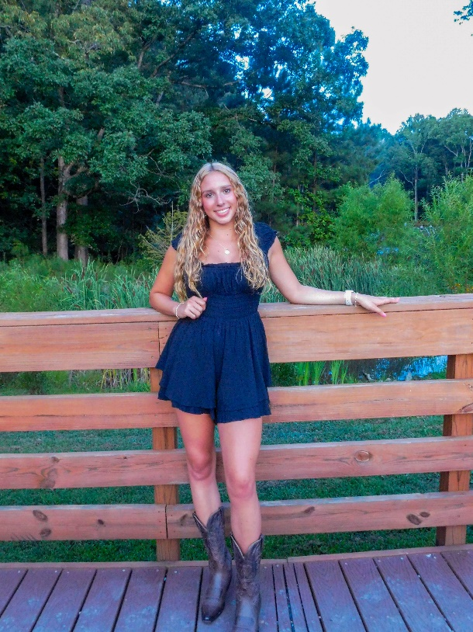
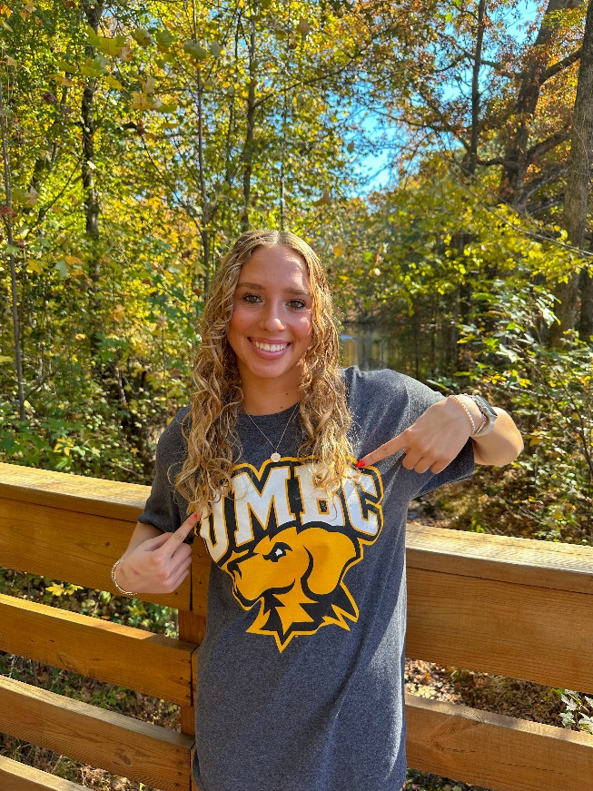
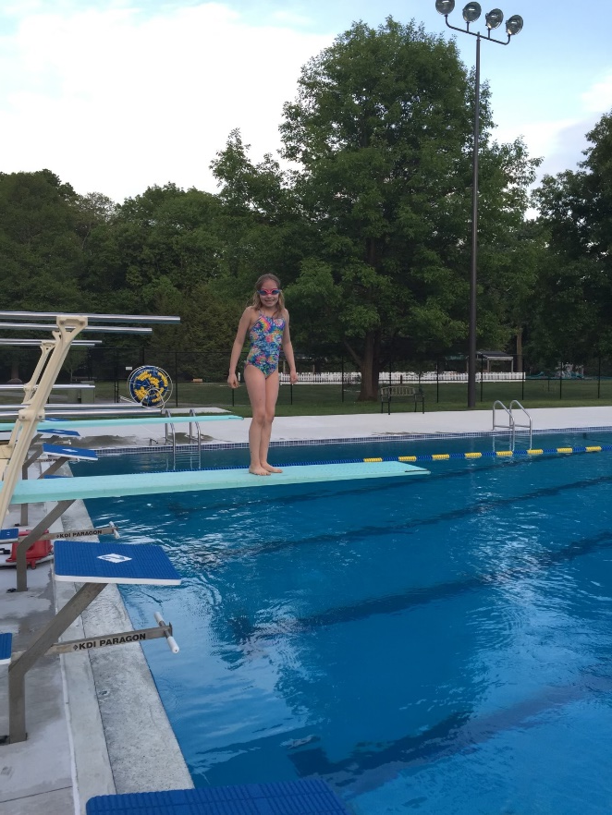
GiannaMarie Conti
4 year team member
Team Captain
Favorite Event: 200 IM
Favorite Memory: winning state all 4 years and getting to celebrate with teammates!
Plans on attending University of Maryland, Baltimore County where she will swim and major in Biomechanical Engineering.

Slide 36
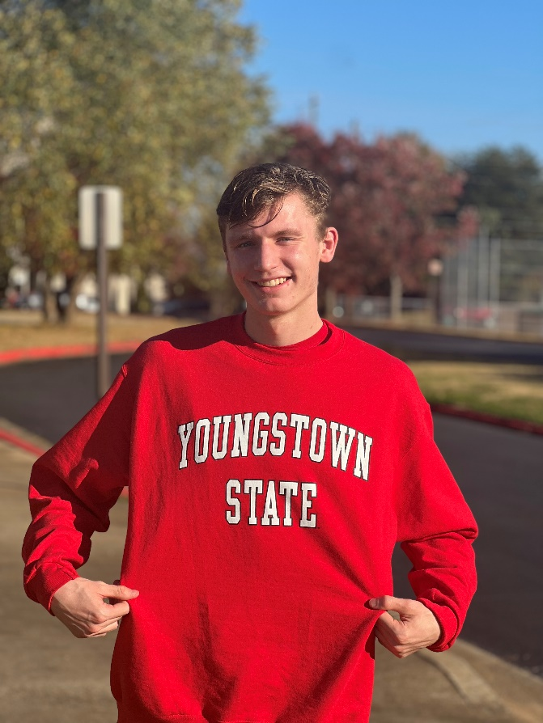
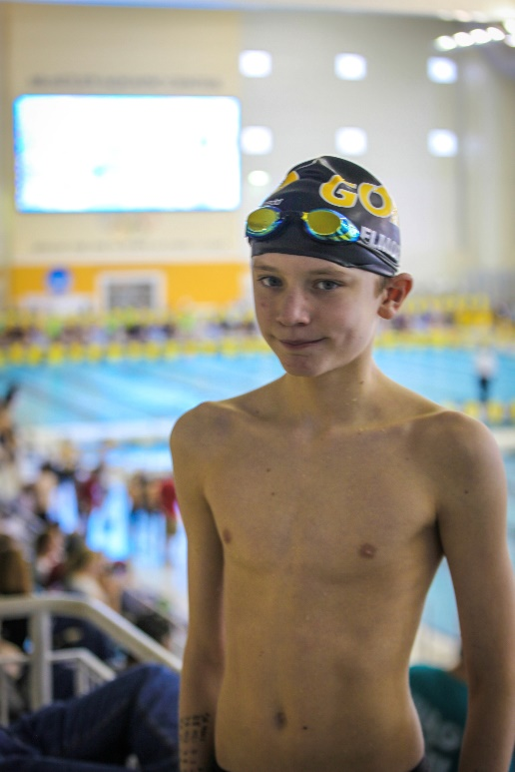
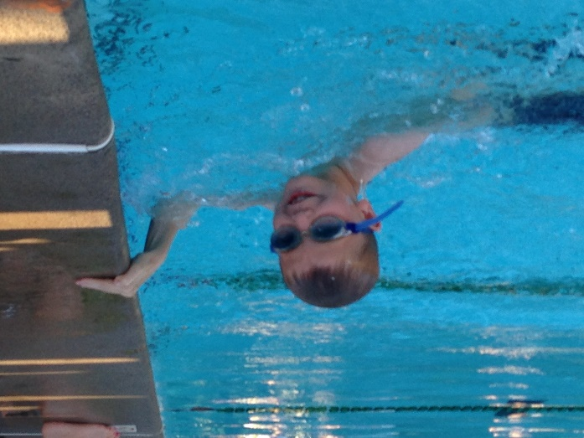
Elliot Elmore
4 year team member
Team Captain
Favorite Event: 50 Free
Favorite Memory: Going to state with all my friends each year
Plans on attending Youngstown State University, swimming and majoring in Exercise Science or Physical Therapy.
“Do not go gentle into that good night, Old age should burn and rave at close of day; Rage, rage against the dying of the light.” -Dylan Thomas

Slide 37
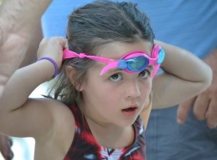
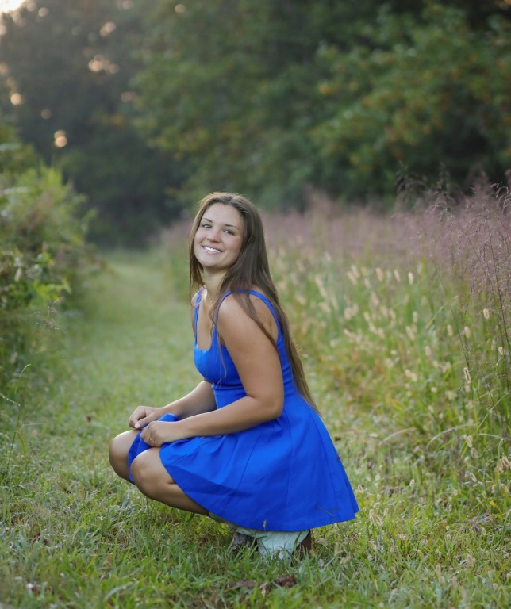
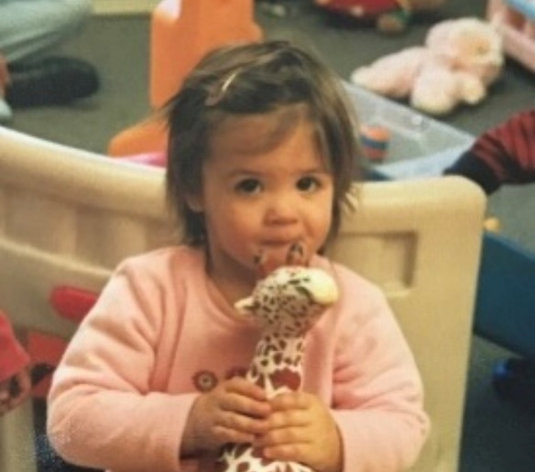
Cosy Gale
4 year team member
Team Captain
Favorite Event: 100 Free and 100 Back
Favorite Memory: Winning State all four years!
Plans on attending Ole Miss.
“What’s for dinner?”

Slide 38
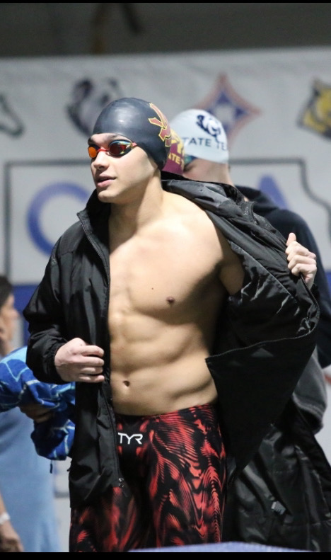
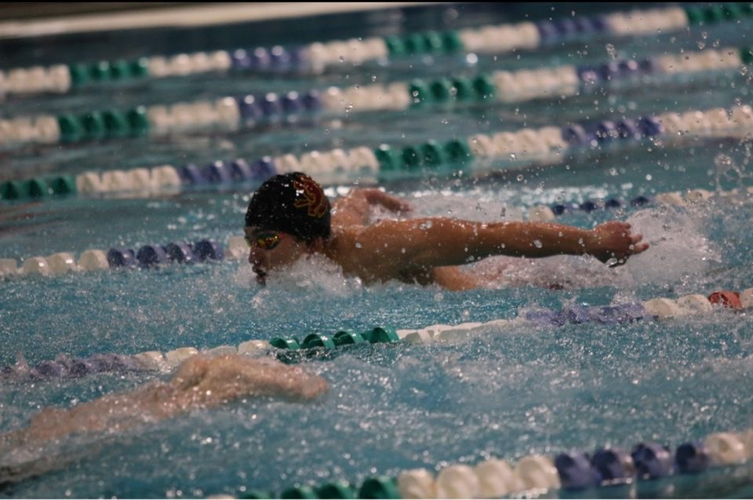
Aidan O’Brien
4 year team member
Team Captain
Favorite Event: 100 Fly
Favorite Memory: Playing music on the bus
Plans on studying Mechanical Engineering at Georgia Tech.
“Never back down, never give up.”

Slide 39
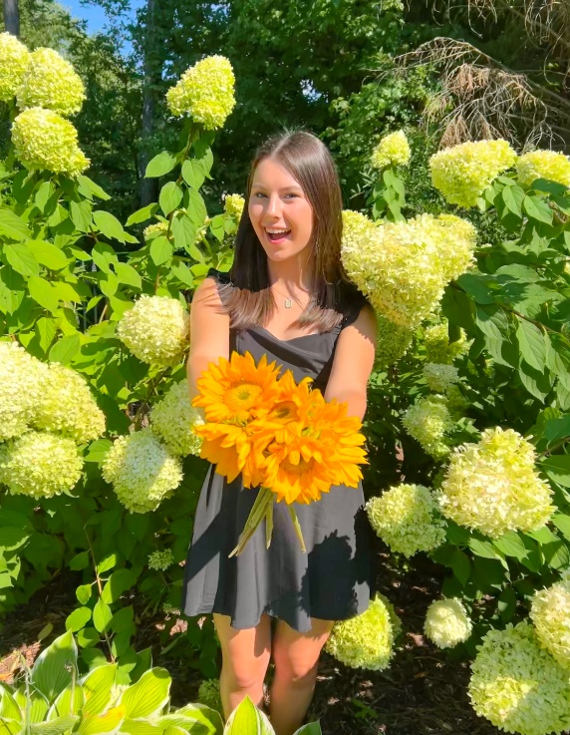


Julia Randall
4 year team member
Team Captain
Favorite Event: 100 Fly
Favorite Memory: Team bonfire this year getting to know everyone.
Plans on attending UGA and studying accounting.
“Be the rainbow in someone else’s cloud.”

Slide 40

High Point Award
The High Point Award is given to a boy and a girl in each grade level. These swimmers or divers have contributed the most to the team point wise during the 2023-24 season. Point totals were based on all meets throughout the season and on individual as well as relay swims.

Slide 41
High Point Award Winners
9th
Gavin Halusic
Kennedy Orcutt
10th
Ethan Jones
Ashlyn Loftin
11th
Cody Miles
Kate Bradley
12th
Aidan O’Brien
GiannaMarie Conti

Slide 42

Most Dedicated Award
The most dedicated award is given to a boy and girl who has consistently worked hard towards their goals throughout the 2023-24 season. They have put forth a tremendous amount of effort and practice and it has shown in their times and performances at meets.

Slide 43
Most Dedicated Award Winners
Oren Horak
Grace Whalen

Slide 44
Rookie Award
The Rookie Award is given to a boy and girl who are first year team members who have made a huge impact on the team in their short amount of time on it. These recipients have consistently had a good attitude, work ethic and have contributed a lot to the team point wise at meets. We are glad to have these rookies and looking forward to the future ☺

Slide 45
Rookie Award Winners
Gavin Halusic
Alie Gale

Slide 46
Most Improved Award
The most improved award is given to both a boy and girl who have made the most progress in both their times and success at practice throughout the season. There hard work has been shown in meets and they should be very proud of their progress!

Slide 47
Most Improved Award Winners
Liam Holder
Ashlyn Loftin

Slide 48
Spirit Award
The Spirit Award is given to a boy and girl who have shown a great deal of school and team spirit throughout the season. These recipients have consistently had a good attitude and have always been a presence at meets cheering on their teammates whenever possible.

Slide 49
Spirit Award Winners
David Cofield
Kate Lindsley

Slide 50
Captain Award
The Captain Award is given to a member of the 2024 graduating class. These recipients have gone above and beyond the coaches’ expectations and have always been there to support the team in any and every way. They have been model athletes for the younger team members to look up to and the team and coaches will greatly miss them next season.

Slide 51
Captain Award Winners
Aidan O’Brien
Julia Randall

Slide 52
2024-25 Captains
……………………….

Slide 53
2024-25 Swim & Dive Captains…
Kate Bradley
Finnly Jollands
Cody Miles
Austin Moon
Annabelle Simmons
Marcello Paez

Slide 54
THANK YOU!!!!!!
To all Parents but especially these ones!
*Senior Parents
Executive Board
Mary George (CoPresident, Pizza and Pasta Party, Senior Breakfast)
Wendy Bucaj (CoPresident, Senior Pictures/Posters)
David Halusic (Vice President)
Kelli O’Shaughnessy (Secretary and website)
Brenda Miles (Treasurer)
Committee Chairs
Kathryn Loftin (Spirit Wear)
Melinda Conti* (Banquet)
Miriam Jones (Caps/Suits, State Dinner)
Terri Elmore* (Homecoming Float)
Lori Kotarba and Caroline Horne* (holiday party)
Marjorie Rath (Food Table)
Sunshine Moon (Banquet)
Andrea Cofield* (Bonfire Host)

