Slide 1

Midlakes Dive
Summer 2025
Season Kickoff Meeting for
Club Managers, Dive Coaches, & Parent Reps
June 14th, 2025
Hosted by Pauline Fletcher, Midlakes Dive Representative
midlakesdiving@gmail.com

Slide 2
Meeting Agenda
Pool Contacts & Team Rosters on Google Docs
Team Roles & Dive Psychology
2025 Key Dates, Meet Schedule, Champs
Insurance, Fees, & Forms
Mandatory SafeSport Training
Swimwear Exception Form
Meet Prep & Organization
Video Trainings for Parents & Volunteers
Tour of Midlakes Dive Website
Coaches Only Meeting

Slide 3
Introductions
Please introduce yourself
  Coaches:
  Name and Club
  Your diving experience – Rec, HS, Club, etc.
  Something awesome or interesting about you
  Parent Reps:
  Name and Club
  Your kids’ names and ages and how long they’ve been diving
  (and also mention your kids have who aren’t diving)
  Something awesome or interesting about you

Slide 4
Contacts & Rosters
  Midlakes Dive Representative
  Pauline Fletcher, PLC: 425-466-8275
midlakesdiving@gmail.com
  Parent Representatives
  MIBC – Jessica Moch
  MSC/MICC – Amanda Bailey
  NHSTC – Melinda van Honschooten
  PLC – Jamie Rogers, Erin Fields
  STC – Brooke Bevis
  WR – Marissa Stratton
  Coaches (make a text group)
  MIBC – Audrey Metcalf & Connor Carson
  MSC/MICC – Olivia Ong & Maya Moncaster
  NHSTC – Abigail Parish
  PLC – Braelyn Fox
  STC – Daniel Marcano
  WR – Annabel Stratton & Rhett Nordberg
  Pool Managers
  MIBC – Katie Boissoneault
  MSC/MICC – Paul Von Destinon
  NHSTC – Emily Vukmir
  PLC – Claudia Stern
  STC – Roger Miron
  WR – Adam Baruffi
  Team Rosters on Google Docs
  Each team has unique link
  Please keep it updated!
  Add SafeSport Info and confirm if diver also doing swim or water polo

Slide 5
Team Roles & Dive Psychology
Team Roles
Coaches: Instructor & cheerleader for kids. Dive sheet meet prep. Track A/B divers!
Parent Reps: Organizer of team, answer parent questions, & arrange volunteers for meets.
Parents: Not the coach; Encourage, not criticize own divers. Be a helpful and educated volunteer at meets.
Dive Psychology
All divers handle stress in different ways! Respect divers when they are on the board. Teach team to be a team and support!

Slide 6
Key Dates: 2025 Regular Season
June 14: Midlakes Dive Season Kickoff Meeting
June 14: Official Midlakes Dive Practices May Begin
Due now: ALL Coaches, email confirmation of CPR/First Aid and SafeSport training to Midlakes Dive Reps
June 14: *****Please reserve time at your pool for all home meets****
June 23: Make sure dive rosters are updated and have SafeSport training. Send Meet Info to all Away Teams coming to your pool this summer!
June 25: First Dive meet
5 Regular Season Meets: June 26-July 22:
Meets on Wed 6/25, Wed 7/2, Wed 7/9, Wed 7/16, Mon 7/21
July 23: Mandatory Coach & Parent Rep Champs Meeting 7:00 pm

Slide 7
Key Dates: Champs
MANDATORY MEETING: July 23, EVENING:
Dive Champs in Person Meeting for Coaches & Parent Reps
PLEASE BRING 3 THINGS:
                Champs Dive Sheets Printed Out on Appropriate Paper
                Make sure Dive Rosters are in FINAL FORMAT
                Registration check made out to Midlakes $18 per diver
Sat. July 26, morning: Senior** Championships: 12’s & 14’s & 15+’s
Sun. July 27, morning: Junior** Championships: 8’s & 10’s
**Please note that Senior Champs is on Saturday! This is due to the conflict with Swim League Champs on Sunday. Senior divers had to choose last year.

Slide 8
Midlakes Fees – 2025
MIDLAKES DIVE CLUB FEE
$70 PAID - THANK YOU!
MIDLAKES DIVER REGISTRATION FEE:
$18 FOR EACH DIVER ON YOUR ROSTER
Fee is due 3 days prior to Dive Championships competition at the Mandatory Coaches Meeting.
This payment may be made as soon as the Dive Team roster is finalized for each club.
PAYMENT INSTRUCTIONS:
Checks should be made payable to “Midlakes Swim League”.
Please indicate “Dive League” in the memo section.
Send payments to the attention of the Midlakes Treasurer at:
Midlakes Swim League, c/o Nancy Anderson, 500 Farmhouse Way, Cle Elum, WA 98922

Slide 9
Forms to Collect
Reminder to collect from each diving family (Links here plus all on website):
  Risk of Injury
  Hold Harmless Agreement
  Concussion Information Sheet
  SafeSport Training for Parents & Divers: Midlakes is tracking this info weekly!
  **If you have an open or joint club, you must still gather these from your non-member athletes.

Slide 10
SafeSport Training
MANDATORY SAFESPORT TRAINING https://safesporttrained.org/
Every coach, parent rep, volunteer, and diver must do SafeSport Training and send a report to Midlakes to verify this is complete.
There is an “Enrollment Key” for each club to associate the training with your club
Age-appropriate for each level
Divers/Participants: SafeSport for Kids (Ages 12 and Under), 15 min (Free)
SafeSport for Youth Athletes (13 and Over), 15 min (Free)
On-Deck Volunteer**: Parents guide to Misconduct in Sport, 30 min (Free)
(all our dive meet volunteers are considered on-deck volunteers)
Coach: SafeSport Trained, 90 min ($20.00) or Refresher 1, 2, or 3
Board Member/Parent Rep: SafeSport for Volunteers Abuse Awareness
and Prevention, 15 min ($9.99)

Slide 11
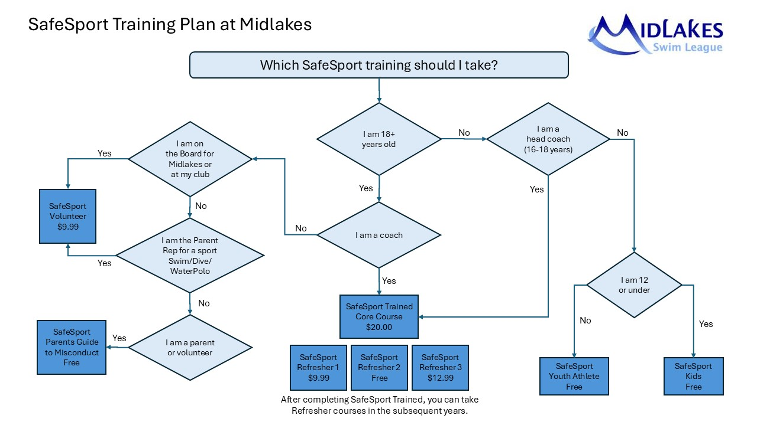
SafeSport Training

Slide 12
Midlakes Diving Swimwear Exception Request Form on Website
Swimwear Standards
This is determined by World Aquatics (formerly FINA) whose regulations we follow.
For Swimwear Standards, please review our Dive Operating Plan on the Midlakes website.
Women’s Swimsuits: No tie fasteners (e.g. no tie-backs), must not extend past shoulders, above neck, or below knees
Men’s Swimsuits: No tie fasteners (e.g. drawstrings), must be one piece not above navel or below knees
All swimwear – meet criteria of modesty & decency, no oversize logos except for own team, no t-shirts or rash guards
Swimwear exception requests for the season can be emailed to Midlakes Reps…. Or….
Swimwear Exception Request Form:
https://docs.google.com/forms/d/e/1FAIpQLSe13a4firujMOxMcO-50WUD-BDJVsS1EZd-rK8otWOqYoS3dg/viewform

Slide 13
Meet Prep: What to Do
Document Prep for Meets (Templates Available on Midlakes Dive Website linked at “Coach/Parent Rep Meet Forms”)
Coaches, All Meets
  Prepare Electronic Dive Sheet in Excel Template prior to meet
  Print Dive Sheets: girls on pink paper, boys on blue paper, non-binary on white
  Emergency Contact Roster for Table (good to laminate for season)
Parent Reps, Home Team
  Organize Volunteers for Meet
  Email Meet Information Sheet to Away Team – Do this 1 week (or more) prior to meet
  Print Label Sheet Template for back of ribbons in Word
  Print Dual Meet Score Sheets (A and B)
  After the Meet
  End of meet: Email Midlakes Dual Dive Meet Score Sheets to the other team and also please send them to midlakesdiving@gmail.com.
  Note: You can scan or just send a photo of the sheets, as long as they’re legible

Slide 14
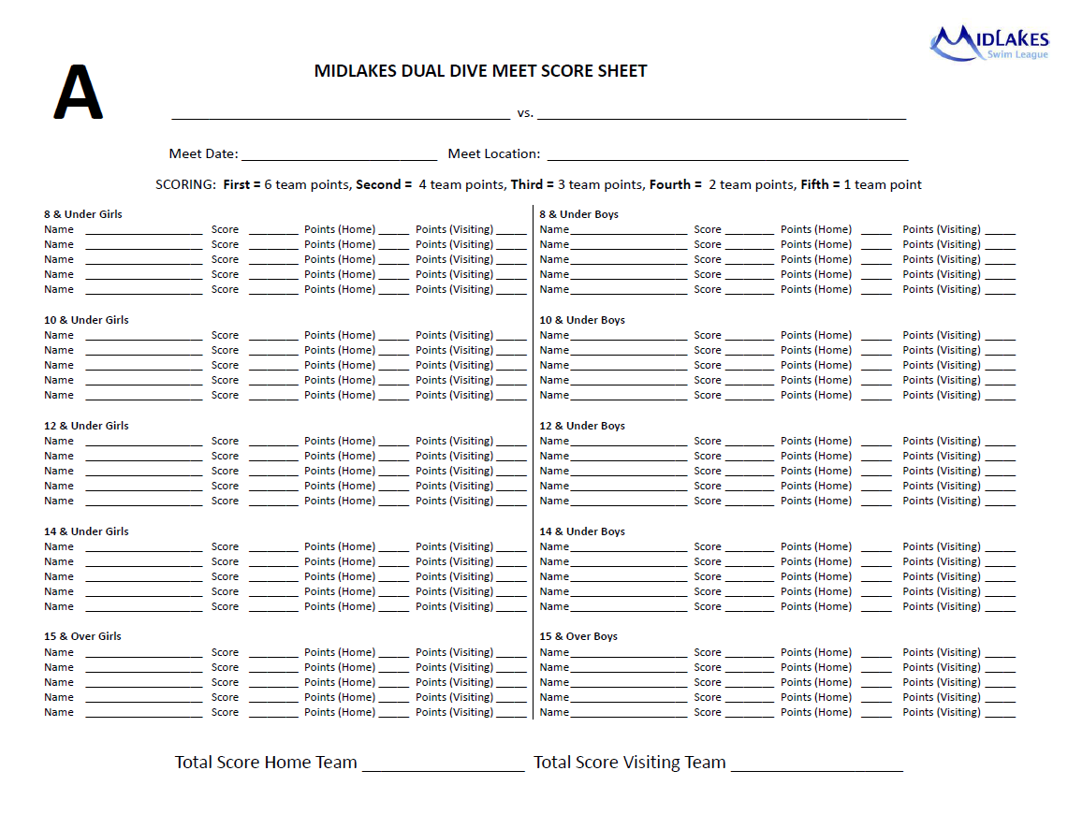
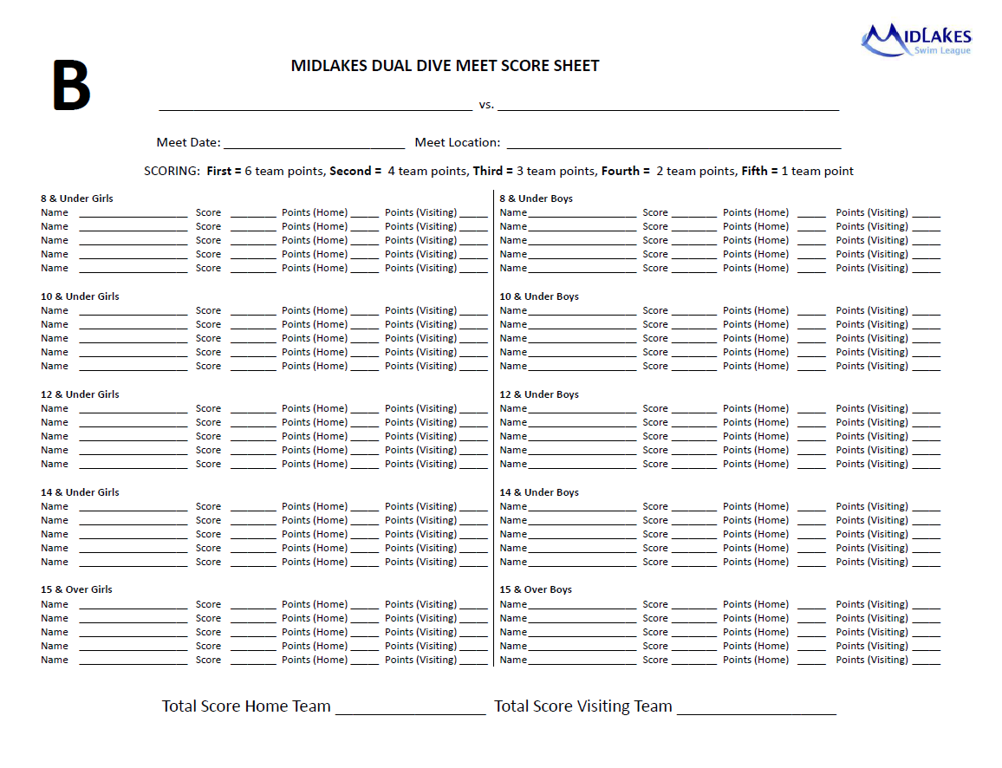
After the Meet: What to Do
  Coach or Parent Rep - After the meet ends
  Please give or email a copy of the Midlakes Dual Dive Meet Score Sheets to the other team.
  Please also send a copy to us at midlakesdiving@gmail.com.
  Note: You can scan or just send a photo of the sheets, as long as they’re legible
If we don’t receive your meet score sheets by the day after the meet, we will email you.
Coaches – Please check if any of your “B” divers have won their division a second time (against at least one competitor). If they have, then they are now an “A” diver.

Slide 15
Meet Prep: Set-up
HOME TEAM: Supplies Needed for Meets
Judging Chairs
        Set up 5 chairs, 3 on one side and 2 on the other side.
        - It’s best if you mix and match home and away judges on each side
        Provide a scoring card deck for each judge
        Provide a laminated or plastic-protected copy of the judging sheets
Scoring Table (recommend to have a canopy tent cover too)
Long table (or two tables) with chairs for 3 scorers and an announcer
PA system/microphone
Dive sheets for both teams, provided by coaches
Dual Meet Score Sheets, A and B
Emergency Contact Roster for both teams
Dive list showing degree of difficulty
Meet labels for ribbons (Avery 5160, pre-print the meet info, label template is available online)
Ribbons, 1st through 6th place, and participant ribbons for exhibition divers or for 7th - 12th places
Pencils and erasers, calculators (phones ok)
Paper weights to keep dive sheets, ribbons, etc. from blowing away

Slide 16
Meet Prep: Volunteers, Scoring, Judging
Volunteers (7-11 total)
Home Team: Meet Referee, Announcer, 2-3 Scorekeepers, 3 Judges (may add 3 more second half judges)
Away Team: 2 Judges (may add 2 more second half judges)
Announcing
Print Announcer script, remind Announcer to say “no score” if there is a failed dive.
Scoring
With 5 judges, drop the high and low score and average the remaining 3 scores.
Scoring Table Set-Up
Recommend canopy tent cover to protect sheets from rain or scorers from sun.
Long score table with 3-4 seats for 3 scorers + announcer; may have a separate awards table if desired.
Judging
For 5 judges, set up chairs with three on one side of the diving board, and two chairs on the other side.
Ribbons
Ribbons are typically awarded in between sessions.
Make sure you have ribbons for 1st-6th places, plus exhibition/participant ribbons.

Slide 17
Organizing Meets: Diver RSVP/Commitments & Volunteer Sign Ups
Options for Organizing Diver RSVP/Commitments & Volunteers Sign Ups for Meets
Team Unify
Signup Genius
Google Docs/Forms
Team Snap
Slack Group
Old School: Email or Paper
Tips
Preparation is key! Prepare for all home meets once! Make labels for ribbons and print out Dual Meet Scoring Sheets ahead of time.
Create sign-ups (RSVP for divers and Sign Ups for Volunteers) for entire season.
Require volunteering of all parents. Communicate this at season’s start.
Communicate frequently before each meet with other team and your team!

Slide 18
Video Training for Parents & Volunteers
Video Training for Parents & Volunteers – Mandatory!
No Parent Orientation Meeting. All done via awesome videos on website.
Please take the time to watch these videos so you know what your parents are seeing.
Dive Parent Orientation (22 min)
Volunteer Judge Training – Best for New Judges (42 min)
Volunteer Judge Training - Refresher Only (19 min)
Volunteer Scorer Training (11 min)
Meet Referee Training (32 min) – not the coach!
Supplemental training – A special Back Dive Half Twist video series that is helpful for Meet Referees.

Slide 19
Midlakes Website Tour
Everything you need is on our website!
https://www.gomotionapp.com/team/reclmslwa/page/diving
Meet Schedule & Pool Contact Info
Training Videos for Parents & Volunteers
Parent Rep Section
Coaches Section
Forms & Resources: Meet Prep Info
Dive Operating Plan

Slide 20
QUESTIONS?
Thank you for joining us,
Parent Representatives and Pool Managers
Any questions before we continue with the coaches’ portion of the meeting?

Slide 21
Midlakes Dive
Summer 2025
Season Kickoff Meeting for Dive Coaches
June 14, 2025
Hosted by Pauline Fletcher, Midlakes Dive Representative
midlakesdiving@gmail.com

Slide 22
Coaches Role
Your Role As a Coach
Safety! On the diving board, on deck, in the water.
Includes water line management, running on deck, using blocks, snapping towels, monkeying around, etc. They are kids! You are in charge.
Diving Instruction: Progression, Consistency
FUN!
Communicate w/ Parent Rep, Families, & Pool Mgr
Make it a positive experience for all involved
Follow Rules in Midlakes Dive Coach Guide

Slide 23
In Case of Emergency
What Happens If There Is an Injury at Dive Practice/Meet
Lifeguard on Duty’s Role
CPR, First Aid
Medical Report
Coach’s Role
Maintain control of other divers
Contact the injured diver’s parent/guardian

Slide 24
“A” or “B” Diver
“A” or “B” Diver?
“A” Diver =
Was an “A” Diver last year + no change in age group (stays in “A”)
Won their age group at Champs in prior year, even if they have moved up to a new age group (new “A”)
After winning 2 meets in a season (against competition, not solo), the diver moves up to “A” Diver status
Qualified for state level in high school
Year-round or very experienced diver that coach designates as “A” caliber
Everyone else competes as a “B” Diver.
Prior Year Champs Results are on Midlakes Website.
Please check these before the first meet!

Slide 25
Exhibition Divers
What If a Diver Doesn’t Have the Dives?
If a diver doesn’t have enough dives, enough groups, DQs with 2 failed dives in the meet, or just feels unsure about competing, you have the option to allow them to participate as an “Exhibition Diver”,
i.e. they will receive scores but cannot place.
This way, they can still be part of the team and part of the fun, without the pressure that comes with getting an extra dive or group they aren’t ready for.

Slide 26
Coaches Meet Prep
Preparing for Meets
Consistency!
Every year Midlakes has coaches with differing backgrounds and differing instruction methods. This has led to inconsistent methods for our divers and occasionally results in score deductions that could have been avoided.
Examples:
Arms up or down when doing jumps – Midlakes Dive standard is arms up for jumps.
One-step vs. three-step hurdles – Midlakes Dive standard is 3-step hurdle.
Back dive ½ twist – This is a difficult dive that is often added in as an “extra” dive in a diver’s portfolio. Midlakes Dive has specific max scores for this dive.
We have created a simplified “Midlakes Dive Judging Chart”, and we hope that all coaches and meet judges will have a more clear understanding of the expectations and valuations of dives under various circumstances.

Slide 27
Midlakes Dive – Why We Do Things the Way We Do
Jumps (100/200) may be competed on the dive sheets with DD 1.0
We are a novice league. Not every diver has time to develop a large portfolio of dives.
With jumps counting as a dive, every diver can get enough dives to compete at meets.
Required first dive
For 8 and under divers, the first dive will always be the Forward Jump, DD 1.0 regardless of position (tuck/pike/straight).
For all other ages, the first dive will always be the Forward Dive, DD 1.9 regardless of position (tuck/pike/straight).
Really? 1.9? Yes, because this is a foundation dive, we want all divers to strive to excel in this skill and work on different positions without worrying about the DD.
How we note position (it’s not A/B/C/D!)
On the dive sheets, you will use T/P/S/F for Tuck, Pike, Straight, and Free position.
This is because it’s easier for our parent judges, scorers, and announcers to figure out. That’s the only reason.

Slide 28
Midlakes Dive – Why We Do Things the Way We Do
Our Midlakes Dive standard is 3-step approach with a hurdle.
We understand this is not the USA Diving standard.
We do this because our parent volunteers are inexperienced at judging and don’t know to give enough credit for elements of the dive like power and height that come from a strong approach and hurdle.
Setting a max score for less than a 3-step approach helps parents set judging scores to the right level.
Dive 5211 Back Dive Half Twist has specific max scores for various dive issues.
This is a difficult dive that is often added in as an “extra” dive in a diver’s portfolio when they need an additional dive group and haven’t mastered other twist dives.
Be clear that foot movement and/or twisting before leaving the board will result in deductions.
Parent judges aren’t well-equipped to know when a diver is “cheating” the twist, so we set up the max score system to create a defined standard and Meet Ref calls it.

Slide 29
Dive # 5211 Back Dive Half Twist
5211 - “The Midlakes Special”
If a diver doesn’t have enough dives or enough groups, many coaches have their divers do dive 5211 Back Dive Half Twist, Straight position.
** Please note, 5211 is always Straight, while most twists are Free position.
This is a difficult dive to do correctly. This is also difficult for our parent judges to know how to judge. So, we have instituted a max score system, specially for this dive (and for 5111 Forward Dive Half Twist).
8 and Under + 10 and Under divers will compete it at DD 1.0. Older divers at DD 1.8.
If diver twists early with feet - max score 2.0
If diver twists early with hips - max score 3.0.
If diver jettisons themself backward to “torpedo” into the twist - max score 4.0.
Please watch the Back Dive Half Twist video series on our Midlakes website.

Slide 30
Meet Prep Using Excel Dive Sheets
MEET PREP – Electronic Dive Sheets
Our Excel spreadsheet for Dive Sheets for meets does all the dive number and DD validation for you using lookup tables.
All you need to do is copy the template worksheet for the age group, “A”/”B” status, and gender of your diver and rename it with the diver’s name, then select the dives for that diver from the drop-down lists for dive number and position.
Please fill out the “name pronunciation” on the dive sheet to make it easier for our announcers!
Benefits
FASTER & FEWER MISTAKES! Automatic pre-fill of club and meet details
Automatic listing of required dives based on age group and for “A” or “B” dive rating
Automatic lookup of dive names based on number
Automatic lookup of degree of difficulty based on dive name and position
Easy format for printing
Color-coding for female/male divers on tabs for ease when printing. Can use white sheet of paper for non-binary divers if desired.
Demonstration….

Slide 31
During the Meet
Coaching: Your Role During the Meet
Make sure dive sheets are correct, especially the groups and positions!
You can make a change to a dive after the meet starts.
** Note: the DD cannot go up, it can only go down.
Make sure to familiarize yourself with Midlakes dive rules which may be different from club or high school rules.
You are usually the diving expert on deck. Please watch for failed dives, missed dives, or 1-step hurdles during the meet.
** Please help the Meet Referee by signaling the infraction.
Please cheer on all the participating divers, not just your own team.
Remember Midlakes League is for FUN!
After the meet, keep all your dive sheets and final scorecard.

Slide 32
Dive Progression
TEACHING BEGINNING DIVE - HELPFUL PROGRESSION – UTILIZE VIDEOS FOR TEACHING!
Dryland warm-up
Dryland (3-step) approach and hurdle
Board approach and hurdle
Review arm position for head-first dives – arms behind ears with flat palms-out in handlock
Forward jump (arms up)
Forward dive (line-up first, then progressing to standing hurdle, then 1-step approach with hurdle, and finally 3-step approach with hurdle)
Back jump (arms up)
Back dive
Egg roll
Front somersault (arms down)
Back somersault (arms down)
Back dive half twist (Midlakes has several max scores on this)
Inward dive (inward progression – leaning back jump, leaning inward pike/cannonball)
Reverse dive (reverse progression – leaning forward jump, leaning reverse cannonball, butt bombs)
  Coaching techniques to increase consistency - e.g. arms up/down, 3-step hurdles

Slide 33
QUESTIONS?
Substitutes for Illness and Vacation coverage
What is your plan if you’re ill or have planned vacation? Who will coach in your place?
Do they have the necessary credentials?
SafeSport Trained
CPR + First Aid
If your substitute does not have the credentials listed above, then practice will have to be canceled.
A parent rep could fill in if they have SafeSport and CPR training.

Slide 34
QUESTIONS?
Interacting with Divers and Parents
What will you do if:
divers are getting out of hand at practice?
divers are messing around on the water line or are roughhousing behind the diving board?
divers are comparing and putting others down?
How will you handle it if:
parents interrupt you at practice to talk about their diver?
parents have an issue with how long another diver (not their child) takes at the diving board?
parents have an issue with their diver’s discomfort with a particular dive?

Slide 35
QUESTIONS?
Some Coaching Notes
Safety
Crow hops – watch out for these and get your diver to stop doing it!
    Head position
    - On forward dives, divers should look up and out. Divers sometimes tuck chins down and this can cause them to end up too close to the board.
    - On backward dives, divers should look at the diving board or at a coach who holds up a number at last moment. When divers throw their head back to find the water, this can cause them to lose footing or get too close to the board.
If the diving board at your club can be accessed from a swim start block, don’t let divers climb up this way. It’s not safe.
Co-Coaching
If you have a head coach + assistant coach dynamic, make sure you have clear communication about what the assistant coach should be working on.
If you have two co-head coaches, work out ahead of time how you will divide responsibilities for creating dive sheets, working with athletes, and managing the coaching space.

Slide 36
QUESTIONS?
Some Coaching Notes
Feedback to Others
Whether you are giving feedback to a diver or to a co-coach, remember to use the
“sandwich” or “Oreo” technique. Put the “filling” (your feedback) between two positives.
Example: “I noticed you really went for it. I think you just need to focus more on keeping your chin up and not looking down when you go. That will help you. Keep your confidence up. You’re making awesome progress.”
Example: “I see you bring a lot of great energy to practice. It is sometimes distracting to some of the other divers which is not safe. Please be careful not to distract someone who is on the board with loud noises or splashing. Keep bringing your great attitude though!”

Slide 37
QUESTIONS?
Group Discussion: Coaching Tips & more…
What coaching tips have helped you in the past?
What coaching tips have you used to help others?
What are a couple of techniques to help a brand-new diver?
What fears or concerns do you have for this season?
What are you excited about for this season?
Coaches, please stay for the demo of the dive spreadsheet. Plan to set this up as soon as you have a roster!

Slide 38
QUESTIONS?
Let’s make it a great 2025 Season!
Your questions are welcome.
I am here to support you.
Text me!
Pauline: 425-466-8275

