Slide 1

NKSL
Swim Officials Clinic updated May 2024

Slide 2
Clinic Overview
Welcome and Introductions
Philosophy of Officiating
Expectations and Professionalism
Technical Rules
Questions

Slide 3
The material in this presentation is adapted from USA Swimming National Committee training material.
Find additional reference material on the NKSL website, Northern Kentucky Swim League : Officials Info (teamunify.com).
Check out the material under Resources/Officials info. There you will find links to officiating videos, printable transcript of the officiating videos, situations to test your knowledge and disqualification codes.

Slide 4
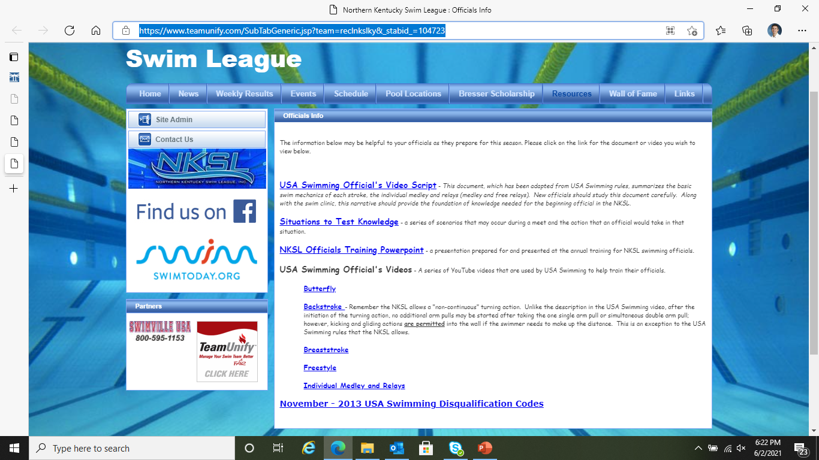

Slide 5
Philosophy of Officiating
Everything is grounded in the rules. The rules determine what is legal and what is not.
NKSL Rules & Regulations - Section II, Rule #2 – Disqualification:
Strick enforcement of all strokes and turns resulting in disqualifications of swimmers shall begin with the first dual meet for all age groups and will include the post season All Star and Championship Meets.
Observation should be consistent for all rules and all swimmers.
The Golden Rule of Officiating: “The benefit of the doubt always goes to the swimmer.”
“Ugly but legal”
Do NOT infer or extrapolate. Call what you see, and see what you call.

Slide 6
Expectations and Professionalism
Maintain positive attitude at all times
No cell phone or texting while working
No alcohol before or while working a meet
Do not cheer for or coach swimmers
Control emotions on deck
Remember “two wrongs don’t make a right”
Do not discuss disqualifications with anyone
Smile!

Slide 7
Technical Rules- Freestyle
Start
Forward start.
Stroke/Kick
Any style may be used. Must break surface throughout the race except swimmer may be submerged after start and each turn not more than 15 meters where head must break surface.
Turns/Finish
Some part of swimmer must touch the wall at completion of each length or required distance.

Slide 8
Watch the Freestyle video
https://www.usaswimming.org/officials/how-to-become-an-official
I recommend that you have a copy of the NKSL Swimming disqualification slip (DQ) in front of you as you watch the video.

Slide 9
Technical Rules- Backstroke
Start
In water facing start end with both hands on gutter or starting grips.
Feet/toes may be above the water, but may not be in, on, above lip, or bent over the gutter at anytime before or after start.
Stroke/Kick
Any style as long as swimmer remains on the back. Must break surface throughout the race except swimmer may be submerged after start and each turn not more than 15 meters where head must break surface. Once on the surface, the swimmer must remain on the surface until the next turn or finish.

Slide 10
Technical Rules- Backstroke
Turns
During turn swimmer may go past vertical to the breast and may utilize a single or one simultaneous double arm pull to initiate the turn.
In the NKSL, the swimmer may makeup distance to the wall with gliding, kicking or streamlining but may not take more than the one arm pull as described in previous bullet point.
Some part of the swimmer must touch the wall at the completion of each length.
Shoulders at or past vertical toward back when feet leave wall.
Finish
Some part of swimmer must touch the wall while on the back.
UPDATE: swimmers may submerge after the head passes the backstroke flags at the finish. Actual rule: Some part of the swimmer must break the surface of the water throughout the race, except that once some part of the head of the swimmer has passed the 5 meters mark immediately prior to reaching for the finish, the swimmer may be completely submerged.

Slide 11
Watch the Backstroke video
https://www.usaswimming.org/officials/how-to-become-an-official
I recommend that you have a copy of the NKSL Swimming disqualification slip (DQ) in front of you as you watch the video.

Slide 12
Technical Rules- Butterfly
Start
Forward start
Stroke
Body kept on breast.
Multiple kicks permitted but first arm pull must bring swimmer to the surface.
Must break surface throughout the race except swimmer may be submerged after start and each turn not more than 15 meters where head must break surface.
Arms, (at least) forearm to wrist, brought forward over water and pulled back simultaneously.

Slide 13
Technical Rules- Butterfly
Kick
Simultaneous up and down movement.
No alternating, scissors, or breaststroke kicking movements.
Turns/Finish
Shoulders at or past vertical toward breast when the swimmer leaves the wall.
Touch should be made with both hands separated and simultaneous at, above, or below the water surface.

Slide 14
Watch the Butterfly video
https://www.usaswimming.org/officials/how-to-become-an-official
I recommend that you have a copy of the NKSL Swimming disqualification slip (DQ) in front of you as you watch the video.

Slide 15
Technical Rules- Breaststroke
Start
Forward start.
Stroke
Body kept on breast.
Stroke cycle is one arm pull and one leg kick in that order.
Simultaneous arm movement.
After start and each turn one arm stroke may be completely back to legs. Head must break surface at widest part of second pull.
Recovery by the hands from the breast-on, under, or over the water. Elbows under water except last stroke before turn or finish.

Slide 16
Technical Rules- Breaststroke
Kick
After start and each turn, prior to the first breaststroke kick, a single butterfly kick is permitted.
Movement of the legs shall be simultaneous vertically.
Feet turned out during propulsive part of kick.
No alternating, scissors, or butterfly kick, except as stated, is allowed.
Turns/Finish
Shoulders at or past vertical toward breast when feet leave wall.
Touch shall be made with both hands separated and simultaneously at, above, or below the water surface.

Slide 17
Watch the Breaststroke video
https://www.usaswimming.org/officials/how-to-become-an-official
I recommend that you have a copy of the NKSL Swimming disqualification slip (DQ) in front of you as you watch the video.

Slide 18
Technical Rules- Individual Medley
Start
Forward start
Stroke/Kick
Rules for each stroke apply.
Must swim ¼ of event distance as prescribed in stroke, in order of Butterfly, Backstroke, Breaststroke, and Freestyle (must be swum in this order).
May not swim in the style of the other three strokes during the freestyle leg.
Turns/Finish
Intermediate turns conform to the turn rules for the stroke.
Transition turns conform to the finish rules for the stroke.

Slide 19
Watch the Individual Medley (IM) video
https://www.usaswimming.org/officials/how-to-become-an-official
I recommend that you have a copy of the NKSL Swimming disqualification slip (DQ) in front of you as you watch the video.

Slide 20
Technical Rules- Relays
Freestyle Relay
Freestyle rules apply.
Each swimmer must swim ¼ of distance.
Medley Relay
Rules pertaining to each stroke apply.
Each swimmer must swim ¼ of event distance as prescribed stroke, in order of Backstroke, Breaststroke, Butterfly, and Freestyle.
May not swim in the style of the other three strokes during the freestyle leg.
Takeoffs
Swimmer’s feet/foot must remain in contact with the starting platform until the incoming swimmer has touched the finish wall or pad.

Slide 21
Watch the Relay video
https://www.usaswimming.org/officials/how-to-become-an-official
I recommend that you have a copy of the NKSL Swimming disqualification slip (DQ) in front of you as you watch the video.

Slide 22
Quick review - role of the Starter
At regular season meets, the starter is often both the starter and the meet referee.
The starter’s primary role is to make sure every swimmer has a fair start and the keep the meet moving at a steady and reasonable pace.
The starter should make sure that the scorer table is aware of any changes made on deck (i.e., combining heats or moving swimmers).
Keep your voice calm but loud enough for every lane to hear. Do not yell or shout the commands.

Slide 23
Starting Commands
The starter should announce the Event and the Heat before each race. For example, “Event 24 – Girls 25-meter freestyle, Heat 1”.
Use the following spoken commands:
1) “Swimmers step-up”
2) “ Take your marks” UPDATE: pluralize the statement.
3) once everyone is in their starting position sound the start signal.
For backstroke and the medley relay starts use the following spoken commands:
1)“Swimmers in the water”
2) “Place your feet”
3) “Take your marks” UPDATE: pluralize the statement.
4) once everyone is in their starting position sound the start signal.

Slide 24
Starting Exceptions
If there is an obvious unfairness with the start, recall the entire heat and try again. An example of an obvious unfairness is someone yelling “GO” just before the starting signal which confuses some or all of the swimmers.
The NKSL allows one allowable false start for each swimmer. If a swimmer false starts, recall the heat. Announce which swimmer false started (for example, “lane 3, that is your one allowable false start”). Start the heat again.
Understand that it is hard to get a perfect start especially with younger athletes. Use fair and consistent judgement when recalling heats. Only recall heats when necessary.

Slide 25
Good Luck!
Questions?

