Slide 1
Castlewood Dragons
2022
Notes:
Kim

Slide 2
Mission and Goals
Friendly, informal, fun summer swim league
Improve swimming comfort and skill
Encourage sportsmanship and teamwork
Have a fun summer Hanging out with old friends and make new ones
Notes:
Kim

Slide 3
Requirements
resident of Castlewood, Highland Village, Double Oak, or Copper Canyon.
5 years old on June 1st and younger than 18 years of age.
Swimmers should able to swim the length of the pool (ages 11+, 2 laps)
  Swimmers must be water safe
  coaches realize that swimmers might be a bit rusty at the beginning of the summer
swimmers 8 years and under, have a responsible adult close to the pool area during all practices and team social events.
parent or family member (16 years or older) willing to volunteer.
Swim Team Registration: www.castlewoodswim.com.
Fees- $150 per swimmer (sibling discount- $25 per swimmer after 1st)
  League fee of $20
  Non-Castlewood residents-additional $25 per family for amenities/pool usage fee
  Team swimsuit (recommended, not required)
Notes:
Kim

Slide 4
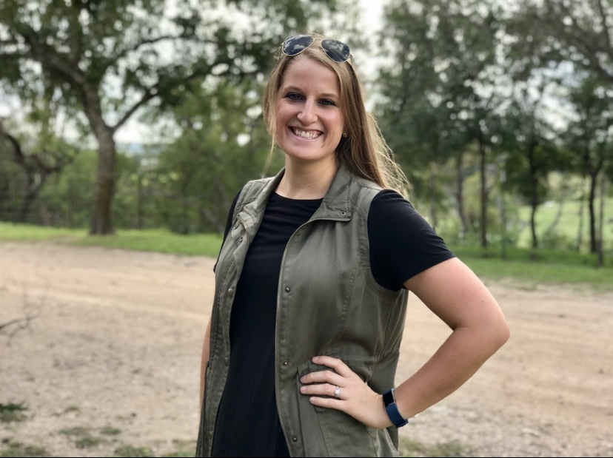
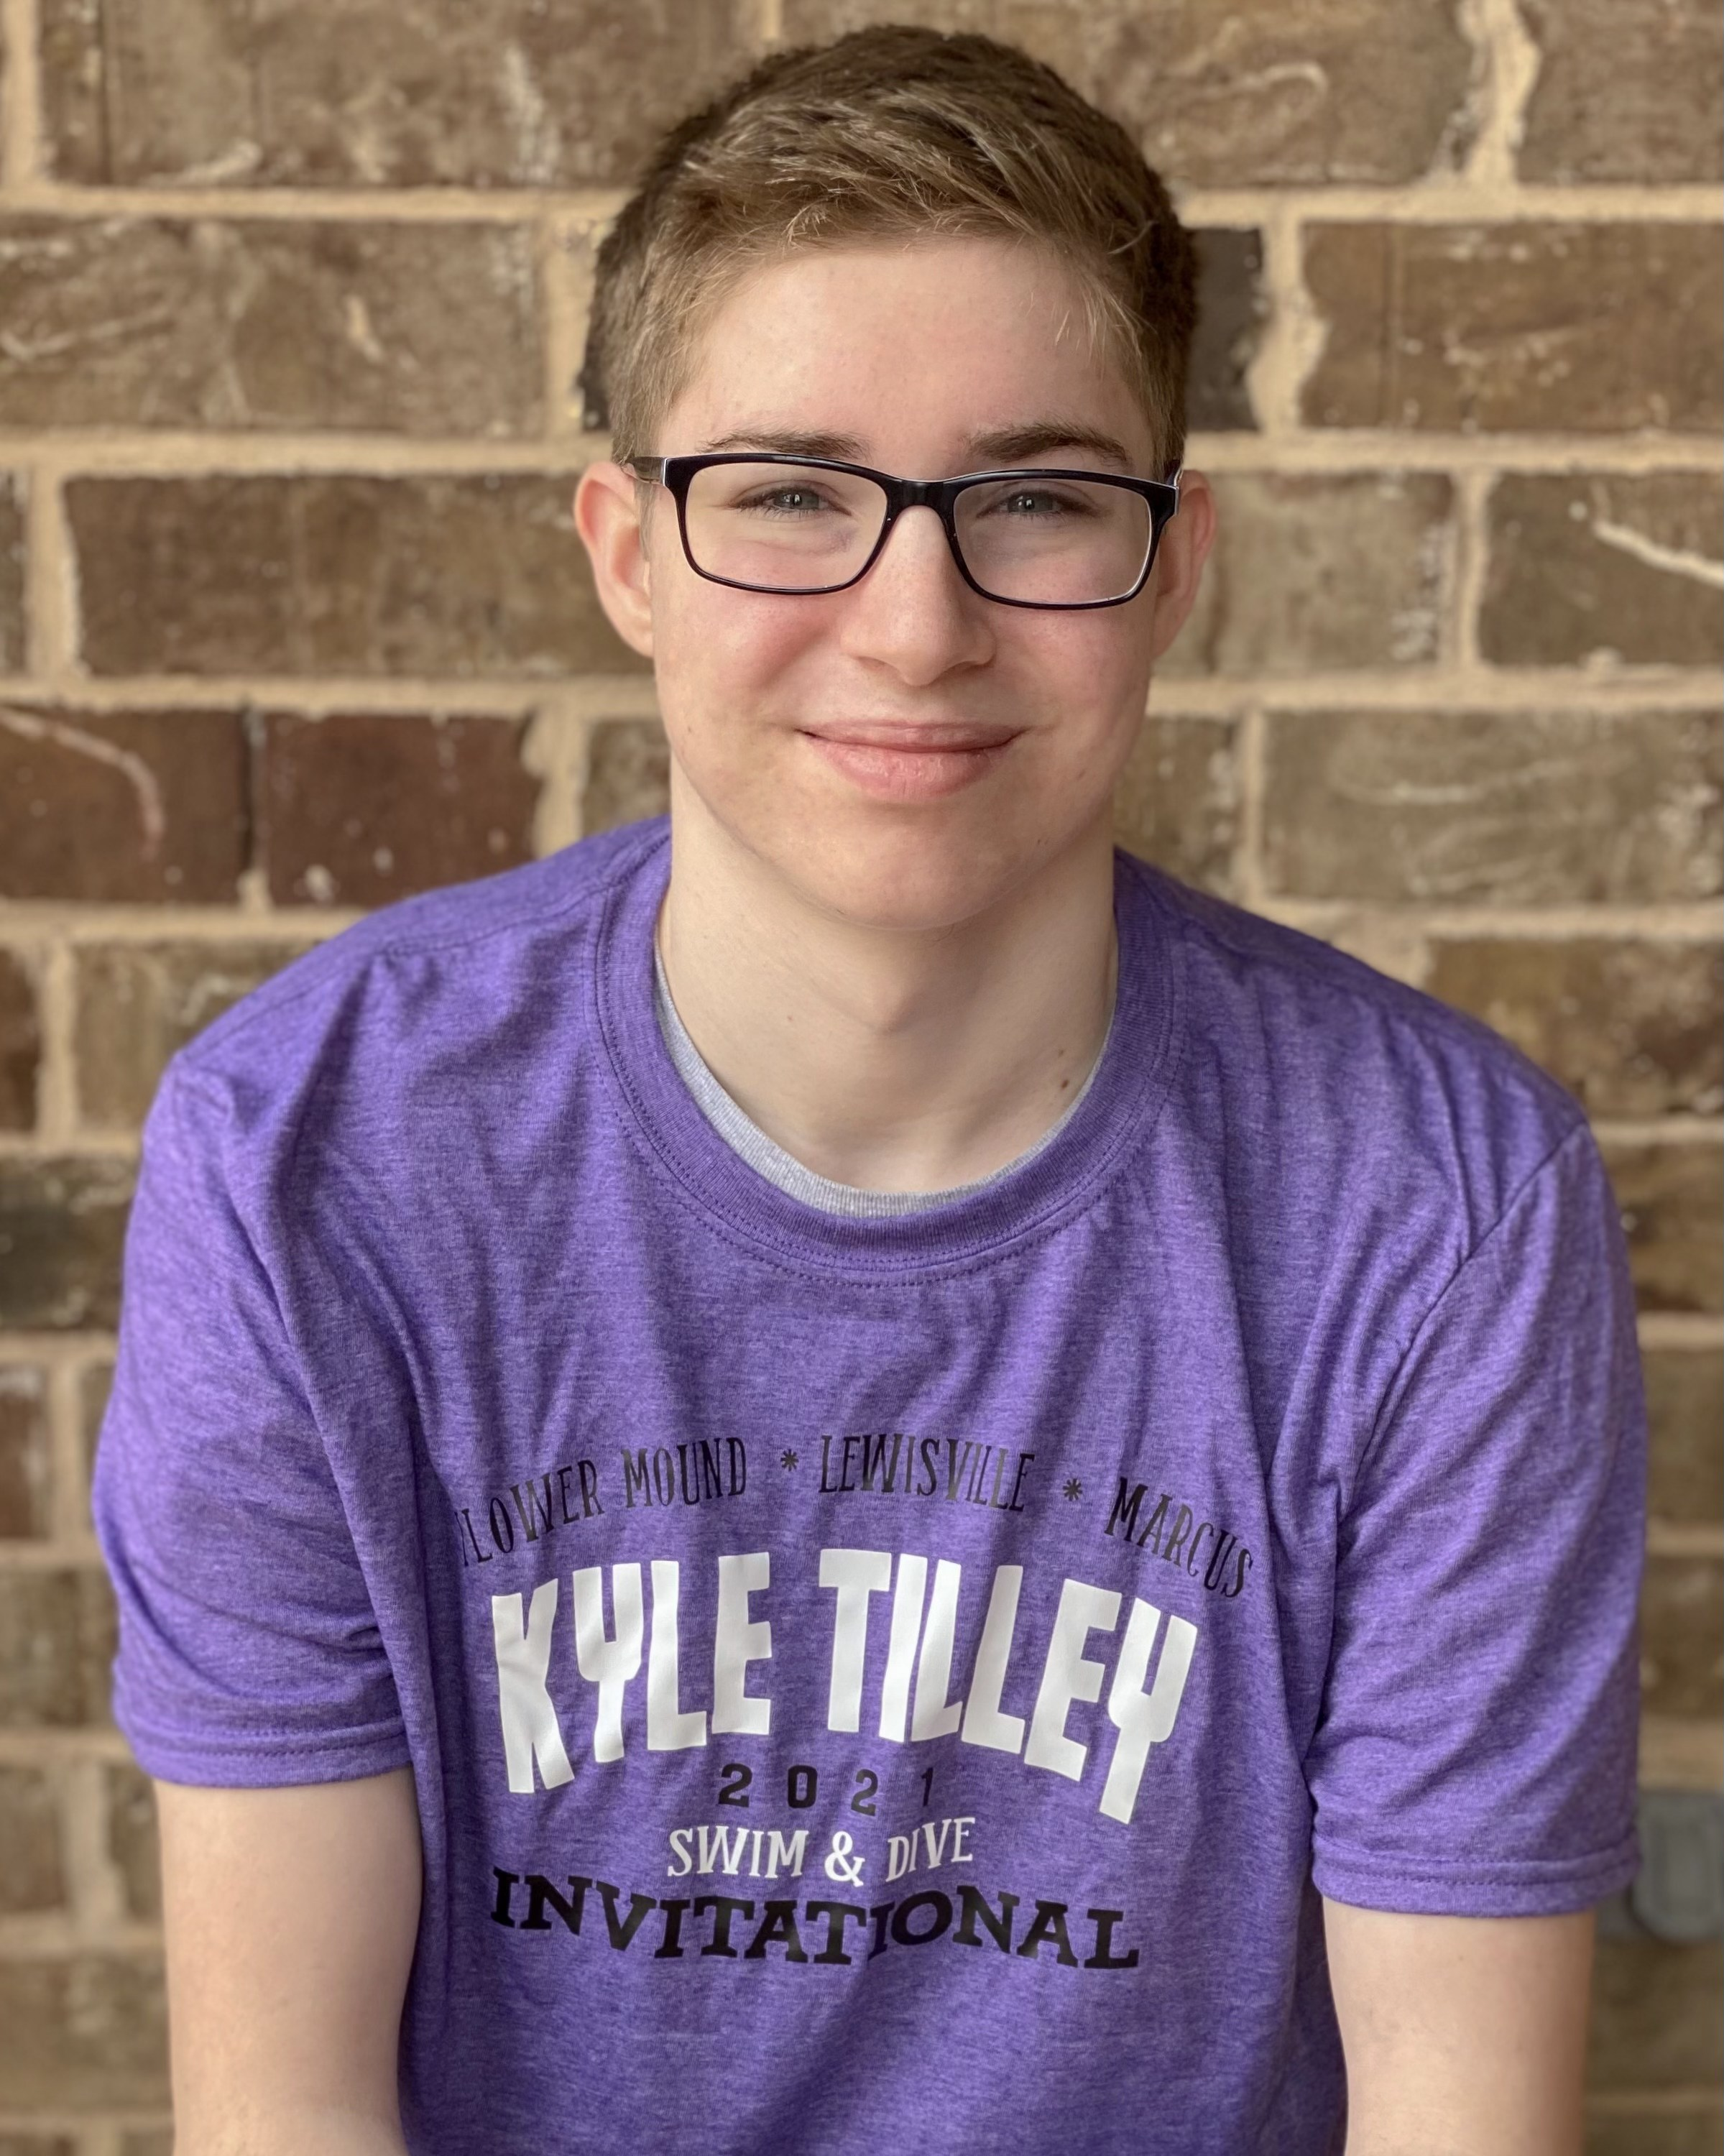
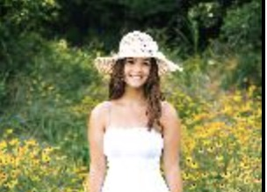
coaches
Head Coach: Melissa Box
LISD Kindergarten Teacher
Coaching for 10+years
5th year with the dragons!
Assistant Coach: Christopher Harvey- 2nd Year Assistant Coach: Stephanie Coutts- 2nd Year
Former Dragons Swimmer and Jr Coach Former Dragons Swimmer and Jr Coach
Marcus Swim Team Marcus Swim and Water polo team
10years swim experience 10 years swim experience
*Jr Coach Program:
details pending
Notes:
Kim

Slide 5
Schedule
3 components of summer swim
  Practice
  Swim meets (come to as many as you can)
  Social events (nothing but fun!)
Notes:
Kim

Slide 6
Practice
  Morning Practices daily tues - fri: Starting May31st – July 8th
  7-8:15AM Age 11+
  8:15-9:15am ages 9&10
  9:15am-10am ages 7&8
  10-10:30am ages 5&6
  *Modified practice June 1st due to picture day
Notes:
Melissa

Slide 7
Meets
Local meets against local swim clubs
100% Volunteer run
Monday mornings: 6/6, 6/13, 6/20, 6/27 and 7/6
Championship meet Tuesday July 12th (qualify by having a time this year)
*Details at castlewoodswim.com
Notes:
Melissa then Amber

Slide 8
Social events
Every week- fun event at practice
  Games
  Treats
  Activities
Special age specific social events
  Afternoon ice cream social for younger
  Late night pizza swim for older
Team wide events
  Kick off- May 9th
  End of season party-July 11th
  Hawaiian falls (extra cost)
  Sun valley (extra cost)
Notes:
Kimberley

Slide 9
Volunteering is a joy!!
…and a requirement
Volunteer run swim team
  We cannot have a swim team without you!
  Examples: timers, bench coordinators
Notes:
Kim or Amber

Slide 10
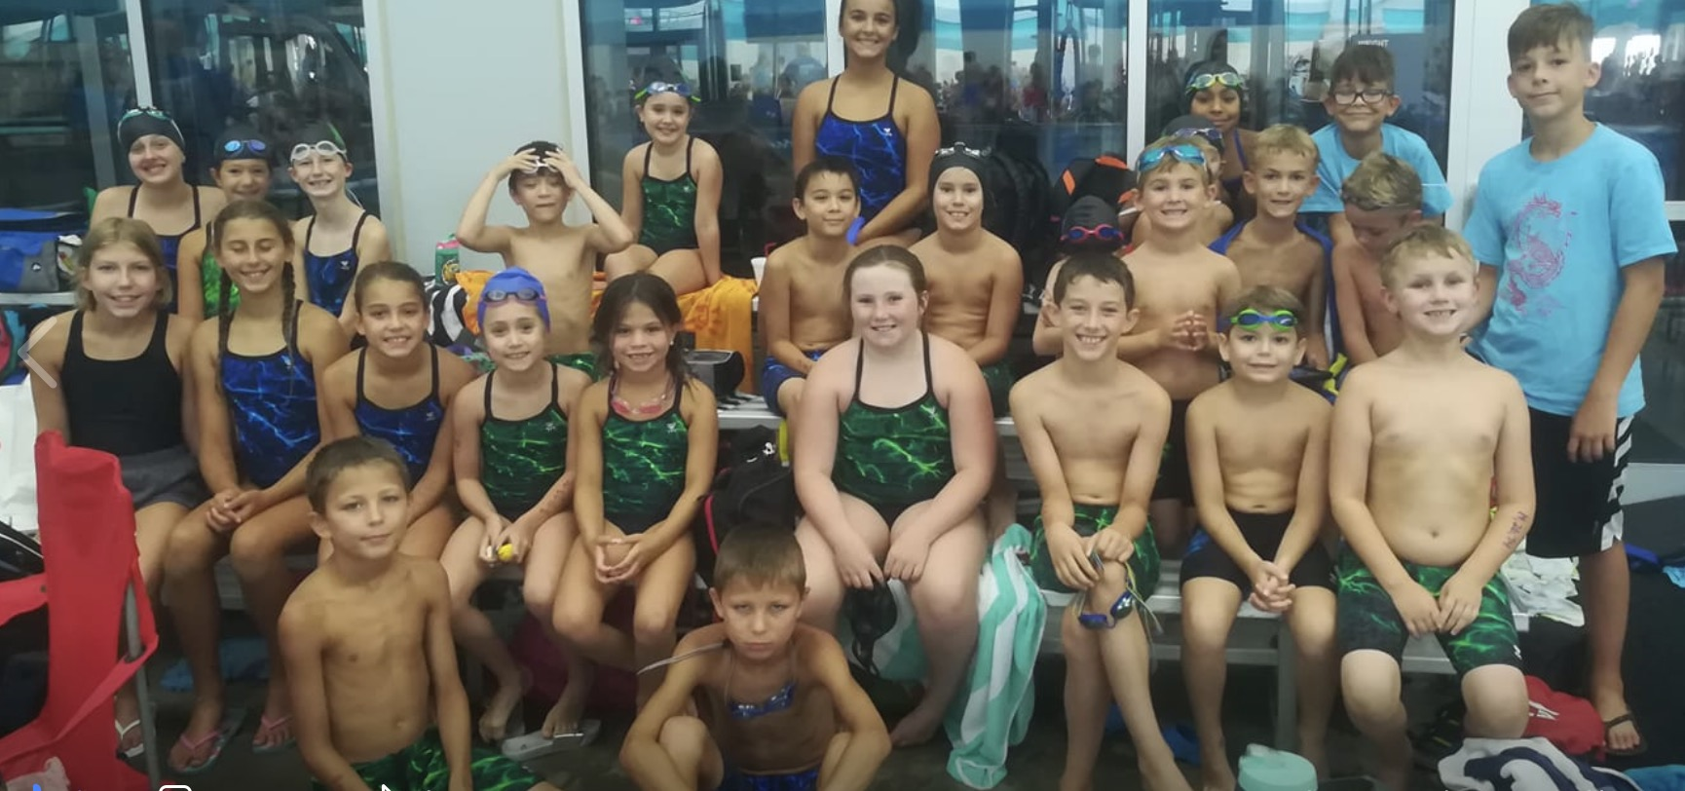
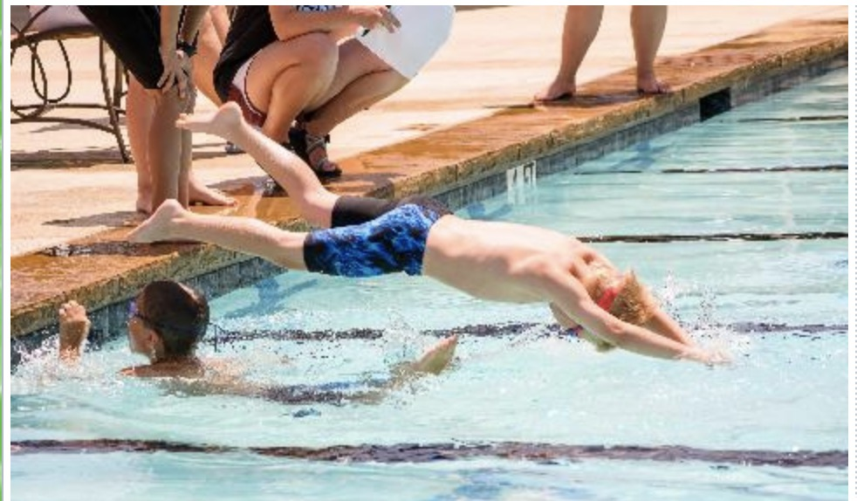
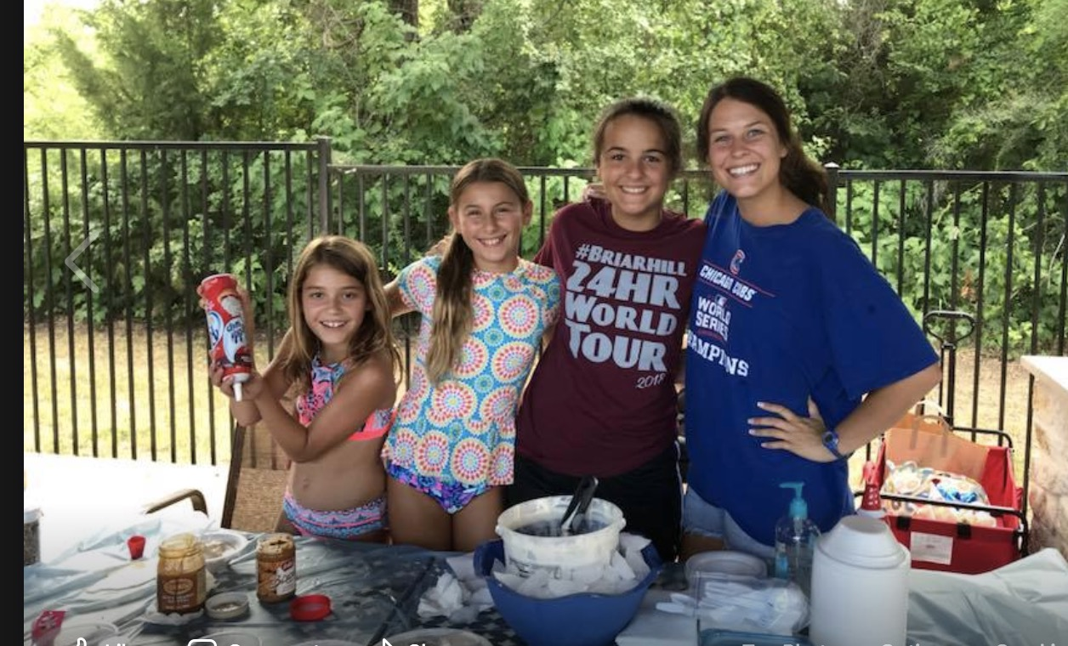
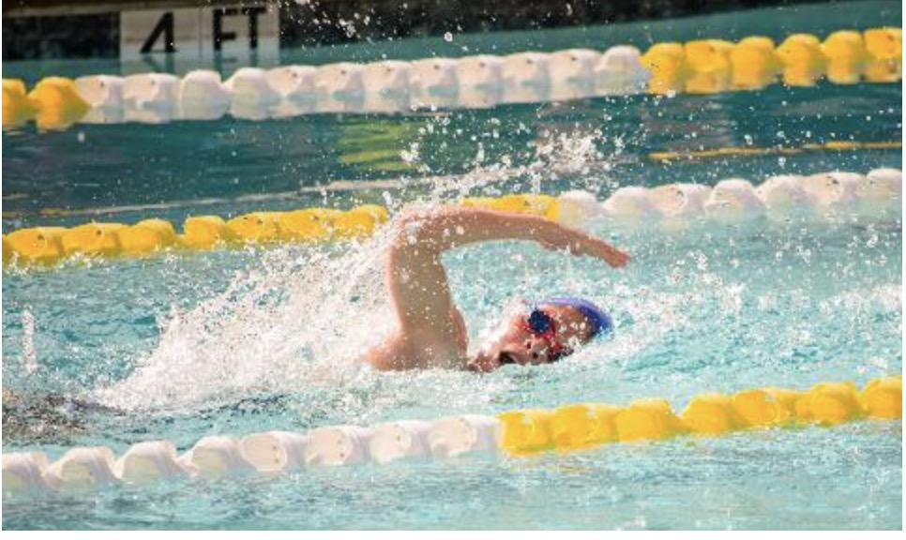
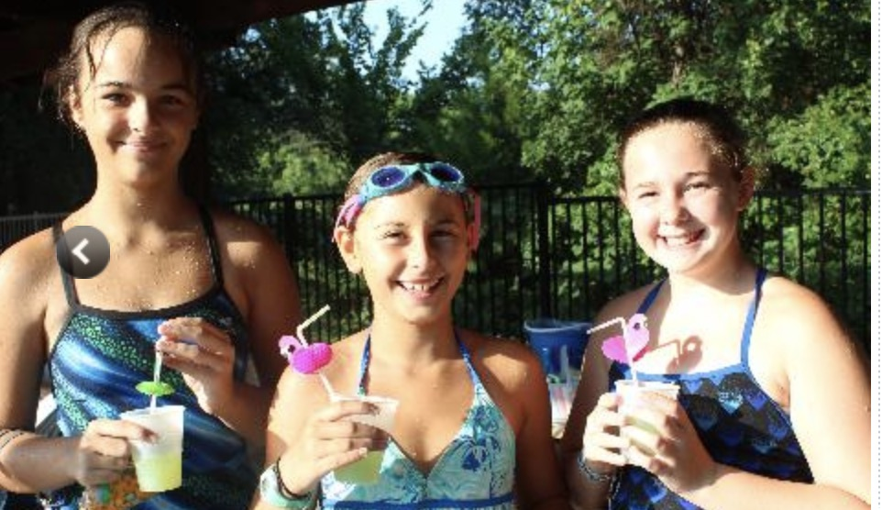
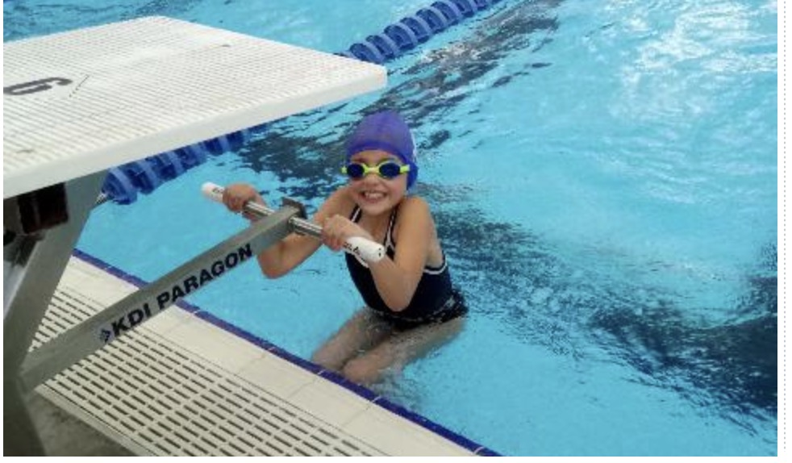
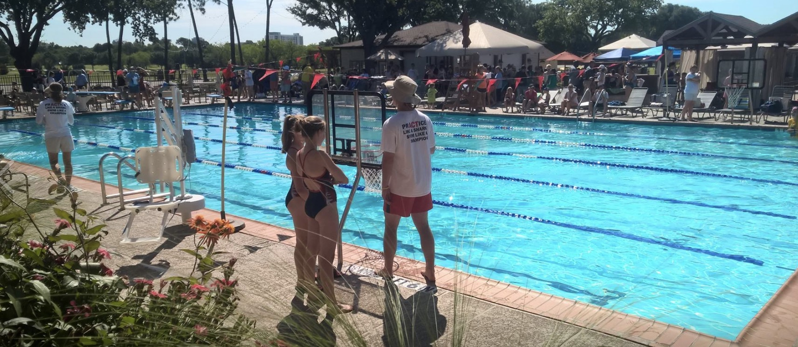
Questions?
Notes:
Kim

