Slide 1

2025 MSA Parent Meeting
August 7, 2025

Slide 2
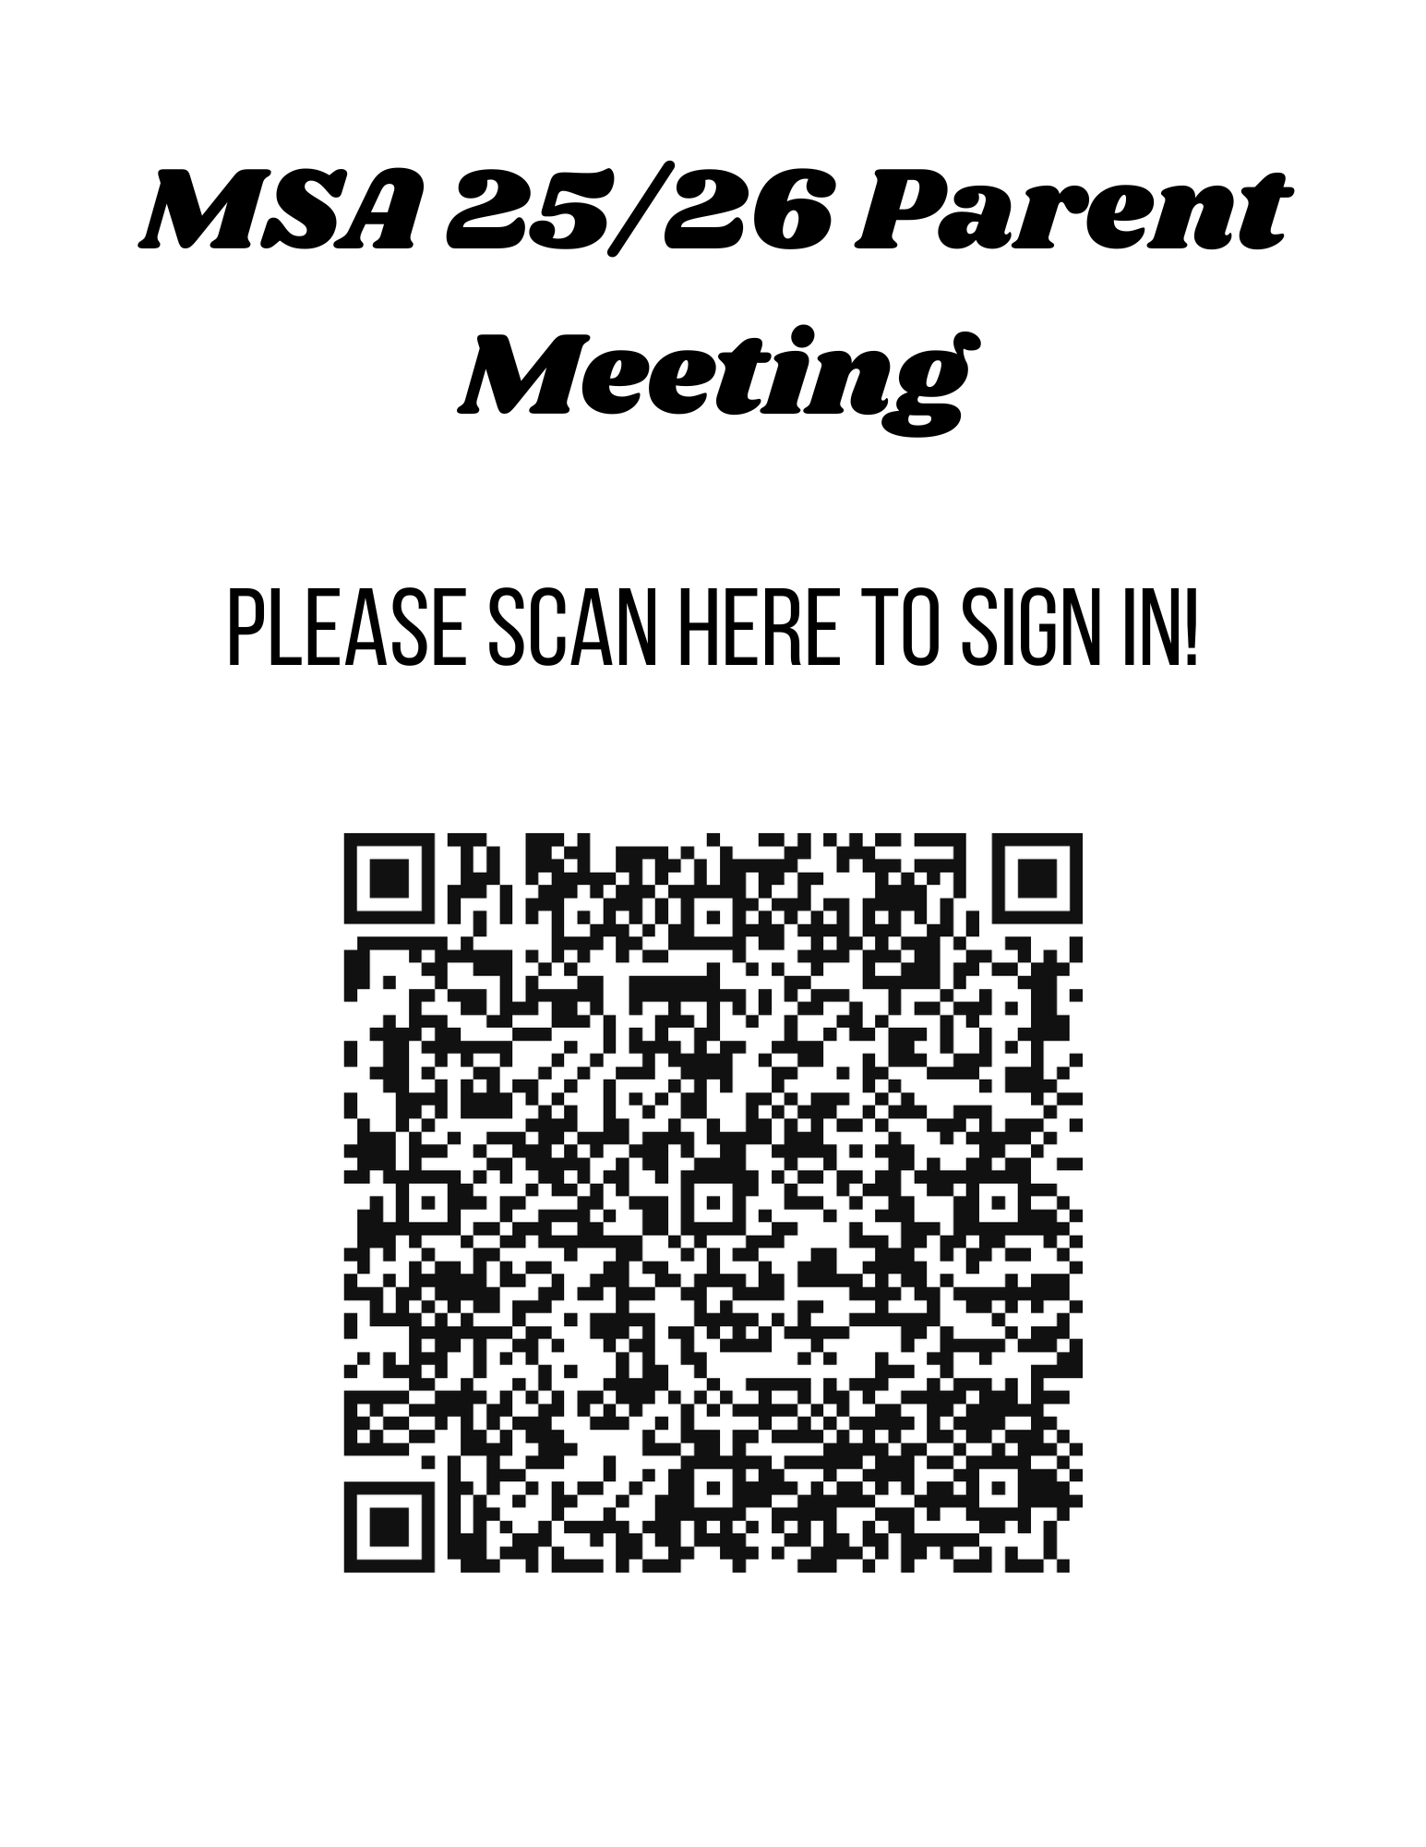

Slide 3
Introduction
MSA Board
Coaching – Erin McCann
Registration/Meet Entries – Bryn Holcombe
Treasurer – Tatiana Robertson
Meet Director – Doug Parkinson
Sponsorships – Kim Lancaster
Officiating – Heather Koehler
Apparel – Emily Kingsborough

Slide 4
MSA Board
Position | Member
President | Sherri Lynn
Vice President | Rachel Delisle
Secretary | Caroline Wathen
Treasurer | Tatiana Robertson
Registrar | Bryn Holcombe
Head Swim Coach | Erin McCann
Meet Director | Doug Parkinson
Sponsorships | Kim Lancaster
Fundraising | Marie Freelove
Apparel | Emily Kingsborough
Social Media | Whitney Briscoe
Hospitality | Courtney Hayden
Head Official | Heather Koehler
Webmaster | Matt Johnson

Slide 5
Coaching
Erin McCann

Slide 6
Coaches
White Group | Coach Doug, Coach Cara, Coach Heather
Yellow Group | Coach Doug, Coach Cara, Coach Heather
Blue Group | Coach Derek, Coach Pam
Bronze Group | Coach Gayle, Coach Doug
Silver Group | Coach Erin, Coach Gayle, Coach Doug
Gold Group | Coach Erin, Coach Roger

Slide 7
New Team Schedule
White: T/TH 3:30-4:30pm.
Yellow: M/W/F 3:30-4:30pm.
Blue: Practice M-F. M/W 3:30-4:45pm. T/TH/F 3:30-4:30pm.
Bronze: Practice M-F. M/W 3:30-4:45pm. T/TH/F 3:30-4:30pm.
Silver: M/W/F 4:00-6:30pm at indoor pool, T/TH 4:00-6:00pm at outdoor pool. Saturday 8:00-10:00am at outdoor pool.
Gold: M-F 4:00-6:30pm. M/W/F at indoor pool, T/TH at outdoor pool. Saturday 8:00-10:00am at outdoor pool.

Slide 8
Team Philosophy
Developing Character & Life Skills: MSA trains athletes to be their best both in and out of the pool–emphasizing resilience and valuable life lessons.
Athlete Development: We prioritize hard work, teamwork, and growth mindset.
Leading by Example: Our coaches model these values through intentional goal-setting and individualized plans for athletes.

Slide 9
Practice Expectations
Practice
Athletes should arrive ON TIME on the deck ready to go with ALL GEAR necessary.
Encourage your athletes to talk and ask the coaches about concerns/questions they have during practice and at meets.
Athletes should strive for great practice attendance to continue improvement.
Swimmers need to respect their teammates learning and their coaches instructions during practice.
Cheer for each other in practice & have fun!

Slide 10
Meet Expectations
Meets
Sign-up for meets early (Meets should be on website for declaration).
Deadline is usually 2 weeks ahead for away meets and 1 week ahead for home meets.
Max out allowed events (10&Under).
Encourage athletes to talk to coaches before and after races
(PLEASE ask for feedback).
Cheer for your teammates!!

Slide 11
Swim Meet Schedule
Dates | Event | Location
Aug. 15 & Sept. 5th | Intrasquad Meet (Non-Sanctioned) | Dublin Pool, Madison
Sept. 13 | SWIM-A-THON | Dublin Pool, Madison
Sept. 20-21 | Fitter & Faster Clinic Ages 9-12 | Dublin Pool, Madison
Sept. 27 | SSA Tyson Green Meet | Scottsboro, AL
Oct. 3 | Intrasquad Meet (Sanctioned) | Dublin Pool, Madison
Oct.17-19 | HSA Fran Norris Invitational | Huntsville, AL
Nov. 1-2 | Fitter & Faster Clinic Ages 11&Over | Dublin Pool, Madison
Nov. 7-9 | MSA Veteran’s Day Meet | Dublin Pool, Madison
Dec. 5-7 | Auburn | Auburn, AL
Jan. 16-18 | HSA TYR Invitational | Huntsville, AL
Jan. 30 - Feb. 1 | Ray Fogg Memorial Invitational | Dublin Pool, Madison
Feb. 6-8 | Regional 3 Championship | Crossplex, Birmingham, AL
Feb. 13 | Last Chance Challenge | Dublin Pool, Madison
Feb. 27-Mar. 1 | Southeastern Championship Meet | Huntsville, AL
Mar. 12-15 (est) | Best of the South | Atlanta, GA
National Events to be announced and all above events are subject to change due to availability

Slide 12
Southeastern Championship
February 27-March 1, 2026 (Short Course)
Southeastern Championship Meet is the primary team goal for MSA Athletes
The next level meet that Age Group Athletes should be striving for is Best of the South
Senior Level Athletes (15&Over) strive for going to Southeastern Championship Meet, scoring team points at SES, and/or making Junior National Qualifying Times (NCSA & ISCA)
*Qualifying Standards will be sent out and posted as they are approved

Slide 13
IMR/IMX
Age | IMR | IMX
10&Under | 100Free, 100IM, 50s of stroke | 200Free, 200IM, 100s of stroke
11-12 | 200Free, 200IM, 50s of stroke | 500Free, 200IM, 100s of stroke
IMR/IMX encourages and challenges newer & younger swimmers (12&Under) to try longer, more complex events.
IMR/IMX prepares swimmers for Bronze/Silver/Gold–group where coaches require them to compete in certain events throughout the year (i.e., Gold group athletes do 400 IM and 500 FR once a year)
We expect older swimmers to swim events coaches sign them up for and/or what they “specialize” in.
Stroke specialization is not applicable to any athlete under 15 years of age.

Slide 14
MAPPs and APT
Minor Athlete Protection Policy & Athlete Protection Policy
Communication (Electronic & In person)
6:00am-5:00pm
Email or SMS (TeamUnify)
Any e-messaging with an athlete must include parent/guardian
All in-person communication must be observable and interruptible
USA SafeSport Recognition
Teaches athletes signs of misconduct
Helps keep athletes safe
US Recognition

Slide 15
Parent Communication
Coach Erin emails out weekly updates via TeamUnify. Check your emails please!
SMS Messaging will be used for any last minute changes to schedule or immediate notices (e.g., weather). Be sure current cell phone number is listed in your account info under “Mobile/SMS” in TeamUnify(OnDeck).
OnDeck in the App version of TeamUnify = same login info.
ThorAlert - Madison City’s weather alert app. Code for Dublin is 150.
MeetMobile–live meet results, psych sheet/heat sheet, prelim/finals

Slide 16
Swim Registration & Meet Entries
Bryn Holcombe

Slide 17
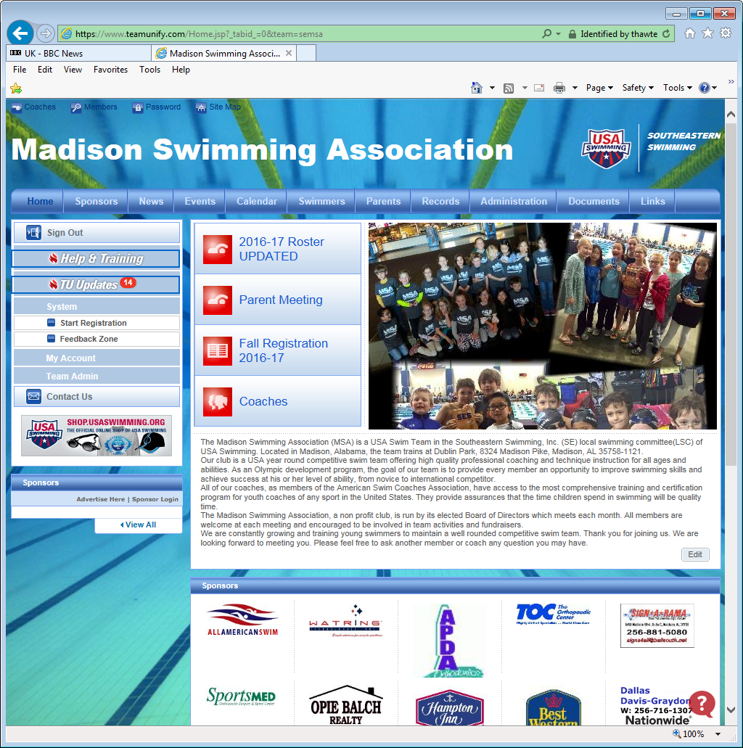
Swim Registration
All swimmers must be registered before they can start practice.
New and Returning
Register on the website
http://www.madisonswimming.org
Go to UPCOMING EVENTS
Select REGISTRATION
Register with USA Swimming
Email link distribution Sept 1st

Slide 18
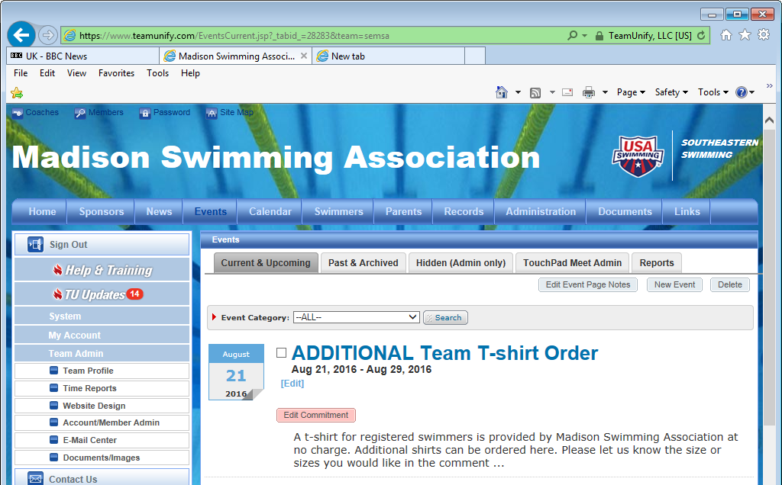
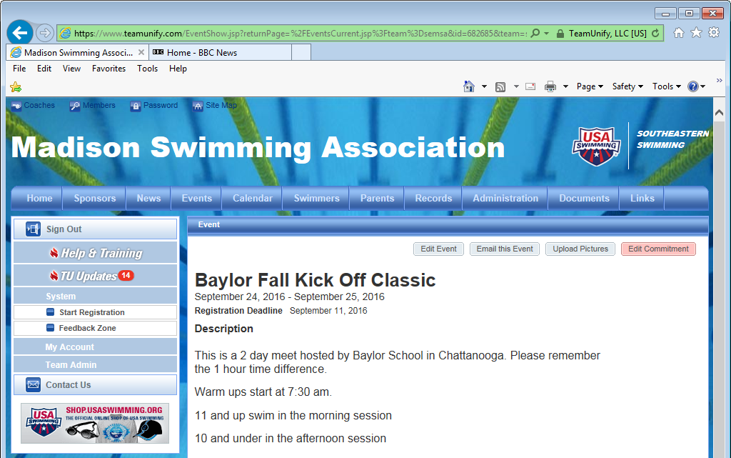
Online Swim Meet Entries
All meet information is located under the EVENTS tab.
Select the MEET
Select “EDIT COMMITMENT”
On the next page pick your swimmer to edit.

Slide 19
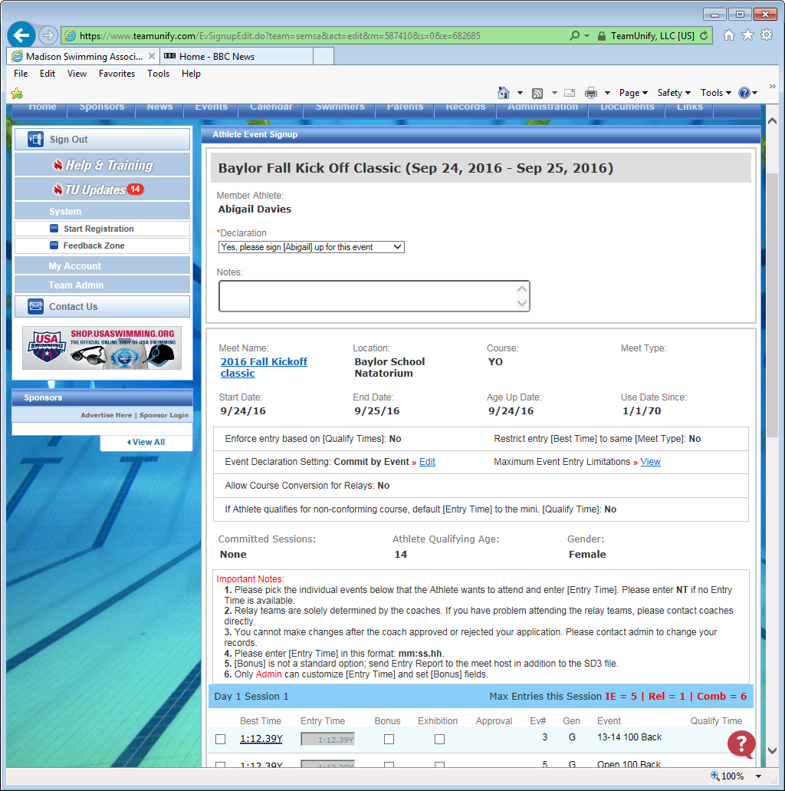
Online Swim Meet Entries
For each swimmer you need to:
In the Declaration box select
YES Please sign up, or
NO Thanks not attending
For YES
Scroll down and you can select the events you wish your swimmer to enter.
Maximum entries per day are highlighted.
Go to the bottom and hit SAVE
Do this for both attending or not attending.

Slide 20
Other MSA Events
(to register for)
Winter Party
Date and Time TBD
Banquet
Year end celebration.
Asbury Methodist Church, Five Points Building
Date and Time TBD

Slide 21
MSA Treasurer
Tatiana Robertson

Slide 22
Treasurer
MSA is a year-round not-for-profit organization but we are not tax-exempt
All officers and meet officials are volunteer only
We operate solely on your monthly dues and meet fees
Meet fees are paid directly to the hosting teams
Monthly dues pay for:
Rental of Dublin Pool for short-course season and rental fees for the long-course season
Coaching Expenses
Rental of facilities used for Christmas party and April Banquet

Slide 23
Treasurer
MSA accepts donations and sponsorships from individuals and organizations
Tax-deductible receipts are provided
Billing is conducted through our Team Unify website
Set up your Credit Card or Bank Transfer for monthly billings which occur on the 1st of each month
Bank Transfer preferred to keep our cost down.
We began charging the CC fees back to parent’s last year.
There is a late fee automatically assessed on the 10th of each month - $10
Please stay on top of your monthly payments

Slide 24
Treasurer
When you sign up your child to swim at a meet, MSA cuts a check for the host team.
Treasurer will then process the fees and set charges up against parent’s account. Can take a month to see charge.
Withdrawal requests from the swim team must be submitted prior to the 15th of the month, or you will be charged for the subsequent month. (**example: if you intend to withdraw beginning in April, we need to know before March 15th, otherwise you will be responsible for the April fees).

Slide 25
MSA Fundraising Events:
Swim Meets
Swim-A-Thon
Doug Parkinson & Marie Freelove

Slide 26
Why Fundraise?
MSA cannot operate without fundraising
Fundraising provides for:
Facility fees
Coach salaries
Swimmer training equipment
Competition equipment
Goals this year:
Some touch pads (~$1,600 each)
Push buttons, cables, tripods, etc.
Unexpected and miscellaneous costs
Thank you for helping us raise money for MSA!!

Slide 27
Swim Meet Schedule
Dates | Event | Location
Aug. 15 | Intrasquad Meet (not USA-S sanctioned) | Dublin Pool, Madison
Sept. 13 | SWIM-A-THON (mandatory fundraiser) | Dublin Pool, Madison
Sept. 20-21 | Fitter & Faster Clinic Ages 9-12 | Dublin Pool, Madison
Sept. 27 | SSA Tyson Green Meet | Scottsboro, AL
Oct. 3 | Intrasquad Meet (not USA-S sanctioned) | Dublin Pool, Madison
Oct.17-19 | HSA Fran Norris Invitational | Huntsville, AL
Nov. 1-2 | Fitter & Faster Clinic Ages 11&Over | Dublin Pool, Madison
Nov. 7-9 | MSA Veteran’s Day Meet (mandatory volunteering) | Dublin Pool, Madison
Dec. 5-7 | Auburn | Auburn, AL
Jan. 16-18 | HSA TYR Invitational | Huntsville, AL
Jan. 30 - Feb. 1 | Ray Fogg Memorial Invitational (mandatory volunteering) | Dublin Pool, Madison
Feb. 6-8 | Regional 3 Championship (8&under championships) | Crossplex, Birmingham, AL
Feb. 13 | Last Chance Challenge (invite only) | Dublin Pool, Madison
Feb. 27-Mar. 1 | Southeastern Championship Meet (qualifiers only) | Huntsville, AL
Mar. 12-15 (est) | Best of the South (qualifiers only) | Atlanta, GA
National Events to be announced and all above events are subject to change due to availability

Slide 28
Swim-a-Thon
September 13, 2025

Slide 29
Swim-A-Thon
MSA is hosting a Swim-A-Thon Fundraiser this year
Sept 13th, 2025
8:15am-9:15am Silver and Gold groups
9:30am-10:30am Blue and Bronze groups
10:45am-11:45am White and Yellow groups
All swimmers are required to participate. To help families with multiple swimmers we have a sliding scale:
1st swimmer goal- $60
2nd swimmer goal- $40
3rd swimmer goal- $20
Don’t let the goals limit you!
We need help to pull this off! Please let Marie Freelove know if you can help on the Swim-a-Thon committee.

Slide 30
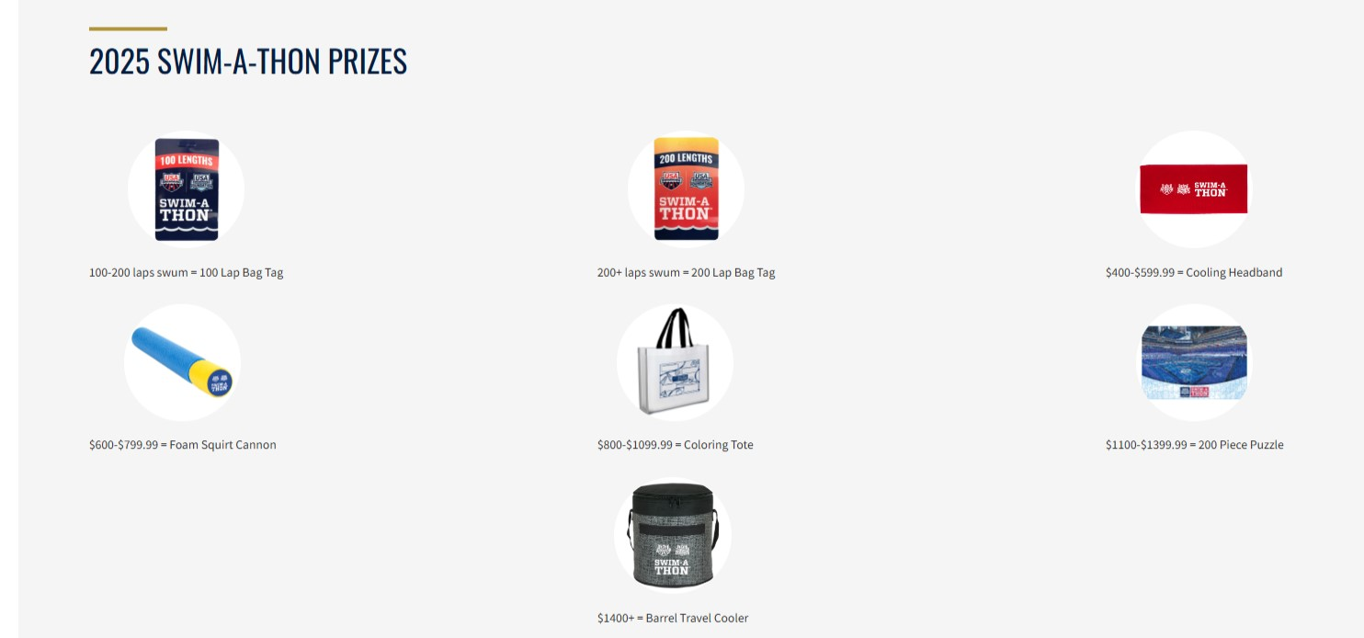
Swim-A-Thon
Food and Prizes
Food/Drink table set up to fuel our swimmers.
Raffle drawings for swimmers during the event.
USA Swimming prizes up for grabs!

Slide 31
MSA-Hosted
Swim Meets
Doug Parkinson

Slide 32
MSA-Hosted Meets
Veteran’s Day: 7- 9 Nov, 2025
Ray Fogg Memorial Meet : 30 Jan - 1 Feb, 2026
MSA will host some intrasquad meets, as well, but are not considered fundraising events

Slide 33
MSA Hosted Meets
To host a meet successfully, we need volunteers!
Many job slots are available per meet.
Lane Timers, Bullpen, Officials, Hospitality, Concessions, Announcing, Setup/Clean-up, etc.
Each MSA family is required to volunteer for two sessions per meet.
$100 team contribution for failing to fulfill volunteer obligations. Per Meet!
THE PRIMARY GOAL IS TO HOST A WELL-RUN MEET WHERE WE
PROVIDE A GREAT ENVIRONMENT FOR COMPETITION AND SUCCESSFULLY RAISE FUNDS FOR THE TEAM.

Slide 34
For More Information About…
General meet info or meet environments, etc.
Email: douglas@parkinson925.net
Board members
Coaches
Other experienced swim families
For more information on volunteer positions
Email: douglas@parkinson925.net
Board & Other experienced swim families
OFFICIALS → discussed next section
I promise you, that coaches and board will distribute as much meet info as possible when it is available.

Slide 35
Officiating
Heather Koehler

Slide 36
Officiating
MSA has a great history of officiating.
We need officials to run sanctioned meets.
Becoming an official requires investment.

Slide 37
Officiating
Wet Side
Wet Side officials are those that you commonly see around the deck.
Stroke and Turn
Chief Judge
Starter
Deck Referee
Best seats (well position as you will be standing) in the house. Always have a clear view of the pool.
Dry Side
Dry Side officials are those working behind the computer to make sure your swimmers have the most accurate times possible
Administrative Official
Administrative Referee
Like the Wet Side, best seats in the house, but you stay dry. ;)

Slide 38
Officiating
How do I become an official for USA Swimming?
You’ll need to become a member of USA Swimming.
Attend officials clinic (at Dublin before a swim meet)
Take online training through USA Swimming
Work as an apprentice to get your on the job training.
And then … have fun!
Heather Kohler can help you get started

Slide 39
MSA Sponsorships
Kim Lancaster

Slide 40
MSA Sponsors for August 2025-May 2026
MSA is a 501 (c3), non-profit organization
Swimmer dues and fees cover normal operating costs such as:
Pool usage
Coach salary
Insurance
Sponsorship money helps offset for additional items such as:
Swim Meet equipment (touch pads, sound system, scoreboard, etc)
Awards and treats (ribbons, heat winner awards, medals)
Extra hospitality food and refreshments not covered by initial registration fee
Scholarships for swimmers in need of financial assistance

Slide 41
MSA Sponsorships
If you are interested in sponsorship or providing a company name with Point of Contact (POC) to sponsor MSA, contact Kim Lancaster at madisonswimassoc@gmail.com

Slide 42





Thank you to our current MSA Corporate Sponsors

Slide 43
Apparel
Emily Kingsborough

Slide 44
Practice Equipment/Gear
Yellow & White: Fins | KickBoard | Pull Buoy
Blue & Bronze: Fins | KickBoard | Hand Paddles | Pull Buoy
Silver: Fins | KickBoard | Hand Paddles | Pull Buoy
Gold: Fins | KickBoard | Hand Paddles | Pull Buoy | Snorkel | Tempo Trainer

Slide 45
Where to Get Gear
MSA Swim Outlet Store
https://www.swimoutlet.com/collections/msa
Saturn Sports (formerly First Place Athletics)
3061 Leeman Ferry Rd SW, Huntsville, AL 35801
(Store has recently moved)

Slide 46
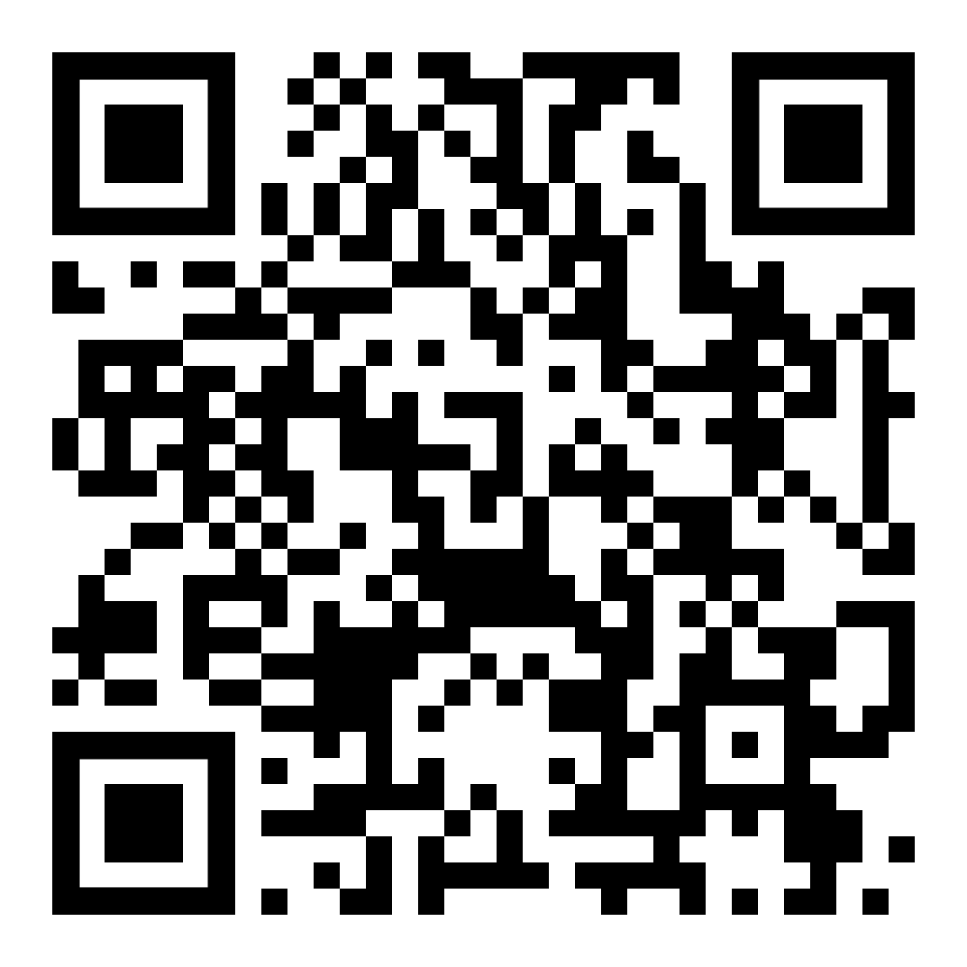
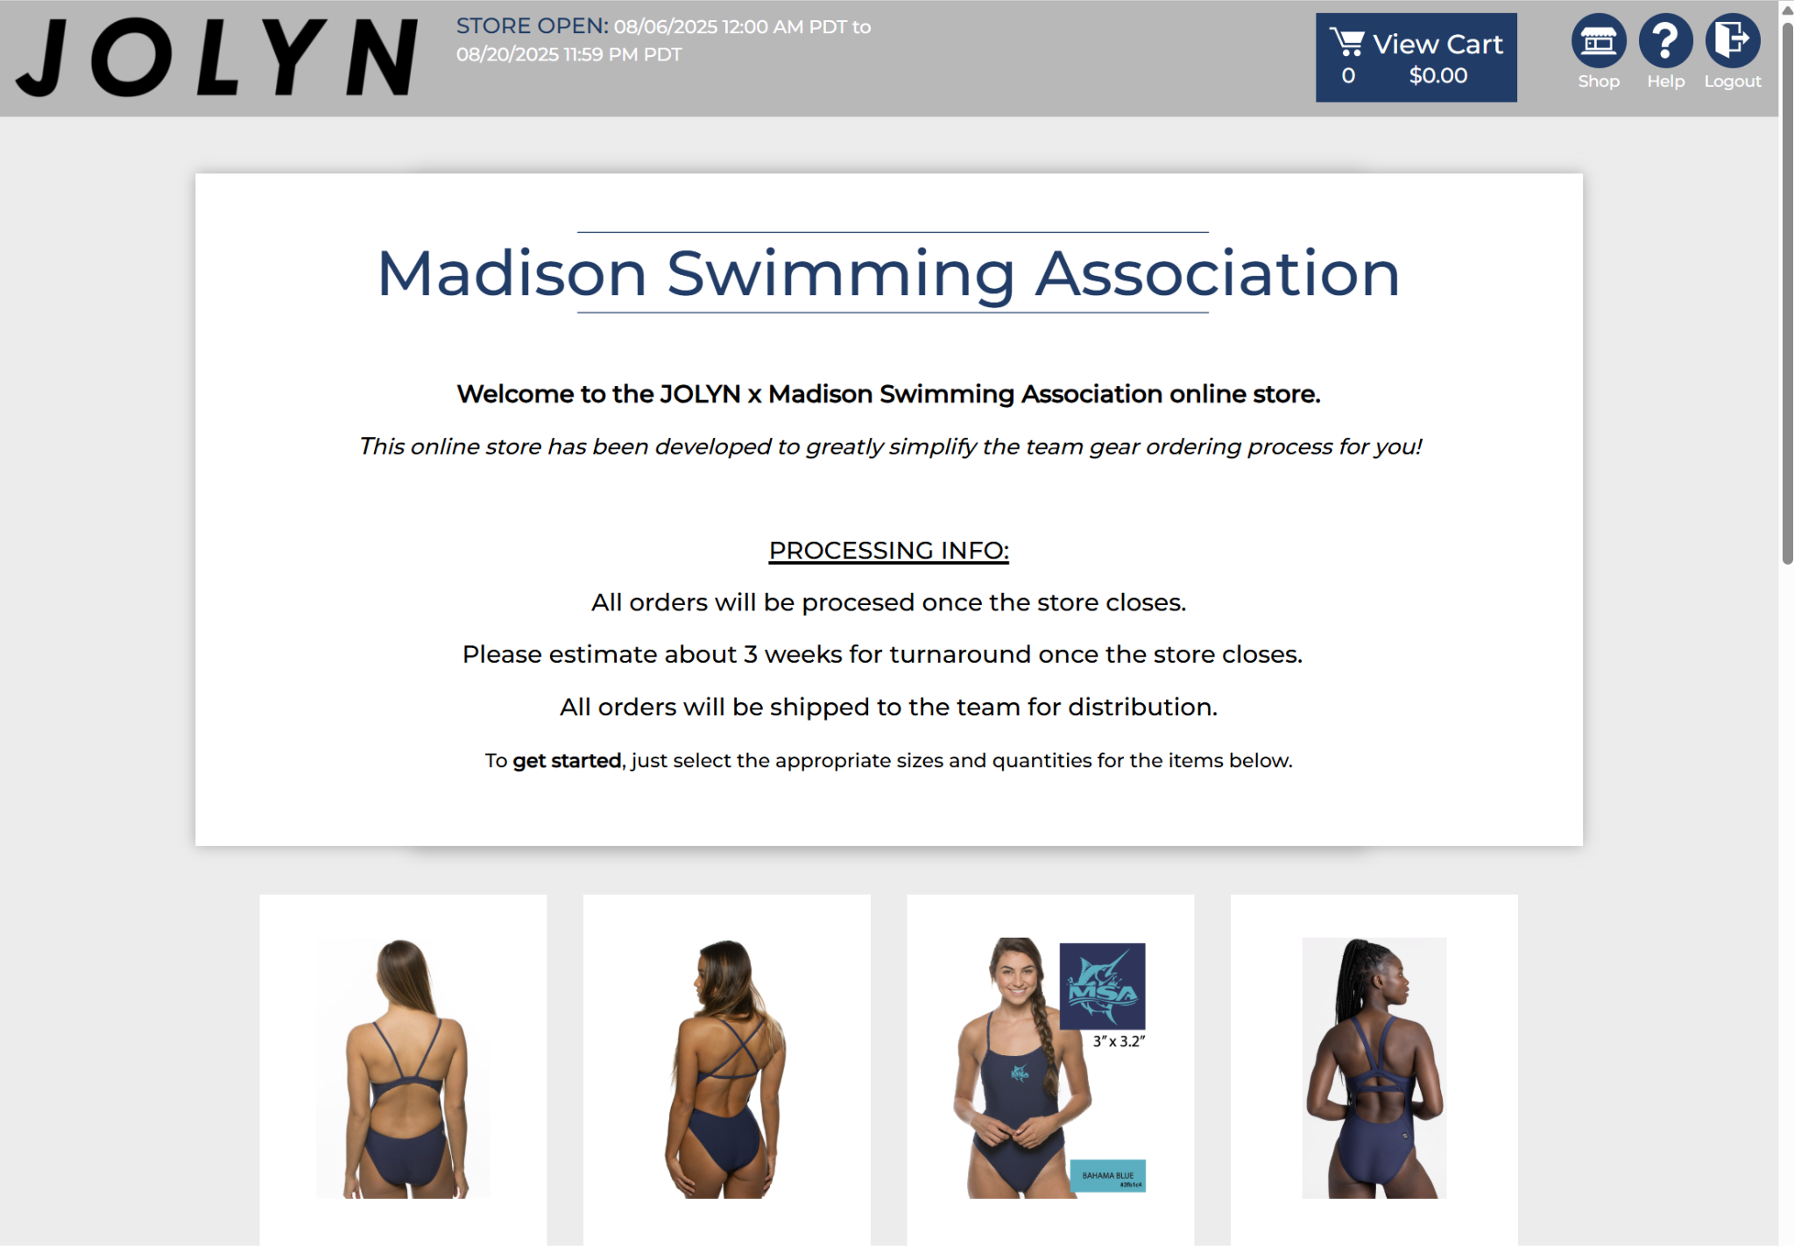
Team Suits
https://jolynclothing.tuosystems.com/stores/msa25
This year, team suits will be ordered through our Jolyn store.
The store will be open 08/06/2025 at 12:00 AM PDT through 08/20/2025 at 11:59 PM PDT.
All orders are final due to MSA logo personalization.
Be sure to use the fit kit to confirm your swimmer’s correct size before ordering.
Orders will be delivered to the pool approximately three weeks after the store closes.

Slide 47
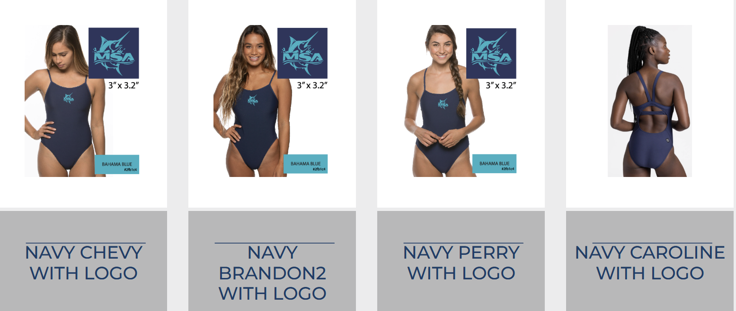
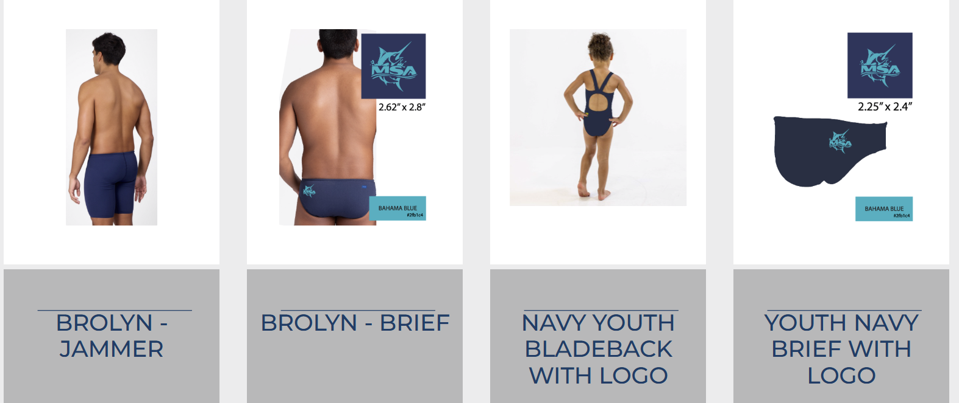
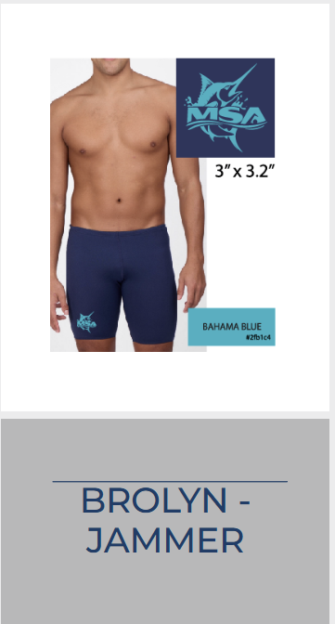



Slide 48
Jolyn Fit Kit
The Jolyn Fit Kit will be available at practice on:
Friday, August 8
Monday, August 11
Tuesday, August 12
Suits need to be tight to reduce drag in the water. Only wear team suit for meets in order to preserve.
Cheaper practice suits are recommended for daily use to maintain tightness of competition suits.

Slide 49

Personalized Caps
Each MSA swimmer will receive TWO personalized team caps.
These caps are considered part of the official uniform and are required at all meets.

Slide 50


Team Shirt
All MSA athletes will receive a team shirt!
Please be sure sizing is correct by doing the following:
On Deck app
Membership
My account
Members
Click child’s name Under their name will be highlighted the “Profile” tab. Scroll right until you see “Apparel”.
Tap “Shirt Size” and edit as needed.
Be sure to save your work!

Slide 51
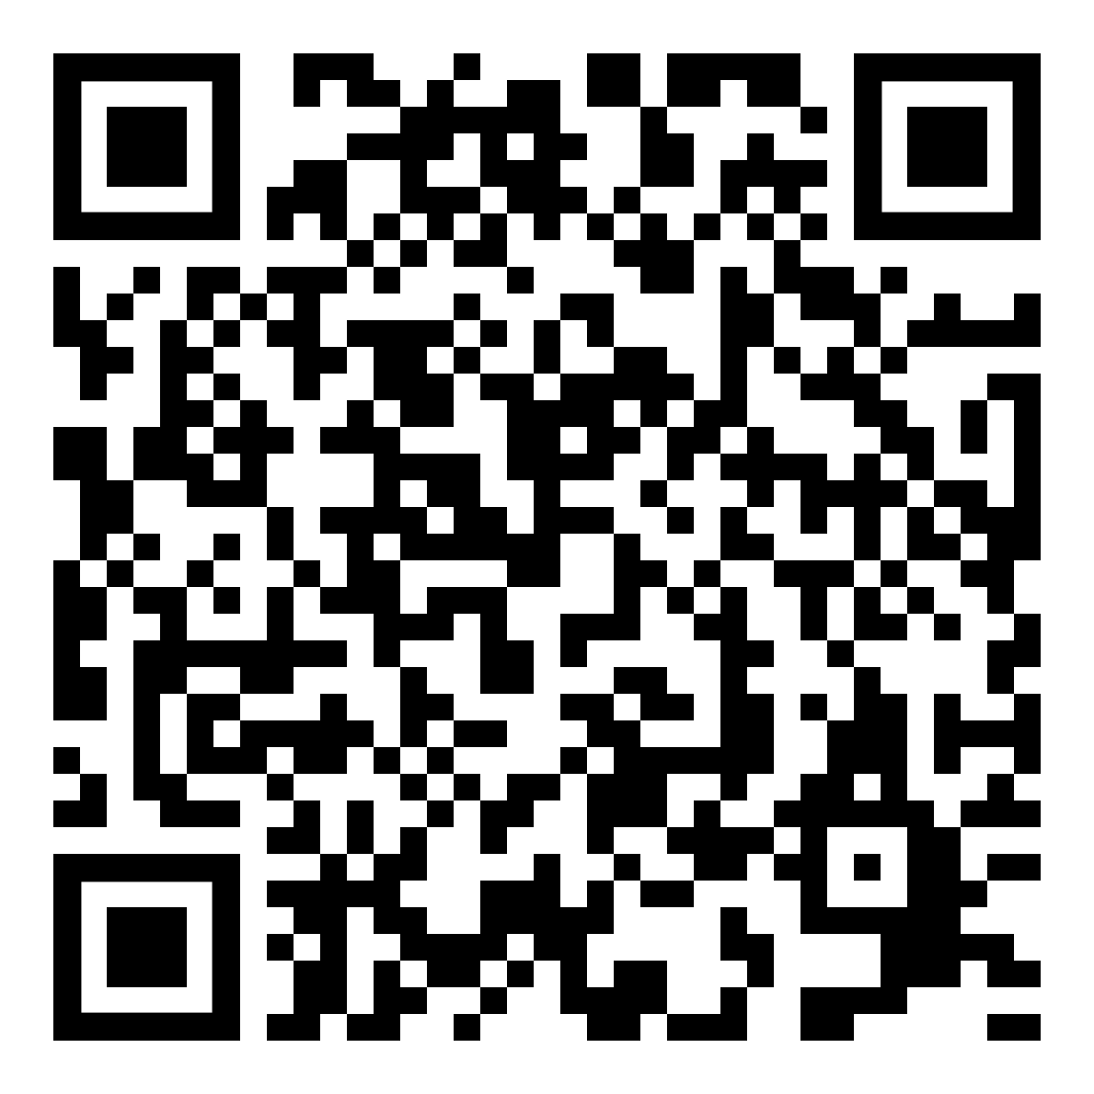
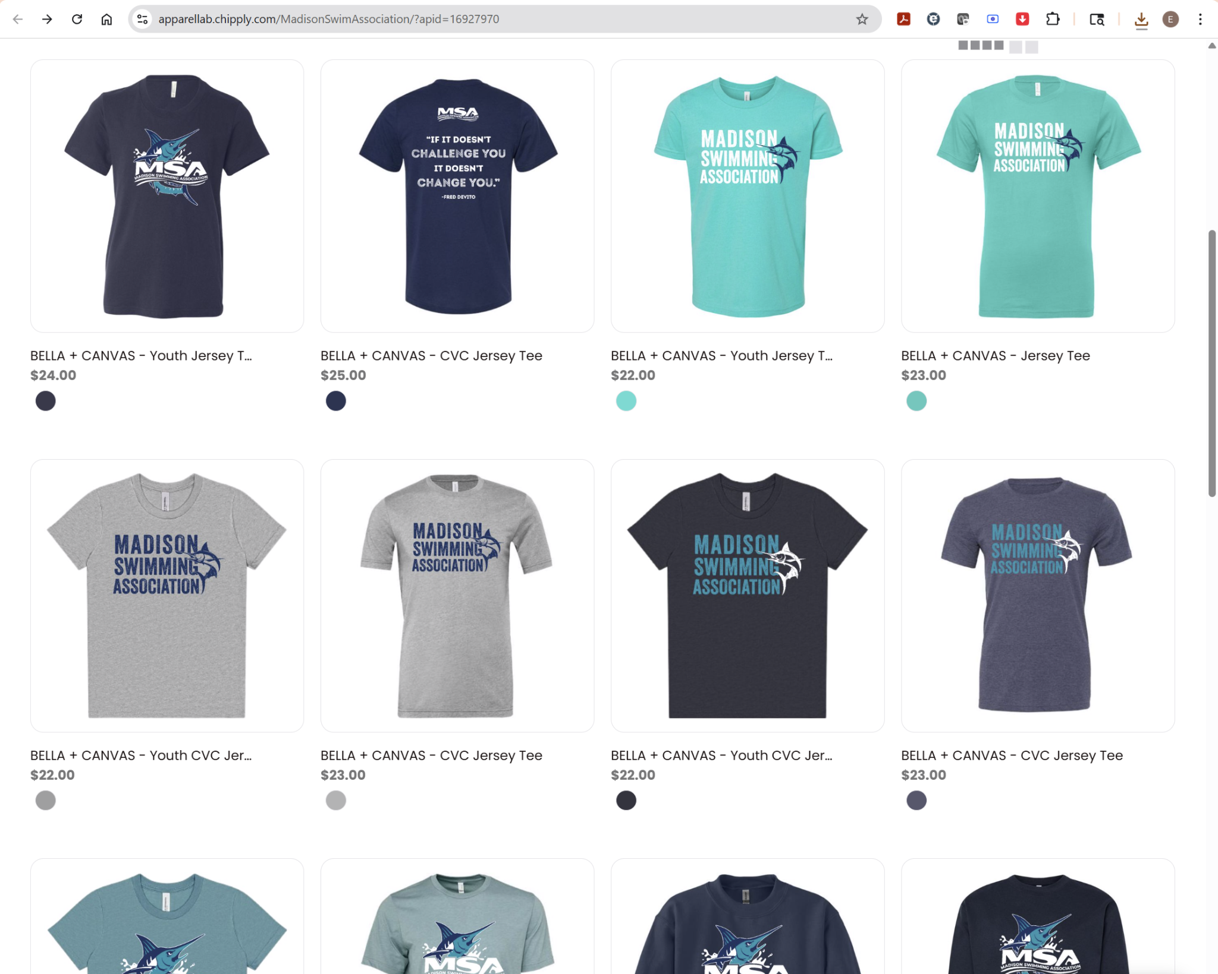
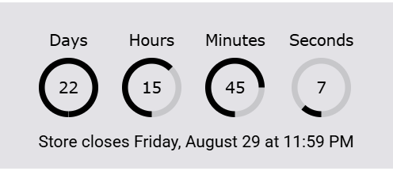
MSA Merch Store
https://apparellab.chipply.com/MadisonSwimAssociation/?apid=16927970
Merch Store closes Friday, August 29 at 11:59PM
Orders can be shipped directly to you, or we will have a pickup day at the pool.

Slide 52
Questions?

Slide 53
Thank you for attending!
http://www.madisonswimming.org

