Slide 1



DART-Solano
Staff Planning Session

Slide 2
Gold Medal Standards, Gold Medal Efforts, Gold Medal Club
What is DART-Solano?
“If the Why is powerful, the How is easy”
Team Culture/Values
University of Miami Video
Jim Harbaugh-Stanford
Sanders-Colorado

Slide 3

Teamwork
Work
Technique
Balance (Students/Athletes) Safe Environment
Community
Fun

Slide 4
Divisions of DART-Solano
Learn to Swim/Developmental Develop Strokes
Learn to swim-life skills
Body movements in water
Learn all four strokes
Learn basic dive
Learn basic turns
Age Group Competitive Improve Strokes
Stroke Definition-competitive strokes
Learn how to work in sets
Kicking (fast kicking/underwater kicking)
Basic Race Strategy
Senior Competitive Perfect Strokes Leadership/Ownership/Workmanship/Sportsmanship
Water Polo
High School and Junior Polo
Additional Programs
Adult Fitness/Clinics/Special Events/Promotions/Community Service

Slide 5
Staff Roles
Arrive on Time
Dress the Part Be proud of the DART logo
Show up to Coach and Teach
Athlete Centric Program
Provide Leadership to the swimmers and parents
Maintain Safety/Follow up on any safety issues
On Deck Coaching
Always engaged
Always moving
Talk to each kid (3 times per practice-Nitro goal)
Before Practices
Setup for practice-create your learning environment
Safety check-report any issues
Clean Up After Practices
Pool Covers and Safety
Deck and Bleacher Check-lost and found and trash
Make sure swimmers are picked up before leaving

Slide 6
Off Deck Planning
Organized daily practice
Organized weekly plan
Organized season plan
Communication to Parents
Group Packets-Set Expectations for the Season
Group Pages on Website-Lead Coach DART - Senior Groups (teamunify.com) Team Events/Organize and Attend
Goal Meetings
Swim Meets
Setup-organize coaching and team area
Communication before, during and after meets
Coaching During Meets
Developmental Grace?
Age Group Competitive Grace?
Senior Ricky?
Staff Meetings
Coaches Division Weekly/All Staff Monthly
Admin Weekly Planning/Working Meetings

Slide 7
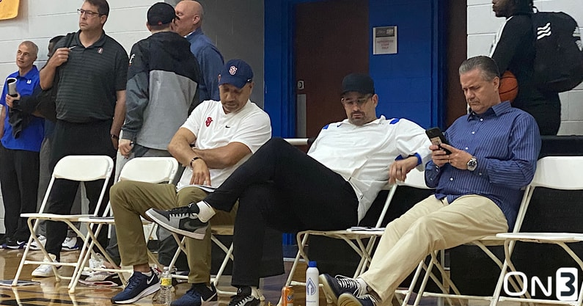

Slide 8
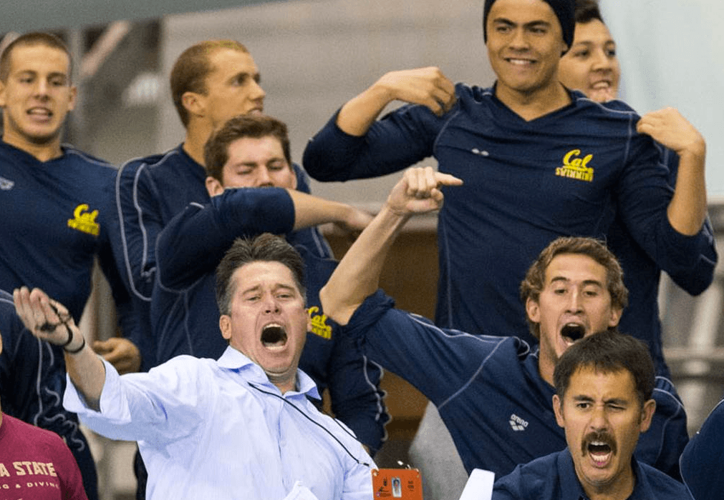

Slide 9
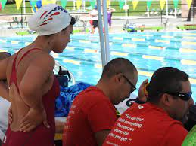

Slide 10
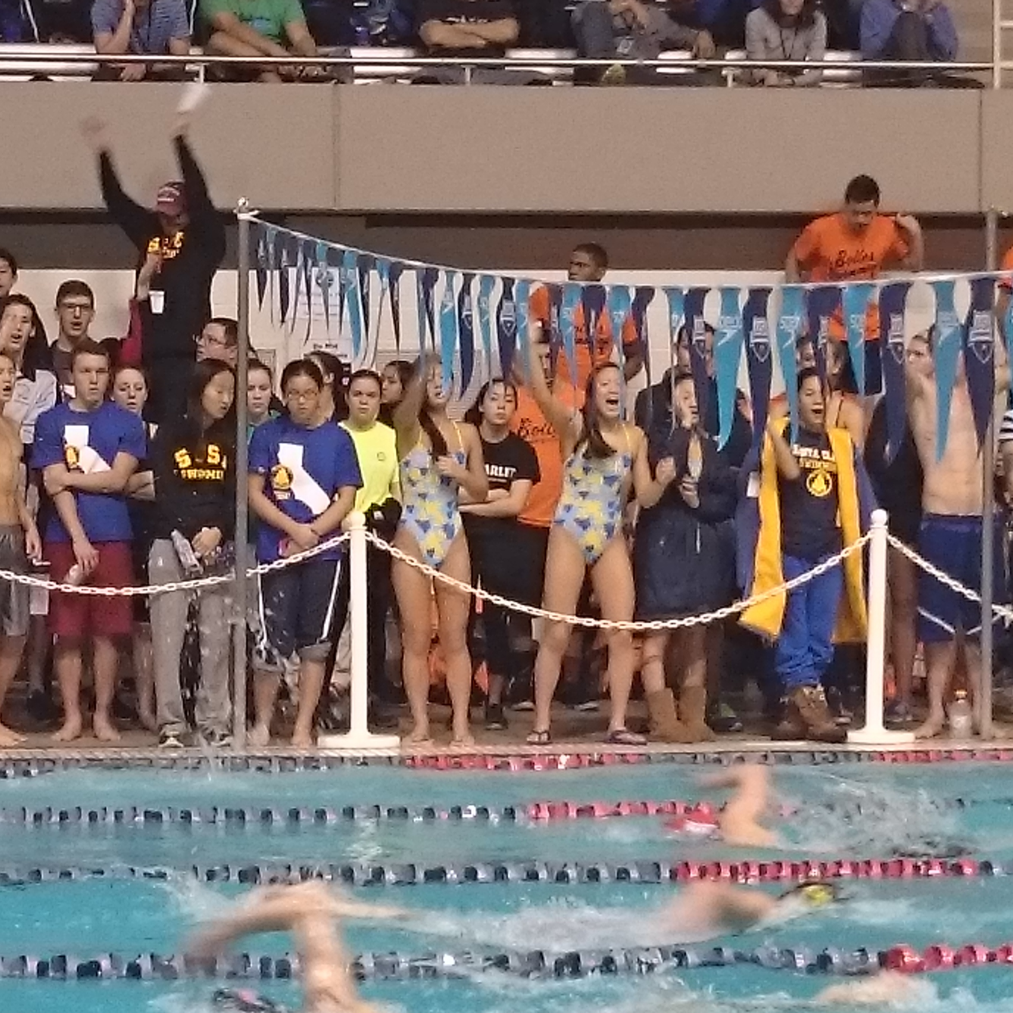

Slide 11
Athlete Roles
Arrive on Time
Dress the Part
Show up to Learn, Work and be part of the Team
Provide Leadership
Represent the team (DART and TYR attire)
Be Safe
Practices
Remain Engaged-Listen to Coaches When Talking
Drills/Sets/Practices as designed
Improve
Have Fun
Dryland-correct attire
Before Practices
Meet is designated area (bleachers or designated on deck)
Equipment for practice-bring all required equipment
Following Practices
Pool Covers and Safety
Gear and Personal Items
Trash-must be thrown away

Slide 12
Outside of Practices
Read Group Packets (Younger swimmers review with parents)
Attend and participate in team events
Goal Meetings (competitive swimmers)
Swim Meets
Sign up for designated meets
Communicate if cannot attend
Wear Team Attire
Swimmer/Parent Meetings
Swimmers
Parents

Slide 13
Parent Roles
Drop off and pick up on time
Support the team Provide leadership to newer families
Support the staff
Represent the team DART and TYR attire
Safety On deck and on campus
Practices
Remain in designated areas
Park in designated areas
Do not coach swimmers during practices
Talk to coaches before practices or after pool covers
Outside of Practices
Read group packets (Younger swimmers review with parents)
Read team communication
Attend and participate in team events and meets
Goal Meetings (competitive swimmers)
Age Group-swimmer and parent?
Senior-swimmer (academic meeting parent and swimmer)

Slide 14
Swim Meets
Sign up for designated meets on time
Sign up for designated volunteer shifts
Wear Team Attire
Team Travel
Financial
Support if Travel with Families
Parent Meetings
Specific to Swimmer or Group
Educational Meetings

Slide 15
Parent Handbook
Meet Volunteer Hours
Hosted Meets
Away Meets
Additional Volunteer Hours
Group/Team Events/Officiating/Committees
1-Long Term Planning (assigned by Head Coach)
2-Fundraising-support team wishlist and travel
3-Event Planning and Support
Awards Banquet-annual
Awards Banquet-summer
Coach Birthdays
Holiday Events
4-Equipment/Team Support
Timing System
Shed/Equipment/Team Improvement
5-Admin Committee (taxes, reports, etc)
6-Board of Directors (staff and other)

Slide 16
Recognition/Social Media
Website-Main News/Email Capabilities/Division Pages
Website-Sub Sites Swim Lessons/Water Polo/Winters
Social Media Sites Instagram/Facebook (posts and stories)
Swimmer of the Meet Week Following Meet
Group Awards Specific to Divisions
Awards Banquet Annual and Summer
Volunteer Recognition
Birthdays/Holidays/Special Days
Post Meet Recognition Ribbons, Awards, etc
Other ways to recognize swimmers
Marketing
Social Media
Website
Facebook Groups
School Flyers (Electronic)
Local Newspapers
Community Events

Slide 19
Schedule Overview
Practice Schedule-Winter
Meet Schedule 2023
Practices (Jan-April)
Practice (May-August)
Rod/Fairfield/American Canyon City/Winters-Swim
Rod/American Canyon High-polo
Meets
Meet Schedule
Rec Meet Schedule-add meets at meeting
Events
Education
Parents
Swimmers

Slide 20
Stroke Technique
Intro/Beginner/Yellow/Blue
Basic Drills-Learn How to Do/Develop Strokes
Body/Head Position/Movement Patterns
Age Group/Senior Prep
Intermediate Drills-Improve Strokes
Efficiency/Injury Prevention
Stroke Speed/Kick Speed/Stroke Count for Efficiency/Kick Distance
Senior/National Development
Advanced Drills-Perfect Strokes
Power/Speed/Efficiency
Stoke Rate/Kick Rate/Tempo/Stroke Count/Kick Count
Specific Areas of Stroke
Stroke Technique-Review each stroke (Mark slides)
Stroke Drills
Drill Lists-Submit (Ricky will compile a list)

