Slide 1

Voltage Aquatics
Intro to Competitive swimming

Slide 2
Welcome!
Thank you for your interest in Voltage Aquatics. The following slides will give you an insight to our team as well as the world of competitive swimming.
If you have not yet registered for the team, please contact us to schedule a tryout practice.
Coach Phoebe (208) 521- 6792 pahiphoe@isu.edu

Slide 3
About the team
Voltage Aquatics is a 501(c)3 non-profit organization. It began as the Idaho Falls Cutthroats in 1997. Six years ago the team combined with the Poison Darts in Blackfoot and was renamed Voltage Aquatics. After the city of Blackfoot closed its pool, the team ceased operations in Blackfoot. Just over three years ago the Idaho Falls Piranha Swim Team (IFST) became financially insolvent and dissolved. Many IFST coaches and members joined Voltage at that time.
Voltage Aquatics is the only USA Swimming sanctioned club in the Idaho Falls area. We offer training groups for all abilities from learn to swim to national level competitions. We look forward to working with your swimmers.

Slide 4
Voltage Aquatics
Voltage Aquatics caters to ALL athletes. We offer programs for beginners to those that have dreams of Olympic Gold. VOLT wants all swimmers, regardless of their level of commitment and ability, to feel good about what they do as a member of our club. VOLT also recognizes that our athletes have interests outside of swimming and will work with you to find a balance between them.
Club swimming helps teach dedication, teamwork, commitment, and hard work. The quality coaching staff at Voltage Aquatics is committed to these values. They are eager to work with your child in helping to develop these skills and our coaching staff is well trained in the latest swimming techniques.

Slide 5
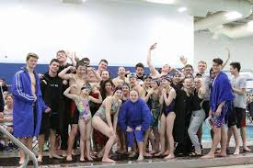
VOLTAGE AQUATICS Mission statement
Mission: Strengthen our community through positive development of youth. We embrace and inspire all ability levels of swimmers by providing the best possible environment and resources that will emphasize responsibility, dedication, physical fitness and personal excellence necessary for success in competitive swimming and beyond.
Vision: Values, Opportunity, Leaders, Team
(VOLT)

Slide 6
Voltage training group Breakdown
The team is split into training groups based on age and ability level
Athletes are placed into groups based on effort/attitude at practice/ meets, technique, attendance, and age. Group assignments are discussed and decided by the coaching staff. If you have questions, please ask the coach.
Your child will be placed in the correct training group during their first week of practice
Swimmers are assessed during practice each month, when ready to move into the next training group the coach will notify the swimmer and parent.
Swimmers 12 - 19 years old
  Lightning, Senior 1, Senior 2, Pre Senior
Swimmers 9 - 12 years old
  Firebolts 1, Firebolts 2, Firebolts 3
Swimmers 5 - 9 years old
  Sparks 1, Sparks, 2, Sparks 3
Swimmers 3 - 6
  Mini sparks, Future Champions

Slide 7
Required Training Equipment
Lightning
  Goggles, and caps for longer hair
  Fins
  Paddles + Buoy
  Snorkel
  Socks
Mini sparks
  Goggles and Caps for longer hair
Sparks 1 & 2 & 3 & and Firebolts 3
  Goggles and Caps for longer hair
  Fins
Firebolts 2
  Goggles and Caps for longer hair
  Fins
  Paddles + buoy (recommended)
Pre – Senior
  Goggles and Caps for longer hair
  Fins
Senior 1 & 2
  Goggles and Caps for longer hair
  Fins
  Paddles + buoy
  Snorkel ( recommended )
Order equipment at our team store at www.swimoutlet.com/Affiliate_StoreDetail.asp?sid=9525

Slide 8
The learning process
We are happy to be apart of your child’s swimming education. Just leave the teaching to us.Your child has been placed in a group with children of similar age and swimming ability. Our policy is to teach in a positive and structured environment. While continuous progression is ideal, we are aware that all children excel at different rates. Please don’t be worried if it seems that your child has reached a plateau and is not progressing in the way you had hoped. It is common for children to appear to make little progress at some stages, but in most cases this is a short term problem. Our professional certified coaches work hard to build a trusting relationship with each child, as this makes the learning process much easier. We cannot tell you ahead of time how long it will take for your child to swim, or compete, or even compete on a high level, but we will do our best to make progress as rapidly as possible. Please keep in mind that learning to swim requires time and patience. This is an ongoing process and even once they learn to swim, advanced groups are encouraged. It is important to give the children positive reinforcement and you as the parent can help by supporting your child’s coach.
In all our beginner, or developmental groups the coaches are in the water with the children teaching the foundations of swimming. The more advanced groups are designed to help your child learn to compete and are preparing them for racing in a swim meet. Please attend practice regularly and be on time so your child can be ready to learn. Although practices are offered multiple days a week, it is not a requirement to have 100% attendance each month. Depending on what group your child is in, and depending on what their personal goals are, will depend on how much practice time they need.

Slide 9
Fees, Fundraising, & Volunteer hours for the 2020- 2021 season
Monthly fees by group
Mini sparks | $60.00
Sparks 3 | $65.00
Sparks 2 | $70.00
Sparks 1 | $85.00
Firebolts 3 | $80.00
Firebolts 2 | $90.00
Firebolts 1 | $105.00
Pre senior | $100.00
Senior 2 | $115.00
Senior 1 | $125.00
Lightning | $135.00
Monthly fees: Monthly fees are charged on the first of each month. They are based on your swimmers practice group (shown in the chart to the left)
Our team also offers a family discount! The first two swimmers will be charged full price, the third, fourth, fifth, etc swimmers will be charged 50% of the monthly fee

Slide 10
Fees, Fundraising, & volenteer hours for the 2020- 2021 season…continued
Amount / year | Groups
$0 | Mini Sparks, Future Champions
$100 | Sparks 2, Sparks 3, Firebolts 2, Firebolts 3
$300 | Sparks 1, Firebolts 1, Pre-senior, Senior 2
$500 | Senior 1, Lightening
Fundraising: Fundraising gives families the option to raise money to go towards the team's expenses, instead of raising the monthly dues to cover the costs it takes to run the team. Our biggest expense is pool rental, much of this money goes towards paying our monthly pool rental fee. We also use this to cover the coaching staffs wages, team website, coaches travel and team equipment.
Fundraising options
Swim – A – Thon
Swimoutlet.com
Amazonsmile.com
Script
Swim meet sponsorships
Other yearly fundraisers include selling items such as Ice cream.
*Each family is only responsible for the fundraising commitment of their highest-level swimmer.

Slide 11
Fees, Fundraising, & Volenteer hours for the 2020- 2021 season…continued
Ways to earn your volunteer hours:
Work at a swim meet
  Become an Official
  Timers
  Computer table
  Meet marshals
  Concessions
  Awards
Become a board member
Photographer at swim meets
Help with team activities
Write newspaper articles for the team
Help with team travel
Donate items
If you have other suggestions, we are always open to new ideas.
Service Hours: Each family is required to volunteer 20 hours towards the team throughout the year (September 1-August 31). These hours can be accomplished by donating requested items (usually food), volunteering for team events, and volunteering at swim meets. Any hours not met by August 31 will be billed at $20 per hour.
The team hosts 4 local swim meets + 1-2 inter-squad meets each year in order to gives swimmers a chance to compete without travel. In order to accomplish this we need a lot of parent support!
Thank you in advance for your support

Slide 12
Registration
We highly recommend coming to one tryout practice before registering for the team. This will ensure that your swimmer is in the correct training group.
Register at voltageaquatics.org
Scroll down the homepage of the team website until you see the red square that says “ register here”
Click on the link “continue or check status”
Create a new account
Follow the instructions on each page
Make sure to click submit on the last page or your registration will no go throug
Contact us today to set up a tryout practice

Slide 13
Fees at Registration
First month’s practice fees will be charged when you register
USA Swimming membership registration fee $76.00 (2020- 2021) will be charged when you register. This fee goes directly to USA swimming. Voltage Aquatics does not collect any of this fee, which makes it nonrefundable after registration. This includes a secondary insurance, a subscription to splash magazine, and the opportunity to compete at USA swimming sectioned events. *This fee is reduced considerably for those swimmers who qualify for free or reduced hot lunch through the school system (letter from school district stating such is required as proof).
$20.00 team admin registration fee. This fee goes towards covering costs of the admin side of the team. Including processing your registration and supporting the team website.

Slide 14
VOLT COACHES
Head Coach: Phoebe Pahis
Assistant coaches: Tim Wayland, Casi Pahis, Liz Grimes, Christine Dustin
Coaches Certification (minimum requirements):
USA Swimming non-athlete registration
CPR
Safety training for swim coaches (include first aid and water rescue)
Athlete protection ( safe sport training)
Concussion training
Background check
ASCA level 1 part A and B
Previous Swimming experience and continued education through USA Swimming or ASCA
All the Voltage coaches have years of competitive swimming experience and competitive coaching experience.

Slide 15
Volt board (volunteer)
Voltage Aquatics is run by a volunteer parent board
All Board members are required to register with USA Swimming and complete a background check.
All Voltage team members can attend board meetings.
If you are interested in attending a meeting please reach out for a meeting schedule.
Christy Taylor (President)
William Green (Secretary)
Melinda Balsmeier (Treasurer)
Jennifer Ropp (Fundraising)
Layne McCord (Team activities)
Cheri Weimer (Meets)
Drew Pendlebury (at large - just finished his term as president)

Slide 16

Volunteers
Parent volunteers are needed for the team to be successful.
Parent volunteers are needed for
  Running meets
  Fundraising
  Team activities
  After and during practice activities

Slide 17
Volunteers
  Team activities
    Alive after five
    Kick off party
    Holiday parties
  After and during practice activities
    Holiday hot chocolate
    Psych up week
    Birthday cupcakes monthly
    We are always open to creative new ideas.
  Running meets
    Pre planning
    Officials
    Admin table
    Timers
    Hospitality
    Results and awards
    Concessions
  Fundraising
    Swim a thon
    food nights (culvers/panda)
    Ice cream sales etc.
    Script and amazon smiles

Slide 18
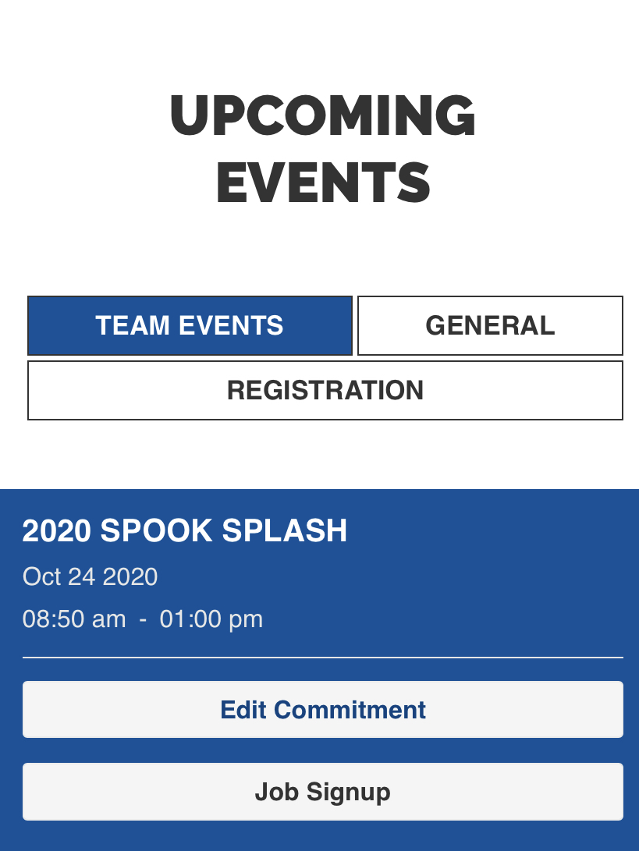
Swim Meets
The team attends on average1 – 2 meets each month. All meets are optional and have an additional cost. The cost of each meet is different based on the hosting team.
How to sign up for a meet?
Go to the team website: Voltageaquatics.org
Click on the swim meets tab to see available events. Or scroll down the home page to see available events (Desktop and mobile will be slightly different. Make sure you are logged into your account).
Click on edit commitment for the event you are interested in.

Slide 19
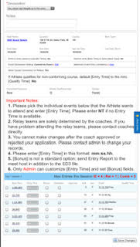
Swim Meets continued
Declare “yes” for your swimmer to attend the meet
Choose the events
  Or leave blank if you want the coaches to pick their events
Your account will receive an email every time a meet becomes available for registration
Late entries – entries always have a deadline. If you miss the deadline we are unable to enter your swimmer in the meet.

Slide 20
Meets and how are they run
We currently host 4 meets per year which other teams are invited to
  Spook Splash in October
  Holiday Classic in December
  IMX meet in April
  Mashed Potato Dash in June or July
We started running intra squad meets this past season
  Meets only with our swimmers
In order for times to count each meet must be sanctioned by USA Swimming

Slide 21
Meets and how are they run
Meets are divided into 2 seasons
  Short course (meters) typically September – March
  Long course (yards) typically April – August
Meets are run by volunteers
  Officials: stroke and turn, starter, ref, administrators
  Timers
  Concessions and hospitality
  Awards
  And many more
Meets are an extra fee for entry which is determined by the host team

Slide 22

USA Swimming
USA Swimming is the National Governing Body of swimming in the United States
Includes swimmers at an age group level to the Olympic level, coaches and volunteers
There are more than 2,800 teams
USA Swimming Goals
  Build a base
  Promote the sport
  Achieve competitive success
Non Profit run by a board of directors
Part of the annual USA Swimming registration fee goes to support this organization

Slide 23
USA Swimming
USA Swimming Registration
  Liability insurance required to participate on a USA Swimming sanctioned team
  All swimmers, coaches, officials, and any adults that work directly with swimmers
  Splash Magazine
House of delegates and Board of Directors
  Make decisions about rule changes, fees, meets, etc.
  Annual Meeting
  Each Local Swimming Committee has votes as part of the delegates
  Anyone can be on the board
  Mostly volunteer

Slide 24

Snake river swimming
Our local Swimming Committee (LSC)
Mission: “STRIVE TOGETHER, THRIVE TOGETHER, helping swimmers to achieve success from the grassroots level to the elite.”
Vision: “Strive, Rise, Succeed”

Slide 25
SNake river swimming
SRS TEAMS
Voltage Aquatics (Idaho Falls) Portneuf Valley Swim Team (Pocatello) Magic Valley Marlins (Twin Falls) Sun Valley 5B (Sun Valley) Elko Swim Team (Elko, Nevada) Boise Swim Club (Boise) Boise Y Swim Team (Boise) Streamliner Aquatics (Meridian) Nampa Swim Team (Nampa) Caldwell Swim Club (Caldwell)

Slide 26
Snake river swimming
Regional Board of Directors and House Of Delegates
  Decide rules and changes regarding our LSC in conjunction with the rules set by USA swimming
  Meet 2+ times per year
  Anyone can get involved
    We have 3 board members on our team, 1 swimmer and 2 parents
    We have fewer members on this side of the state so it is important to have votes
  If you want change regionally this is where it happens

Slide 27
Officials and how to become one
Officials are needed to run any sanctioned meet
Steps to become an official
  Take a course for stroke and turn
  Complete training hours
  If you want to move on to starter or ref additional training is required
All officials also register with USA Swimming and must complete a background check and athlete safety training in order to keep our kids safe.

Slide 28
Usa swimming meet progression
  Beginner meets (invitationals)
    Most local and LSC meets
  Snake River Winter/Summer championships – qualifying times
  Age group regionals – qualifying times
  Age group zones – qualifying times
  Senior zones – qualifying times
  Futures- qualifying times
  Jr. Nationals – qualifying times
  Nationals – qualifying times
  Olympic trials – qualifying times
  Olympics – top 2 in trials for individual events

Slide 29
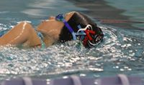
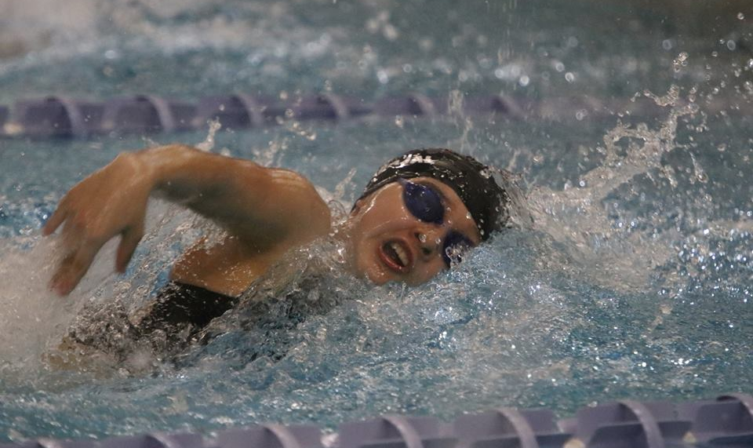
Motivational time standards
USA Swimming motivational time standards
  B times
  BB times
  A times
  AA times
  AAA times
  AAAA times
  Click here to see the motivational time standards

Slide 30
College swimming
We have many swimmers who swim in College and many get partial to full scholarships
There are collage swimming programs for a variety of different commitment levels
If Collage swimming is one of your goals, we can help you achieve it!

Slide 31
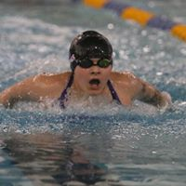
Resources
www. voltageaquatics.org
www.snakeriverswimming.org
www.usaswimming.org
Facebook (VOLT Aquatics)
Instagram (Voltage Aquatics)

