Slide 1
2024 Border Zone Team Information
Brett Elliott
Border LSC General Chair
(Brett.r.elliott+swim@gmail.com)

Slide 2
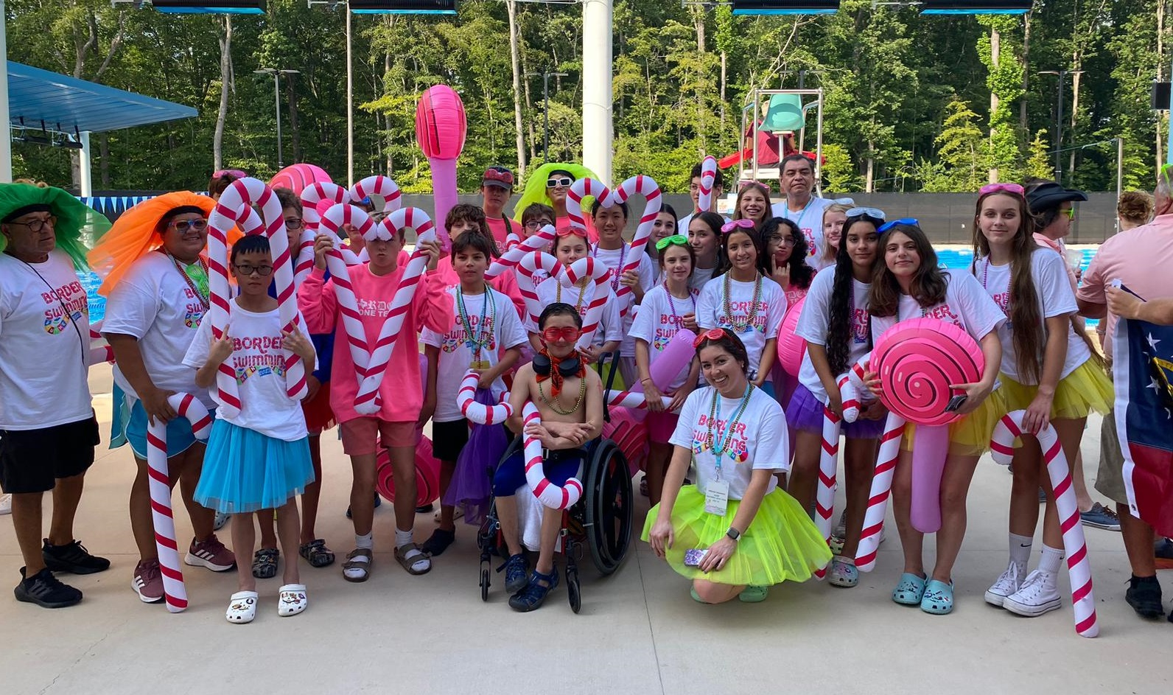
What is the Zone Championship
4 Day Meet for the 11-12 and 13-14 Age Group Swimmers
One Team per Local Swimming Committee (not club based)
Extremely Fun
Extremely Loud
Extremely Competitive
Border pays:
Coaches travel and rooms
SWAG (4 shirts, 2 swimcaps,
Large swim bag, etc)
Meet Fees
Last Year results:
https://www.swimcloud.com/results/273452

Slide 3
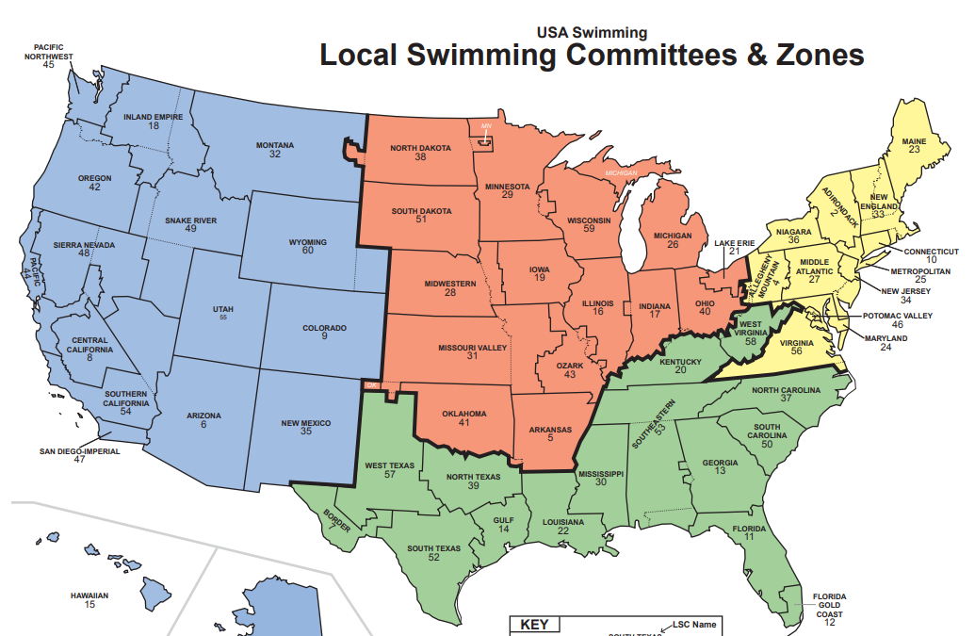
USA Swimming Zones Map

Slide 4

USA Swimming Competition Tiers
Trials
Nationals
Junior Nationals
Futures
Sectionals
Zone Championships
LSC Championships

Slide 5
2024 Age Group Zone Info
MEET INFORMATION
Location: Midland, TX
Dates:
Meet: July 24, 2024 thru July 27, 2024
Travel: July 23, 2024 and July 28, 2024
Travel by Charter Bus
TEAM SIZE
Each Local Swimming Committee (LSC) that fields a team and competes at the Southern Zone Age Group Championship is limited to a roster of 32 Age-Group (11-12 & 13-14) Athletes and 6 Swimmers with a Disability.
ENTRY LIMITS
Each swimmer is limited to: Six (6) individual events for the meet, Three (3) individual events per day

Slide 6
Border Zone Team Selection Criteria
To be eligible for consideration of the Border Swimming Zones Team, swimmers must meet ALL criteria below:
Athletes must be a current registered member of Border Swimming
Athletes must be between the ages of 11 and 14 on the first day of competition, July 24, 2024.
Athletes must achieve the qualifying standard between July 24, 2022 and March 31, 2024 in order to be considered for selection
Athletes will be aged up to July 24th, 2024 for the selection process
Example: Swimmer who is 12 with a birthday in June will be placed in 13-14 age group for Power Point review
Athletes must achieve total power points of 2000 in their best 4 event types to be considered qualified, subject to team size discussion by the Zones Committee
Qualifying events from multiple courses (LCM, SCY) can only be counted towards an event 1 time. Example: if an athlete has 500+ Power Points for both LCM and SCY in the 100 Breaststroke, that counts as ONE qualified event and the higher of the two will included in the calculation
Non-conforming events such as 50’s and 100 IM (Age 13+) will not be used in the selection process

Slide 7
Border Zone Team Selection Process
The Zones Team will be selected as follows:
The pool of athletes who qualify will be announced.
The top 8 qualified athletes per gender, per age group, who accept, will be named to the TEAM.
If one of the top 8 does not accept the selection, the next qualifying swimmer will be asked until the Team size is met.

Slide 8
Swimmers with a Disability
Swimmers with a Disability can apply and the top 3 boys and top 3 girls based on power points will be selected.
Swimmers with a Disability must be between the ages of 11 and 18 on the first day of the competition, July 24, 2023.
Swimmers' disability must satisfy the definition of a disability as outlined in USA Swimming Rules and Regulations: a permanent physical or mental impairment that substantially limits one or major life activities. These swimmers are not required to meet the time standards and power points for their age group/events; however, they must provide a time for each event they enter.

Slide 9
Calculating Power Points
USA Swimming Power Points
Every swim listed in the USA Swimming times database includes a Power Point value. This point system allows for comparison of the quality of performances across strokes, distances and events, as well as between age groups. The power point scale ranges from 1 to 1100 points. The higher the points, the stronger you are in that event.
Individual Time Search
https://www.usaswimming.org/times/individual-times-search
Power Point Calculator
https://www.usaswimming.org/times/popular-resources/power-point-calculator

Slide 10
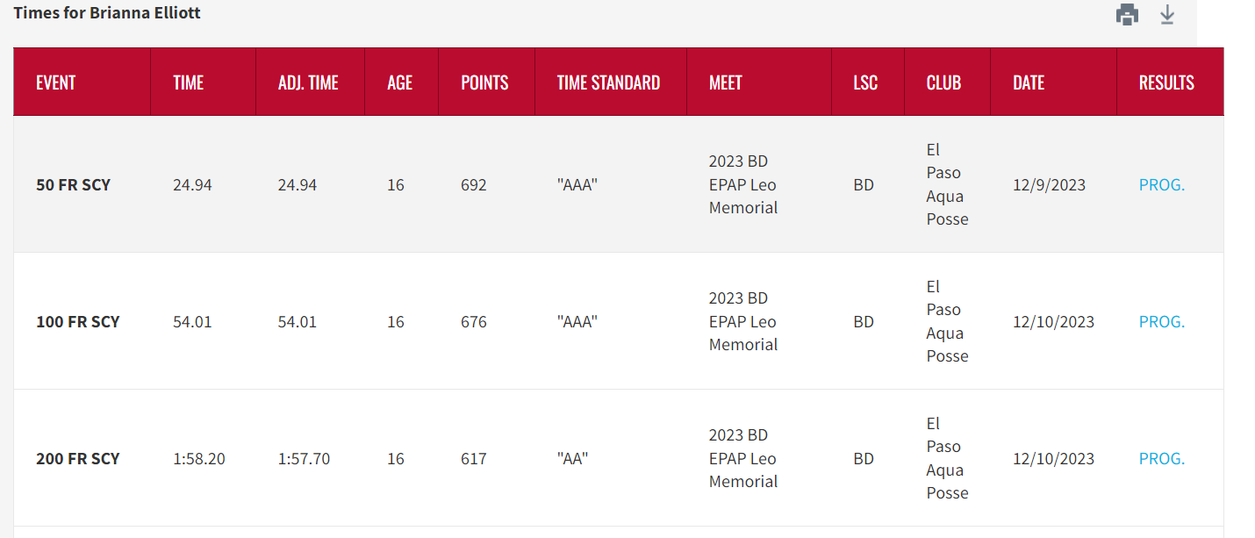
Individual Time Search

Slide 11
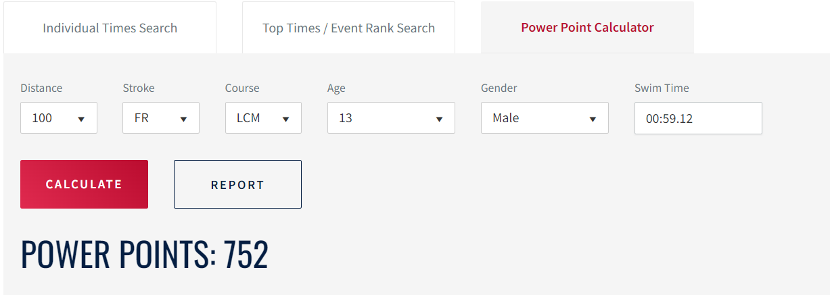
Power Point Calculator

Slide 12
SWIM FAST!
Any Questions?

