Slide 1
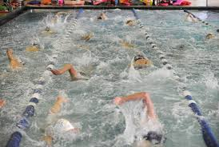
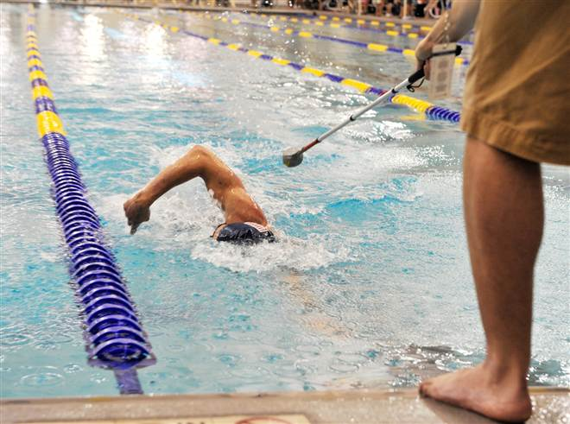
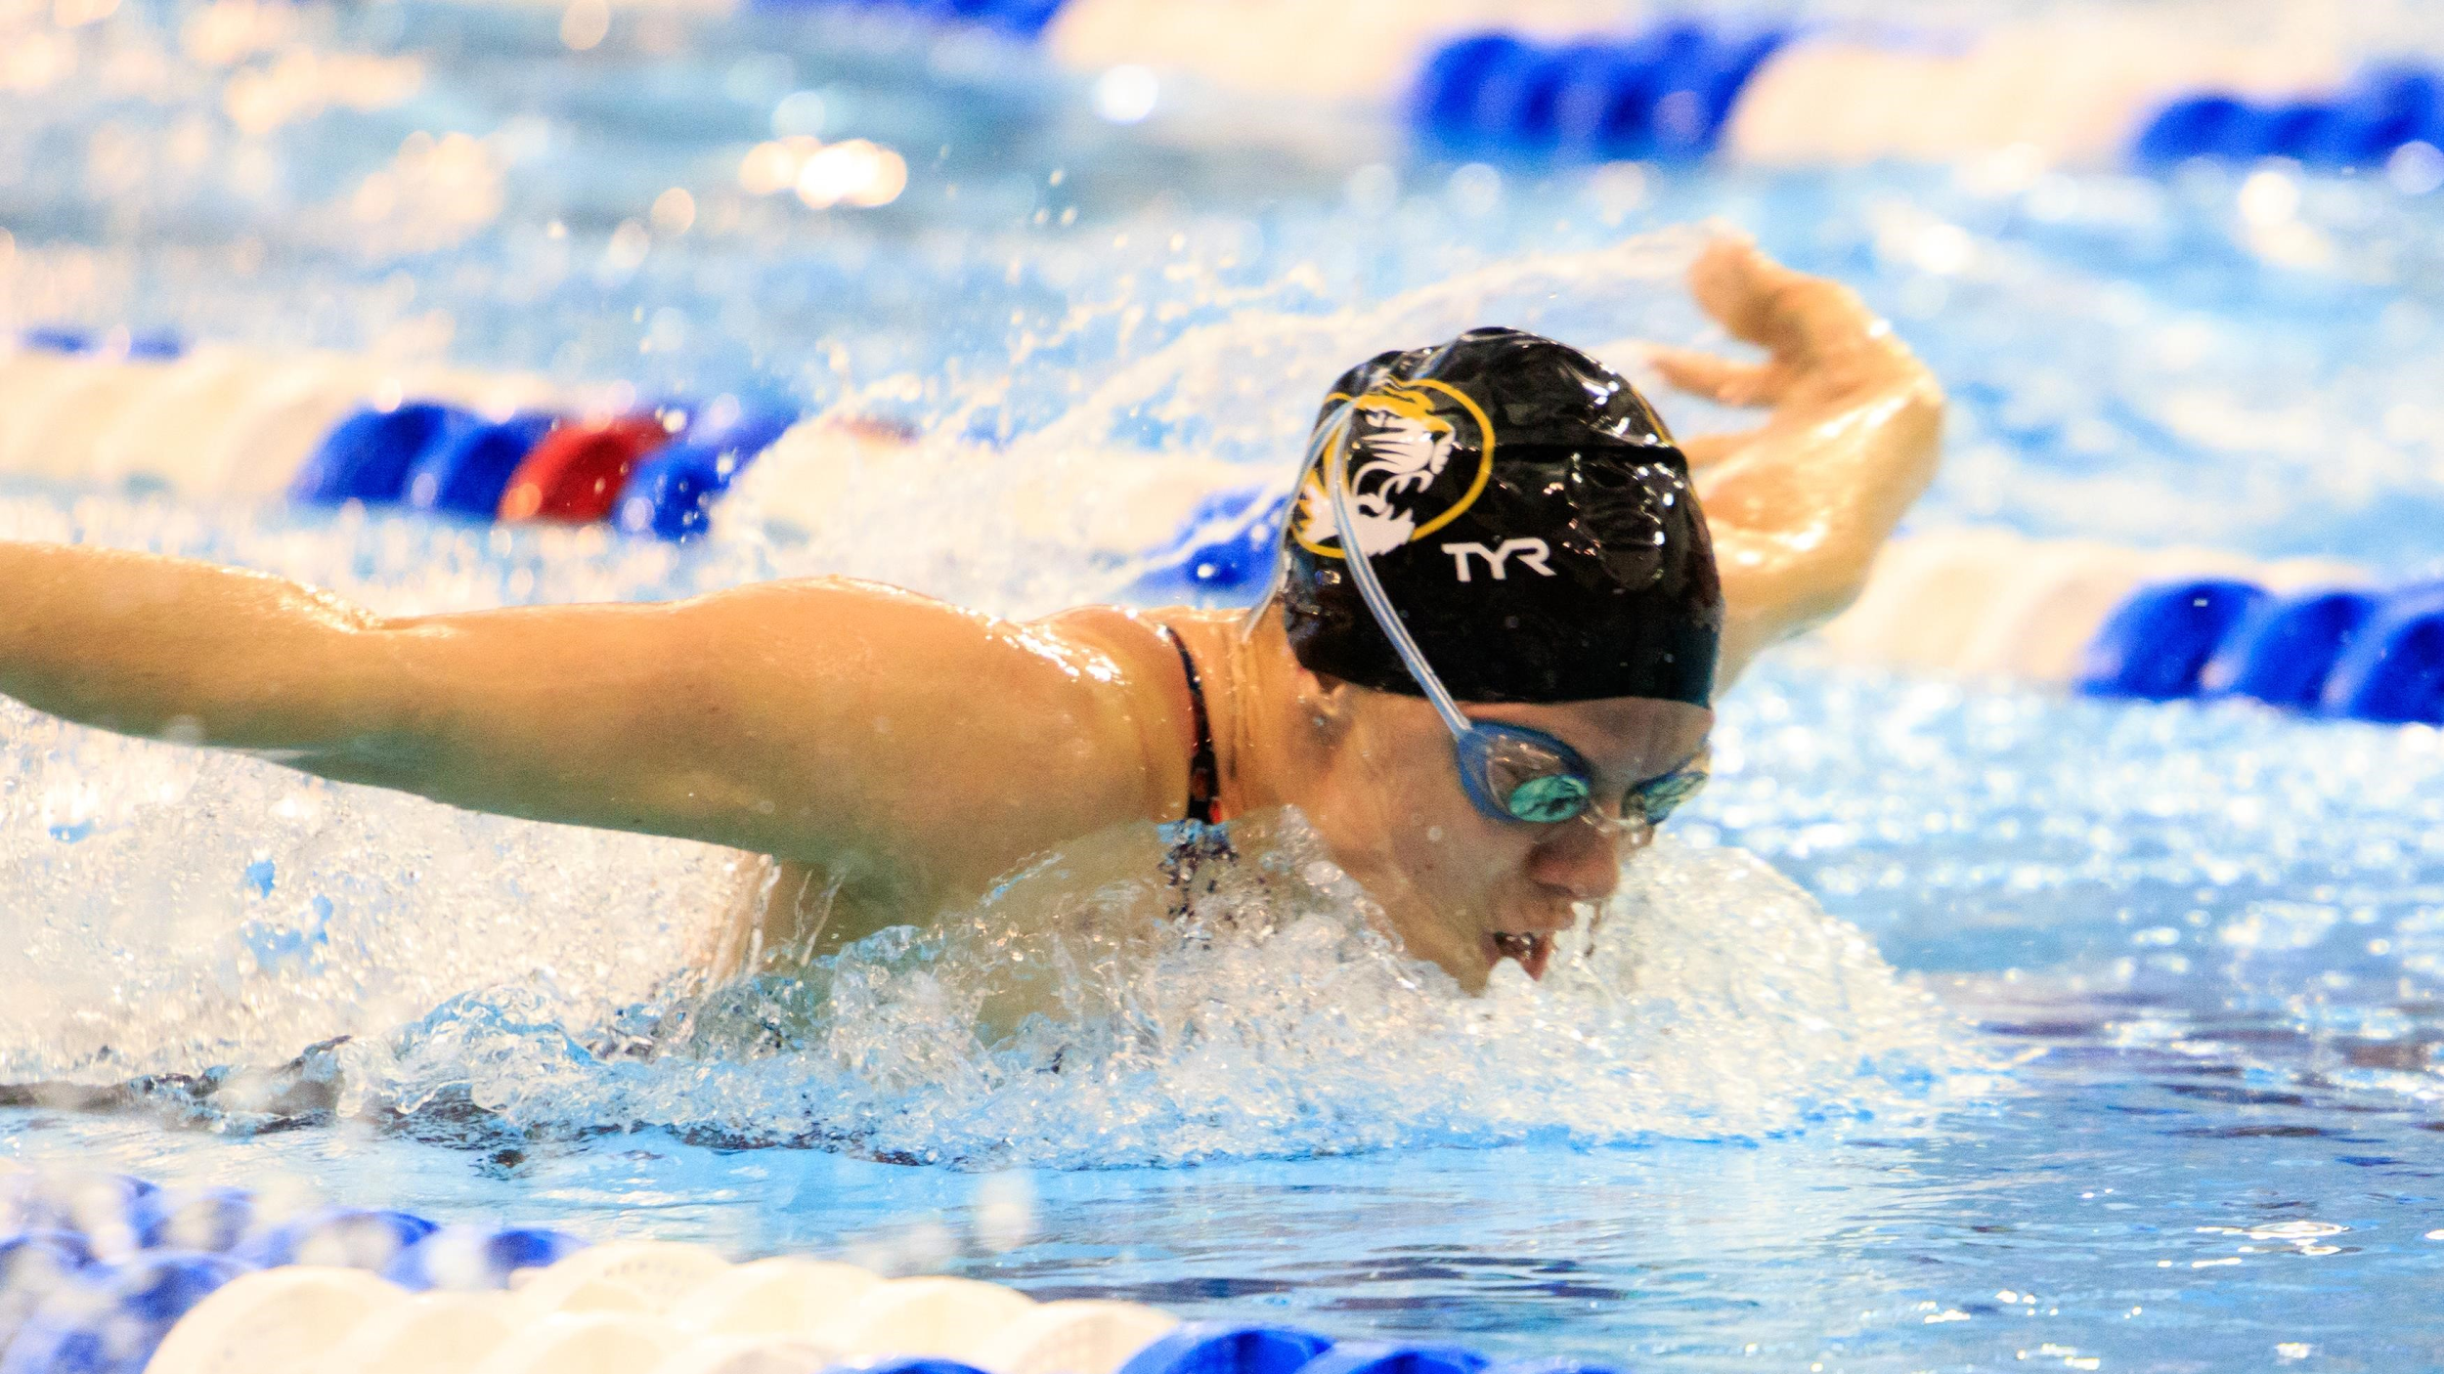
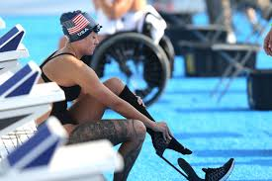
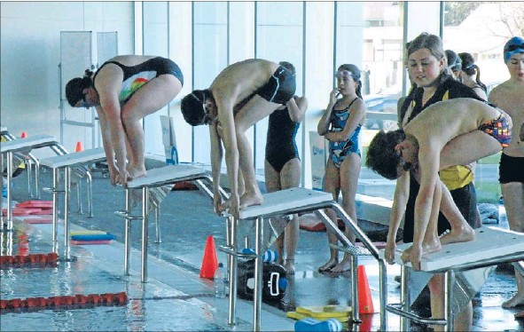
USA-Swimming
Giving Parallel Competition To ALL Swimmers
Notes:
Officiating a USA swimmer with a disability.
First and foremost it is important to understand that the rule book governing all USA Swimming meets is the latest version of the USA Swimming Rulebook. Furthermore all swimmers who compete in any USA Swimming meet do so in accordance with these USA-S rules and regulations. Therefore all the swimmers entered in any USA-S meet must comply with USA-Swimming Rulebook.

Slide 2
USA-S Para Swimming
Any swimmer who has a permanent physical or cognitive impairment that substantially limits one or more major life activities
Includes persons with:
Physical
Visual
Hearing
Cognitive disabilities

Slide 3
All ATHLETES want an even playing field by competing in an equitable, unbiased pool against other athletes who will push them to their top levels of performance.
Notes:
You as officials should not feel bad for any swimmer. If you observe them not swimming per the USA-Swimming Rules , you must make a call. If we let our emotions as officials cloud our ability to objectively observe swims and not apply the rules, then we are not protecting the swimmers. We are not giving every swimmer swimming under USA Swimming Rules and Regulations fair and equitable water
"When we observe disability swimmers and we do not make a call and give them a “pass”, we have not given them a solid foundation of legal swims per USA-S Rules and Regulations. When a swimmer potentially moves onto U. S. Paralympics Swimming or another swimming program, they could be at a disadvantage because by not observing their swims per USA-S Rules and Regulations, we have not set them up on the path for success for other swimming programs.

Slide 4
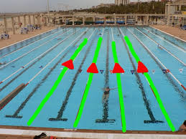
Para Swimming in USA-S is about creating parallel competition for USA-S swimmers with a disability*
Notes:
Society gets very opinionated about “names” labels” personally I have cerebral palsy I have swam my whole life NEVER competitively I was never good enough to make a team but was told I could take all the lessons I wanted to learn how to swim I personally am not offended by the words para or disability just simply include me.
USA- S we are still collaborating and working through this exciting time. We have not decided on universal terminology so during this presentation I will interchangeable use para swimmer, swimmer with a disability.

Slide 5
USAS Para Swim APPROVED Motivational Time Standards
History and Rational
Para swimmers have had no standards in which to attach personal goals until they’ve been classified and reached the Can-Am standard. From there it’s quite a leap to Emerging Team status with US Paralympics.
Para swimmers have been graciously accepted in many meets, but with little consistency.
Unfortunately, they have also been denied access to several meets due to no available standards.
More recently, standards for para-swimmers have been despairingly applied across meets of similar ability in comparison to those for traditional swimmers.
These standards represent 3 years of research and development by several members of the disability committee in collaboration with other professionals and volunteers with vested interest in the sport of para-swimming.
Today marks a historical date in the advancement of para-swimming nationwide!
Educate
Empower
Engage

Slide 6
Para-groupings
P1 - non-ambulatory (wheelchair bound): limited use of all four extremities.
P2 - dwarfism, multiple limb deficiencies, ambulatory with assistance, can be wheelchair bound with high functioning upper body.
P3 - single limb deficiencies, visual impairments, and intellectual impairments, ambulatory without significant assistance.
Educate
Empower
Engage

Slide 7
USAS National Disability Committee Approved Motivational Para Time Standards
LSC Championships
Zone Championships
Sectional Championships
Educate
Empower
Engage

Slide 8
Para 1 LSC Motivational Time Standards
Para 1 LSC Motivational Time Standards
 | Girls |  |  |  |  |  |  |  |  | Boys
P1 - non-ambulatory (wheelchair bound): limited use of all four extremities | 10 & U P1 |  | 11-12 P1 |  | 13-14 P1 |  | 15 & O P1 |  | P1 | 10 & U P1 |  | 11-12 P1 |  | 13-14 P1 |  | 15 & O P1
 | SCY | LCM | SCY | LCM | SCY | LCM | SCY | LCM |  | SCY | LCM | SCY | LCM | SCY | LCM | SCY | LCM
 | 1:37.89 | 1:44.49 | 1:29.39 | 1:29.39 | 1:26.19 | 1:26.19 | 1:24.89 | 1:24.89 | 50 FR | 1:39.29 | 1:39.29 | 1:30.29 | 1:30.29 | 1:21.29 | 1:21.29 | 1:18.29 | 1:18.29
 | 3:25.49 | 3:45.49 | 3:07.69 | 3:07.69 | 3:00.79 | 3:00.79 | 2:58.09 | 2:58.09 | 100 FR | 3:44.19 | 3:44.19 | 3:23.79 | 3:23.79 | 3:03.49 | 3:03.49 | 2:56.69 | 2:56.69
 | 8:12.09 | 8:12.09 | 7:29.39 | 7:29.39 | 7:12.99 | 7:12.99 | 7:06.49 | 7:06.49 | 200 FR | 6.09.09 | 6:09.09 | 5:35.59 | 5:35.59 | 5:01.99 | 5:01.99 | 4:50.90 | 4:50.89
 | 1:55.89 | 1:55.89 | 1:45.79 | 1:45.79 | 1:41.99 | 1:41.99 | 1:40.39 | 1:40.39 | 50 BK | 1:22.89 | 1:22.89 | 1:15.39 | 1:15.39 | 1:07.89 | 1:07.89 | 1:05.39 | 1:05.39
 | 3:33.99 | 3:32.99 | 3:14.59 | 3:14.59 | 3:07.49 | 3:07.49 | 3:04.59 | 3:04.59 | 100 BK | 3:01.19 | 3:01.19 | 2:44.69 | 2:44.69 | 2:28.19 | 2:28.19 | 2:22.69 | 2:22.69
 | 1:47.29 | 1:47.29 | 1:30.99 | 1:37.99 | 1:34.39 | 1:34.39 | 1:32.99 | 1:32.99 | 50 BR | 1:29.59 | 1:29.59 | 1:21.49 | 1:21.49 | 1:13.29 | 1:13.29 | 1:10.59 | 1:10.59
 | 5:05.89 | 5:05.89 | 4:39.39 | 4:39.39 | 4:29.19 | 4:29.19 | 4:25.19 | 4:25.19 | 100 BR | 4:19.99 | 4:19.99 | 3:56.39 | 3:56.39 | 3:32.69 | 3:32.69 | 3:24.89 | 3:24.89
 | 2:52.49 | 2:52.49 | 2:37.49 | 2:37.49 | 2:31.79 | 2:31.79 | 2:29.49 | 2:29.49 | 50 FL | 2:48.09 | 2:48.09 | 2:32.79 | 2:32.79 | 2:17.49 | 2:17.49 | 2:12.39 | 2:12.39
 | 7:07.49 | 7:07.49 | 6:30.39 | 6:30.39 | 6:16.19 | 6:16.19 | 6:10.49 | 6:10.49 | 150 IM | 7:30.09 | 7:30.09 | 6:49.19 | 6:49.19 | 6:08.19 | 6:08.19 | 5:54.59 | 5:54.59

Slide 9
Para 2 LSC Motivational Time Standards
Para 2 LSC Motivational Time Standards
 | Girls |  |  |  |  |  |  |  |  | Boys
P2 - dwarfism, multiple limb deficiencies, ambulatory with assistance, can be wheelchair bound with high functioning upper body. | 10 & U P2 |  | 11-12 P2 |  | 13-14 P2 |  | 15 & O P2 |  | P2 | 10 & U P2 |  | 11-12 P2 |  | 13-14 P2 |  | 15 & O P2
 | SCY | LCM | SCY | LCM | SCY | LCM | SCY | LCM |  | SCY | LCM | SCY | LCM | SCY | LCM | SCY | LCM
 | 56.89 | 59.79 | 51.49 | 54.19 | 46.89 | 49.39 | 46.19 | 48.59 | 50 FR | 53.99 | 56.79 | 49.09 | 51.69 | 44.19 | 46.49 | 42.59 | 44.79
 | 2:06.59 | 2:13.19 | 1:54.69 | 2:00.69 | 1:44.39 | 1:49.89 | 1:42.79 | 1:48.19 | 100 FR | 1:59.09 | 2:05.29 | 1:48.29 | 1:53.99 | 1:37.39 | 1:42.59 | 1:33.79 | 1:38.79
 | 4:20.49 | 4:34.19 | 3:56.09 | 4:08.49 | 3:34.89 | 3:46.29 | 3:31.69 | 3:42.79 | 200 FR | 4:11.89 | 4:25.09 | 3:48.49 | 4:00.99 | 3:26.09 | 3:36.89 | 3:18.49 | 3:28.89
 | 1:09.09 | 1:12.69 | 1:02.59 | 1:05.89 | 56.99 | 59.99 | 56.09 | 59.09 | 50 BK | 1:01.09 | 1:04.29 | 55.49 | 58.39 | 49.99 | 52.59 | 48.09 | 50.69
 | 1:39.79 | 2:48.19 | 2:24.79 | 2:32.49 | 2:11.89 | 2:18.79 | 2:09.89 | 2:16.69 | 100 BK | 2:32.79 | 2:40.89 | 2:18.89 | 2:26.29 | 2:05.09 | 2:11.59 | 2:00.39 | 2:06.79
 | 1:12.09 | 1:15.89 | 1:00.79 | 1:03.99 | 55.29 | 58.29 | 58.69 | 1:01.69 | 50 BR | 1:09.19 | 1:12.79 | 1:02.89 | 1:06.19 | 56.59 | 59.59 | 54.49 | 57.39
 | 2:39.99 | 2:48.39 | 2:24.99 | 2:32.59 | 2:11.99 | 2:18.89 | 2:09.99 | 2:16.79 | 100 BR | 2:33.39 | 2:41.49 | 2:19.49 | 2:26.79 | 2:05.49 | 2:12.09 | 2:00.89 | 2:07.19
 |  |  | 5:17.19 | 5:34.19 | 4:24.89 | 4:38.79 | 4:44.69 | 4:59.59 | 200 BR |  |  | 5:00.99 | 5:16.79 | 4:30.89 | 4:45.09 | 4:20.89 | 4:34.59
 | 1:09.59 | 1:13.19 | 1:03.09 | 1:06.39 | 57.39 | 1:00.39 | 56.59 | 59.49 | 50 FL | 55.89 | 58.79 | 50.79 | 53.49 | 45.69 | 48.09 | 43.99 | 46.39
 | 2:58.89 | 3:08.29 | 2:42.09 | 2:50.59 | 2:27.59 | 2:35.29 | 2:25.39 | 2:32.99 | 100 FL | 2:55.29 | 3:04.49 | 2:39.39 | 2:47.79 | 2:23.39 | 2:30.99 | 2:18.09 | 2:25.39
 | 5:31.79 | 5:49.19 | 5:00.59 | 5:16.39 | 4:33.69 | 4:48.09 | 4:43.69 | 4:43.69 | 200 IM | 5:12.39 | 5:28.89 | 4:43.99 | 4:58.99 | 4:15.59 | 4:29.09 | 4:06.19 | 4:19.09

Slide 10
Para 3 LSC Motivational Time Standards
Para 3 LSC Motivational Time Standards
 | Girls |  |  |  |  |  |  |  |  | Boys
P3 - single limb deficiencies, visual impairments, intellectual impairments, ambulatory without significant assistance. | 10 & U P3 |  | 11-12 P3 |  | 13-14 P3 |  | 15 & O P3 |  | P3 | 10 U P3 |  | 11-12 P3 |  | 13-14 P3 |  | 15 & O P3
 | SCY | LCM | SCY | LCM | SCY | LCM | SCY | LCM |  | SCY | LCM | SCY | LCM | SCY | LCM | SCY | LCM
 | 44.09 | 48.89 | 39.89 | 44.29 | 36.39 | 40.39 | 35.79 | 39.69 | 50 FR | 39.79 | 44.19 | 36.19 | 40.19 | 32.59 | 36.19 | 31.39 | 34.79
 | 1:33.89 | 1:44.29 | 1:25.09 | 1:34.49 | 1:17.49 | 1:26.09 | 1:16.39 | 1:24.79 | 100 FR | 1:26.49 | 1:36.09 | 1:18.59 | 1:27.29 | 1:10.79 | 1:18.59 | 1:08.09 | 1:15.69
 | 3:51.49 | 4:17.19 | 3:29.79 | 3:53.09 | 3:10.99 | 3:32.19 | 3:08.09 | 3:28.99 | 200 FR | 3:17.69 | 3:39.59 | 2:59.69 | 3:19.69 | 2:41.69 | 2:59.59 | 2:35.79 | 2:53.09
 | 7:01.59 | 7:43.19 | 6:22.09 | 6:59.79 | 5:47.79 | 6:22.19 | 5:42.59 | 6:16.39 | 500/ 400 FR | 7:45.09 | 7:30.09 | 7:00.09 | 6:49.19 | 6:15.09 | 6:08.29 | 6:00.09 | 5:54.69
 |  |  | 18:00.49 | 15:19.59 | 16:32.09 | 14:04.39 | 16:18.49 | 13:52.79 | 1000/ 800 FR |  |  | 16:02.39 | 15:37.49 | 14:19.29 | 14:03.69 | 13:44.99 | 13:32.49
 |  |  | 32:31.69 | 30:29.19 | 30:01.09 | 28:08.19 | 29:37.99 | 27:46.39 | 1650/ 1500 FR |  |  | 29:30.19 | 31:55.79 | 26.20.49 | 28:44.19 | 25:17.29 | 27:40.29
 | 53.39 | 59.29 | 48.39 | 53.69 | 44.09 | 48.99 | 43.39 | 48.19 | 50 BK | 45.59 | 50.69 | 41.49 | 46.09 | 37.29 | 41.49 | 35.89 | 39.89
 | 1:52.49 | 2:04.99 | 1:41.99 | 1:53.29 | 1:32.89 | 1:43.19 | 1:31.49 | 1:41.59 | 100 BK | 1:36.09 | 1:46.79 | 1:27.39 | 1:37.09 | 1:18.59 | 1:27.39 | 1:15.69 | 1:24.09
 |  |  | 4:04.79 | 4:31.89 | 3:42.99 | 4:07.69 | 3:39.59 | 4:03.89 | 200 BK |  |  | 3:29.49 | 3:52.79 | 3:08.59 | 3:29.49 | 3:01.59 | 3:21.79
 | 56.79 | 1:03.09 | 51.49 | 57.19 | 46.79 | 51.99 | 46.09 | 51.19 | 50 BR | 49.79 | 55.29 | 45.29 | 50.29 | 40.79 | 45.29 | 39.29 | 43.59
 | 1:59.69 | 2:12.99 | 1:48.49 | 2:00.49 | 1:38.69 | 1:49.69 | 1:37.19 | 1:47.99 | 100 BR | 1:50.59 | 2:02.89 | 1:20.49 | 1:51.69 | 1:30.49 | 1:40.49 | 1:27.19 | 1:36.79
 |  |  | 4:20.29 | 4:49.19 | 3:56.99 | 4:23.29 | 3:53.29 | 4:19.19 | 200 BR |  |  | 3:40.09 | 4:04.49 | 3:18.09 | 3:40.09 | 2:56.09 | 3:31.89
 | 48.29 | 53.59 | 43.69 | 48.49 | 39.79 | 44.19 | 39.19 | 43.49 | 50 FL | 43.29 | 48.09 | 39.29 | 43.69 | 35.39 | 39.29 | 31.49 | 37.89
 | 1:41.69 | 1:52.89 | 1:32.09 | 1:42.29 | 1:23.89 | 1:33.19 | 1:22.59 | 1:31.69 | 100 FL | 1:30.89 | 1:40.99 | 1:22.59 | 1:31.99 | 1:14.39 | 1:22.59 | 1:06.09 | 1:19.59
 |  |  | 3:40.99 | 4:05.49 | 3:21.39 | 3:43.69 | 3:18.09 | 3:40.09 | 200 FL |  |  | 3:29.19 | 3:52.39 | 3:26.29 | 3:29.19 | 2:47.39 | 3:21.39
 | 3:57.99 | 4:24.39 | 3:35.69 | 3:59.59 | 3:16.29 | 3:38.09 | 3:19.39 | 3:34.79 | 200 IM | 3:29.69 | 3:52.99 | 3:10.69 | 3:31.79 | 2:51.59 | 3:10.69 | 2:32.49 | 3:03.59
 |  |  | 8:34.59 | 9:25.49 | 7:48.39 | 8:34.69 | 7:41.39 | 8:26.99 | 400 IM |  |  | 7:46.79 | 8:20.09 | 6:56.79 | 7:30.09 | 6:40.09 | 7:13.39

Slide 11
Para 1 ZONE Motivational Time Standards
Para 1 ZONE Motivational Time Standards
 | Girls |  |  |  |  |  |  |  |  | Boys
P1 - non-ambulatory (wheelchair bound): limited use of all four extremities | 10 & U P1 |  | 11-12 P1 |  | 13-14 P1 |  | 15 & O P1 |  | P1 | 10 & U P1 |  | 11-12 P1 |  | 13-14 P1 |  | 15 & O P1
 | SCY | LCM | SCY | LCM | SCY | LCM | SCY | LCM |  | SCY | LCM | SCY | LCM | SCY | LCM | SCY | LCM
 | 1:37.89 | 1:37.89 | 1:29.39 | 1:29.39 | 1:22.89 | 1:22.89 | 1:21.59 | 1:21.59 | 50 FR | 1:33.29 | 1:33.29 | 1:24.29 | 1:24.29 | 1:18.29 | 1:18.29 | 1:15.29 | 1:15.29
 | 3:25.49 | 3:25.49 | 3:07.69 | 3:07.69 | 2:53.99 | 2:53.99 | 1:51.19 | 1:51.19 | 100 FR | 3:30.59 | 3:30.59 | 3:10.29 | 3:10.29 | 2:56.69 | 2:56.69 | 2:49.89 | 2:49.89
 | 8:12.49 | 8:12.49 | 7:29.39 | 7:49.39 | 6:56.59 | 6:56.59 | 6:50.09 | 6:50.09 | 200 FR | 5:46.79 | 5:46.79 | 5:13.19 | 5:13.19 | 4:50.89 | 4:50.89 | 4:39.69 | 4:39.69
 | 1:55.89 | 1:55.89 | 1:45.79 | 1:45.79 | 1:38.09 | 1:38.09 | 1:36.59 | 1:36.59 | 50 BK | 1:17.89 | 1:17.89 | 1:10.39 | 1:10.39 | 1:05.39 | 1:05.39 | 1:02.79 | 1:02.79
 | 3:32.99 | 3:32.99 | 3:14.59 | 3:14.59 | 3:00.39 | 3:00.39 | 2:57.49 | 2:57.49 | 100 BK | 2:50.19 | 2:50.19 | 2:33.69 | 2:33.69 | 2:22.69 | 2:22.69 | 2:17.29 | 2:17.29
 | 1:47.29 | 1:47.29 | 1:30.99 | 1:37.99 | 1:30.79 | 1:30.79 | 1:29.39 | 1:29.39 | 50 BR | 1:24.19 | 1:24.19 | 1:16.09 | 1:16.09 | 1:10.59 | 1:10.59 | 1:07.89 | 1:07.89
 | 5:05.89 | 5:05.89 | 4:39.39 | 4:39.39 | 4:18.99 | 4:18.99 | 4:14.99 | 4:14.99 | 100 BR | 4:04.19 | 4:04.19 | 3:40.59 | 3:40.59 | 3:24.89 | 3:24.89 | 3:14.99 | 3:16.99
 | 2:52.49 | 2:52.49 | 2:37.49 | 2:37.49 | 2:25.99 | 2:25.99 | 2:23.69 | 2:23.69 | 50 FL | 2:37.89 | 2:37.89 | 2:22.59 | 2:22.59 | 2:12.39 | 2:12.39 | 2:07.29 | 2:07.29
 | 7:07.49 | 7:07.49 | 6:30.39 | 6:30.39 | 6:01.89 | 6:01.89 | 5:56.19 | 5:56.19 | 150 IM | 7:02.79 | 7:02.79 | 6:21.89 | 6:21.89 | 5:54.59 | 5:54.59 | 5:40.99 | 5:40.99

Slide 12
Para 2 ZONE Motivational Time Standards
Para 2 ZONE Motivational Time Standards
 | Girls |  |  |  |  |  |  |  |  | Boys
P2 - dwarfism, multiple limb deficiencies, ambulatory with assistance, can be wheelchair bound with high functioning upper body. | 10 & U P2 |  | 11-12 P2 |  | 13-14 P2 |  | 15 & O P2 |  | P2 | 10 & U P2 |  | 11-12 P2 |  | 13-14 P2 |  | 15 & O P2
 | SCY | LCM | SCY | LCM | SCY | LCM | SCY | LCM |  | SCY | LCM | SCY | LCM | SCY | LCM | SCY | LCM
 | 53.29 | 56.09 | 48.79 | 51.29 | 45.19 | 47.49 | 44.49 | 46.79 | 50 FR | 50.69 | 53.39 | 45.79 | 48.19 | 42.59 | 44.75 | 40.89 | 43.09
 | 1:58.69 | 204.89 | 1:48.39 | 1:54.09 | 1:40.49 | 1:45.69 | 1:38.89 | 1:44.09 | 100 FR | 1:51.89 | 1:57.69 | 1:40.99 | 1:46.39 | 01:33.9 | 1:38.79 | 1:30.19 | 1:34.99
 | 4:04.29 | 4:17.09 | 3:43.09 | 3:54.79 | 3:26.59 | 3:37.69 | 2:23.59 | 3:34.29 | 200 FR | 3:56.59 | 4:09.09 | 3:33.69 | 3:44.99 | 03:18.5 | 3:28.89 | 3:10.79 | 3:20.89
 | 1:04.79 | 1:08.19 | 59.19 | 1:02.29 | 54.89 | 57.69 | 53.99 | 56.79 | 50 BK | 57.39 | 1:00.39 | 51.79 | 54.49 | 48.19 | 50.69 | 46.29 | 48.69
 | 2:29.89 | 2:37.69 | 2:16.89 | 2:24.09 | 2:06.89 | 2:13.49 | 2:04.89 | 2:11.39 | 100 BK | 2:23.59 | 2:40.89 | 2:09.69 | 2:16.49 | 02:00.5 | 2:06.79 | 1:55.79 | 2:01.89
 | 1:07.69 | 1:11.19 | 1:01.79 | 1:04.99 | 57.29 | 1:00.29 | 56.39 | 59.29 | 50 BR | 1:04.99 | 1:08.39 | 59.19 | 1:01.79 | 54.59 | 57.39 | 52.39 | 55.19
 | 2:29.99 | 2:37.89 | 2:16.99 | 2:24.19 | 2:05.19 | 2:13.69 | 2:05.09 | 2:11.59 | 100 BR | 2:24.09 | 2:31.69 | 2:10.19 | 2:16.99 | 02:00.9 | 2:07.19 | 1:56.19 | 2:02.39
 | 5:28.59 | 5:45.79 | 5:00.09 | 5:15.79 | 4:38.19 | 4:52.79 | 4:33.79 | 4:48.19 | 200 BR |  |  | 4:40.89 | 4:55.69 | 04:20.9 | 4:34.59 | 4:10.79 | 4:23.99
 | 1:05.29 | 1:08.69 | 59.59 | 1:02.69 | 55.19 | 58.09 | 54.39 | 57.19 | 50 FL | 52.49 | 55.29 | 47.39 | 49.89 | 44.09 | 46.39 | 42.39 | 44.59
 | 2:47.69 | 2:56.49 | 2:33.19 | 2:41.19 | 2:22.09 | 2:29.49 | 2:19.79 | 2:27.09 | 100 FL | 2:44.69 | 2:53.29 | 2:28.69 | 2:36.59 | 2:18.29 | 2:25.39 | 2:12.79 | 2:19.79
 | 5:11.09 | 5:27.39 | 4:44.09 | 4:58.99 | 4:23.39 | 4:37.19 | 4:19.19 | 4:32.79 | 200 IM | 4:53.49 | 5:09.89 | 4:26.09 | 4:38.99 | 4:06.29 | 4:19.09 | 3:56.69 | 4:09.19

Slide 13
Para 3 ZONE Motivational Time Standards
Para 3 ZONE Motivational Time Standards
 | Girls |  |  |  |  |  |  |  |  | Boys
P3 - single limb deficiencies, visual impairments, intellectual impairments, ambulatory without significant assistance. | 10 U P3 |  | 11-12 P3 |  | 13-14 P3 |  | 15 & O P3 |  | P3 | 10 U P3 |  | 11-12 P3 |  | 13-14 P3 |  | 15 & O P3
 | SCY | LCM | SCY | LCM | SCY | LCM | SCY | LCM |  | SCY | LCM | SCY | LCM | SCY | LCM | SCY | LCM
 | 41.39 | 45.89 | 37.79 | 41.89 | 34.99 | 38.79 | 34.39 | 38.19 | 50 FR | 37.39 | 41.49 | 33.79 | 37.49 | 31.39 | 34.79 | 30.09 | 33.49
 | 1:28.09 | 1:37.79 | 1:20.39 | 1:29.29 | 1:14.59 | 1:22.79 | 1:13.39 | 1:21.49 | 100 FR | 1:21.19 | 1:30.19 | 1:13.39 | 1:21.49 | 1:08.29 | 1:15.79 | 1:05.49 | 1:12.79
 | 3:37.09 | 4:01.19 | 3:18.29 | 3:40.29 | 3:03.79 | 3:24.19 | 3:00.89 | 3:20.99 | 200 FR | 3:05.69 | 3:26.29 | 2:47.69 | 3:06.39 | 2:41.79 | 2:53.09 | 2:29.79 | 2:46.39
 | 8:14.09 | 7:14.29 | 7:31.29 | 6:36.69 | 6:58.29 | 6:07.69 | 6:51.69 | 6:01.89 | 500/ 400 FR | 8:01.09 | 7:02.89 | 7:14.39 | 6:21.89 | 6:43.49 | 5:54.69 | 6:27.89 | 5:40.99
 |  |  | 17:06.19 | 14:33.39 | 15:58.09 | 13:35.39 | 15:44.49 | 13:23.79 | 1000/ 800 FR |  |  | 17:08.19 | 14:34.99 | 15:54.69 | 13:32.49 | 15:17.89 | 13:01.19
 |  |  | 30:59.39 | 29:02.59 | 29:03.69 | 27:13.89 | 28:40.09 | 26:52.09 | 1650/ 1500 FR |  |  | 27:23.69 | 29:48.09 | 29:31.59 | 27:40.29 | 24:15:09 | 26:36.49
 | 52.19 | 57.89 | 46.89 | 52.09 | 42.99 | 47.69 | 42.19 | 46.79 | 50 BK | 42.79 | 47.59 | 38.69 | 42.99 | 35.99 | 39.89 | 34.59 | 38.39
 | 1:45.49 | 1:57.19 | 1:36.38 | 1:47.09 | 1:29.39 | 1:39.29 | 1:27.99 | 1:37.69 | 100 BK | 1:30.29 | 1:40.29 | 1:21.59 | 1:30.59 | 1:15.69 | 1:24.09 | 1:12.79 | 1:20.89
 |  |  | 3:57.09 | 4:23.39 | 3:36.89 | 4:00.89 | 3:32.79 | 3:56.39 | 200 BK |  |  | 3:15.59 | 3:37.29 | 3:01.69 | 3:21.79 | 2:54.59 | 3:13.99
 | 52.69 | 58.49 | 47.49 | 52.69 | 43.39 | 48.19 | 42.59 | 47.29 | 50 BR | 46.79 | 51.99 | 42.29 | 46.99 | 39.29 | 43.59 | 37.79 | 41.89
 | 1:52.29 | 2:04.69 | 1:42.59 | 1:53.89 | 1:35.09 | 1:45.59 | 1:33.49 | 1:43.89 | 100 BR | 1:43.89 | 1:55.39 | 1:33.79 | 1:44.29 | 1:27.19 | 1:36.79 | 1:23.79 | 1:33.09
 |  |  | 3:49.99 | 4:15.49 | 3:30.39 | 3:53.69 | 3:26.39 | 3:49.29 | 200 BR |  |  | 3:25.39 | 3:48.19 | 3:10.79 | 3:31.89 | 3:03.39 | 3:23.79
 | 47.39 | 52.59 | 42.59 | 47.29 | 38.99 | 43.29 | 38.29 | 42.49 | 50 FL | 40.59 | 45.09 | 36.69 | 40.79 | 34.19 | 37.89 | 32.79 | 36.39
 | 1:35.39 | 1:45.89 | 1:27.09 | 1:36.69 | 1:20.69 | 1:29.59 | 1:19.39 | 1:28.19 | 100 FL | 1:25.39 | 1:34.89 | 1:25.09 | 1:25.69 | 1:11.69 | 1:19.59 | 1:08.89 | 1:16.49
 |  |  | 3:45.69 | 4:10.69 | 3:26.39 | 3:49.29 | 3:22.49 | 344.99 | 200 FL |  |  | 3:15.19 | 3:36.89 | 3:01.29 | 3:21.39 | 2:44.29 | 3:13.69
 | 3:43.19 | 4:07.89 | 3:23.79 | 3:46.39 | 3:08.99 | 3:29.89 | 3:05.99 | 3:26.59 | 200 IM | 3:16.99 | 3:38.89 | 2:57.99 | 3:17.69 | 2:45.29 | 3:03.59 | 2:38.89 | 2:56.49
 |  |  | 8:12.89 | 9:07.59 | 7:30.79 | 8:20.79 | 7:22.29 | 8:11.39 | 400 IM |  |  | 7:13.39 | 7:46.79 | 6:30.49 | 7:13.79 | 6:56.79 | 6:56.79

Slide 14
Para 1 Sectional Motivational Time Standards
Para 1 Sectional Motivational Time Standards
 | Girls |  |  |  |  | Boys
P1 - non-ambulatory (wheelchair bound): limited use of all four extremities | Sectional |  | Bonus |  | P1 | Sectional |  | Bonus
 | SCY | LCM | SCY | LCM |  | SCY | LCM | SCY | LCM
 | 1:18.39 | 1:18.39 | 121.59 | 121.59 | 50 FR | 1:12.29 | 1:12.29 | 1:15.29 | 1:15.29
 | 2:44.39 | 2:44.39 | 1:51.19 | 1:51.19 | 100 FR | 2:43.09 | 2:43.09 | 2:49.89 | 2:49.89
 | 6:33.69 | 6:33.69 | 6:50.09 | 6:50.09 | 200 FR | 4:28.49 | 4:28.49 | 4:39.69 | 4:39.69
 | 1:32.69 | 1:32.69 | 1:36.59 | 1:36.59 | 50 BK | 1:00.29 | 1:00.29 | 1:02.79 | 1:02.79
 | 2:50.39 | 2:50.39 | 2:57.49 | 2:57.49 | 100 BK | 2:11.79 | 2:11.79 | 2:17.29 | 2:17.29
 | 1:25.79 | 1:25.79 | 1:29.39 | 1:29.39 | 50 BR | 1:06.19 | 1:05.19 | 1:07.89 | 1:07.89
 | 4:04.79 | 4:04.79 | 4:14.99 | 4:14.99 | 100 BR | 3:09.09 | 3:09.09 | 3:14.99 | 3:16.99
 | 2:17.99 | 2:17.99 | 2:23.69 | 2:23.69 | 50 FL | 2:02.29 | 2:02.29 | 2:07.29 | 2:07.29
 | 5:41.99 | 5:41.99 | 5:56.19 | 5:56.19 | 150 IM | 5:27.29 | 5:27.29 | 5:40.99 | 5:40.99

Slide 15
Para 2 Sectional Motivational Time Standards
Para 2 Sectional Motivational Time Standards
 | Girls |  |  |  |  | Boys
P2 - dwarfism, multiple limb deficiencies, ambulatory with assistance, can be wheelchair bound with high functioning upper body. | Sectional |  | Bonus |  | P2 | Sectional |  | Bonus
 | SCY | LCM | SCY | LCM |  | SCY | LCM | SCY | LCM
 | 42.69 | 44.89 | 44.49 | 46.79 | 50 FR | 39.29 | 41.39 | 40.89 | 43.09
 | 1:34.89 | 1:39.89 | 1:38.89 | 1:44.09 | 100 FR | 1:26.59 | 1:31.19 | 1:30.19 | 1:34.99
 | 3:15.39 | 3:25.69 | 3:23.59 | 3:34.29 | 200 FR | 3:03.19 | 3:12.79 | 3:10.79 | 3:20.89
 | 51.79 | 54.49 | 53.99 | 56.79 | 50 BK | 44.39 | 46.79 | 46.29 | 48.69
 | 1:59.89 | 2:06.19 | 2:04.89 | 2:11.39 | 100 BK | 1:51.19 | 1:56.99 | 1:55.79 | 2:01.89
 | 54.09 | 56.89 | 56.39 | 59.29 | 50 BR | 50.29 | 52.99 | 52.39 | 55.19
 | 1:59.99 | 2:06.29 | 2:05.09 | 2:11.59 | 100 BR | 1:51.59 | 1:57.49 | 1:56.19 | 2:02.39
 | 4:22.79 | 4:36.59 | 4:33.79 | 4:48.19 | 200 BR | 4:00.79 | 4:13.49 | 4:10.79 | 4:23.99
 | 52.19 | 54.89 | 54.33 | 57.19 | 50 FL | 40.69 | 42.79 | 42.39 | 44.59
 | 2:14.19 | 2:21.19 | 2:19.79 | 2:27.09 | 100 FL | 2:07.49 | 2:14.19 | 2:12.79 | 2:19.79
 | 4:08.79 | 4:21.89 | 4:19.19 | 4:32.79 | 200 IM | 3:49.19 | 3:59.19 | 3:56.69 | 4:09.19

Slide 16
Para 3 Sectional Motivational Time Standards
Para 3 Sectional Motivational Time Standards
 | Girls |  |  |  |  | Boys
P3 - single limb deficiencies, visual impairments, intellectual impairments, ambulatory without significant assistance. | Sectional |  | Bonus |  | P3 | Sectional |  | Bonus
 | SCY | LCM | SCY | LCM |  | SCY | LCM | SCY | LCM
 | 33.09 | 36.69 | 34.39 | 38.19 | 50 FR | 28.89 | 32.19 | 30.09 | 33.49
 | 1:10.39 | 1:18.19 | 1:13.39 | 1:21.49 | 100 FR | 1:02.89 | 1:09.89 | 1:05.49 | 1:12.79
 | 2:53.69 | 3:12.89 | 3:00.89 | 3:20.99 | 200 FR | 2:23.79 | 2:39.79 | 2:29.79 | 2:46.39
 | 6:35.19 | 5:47.39 | 6:51.69 | 6:01.89 | 500/ 400 FR | 6:12.49 | 5:27.39 | 6:27.89 | 5:40.99
 | 15;10.39 | 12:54.79 | 15:44.49 | 13:23.79 | 1000/ 800 FR | 14:41.29 | 12:29.99 | 15:17.89 | 13:01.19
 | 27:41.99 | 25:57.69 | 28:40.09 | 26:52.09 | 1650/ 1500 FR | 23:10.89 | 25:32.59 | 24:15.09 | 26:36.49
 | 40.09 | 44.49 | 42.19 | 46.79 | 50 BK | 33.19 | 36.89 | 34.59 | 38.39
 | 1:24.49 | 1:33.79 | 1:27.99 | 1:37.69 | 100 BK | 1:09.89 | 1:17.69 | 1:12.79 | 1:20.89
 | 3:22.59 | 3:45.09 | 3:32.79 | 3:56.39 | 200 BK | 2:47.59 | 3:06.19 | 2:54.59 | 3:13.99
 | 40.49 | 44.99 | 42.59 | 47.29 | 50 BR | 36.19 | 40.29 | 37.79 | 41.89
 | 1:29.79 | 1:39.69 | 1:33.49 | 1:43.89 | 100 BR | 1:20.49 | 1:29.39 | 1:23.79 | 1:33.09
 | 3:16.29 | 3:38.39 | 3:26.39 | 3:49.29 | 200 BR | 2:56.09 | 3:15.59 | 3:03.39 | 3:23.79
 | 36.39 | 40.39 | 38.29 | 42.49 | 50 FL | 31.49 | 34.99 | 32.79 | 36.39
 | 1:16.29 | 1:24.69 | 1:19.39 | 1:28.19 | 100 FL | 1:06.09 | 1:13.49 | 1:08.89 | 1:16.49
 | 3:12.89 | 3:34.29 | 3:22.49 | 344.99 | 200 FL | 2:47.39 | 3:05.89 | 2:44.29 | 3:13.69
 | 2:58.49 | 3:18.29 | 3:05.99 | 3:26.59 | 200 IM | 2:32.49 | 2:49.49 | 2:38.89 | 2:56.49
 | 7:01.19 | 7:47.99 | 7:22.29 | 8:11.39 | 400 IM | 6:06.79 | 6:40.09 | 6:56.79 | 6:56.79

Slide 17
Protocol for officiating a swimmer with a disability
The coach notifies the Meet Committee/ Meet Referee when a swimmer with a disability is entered into a meet and requests necessary accommodations.
Responsibilities - Swimmer: 105.1.2A
The swimmer (or the swimmer's coach) is responsible for notifying the Referee, prior to the competition, of any disability of the swimmer and of the requested modification. The swimmer/coach shall provide any assistant(s) or equipment (tappers, deck mats, etc.) if required
Notes:
Officiating a USA swimmer with a disability.
First and foremost it is important to understand that the rule book governing all USA Swimming meets is the latest version of the USA Swimming Rulebook. Furthermore all swimmers who compete in any USA Swimming meet do so in accordance with these USA-S rules and regulations. Therefore all the swimmers entered in any USA-S meet must comply with USA-Swimming Rulebook

Slide 18
Examples of Necessary Accommodations
Goes beyond, “They need to swim in this lane”
Take longer to get to blocks
Have an assistant at the blocks
In the water start
Longer to get out of the pool.
Any stroke movement(s) that are different from technical rules & regulations of USA-S swimming
ask to see if a mat can be placed at lane getting in and out of
Hand signals
Notes:
all the from the previous slide plus/…...The more the coach/ swimmer communicates with the meet personnel the more equitable the water will be for ALL athletes

Slide 19
Protocol for officiating a swimmer with a disability
The Meet Referee communicates back with the coach and makes any reasonable accommodation(s) for swimmer.
The Meet Referee is responsible for communicating any swimmer and accommodation(s) to assigned officials before the meet begins.
CJ may notify officials during officials briefing that disability swimmers will be swimming in the meet and any accommodations needed.

Slide 20
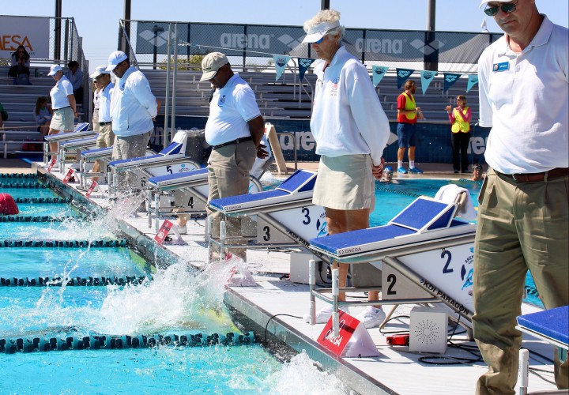
The Officials’ Job
know the rules
observe swims
when observe something in violation with the rules, raise your hand
ALL swimmers competing in a USA-S sectioned meets are observed by the rules and regulations of USA-S
Notes:
If you observe something in violation with the rules and do not report it, you have potentially put swimmers at a disadvantage.
Motivational times are now being entered into the swims database for USA-S para swimmers. an Official’s documentation of an observation per the USA-S rules and regulations is becoming more and more important as USA-S with a disability move on to other programs.

Slide 21
Protocol for officiating a swimmer with a disability
Officials
observe swims per the meet protocol
If observe something in violation with the rules, raise your hand
ALL swimmers competing in a USA-S sectioned meets are observed by the rules and regulations of USA-S
Notes:
All observations should be made based on the actual rule — not on the swimmer’s technique

Slide 22
Protocol for officiating a swimmer with a disability
It is the responsibility of the CJ and/or the Deck Referee to vet any call from an official for a swimmer with a disability.
ALL swimmers competing in a USA-S sectioned meets are observed by the rules and regulations of USA-S
Notes:
The CJ and /or Deck Referee with know what to do with your observation involving a swimmer with a disability.
AND
depending on your observation the call is upheld or given to the admin table and coach to validate the swim and get the swimmer’s time entered correctly into SWIMS.

Slide 23
REMINDER
Same rules apply in USA Swimming for both able-bodied and para-swimmers:
Observe swims per the meet protocol
If something is observed in violation of the rules, raise your hand and make the call
It is the responsibility of the Deck Referee to vet any call from an official for a swimmer with a disability.

Slide 24
THANK YOU! and follow us
Twitter: @Usaswimming
Instagram:@usaswimming
Like our Facebook page: USA-S on FB
Susan Mechler Official
Ohio Disability Committee
susan.mechler@gmail.com
Notes:
Relax, officiating USA-S Para Swimmers is no different than officiating any other swimmer in a meet governed by the USA swimming rule book

