Slide 1

2025 Athlete Report
Saturday, September 27th, 2025
Brianna Elliott, SZ Junior Athlete Representative

Slide 2
April All Zone Summit
Stats: over 80 athlete reps attended across all zones, with nearly all 58 LSCs represented.
Topics covered:
Controllables and Uncontrollables (CZ)
Sports Nutrition and Wellness (WZ)
Learning through Leadership (SZ)
Legislation (EZ)
Each Zone was responsible for creating and presenting each one of the content topics. Southern Zone’s was the highest rated by athletes in the exit poll.

Slide 3
August SZ x WZ Joint Summit
Topics:
Balance Within Life and Swim
Governance and Leadership
Social Media
Discussion based, breakout rooms with a mix of athlete reps from the Western Zone and Southern Zone.

Slide 4
National LSC Awards Program
An effort spearheaded in large part by Brianna Elliott
Recognized accomplishments of LSCs across the country in the following areas at the April 2025 All Zone Virtual Summit:
  Outstanding LSC; Breakout LSC; Trailblazer; Social Media; DEI; Civic Engagement; Zone Impact
Recognized accomplishments of LSCs across the country in the following areas at the September 2025 Denver Summit:
  Outstanding; Breakout; Trailblazer; Athlete Development; Digital Engagement SafeSport; Resilience & Perseverance; Splash Factor; Zone Impact

Slide 5
LSC Check-in Program
Separated LSCs into tiers based on their goals and struggles
Met with the tiers as groups to mentor them
  LSC reps learned from each other in the group settings
  LSC reps learned from zone reps
Zone reps garnered an understanding of each LSCs accomplishments and goals

Slide 6

X
2026 Joint Summit Proposal

Slide 7
Basic Quick Facts
Dates (for a vote):
June 11th - 14th
June 18th - 21st (with EZ!)
Site:
Emory University (Atlanta, GA)
Attendees:
We ask that each LSC send 4 Athletes and 1 Chaperone (encouraged for LSC Senior reps to attend, though not required. Other athletes can be non-board athletes, if desired)

Slide 8
Important Info About Dates!
June 18th - 21st dates are STRONGLY RECOMMENDED for the following reasons:
USA Swimming staff, Leland Brown III and Liz Hahn, have COMMITTED to being at the summit to present FREE OF CHARGE. HOWEVER, they can only make the June 18th - 21st time window NOT the June 11th - 14th dates.
The Southern Zone Athlete Director will NOT be able to attend the June 11th - 14th dates, ONLY the June 18th - 21st; one of the main presenters and leaders of the summit.

Slide 9
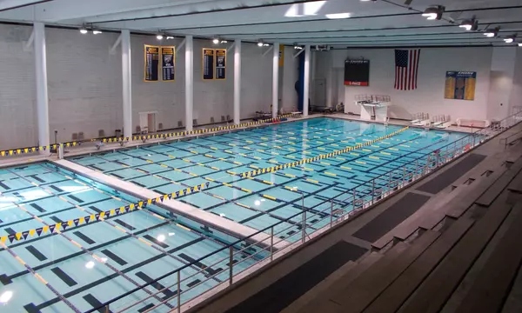
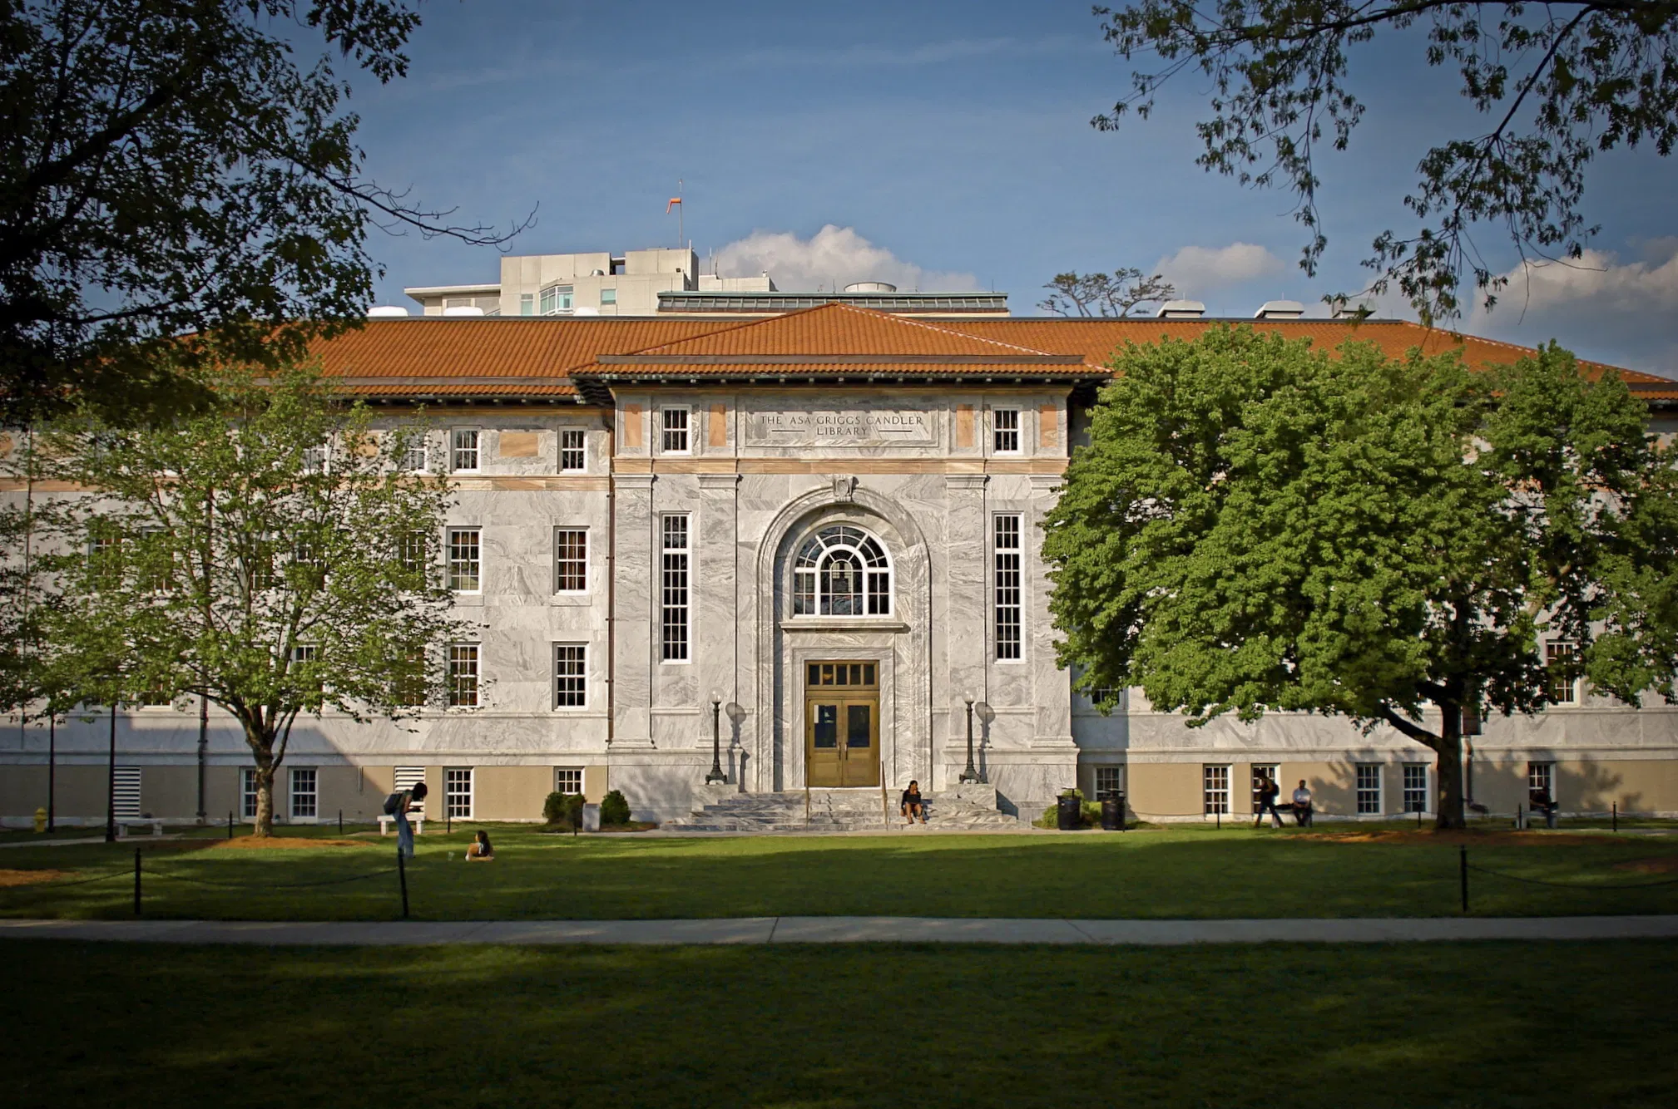
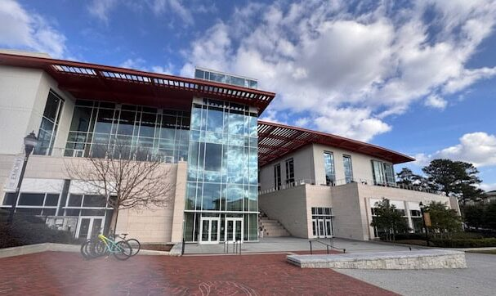
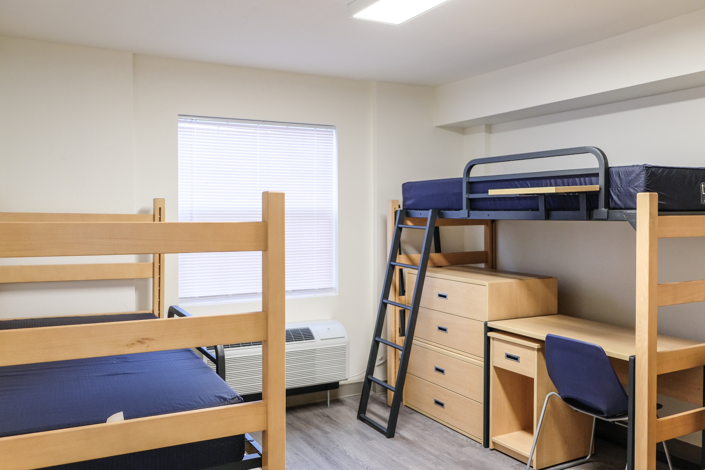

Emory University (Atlanta, GA)

Slide 10
NEW Mission and Goal of 2026 Athlete Summit
2026 Mission: To engage zone athletes in bold, collaborative conversations and wild idea-sharing across LSCs, pushing the boundaries of creativity and leadership, to develop action plans that spark effective communication, drive impactful change, and ensure lasting success and continuity for LSC athlete committees.
2026 Vision: “Go Wild!: Bold Ideas, Real Action.”
Diving deeper into critical thinking and creativity to solving problems and creating solutions.
Engaging with National Committees to work towards collective problem solving
Understanding the necessary skills for critical thinking, communication, and problem solving

Slide 11
2026 Athlete Summit Logo Reveal

Slide 12


Slide 13
Meet Your 2026 Athlete Summit Leadership Team!
Athlete Track Leaders:
Nicole Caruso
Louis Roux
TJ Walsh
Nicole Zhang
Two select AEC reps
One select social media rep
Non-Athlete Track Lead Curriculum Coordinator:
Pam Lowenthal
Additional Zone Leaders:
Melissa Hellervik-Bing
SZ Coach Director
Jamie Platt
Tom Ugast
Up to Four USA staff members

Slide 14
Athlete Track Tentative Plans

Slide 15
Session Highlights
DEI & Safe Sport Session
  With USA Swimming Staff (Leland & Liz) → ONLY on June 18th -21st dates
Bold Critical Thinking
  Collaborative Leadership
  Unlock Creative Thinking
  Trailblazing Critical Thinking
Communication & Persuasion
  Pitching & Persuasion
  Project Communication
Continuity & “Shark Tank”
  Survival Guide
  Problem Solution “Shark Tank”

Slide 16
Non-Athlete Track Tentative Plan

Slide 17
Who Should Attend?
We are gearing this towards non-athlete representatives who work closely with the athlete representatives in your LSC. This could be someone on the Board of Directors or someone who is an athlete liaison to the athletes committee.
A great chance to get to know the commonalities of issues all face within the Zone, have conversations on how to successfully implement ideas, and support your LSC athlete leaders

Slide 18
The Benefit for Non-Athletes!
Getting to see and know our athlete leaders of the future and what they can bring back to their club and LSC with your support.

Slide 19
Non-Athlete Track Schedule
As most non-athletes have working jobs, Thursday & Friday morning provide flexibility for them to wrap up their work week before engaging in curriculum and designated track.
Optional non-athlete sessions will be available with the athletes or individual discussions with Zone Leaders & USA Swimming staff during those time periods.

Slide 20
Thursday/Friday Schedule Plan
LSC attendees arrive Thursday.
All attend the initial welcome meeting and review the daily schedule.
A list of joint workshops will be supplied by the Athlete Summit leaders.
Non-athletes first session will begin Friday afternoon as a joint session with the athletes followed by an individual session. (Hopefully this will accommodate anyone’s work schedule)
Following dinner there will be a non athlete social.

Slide 21
Friday Topic Schedule
There will be two mandatory sessions for the non-athletes track starting in the afternoon.
The first will be a critical thinking warm up with the athletes followed by some individual programming during that same block.
The second session will focus on “Puzzles vs Mysteries” comparing easy problems to solve versus outside of the box problems that don’t have a clear cut answer.
An adult social will follow dinner in the evening.

Slide 22
Saturday Topic Schedule
Saturday will be focused on preparing for Sunday’s presentation of the non-athletes take on out of the box problems and concerns within USA Swimming and the zones.
Sessions will be focused on success stories, ways of working, and then group discussion and work time on generated problem statement.

Slide 23
Sunday Topic Schedule
“Shark Tank” for non-athletes & athletes to pitch solutions and ideas for successful implementation in the sport & then vice versa
Keeping with continuity and sustainability of athlete initiatives & allowing attendees to generate ideas and critical thinking at the national level then provide the same way of thinking locally in LSCs.

Slide 24
The Financials

Slide 25
Costs for LSC/Zone
LSCs will be responsible for covering transportation to/from the event, meals, & rooming for their contingency.
Athletes will be in a double or single bedroom for the event. Chaperones may opt in to the same setup with designated chaperone blocks.
SZ & EZ will cover all other costs including social event cost, meeting spaces, swag, and other costs!
SZ & EZ will supply $12,000 each to cover these costs as in the budget.

Slide 26
Any questions or comments?

