Slide 1

What is Safe Sport?
Safe Sport is USA Swimming abuse prevention effort.
USA Swimming is committed to fostering a fun, healthy, and safe environment for all its members.
The Safe Sport program has a wealth of resources, policies, best practices, tools, and procedures to help empower you to create and maintain a healthy and safe environment for your athletes.

Slide 2

What does that mean for this swim club?
All non-athlete members (coaches, officials, etc.) are subject to a criminal background check and a pre-employment screening, as well as complete USA Swimming’s Athlete Protection Training.
All member clubs are required to have athlete protection policies in place with regard to travel, electronic communication, and anti-bullying.
Swim clubs have access to an arsenal of resources to assist the club leadership with implementing the best practices guidelines for athlete protection.
Notes:
Safe Sport works hard to ensure that USA Swimming’s members are safe for kids by screening and selecting the right people and by educating its members about child abuse, grooming behaviors, warning signs, and athlete protection.
Protecting kids so that they have a positive experience is a daily task, and there is a wealth of information and expertise available to teams in order to make this effort as easy as possible.

Slide 3

How will my child be protected?
Required Policies:
Team Travel
Electronic Communication
Anti-Bullying Plan
Recommended Policies:
Photography
Locker Room Monitoring
Best Practice Guidelines
Codes of Conduct for Coaches, Athletes, and Parents
Notes:
Putting policies in place and using conduct guidelines helps to establish a bandwidth of behavior expectation. It allows you to clearly define what is okay and what is not okay, and it allows you to take actions against behaviors that fall outside of the team’s bandwidth of expectation.
Model policies, best practice guidelines, and model codes of conduct are all available in USA Swimming’s Safe Sport Resource Library. Teams are encouraged to develop their own polices and codes and may use the provided models as a guide.

Slide 4
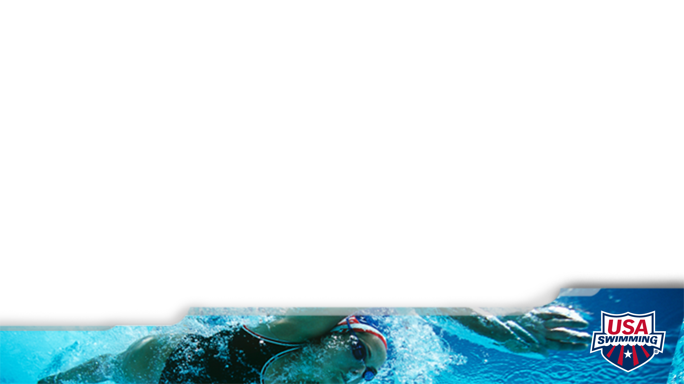
What is the expectation for my involvement?
Communicate with your child, your child’s coaches, and other parents.
Observe practices and help out at meets and team events.
Know the standards of conduct for all coaches, volunteers, and athletes, and speak up if the standards are not being upheld.
Notes:
As parents, you should support your child’s swimming experience by attending practices and meets, celebrating your child’s accomplishments, and enjoying his/her growth.
Most boundary issues, instances of misconduct, and negative behaviors can be mitigated—or prevented—by open and transparent communication.
If you notice something that doesn’t seem right, don’t suffer or stew in silence. Talk to someone.

Slide 5

Who do I contact if I have a concern?
Head Coach: _______Nic Sardo_______________________
Assistant Coach: ______Jordan Carey____________________
USA Swimming Safe Sport: safesport@usaswimming.org
(719) 866-4669

