Slide 1

Nutrition for Swimmers (and their parents)
Karl Hamouche, founder
www.swimsmarttoday.com

Slide 2
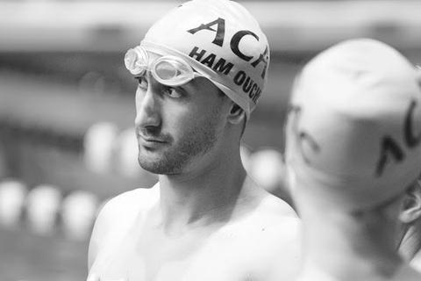
About Karl
Biology Undergrad at Iowa state university
1 year of exercise science graduate work
Medical school at the University of Iowa
Resident in Wichita, Kansas
3 years as a coach, including head satellite coach
Still involved in the club scene with coaches
Still train and race (old man races only though)

Slide 3
The Goal
Need to refuel the muscle’s sugar storage as much as possible after every workout
Need to avoid sending sugar to fat cells instead of muscle
Need to schedule the right foods around workout and competition
Keeping gut bacteria happy and micro-nutrients

Slide 4
If you zone out… remember this
Eating food that is good for you is all that matters
The faster something spoils, the better it is for you
Milk and veggies vs chips and jam
The longer it takes to make it, the better it is for you
Pot roast vs microwaving a pre-made frozen meal

Slide 5
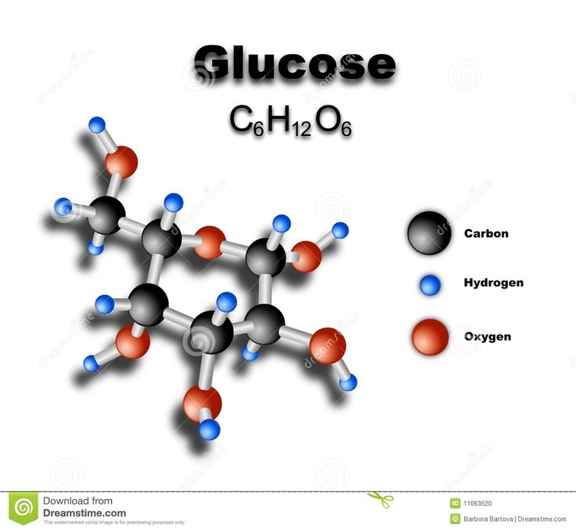
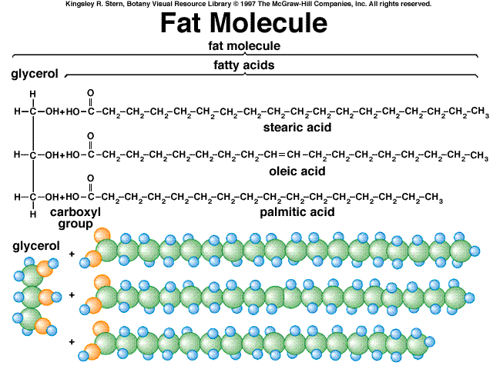
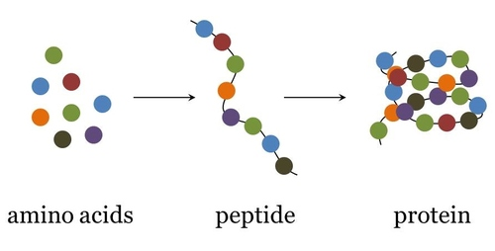
A good Balance
Protein: 10-35%
Fat: 20-35%
Carbs: 45-65%
BUT… not all carbs are the same
And… they have different effects at different times

Slide 6
Protein… simple
Protein
Not used for fuel (for the most part)
Swimmers Don’t need to bulk
So really don’t need to adjust in a swimmer’s diet
Can be useful in refueling the liver since protein can be converted to sugar there. And Sugar from liver maintains blood sugar during exercise.
If you wanna be fancy (but not necessary):
Protein use is highest during the first two weeks of the season before your body is in shape
increase intake from 1 to 2.0 grams/kilogram/day for first 2 wks

Slide 7
Fats
Fats
Used a lot as fuel in swimming
basically unlimited supply is available (even in skinny kids), so we don’t need to increase our intake, especially since carbs and proteins can be converted to fat if we overdose on those.
Stay away from the trans fats: https://health.clevelandclinic.org/2015/07/avoid-these-10-foods-full-of-trans-fats/
These are synthetic fats that have no use in the body
Limit Saturated fats: Bacon, coconut oil, fat in milk and red meat
Feel free to eat up mono and poly-unsaturated fats: Olive oil, fat in nuts, avocados

Slide 8
Where to find bad fats
Cakes, pies and cookies (especially with frosting) Most cake and cookies
Biscuits
Breakfast sandwiches
Margarine (stick or tub)
Crackers
Microwave popcorn
Cream-filled candies
Doughnuts.
Fried Fast food
Frozen pizza

Slide 9
Carbs (aka… sugar)
Swimming workouts burn carbs, and you only have a limited amount in muscles
At the end of workout, we need to refuel the muscles as quick as possible
But the wrong carbs at the wrong time will refuel fat cells instead of muscles= bad
We can control where the sugar goes by understanding:
Insulin
Glycemic index
Workout loopholes
Hint: fructose has no use in the body and 90% eaten will turn into fat no matter what, so avoid at all costs!

Slide 10
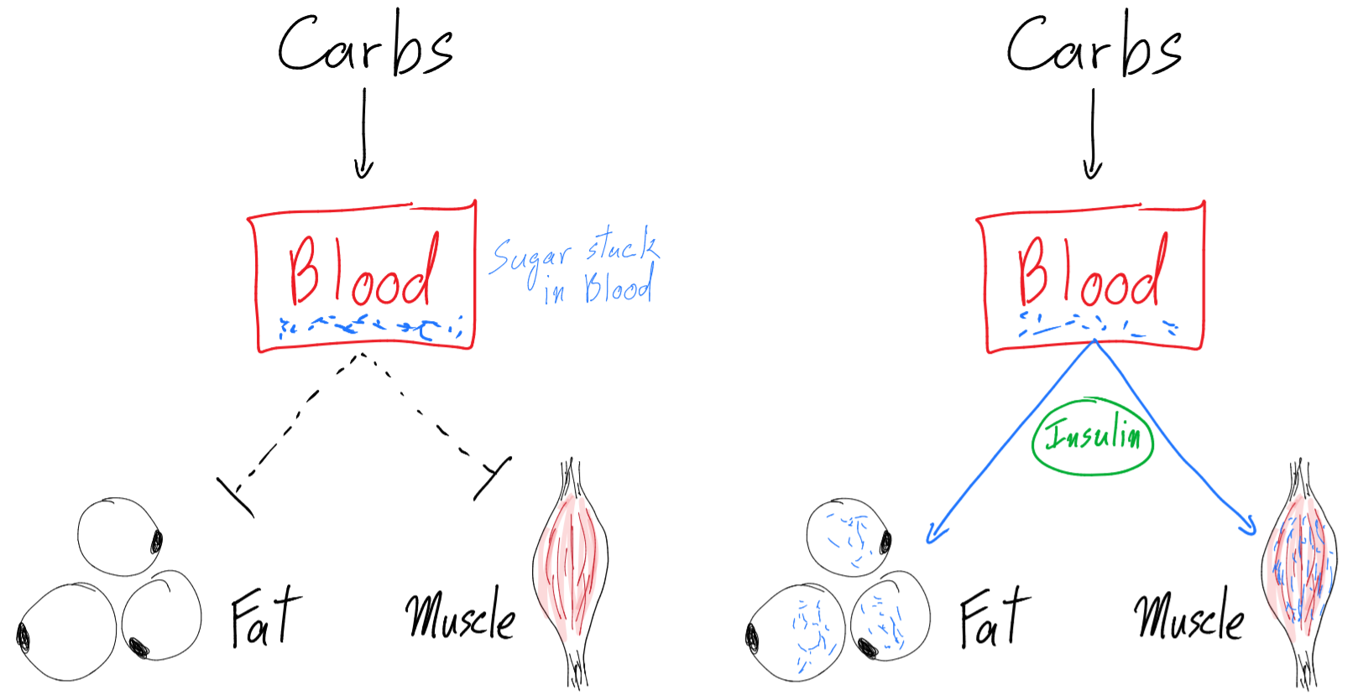
Insulin gives permission for muscles/fat to take sugar out of blood

Slide 11
Insulin is bad…mkay
Sending half the sugar we eat to fat cells is not going to help in the next workout
Need to maximize getting sugar to the muscles
Different foods will cause a different rise in insulin
Measuring that is called the glycemic index (gi)

Slide 12
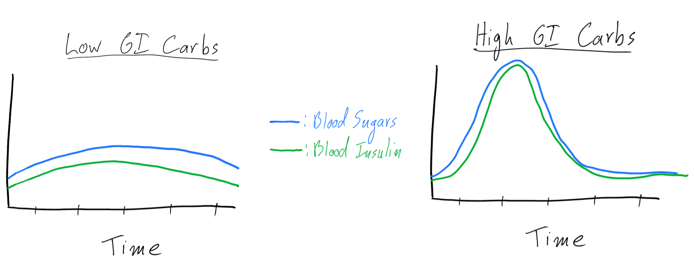
Glycemic index measures how fast blood sugars rise, and therefore how high insulin rises

Slide 13
Foods by glycemic index
https://www.health.harvard.edu/diseases-and-conditions/glycemic-index-and-glycemic-load-for-100-foods
Simple list
http://ajcn.nutrition.org/content/76/1/5.full.pdf
>1000 foods listed
Easier to group them as high, medium, low index foods
High GI foods: >70
Medium GI foods: 40-70
Low GI foods: <40

Slide 14
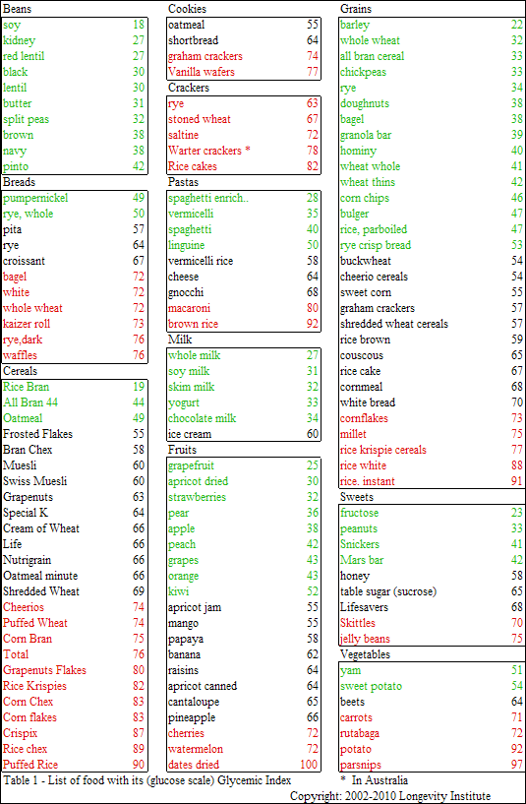

Slide 15
(FYI slide) Glycemic index vs. Glycemic load
The glycemic index is measured by feeding people 50g of carbs from a food and measuring the effect on blood sugar
This does not take into account how many servings you need to eat to get 50g of carbs
That means even though watermelon has a glycemic index of 72, each serving has so little sugar, you would have to eat the whole melon to get any rise in sugar.
Combining gi and sugar per serving is called: glycemic load
Since swimmers overeat just about everything, we can simplify the world and just focus on glycemic index

Slide 16
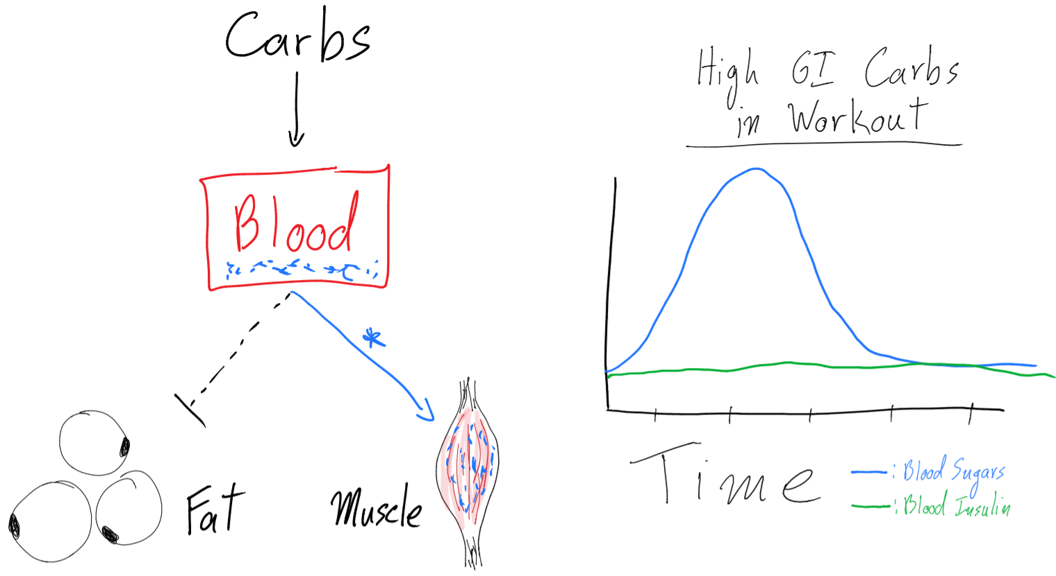
The workout loophole: Muscles can “steal” sugar out of the blood without permission from insulin if working out!

Slide 17
Carbs summary
Insulin is bad
Sugar raises insulin
High glycemic index foods raise insulin more, causing fatness and muscles don’t get the sugar they need
Insulin can be avoided by eating low glycemic index foods or by eating during and right after workout (like… within 30 min of getting out of the water)

Slide 18
Meal planning: 3 meals 3 snacks
Knowing what we learned and running doubles… Let’s schedule 3 meals and 3 snacks per day to fuel
Burning about 4000-6000 calories a day!!
The pattern:
high glycemic liquids during workout
Medium glycemic foods after workout
Lower glycemic foods the further away from workout
No junk food: garbage in = garbage out

Slide 19
Wake up for morning practice
Snack 1: refueling liver
30-60 min before hitting water
Liquid snack of low to medium GI food focusing on carbs and caffeine
breakfast shake, apple, orange (not juice… the real fruit please)
Morning workout
Sugar drinks (super high gi) after warmup and throughout workout.
Between exiting the pool and hitting the shower, another big bottle of sugar drink
(chocolate, fruit rollups, dried dates… they are ok here, but only before showering)
Meal 1: Breakfast
Balanced meal with medium GI carbs, protein and fats
Eggs, bacon, oatmeal, milk, yogurt…
No juices! We are gonna be done with those. NO doughnuts, pancakes or cakes or processed bread, too much trans fats

Slide 20
5. Snack 2 (can be before or after meal 2, depending on when lunch is at school)
1. Low gi foods, something salty to keep your hydration up
2. almonds, avocado, nuts, seeds, another shake, cheeeeeese
6. Meal 2: lunch
1. balanced meal with low gi carbs, protein, fats
2. meat and veggies, very paleo here
3. no corndogs, hamburgers, fried chicken… too much bad fat. If you have to bring food to school, do it!!
7. Afternoon workout
1. Sugar drinks after warmup and throughout workout.
2. Between exiting the pool and hitting the shower, another big bottle of sugar drink
3. (chocolate, fruit rollups… they are ok here, but only before showering)

Slide 21
8. Meal 3: dinner
1. balanced meal with mostly medium gi carbs, protein and fats
2. spaghetti, beans, rice with associated meats and veggies. Fruit for dessert.
3. no cake, no bread, no bagels, no cookies or muffins please. We are done with these too.
9. Snack 3: bedtime recovery
1. Protein based snack with some very low GI carbs
2. Protein shake, cheese, jerky, milk.
10. Fluids throughout the day
Need to get about 4 liters (1 gallon) of fluid a day. That’s 4 x 32oz bottles. Not sugar based drinks unless it is during workout. If needed, weigh yourself daily before and after practice to monitor for hydration status. A loss of 1-2% of body weight in water will cause practice to hurt more and suck more.

Slide 22
You Can remove snacks 1 or 2 if you only have one workout that day. Remove all snacks on off days and during the off season.

Slide 23
Meet Day Eating
The goal is to race without feeling hungry or full
We want insulin to be on the way down, and blood sugar to still be high
Since you can spend 8 hours at the pool between prelims and finals, snacks will be essential
Try to eat a meal 2-3 hours before getting on the blocks
Mostly low to medium gi carbs with some protein (probably a shake is best). Limit fat since it takes a long time to digest.
Snack on salty low gi carbs to keep you thirsty and not hungry. Dried fruit, nuts…
Eat a big balanced meal as soon as possible after the session, this may be the only meal before finals
End the day with more emphasis on protein to rebuild muscle during the night

Slide 24
Body builders have saying: “built in the gym, chiseled in the kitchen” We can learn from that too

Slide 25
Microbiome: keeping your gut bacteria happy
An experiment was done where they took the gut bacteria (poop) from a thin mouse and put it in a fat mouse, and vise versa. Without changing diet or exercise, the fat mouse got thin, and the thin mouse got fat.
https://www.ncbi.nlm.nih.gov/pmc/articles/PMC5045147/
Gut bacteria are a big deal, and you can feed the good ones or the bad ones based on what you eat.
Fiber and Probiotic foods feed good bacteria
Processed sugar and trans fat (junk food) feed bad bacteria
Yogurt (non-flavored please), miso, kimchi, keifer, sauerkraut are all good probiotic foods.

Slide 26
Micro-nutrients
As long as the diet is balanced, most swimmers get most micronutrients, and multivitamins are mostly a waste of money
Except for these
Iron: girls (and vegans) especially should be on a daily iron supplement. Nature made 65mg are probably the best. (Can cause constipation and black poops fyi).
Vitamin D: especially up north where the sun don’t shine. 1-2000 units a day is good. (can’t really overdose on this stuff).

Slide 27
Depending on parents and school to cook you good meals and snacks is not an excuse for eating crap. Go to the grocery store with your parents and cook for yourself if you have to. Bring food from home and eat your own lunch at school. I remember the garbage they serve and it’s cheaper if you do it yourself.

Slide 28
That’s it! You know everything about good nutrition. It’s probably time for practice.

Slide 29
For more information like this visit www.swimsmarttoday.com
For more great ideas and learning, follow us:
Facebook: https://www.facebook.com/swimsmarttoday/
Instagram: https://www.instagram.com/swimsmarttoday/

