Slide 1
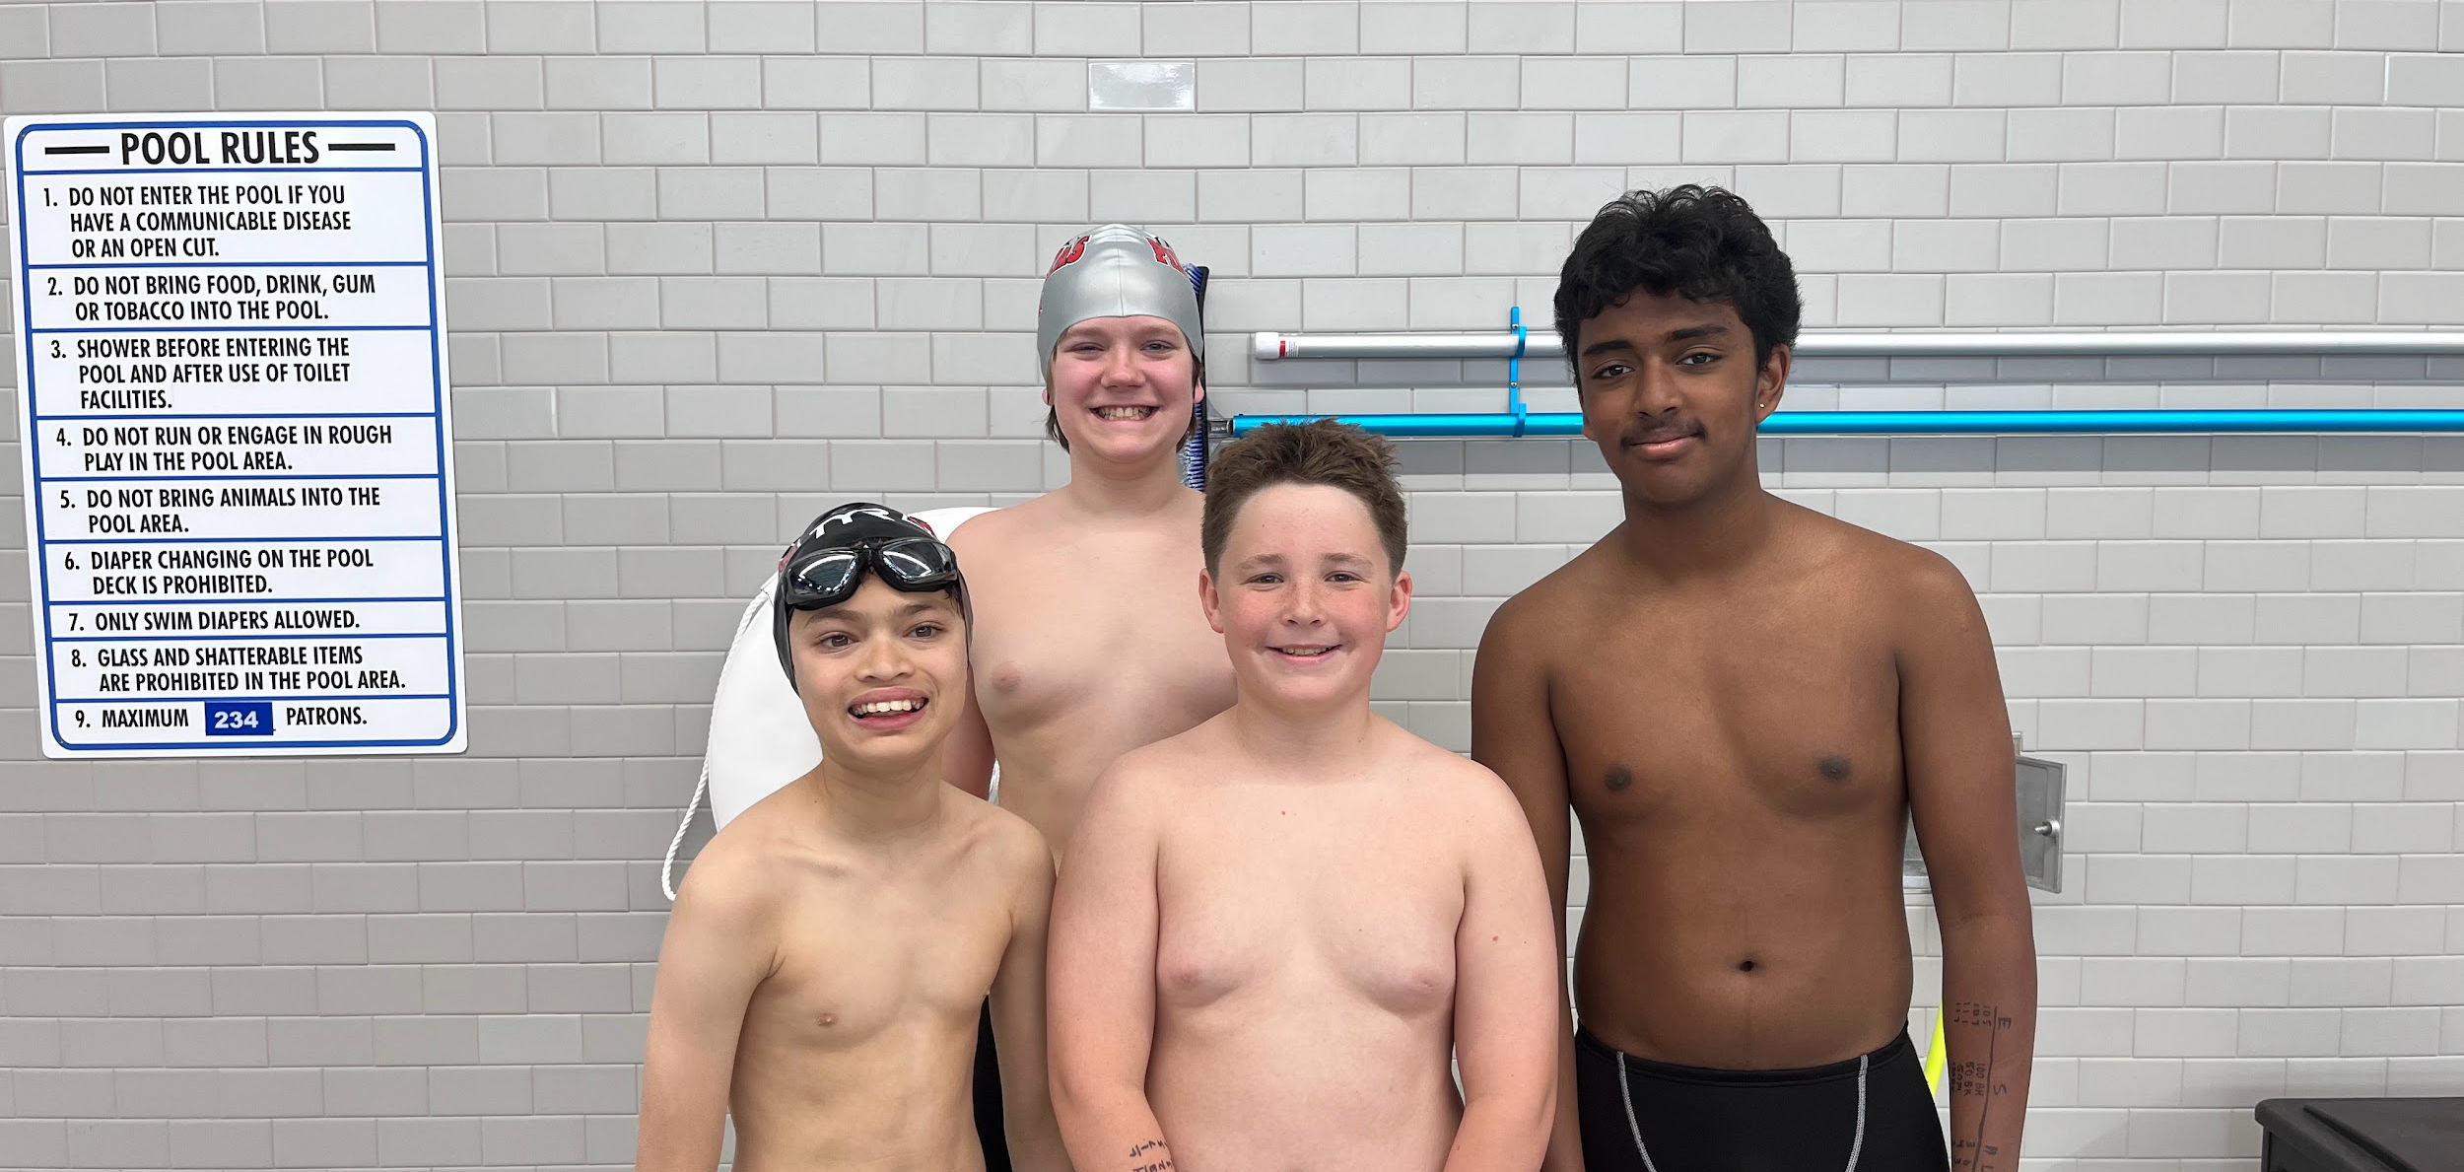
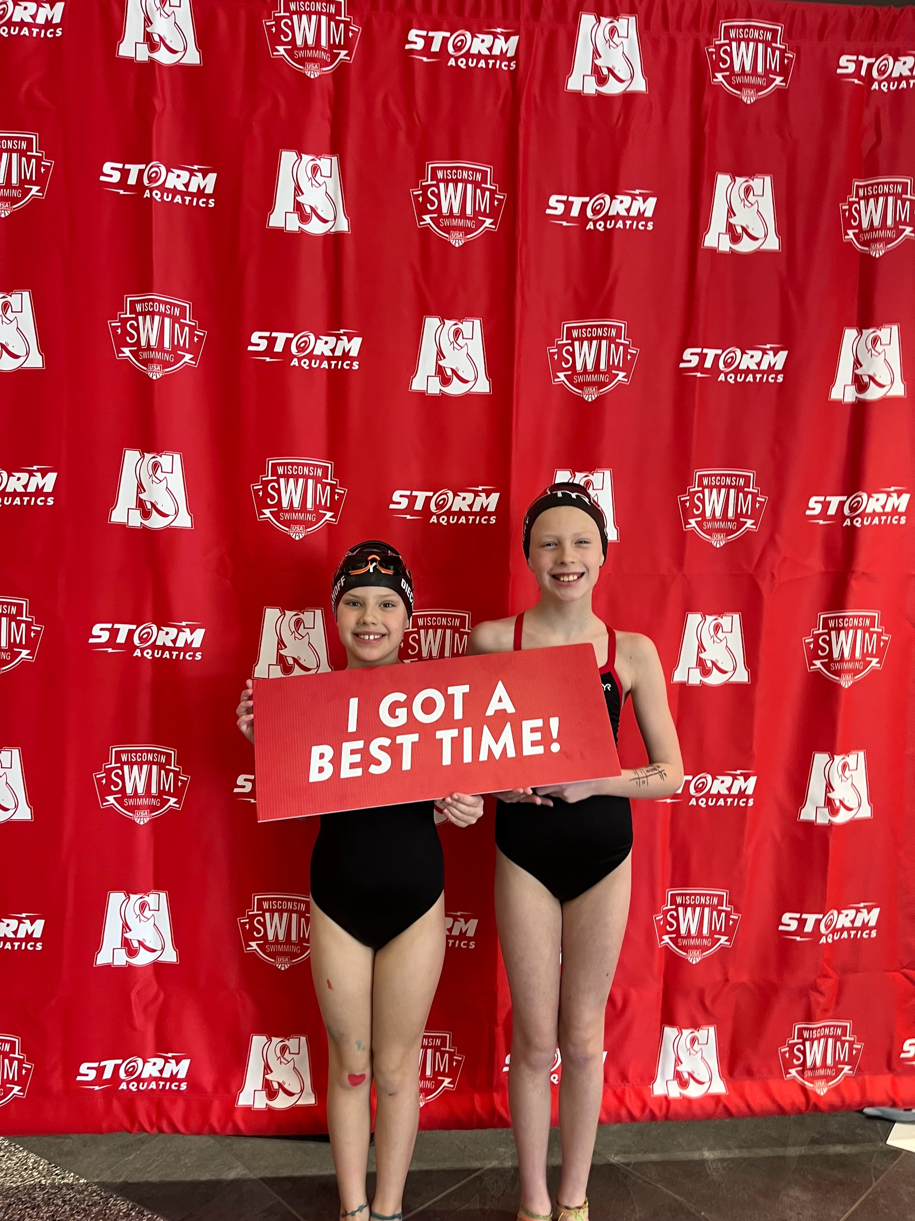
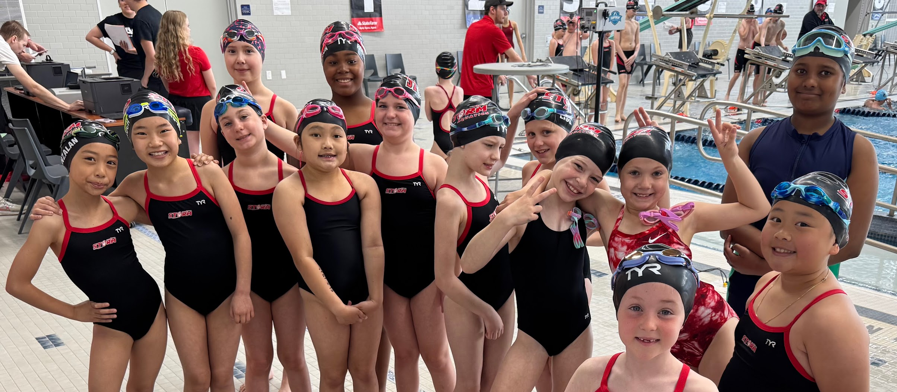
Storm Aquatics
Volunteering

Slide 2
VOLUNTEER POLICY

Slide 3
HOME MEETS
1 shift/ each day your swimmer is in the meet
If there is a need for volunteers, you may be asked to work additional shifts
  First asked will be parents with multiple swimmers
A family’s shift can be covered by anyone (relative, neighbor, friend, etc)
  If this is the case, notify Emily Doughty
Anyone can sign up as soon as positions are posted, if you do not sign up by the deadline, you will be assigned a position, and charged a $25 fee
If you don't fill your assigned role, you will be charged a $100 fee. Additionally, you will be billed additional missed sessions if in a larger meet.
Early departure will be considered a “no show” and will result in a $100 fee.
All fees MUST be paid before you can sign your swimmer up for another meet.
Volunteer Policy

Slide 4
HOME MEETS
All volunteer positions are able to change as the meet director sees fit.
  Additional duties may be assigned
  Times will be approximate until the final timeline of the meet is given, please double check meet times/ shift times the day before the meet.
The Winter Classic or Regionals have many days and sessions
  You may be required to volunteer in every session your swimmer swims.
  The meet director will contact you if this is the case beforehand.
The meet director has the right to modify all positions requests and you may be moved from your position to fit meet needs.
Most on deck jobs do not allow phone usage due to SafeSport requirements.
Volunteer Policy

Slide 5
ON DECK JOBS

Slide 6

ANNOUNCER
Announce officials meeting with timers/runners.
Announce the events at meets over the microphone on deck.
Make any other general announcements, including concession sales and sponsorships per script requirements.
On Deck Jobs

Slide 7
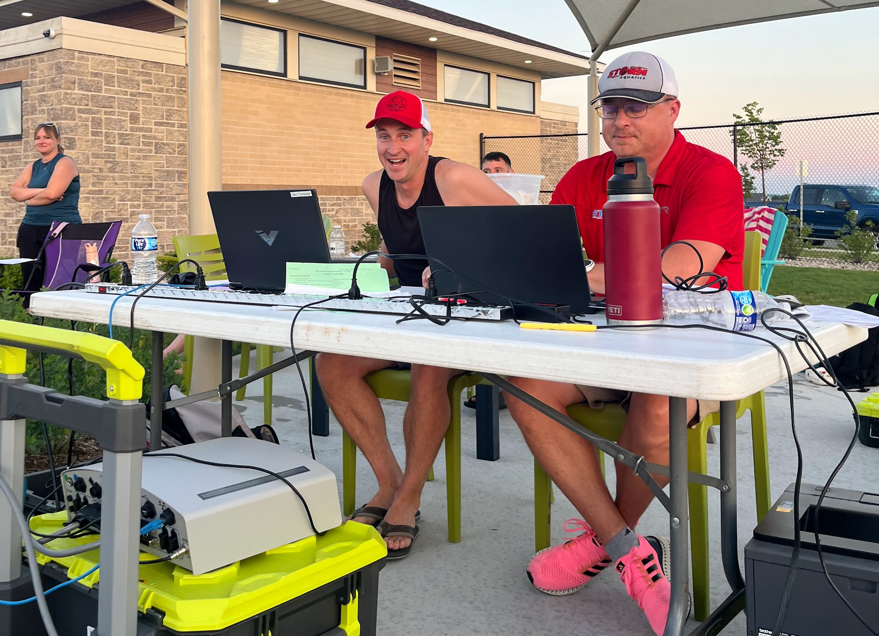
HYTEK/ Timing Computers
Training Required
Works with officials
Operate computers during the meet.
Operate computer-based timing devices and record the times for the swimmers and assist with the on deck set up and take down of timing system.
On Deck Jobs

Slide 8
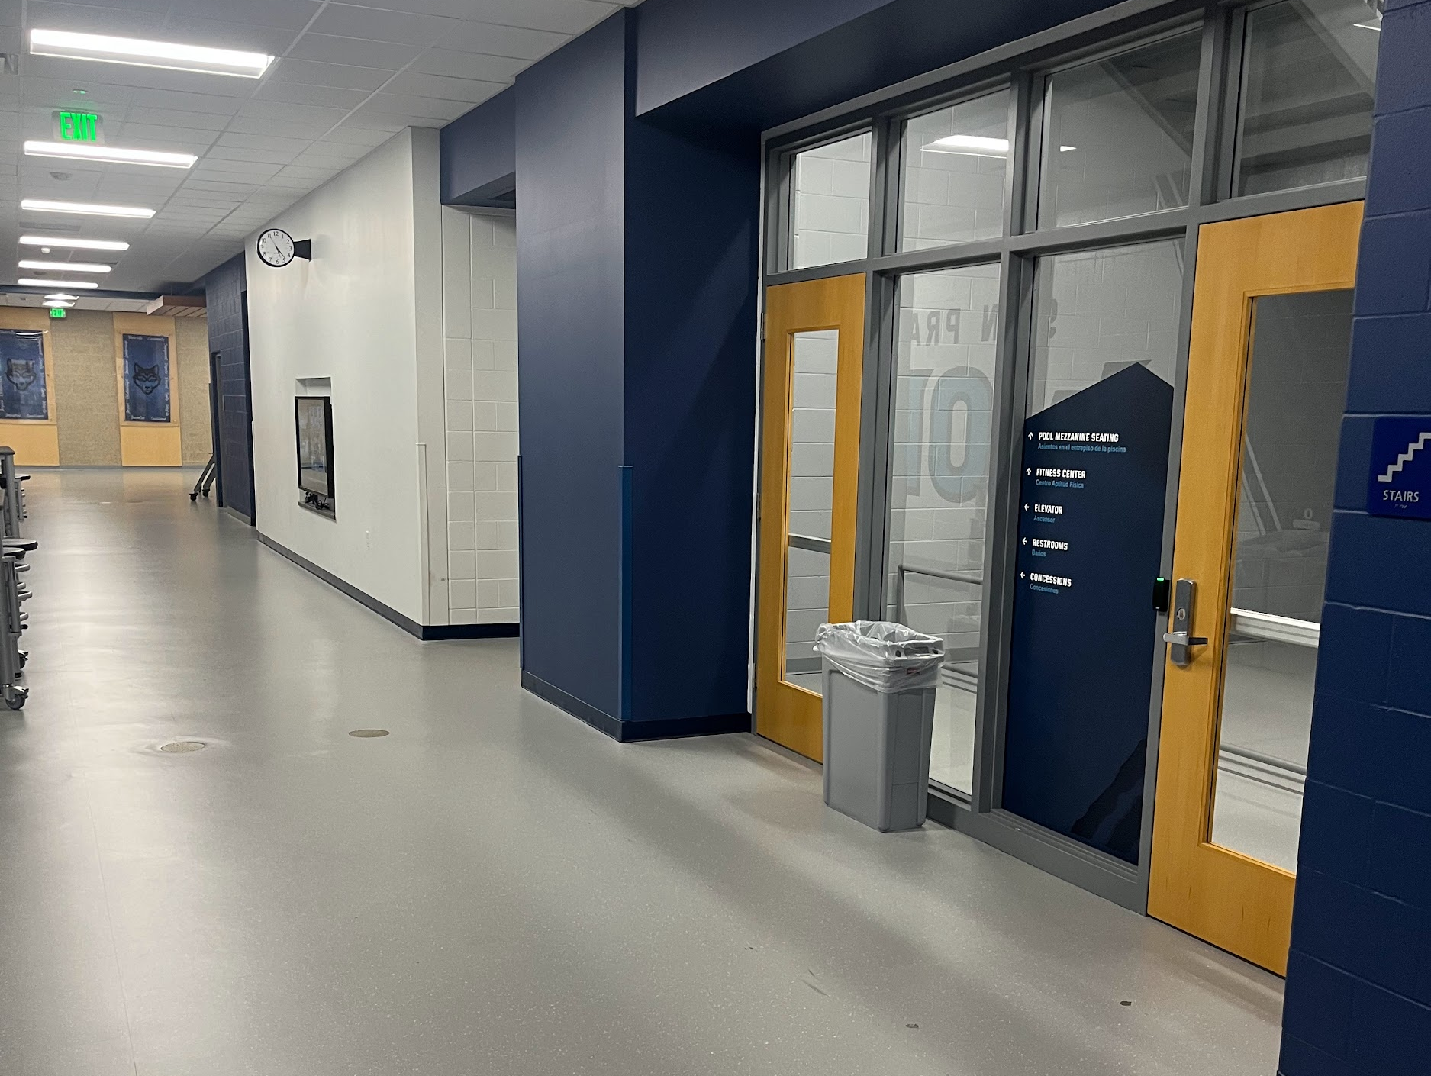
Door
Monitor
Monitor to ensure only eligible participants access pool deck. Ex. officials, meet marshals, coaches, athletes, timers, lane monitors, runners, heat winner volunteer, team photographer.
Monitor to make sure parents/guardians do not access pool deck.
May have to assist in relaying messages, items, etc to allowed people on deck from non-allowed people on deck.
If there are not two door monitors, volunteer coordinators should be flagged down to assist to avoid leaving door unattended.
On Deck Jobs

Slide 9

Heat
Winner
Distributer
Hand out the heat winner awards after each heat
On Deck Jobs

Slide 10
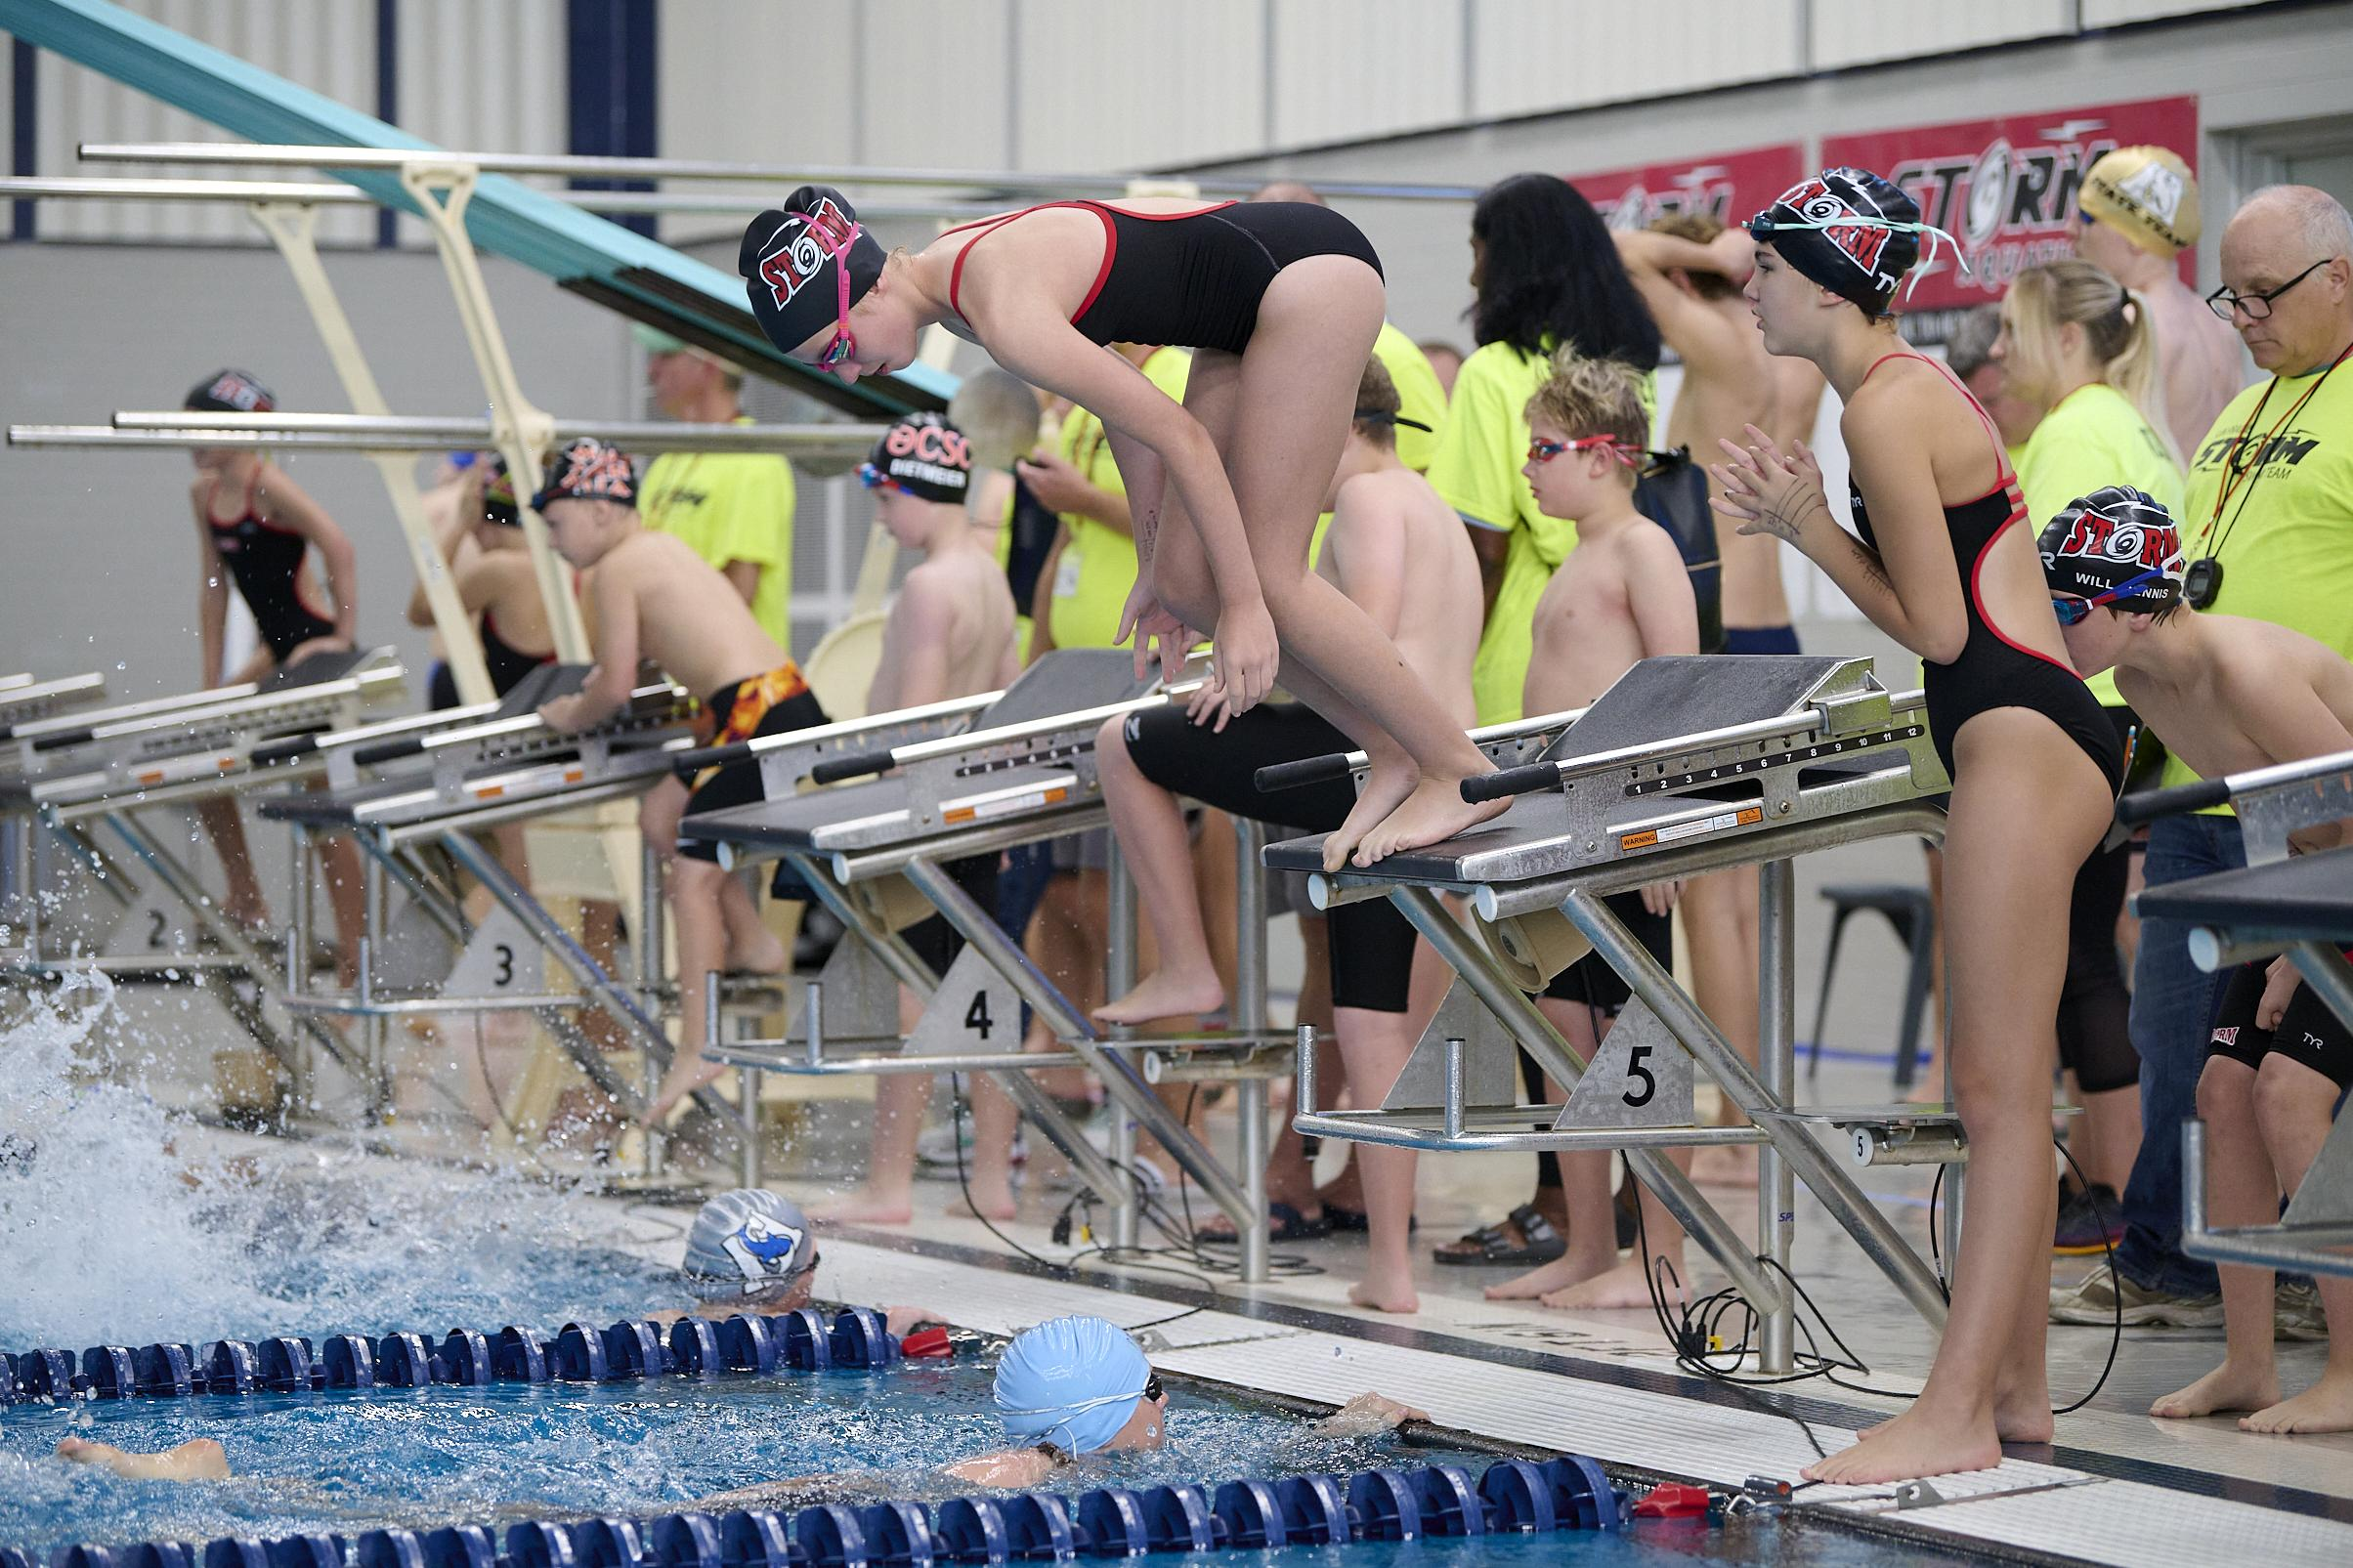
Lane Monitors
Work with swimmers behind the blocks to identify where they should be and that they make their event
Make sure lanes are empty if nobody is swimming in them
On Deck Jobs

Slide 11
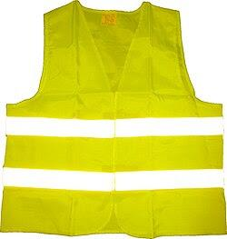
Meet Marshals
Training Required
Monitor the pool area during warmups for safety, clear lanes for warm ups and monitor hallway and bathrooms for improper conduct. This position will monitor the pool deck (only allowing authorized personnel on the deck), the bathrooms and the hallway to ensure safety of the swimmers.
On Deck Jobs

Slide 12
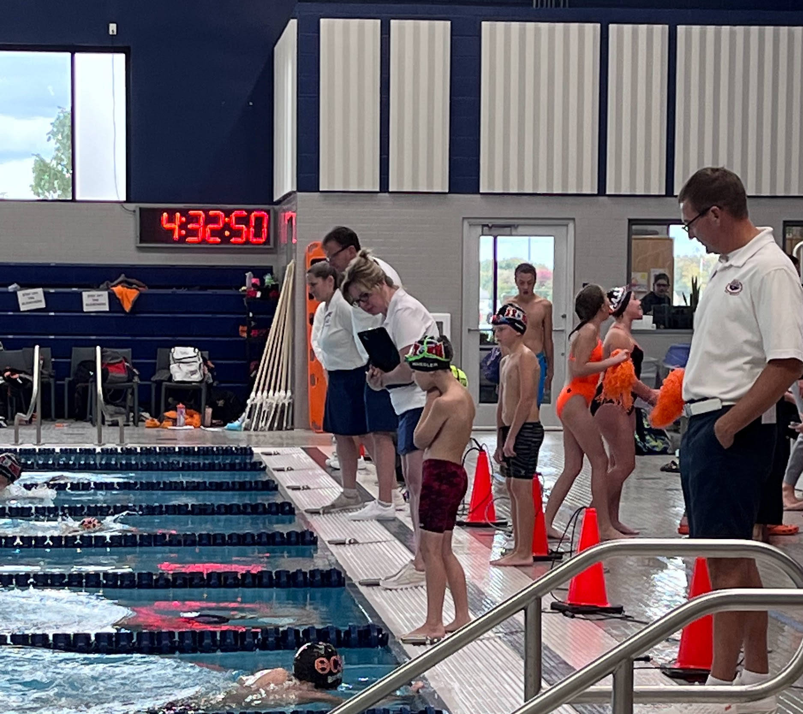
Officials
Training Required
Work with head official to check that all swimming is legal and in compliance with rules
On Deck Jobs

Slide 13
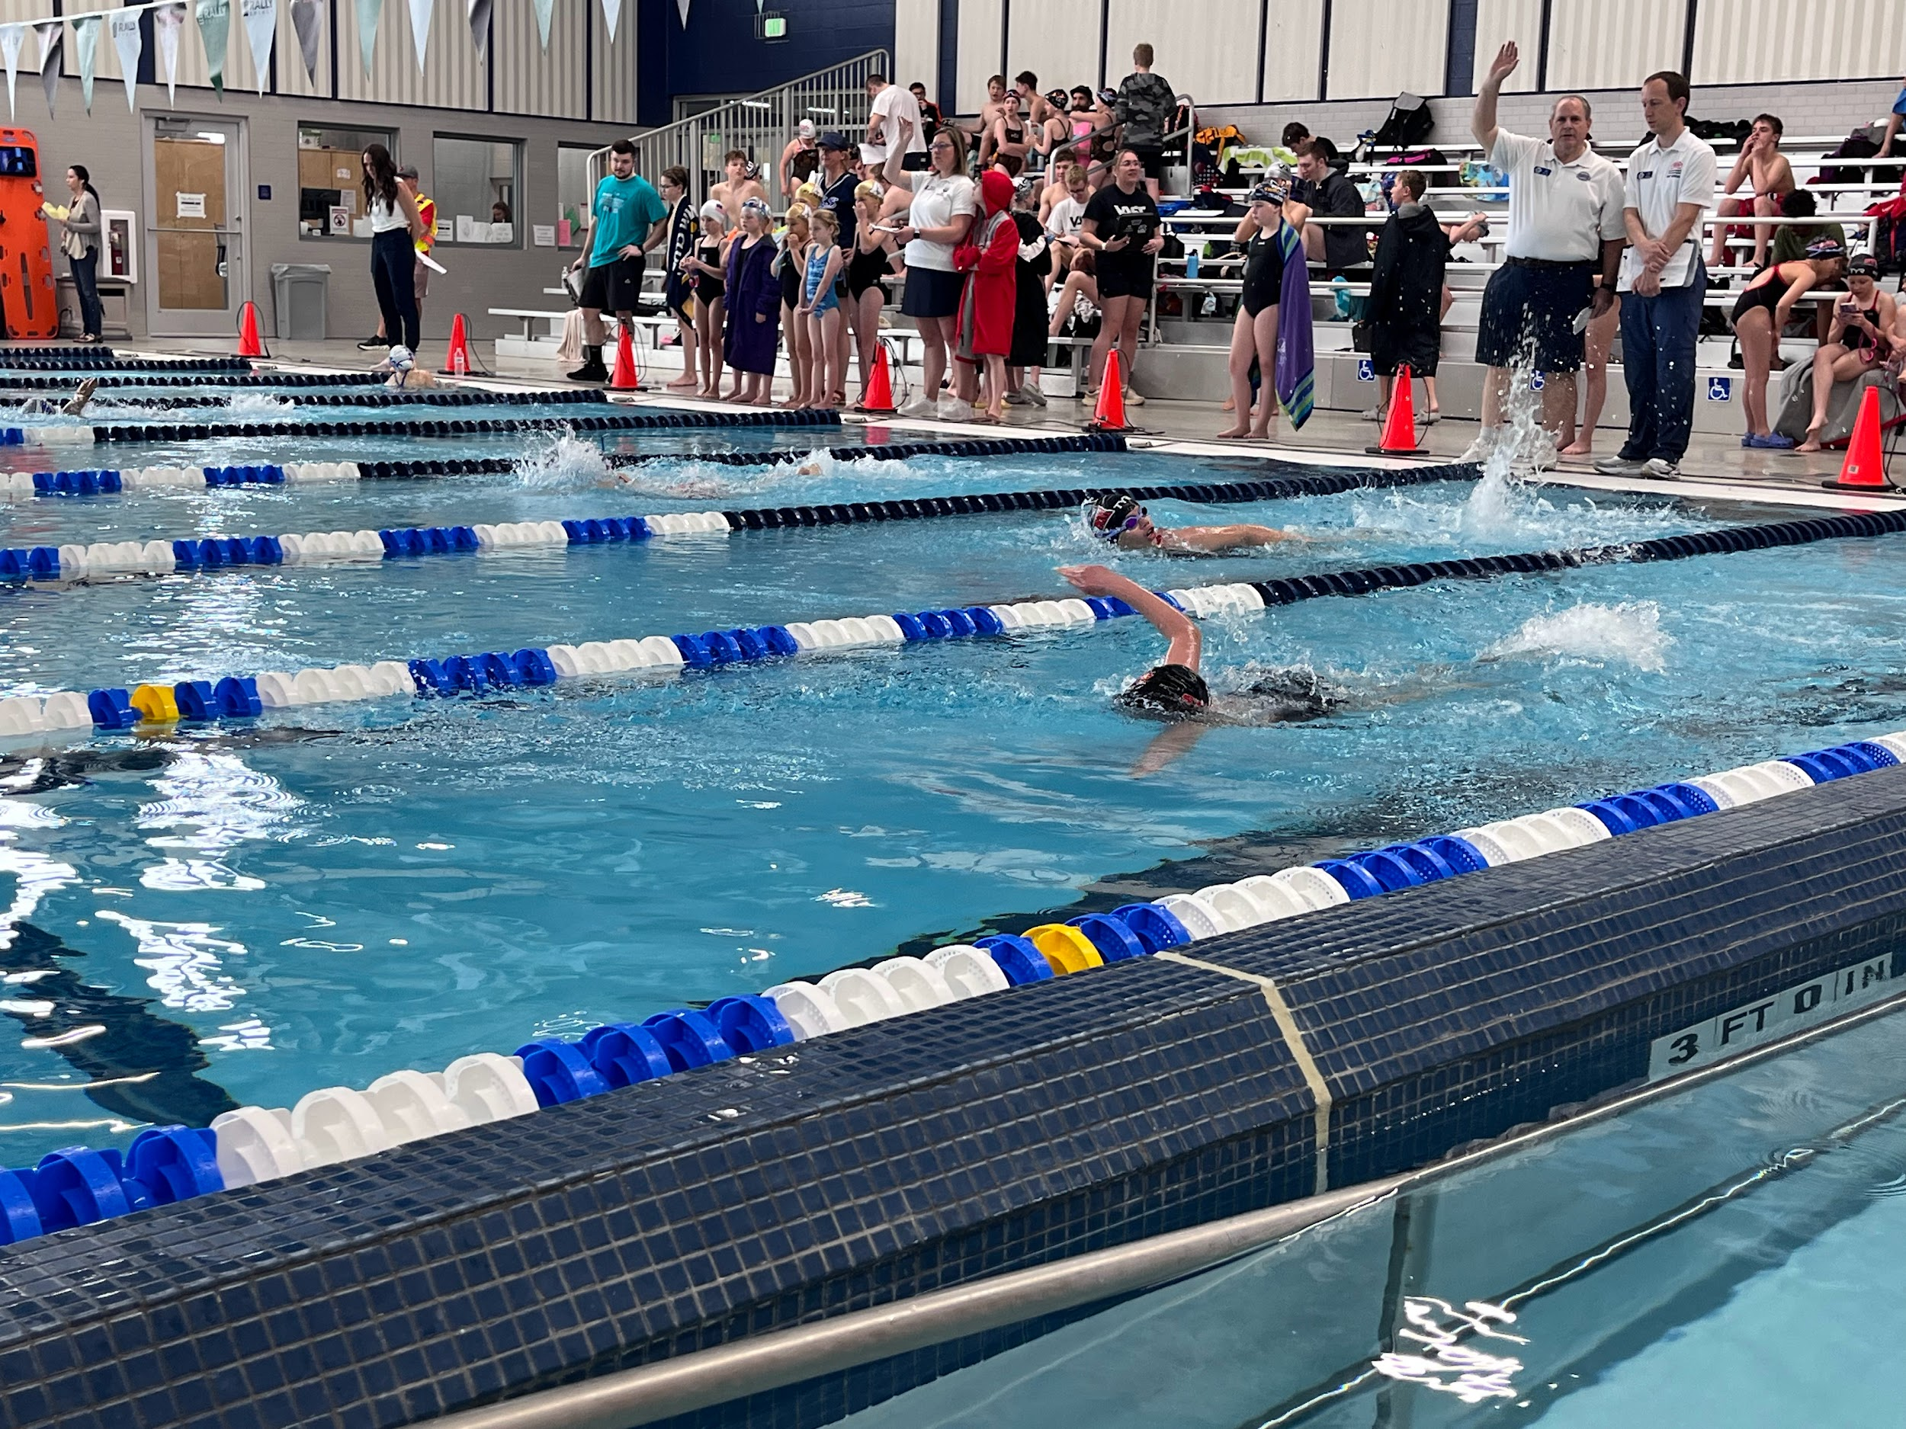
Runner
Check-in with officials at pre-session meeting (usually 20 minutes before start of meet).
Collect timing sheets after each event and take them over to the timing table.
Collect DQ slips from officials and turn in to computer table.
Once results are printed the, post results on the wall and give to awards table to start making awards
On Deck Jobs

Slide 14
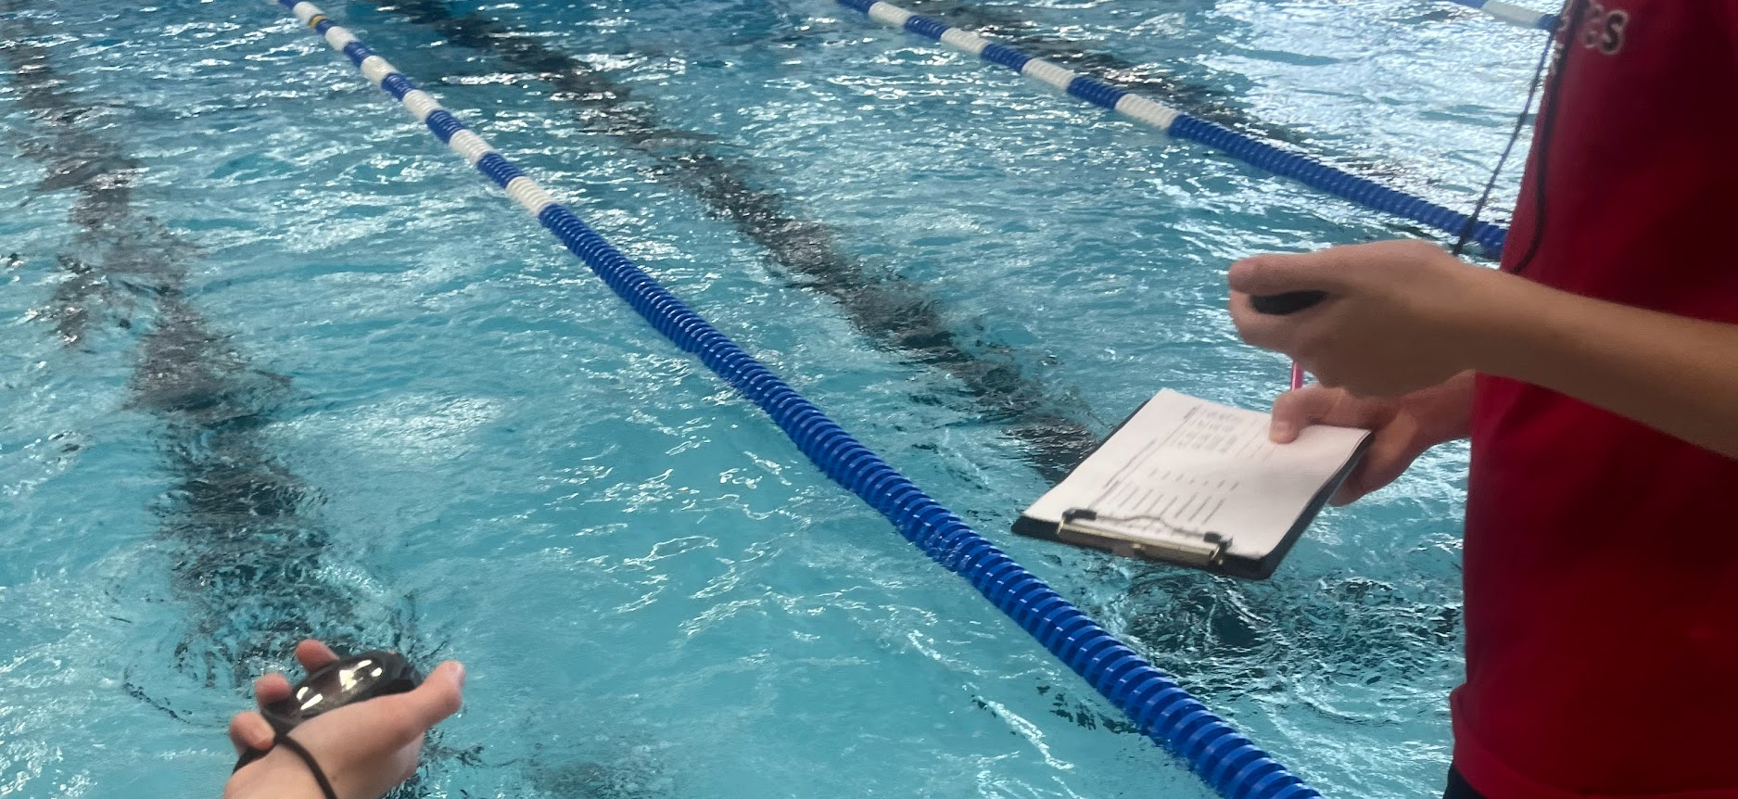
Timer
Check-in with officials at pre-session meeting (usually 20 minutes before start of meet).
Time the swimmers with a partner. One person will handle the clip board with the time sheets attached to it and both will work the stopwatch and plunger. The stopwatch is started when the race starts and will be stopped by the timer when the swimmer in the lane in which you are timing in touches the wall. The timer will then record the time on the sheet attached to the clipboard.
On Deck Jobs

Slide 15
OFF DECK JOBS

Slide 16

Admissions/ Awards
Off Deck Jobs
Use ipad/device (see user instructions) to check in ticket holders on Hometown Ticketing Help spectators purchase tickets and obtain heat sheets from online (see signs with wifi and QR information).
Track tickets sold via cash
Record cash total at the end of the session
As results are finalized, place stickers on the ribbons for each event and file ribbons in team folders.

Slide 17

Awards/ Clean Up
Help process the last batch of awards. Help clean up trash, take down signage, put away equipment, stack chairs and put in storage, any other duties as needed.
Off Deck Jobs

Slide 18

Concessions
Set up of food and drink, tables and seating, hang signs, and anything else that will be needed in order to set up for concessions.
Take down concessions area including tables and seating, removing signs, transport items, assist with any clean up duty as necessary.
Responsible for handling and ringing in all transactions with guests; assist in preparing customer orders and cleaning designated working areas and equipment used during the event.
Process Square, venmo or cash sales.
Work at concession stand. Prepare and serve concessions to swimmers and spectators attending the meet.
Off Deck Jobs

Slide 19
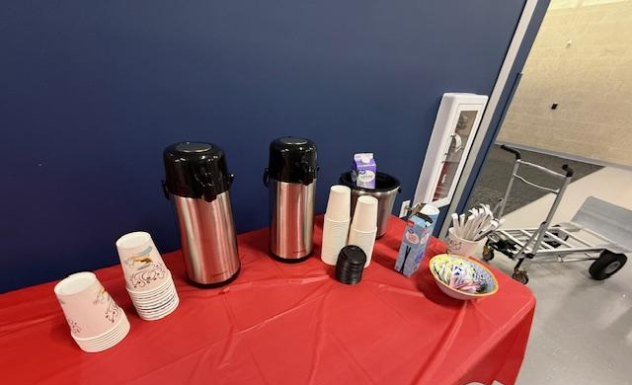
Hospitality
Work under direction of Hospitality Manager to stock the Hospitality Room with food and drink for the coaches and officials
Walk around the deck with refreshments for the working officials, coaches, computer and timing system crews and timers.
Off Deck Jobs

Slide 20

Float/ On Call
Be prepared and ready to help in any position if needed.
Must check in at the volunteer table and share your phone number at the beginning of your session.
Off Deck Jobs

Slide 21

Unloading/ Set Up
Unloading cars, set up staging area, hang up signage, set up chairs, set-up concessions, door monitoring, information/directions, any other set up duties as needed.
Off Deck Jobs

Slide 22

Volunteer Check- In
Check in volunteers for the meet; provide each person with information on what they are doing, name tag, and vest if necessary. Work with the meet director to identify who hasn't shown to be contacted. During down time, help with awards.
Off Deck Jobs

