Slide 1
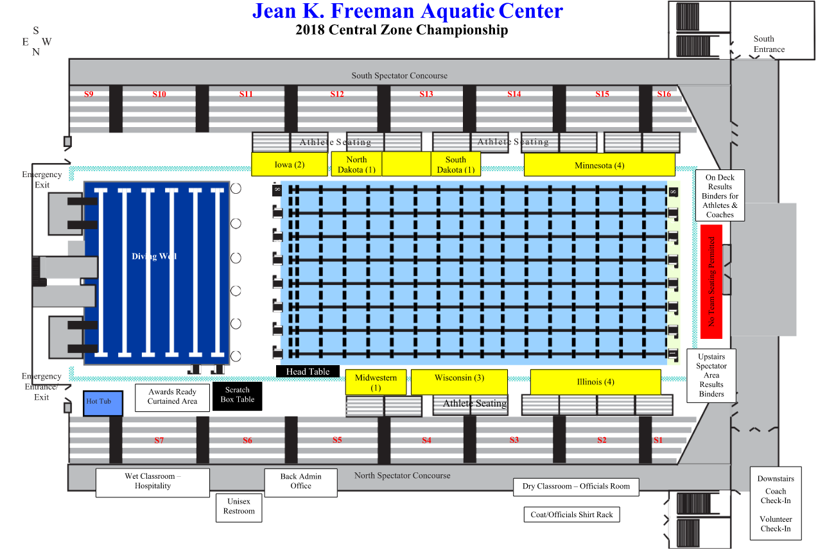
2022 Central Zone Championship
Midwest (2)
Minnesota (5)
North Dakota
(1)
Wisconsin
(3)
Illinois (4)

