Slide 1
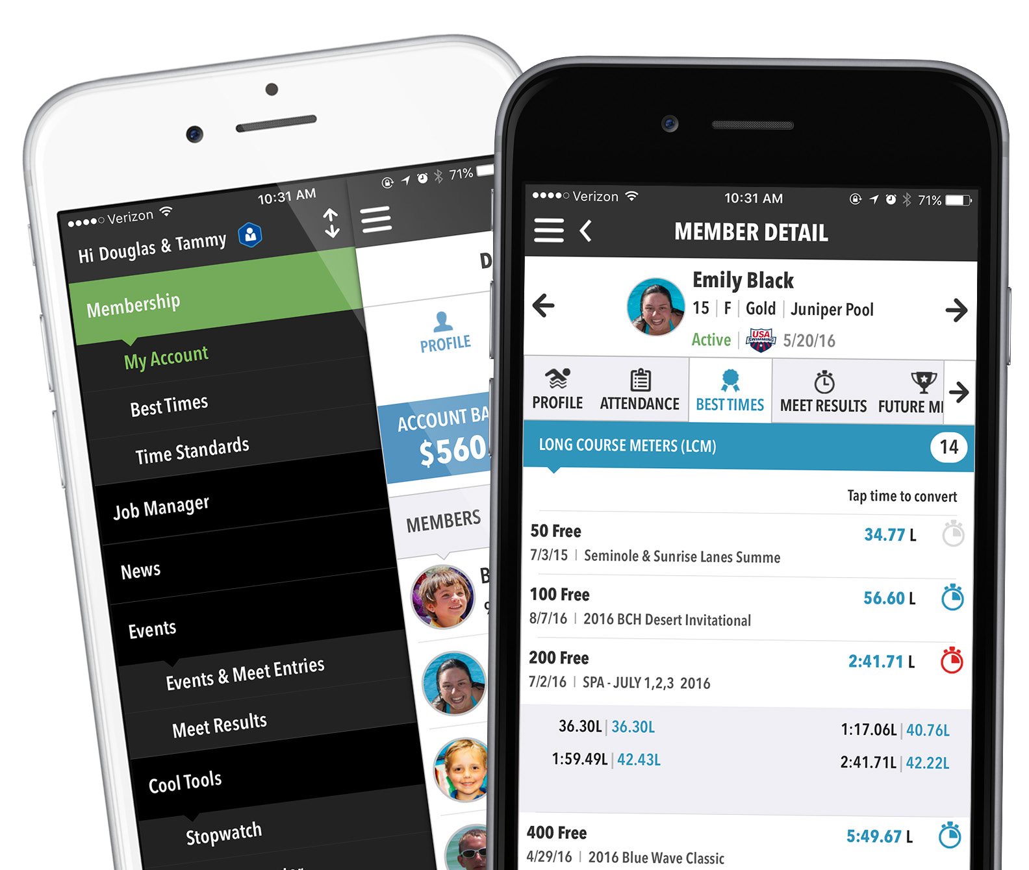
OnDeck
Parent Quick-Start Guide
Mobile Swim Team Management Made Better
www.teamunify.com
support@teamunify.com

Slide 2

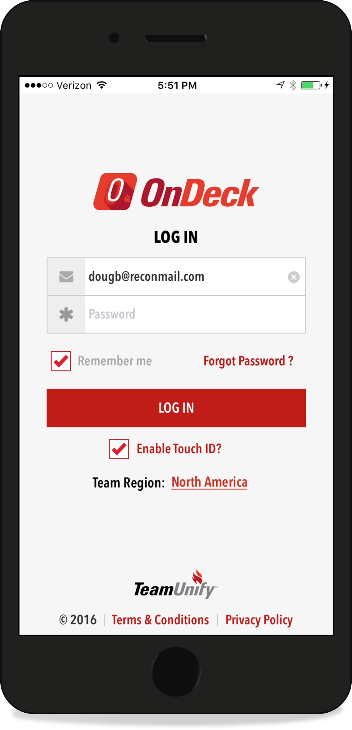



OnDeck
Install and Log In
2
Search for OnDeck in the App Store (iOS) or Google Play (Android), install and launch.
Enter same email and password you use for your team’s TeamUnify website.
Tap if you forgot password
Check to use Touch ID instead of password (when available)
Tap FIRST if you live in another region.
www.teamunify.com
support@teamunify.com

Slide 3
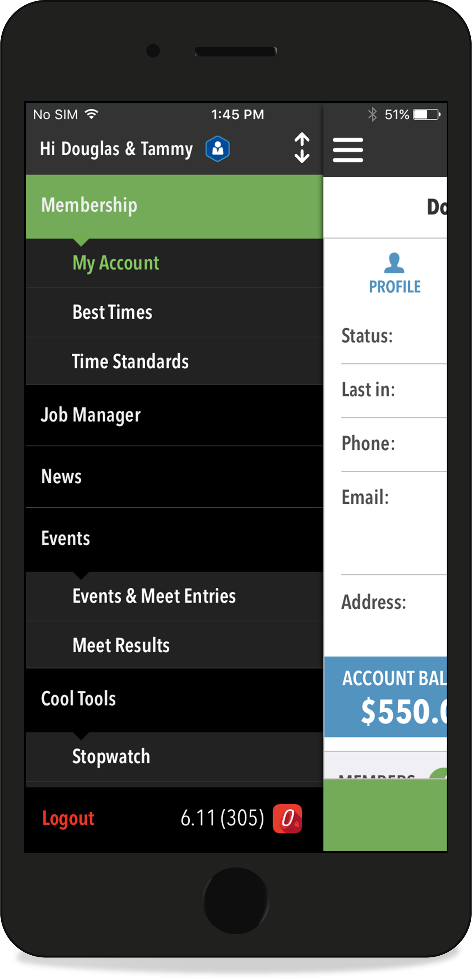




OnDeck
Anatomy of OnDeck
Navigation
3
Membership
Access and edit your Account and Member profiles, view account balance, view best times, and compare swimmers against time standards.
Tap
or Swipe
for menu
Long press to rearrange
Menu Items. top screen shows
first upon login.
Job Manager – CURRENTLY NOT USED BY YCV
News
View and share current and archived team news.
Events
View upcoming events, time swimmers at meets, and view past meet results.
Cool Tools
Stopwatch, Time Converter, and Pace Calculator.
www.teamunify.com
support@teamunify.com

Slide 4
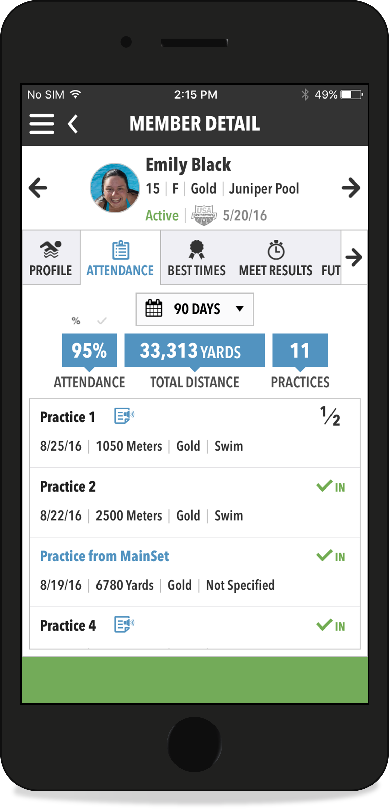
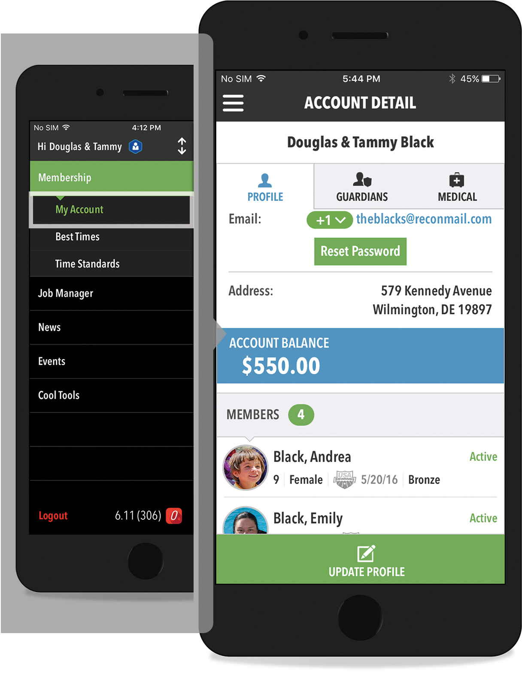
OnDeck
My Account
4
Update your account info, manage your swimmers and view your account balance.
Tabs view various info
View additional emails
Arrows cycle through swimmers
Tabs view various info; swipe to see more
Compare best times to time standards
Set attendance date range
View/listen to notes
Tap name to view
www.teamunify.com
support@teamunify.com

Slide 5
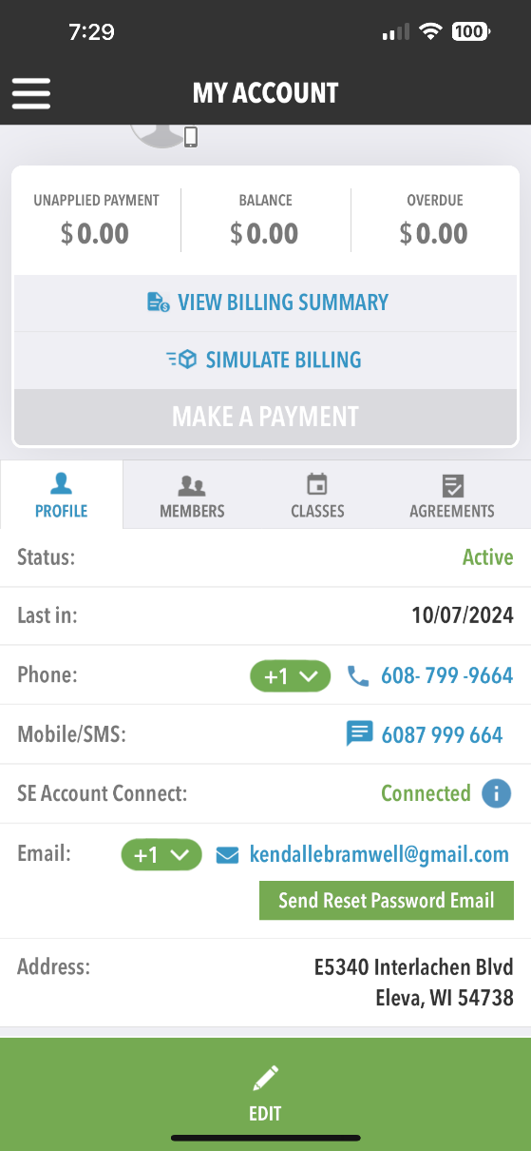
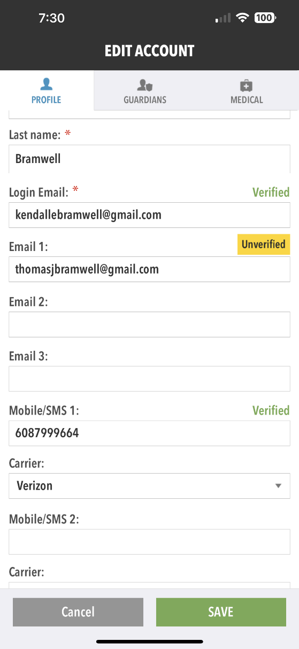
OnDeck
My Account
5
Update your communication settings to receive text messages
Enter mobile number and carrier and save changes
Click on edit
www.teamunify.com
support@teamunify.com

Slide 6
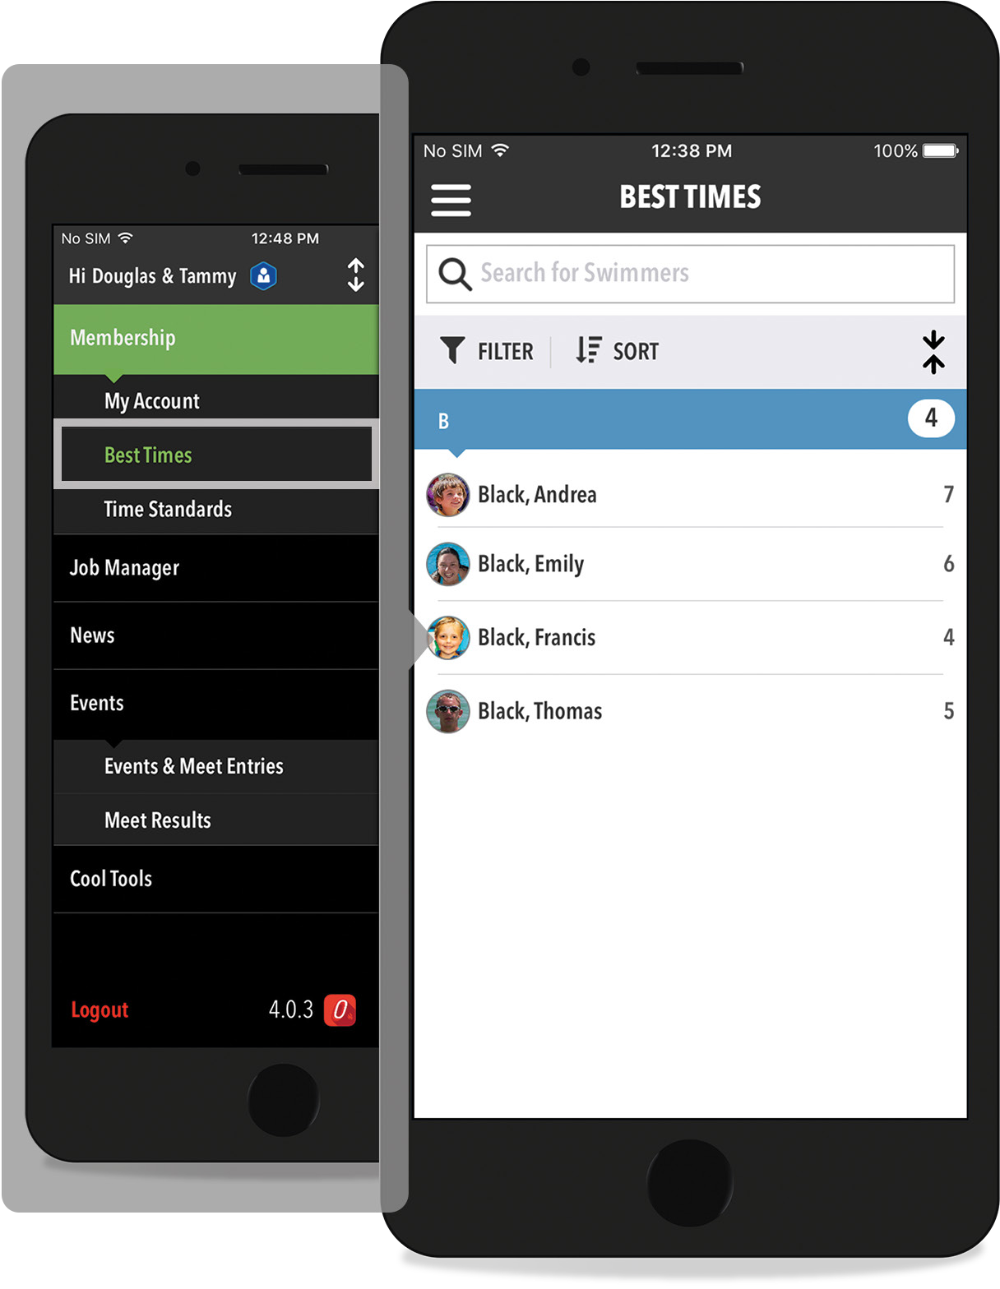
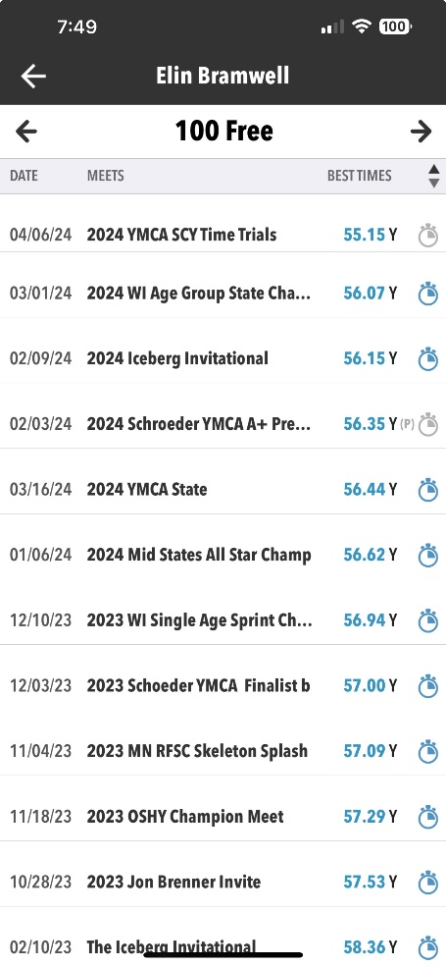
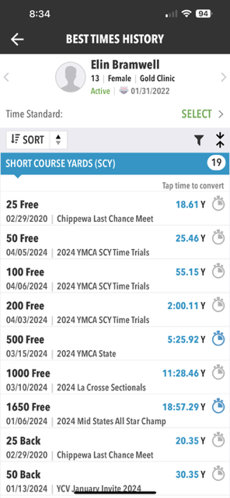
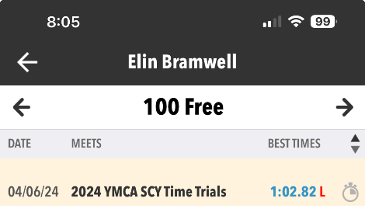
OnDeck
Best Times
Compare With Time Standards
6
View best times for your swimmers and compare with time standards. This is also accessible in each swimmer’s profile.
View of every time swam in that event
Select Swimmer
Select Event (Scroll Down for LCM List)
Can list in order by date or by best time
Click on clock to convert time
Y – SCY/L- LCM/S-SCM
Tap swimmer to view their best times
www.teamunify.com
support@teamunify.com

Slide 7
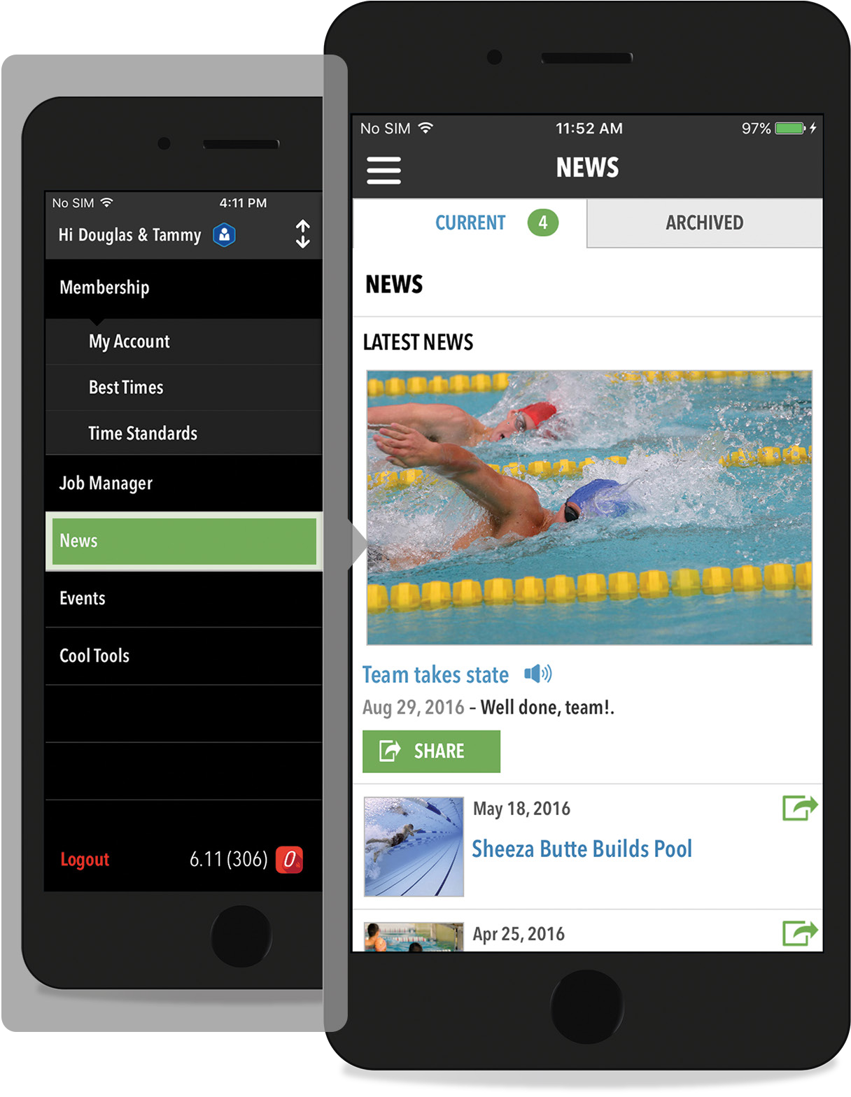
OnDeck
News
7
View news created by your team. You can even share via email, Facebook and more!
View archived news
Article has voice note
Share via Message, email, Facebook, and more, or print
Tap title to view and share
www.teamunify.com
support@teamunify.com

Slide 8
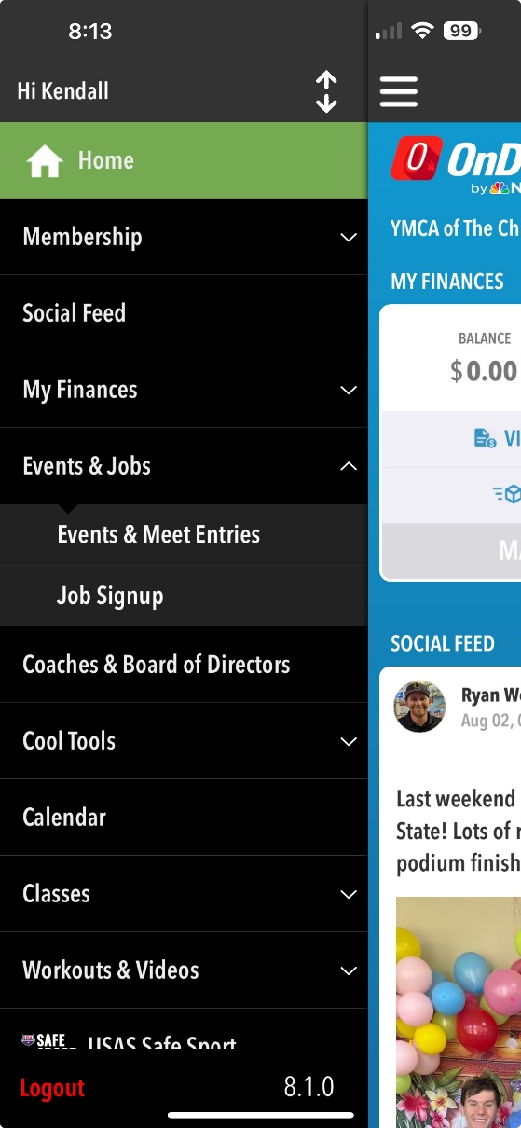
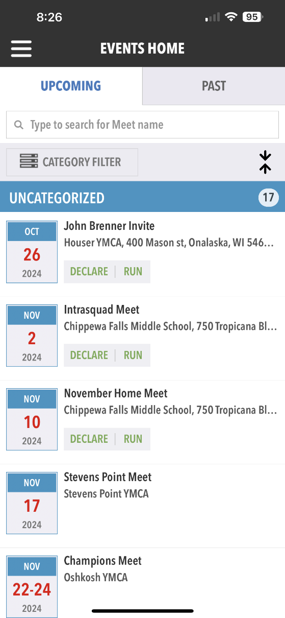
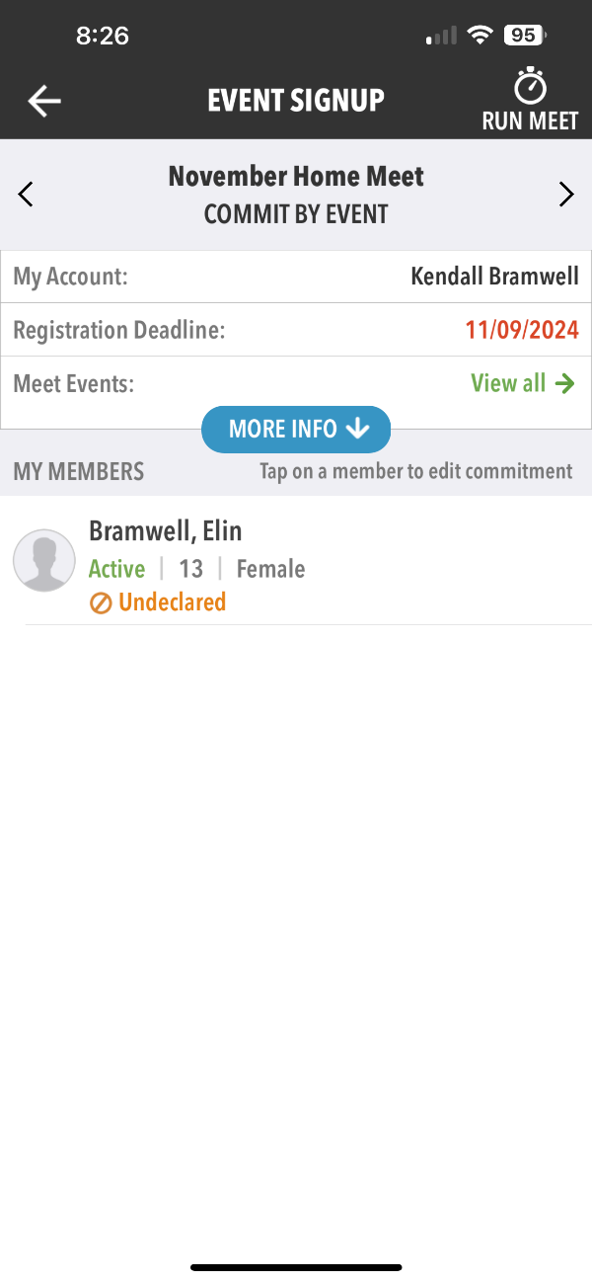
OnDeck
Events & Meet Entries
Overview
8
In OnDeck it is easy to explore and sign up for events.
Click on swimmers name to declare “Yes” for swim meet
www.teamunify.com
support@teamunify.com

Slide 9
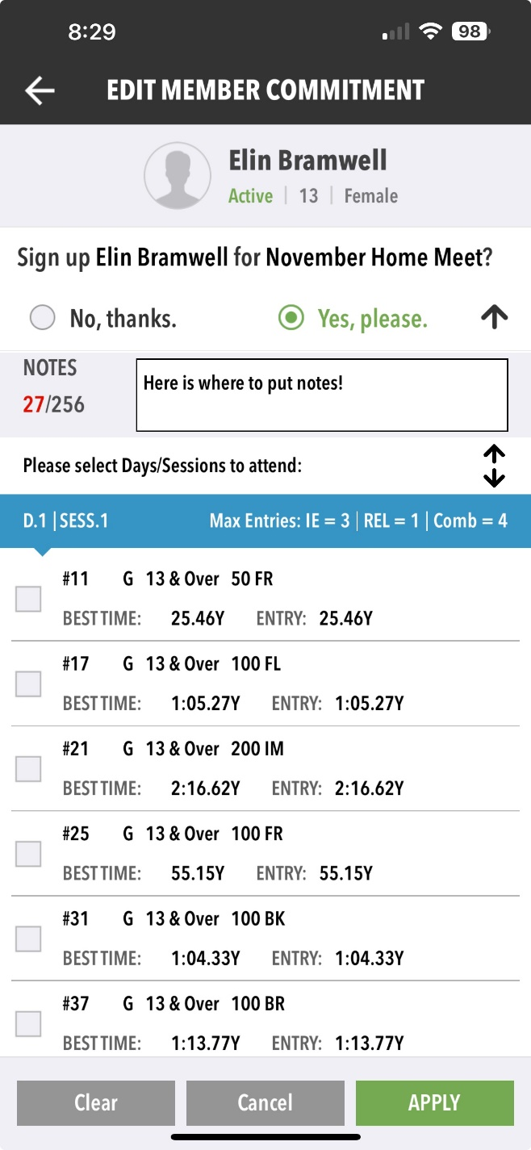
OnDeck
Events & Meet Entries
Continued
9
In OnDeck it is easy to explore and sign up for events.
3. Use the notes section to communicate with the coach for example: We are only swimming one session on Saturday/We need to leave meet by 2pm/does not want to swim 200 fly for anything ☺
1. Click Yes, please. Or No, thanks. to declare for the meet
2. Click on blue event session to see what events are occurring in which session. Note that this will display the swimmers best time and entry time for the event. Coach discretion for all event selections but you can use this to communicate preferences
www.teamunify.com
support@teamunify.com

Slide 10
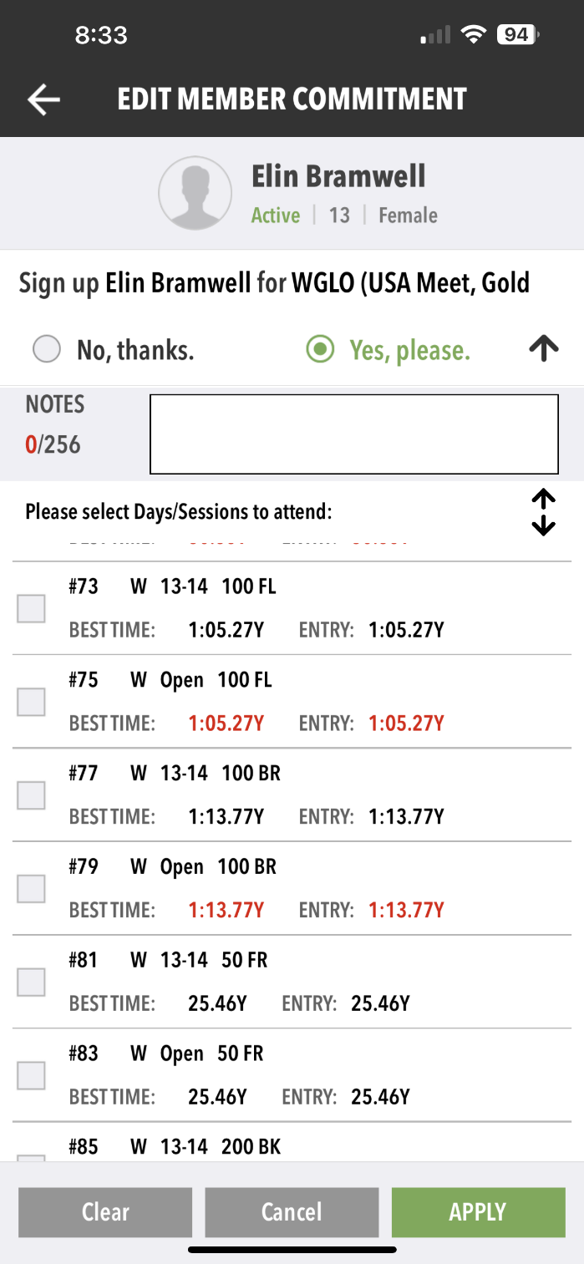
OnDeck
Events & Meet Entries
Continued
10
Useful TIPS for Events Section.
Some meets offer age based races and open races. Pay attention when selecting. Frequently this will be offered in separate sessions so double check if you are only seeing open races that you are on the correct session.
Times in Red indicate the swimmer does not meet the qualifying time for that event. Times in Black indicate that they do meet the standard.
www.teamunify.com
support@teamunify.com

Slide 11
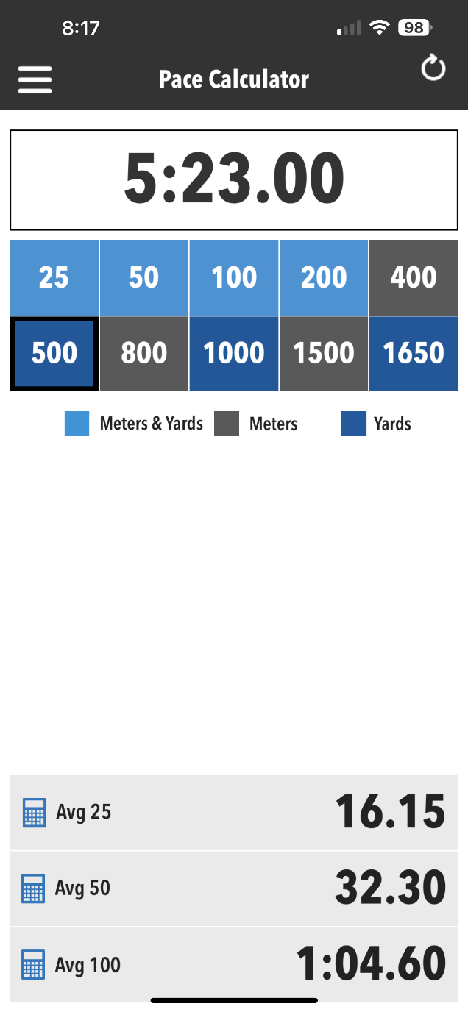
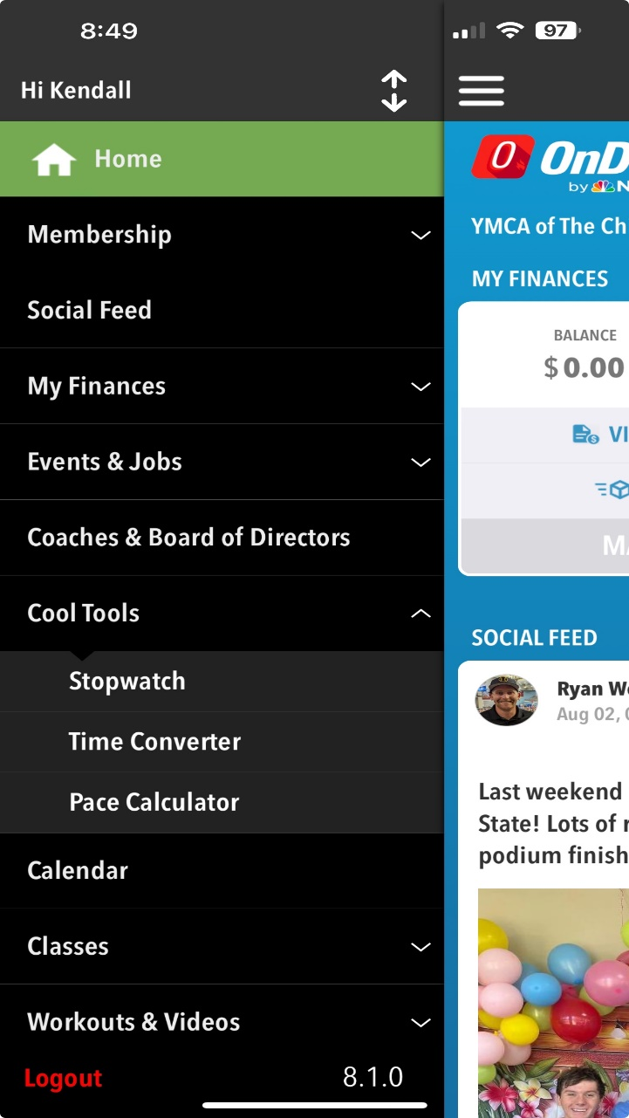
OnDeck
Cool Tools
11
1. PACE Calculator
1. Enter in desired time
2. Select distance and meters/yards
Calculated pace will display in 25/50/and 100 yard or meter increments
www.teamunify.com
support@teamunify.com

