Slide 1

MINOR ATHLETE ABUSE PREVENTION POLICY
OFFICIALS-WHAT YOU NEED TO KNOW
Notes:
We prevent abuse by having our eyes and ears open. We intervene by reporting it to government officials and Safe Sport. Both actions are necessary to keep kids safe and/or get them in a safe place.

Slide 2
BACKGROUND AND OVERVIEW of MAAPP
CONGRESSIONAL MANDATE
APPROVED BY USA SWIMMING BOD APRIL 26TH
EFFECTIVE JUNE 23 2019
SEPTEMBER CONVENTION- APPROVED AT HOD TO MAINTAIN STATUS AS NATIONAL GOVERNING BODY
Notes:
Committee is working closely with Center for Safe Sport on changes and ammendments.

Slide 3
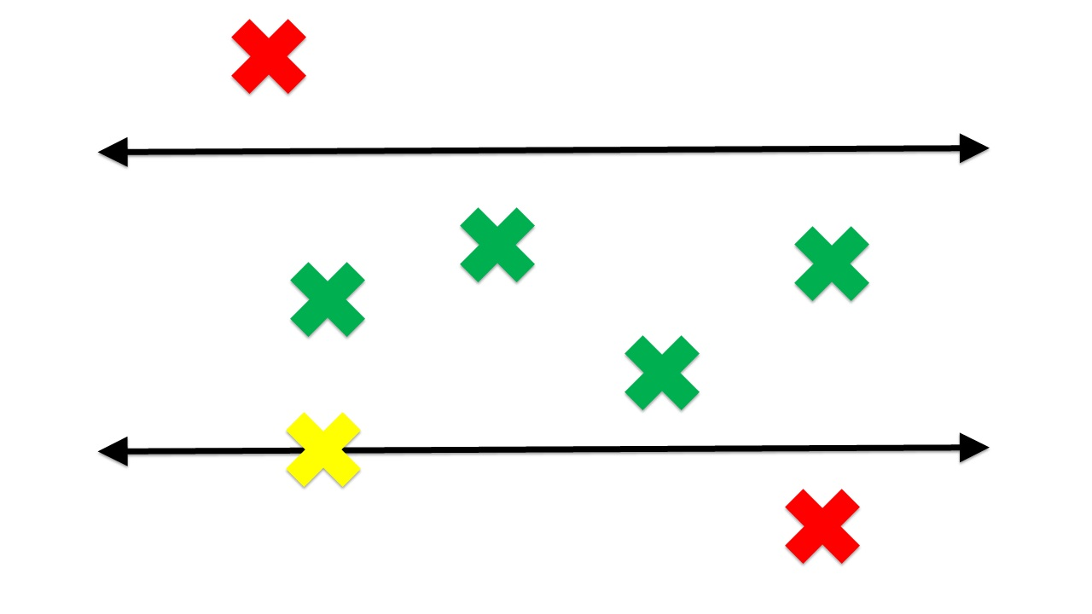
MAAPP HIGHLIGHTS
THERE WILL BE COMPLIANCE CHECKS AT ALL LEVELS
MUST BE IMPLEMENTED AS IS AT TEAM AND LSC LEVEL (NO OMISSIONS) BUT CAN ADD TO TAILOR TO TEAM OR LSC.
RESOURCES AND WEBINARS ARE AVAILABLE ONLINE
ASK QUESTIONS
Notes:
boundaries help us know Safe Sport is basically
3 things: Education, Policies and Action. The action comes from me and you. It
also comes from our coaches, officials and others who work together to help keep
our swim community safe for everyone, especially athletes.
(Next Picture) Education and policies
help us know what’s okay and what’s
not. Then, the action comes as we work
together to keep the “good stuff”
happening (I point to the green “x’s”) and
speak up when something seems off.
(Point to the yellow and red.)

Slide 4
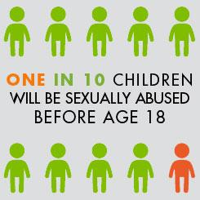
BEFORE MEET
ADULT ATHLETES (AGE 18) MUST COMPLETE ATHLETE PROTECTION TRAINING, CAN NOT COMPETE IF NOT CURRENT.
FLAG ON MEET RECONCILIATION/ REGISTRAR
EDUCATION SUGGESTED-PLAN GROUPS OF ATHLETES TO TAKE TOGETHER
PRESENT AT PARENT MEETINGS, REGISTRATION NIGHTS, CHECK BOX ON TEAMUNIFY REGISTRATION (for example)
REVIEW PAGES OF FAQ’S and MEET LANGUAGE
Notes:
FAQ online and I brought copy
Meet language
DUAL SANCTIONED
USMS
MAAPP applies to Applicable Adults, so if a USMS member meets one of the definition prongs, then that USMS member is an Applicable Adult and must adhere to the MAAPP requirements. More than likely, it would be the “Any other adult authorized to have regular contact with or authority over a minor athlete.” Most likely, we would not consider a USMS member who only has contact with a minor athlete by virtue of being at the same competition to meet this standard and be considered an Applicable Adult. However, a USMS member who regular trains with minor athletes at practice would be more likely to meet this standard. It’s a very fact-specific determination.
A suggested best practice would be to include MAAPP in the meet information to alert adult participants that MAAPP will apply to the competition. We have sample language on the MAAPP website at www.usaswimming.org/maapp.

Slide 5
TIMERS, MARSHALLS, ETC DO NOT HAVE TO BE BACKGROUND CHECKED, Must check in, best to sign in, MAAPP volunteer badges are helpful
APPLICABLE ADULTS ARE ANY MEMBER AND NON-MEMBER THAT HAS AUTHORITY OVER MINOR ATHLETES
CLUBS MUST KEEP WRITTEN ACKNOWLEDGEMENT ANNUALLY
COMMON SENSE IS KEY
EMERGENCY CIRCUMSTANCES-COMMUNICATION
BLANKET CONSENT FROM PARENTS IS NOT ACCEPTABLE-must be dated and specific.
Notes:
Show badge, cost effective and easy! Clerk of course

Slide 6
ONE ON ONE INTERACTIONS
OBSERVABLE AND INTERRUPTIBLE
ANOTHER ADULT/OFFICIAL PRESENT
DOORS/CURTAINS OPEN
NO SHARED HOTEL ROOM OR OVERNIGHT LODGING DURING TEAM TRAVEL
MENTAL HEALTH OR HEALTHCARE PROVIDERS EXCEPTIONS TO PROTECT PRIVACY
Notes:
Incident at Sr Zones, Official reported massage, odd looking situation
Happens where others can see and interrupt

Slide 7

SOCIAL MEDIA AND ELECTRONIC COMMUNICATION
MUST BE PROFESSIONAL IN NATURE
OPEN AND TRANSPARENT- LEGAL GUARDIAN or COACH
MUST BE COPIED
TEAM COMMUNICATION IS OK IF ANOTHER ADULT IS COPIED
8 AM TO 9 PM UNLESS EMERGENCY OR TEAM TRAVEL
NO PRIVATE SOCIAL MEDIA UNLESS A FAN/CELEBRITY PAGE. TEAM PAGE IS OK. MUST ‘UNFRIEND’ IF NOT YOUR CHILD
Notes:
90% of victims know their abuser

Slide 8
TEAM TRAVEL
LOCAL TRAVEL- ALWAYS TWO ATHLETES OR A SECOND ADULT UNLESS IN WRITING FROM LEGAL GUARDIAN
TWO DEEP LEADERSHIP
OBSERVABLE AND INTERRUPTIBLE ENVIRONMENTS
ADULT ATHLETES MAY SHARE ROOMS WITH MINOR ATHLETES WITH PARENT PERMISSION
AIRBNB, CAMP OUTS,CONDOS- not allowed for TEAM TRAVEL
REPLACES CURRENT TRAVEL POLICIES
Notes:
Two deep leadership
Observable and interruptible
Miami example

Slide 9

THINK
ADULT ATHLETES MAY SHARE ROOMS WITH MINOR ATHLETES WITH PARENT PERMISSION (SIMILAR AGE RANGE)
ATHLETES ARE STILL FRIENDS WHEN ONE TURNS 18.
COMMON SENSE IS A MUST
Notes:
One in 7 perpetrated by juveniles on schooldays

Slide 10
LOCKER ROOM AND CHANGING AREAS
What is your monitoring plan?
Use locker rooms
Prefer separate areas /facilities for Coaches and Officials
Turn around, don’t parade around, do not show private parts
No adults alone with minors… doesn’t apply to the public. ☹ Legal guardians are discouraged not prohibited.
Notes:
Pick one of 4 offerings and post your choice in bathrooms

Slide 11

MASSAGES & RUBDOWNS
As a team function or training modality; does not apply to a personal massage at non-team function
Open and interruptible location by certified/licensed professional
Coach must not perform under any circumstances
Written consent
Second adult must be present
Do not help athletes stretch or apply creams/ointments
Notes:
Use example at Sr Zones

Slide 12
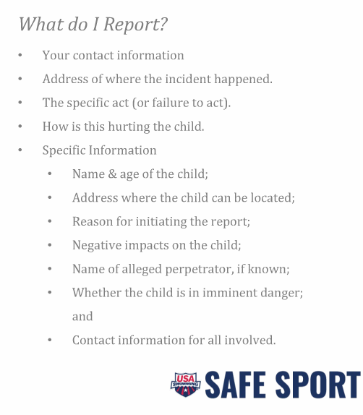
REPORTING-HOW?
(720) 524-5640, or find more information at
www.uscenterforsafesport.org
Notes:
MANDATORY REPORTING RULE
Pursuant to federal law, all adults authorized to interact with minor or amateur athletes who learn of facts that give reason to suspect that a child has suffered an incident of child abuse, including sexual abuse, shall make a report of the suspected abuse to law enforcement and/or your state’s designated agency within 24 hours.

Slide 13

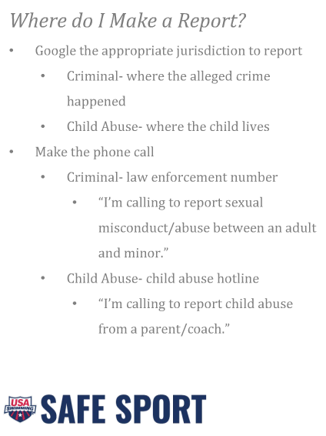
WHERE DO I REPORT?
Pocket Card Workgroup
SRSSAFESPORT@GMAIL.COM
Notes:
Oregon statewide number to report abuse to DHS is 855 503 SAFE
However, calling that number does not guarantee a police report is written. Some circumstances warrant a call to the police for immediate police intervention and a call to DHS.

Slide 14

CONTACTS
PREVENT ~ RESPOND ~ REPORT
https://www.usaswimming.org/Home/safe-sport
https://uscenterforsafesport.org/
srssafesport@gmail.com
Notes:
I’m here to help get current information to you and support your clubs as well. 80% are sexually abused after age 8

