Slide 1

USA Registration Tutorial
Step by Step Guide

Slide 2
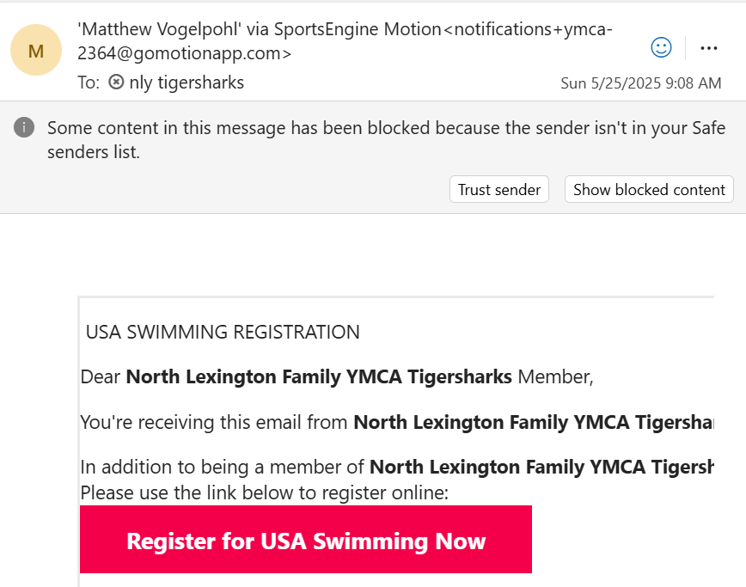
Check E-mail for USA Invite from "Matthew Vogelpohl via Sports Engine"
Click

Slide 3
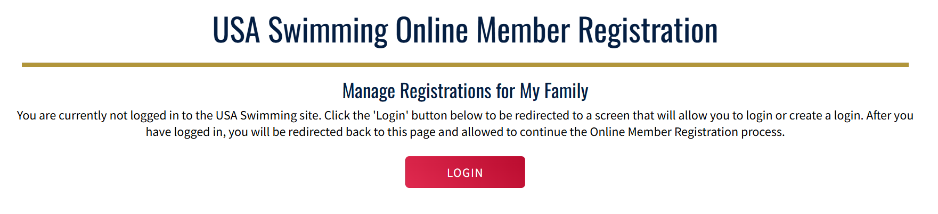
Log in Or Create a Log In for USA Swim (Family Account)
You will need to create a family account if this is your first USA swimmer you are registering. If you have other children registered, or you were a USA swimmer yourself, then you will be able to log in on the next screen

Slide 4
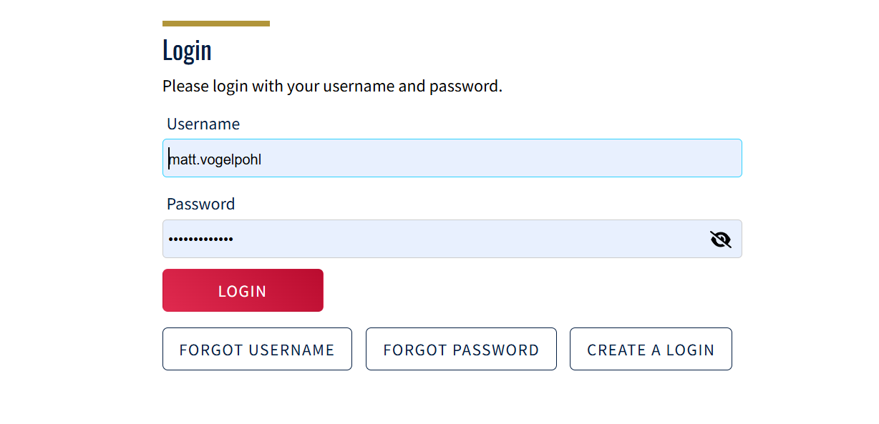
Current Family Account Log In
If you have an active USA swimming account already, just click Log In after inputting your credentials if you don’t have them saved to your browser.
Current Family Accounts – SKIP TO SLIDE 9 after logging in

Slide 5
New Family Account Creation
New Families – click "Create Log In" to start the process of creating your new family account to add your swimmers to.

Slide 6
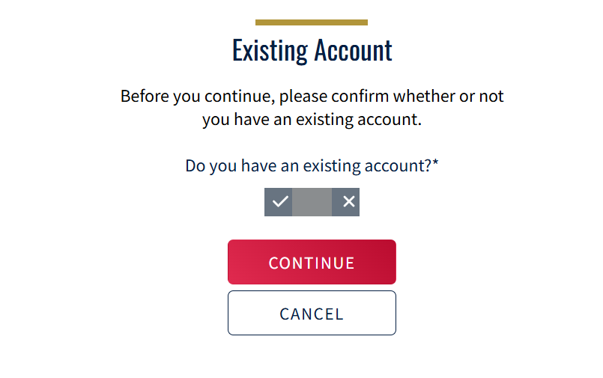
New Family Account - Existing Account Confirmation
This screen may pop up after creating New Family Account. Toggle to No ("X") and Click Continue.

Slide 7
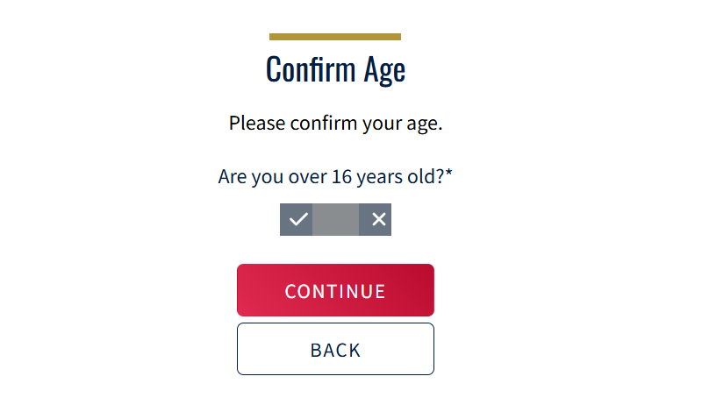
New Family Account – Age Confirmation
If you are registering a swimmer over the age of 16 for the first time then you can create the account in your swimmer's name and forego the Family Account.
If your swimmer is 16 or under then you need to proceed with the Family Account then add swimmers

Slide 8
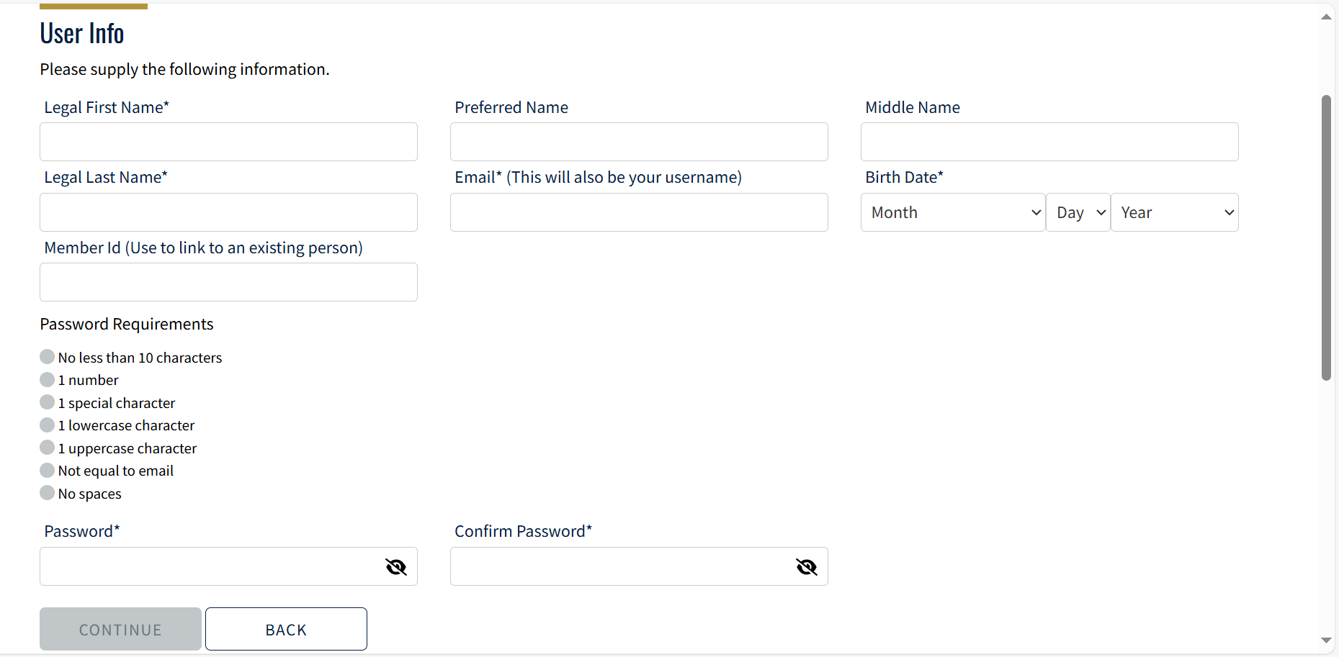
New Family Account – Complete Profile
Complete all fields on this page then click Continue.

Slide 9
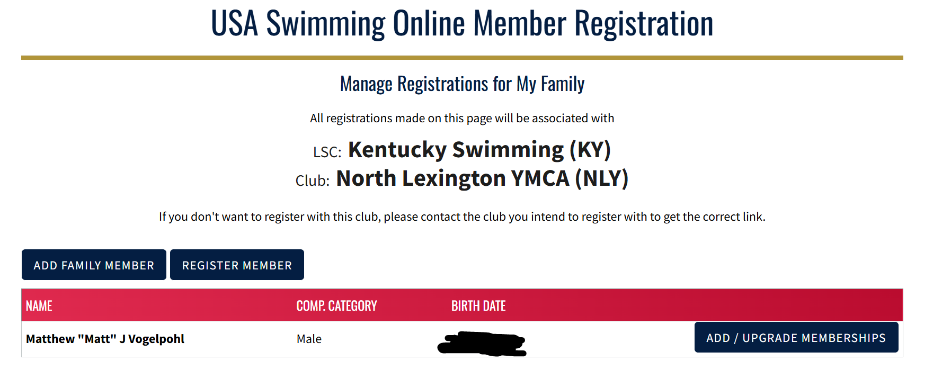
Add Family Member
Make sure our Team is listed here otherwise you won't be connected to the Tigersharks
From here the process should be the same to add your athlete.
New Accounts may ask you to log in after creating your credentials/account
CLICK

Slide 10
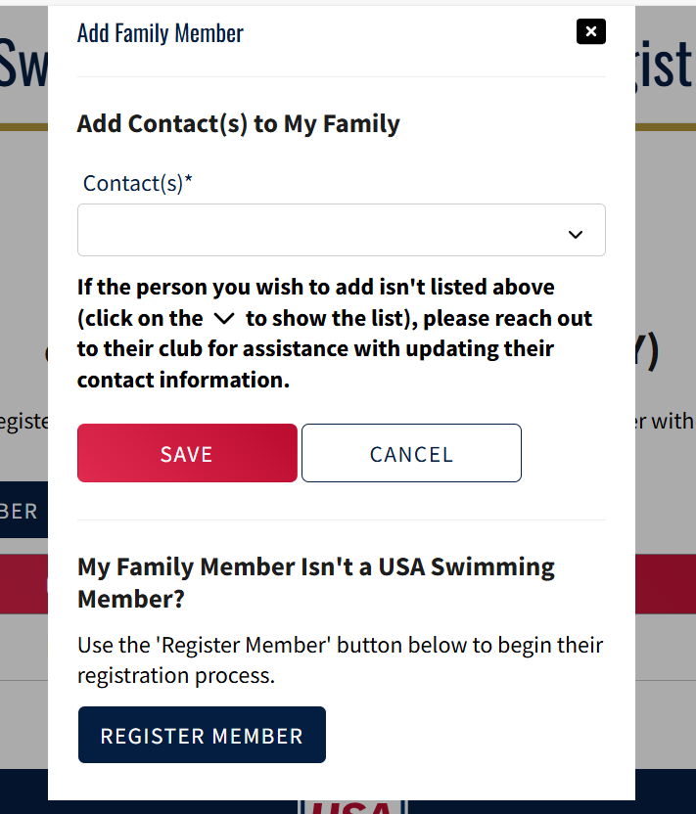
Pop Up – Click Register Member
Ignore this section

Slide 11
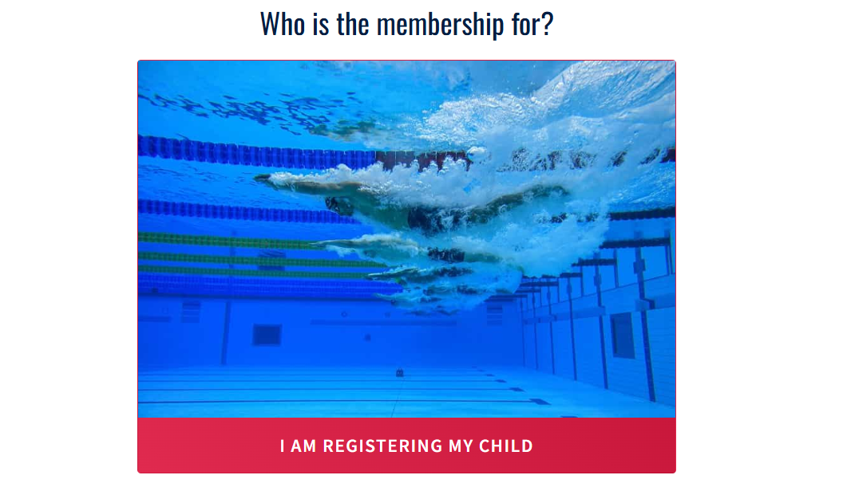
Register My Child – Click the Red Button

Slide 12
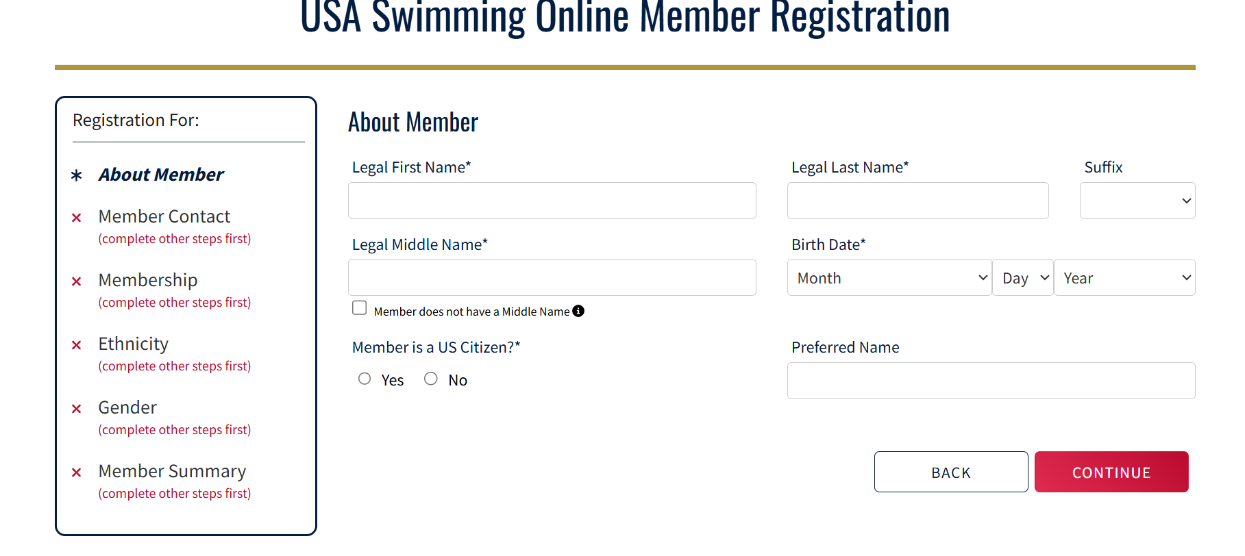
Create Swimmer Account – Step 1
Complete this page & click Continue

Slide 13
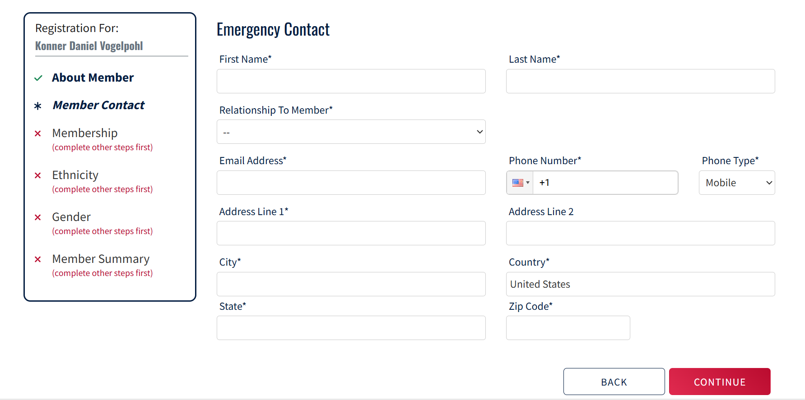
Create Swimmer Account – Step 2
Complete this page & click continue

Slide 14
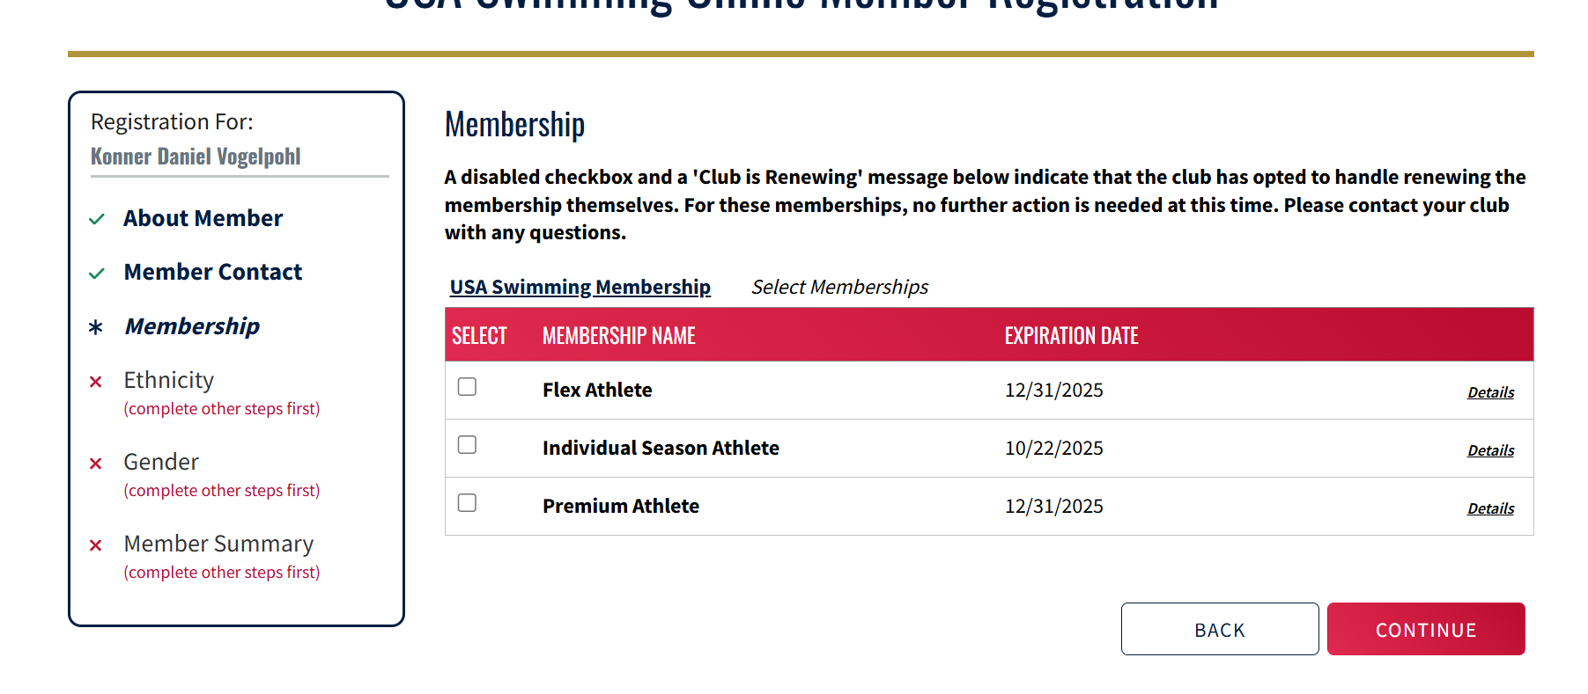
Create Swimmer Account – Step 3
Choose your Membership Type.
Pay attention to Expiration dates – each type is only so long.
Flex Athletes are for 12&under only and can only attend 2 USA Only meets (DOES NOT INCLUDE State Championship). But it is the cheapest option if you don't plan on many meets.
Premium Membership includes State Championships with no limit on USA only meet participation

Slide 15
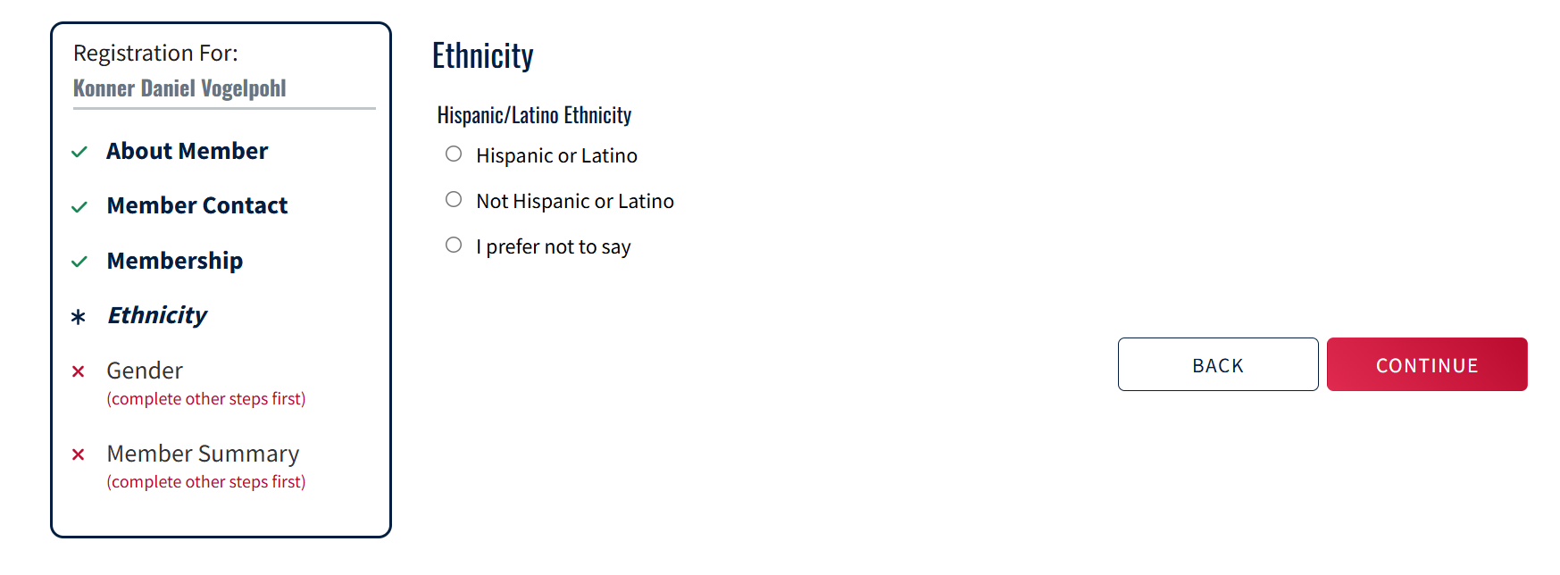
Create Swimmer Account – Step 4
Choose Your Swimmer's Ethnicity & Click Continue
If you choose Not Hispanic or Latino – additional options will pop up to choose from

Slide 16
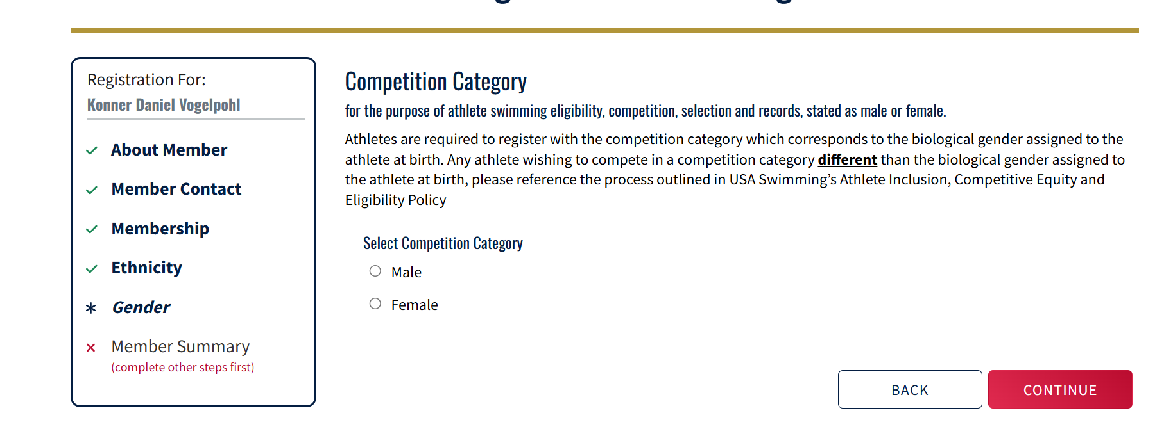
Create Swimmer Account – Step 5
Choose Your Athlete's Gender and click Continue

Slide 17
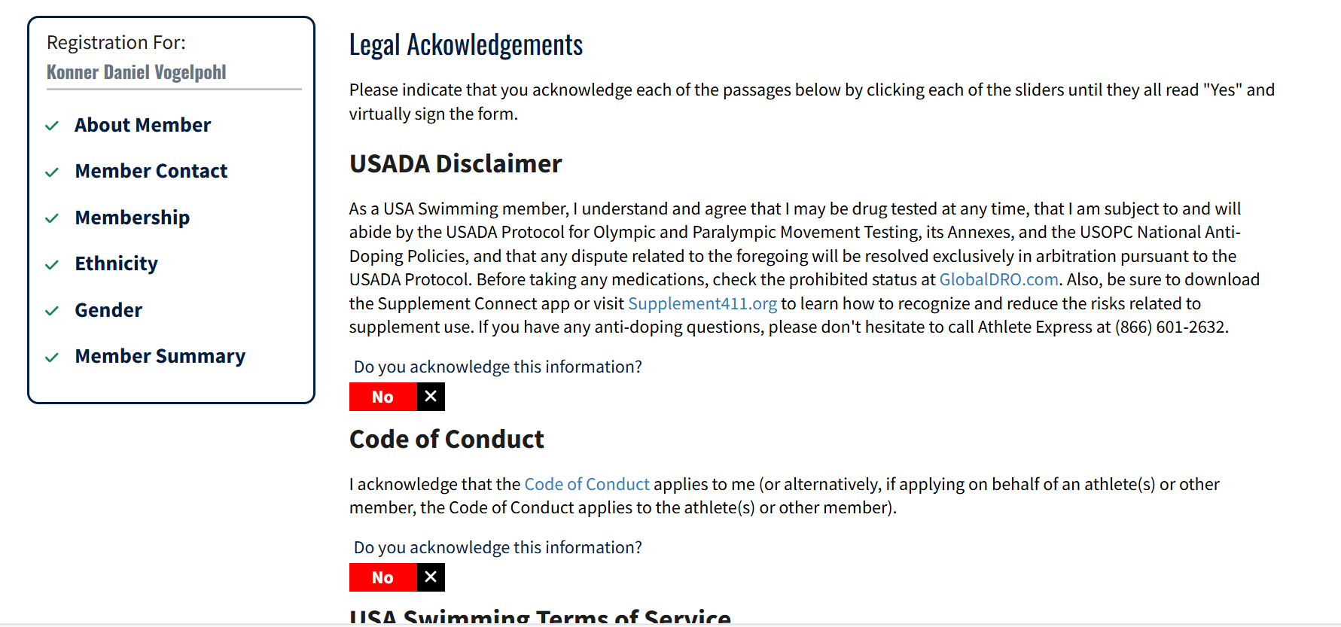
Create Swimmer Account – Step 6
Toggle YES to each of the Legal Acknowledgements & Click Continue at the bottom of the page.

Slide 18
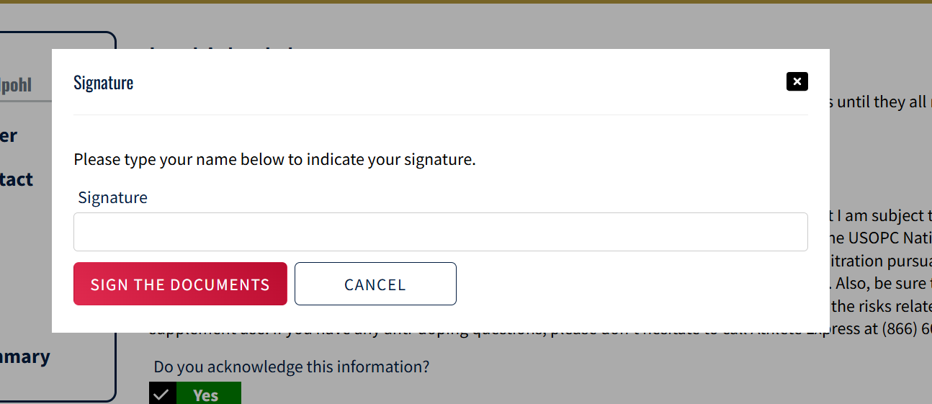
Create Swimmer Account – Step 7
Type your Name to Sign off on the Legal Acknowledgements.

Slide 19
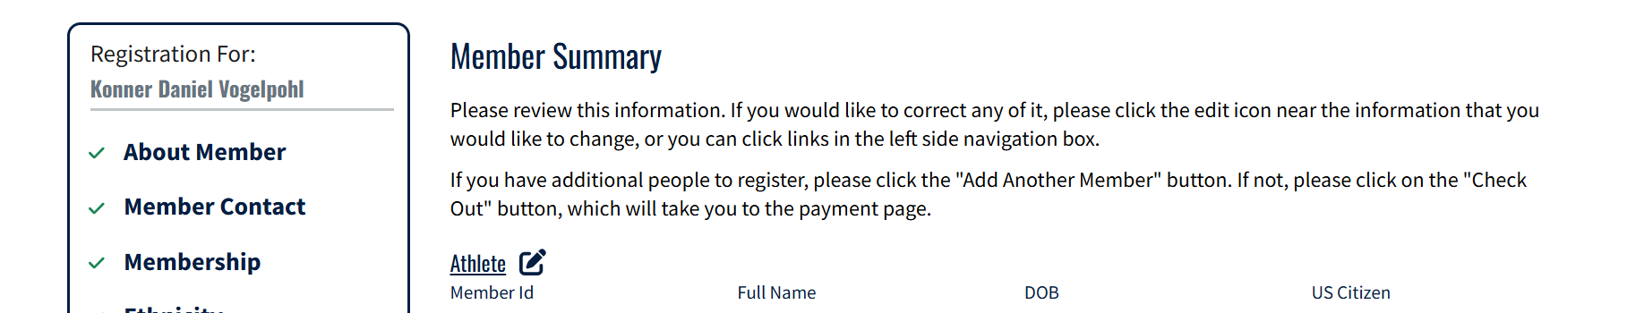
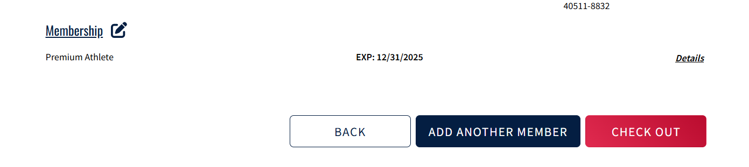
Create Swimmer Account – Step 8
Review all the details you just filled in and check for accuracy – then click CHECKOUT.
Unless you need to add another Athlete – then click the BLUE button and repeat Steps 1-8 for all other athletes you need to add THEN CLICK CHECKOUT when ALL athletes have been added to your Family Account

Slide 20
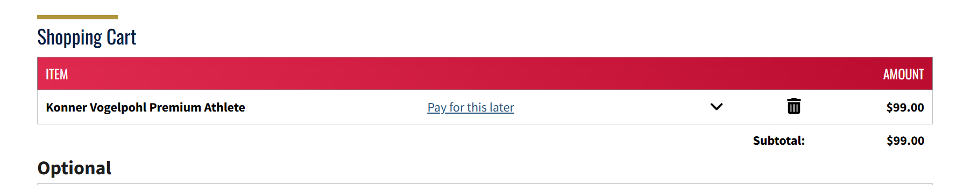
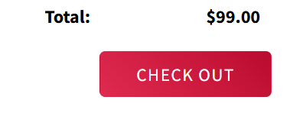
Shopping Cart Review
Review your cart for all athletes you've added – there are several options you can opt in to or opt out. Toggle to Yes or No for each option and click CHECKOUT again.

Slide 21
Final Step - Pay
The Final Step is to input your credit card information & pay. Registration for your swimmer is not complete until you have paid for the membership.
Memberships must be active & paid for PRIOR to meet entry
Pay attention to Membership expiration dates to make sure your swimmer's membership is active for the meet(s) you want to participate in.
If you choose FLEX Athlete with the thought that your swimmer will NOT qualify for the time standards needed for USA State Championships....and then they DO Qualify.....you just log into your family account & upgrade them to the Premium membership if you want them to participate in the USA State Championship & pay the difference in the membership fees.

